Slide 1


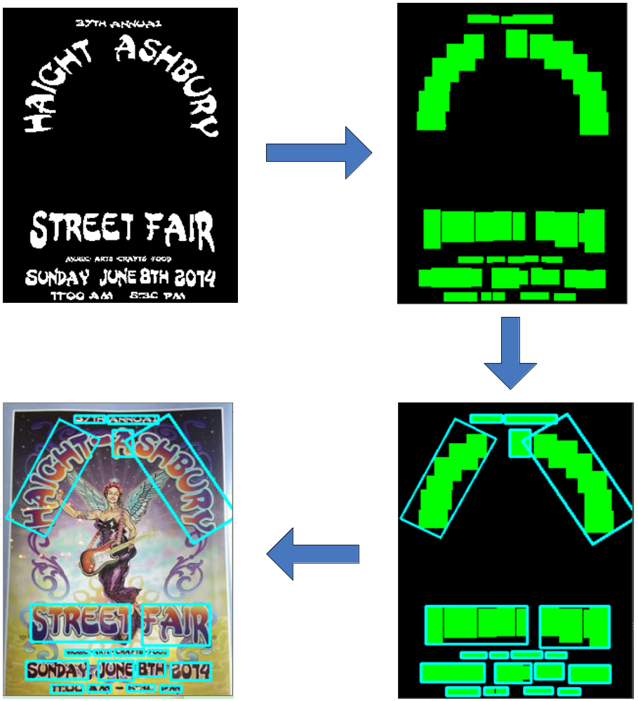
Text Detection in Natural Scenes by Feature Pyramid Network
Research Purpose
Detect Text from Natural Scenes
Neural Network Model
Input (672 * 672 * 3)
Output (672 * 672 * 2)
Difficulties
Con_BN (336 * 336 * 32)
Con_TP (336 * 336 * 32)
Differernt Languages(Eng, JP, CHN)
Multi-Scale and Multi-Orientation
Curved Text Area
Con_DW (336 * 336 * 64)
Con_TP (336 * 336 * 64)
Con_DW (168 * 168 * 128)
MobileNet V1
Con_DW (168 * 168 * 128)
Con_TP (168 * 168 * 128)
Con_DW (84 * 84 * 256)
Con_DW (84 * 84 * 256)
Con_TP (84 * 84 * 256)
Con_DW (42 * 42 * 512)
x5
...
Research Background
Con_DW (42 * 42 * 512)
Con_TP (42 * 42 * 512)
Based on Deep Learning
Micro Neural Network: MobileNet V1
Feature Pyramid Network (FPN)
Feature Pyramid Network
Conv2d (in=inp, out=inp, stride=3)
Con_TP
ConvTranspose2d
BatchNorm2d
ReLU
Con_DW
ReLU
BatchNorm2d
Conv2d (in=inp, out=oup, stride=1)
Conv2d (in=inp, out=oup, stride=1)
BatchNorm2d
Con_BN
BatchNorm2d
Experiment Pipeline
ReLU
ReLU
Input Image
Neural Network
(Pixel classification)
Future Work
Prepare for Text Recognition(OCR)
Design Android Application
Text Region Mask
Mask Contour
Map Contour into Image

