Slide 1
Text Detection in Natural Scenes by Feature Pyramid Network
A1 Group
Fu kangwei

Slide 2

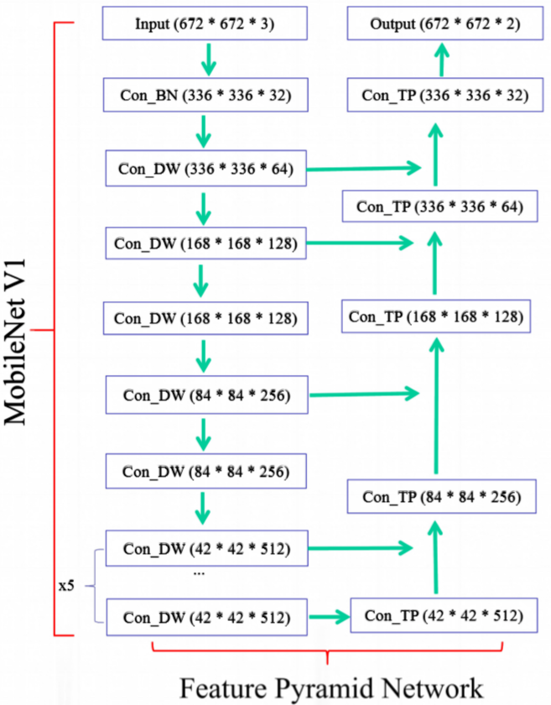
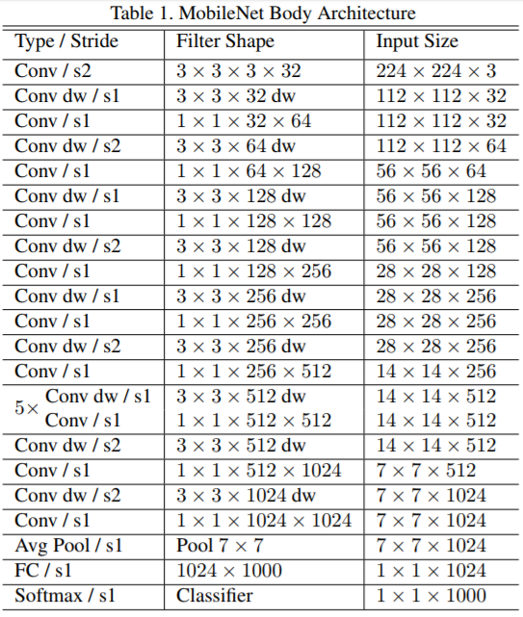
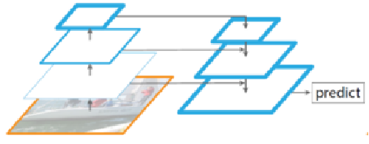
Text Detection in Natural Scenes by Feature Pyramid Network
MobileNet Structure
FPN Structure
Small Neural Network (Suitable for smart phone)
Good at detecting small objects (short text)

Slide 3

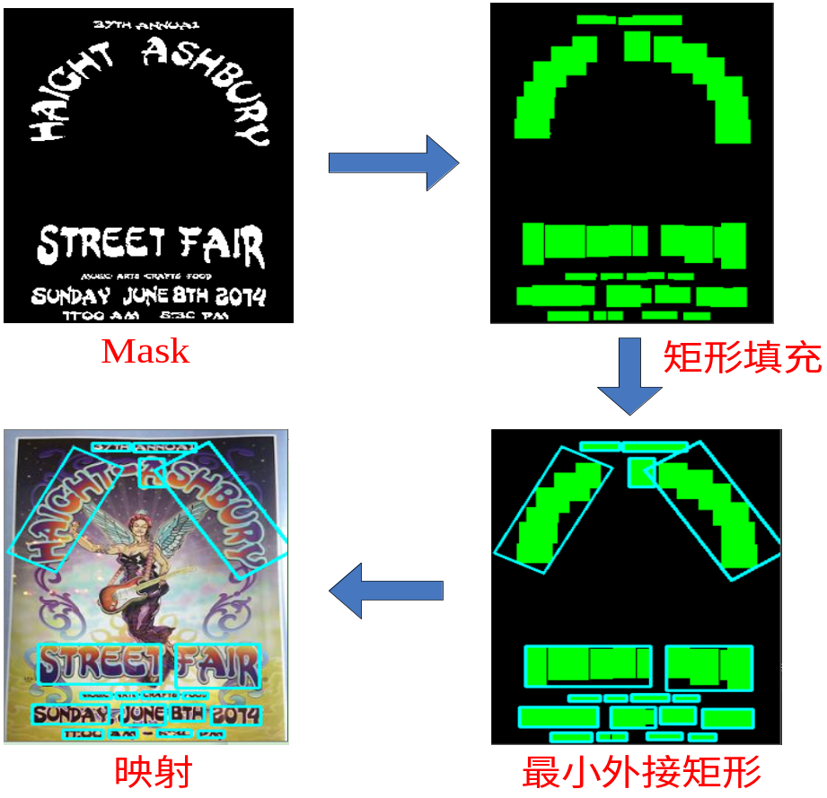
Text Detection in Natural Scenes by Feature Pyramid Network
Generate by Neural Network
Use boundingRect to fill every character
Find mask contour with OpenCV
OpenCV: Powerful computer vision library
Map bounding rectangle to original image
Find minimum bounding rectangle with minAreaRect

