Slide 1
Egocentric Scene Rendering and Segmentation Evaluation with Aria Digital Twin
Reproducing and Benchmarking ADT Synthetic Frames Using Blender + SAM 2.1

Slide 2
Motivation & Goal
The Aria Digital Twin (ADT) dataset provides ground-truth 6-DoF object poses and a synthetic fisheye render
Goal: reproduce the render from scratch using the pose data and 3D models
Benefits:
Enables controlled generation of training and evaluation data (different views, egocentric VS exocentric)
Enables downstream task (segmentation SAM 2.1 Large) evaluation under different image conditions (fisheye VS rectified, etc.)

Slide 3
Dataset Overview
Sequence: Apartment_release_golden_skeleton_seq100_10s_sample
10-second indoor apartment clip, ~300 RGB frames at 1408×1408
Provided ground truth: 6-DoF camera trajectory, per-object T_WO poses, instance segmentation masks (stream 400-1), and a reference synthetic render
3D assets: ~400 GLB object models from the Digital Twin Catalog (DTC)
Camera model: Aria FISHEYE624 — Kannala-Brandt polynomial with 6 radial coefficients; not a standard pinhole or OpenCV fisheye

Slide 4
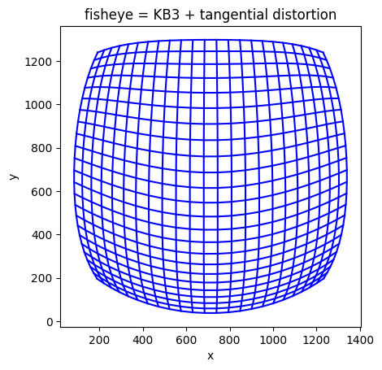
(left) real RGB fisheye frame, (centre) GT instance segmentation colourised, (right) ADT synthetic fisheye render

Slide 5
The Blender Pipeline
ADT CSVs (T_WO, trajectory) → Per-frame JSON → Blender 3.6 Cycles (equirectangular panorama) → FISHEYE624 Remap (Newton-Raphson LUT) → Fisheye PNG

Slide 6
Pose Issue (TODO)

Slide 7
Render Results
Large side-by-side, full width — synthetic on left, our fisheye render on right.
Lighting differs: ADT synthetic uses a proprietary physically-accurate renderer; ours approximates with 4 warm point lights + Filmic tone mapping (exposure = −0.7)

Slide 8
SAM 2.1 Large
Input: rotated 90° CW to upright orientation, resized to 1024×1024 (SAM's native resolution)
real RGB frame
synthetic RGB frame

