Slide 1
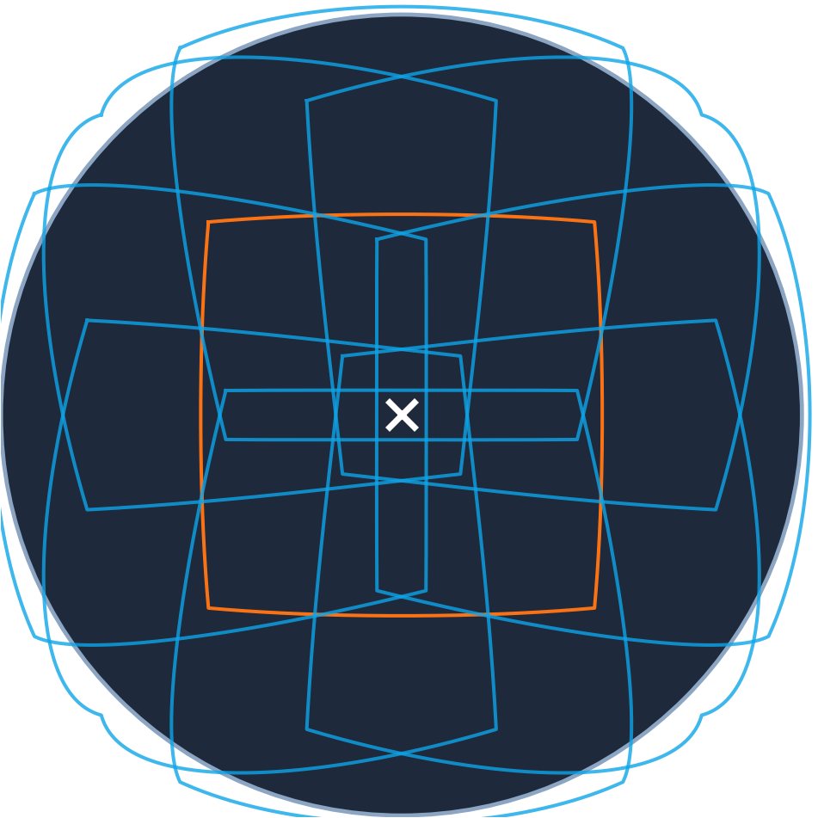
Fisheye Depth Estimation
Adapting perspective-native depth foundation models to wide-FOV fisheye input, without finetuning or with limited finetuning.
VGGT is Meta's general-purpose 3D model: show it photos, it returns a distance for every pixel.
VGGT-Ω is a newer, larger version of it. VGGT-360 is a published method (CVPR 2026) that runs VGGT on 360° panoramas by cutting them into ordinary views — the idea we are porting to a fisheye lens.
The nine windows we cut from each fisheye frame

Slide 2
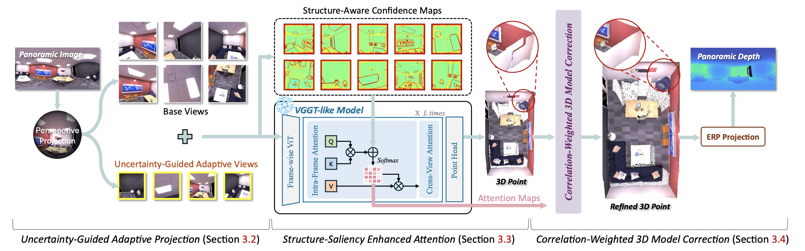
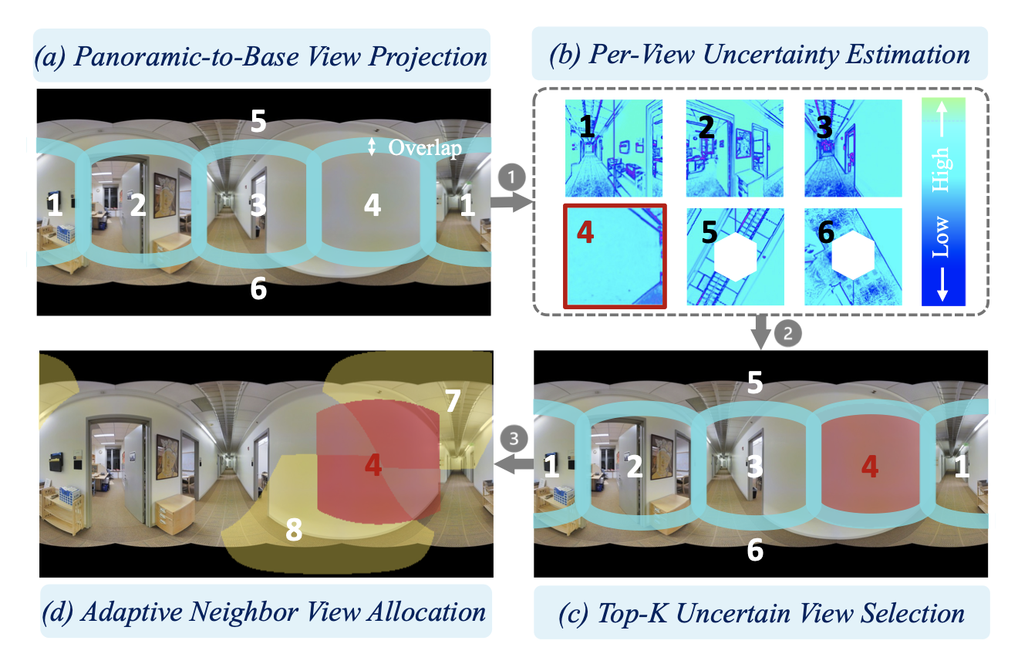
VGGT-360: Geometry-Consistent Zero-Shot Panoramic Depth Estimation
This paper reconstructs a globally coherent 3D representation via VGGT-like 3D foundation models and reprojects it to the
panorama, unifying fragmented per-view predictions into consistent, cross-view correlated depth.

Slide 3
Adapting VGGT-360 to fisheye
Similar to how VGGT-360 cuts the ERP (equirectangular panorama) into different views
1
Cut the frame into nine ordinary-looking windows
Each is redrawn so straight lines are straight — the format the model was trained on.
2
Run the model once, on all nine together
Processed as one group, so the model can put every window on the same distance scale.
3
Stitch the nine depth results back into one frame
Overlaps are blended using the model's own confidence scores.
The nine windows on the fisheye frame.
Together they cover all the lens can see.
Issues: it is hard to generate a small set of views covering the whole fisheye. Right now, we set to 9 views that goes beyond the valid region to do a proof of concept.

Slide 4
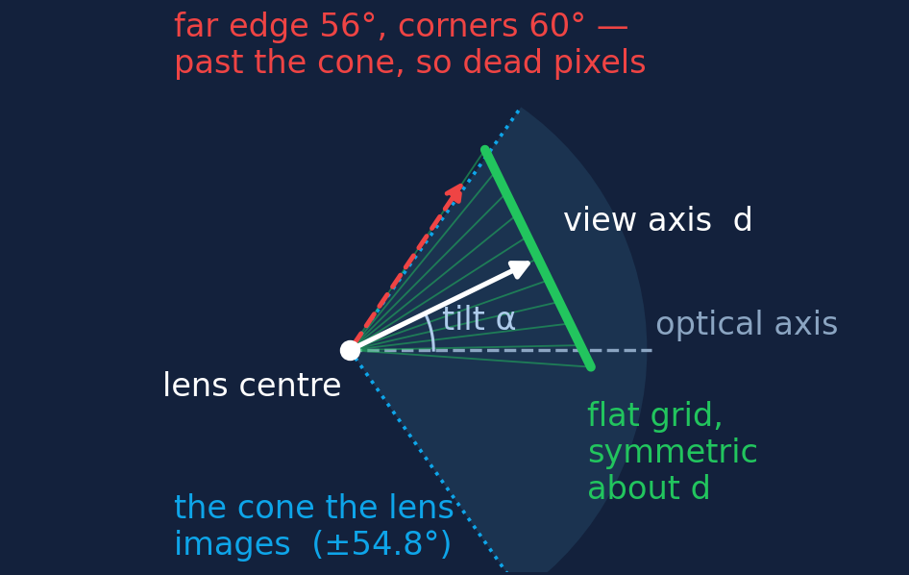
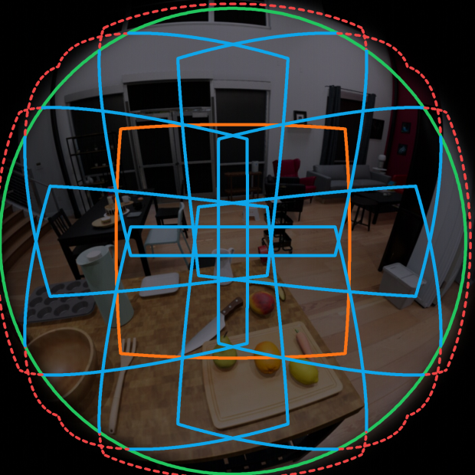
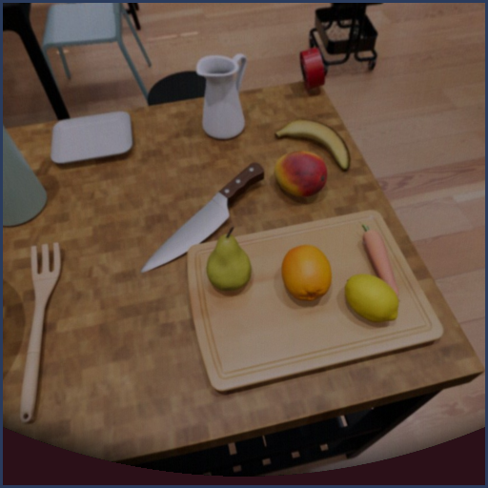
How we generate the nine views
Each view is an ordinary photo centred exactly on its own axis — the only camera VGGT can describe.
one centre view + eight in a ring
green = what the lens images
one ring window as VGGT gets it
94% of it carries image
Pick a direction, stand a flat square grid against the sphere there, and copy back the colour each grid cell's ray lands on.
Why the views must be optical-centred: VGGT's camera is nine numbers — position, rotation and two field-of-view angles. There is no principal point and no distortion term.
It always rebuilds the camera with the principal point at the exact image centre. A tangent grid is symmetric about its own axis, so every window we make is exactly that camera. A raw fisheye crop is not.

Slide 5
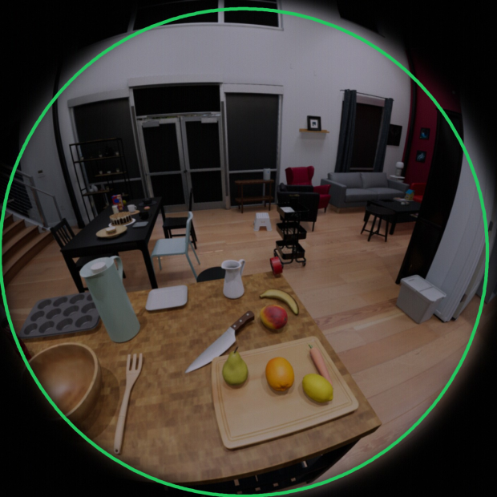
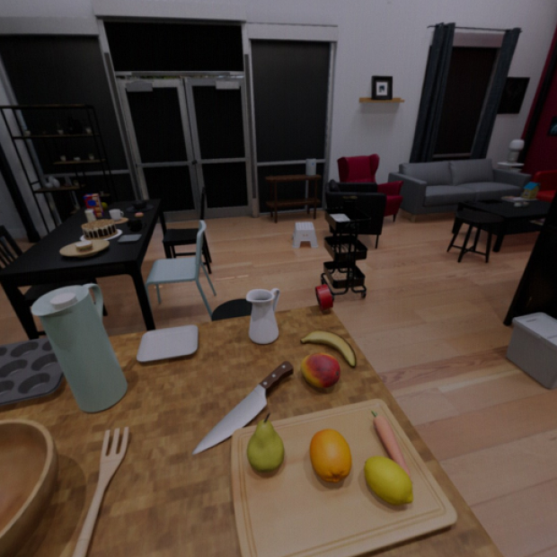
Comparison between different input formats
Three ways to hand one fisheye frame to a model that only understands ordinary photos.
1. raw fisheye frame
2. one rectified view
3. our nine converted windows
every pixel the sensor gives us;
green marks the cone it images
straight lines, but 29.5% of
the cone falls outside it
straight lines and the whole
cone — at nine passes
The raw frame keeps every pixel but bends straight lines. One rectified view removes the distortion and loses the rim — it sees 70.5% of what the lens images.
Nine converted windows keep the whole cone with no distortion, at the price of nine passes.

Slide 6
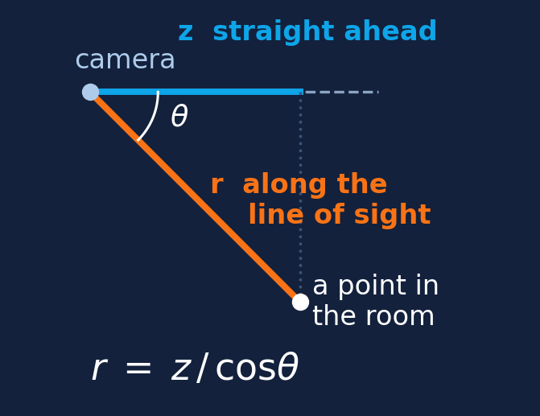
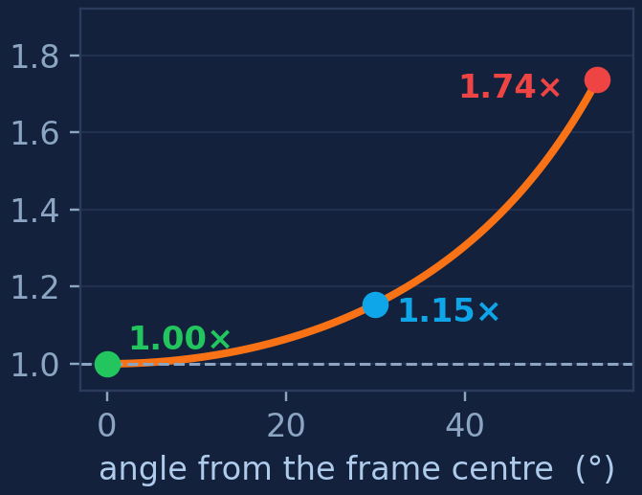
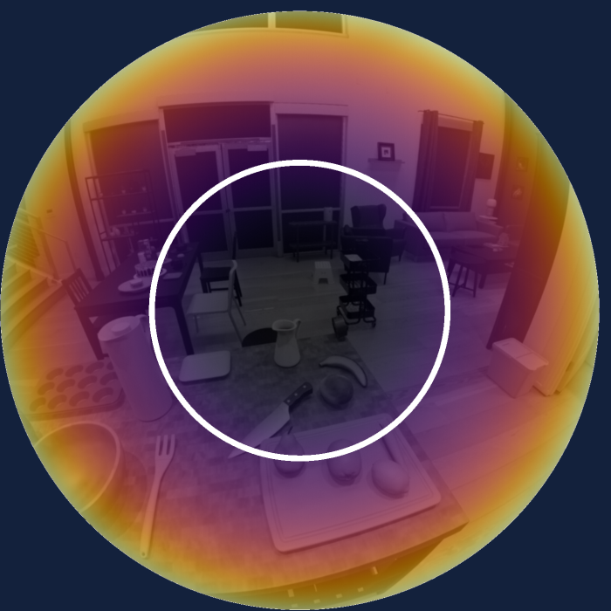
Modification: planar z depth → ray range depth
VGGT assumes pinhole input and returns planar z. A fisheye pixel needs the distance along its own ray.
1. the two distances
2. how far apart they get
3. across a real frame
what VGGT returns (z) against
what a fisheye pixel needs (r)
pure geometry — no model is
involved in this curve
r ÷ z, 1.00× at the centre to 1.74×
at the rim; the white ring is 1.15×
Why we changed it: a window's own corner already sits 1.15× out and the rim of the lens 1.74×. Scoring z against a fisheye's true distance charges the model for a geometry error we introduced.
It is a radial error, so rescaling the whole map afterwards cannot absorb it. The pipeline now converts before anything is compared.

Slide 7
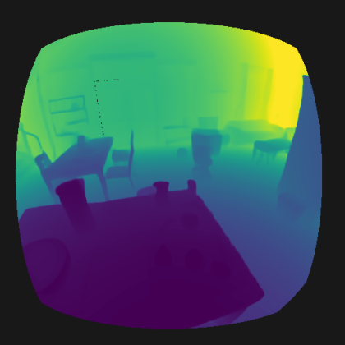
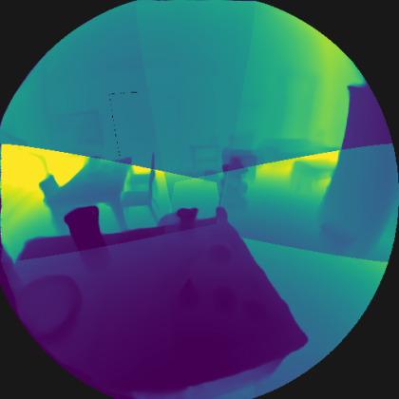
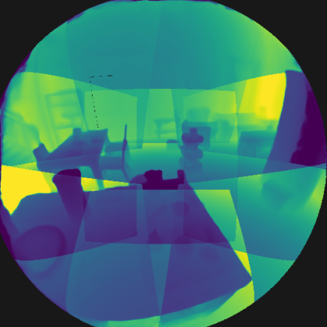
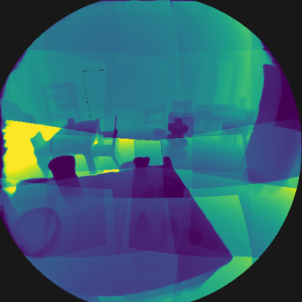
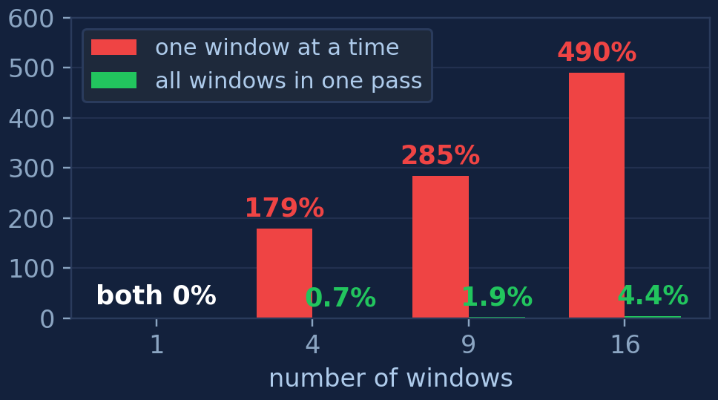
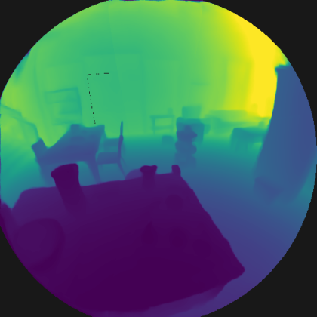
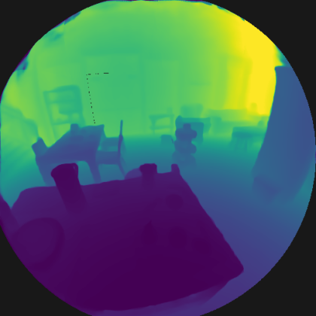

Finding: the "cropped" views have to feed to VGGT together
Same frame, same model, same layouts. One thing changes: together, or one at a time?
one window at a time, stitched afterwards
worst disagreement between two windows about scale ↓ lower is better
all windows in a single pass
1 window
4 windows
9 windows
16 windows
depth colours: dark = near, bright = far
For each overlapping pair take r = median(range_A ÷ range_B); plotted is (exp(max |ln r|) − 1) × 100, the worst pair.
At 16 windows, AbsRel (typical distance error, lower is better) falls from 0.928 apart to 0.078 together, and the worst scale disagreement from 490% to 4.4% — from useless to usable.
Run apart, every window infers its own camera and comes back on its own scale; stitching cannot repair that. Joint inference is now the default. Source: outputs/patch_scale, frame 1 of seq131.

Slide 8
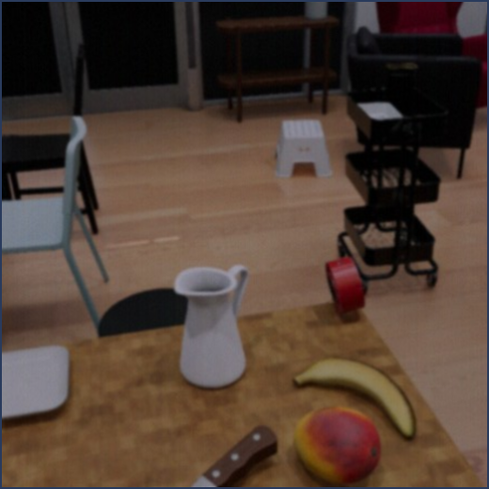
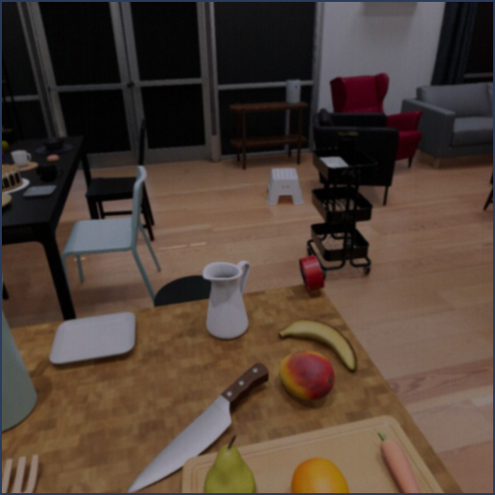
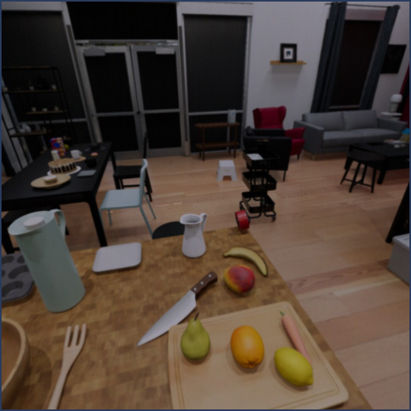
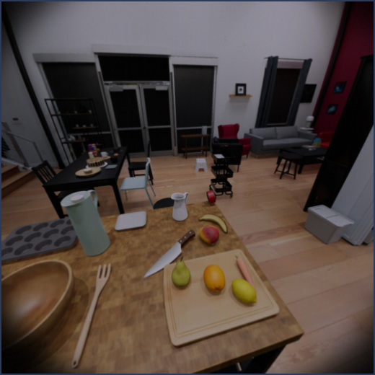
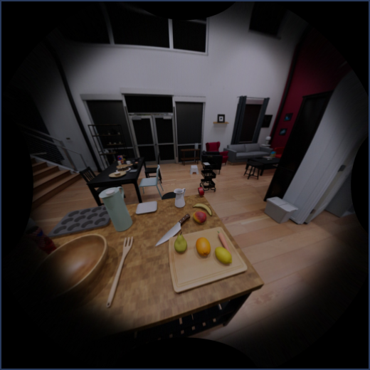
Finding: FOV matters
The same fisheye frame cut into windows of five field-of-view (FOV) widths — what VGGT is handed.
40° wide
60° wide
80° wide
100° wide
120° wide
corners: 22° off axis
corners: 33° off axis
corners: 45° off axis
corners: 58° off axis
corners: 68° off axis
Wider is not free
A window's corners reach much further off axis than its stated width. At 120° they sit 68° out, past the 54.8° the lens images, so they are dead black.
Narrower is not free either
A narrow window shows VGGT less of the room, and it leans on scene context to judge distance. The best width is in between — the next page measures it.
All five are cut from the same frame and centred on the optical axis; only the width changes.

Slide 9
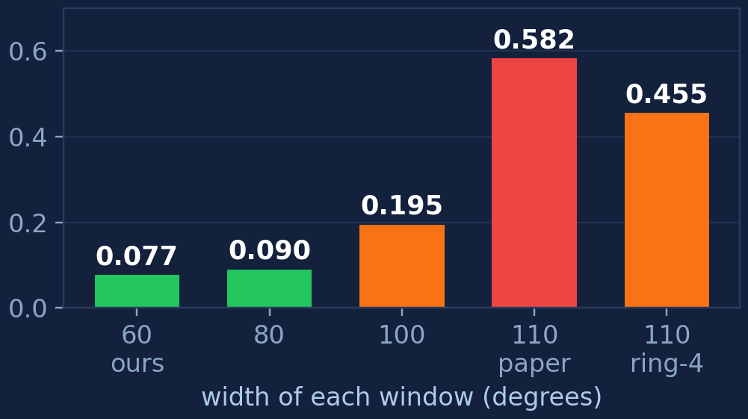
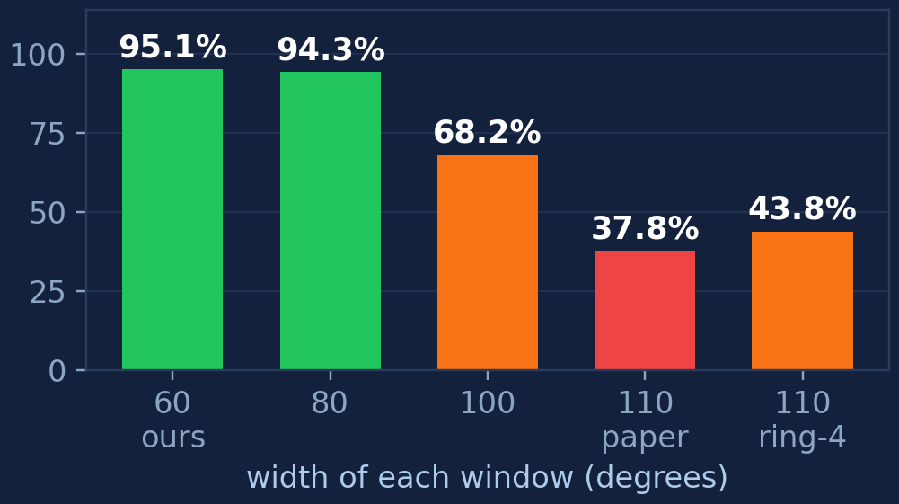
Result: how wide should each window be?
The full pipeline against measured ground truth. 100 frames of one ADT (Aria Digital Twin) sequence.
AbsRel — typical distance error ↓ lower is better
δ1 — pixels within 25% of truth ↑ higher is better
60° — the width this port already used — wins outright.
110° is the published VGGT-360 default. On panoramas it is right; on this fisheye it is 7.5× worse. Widening the ring spacing ("ring-4": four in the ring instead of eight) recovers part of it, never all.
Caveat, measured not guessed: the ring tilt was held at 26° for every width, so the wider arms also carry far more dead pixels — the next page shows what that does. issue #5 · results@8b64312.

Slide 10
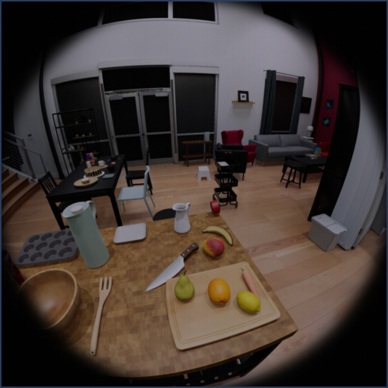
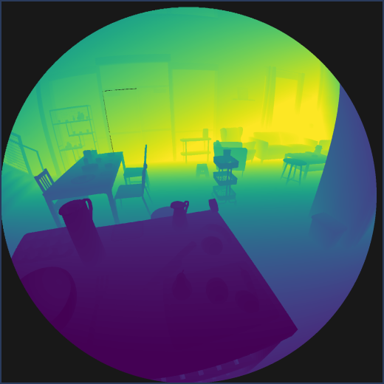
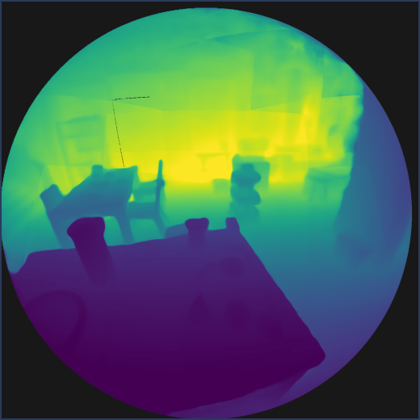
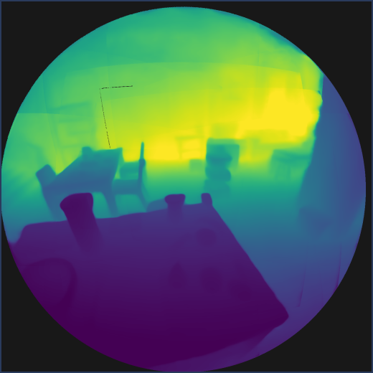
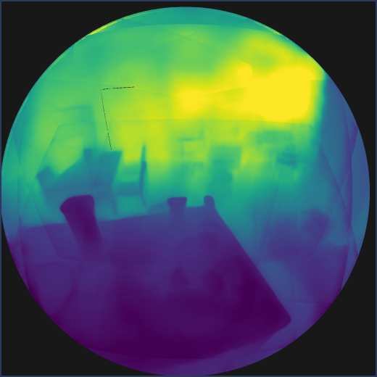
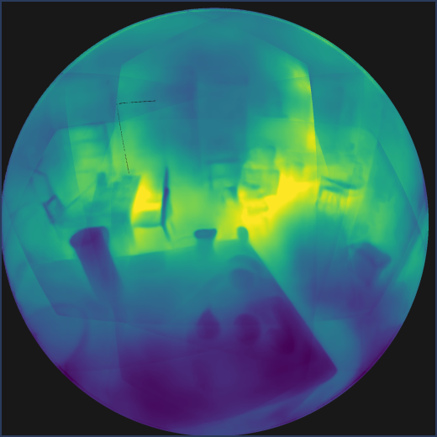
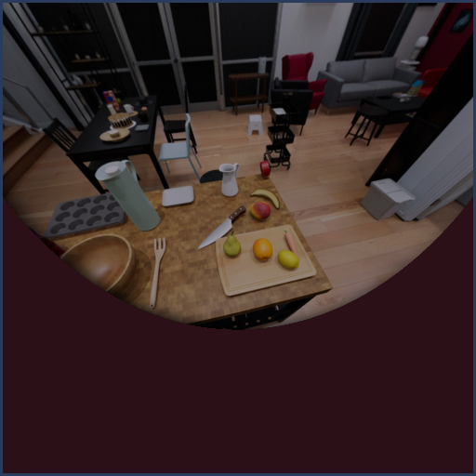
What each width produces — and why 100° and 110° look tiled
Same frame, same nine-window layout, same fusion. Only the width of each window changes.
input
ground truth
60°
80°
100°
110°
raw fisheye
measured
AbsRel 0.077
δ1 95.1%
AbsRel 0.090
δ1 94.3%
AbsRel 0.195
δ1 68.2%
AbsRel 0.582
δ1 37.8%
Depth colours: dark = near, bright = far. Pictures: frame 1; AbsRel and δ1: all 100 frames. issue #5 · results@8b64312.
Yes, the tiling is real — and it is the layout, not a bug.
The ring tilt stays at 26° at every width, so a wider window is never re-spaced: its corners just push past the cone the lens images. At 60°, 95% of the pixels VGGT sees carry image and 3.3 windows cover an average direction. At 110°, only 62% carry image and 7.1 windows pile onto the same direction.
So VGGT is fed large black wedges and fusion blends seven disagreeing predictions per pixel. Left: one 110° ring window as VGGT receives it — 38% of it is dead.

Slide 11
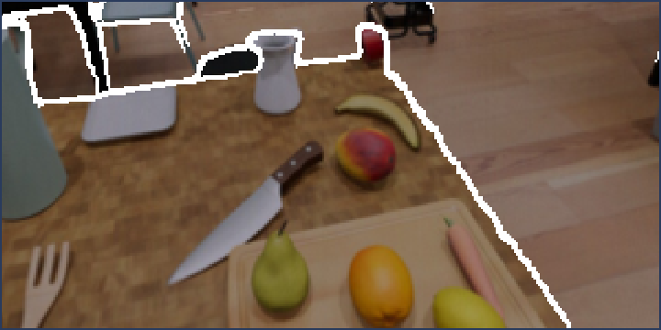
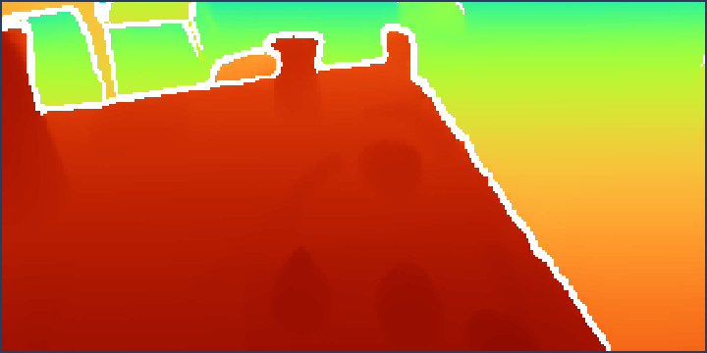
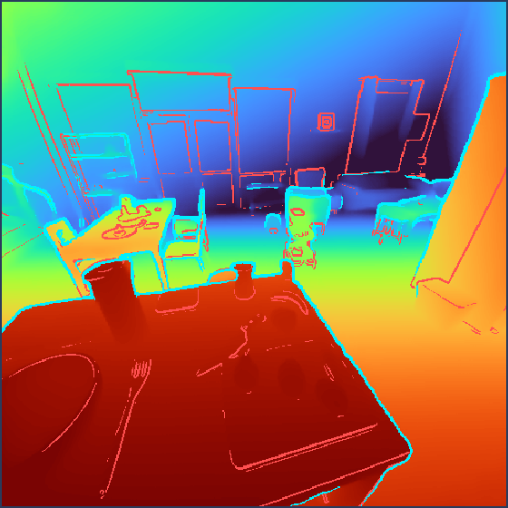
Issue: the predicted depth does not line up with the input
The boundaries sit off the object edges and wander along them. Easy to see, hard to score.
input, with the predicted boundary
predicted distance, same boundary
edges in the input
red = no depth jump
What we see
The white line is where VGGT's predicted distance jumps. On a straight table edge it should be straight and sit on the edge. It sits inside it and wobbles.
Why an edge score does not measure it
Only 13% of the strong edges in the input are places where distance actually changes — the rest are pattern: fruit, knife, floorboards, poster.
TODO — score it against ground-truth depth edges instead.
Measure the distance between the edges of the measured ground-truth depth and the edges of the predicted depth. Both sides are depth, so image texture cannot contaminate it. Not implemented yet.

Slide 12
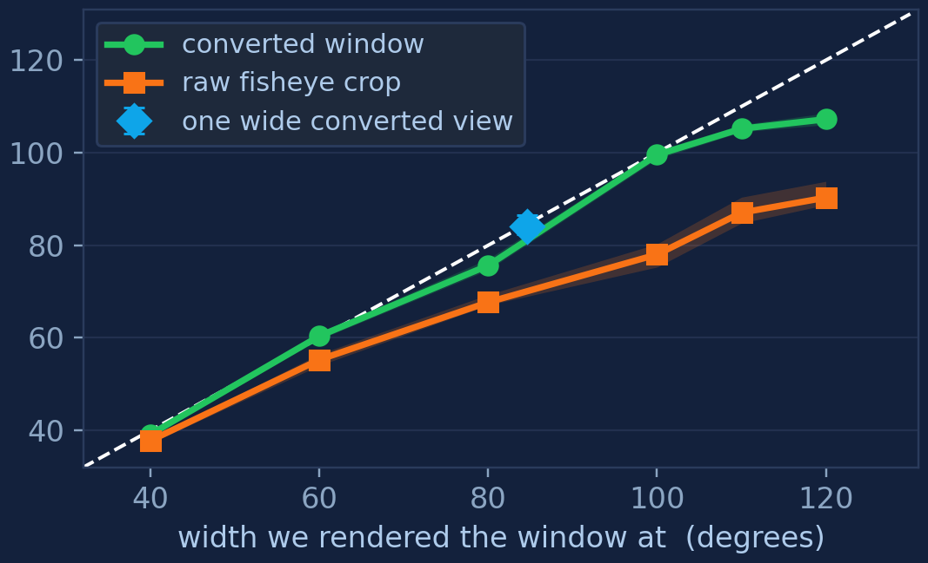
Does VGGT know what lens it is looking through?
Its camera head emits fov_h and fov_w for every input image — its own guess at how wide that image is.
field of view VGGT reports back (degrees)
The three ways we can feed VGGT
converted window
Re-drawn so straight lines stay straight. Our step; nine cover the lens.
raw fisheye crop
A box cut straight out of the fisheye. Cheapest — curvature included.
one wide converted view
The whole frame as a single 84.5° photo. One pass, but 29.5% of the cone is lost.
Where the number comes from
VGGT's camera head predicts nine values per image; fov_h and fov_w are two of them. The field of view is a model output, not something we derive.
Each point is one window we rendered. On the dashed line, VGGT agrees with the camera we handed it. 5 frames of seq131.
Converting first keeps VGGT's own camera estimate within about 1° of the truth up to 100°; a raw fisheye crop puts it 22–30° out. This says VGGT has the right camera in mind, not that its depth is accurate.

Slide 13
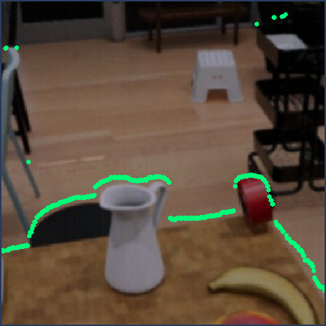
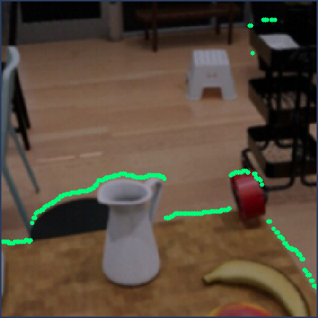


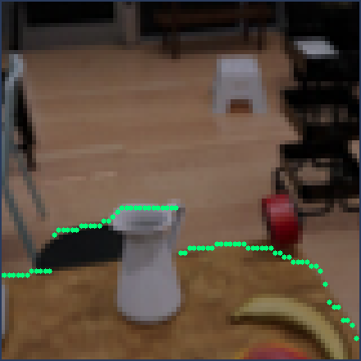
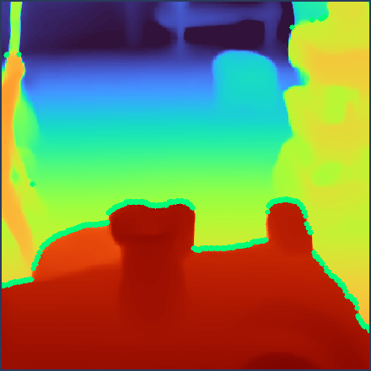
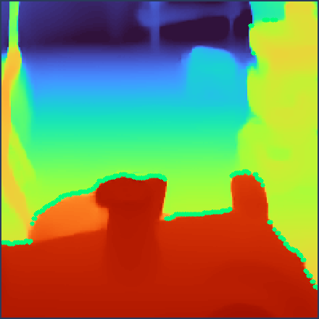
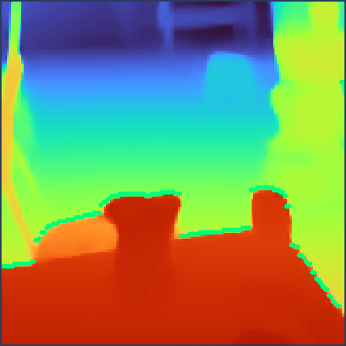
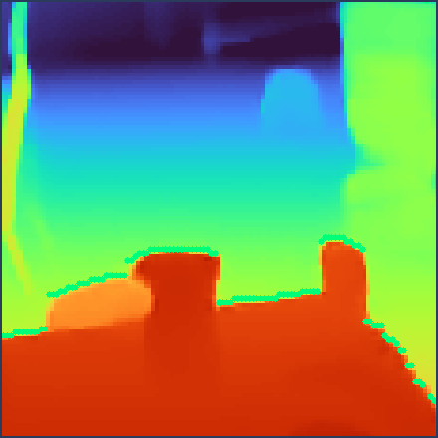
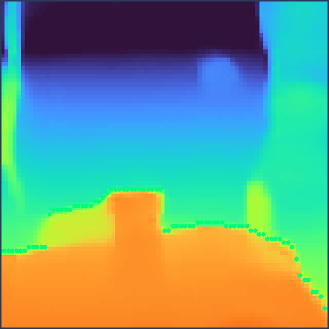
Between different FOV
One separate run of VGGT per column, each on a single converted window of that width.
40° window
60° window
80° window
100° window
120° window
input
predicted
distance
376 px wide
238 px wide
164 px wide
116 px wide
80 px wide
Identical patch of world in every column: a 30° box centred on the optical axis, carried by 376 pixels of depth at 40° and only 80 at 120°.
The green trace is VGGT's own depth boundary, drawn on both rows. Curving round the jug is right; the ragged run along the table edge is not. Depth colours: dark = near, bright = far.

Slide 14



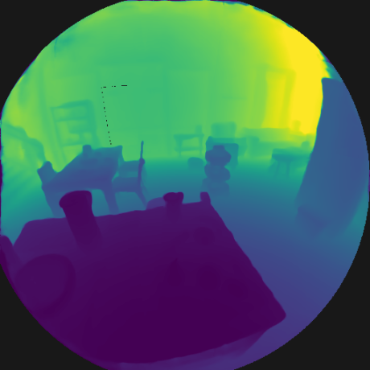
Qualitative comparison · 1 of 2: how many windows
One 100° view, then that same view split into 4, 9 or 16 tiles. This is the tiling study.
1 window
4 windows
9 windows
16 windows
100° wide
79.7° each
58.2° each
45.3° each
Depth colours: dark = near, bright = far, and every panel is on its own colour scale — so compare structure, not colour. More windows does not mean more detail; it means more seams and a flatter room.
AbsRel on this layout: 0.049 with one window, 0.098 with four, 0.118 with nine, 0.116 with sixteen — worse at every step.
Not comparable to page 9: there, nine 60° windows in a ring scored 0.077 over 100 frames. Here, nine tiles of one 100° view score 0.118 on 1 frame.

Slide 15
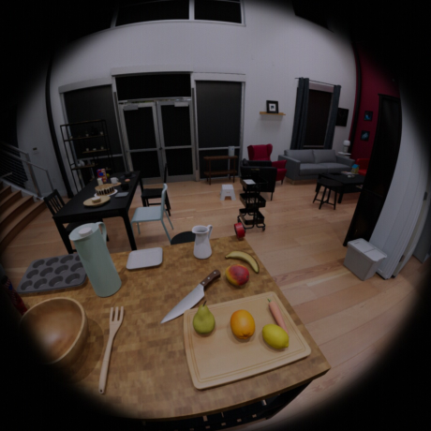
Qualitative comparison · 2 of 2: one wide view vs many windows
Three ways of covering the frame, side by side. Same frame, same model, same fusion grid.
what the camera sees
one wide converted view
16 converted windows
the raw fisheye frame
100° wide, one pass
45.3° each, fused
Depth colours: dark = near, bright = far. AbsRel on this run: one wide view 0.049 · 16 windows 0.116 · wide + 16 together 0.096 · wide + 16 with the wide view weighted 4× 0.102.
The wide view alone is the best of the four. Combining it with the close-up windows does not help — it lands halfway back. The next two pages take that apart.
There is no fourth panel because that run saved no image of its output; both committed overlays are the one-window arm's. Re-run requested — the numbers are unaffected.

Slide 16
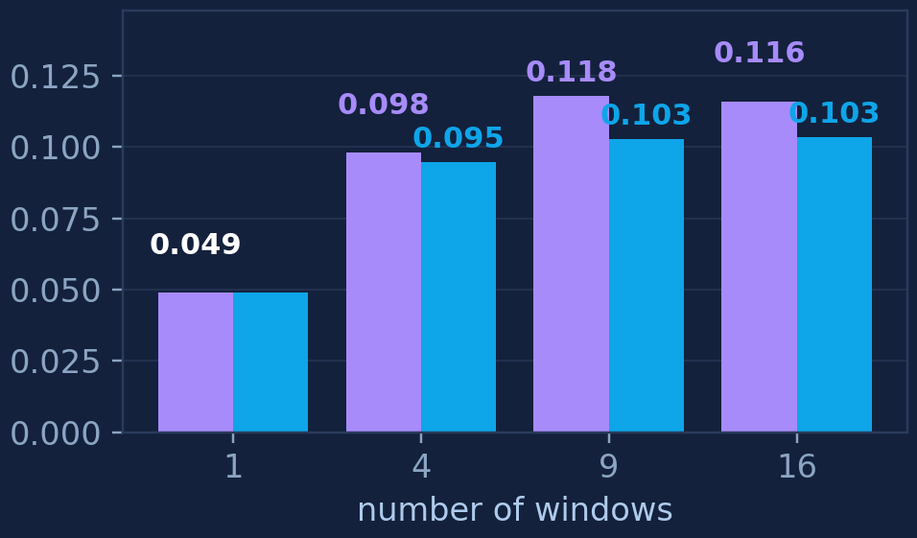
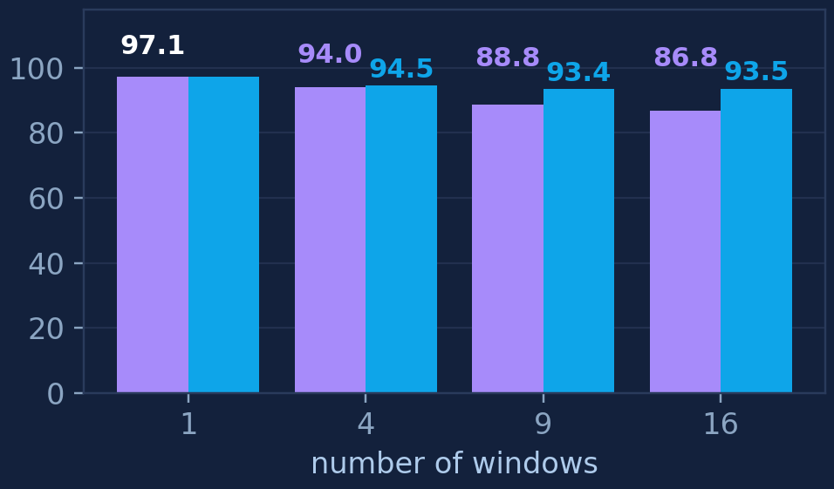
Result: is it the number of tiles, or how narrow each one is?
Cutting a frame into more windows also makes each one narrower. This separates the two.
purple = each window narrows as you add more blue = every window held at 80° wide
AbsRel ↓ lower is better
δ1 — pixels within 25% ↑ higher is better
Width explains a lot of it — on one measure. At 16 tiles, holding every tile at 80° instead of letting it shrink to 45° recovers 6.6 of the 10.3 δ1 points lost against a single view; on AbsRel the same fix recovers only 19%.
Splitting at all is the expensive step: one view to four tiles nearly doubles AbsRel (0.049 → 0.095) with width held fixed. Four to sixteen adds 0.008, close to this run's own repeatability (0.003).
One frame, one sequence; 7 configs, VGGT-Ω on seq131 frame 1. Differences under about 0.01 are not meaningful.

Slide 17
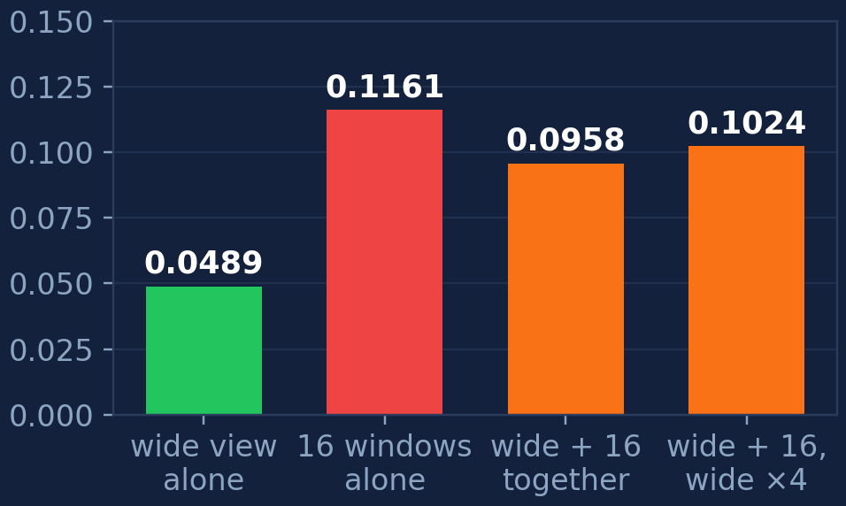
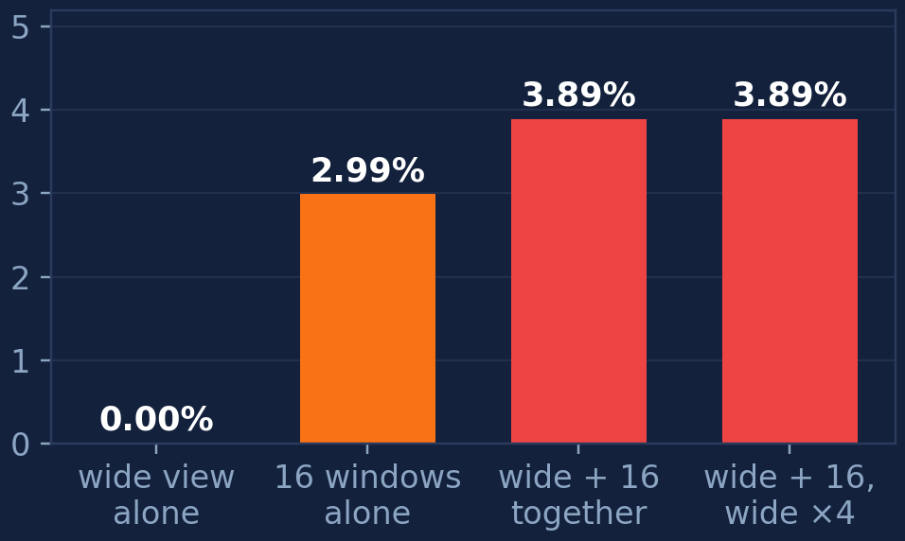
Result: can a wide view and close-up windows be combined in one pass?
Give VGGT the wide view for scale and the windows for detail, at once, and let attention reconcile them.
AbsRel ↓ lower is better
how much the views disagree about scale ↓ lower is better
It does not work. Wide view + 16 windows in one pass lands at AbsRel 0.096 — better than the windows alone (0.116), but roughly twice as bad as the wide view on its own (0.049).
Attention is not reconciling them: the wide view and the windows disagree about scale by 3.89%, more than the sixteen windows disagree among themselves (2.99%).
Nor is it a fusion-weight problem: weighting the wide view 4× heavier makes it worse still (0.102) and leaves the disagreement at exactly 3.89%. Whatever goes wrong happens before the blend.

Slide 18
Conclusions
Four things we can now say.
Windows must go through VGGT together, not one at a time.
Apart, the windows disagree on scale by up to 490% and the fused map shows seams. Together that falls to 4.4%, and AbsRel from 0.93 to 0.078. (1 frame)
Our 60° window is the best width tested — the paper's 110° is far worse here.
Over 100 frames: AbsRel 0.077 at 60° against 0.582 at 110°; δ1 95.1% against 37.8%. The ring spacing was never re-tuned, so at 110° only 62% of each window carries image.
One wide view beats many windows — and the coverage argument for windows is weak.
One 100° view: AbsRel 0.049, already seeing 92.2% of what the lens images. Any tiling: 0.095 or worse. A single 110° view is centred on the axis, so it would cover 100% of the cone in one pass — its own corners are 23% dead, but nothing is missed. Never run. (1 frame)
VGGT is sensitive to input field of view, and this is documented upstream.
VGGT-Ω's training filter drops any sequence outside 30°–120° or with distortion above 0.1, and its limitations section names abrupt field-of-view change and heavy distortion as failure modes.
2 and 3 do not conflict: 60° is the right width IF we tile; 3 says the tiling is what costs accuracy.
References: vggt issue #180 · UAVFF3D arXiv:2605.17942 · VGGT-Ω 2605.15195 · VGGT-360 2603.18943

Slide 19
Next steps
In priority order, with what each one is meant to settle.
1
Right now VGGT is run on a single frame. Increase the number of frames so there are more constraints.
Settles: whether the tiling penalty is really about single-frame ambiguity.
2
Finetune VGGT with DepthAnything, which is always aligned with the input.
Settles: whether a model that is always pixel-aligned removes the ragged boundaries.
3
Combine DepthAnything and VGGT: depth from DepthAnything, cross-frame attention from VGGT.
Settles: whether depth quality and cross-view consistency can be sourced separately.
4
Wrap up as the input-correction baseline and move to other baselines, e.g. positional-encoding finetuning.
Settles: when to stop paying for input correction and start changing the model.

