Slide 1

Slide 1
BWF Badminton
Bayesian Data Analysis Project
Team: TheSurvivors

Slide 2
Introduction
Goal: distribution of the outcomes in a badminton tournament
Approach: Bayesian data analysis on historical data
1

Slide 3
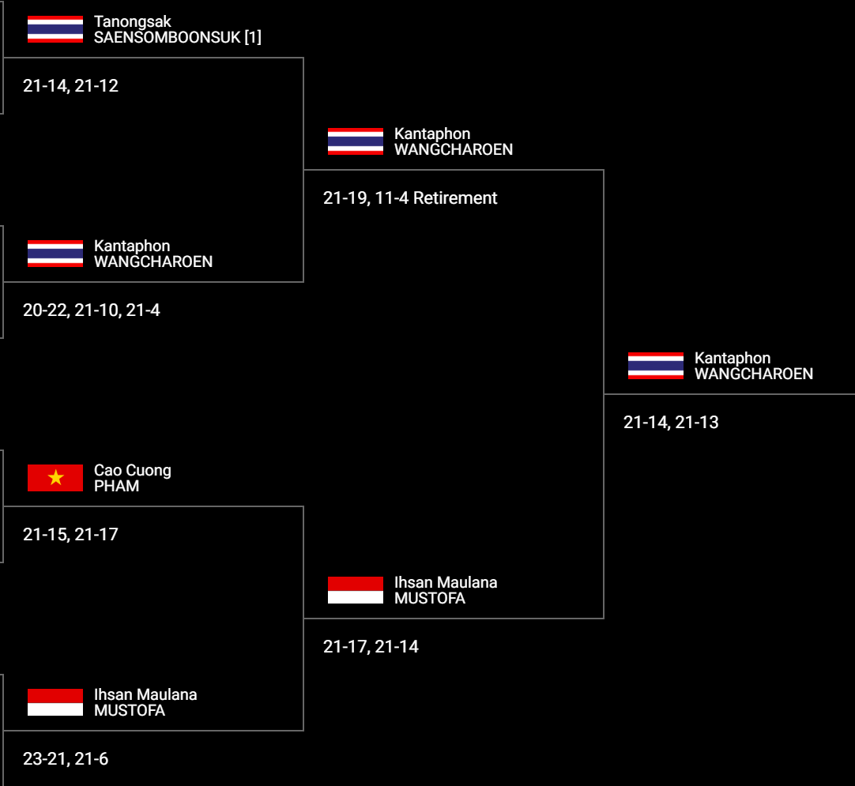
2

Slide 4
Ranking spread
Ranking spreads = rank(2nd player) – rank(1st player)
For example:
Spread(from 1st rank player to 8th rank player) = 8 - 1 = 7
Spread(from 2nd rank player to unrank player) = 12 - 2 = 10
3

Slide 5
Win degree
Win degrees = {1,2,3,4,5,6}
1 Lose Lose → Lose
2 Lose Win Lose → Lose
3 Win Lose Lose → Lose
4 Lose Win Win → Win
5 Win Lose Win → Win
6 Win Win → Win
4

Slide 6
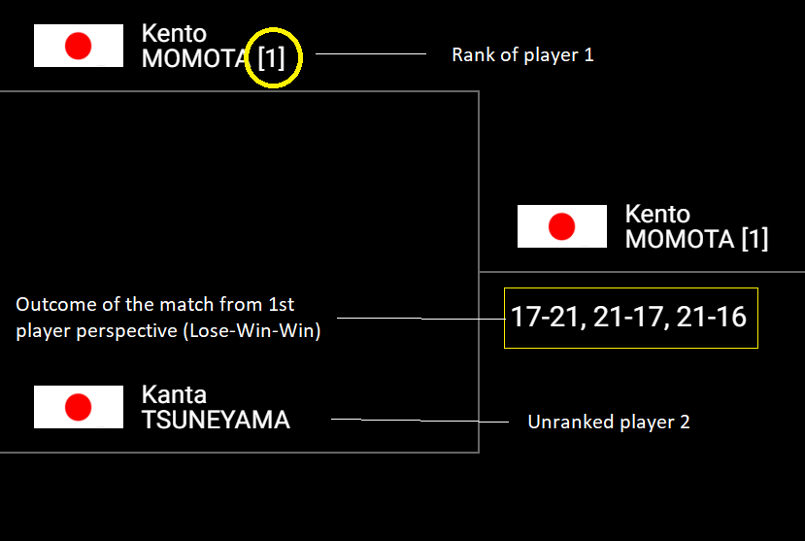
Example of spread 11 and win degree 4
5

Slide 7
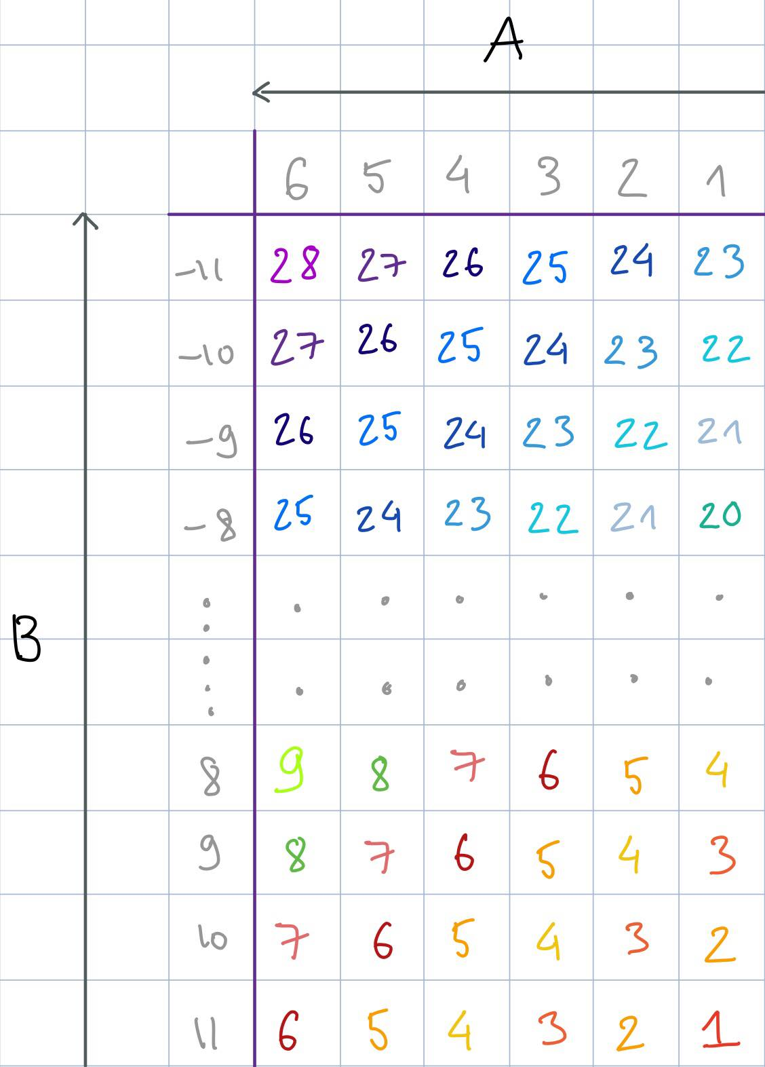
Preprocess
Objective: 1-d space collection
Reduction rules:
Same spreads, higher win degree correlates to higher value (arrow A)
Same win degrees, lower spread correlates to higher value (arrow B)
How:
Starts with an extreme value
Increase by step 1
6

Slide 8
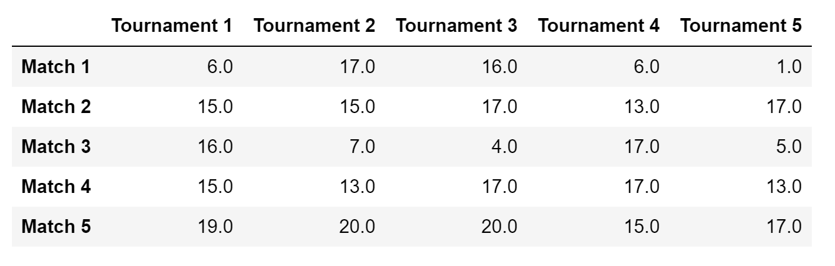
Dataset
Outcome of the dataset after preprocessing (67x5)
7

Slide 9
Models
Priors
Uniform (weak prior)
Inverse Gamma (on variance, conjugate prior to the normal likelihood)
Likelihood
Normal
Models
Pooled with uniform prior
Pooled with inverse gamma prior
Hierarchical with uniform prior
Hierarchical with inverse gamma prior
8

Slide 10
Convergence diagnostics 1/2
Pre-conditions
Stan’s default parameters
adapt_delta=0.9
Validation criteria
Rhat < 1.1
Effective sample size high
Divergences 0
9

Slide 11
Convergence diagnostics 2/2
HIERARCHICAL MODEL
WITH UNIFORM PRIOR
HIERARCHICAL MODEL
WITH INVERSE GAMMA PRIOR
POOLED MODEL WITH INVERSE GAMMA PRIOR
All failed → adapt_delta=0.93
Use non-centered
parametrization
POOLED MODEL WITH UNIFORM PRIOR
1 fail: divergences 2% → non-centered parametrization
OK
OK
OK ENOUGH
(divergences 0.025%)
OK ENOUGH
(divergences 0.025%)
10

Slide 12
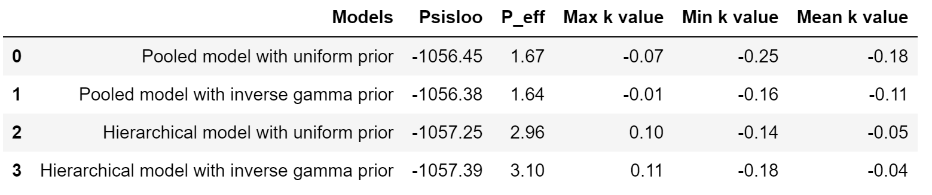
Model comparison with PSIS-LOO
All the models are reliable (very low k-values)
Model with best predictive accuracy is Pooled model with inverse gamma prior (highest PSIS-LOO value)
11

Slide 13
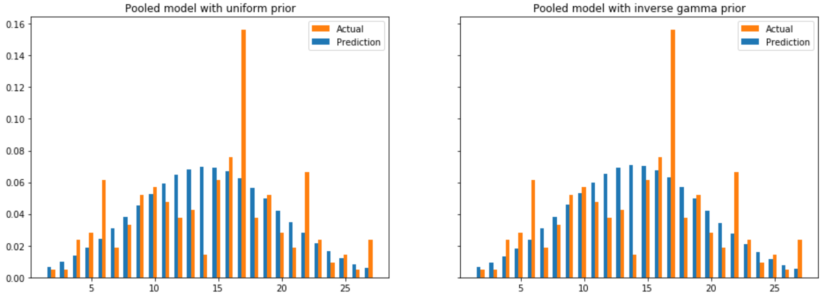
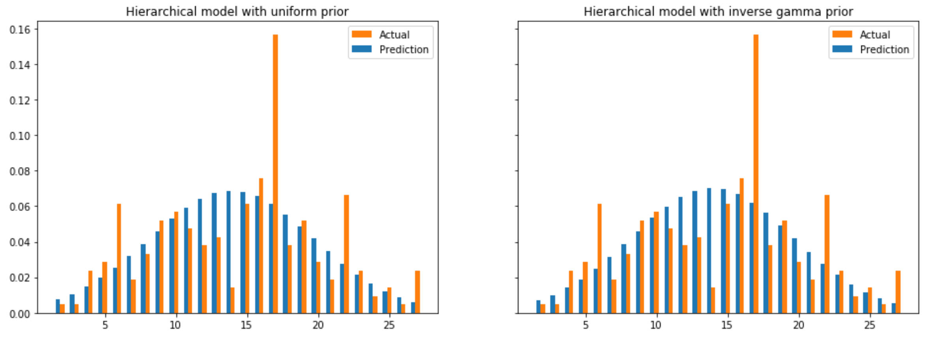
Posterior predictive checking
Similar trend
Errors are considerable why?
12

Slide 14
Conclusions 1/2
Problems
Direct inference of a single match
Divergences in hierarchical model
Improvements
Alternative models: Binomial, Multinomial
Joint distribution of some parameters (absolute ranking + win degree)
Sensitivity analysis for the prior and model
13

Slide 15
Conclusions 2/2
Badminton domain perspective:
Visible correlation between spread and win degree
Extreme outcome (towards 1 or 28) not expected
Statistical inference perspective
Given the domain knowledge, one would expect the distribution of the estimand to be a normal distribution
Highly data-driven
Hierarchical model ends up as pooled model
14

Slide 16
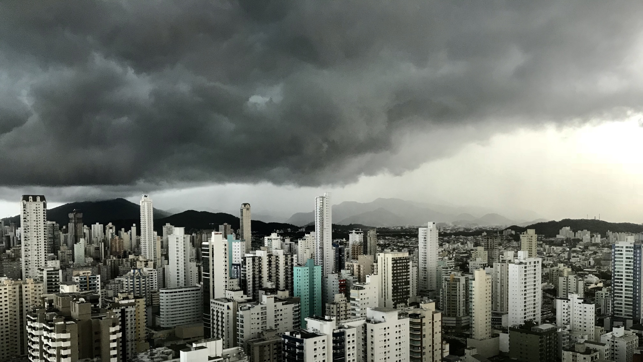
Slide 11
THANK YOU

