Slide 1

Slide 1
BWF Badminton
Bayesian Data Analysis Project
Team: TheSurvivors

Slide 2
Introduction
Goal: analyze the distribution of the outcomes in a badminton tournament
Approach: apply Bayesian data analysis on historical data of badminton tournaments
Problem analysis: ???
1

Slide 3
Dataset 1/4
1st player’s perspective
Tournament
Players: 8 seed and some unranked
→ spread = rank(2nd player) – rank(1st player)
→ spread space = {-11,-10,…,10,11}
Match:
1 Lose Lose → Lose
2 Lose Win Lose → Lose
3 Win Lose Lose → Lose
4 Lose Win Win → Win
5 Win Lose Win → Win
6 Win Win → Win
→ Win degree space ={1,2,3,4,5,6}
2

Slide 4
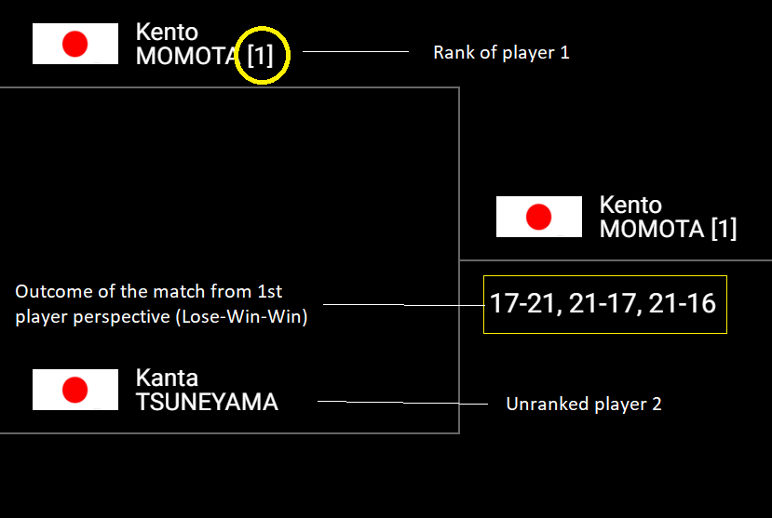
Dataset 2/4
Example of spread 11 and win degree 4
3

Slide 5
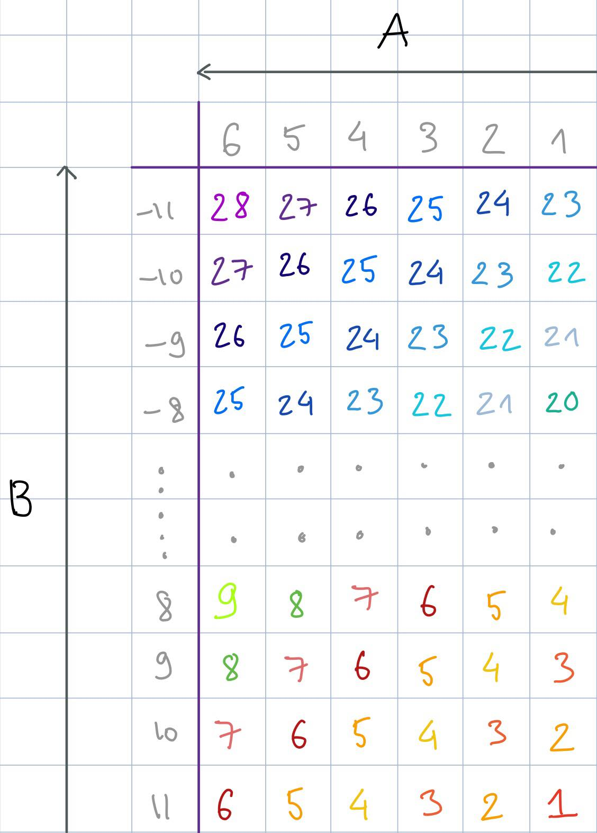
Dataset 3/4
Convert observations (spread and win degree) to 1D space collection
Mapping table (23x6)
Columns: win degree
Rows: spread
Space = {1,…,28}
Step between values 1
Same spreads, higher win degree correlates to higher value (arrow A)
Same win degrees, lower spread correlates to higher value (arrow B)
Use mapping table for each match in the tournament and map each observation to one value from {1,…,28}
4

Slide 6
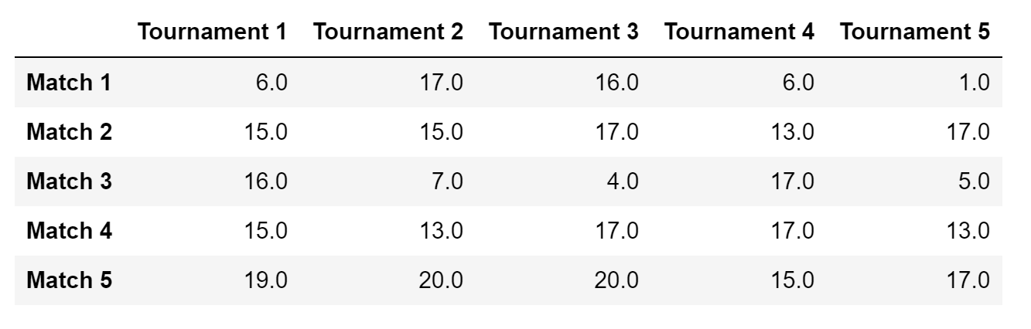
Dataset 4/4
Outcome of the dataset after mapping (75x5)
5

Slide 7
Models
Priors
Uniform (weak prior)
Inverse Gamma (on variance, conjugate prior to the normal likelihood)
Likelihood
Normal
Models
Pooled with uniform prior
Pooled with inverse gamma prior
Hierarchical with uniform prior
Hierarchical with inverse gamma prior
6

Slide 8
Convergence diagnostics 1/2
Pre-conditions
Stan’s default parameters
adapt_delta=0.9
Validation criteria
Rhat < 1.1
Effective sample size high
Divergences 0
7

Slide 9
Convergence diagnostics 2/2
HIERARCHICAL MODEL
WITH UNIFORM PRIOR
HIERARCHICAL MODEL
WITH INVERSE GAMMA PRIOR
POOLED MODEL WITH INVERSE GAMMA PRIOR
All failed → adapt_delta=0.93
Use non-centered
parametrization
POOLED MODEL WITH UNIFORM PRIOR
1 fail: divergences 2% → non-centered parametrization
OK
OK
OK ENOUGH
(divergences 0.025%)
OK ENOUGH
(divergences 0.025%)
8

Slide 10
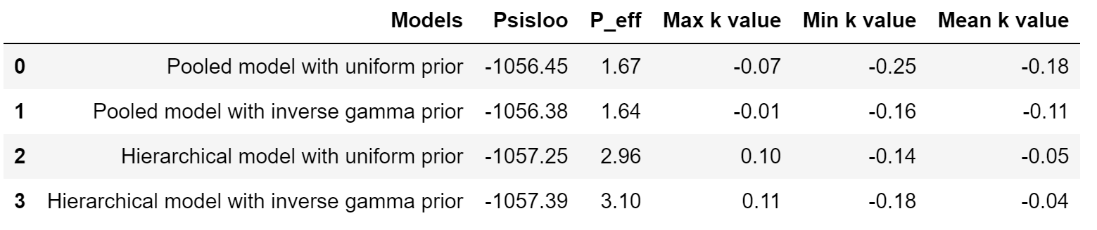
Model comparison with PSIS-LOO
All the models are reliable (very low k-values)
Model with best predictive accuracy is Pooled model with inverse gamma prior (highest PSIS-LOO value)
P_eff discussion??
9

Slide 11
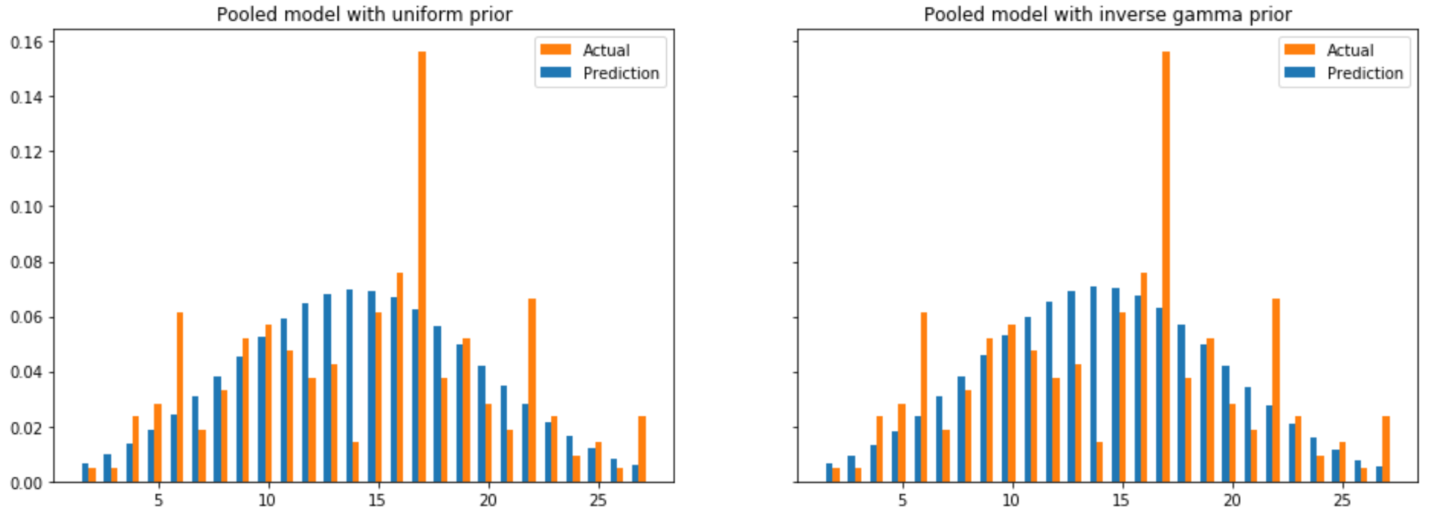
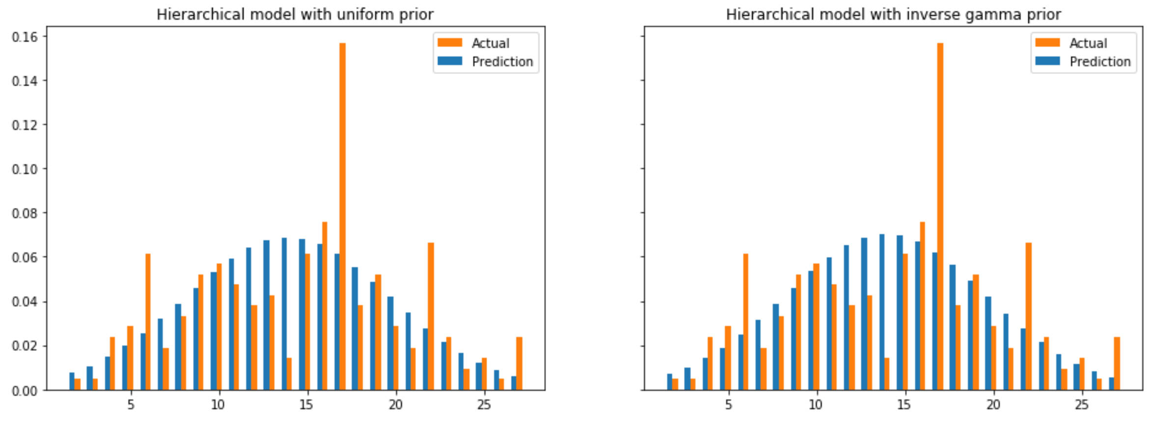
Posterior predictive checking
All models are similar (all the tournaments were consistent)
Too small data of the actual tournament (normal distribution cannot be constructed)
Errors are considerable between prediction and actual distribution ????
10

Slide 12
Conclusions 1/2
Problems
Data model cannot be used for direct inference of a single match
Improvements
Binomial model could be a good fit as well
Multinomial model could be considered
Data model can be improved using joint distribution of some parameters (absolute ranking + win degree) for the estimand
Sensitivity analysis for the prior and model
11

Slide 13
Conclusions 2/2
Badminton domain perspective
There is a visible correlation between spread and win degree
Probability of extreme outcome (towards 1 or 28) are low and not expected in the tournament
Statistical inference perspective
Given the domain knowledge, one would expect the distribution of the estimand to be a normal distribution
Given the found posteriors, we can see the result is highly data-driven
Given two models, pooled and hierarchical, we can see that hierarchical model ends up as pooled model
12

Slide 14
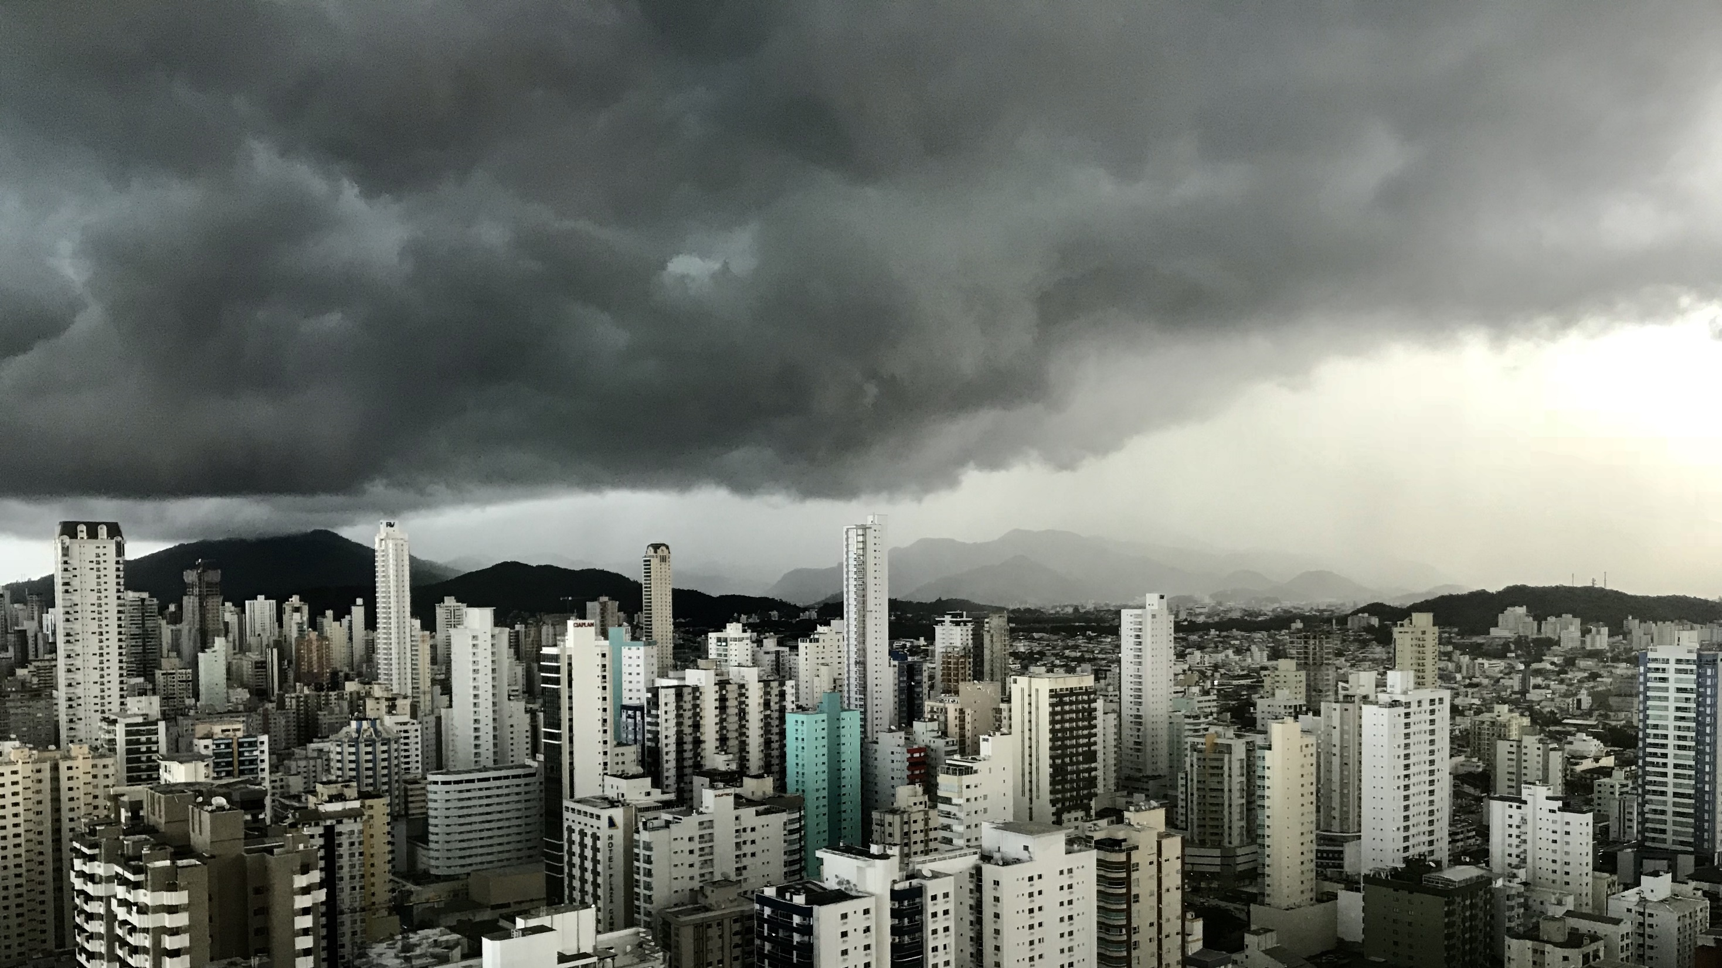
Slide 11
THANK YOU

