Slide 1
RIOT ON
ARM CORTEX 0 AND
NORDIC BLUETOOTH LE
software project telematics [1]
summer 2014 – FU Berlin
by Adam, Christian and Timo

Slide 2
Project tasks
Porting RIOT to nrf51822
Get the Bluetooth LE module running
  Access and read registers of that module
Communicate between 2 boards

Slide 3
Planed, TODO & done
Introduction
  Get overview of documentation
    Cortex M0
    nrf BLE
  Get in touch with RIOT [5]
  Installing toolchain for Cortex M0

Slide 4
Planed, TODO & done
→ Recompile / adjust RIOT modules for processor
  adjust board environment
  First programing: using onboard LED‘s
  flash script
  Usung UART for debugging
  → adjust timer.c for nrf58122
  → Task switching
    → provided by cortexm_common
    → currently build erros

Slide 5
Planed, TODO & done
Access and read nRF registers
  → port routines to access BLE registers from nRF SDK
Bluetooth communication between boards
  → add higher layer routines for BLE communication
  → make new example for sending and receving BLE msg

Slide 6
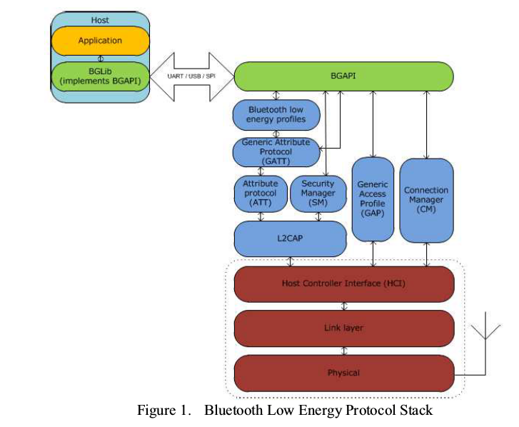
BLE modules
[1] BLE modules outline

Slide 7
Schedule
TOPIC | planned | reality
Introduction -reading documents - riot overview - setup toolchain | 3 weeks | 4 weeks
porting to our plattform | 4 weeks | > 5 weeks (still in progress)
BLE communication | 4 weeks | 3 weeks
Documentation | 2 weeks | 1 week

Slide 8
Links and Sources
[1] Jara, Fernández, López, Zamora, Ubeda, Skarmeta, Evaluation of Bluetooth Low Energy capabilities for continuous data transmission from a wearable electrocardiogram,Computer Sciences Faculty, University of Murcia, 2012 Sixth International Conference on Innovative Mobile and Internet Services in Ubiquitous Computing

