Slide 1
RIOT ON
ARM CORTEX 0 AND
NORDIC BLUETOOTH LE
software project telematics [1]
summer 2014 – FU Berlin
by Adam, Christian and Timo

Slide 2
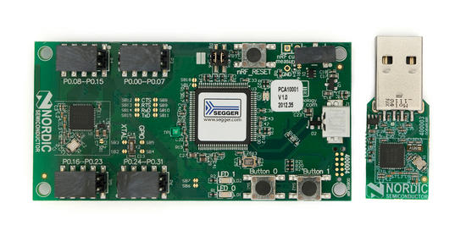
Hardware
ARM Cortex M0 processor [2]
  Smallest ARM processor
  Low power consumption
  32bit
low energy bluetooth mod nRF51822 [3]
  For 2.4 GHz ultra low-power wireless applications
Source: Nordic Semiconductors

Slide 3
Project tasks
Porting RIOT [4] to our hardware
Get the Bluetooth LE module running
  Access and read registers of that module
Communicate between 2 boards
Optinal: Integration in a wireless sensor network (WSN)

Slide 4
Outline - Introduction
Get overview of documentation
  Cortex M0 [2]
  nrf BLE [3]
Get in touch with RIOT [5]
Installing toolchain for building code for Cortex M0
  Starting with buildroot [6]

Slide 5
Outline – Porting RIOT
Recompile / adjust RIOT modules for processor
Build cycle
  Add features
  Compile binaries
  Flash to board
  Check for errors
First programming: using onboard LED‘s
Usung UART for debugging

Slide 6
Outline – nRF BLE support
Access and read nRF registers
Bluetooth communication between boards
Embedding boards into wireless sensor network

Slide 7
Links
[1] http://mi.fu-berlin.de/inf/groups/ag-tech/
teaching/2014_SS/P_19517g_SWP_Telematik/index.html
[2] http://infocenter.arm.com/help/
index.jsp?topic=/com.arm.doc.dui0497a/index.html
[3] https://www.nordicsemi.com/eng/Products/
Bluetooth-R-low-energy/nRF51822-Development-Kit
[4] https://github.com/RIOT-OS/RIOT/wiki/RIOT-Platforms
[5] https://github.com/RIOT-OS/RIOT/wiki#wiki-start-the-riot
[6] http://buildroot.org/docs.html

