Slide 1
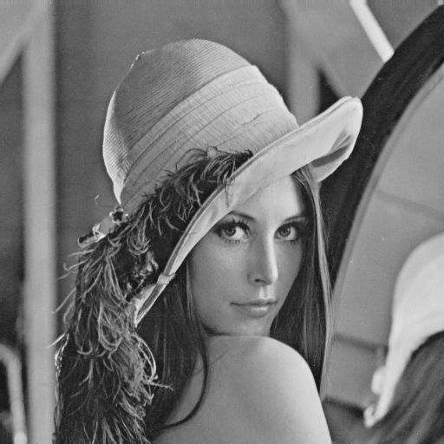


Halide Implementation of
Weighted Median Filter Akari Ishikawa, Hiroshi Tajima and Norishige Fukushima
Nagoya Institute of Technology, Japan
Introduction
Background
CPU microarchitectures become more complex.
it is difficult to write programs suited to each execution environment.
With the recent extension of camera applications, image filtering is essential in image processing.
Weighted median filter
a image denoising method
Has weights to each pixel in the kernel for statical computing values.
- more removal capability of the impulsive noise
The drawback is computational complexity.
Halide
The image processing DSL embedded in C++
A pure functional language
This code is modularized as algorithm and scheduling parts.
Easy to optimize codes for execution environment.
Func blur_3x3(Func f)
{
Func blur_x, blur_y;
Var x, y, xi, yi;
a
blur_x(x,y)=(f(x-1,y)+f(x,y)+f(x+1,y))/3;
blur_y(x,y)=(blur_x(x,y-1)+blur_x(x,y)+blur_x(x,y+1))/3;
.
blur_y.tile(x,y,xi,yi,256,32).vectorize(xi,8).parallel(y);
blur_x.compute_at(blur_y,x).vectorize(x,8);
.
return blur_y;
}
Algorithm parts
0 | 6 | 7 | 1 | 2
0 | 2 | 5 | 8 | 1
9 | 3 | 1 | 9 | 0
0 | 4 | 8 | 5 | 1
1 | 4 | 7
5 | 2 | 3
8 | 6 | 0
 | 6
6 | 6 | 7 | 8 | 1
0 | 6
Scheduling parts
bilateral
weight
sort
Purpose
Provide the Halide code to more simply optimize
WMF for environment.
0 | 1 | 2 | 3 | 4 | 5 | 6 | 7 | 8
median value
Halide inplementation
Halide code is inlined by default.
Less memory consumption ⇔ Increase computation
We need to add scheduling for parallel processing and optimizing the calculation sequence.
Func d_diff, c_diff, bilateral, hist, hist_sum, hist_cumsum, median;
Var x, y, xr, yr, l;
RDom R(-r,2*r+1,-r,2*r+1), R1(1,255), R2(0,255);
Func bilateral(Func& I)
{
d_diff(xr,yr)=exp((xr*xr+yr*yr)/d_norm);
c_diff(xr,yr,x,y)=exp(pow(abs(I(x,y)-I(x+xr,y+yr)),2)/c_norm);
bilateral(xr,yr,x,y)=d_diff(xr,yr)*c_diff(xr,yr,x,y);
distance_diff.compute_root().parallel(yr).vectorize(xr, 16);
return bilateral;
}
Func weightedMedianFilter(Func& I)
{
hist(l,x,y)=0;
hist(I(x+R.x,y+R.y),x,y)+= bilateral(I)(R.x,R.y,x,y);
hist_sum(x,y)=sum(bilateral(I)(R.x,R.y,x,y));
hist_cumsum(l,x,y)=hist(0,x,y);
hist_cumsum(R1,x,y)=hist(R1,x,y)+hist_cumsum(R1-1,x,y);
median(x,y)=-1;
median(x,y)=select(median(x,y)<0,
select(hist_cumsum(R2,x,y)>hist_sum(x,y)/2,R2,-1),median(x,y));
medianVals.vectorize(x, 16).parallel(y)
.update(0).parallel(y).vectorize(x, 16);
hist.compute_at(medianVals, y).vectorize(x, 16)
.update(0).reorder(R.x, x, R.y, y).vectorize(x, 16);
hist_sum.compute_at(medianVals, y).vectorize(x, 16);
hist_cumsum.compute_at(medianVals, y).vectorize(l, 16)
.update(0).vectorize(x, 16);
return median;
}
for(y=0; y < hei; y++)
for(x=0; x < wid, x++)
for(ry=0; ry < r, ry++)
for(rx=0; rx < r, rx++)
bilateral[xr,yr,x,y]=exp((xr*xr+yr*yr)/d_norm) * exp(……);
bilateral[xr,yr,x,y]=d_diff[xr, yr] * exp(……);
add
for(ry=0; ry < r, ry++)
for(rx=0; rx < r, rx++)
d_diff[xr,yr]=……;
Parallelization
Vectorization
result
Kernel size of bilateral filter：9×9
CPU：IntelCorei7-7800X 3.5GHz
Conpila：Visual Studio 2017
Weighted median | Code length | Time
C++ : Alg only | 100 | 128 ms
Halide : Alg only | 45 | 1 hour
Halide : Alg + Schedule | 45 + 8 | 31 ms
Fig.：original image.
Fig.：add noise.
Fig.：weighted median.
Fig.：Implementation of weighted median filter in Halide.

