Slide 1
次元削減 Dimension Reduction
M1 Fukuta Keisuke

Slide 2
Introduction
What is “Dimension Reduction” ?
transforms the data in the high-dimensional space to a space of fewer dimensions without losing necessary information.
Purpose of “Dimension Reduction”
Extract structure of data, Visualization
Enhance generalization
Alleviate curse of dimensionality
Notes:
必要な情報を失うことなく高次元空間に存在するデータをより小さなデータで表現する

Slide 3
主成分分析 Principal Component Analysis

Slide 4
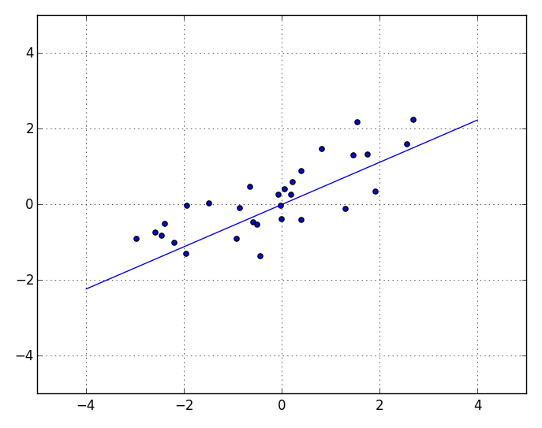
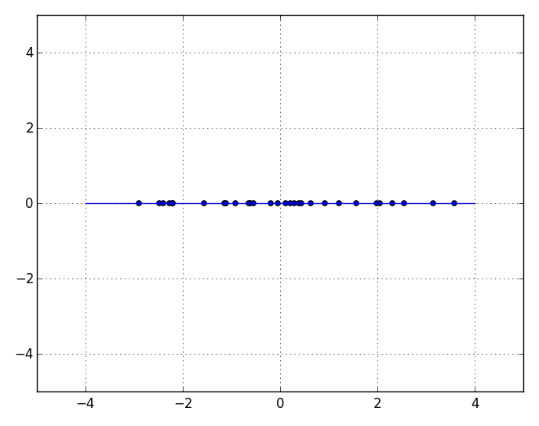
PCA(Principal Component Analysis)
Wikipedia
convert a set of observations of possibly correlated variables into a set of values of linearly uncorrelated variables called principal components.
Notes:
相関性がある 情報を含む観測データを主成分と呼ばれる相関性のない成分で表現すること
データの特徴をよりうまく説明するような新たな軸を元の変数の線形結合によって再構成すること

Slide 5
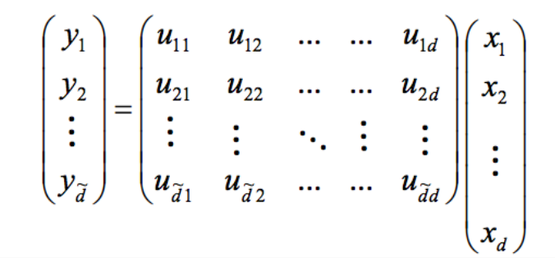
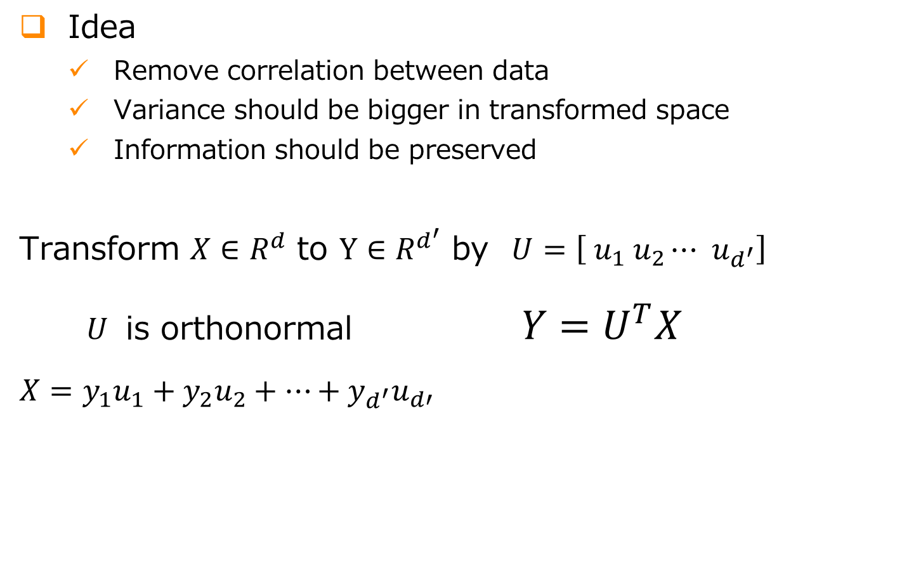
PCA
Idea
Remove correlation between data
Variance should be bigger in transformed space
Information should be preserved
Transform $X∈R^{d}$ to $Y∈R^{d^{′}}$ by $U=\left[ u_{1} u_{2}⋯{ u}_{d^{′}}\right]$
$U$ is orthonormal $Y=U^{T}X$
$$X=y_{1}u_{1}+y_{2}u_{2}+⋯+y_{d^{′}}u_{d′}$$
Notes:
パターンのばらつきが大きいってことは違いをよくあらわしているということ

Slide 6
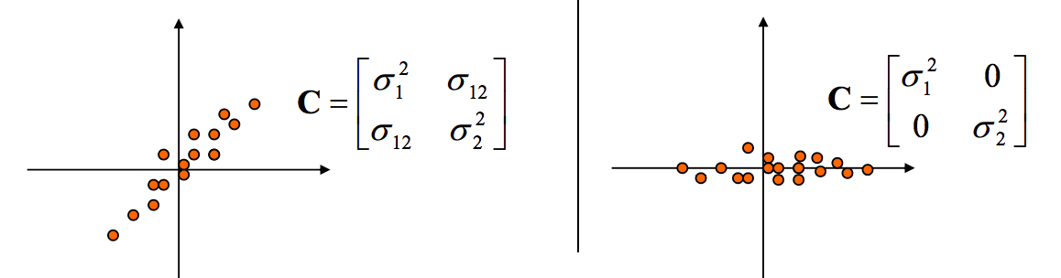
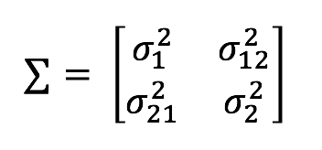
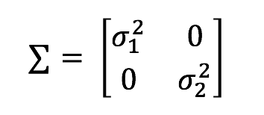
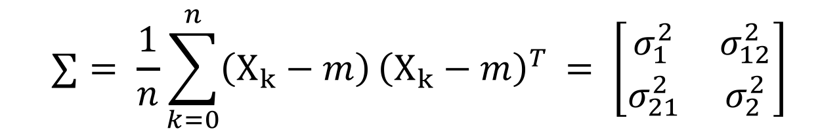
Variance-Covariance Matrix
$$∑= \frac{1}{n}\sum_{k=0}^{n}{\left(X_{k}−m\right)}{\left(X_{k}−m\right)}^{T }= \left[\begin{matrix}σ_{1}^{2} & σ_{12}^{2} \\ σ_{21}^{2} & σ_{2}^{2}\end{matrix}\right]$$
Ex.1) If there is correlation
between variables
Ex.2) If there is no correlation

Slide 7
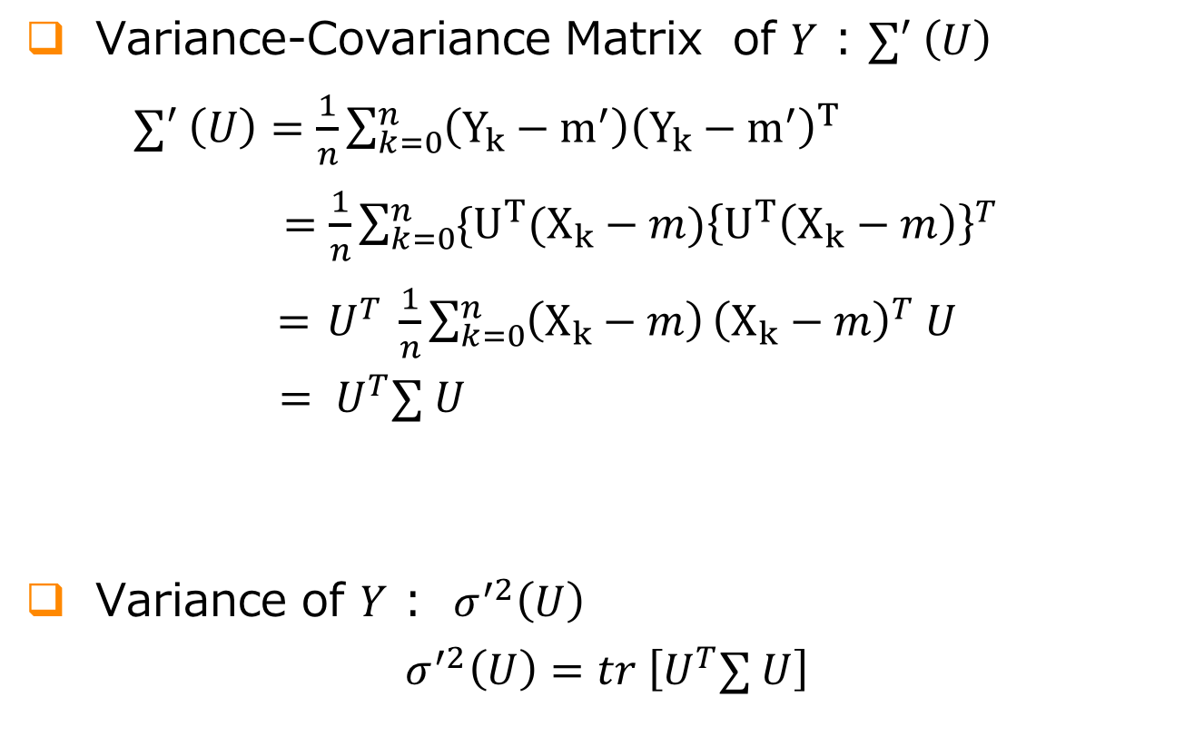
PCA
Variance-Covariance Matrix of $Y$ : $∑′ \left(U\right)$
$∑′ \left(U\right)=\frac{1}{n}\sum_{k=0}^{n}{\left(Y_{k}−m^{′}\right){\left(Y_{k}−m^{′}\right)}^{T}}$
$=\frac{1}{n}\sum_{k=0}^{n}{{{\{U}^{T}(X_{k}−m)\left\{U^{T}\left(X_{k}−m\right)\right\}}^{T}}$
$={ U}^{T} \frac{1}{n}\sum_{k=0}^{n}{\left(X_{k}−m\right)}{\left(X_{k}−m\right)}^{T} U$
$= U^{T}∑ U$
Variance of $Y$ : $σ^{′2}\left(U\right)$
$σ^{′2}\left(U\right)=tr \left[U^{T}∑ U\right]$
$∑$ is variance-covariance matrix of original data

Slide 8
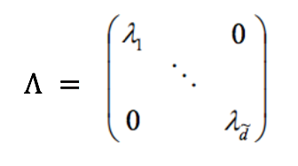
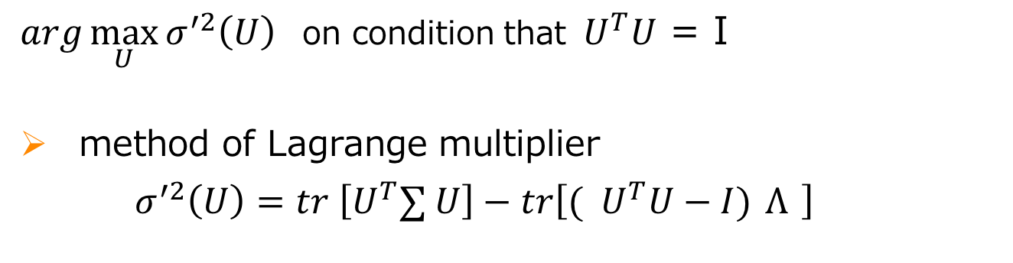

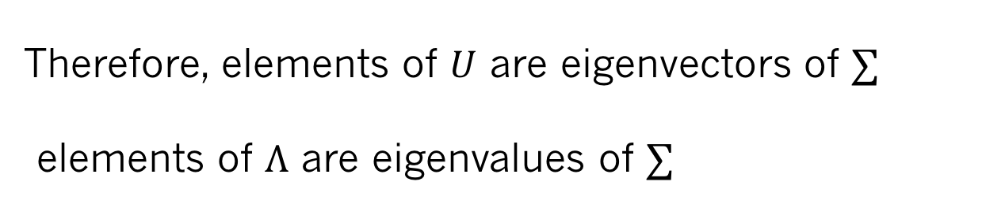
PCA
$arg\max_{U}{σ^{′2}\left(U\right) }$ on condition that${ U}^{T}U$= I
method of Lagrange multiplier
$σ^{′2}\left(U\right)=tr \left[U^{T}∑ U\right]−tr\left[({ U}^{T}U−I) Λ \right]$
$$∑U=UΛ$$
Therefore, elements of $U$ are eigenvectors of $∑$
elements of $Λ$ are eigenvalues of $∑$

Slide 9
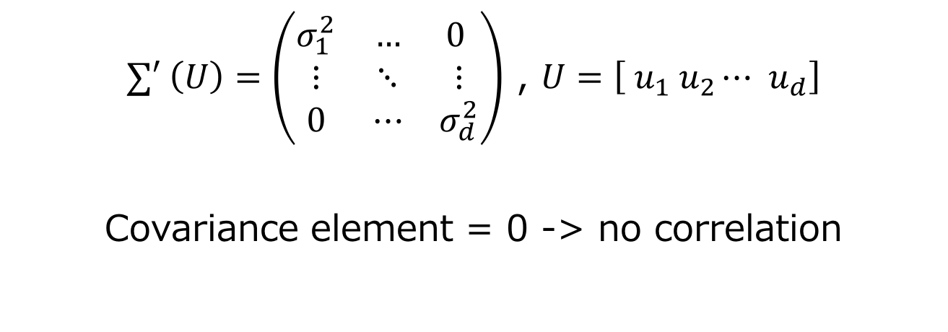
PCA
$∑′ \left(U\right)=U^{T}∑ U$ and $U^{T}= U^{−1} ( ∵U is orthonormal)$
$∑′ \left(U\right)=\left(\begin{matrix}σ_{1}^{2} & … & 0 \\ ⋮ & ⋱ & ⋮ \\ 0 & ⋯ & σ_{d}^{2}\end{matrix}\right)$ , $U=\left[ u_{1} u_{2}⋯{ u}_{d}\right]$
Covariance element = 0 -> no correlation

Slide 10
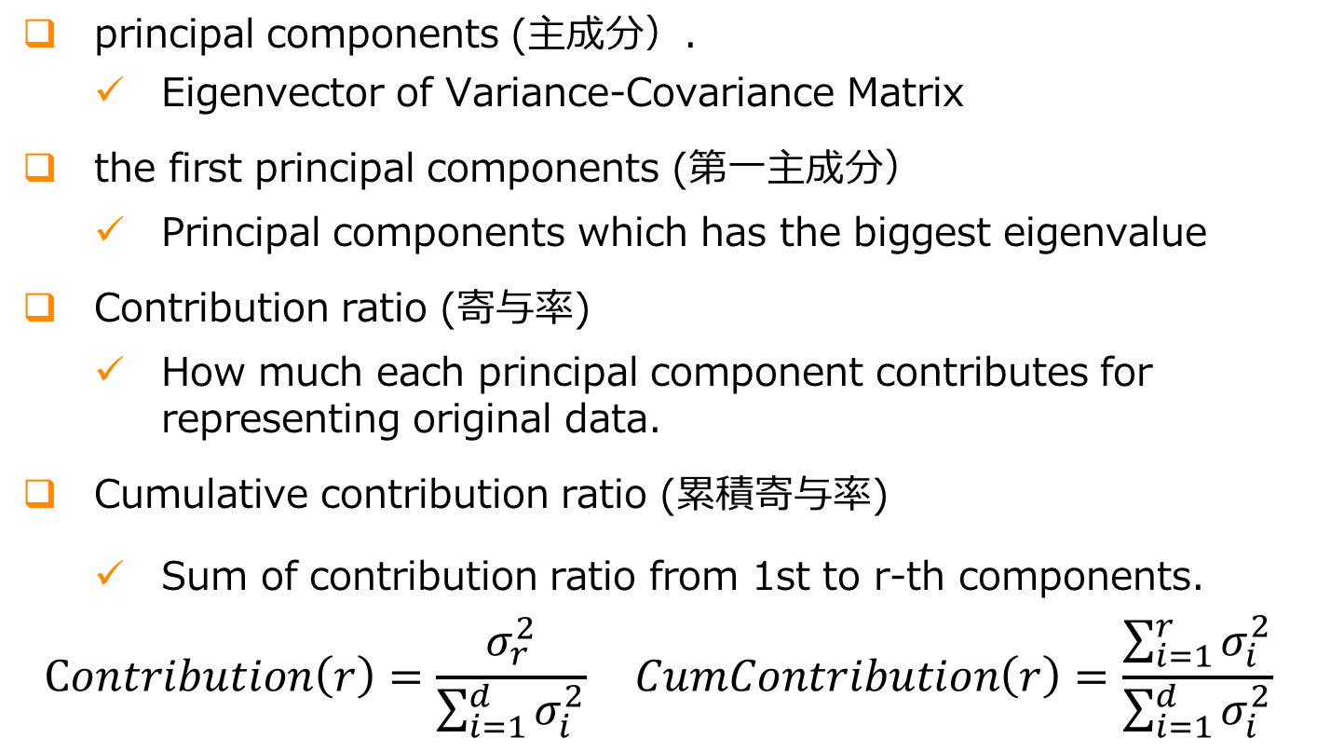
PCA
principal components (主成分）.
Eigenvector of Variance-Covariance Matrix
the first principal components (第一主成分）
Principal components which has the biggest eigenvalue
Contribution ratio (寄与率)
How much each principal component contributes for representing original data.
Cumulative contribution ratio (累積寄与率)
Sum of contribution ratio from 1st to r-th components.
$$Contribution\left(r\right)=\frac{σ_{r}^{2}}{\sum_{i=1}^{d }{σ_{i}^{2}}} CumContribution\left(r\right)=\frac{\sum_{i=1}^{r }{σ_{i}^{2}}}{\sum_{i=1}^{d }{σ_{i}^{2}}}$$

Slide 11
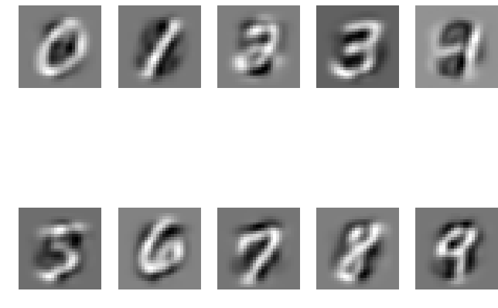
PCA - Demo
MNIST data
large database of handwritten digits

Slide 12
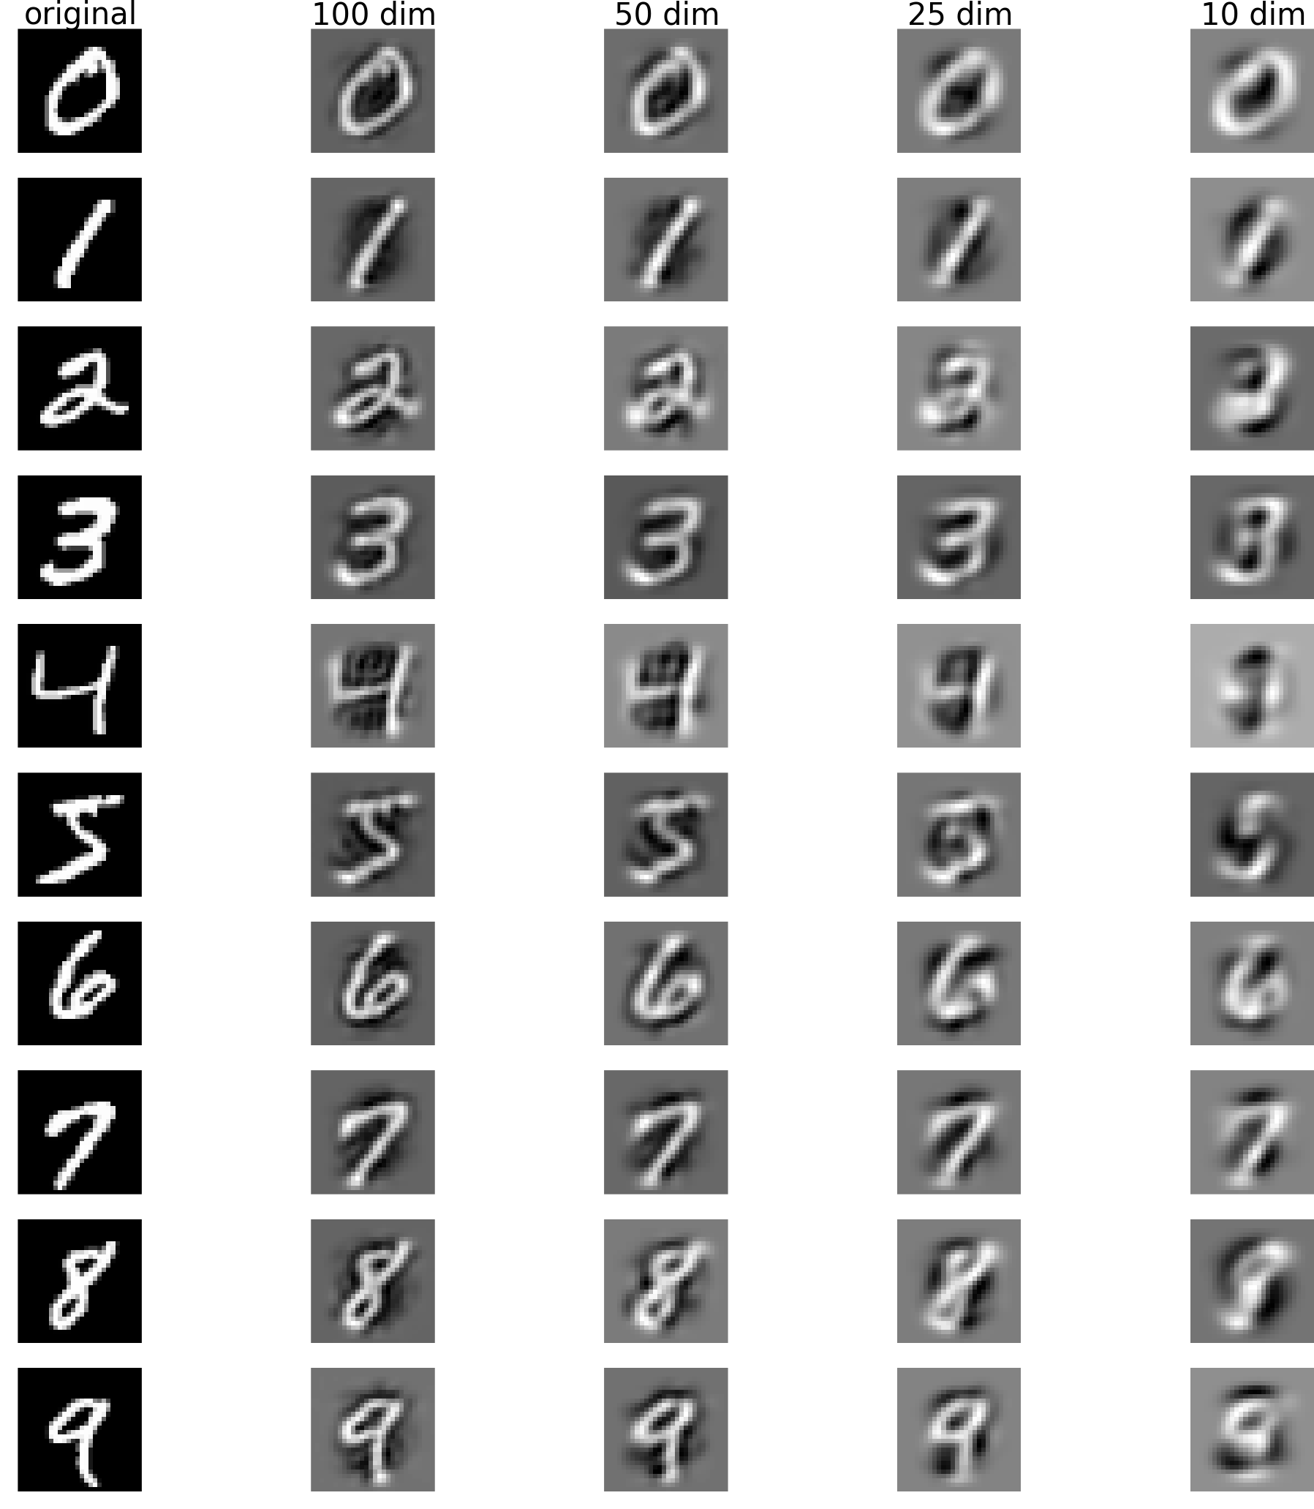

Slide 13
線形判別分析 Linear Discriminant Analysis

Slide 14
Linear Discriminant Analysis
Difference between PCA
PCA intends to approximate distribution of pattern with lower dimensional space.
Purpose of LDA is to maximize a degree of separation between classes in order to classify.
Characteristic
It is used when feature of data and their class are known.
Maximize ratio of inter-class variance and in-class variance.
Notes:
パターンの分布を近似
クラス間の分離

Slide 15
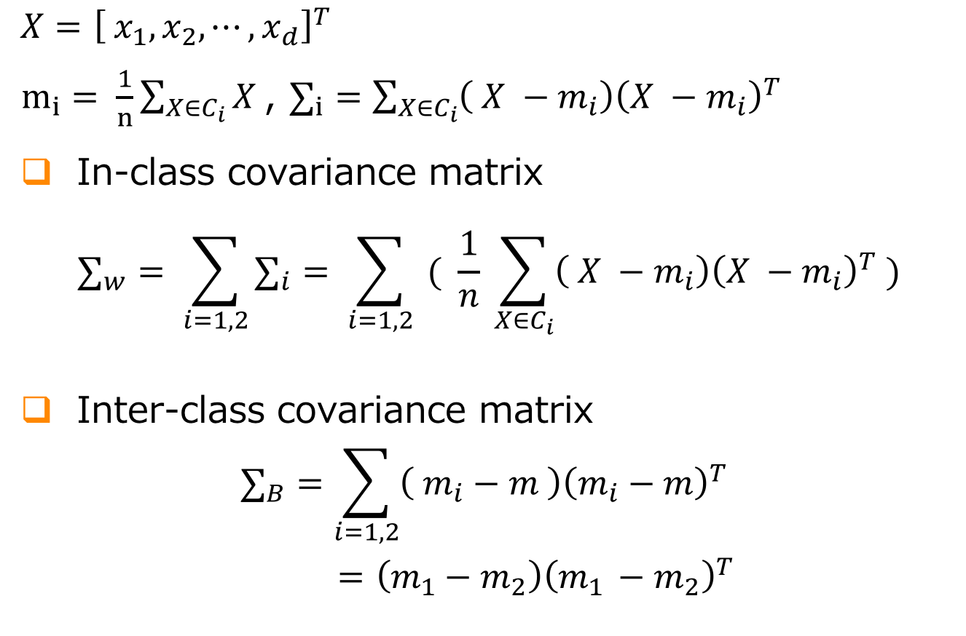
LDA
$$X={\left[ x_{1}, x_{2}, ⋯, x_{d}\right]}^{T}$$
$m_{i}= \frac{1}{n}\sum_{X∈C_{i}}{X }$, $∑_{i}=\sum_{X∈C_{i}}{\left( X −m_{i}\right){\left(X −m_{i}\right)}^{T} }$
In-class covariance matrix
$$∑_{w}= \sum_{i=1,2}{∑_{i}}= \sum_{i=1,2}{ ( \frac{1}{n} \sum_{X∈C_{i}}{\left( X −m_{i}\right){\left(X −m_{i}\right)}^{T} )}}$$
Inter-class covariance matrix
$$∑_{B}=\sum_{i=1,2}{\left( m_{i}−m \right){\left(m_{i}−m\right)}^{T}}$$
$=\left(m_{1}−m_{2}\right){\left(m_{1 }−m_{2}\right)}^{T}$

Slide 16
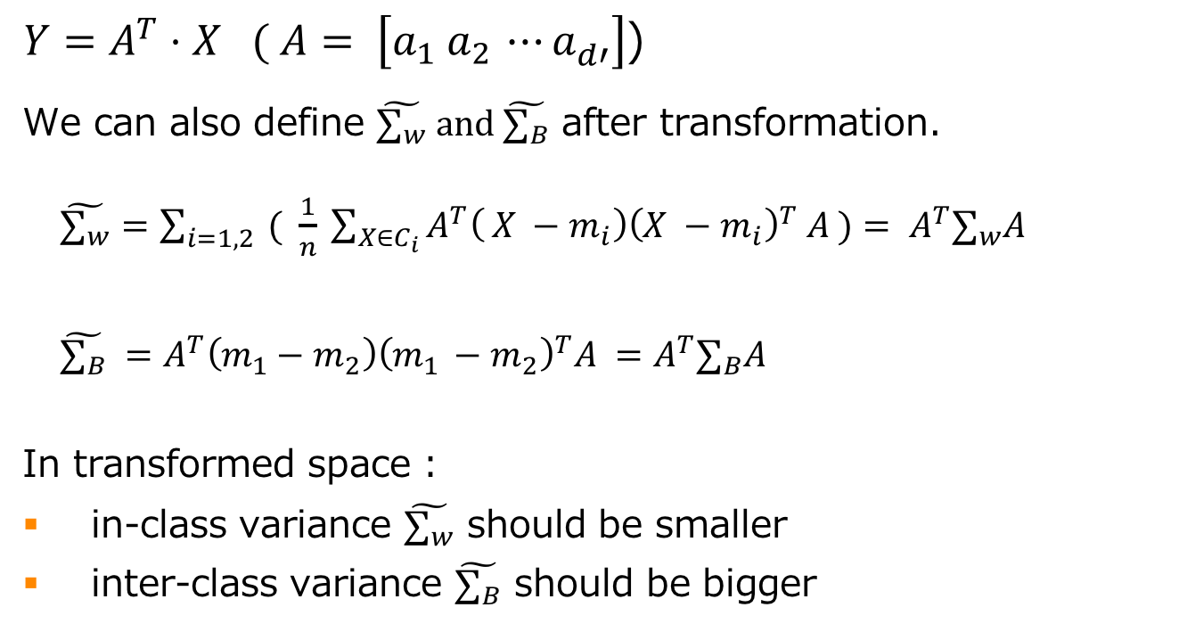
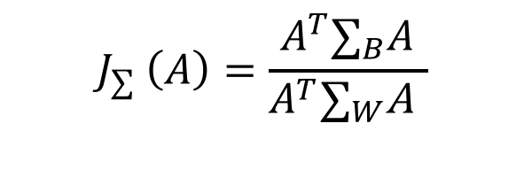
LDA
$Y=A^{T}⋅X ( A= \left[a_{1} a_{2 }⋯a_{d′}^{}\right]$)
We can also define $\tilde{∑_{w}} and \tilde{∑_{B}}$ after transformation.
$\tilde{∑_{w}}=\sum_{i=1,2}{ ( \frac{1}{n} \sum_{X∈C_{i}}{A^{T}\left( X −m_{i}\right){\left(X −m_{i}\right)}^{T} A )}}= A^{T}∑_{w}A$
$\tilde{∑_{B}} =A^{T}\left(m_{1}−m_{2}\right){\left(m_{1 }−m_{2}\right)}^{T}A =A^{T}∑_{B}A$
In transformed space :
in-class variance $\tilde{∑_{w}}$ should be smaller
inter-class variance $\tilde{∑_{B}}$ should be bigger
$$J_{∑} \left(A\right)=\frac{A^{T}∑_{B}A}{A^{T}∑_{W}\text{A} }$$

Slide 17

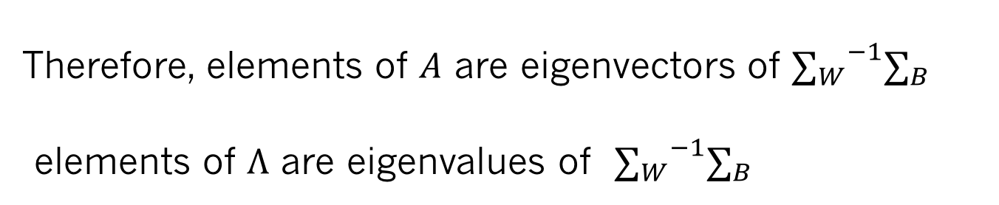

LDA
$arg\max_{A}{{ J}_{∑} \left(A\right) }$ on condition that${ A}^{T}∑_{W}\text{A}$= I
method of Lagrange multiplier
${ J}_{∑} \left(A\right)=A^{T}∑_{B}A − \left({ A}^{T}∑_{W}A−I\right)Λ$
$${∑_{W}}^{−1}∑_{B} A=A Λ$$
Therefore, elements of $A$ are eigenvectors of ${∑_{W}}^{−1}∑_{B}$
elements of $Λ$ are eigenvalues of ${∑_{W}}^{−1}∑_{B}$

Slide 18
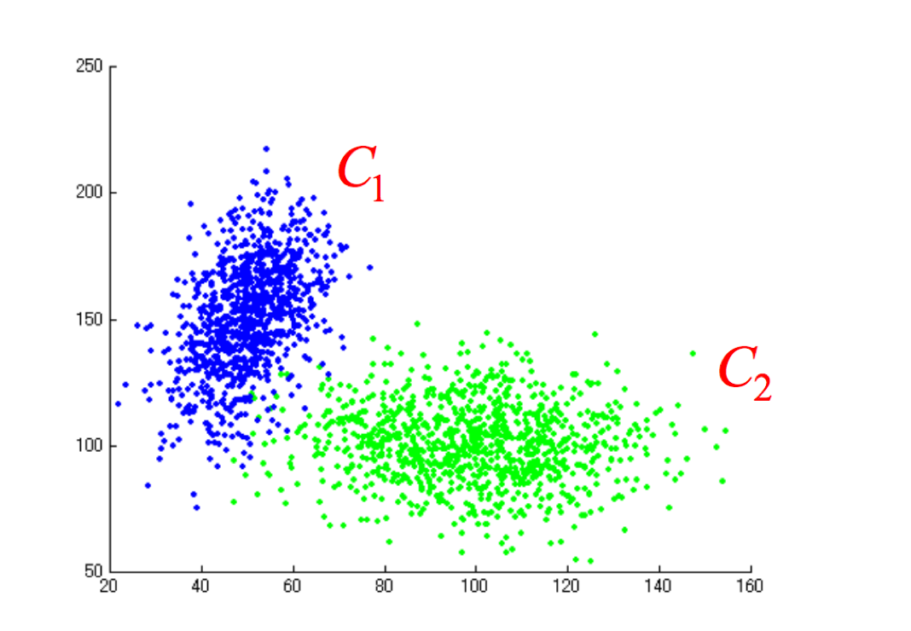
Comparison
Ex. Two Gaussian distribution

Slide 19
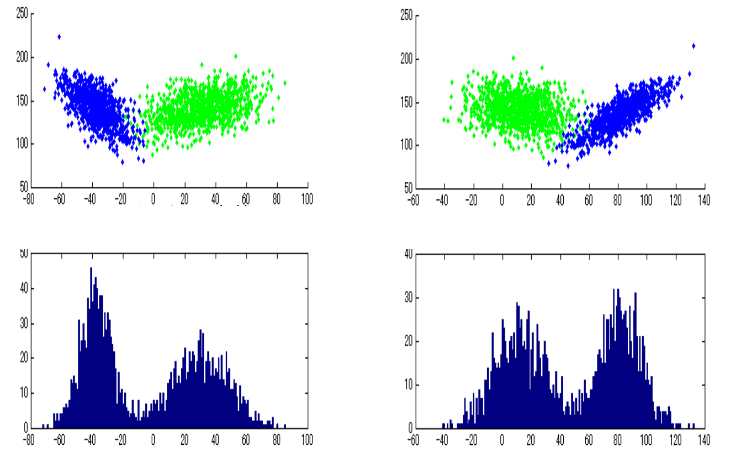
Comparison
Transformation by LDA
Transformation by PCA

Slide 20
オートエンコーダー
Auto Encoder

Slide 21

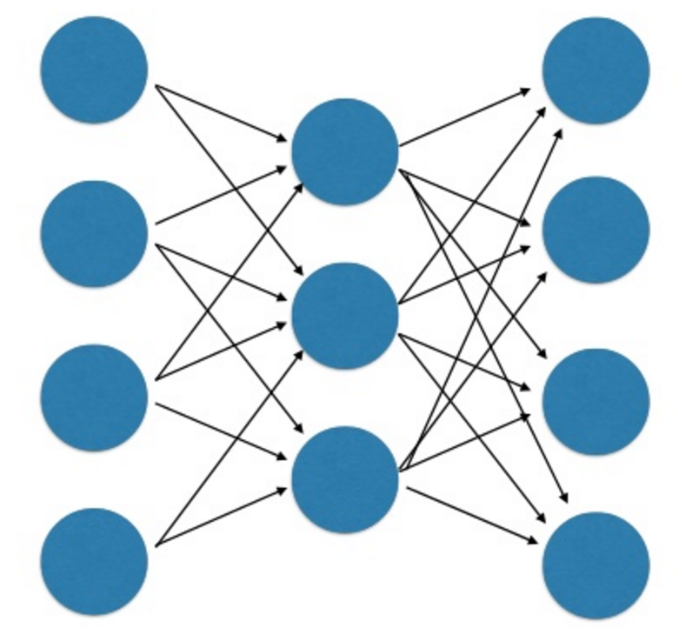
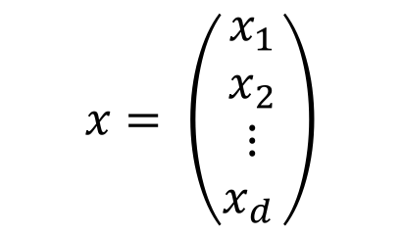
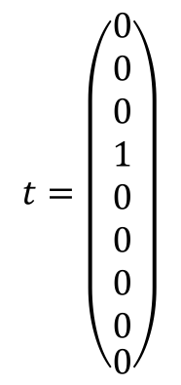

Auto Encoder
Neural Network
$$z=σ( W⋅x)$$
$$t=\left(\begin{aligned}\begin{aligned}0 \\ 0 \\ 0 \\ 1 \\ 0 \\ 0 \\ 0 \\ 0\end{aligned} \\ 0\end{aligned}\right)$$
$$x= \left(\begin{aligned}x_{1} \\ x_{2} \\ ⋮ \\ x_{d }\end{aligned}\right)$$
hidden
input
output

Slide 22
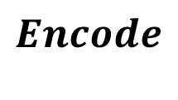
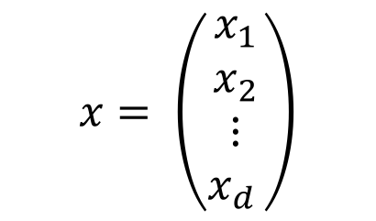
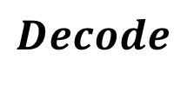
Auto Encoder
Auto Encoder
$$x= \left(\begin{aligned}x_{1} \\ x_{2} \\ ⋮ \\ x_{d }\end{aligned}\right)$$
$$x= \left(\begin{aligned}x_{1} \\ x_{2} \\ ⋮ \\ x_{d }\end{aligned}\right)$$
$$Encode$$
$$Decode$$

Slide 23
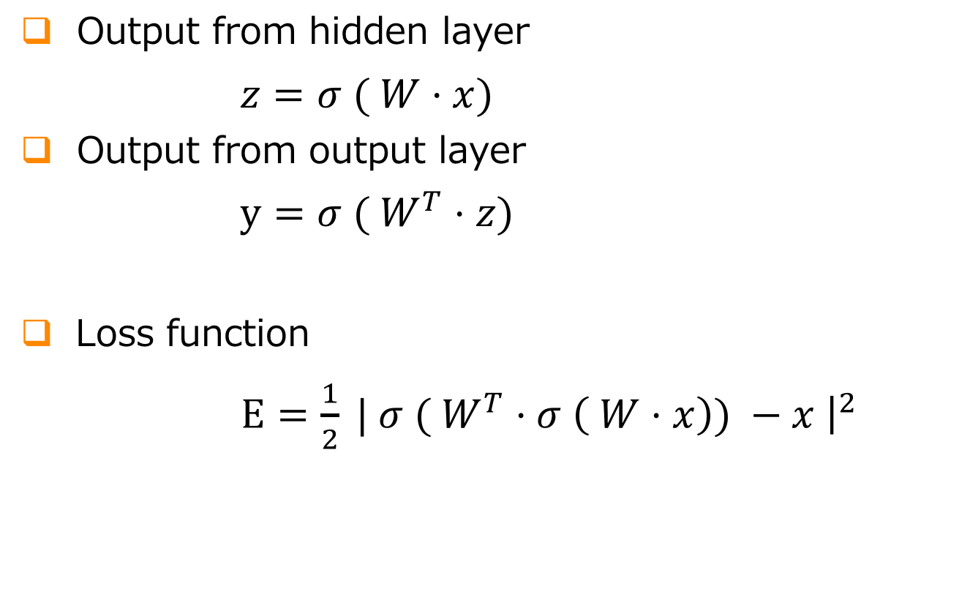
Auto Encoder
Output from hidden layer
$z=σ ( W⋅x)$
Output from output layer
$y=σ ( W^{T}⋅z)$
Loss function
$E=\frac{1}{2} | σ ( W^{T}⋅σ \left( W⋅x\right){) −x \left.​\right|}^{2}$

Slide 24
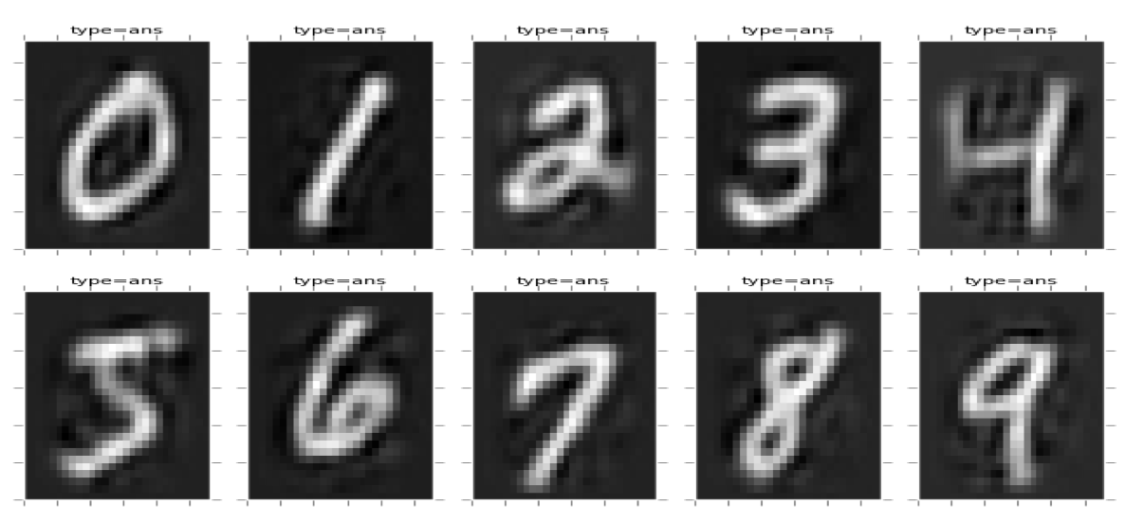
Auto Encoder

Slide 25
Thank you for listening!

