Slide 1



Yield-Max
Ful Belin Korukoglu
11/12/2023

Slide 2
Outline
Background
Objectives
SDG Relation
Methodology
Dataset and EDA
Model
Hyperparameter Tuning
Outputs
Next Steps

Slide 3
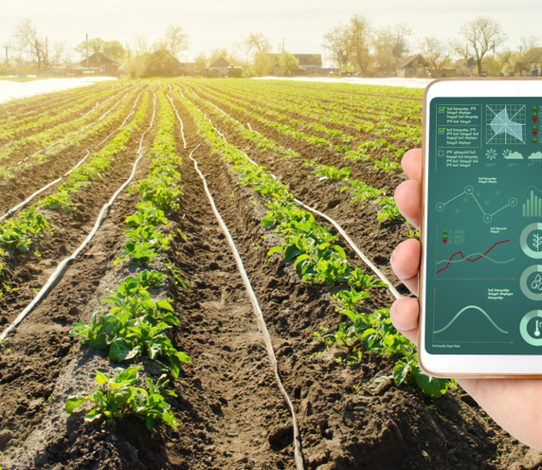
Background
Accurate crop yield recommendation is essential for informed decision-making in agriculture, with various algorithms being commonly employed.
These models leverage diverse evaluation and validation approaches ensuring nuanced assessments of their effectiveness in recommending optimal crop yields.
The complexity of agricultural data necessitates adaptable models to capture nuances, reflecting the dynamic nature of different crops and environmental factors.

Slide 4

Objectives and SDG relation
The primary goals of the AI application are centered on addressing agricultural challenges and contributing to Sustainable Development Goal 2 (Zero Hunger).
It aims to empower farmers with tailored recommendations based on historical data, current weather, and soil conditions to maximize crop yields.
The application promotes global food security by helping farmers choose optimal crops, fostering sustainable practices, and optimizing resource use.

Slide 5
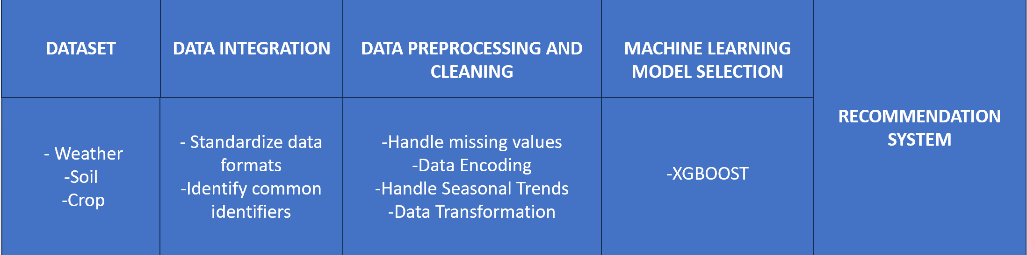
Methodology
The project utilizes the SoilHealthDB dataset, consolidating soil health data from 281 studies across 41 countries, with 42 soil health indicators and 45 background indicators. This dataset serves as the cornerstone for machine learning tasks geared towards enhancing agricultural decision-making.

Slide 6
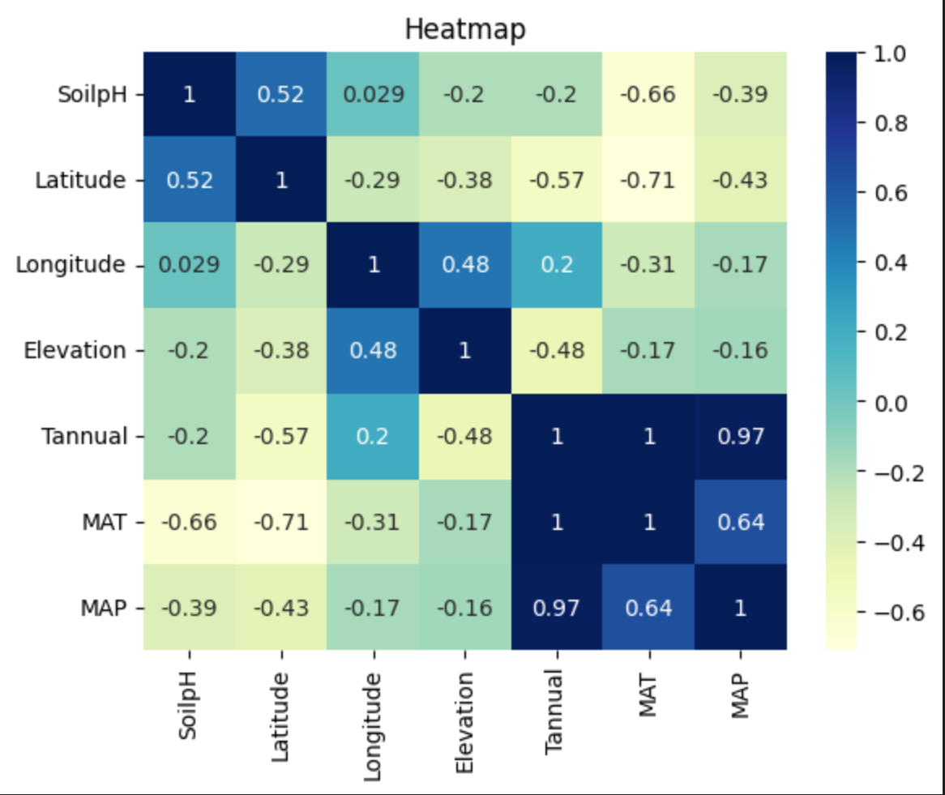
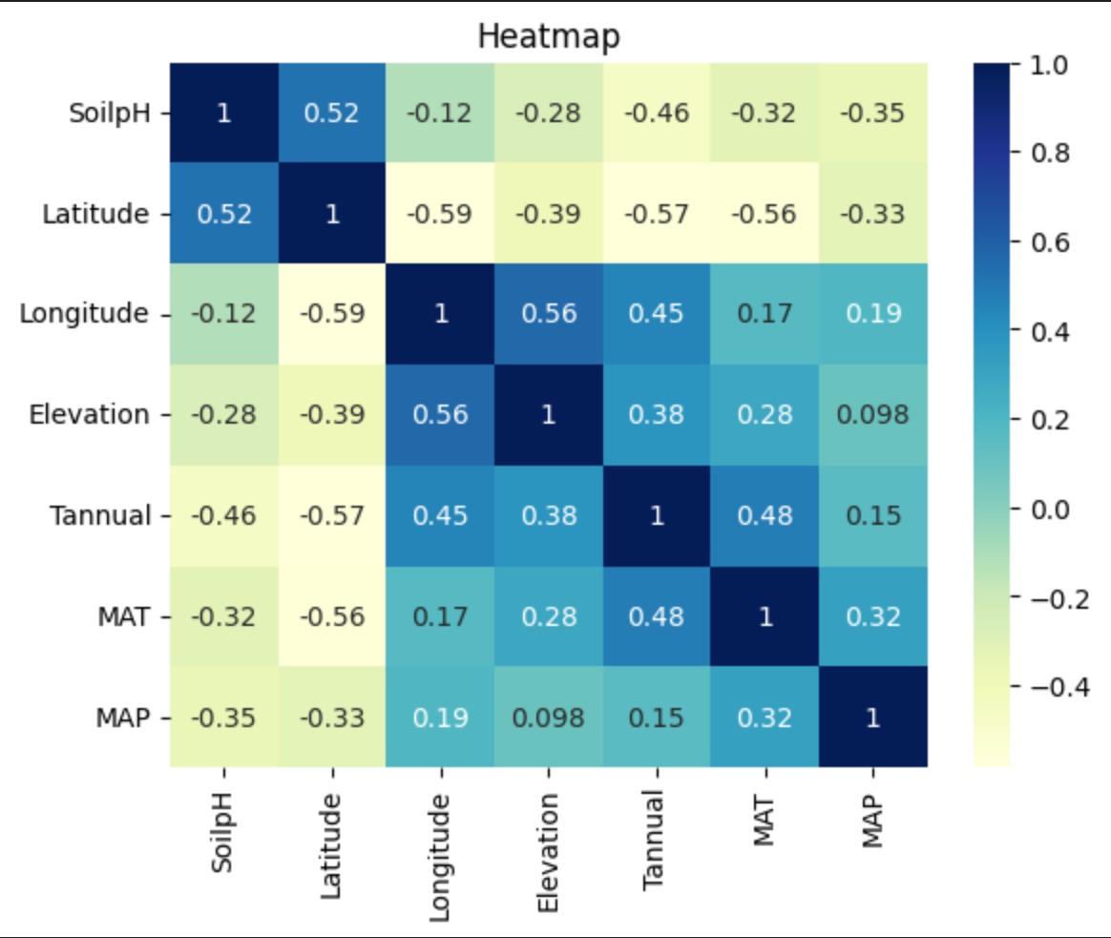
Missing values
were handled
K-NN

Slide 7
Model
XGBoost algorithm was selected for its suitability in handling complex relationships within agricultural data. The model was trained on the preprocessed dataset, allowing it to learn patterns and relationships for accurate crop yield recommendation. Evaluation metrics such as ROC-AUC, Precision, Recall, and F1 score were used.
Hyperparameter tuning
GridSearchCV was used to finetune the model.

Slide 8
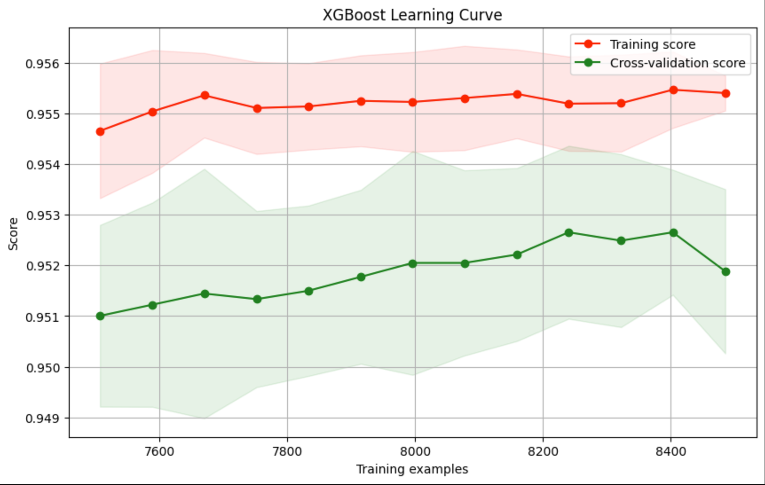
Precision: 0.9526
Recall: 0.9557
F1 Score: 0.9508
ROC-AUC: 0.9995
Learning Complex Patterns:
Model captures intricate structures with increasing training scores.
Demonstrates ability to adapt and enhance performance on the training set.
Generalization to Unseen Data:
Rising cross-validation scores indicate successful generalization.
Model not only memorizes training data but also extends to new, unseen data during cross-validation.

Slide 9
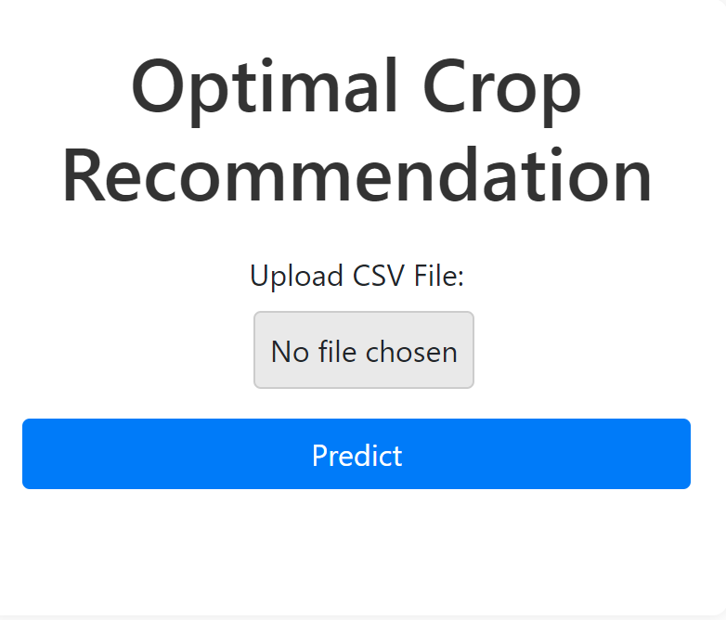
Next steps
Deployment
A user-friendly web interface is being created using Flask, HTML, CSS, and Bootstrap to deploy the AI application and make it accessible to farmers over the internet.
The web interface will facilitate the interaction with the XGBoost providing farmers with personalized crop recommendations based on historical data, weather patterns, and soil conditions.

