Slide 1
Planting Planner, Harvest Date

Slide 2
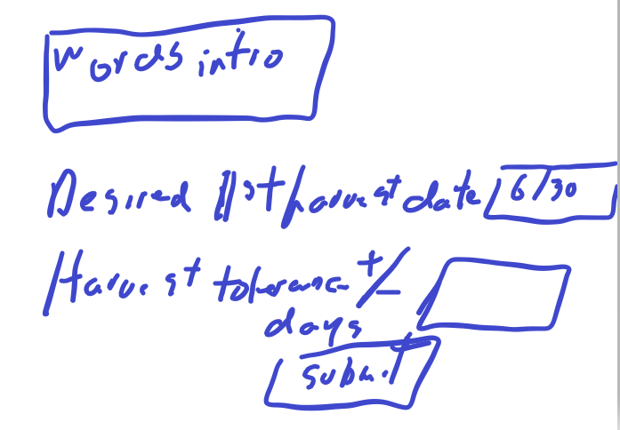
First page scribble

Slide 3
First page
Intro: This page is about planning when to plant today, to get the harvest you want at future date
Note climate factors to consider clickhere
Input fields:
Desired Harvest begin date: _________
Note: output will give both expected begin and end dates
Date tolerance
Provide # days allowed on either side of above date: _____________

Slide 4
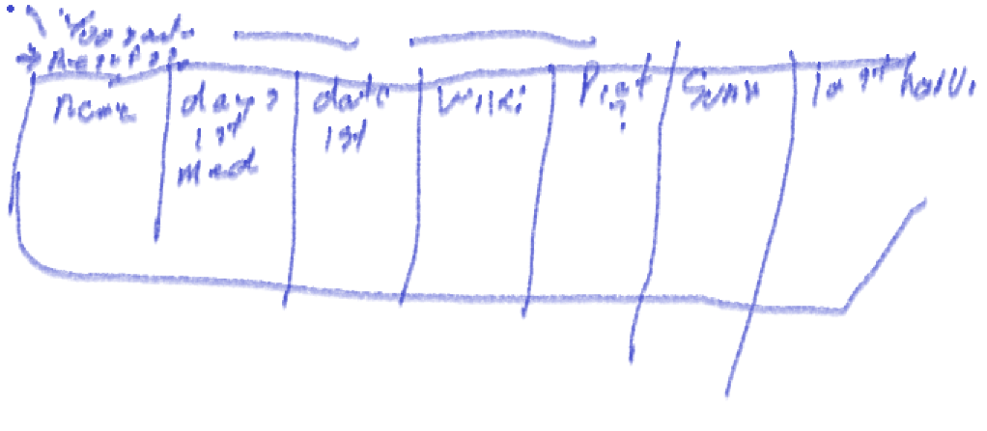
Output page scribble

Slide 5
Output page
Table returned:
Crop Name | Wikipedia Link | Expected 1st harvest date | Expected last harvest date | Desired sunniness value for this crop

Slide 6
Potential Enhancements
Allow database for users to return to see previous entries
Provide weather data for users location using APIs for historicals and whatever for current
Provide hours of sunshine for location for specified date
Wiki or someplace would provide needs for crop of temperatures and sunshine. Allow users to enter this data for them and others in future

