Slide 1
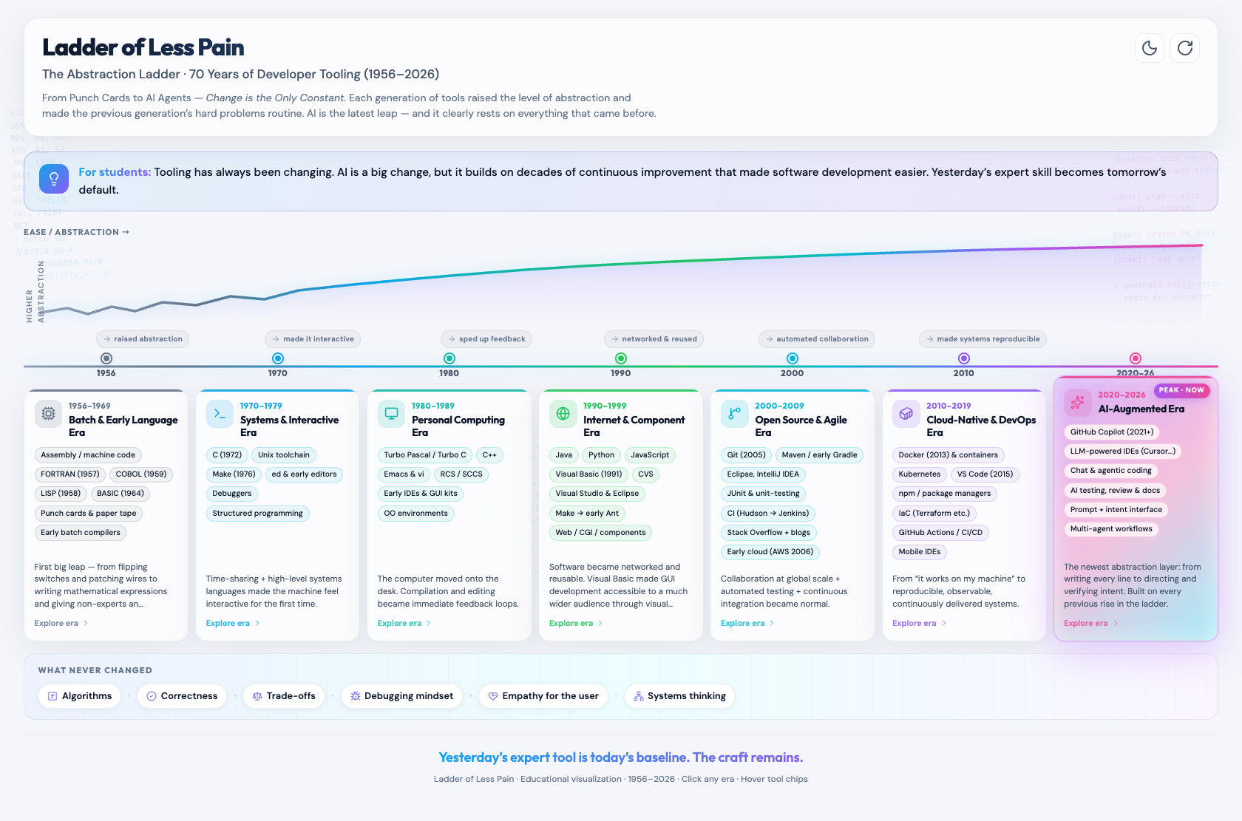
Ladder of Less Pain
Made with
Grok Build
The Abstraction Ladder · 70 Years of Developer Tooling (1956–2026)
Live fullergalway.github.io/ladder-of-less-pain
Yesterday's expert tool is
today's baseline. The craft remains.
Repo github.com/fullergalway/ladder-of-less-pain

Slide 2
The message for students
Tooling has always been changing. AI is a big change — and it rests on every prior rise of the ladder.
1956–1969
1970s–80s
1990s–2000s
2010s–2026
Batch & languages
Punch cards → FORTRAN,
COBOL, BASIC
Interactive systems
Unix, C, PCs,
Turbo tools
Network & collaborate
Web, Git, CI,
open source
Cloud → AI agents
Containers, Copilot,
intent as interface
Where to find it
Made with Grok Build
Interactive · single HTML file
Open source on GitHub
https://fullergalway.github.io/ladder-of-less-pain/
https://github.com/fullergalway/ladder-of-less-pain
What never changed: Algorithms · Correctness · Trade-offs · Debugging · Empathy · Systems thinking
Yesterday's expert tool is today's baseline. The craft remains.

