Slide 1
Community ACTIONMaps! Mapping Safety Net Service Needs
Challenge leader: Clare Higgins
Census rep: Ana-Maria Garcia
Carrie Bernstein, Caleb Fassett, Lydia, Lissie Fein, Kevin McKenna, Bob Stark, Matthew Wimmer, Terri Yu

Slide 2

Located in Greenfield, Massachusetts
Provides essential services for people of lower incomes in the Franklin, Hampshire, and North Quabbin Regions
Services include home weatherization, fuel assistance, financial counseling, youth programs, nutrition assistance
Runs 40 programs for 30,000 people

Slide 3
Challenge
Are there better ways to assess need, so that services are better matched to areas of greatest need?
Have many databases in spreadsheet format
Can we visualize this data with mapping technology?
Must preserve anonymity of clients

Slide 4
Mapping app design
Visualization
(Leaflet, OpenStreetMap)
Census data
Data processing
(Python)
Client data
UI data entry tool
(Many thanks to the OpenStreetMap group for their help!)

Slide 5
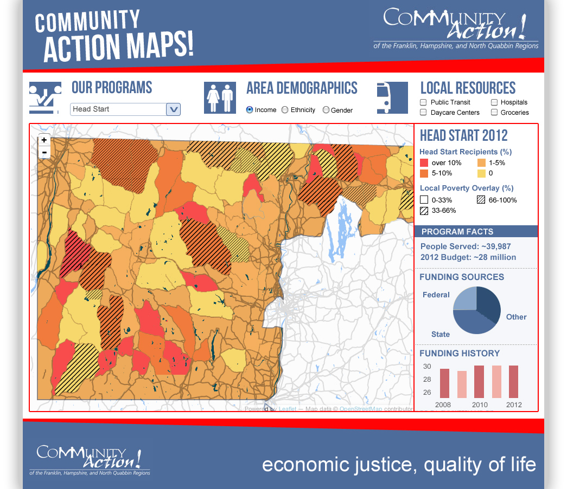
Our mockup

