Slide 1
Prescribing of Opioids among Medical
Professionals
Yonaton Heit

Slide 2
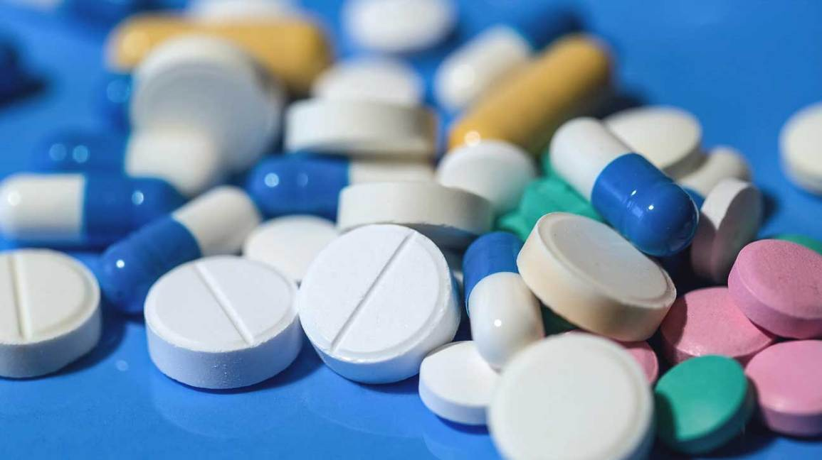
Objective
Detect possible opioid abuse from outliers in opioid claims of health care providers.
Data Source:
  Drug claims to Medicare Part D from 2013.
  https://www.cdc.gov/drugoverdose/pdf/pubs/2018-cdc-drug-surveillance-report.pdf
Source:https://www.healthline.com/health-news/
opioids-problems-for-chronic-pain-patients

Slide 3
Background
In 2016, approximately 63,693 Americans died from drug-overdosing.
42,249 (66.4%) involved at least one prescription and/or illegal opioid.
Due to their addictive nature, opioids are treated as controlled substances in the United States.
https://www.drugabuse.gov/related-topics/trends-statistics/overdose-death-rates
Source:https://www.healthline.com/health-news/
opioids-problems-for-chronic-pain-patients

Slide 4
Financial Cost of Opioid Crisis
In 2016, it was estimated that 11.5 million or 4.3% of US population over the age of twelve misused illegal or prescription opioids.[1]
Based on 2013 data, it was estimated that the economic burden for the misuse of opioids was $78.5 billion.[2]
The health care costs to private insurance companies was $14.0 thousand per patient.[2]
It is in the interest of insurance companies to track the misuse to prescription opioids.
[1]Hoots, B. H.; Seth, P. “Annual Surveillance Report of Drug-Relate”, 2018
[2] Florence, C. S.; Zhou, C.; Luo, F.; Xu, L. Medical Care 2016, 54, 901–906.

Slide 5
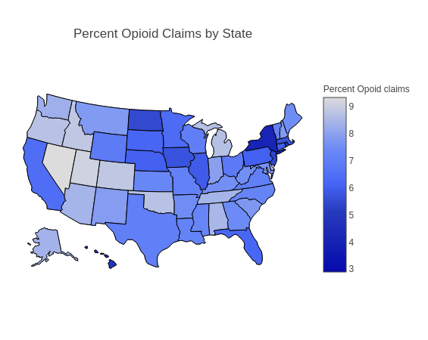
Data Set:
2013 dataset providers for each health care provider
  Name
  number of opioid and drug claim
  percentage of claims that are opoids
  zip code, state, and city
  specialty
There are 1,049,326 healthcare providers on the database,
496,744 that prescribe opioids.

Slide 6
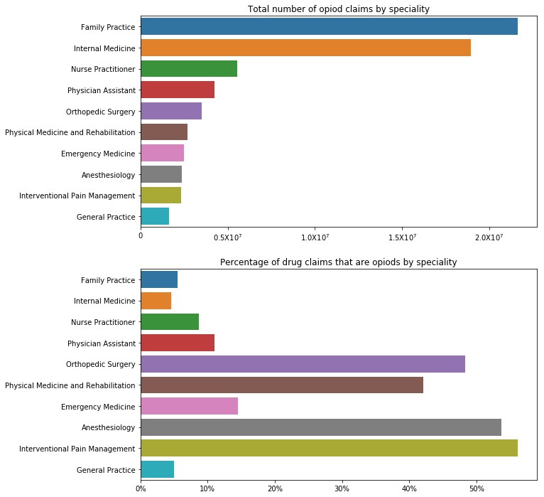
Top Ten Opioid Prescriber by Specialty

Slide 7
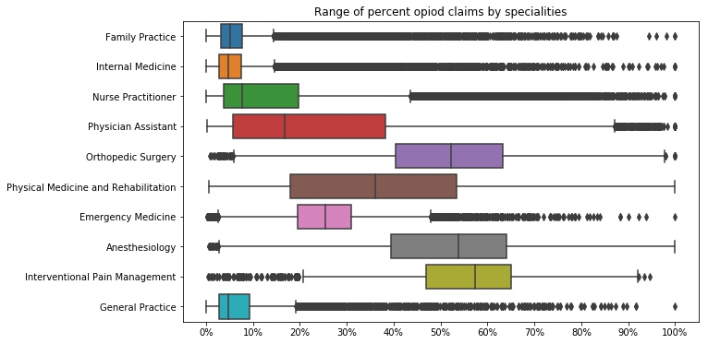
Top Ten Opioid Prescriber Range
Health care providers that do not prescribe opioids were excluded.

Slide 8
Top Ten Opioid Prescriber Range
specialty description | median | 1Q | 3Q | top whisk | bottom whisk | # outliers | # providers | % outliers
Family Practice | 5.09 | 3.28 | 7.72 | 14.37 | 0.00 | 5267 | 84070 | 6.27
Internal Medicine | 4.74 | 2.85 | 7.55 | 14.60 | 0.00 | 4826 | 82311 | 5.86
Nurse Practitioner | 7.68 | 3.77 | 19.72 | 43.66 | 0.00 | 3883 | 43495 | 8.93
Physician Assistant | 16.83 | 5.67 | 38.24 | 87.10 | 0.00 | 204 | 40308 | 0.51
Orthopedic Surgery | 52.26 | 40.35 | 63.35 | 97.86 | 5.85 | 52 | 19969 | 0.26
Physical Medicine and Rehabilitation | 36.09 | 17.87 | 53.45 | 100.00 | 0.00 | 0 | 6164 | 0.00
Emergency Medicine | 25.55 | 19.62 | 30.97 | 47.99 | 2.60 | 642 | 36000 | 1.78
Anesthesiology | 53.77 | 39.48 | 64.06 | 100.00 | 2.61 | 24 | 3562 | 0.67
Interventional Pain Management | 57.42 | 46.90 | 65.00 | 92.15 | 19.75 | 93 | 1865 | 4.99
General Practice | 4.80 | 2.70 | 9.30 | 19.19 | 0.00 | 790 | 7143 | 11.06
Health care providers that do not prescribe opioids were excluded.

Slide 9
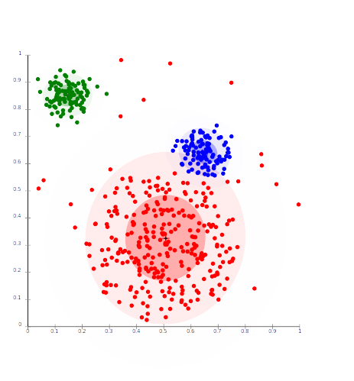
Clustering
Clustering:
  Unsupervised machine learning method
  Used to assign labels to data based on attributes.
For each specialty,
  Clusters are created based on attributes
  Health care provides are assigned a cluster an anomaly detection based on cluster.
Source: https://en.wikipedia.org/wiki/Cluster_analysis

Slide 10
Why Cluster
Level of opioid prescribed may be affected by other factors other than specialty.
For example: Geography.
Opioid use differs from one geography region to another.
Once clusters, health care providers that were outliers by their specialty may not be within their cluster.

Slide 11
Attributes
Attributes were found in additional databases and assigned based on geography.
Other than percent opioid claims and number of opioid claims, attributes used are:
  Longitude and latitude
  City population
  Temperature (year min, max, and average)
  City median income
4% of health care providers were discarded from dataset because difficult assigning one more attributes.
Source:
  https://simplemaps.com/data/us-zips
  https://www.kaggle.com/berkeleyearth/climate-change-earth-surface-temperature-data
  https://www.kaggle.com/goldenoakresearch/us-household-income-stats-geo-locations

Slide 12
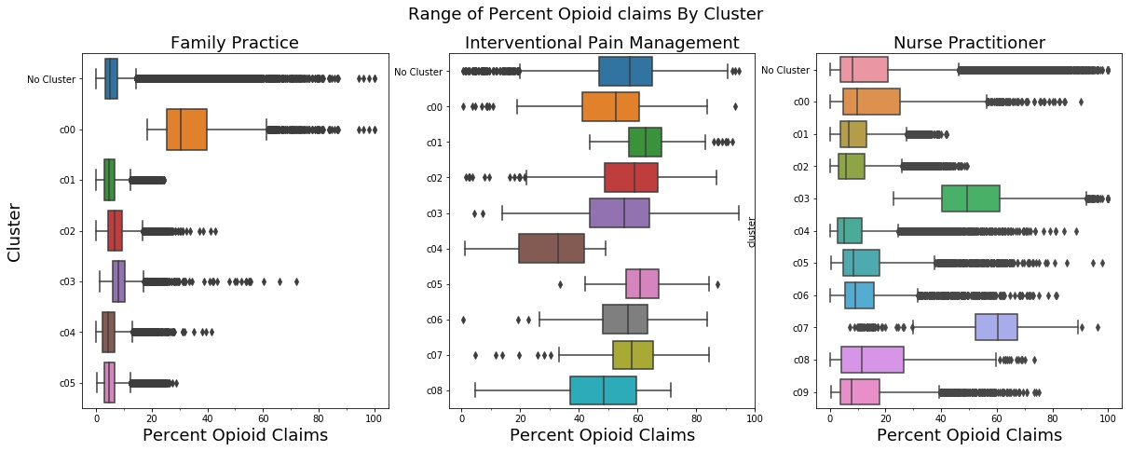
Clustering Pattern
Of the top ten specialties that proscribe opioids, three clustering patterns
  Pattern one: family practice, internal medicine, emergency medicine and general practice
  Pattern two: orthopedic surgery, physical medicine and rehabilitation, anesthesiology, and interventional pain management
  Pattern three: Nurse practitioners and physician assistant

Slide 13
Testing model against known cases of fraud
In 2018, the United States Department of Justice had a massive crackdown on the health care opioid fraud.
  Of these charged, 162 were prosecuted for prescribing and distributing opioid and other narcotics.
  Checking numerous articles, four health care providers were charged as part of this investigate and in our database
An addition doctor in the database was charged 2016 for opioid fraud
List of doctors:
  Bothra Rajendra (general surgery)
  Eric Backo (physical medicine and rehabilitation)
  Madhu Garg (family practice)
  Lawrence Miller (family practice)
  Samson Orusa (internal medicine)

Slide 14
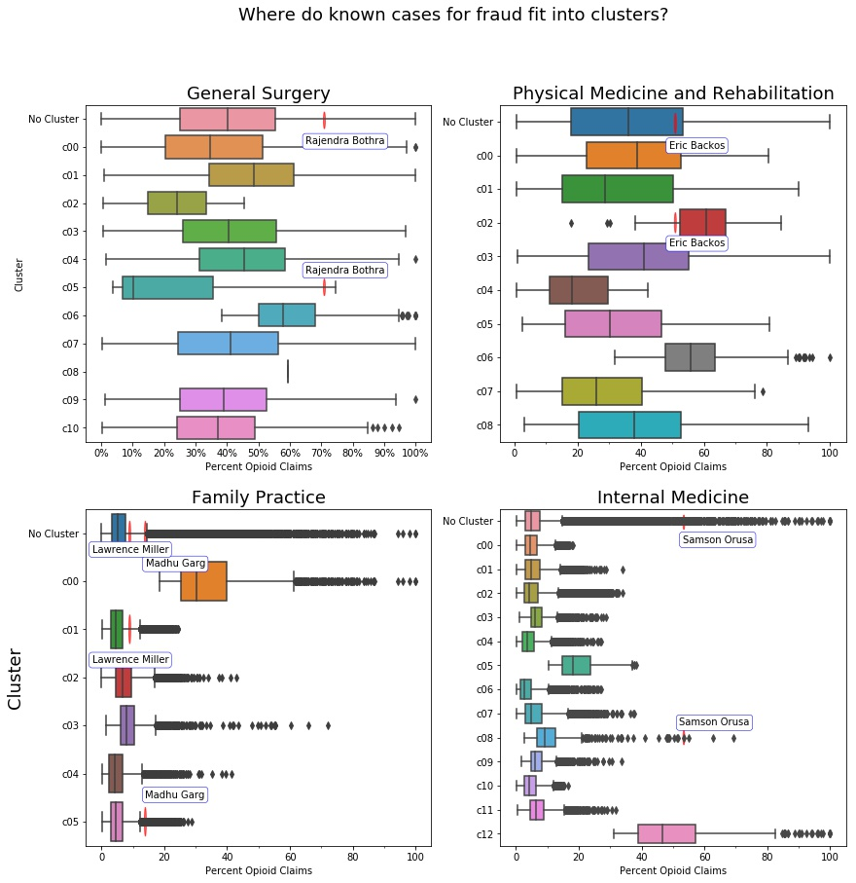
  Madhu Garg, Lawrence Miller, and Samson Orusa
Two cases of fraud successfully identified as outliers.
One borderline cases.
For Madhu Garg clustering improved anomaly detection

Slide 15
  Bothra Rajendra and Eric Backos
One borderline outlier
One failed to be detected as an outlier.

Slide 16
Conclusion
Of the 5 cases of known fraud examined:
  There were 2 clear cases clear outliers.
  There were 2 borderline cases.
  There was one that failed to be marked as anomalous
  It would be desirable
It would be desirable to have more cases of known fraud to test model.
It would be recommended based on the outliers or borderline outliers within a cluster should be examined for possible fraud.
Clustering help in 2 of the five cases.
Being anomalous within the cluster is not enough for the health care provider to have opioid

Slide 17
Future Work
Given the 2 borderline cases, the boundaries for outliers should be examined more closely.
It may be beneficial to focus on the opioids that are commonly abused, such as oxycodone
Dollar amount of claims which may be a strong indicator of fraud. This was used by considered by Gleb Esman who worked on a similar project and successfully identified fraudulent claims. [1]
[1] Desman, G. ‘Building a $60 Billion Data Model to Stop US Heathcare Fraud’ <https://www.splunk.com/blog/2017/09/28/building-a-60-billion-
data-model-to-stop-us-healthcare-fraud-with-splunk-and-machine-
learning.html>.

Slide 18
Special Thanks
Yogendra Pandey, my adviser at SpringBoard, for all his help.
Liam Doherty, for creating the template for these slides.
https://github.com/dohliam/libreoffice-impress-templates

