Slide 1
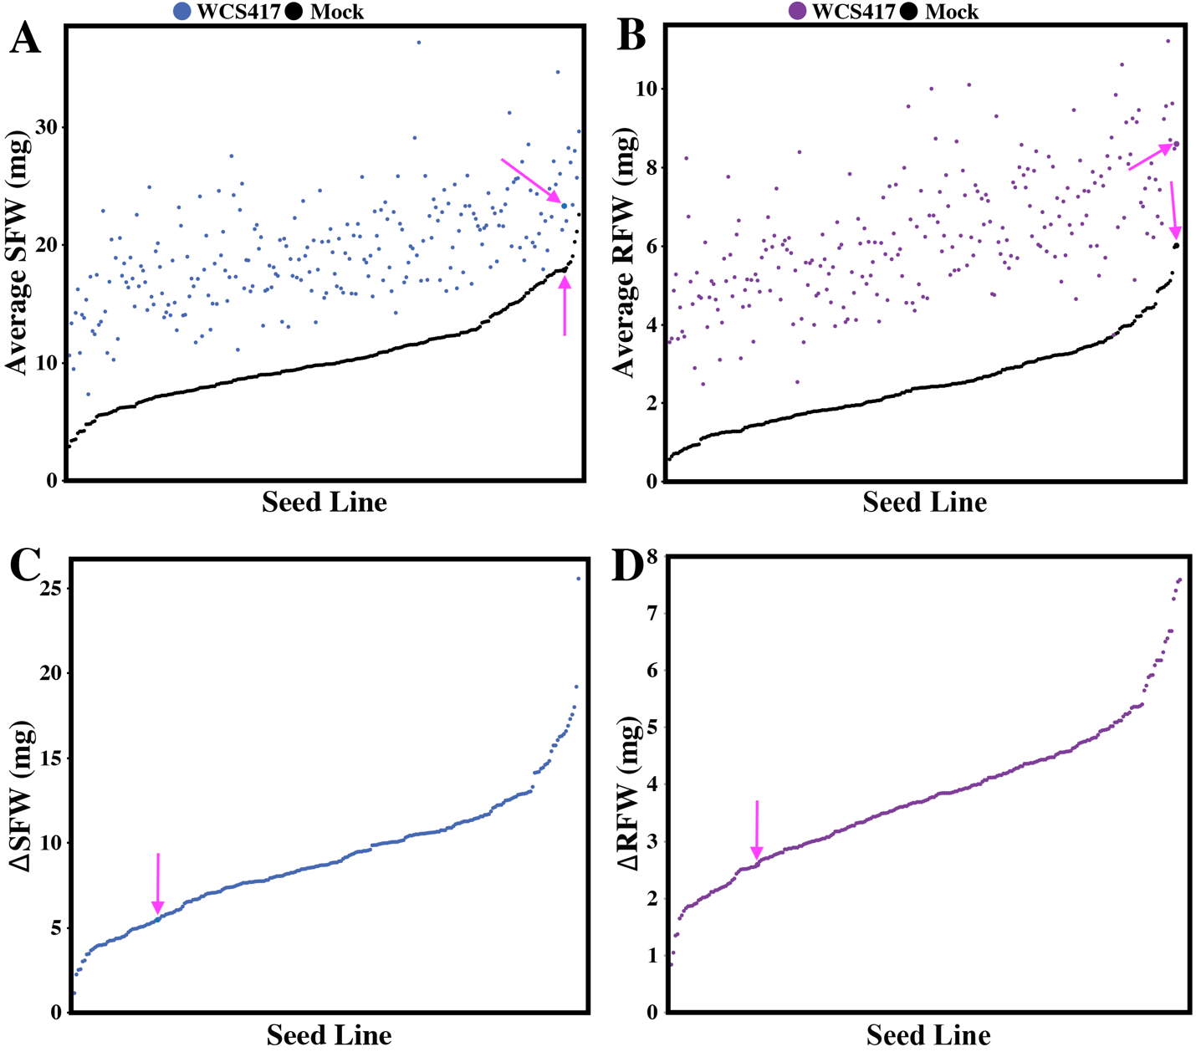
Natural variation in Arabidopsis reveals host genetic loci underlying WCS417-mediated drought rescue
243 accessions screened so far (still in progress…)
Notes:
243 accessions screened so far (still in progress, 20 accessions left)

Slide 2
Natural variation in Arabidopsis reveals host genetic loci underlying WCS417-mediated drought rescue
243 accessions screened so far (still in progress…)
Notes:
243 accessions screened so far (still in progress, 20 accessions left)

Slide 3
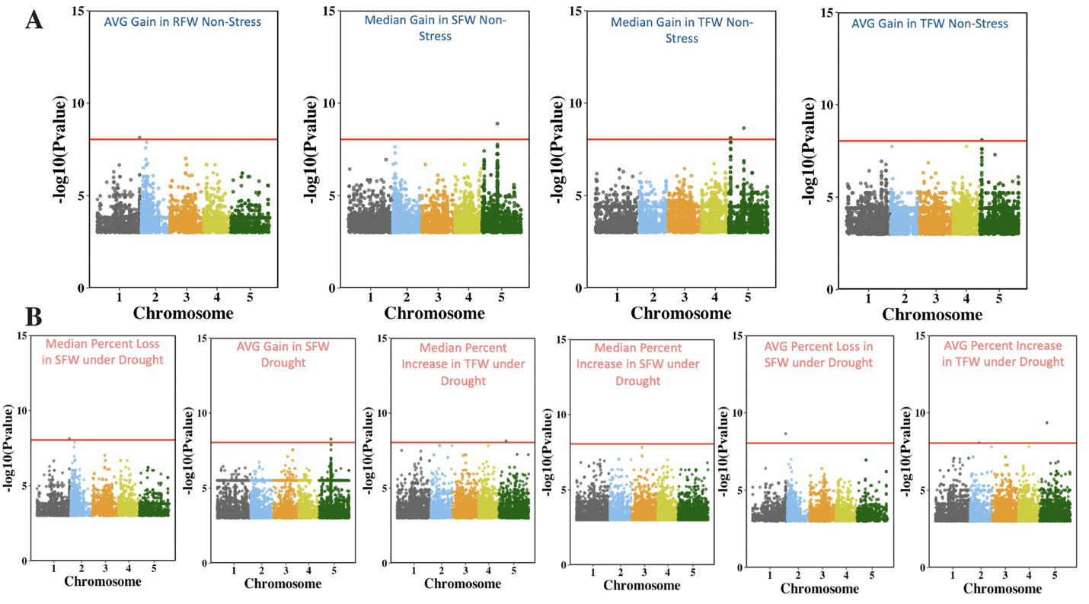
Natural variation in Arabidopsis reveals host genetic loci underlying WCS417-mediated drought rescue

Slide 4
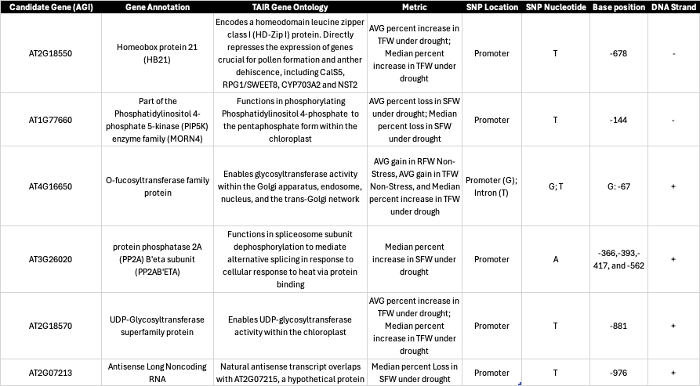
Natural variation in Arabidopsis reveals host genetic loci underlying WCS417-mediated drought rescue

