Slide 1
FULLSTACK-5
Team leader- Vishvjeet Thakur
Hriday
Jitesh Singla
Vedansh Singh
Vidit Sarin
Nitin Singh
Team Fullstacks - 05

Slide 2
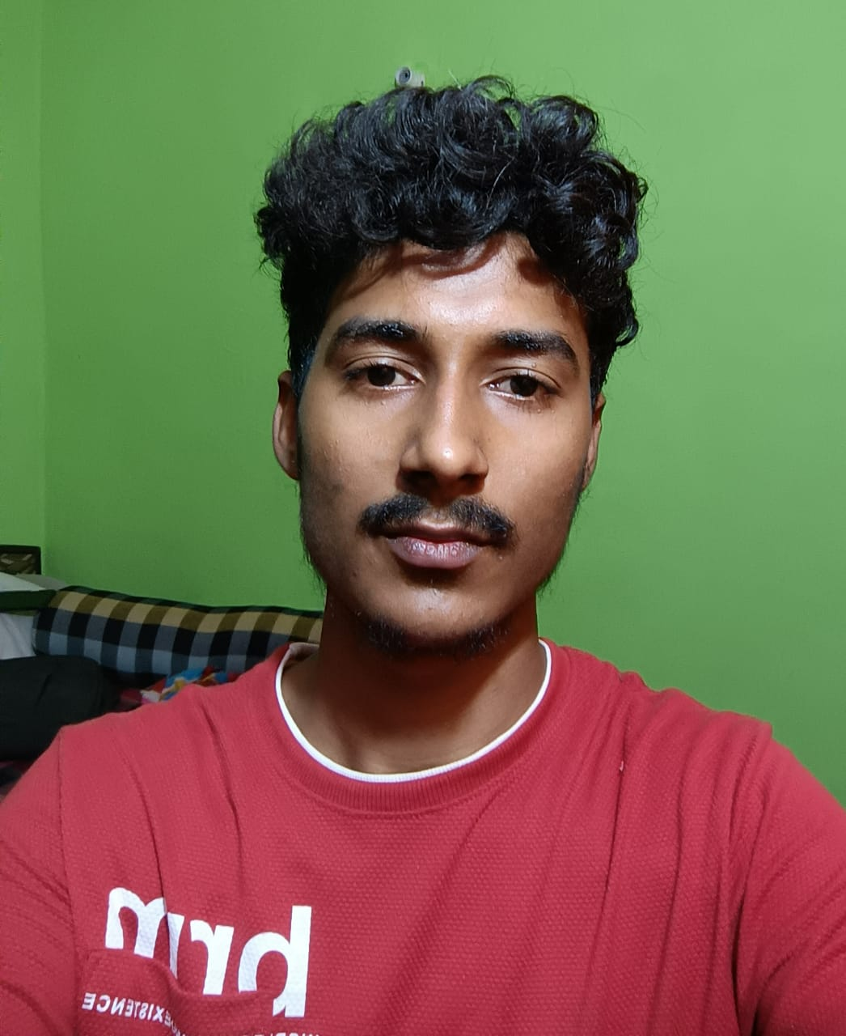
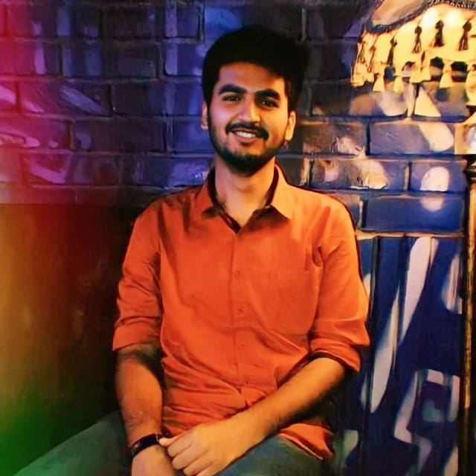
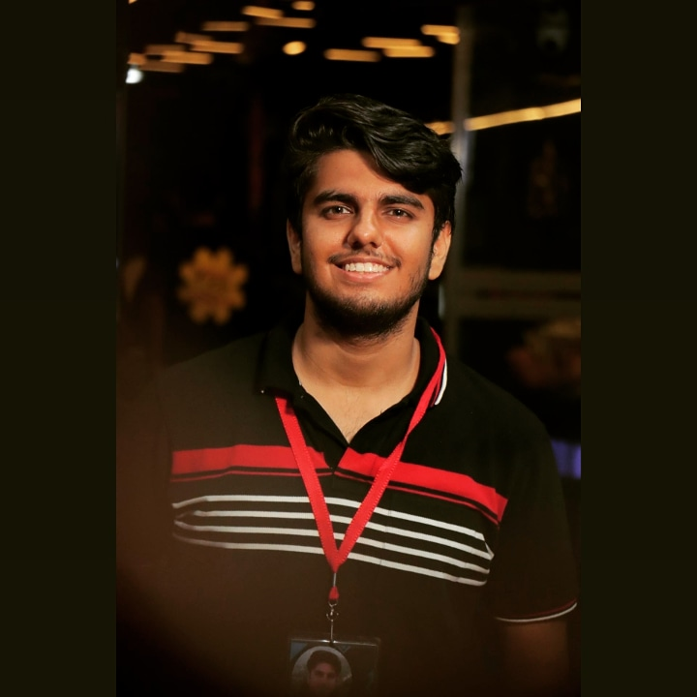
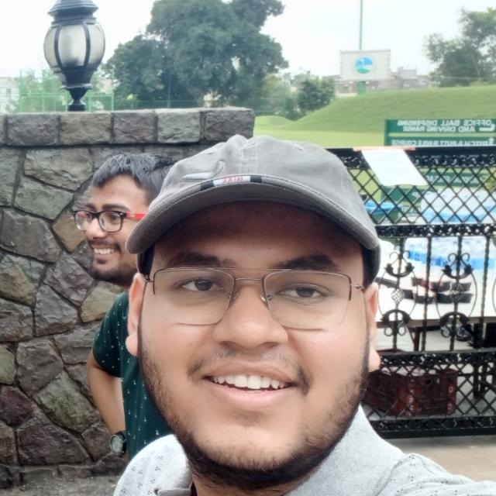

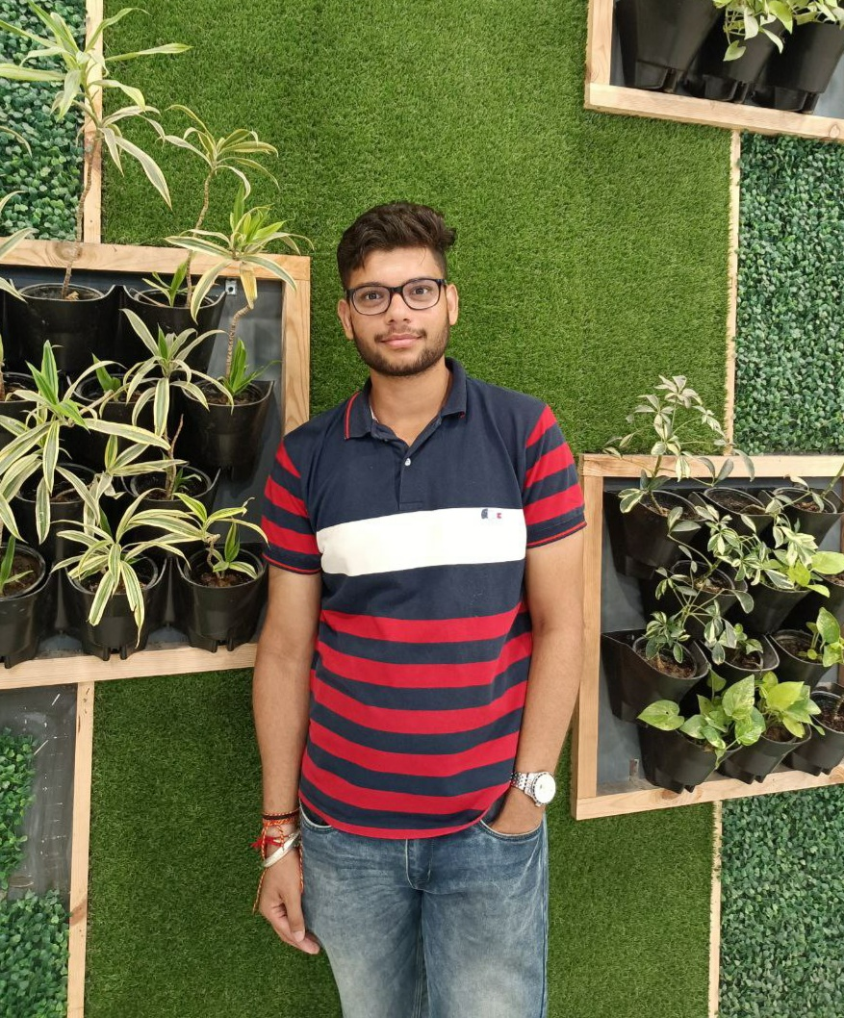
Team Leader:-Vishjeet
Vedansh
Vidit
Jitesh
Hriday
Nitin

Slide 3
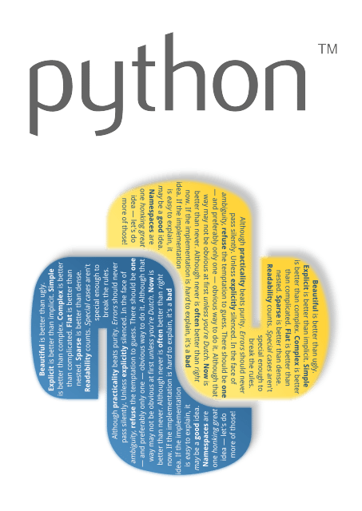
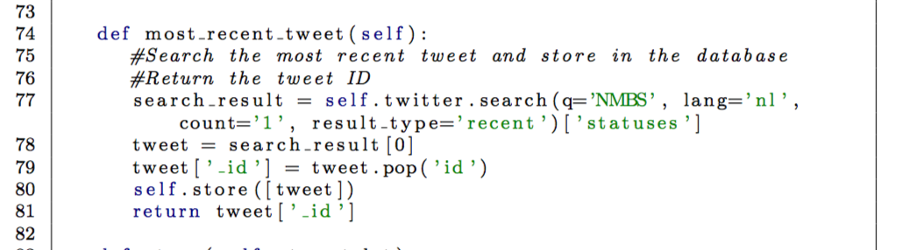
Python
Object Oriented and Structured Programming Language
Easily Readable Language
Large Standard Library
Wide Range use
Significant indentation
Uses Dynamic Typing
Team Fullstacks - 05

Slide 4
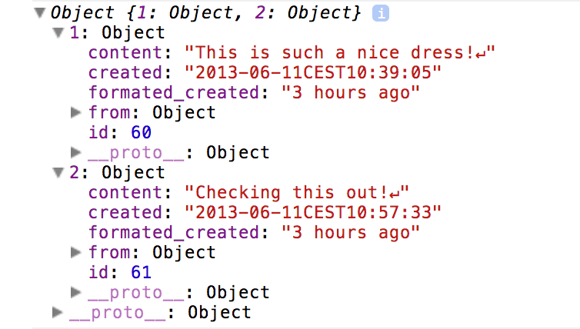
JavaScript Object Notation
Text Format to store and transport data.
Self-Describing
Send Data between computers
Language Independent
Store Temporary Data
Syntactically similar format with Javascript
Team Fullstacks - 05

Slide 5

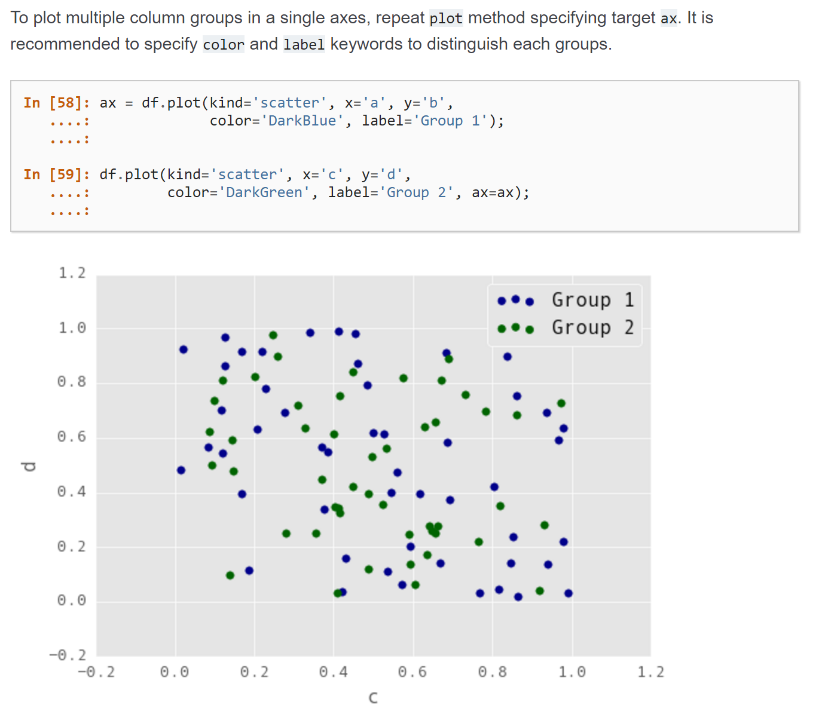
Pandas
Python library.
Source data analysis
Data manipulation tool
Reshaping and pivoting data sets.
Highly optimized for performance.
Use of CSV files to store big data
Team Fullstacks - 05

Slide 6
Two main componets of are program are:-
Code generation
Code execution
Takes input from user in form of
Source.json
Target.json
Mapping.csv
Generate code for transformation of Source.json to Target.json by Mapping.csv
Used python as the main coding language and also used some of its libraries/modules ,example
Pandas
Numpy
Gradio
Json module
Used code generated already, to generate new file.
Team Fullstacks - 05

