Slide 1
Read for the step3: Key features of mongodb
Data is stored in BSON and presented in JSON.
Server-side JavaScript is supported (JavaScript expressions and functions).
Document oriented database where there are no tables and no row-based data.
NoSQL, where there is no schema. Documents can have different structures. Documents can be embedded. This is specifically designed for horizontal scaling.
By default, there is a primary key (_id), which is an auto-generated field for every document.
Sharding is supported which is very much essential for horizontal scaling and replication.
It has automatic load balancing and fault tolerance configurations.

Slide 2
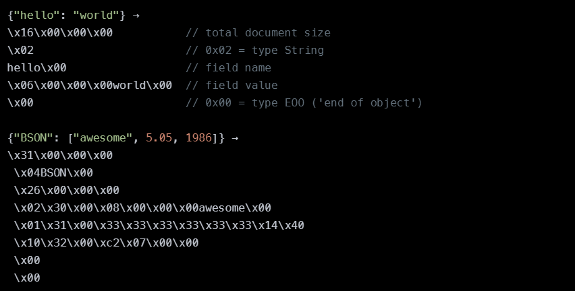
READ FOR THE STEP 3 What BSON looks like

Slide 3
READ FOR STEP 3: What is objectId (_id) ?
ObjectId in the MongoDB is same as the primary key in the conventional RDBMS.
It is by default set by MongoDB for every document that is created inside any collection.
ObjectIds are small, unique, fast to generate and ordered.
ObjectId values comprises of a 12 bytes hexadecimal number which is unique for every document.
_id: ObjectId(4 bytes timestamp, 3 bytes machine id, 2 bytes process id,
3 bytes counter)
"_id": ObjectId("5901832c91427cac52e9ea8f")

Slide 4
READ FOR THE STEP 3: we’ll create the models, and this includes using datatypes. Major datatypes in mongodb:
String
Integer
Boolean
Double
Min/Max keys
Arrays
Timestamp
Object
Null
Symbol
Date
ObjectID
Binary data
Code
Regular expression

Slide 5
Step 3
B) In the file Olympics/model/User.js create the model for the “users” collection: const mongoose = require('mongoose');
const Role = require('./Role')
userSchema = new mongoose.Schema({
name: { type: String, required: true },
email: { type: String, required: true, unique: true },
password: { type: String, required: true },
role: { type: mongoose.Schema.Types.ObjectId, ref: 'Role',
required: true }
})
const User = mongoose.model('User', userSchema)
module.exports = User
A) Create directory olympics/model and inside it - the file Role.js, that will contain definition of the collection “roles” – but in “Mongoose” we create it through defining a schema, and then creating a MODEL – model is like a class. We even could add it methods. const mongoose = require("mongoose");
const Role = mongoose.model(
"Role",
new mongoose.Schema({
userType: {
type: String,
enum: ['user', 'moderator', 'admin']
}
})
);
module.exports = Role;

Slide 6
STEP 3 continued
C) Add one more field to User schema: “sport” and make for it the default value “Judo”
D) Create in the directory Olympics/model also common file index.js – import there Role and User
E) When we create first documents of the models User and Role – the collections will be created, so we want to initialize the models with several documents, for this we’ll create 2 async functions: initRole() and initUser()
F) In initRole() we don’t want to create the roles again and again, so check if there already some documents exist: let count = await Role.estimatedDocumentCount();
If yes, get out of the function, if not …

Slide 7
STEP 3 continued
J) The function is ready – let’s envelope it with try-catch
K) In initUser() we start from checking if the user we’re going to create is already exist:
let YaelArad = await User.findOne({email:'yarad@gmail.com'});
console.log(`YaelArad=\n`,YaelArad)
if (YaelArad) {
console.log('The user Yael Arad is already exist');
return;
}
L) And we create the user: new User({name: "Yael Arad",
email:'yarad@gmail.com',password:'123',
role: admin._id}).save();
console.log("added 'Yael Arad' users collection");
G) We create document with userType “user” and chain (in MongoDB we say “pipe”) to it function “save()” – it will be saved in the collection new Role({userType: "user"}).save();
console.log("added 'user' to roles collection");
H) Do the same for the userType “moderator” I) Create a global variable “admin” outside the function, as we want to save the pointer to the next document: admin = new Role({userType: "admin"});
admin.save();
console.log("added 'admin' to roles collection");

Slide 8
Step3 – the end
M) We create now the async function init() to envelop the both functions initRole() and initUser() – and we want to use “await” with initRole() to make sure that we’ve got “admin” document before we create our user
N) Finally we fill the command to run init()
O) In the main server.js require model/index.js and it’ll run the init()
P) ensure that you see the new roles and the new user in your Olympics DB

