Slide 1





jwt-authentication … Olympics
Prepare for the first step …

Slide 2
Step1
C) Inside the directory olympics/server create simple NodeJS-Express server in the file server.js – it should:
i) listen on some port ii) has one route of app.get(‘/’, …) iii) answer to HTTP request of get(‘/’) “I am Olympics API” iv) start by “npm start”
D) Ensure it works OK
E) Come back for the next step
A) Create directory “olympics”
B) Inside this directory create directory “server”

Slide 3
Step1 hints
6. In the file server.js - - import “express” - - set port variable with some number (with the default option to take the port number from the environment), like const port = process.env.PORT || 3000; - - create the server, named “app” - - make the app.get(‘/’, …) route - - add it callback function that gets (req,res) and only responds ‘I am Olympics API’ ‘’ - - add it a listener that listens on the given port and tells the port number
7. $ npm start
8. In the browser address line send get(‘/’) request to the server and ensure that it responds
1. $ cd olympics/server
2. $ npm init –y
3. In package.json change the name of the main file to “server.js”
4. In package.json in the part of “scripts” add the script "start": "nodemon server.js",
5. Install “express” by $ npm i express
<h1 style="font-family: fantasy; color: cornflowerblue;">I am Olympics API</h1>

Slide 4

READ FOR STEP 2 : Mongo DB
MongoDB name comes from HuMONGOus data.
MongoDB is comprised of DATABASES -> COLLECTIONS -> DOCUMENTS
MongoDB is a document database – scalable, flexible (with flexible structure), fast and appropriate as for small so for huge stocks of data
It is a NoSQL Database.
It is Open source and free to use.
It is a cross-platform database which works with almost every platform (Windows, Mac, Linux) .
It stores data in flexible, JSON like documents - BSON.

Slide 5
READ FOR STEP 2: Basic sql to mongodb Terminology comparison
Terminology & Concept Comparison:
SQL | MongoDB
database | database
table | collection
row | document or BSON document
column | field
index | index
table joins | $lookup, embedded documents
primary key (need to specify column or combination of column) | primary key (automatically set to _id field)
aggregation | aggregation pipeline

Slide 6
READ FOR STEP 2 : ROLES in OLYMPICS APP:
Admin, Moderator, User – each one of them can use only his views
All others – are public, guests – they also could use some views
For this we will need Database and inside it the collections of “roles” and “users”.

Slide 7
STEP 2
A) Use “Compas” GUI of MongoDB and create Database named “olympics” – it will ask you about the name for the first Collection – so let it be “sports”
B) Now back to the server, there we install “mongoose”
C) Inside olympics/server we create the file .env – for environment variables and fill it by: MONGODB_URI='mongodb://127.0.0.1:27017/olympics’
D) Now stop the server. In the window of the server run: $ source .env (reminder – this command runs the script .env that creates the environment variables, for now it is only MONGODB_URI, but there will be more)
E) You could also install dotenv package to perform this action automatically, but it should be never used in production, so install it for development only like this: $ npm i –D dotenv and after that put into server.js: const express = require('express');
require('dotenv').config();

Slide 8
STEP 2 - continued
const mongoose = require('mongoose');
const connectDB = async () => {
try {
console.log(`process.env.MONGODB_URI : ${process.env.MONGODB_URI}`);
await mongoose.connect(process.env.MONGODB_URI, {});
console.log('Connected to MongoDB, Mazal Tov!');
} catch (err) {
console.log('Error connecting to MongoDB:');
throw err;
}
};
module.exports = connectDB;
F) Create directories olympics/server/db and olympics/server/model
G) In olympics/server/db we create file db.js and create inside async connect function, for example:
H) Import it into the main server file, and run the function somewhere there (before the creation of the Express server, for example)
I) Ensure that the server connects to DB

Slide 9
STEP 2 - hints
1. To import the DB connection function into the main server.js file:
const express = require('express');
require('dotenv').config();
const connectDB = require('./db/db’);
2. To run it:
connectDB();
const app = express();
(you could use the keyword await before, but we anyway kill the process, if the server does not connect to the DB)
C) If it does not connect to the server, ensure that DB is up and you’re working OK with Compass,
And ensure, that your connection line does not include “localhost” but explicit IPV4 address (as NodeJS translates localhost to IPV6 address, but mongodb does not use this form of the address yet):
MONGODB_URI='mongodb://127.0.0.1:27017/olympics’

Slide 10
Read for the step3: Key features of mongodb
Data is stored in BSON and presented in JSON.
Server-side JavaScript is supported (JavaScript expressions and functions).
Document oriented database where there are no tables and no row-based data.
NoSQL, where there is no schema. Documents can have different structures. Documents can be embedded. This is specifically designed for horizontal scaling.
By default, there is a primary key (_id), which is an auto-generated field for every document.
Sharding is supported which is very much essential for horizontal scaling and replication.
It has automatic load balancing and fault tolerance configurations.

Slide 11
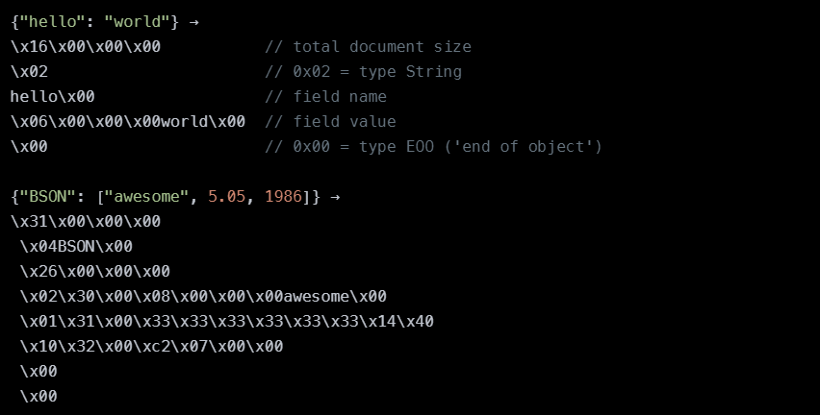
READ FOR THE STEP 3 What BSON looks like

Slide 12
READ FOR STEP 3: What is objectId (_id) ?
ObjectId in the MongoDB is same as the primary key in the conventional RDBMS.
It is by default set by MongoDB for every document that is created inside any collection.
ObjectIds are small, unique, fast to generate and ordered.
ObjectId values comprises of a 12 bytes hexadecimal number which is unique for every document.
_id: ObjectId(4 bytes timestamp, 3 bytes machine id, 2 bytes process id,
3 bytes counter)
"_id": ObjectId("5901832c91427cac52e9ea8f")

Slide 13
READ FOR THE STEP 3: we’ll create the models, and this includes using datatypes. Major datatypes in mongodb:
String
Integer
Boolean
Double
Min/Max keys
Arrays
Timestamp
Object
Null
Symbol
Date
ObjectID
Binary data
Code
Regular expression

Slide 14
Step 3
B) In the file Olympics/model/User.js create the model for the “users” collection: const mongoose = require('mongoose');
const Role = require('./Role')
userSchema = new mongoose.Schema({
name: { type: String, required: true },
email: { type: String, required: true, unique: true },
password: { type: String, required: true },
role: { type: mongoose.Schema.Types.ObjectId, ref: 'Role',
required: true }
})
const User = mongoose.model('User', userSchema)
module.exports = User
A) Create directory olympics/model and inside it - the file Role.js, that will contain definition of the collection “roles” – but in “Mongoose” we create it through defining a schema, and then creating a MODEL – model is like a class. We even could add it methods. const mongoose = require("mongoose");
const Role = mongoose.model(
"Role",
new mongoose.Schema({
userType: {
type: String,
enum: ['user', 'moderator', 'admin']
}
})
);
module.exports = Role;

Slide 15
STEP 3 continued
C) Add one more field to User schema: “sport” and make for it the default value “Judo”
D) Create in the directory Olympics/server/model also common file index.js – import there Role and User
E) When we create first documents of the models User and Role – the collections will be created, so we want to initialize the models with several documents, for this we’ll create 2 async functions: initRole() and initUser()
F) In initRole() we don’t want to create the roles again and again, so check if there already some documents exist: let count = await Role.estimatedDocumentCount();
If yes, get out of the function, if not …

Slide 16
STEP 3 continued
J) The function is ready – let’s envelope it with try-catch
K) In initUser() we start from checking if the user we’re going to create is already exist:
let YaelArad = await User.findOne({email:'yarad@gmail.com'});
console.log(`YaelArad=\n`,YaelArad)
if (YaelArad) {
console.log('The user Yael Arad is already exist');
return;
}
L) And we create the user: new User({name: "Yael Arad",
email:'yarad@gmail.com',password:'123',
role: admin._id}).save();
console.log("added 'Yael Arad' users collection");
G) We create document with userType “user” and chain (in MongoDB we say “pipe”) to it function “save()” – it will be saved in the collection new Role({userType: "user"}).save();
console.log("added 'user' to roles collection");
H) Do the same for the userType “moderator” I) Create a global variable “admin” outside the function, as we want to save the pointer to the next document: admin = new Role({userType: "admin"});
admin.save();
console.log("added 'admin' to roles collection");

Slide 17
Step3 – the end. To be continued …
M) We create now the async function init() to envelop the both functions initRole() and initUser() – and we want to use “await” with initRole() to make sure that we’ve got “admin” document before we create our user
N) Finally we fill the command to run init()
O) In the main server.js require model/index.js and it’ll run the init()
P) ensure that you see the new roles and the new user in your Olympics DB

Slide 18
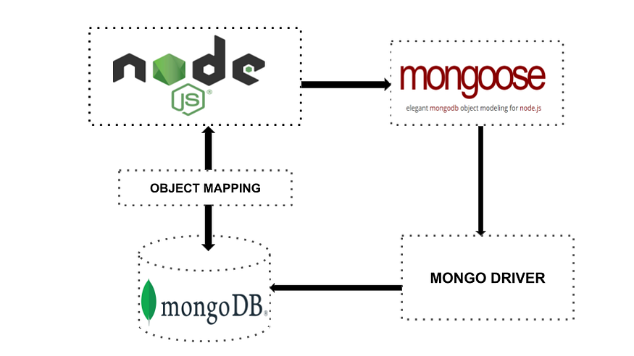
ReMINDER for the step 4 WHAT IS MONGOOSE?
Mongoose is an Object Data Modeling (ODM) library for MongoDB and Node.js. It manages relationships between data, provides schema validation, and is used to translate between objects in code and the representation of those objects in MongoDB.
We could create our models directly in the code – and they will be mirrored in the DB – no need to create special scripts for DB, everything in one place

Slide 19



step 4 Add one more model and initialize
A) Like we did with User and Role, add model Sport, It’s schema could be for example: name: { type: String, required: true },
isOlympic: { type: Boolean, required: true},
isSummerOlympic: { type: Boolean, required: true},
img: { type: String }
B) Now initialize it with ‘judo’ document – it is Olympic and Summer Olympic too (you could download the images from here – and set them in some assets/images directory – so you’ll get the image names)

Slide 20
STEP 4. Let’s try some routing
A) Let’s create in server.js a route for getting all the sports
The start of it will be app.get(‘/api/sports’ ….
And it will use the function like
(req,res)=>{
try{
const sport = await Sport.find()
res.status(200).json(sport)
}catch(err){
console.error("There is an error:",err)
res.status(500).json({err: "Internal error"})
}
}
B) Make it work – try it from the browser

Slide 21
READ FOR STEP 5: Basic crud operations
The basic operations in every database comprises of the following four operations:
CREATE (http verb “POST”)
READ (http verb “get”)
UPDATE (http verbs “put”/”patch”)
DELETE (http verb “delete”)
In MongoDB these four basic operations are achieved using the unique style of writing.
We’ve already tried “find()” to respond to “get” request.
We’re also know the function “save()” – we could use it for “post” request, but there is also “create()”

Slide 22

STEP 5 – first of all, let’s try “POST”, but how?
A) For this we’ll need some helper tool, called “Postman” – install it
B) Meanwhile in server.js create one more route, for

Slide 23
STEP 5 – Now we’re going to create a real API
A) Create directory Olympics/server/routes and inside it sports.js

Slide 24
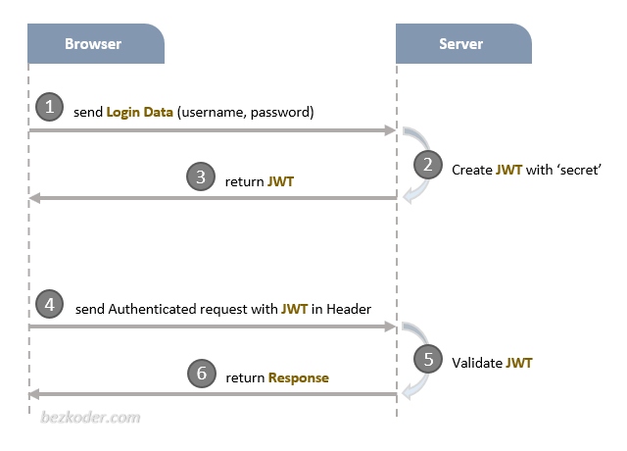
There are three important parts of a JWT: Header, Payload, Signature. Together they are combined to a standard structure: header.payload.signature.
The Client typically attaches JWT in Authorization header with Bearer prefix:
Authorization: Bearer [header].[payload].[signature]

Slide 25
Why mongodb is important ?
MongoDB is important in many aspects and some of those major points are as follows:
It is document oriented and does not need the row and column format of the data.
It gives high performance.
It is dynamic in nature where you don’t need to predefine a schema like in conventional RDBMS.
There is no concept of Joins in MongoDB instead it has $lookup aggregation operator in versions >=3.2. There is a mongoose alternative as well which is called as populate() that is used to reference documents in other collections.
MongoDB stores data in JSON format which allows to send the data in whatever form you want.

Slide 26
How to install & run mongodb ?
To install the MongoDB you need to visit the download section of the official website. Visit the following link: https://www.mongodb.com/download-center/community. Select the version, OS and the package there and then click download.
After download is completed double click the file (e.g.:- mongodb-win32-x86_64-2008plus-ssl-3.4.5-signed.msi). This will start the installation.
Go through all the steps. Simply click next on each step and at the last step click on Finish button. This will install the MongoDB on your system.
RUNNING THE MONGODB IN SYSTEM:
Create the folder → C:\data\db (In this case after creating the folder, you need to double click the mongod.exe file or just need to start the command line terminal and run the command mongod).
To be continued…

Slide 27
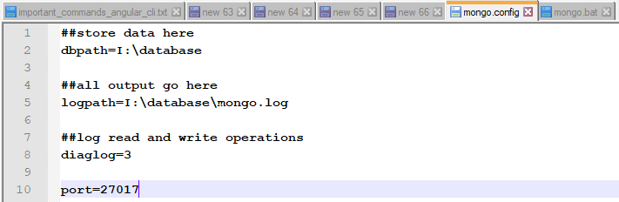
HOW TO INSTALL & RUN MONGODB ?
…in continuation
Alternatively you can create the folder at a different location and give its reference in mongo.config file. Then in mongo.bat file write the reference of the mongo.config file and run it whenever you want to start the mongodb server.
Mongo.config file has some other parameters which are described in the below image.
It comprises database path reference, log file path reference and port number reference.
To be continued…

Slide 28
HOW TO INSTALL & RUN MONGODB ?
…in continuation
The mongo.bat file will have a reference to mongo.config file.
The command written inside the mongo.bat file is:
mongod -f mongo.config
It is shown in the below image.
This will allow the server to read the config file and refer the location of the database.
The default port that the mongodb server reads is 27017.

Slide 29
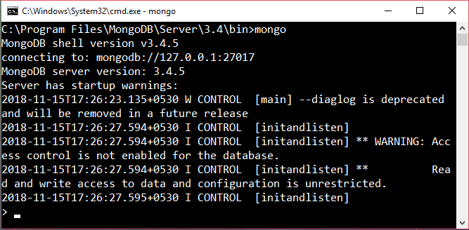
Basic crud operations
STARTING THE MONGODB INSTANCE IN THE TERMINAL
Go to the terminal and give the command mongo there so as to start the MongoDB CLI.
This will start the mongo instance in the terminal from where you can work on mongodb and fire queries.
…to be continued

Slide 30
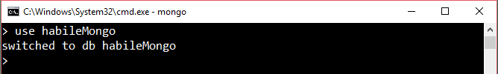
Basic crud operations
…in continuation
CREATING THE DATABASE USING THE use COMMAND
Go to the terminal and write the command use <database_name> where database name will be replaced by the name of your database. This will create the database with the name which you want.
Alternatively it can be achieved by using any of the GUI tool and from there you can create the new database. But this GUI tool will first need to be connected to the host at the desired port number.
…to be continued

Slide 31
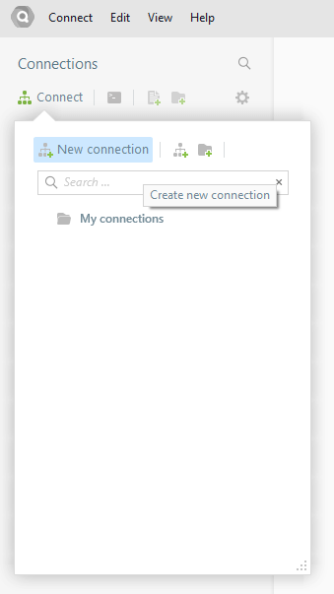
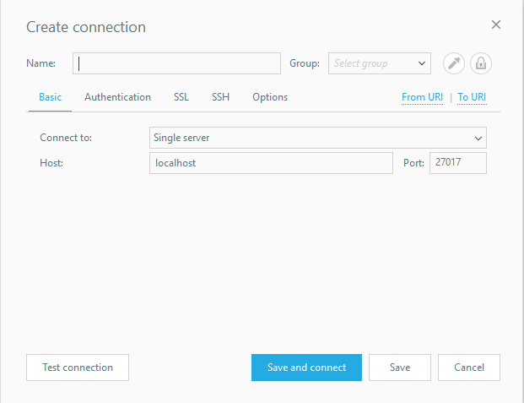
Basic crud operations
The GUI tool which is shown above is QueryAssist
You can Give a name to the instance from the tool.
…to be continued

Slide 32
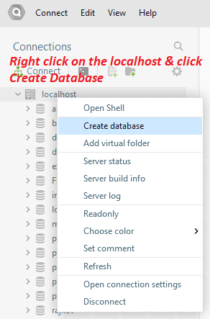
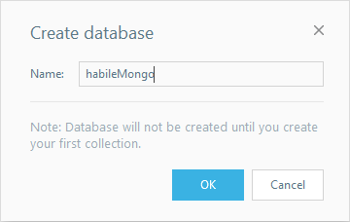
Basic crud operations
By this way you can create the database in MongoDB.
Observe the note written in the Create Database Pop Up
…to be continued

Slide 33
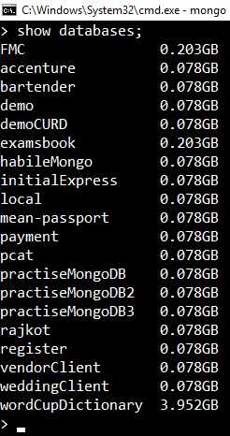
Basic crud operations
NOTE: You can ensure that your database has been created or not by using the show databases or show dbs command. The database will only appear when you have at least one collection inside it.
To create a collection inside the recently created database, you must use the insert command:
db.employee.insert({'name': 'John Doe', 'empId': 'HL0014’});
Now when you hit the show dbs or show databases command, it will show your database.
…to be continued

Slide 34
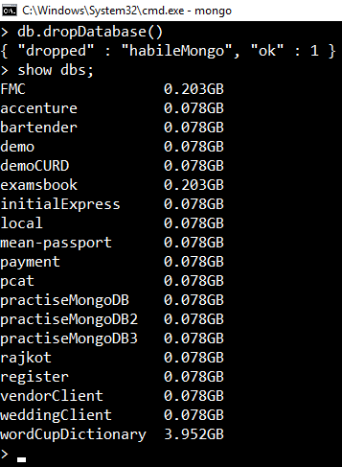
Basic crud operations
DROPPING A DATABASE
To drop a database in MongoDB you need to type the following command.
db.dropDatabase()
This will drop the selected database. If database is not selected then it will delete the default ‘test’ database.
Now you can check through show dbs or show databases command, that your created database is dropped.
You can clearly see in the picture that the habileMongo database is now not listed. It was dropped using the command above.
…to be continued

Slide 35
Basic crud operations
For previous operation’s result to be visible, one must first create a collection inside it. So, let’s start with CRUD operations.
CREATE
For creating a collection use the following command
db.createCollection(name, options)
…to be continued
Parameter | Type | Description
Name | String | It is the name of the collection that is to be created
Options | Document | Specifies option about the memory size and indexing. This is completely optional.

Slide 36
Basic crud operations
Options can have the following fields:
…to be continued
Field | Type | Description
capped | Boolean | (Optional) If true, enables a capped collection. Capped collection is a fixed size collection that automatically overwrites its oldest entries when it reaches its maximum size. If you specify true, you need to specify size parameter also.
autoIndexId | Boolean | (Optional) If true, automatically create index on _id fields. Default value is false.
size | number | (Optional) Specifies a maximum size in bytes for a capped collection. If capped is true, then you need to specify this field also.
max | number | (Optional) Specifies the maximum number of documents allowed in the capped collection.

Slide 37

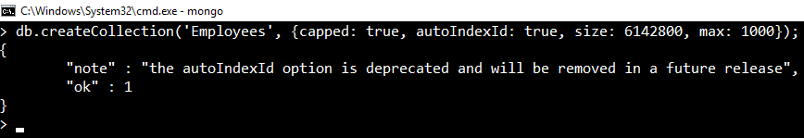
Basic crud operations
EXAMPLE:
1. Without Options parameter –
db.createCollection(‘Employees’);
This will create the Employees collection.
2. With Options parameter
db.createCollection(‘Employees’, {capped: true, autoIndexId: true, size: 6142800, max: 10000});
…to be continued

Slide 38

Basic crud operations
INSERT DOCUMENT
For inserting the document in MongoDB collection, you need to write the following command:
db.collection_name.insert(document)
Where in place of collection name you can place your collection name.
db.Employees.insert({‘name’: ‘John Doe’, ‘empId’: ‘HL0014’})
…to be continued

Slide 39
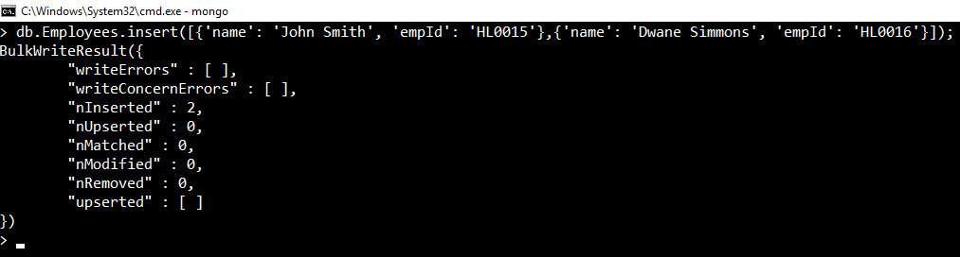
Basic crud operations
INSERT DOCUMENT
To insert multiple documents inside a single query, you must pass an array of documents in the insert() command:
db.Employees.insert([{'name': 'John Smith', 'empId': 'HL0015'},{'name': 'Dwane Simmons', 'empId': 'HL0016'}]);
…to be continued

Slide 40

Basic crud operations
UPDATE
For updating any document, an update() or save() method is used:
db.Employees.update({'name': 'John Smith’},{$set:{'name': 'John Smith Carlos’}});
NOTE: By default mongodb will update only a single document. To update multiple documents , there is a need to set the ‘multi’ parameter to true.
db.Employees.update({'name': 'John Smith’},{$set:{'name': 'John Smith Carlos’}}, {multi: true});
…to be continued

Slide 41
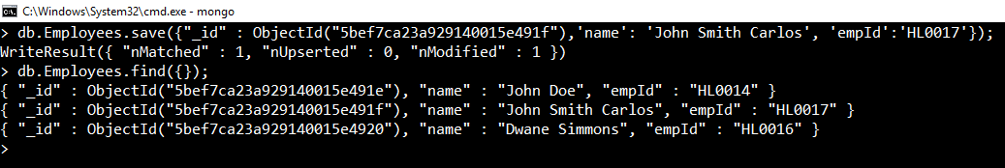
Basic crud operations
UPDATE
Using save() method:
Save method will replace the existing document with the new document passed in the save() method.
db.Employees.save({"_id" : ObjectId("5bef7ca23a929140015e491f"),'name': 'John Smith Carlos', 'empId':'HL0017’});
NOTE: If Save method is used without _id, then it will update the document else it will insert a document.
…to be continued

Slide 42
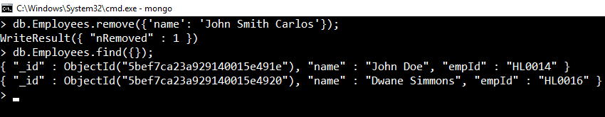
Basic crud operations
DELETE
To delete a document , MongoDB has remove() method.
db.Employees.remove({'name': 'John Smith Carlos’});
This will remove all the documents matching with the conditions.
To remove only one matching document there is deleteOne() method or remove() method with justOne parameter.
…to be continued

Slide 43
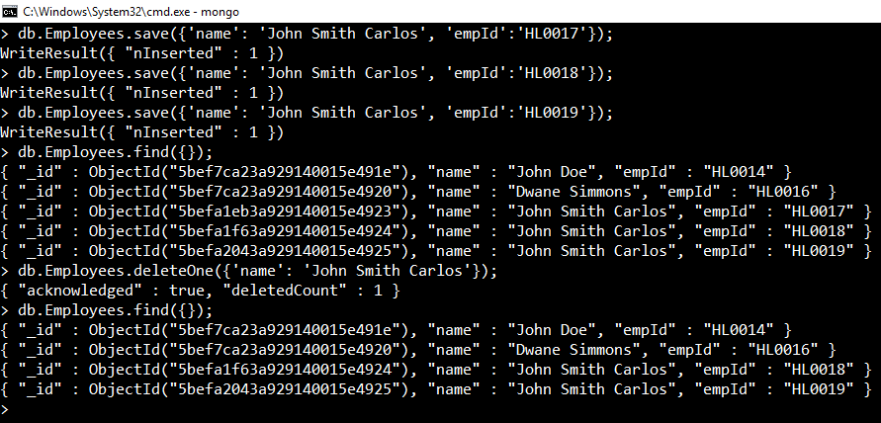
Basic crud operations
DELETE
To delete a document , MongoDB has remove() method.
db.Employees.deleteOne({'name': 'John Smith Carlos’});
The other way to delete single document is : use the findOne() method first to find the matching first document and then use remove() method.
…to be continued

Slide 44
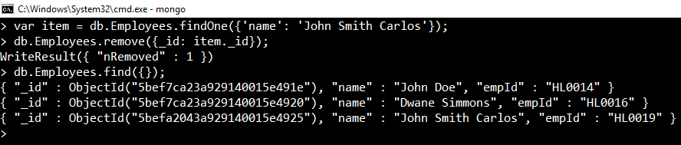
Basic crud operations
DELETE
This way you can remove a particular document from the collection.
findOne() method searches all the data and returns the first matching document. You can pass the condition inside the findOne() method.m
NOTE: If you don’t specify the deletion criteria (db.Employees.remove()), then it will delete all the documents inside the collection.

Slide 45
IMPORTANT PROJECTION & QUERY METHODS
find()
find() is the essential projection method which helps in selecting only the necessary data.
db.Employees.find({});
findOne()
This method returns the first matched document from the collection. You need to specify the condition inside the findOne() method.
db.Employees.findOne({'name': 'John Smith Carlos’});
pretty()
This method is used to display the text in the formatted way.
…to be continued

Slide 46
IMPORTANT PROJECTION & QUERY METHODS
distinct()
distinct() is the essential method which helps in returning an array of documents that have distinct values for a specified field.
db.Employees.distinct({‘name’});
isCapped()
This method is used to check whether that collection is capped or not.
db.Employees.isCapped();
It will return a Boolean value. If capped then true other wise false.
limit()
This method is used to limit the records in MongoDB. It accepts the number type argument.
db.Employees.find({}).limit(2);

Slide 47
IMPORTANT PROJECTION & QUERY METHODS
skip()
This method is used to skip the number of documents. It accepts the number type argument.
db.Employees.find({}).limit(1).skip(1);
sort()
This method is used to sort the documents in MongoDB.
db.Employees.find({}).sort({‘name’: -1});
This will sort the document in descending order on the field name.
…to be continued

Slide 48
IMPORTANT operators
AND
This is the operator used to query the data with AND relation. It will search the document satisfying the conditions that you pass in the query.
db.Employees.find({$and: [{‘name’: ‘John Smith Carlos’}, {‘EmpId’: ‘HL0020’}]});
OR
This operator is used to query the data with OR relation. It will search the document and return the result if any of the specified condition is fulfilled.
db.Employees.find({$or: [{‘name’: ‘John Smith Carlos’}, {‘EmpId’: ‘HL0020’}]});

Slide 49
RDBMS Where clause equivalents in MongoDB
Operation | Syntax | Example | RDBMS Equivalent
Equality | {<key>:<value>} | db.Employees.find({"name":"John Doe"}).pretty() | where name = John Doe'
Less Than | {<key>:{$lt:<value>}} | db.Employees.find({"salary":{$lt:20000}}).pretty() | where salary < 20000
Less Than Equals | {<key>:{$lte:<value>}} | db.Employees.find({"salary":{$lte:20000}}).pretty() | where salary <= 20000
Greater Than | {<key>:{$gt:<value>}} | db.Employees.find({"salary":{$gt:20000}}).pretty() | where salary > 20000
Greater Than Equals | {<key>:{$gte:<value>}} | db.Employees.find({"salary":{$gte:20000}}).pretty() | where likes >= 20000
Not Equals | {<key>:{$ne:<value>}} | db.Employees.find({"salary":{$ne:20000}}).pretty() | where likes != 20000

Slide 50
Where mongodb is best suitable?
MongoDB is best suited for unstructured and semi-structured data such as:
Social media posts
Web pages
Emails
Medical records
Reports
Raw data from marketing researches
Scientific data

Slide 51
Excellent MongoDB learning references
SQL to MongoDB mapping Chart https://docs.mongodb.com/manual/reference/sql-comparison/
What is NoSQL? https://www.mongodb.com/nosql-explained
MongoDB and MySQL Comparison https://www.mongodb.com/compare/mongodb-mysql
MongoDB Cheat Sheet https://blog.codecentric.de/files/2012/12/MongoDB-CheatSheet-v1_0.pdf
Organized Reference card – PDF file – Dzone https://dzone.com/refcardz/mongodb?chapter=1
…to be continued

Slide 52
Excellent MongoDB learning references
Online Course Catalogue https://university.mongodb.com/courses/catalog
MongoDB resources – starter kit https://resources.mongodb.com/getting-started-with-mongodb
Brief Introduction to MongoDB by Eliot Horowitz (CTO & Co-founder of MongoDB) https://www.youtube.com/watch?v=EE8ZTQxa0AM

Slide 53

Habilelabs Pvt Ltd
A premier software development company
Contact Us
info@habilelabs.io
www.habilelabs.io
Follow Us On LinkedIn

