Slide 1
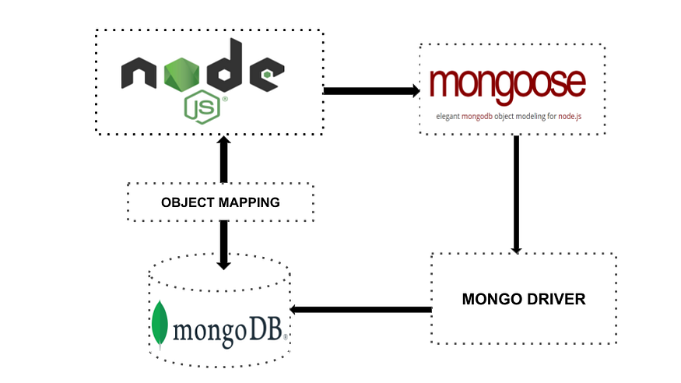
ReMINDER for the step 4 WHAT IS MONGOOSE?
Mongoose is an Object Data Modeling (ODM) library for MongoDB and Node.js. It manages relationships between data, provides schema validation, and is used to translate between objects in code and the representation of those objects in MongoDB.
We could create our models directly in the code – and they will be mirrored in the DB – no need to create special scripts for DB, everything in one place

Slide 2
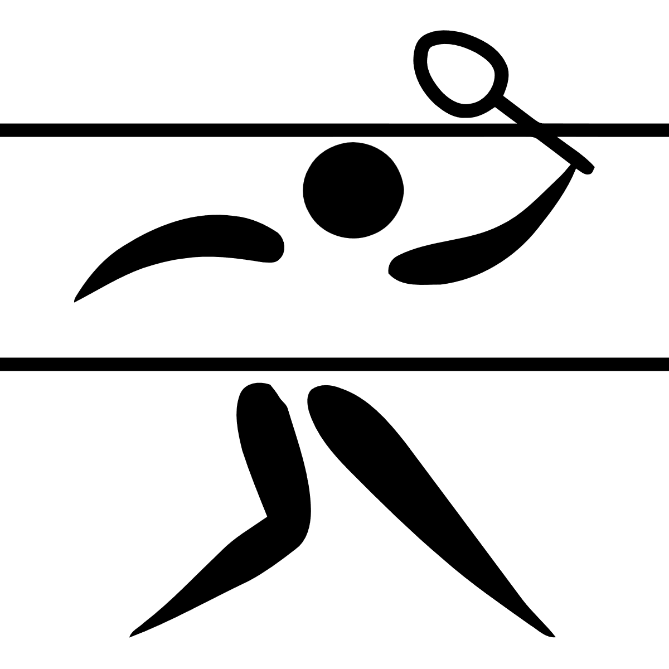


step 4 Add one more model and initialize
A) Like we did with User and Role, add model Sport, It’s schema could be for example: name: { type: String, required: true },
isOlympic: { type: Boolean, required: true},
isSummerOlympic: { type: Boolean, required: true},
img: { type: String }
B) Now initialize it with ‘judo’ document – it is Olympic and Summer Olympic too (you could download the images from here – and set them in some assets/images directory – so you’ll get the image names)

Slide 3
STEP 4. Let’s try some routing
A) Let’s create in server.js a route for getting all the sports
The start of it will be app.get(‘/api/sports’ ….
And it will use the function like
(req,res)=>{
try{
const sport = await Sport.find()
res.status(200).json(sport)
}catch(err){
console.error("There is an error:",err)
res.status(500).json({err: "Internal error"})
}
}
B) Make it work – try it from the browser

