Slide 1
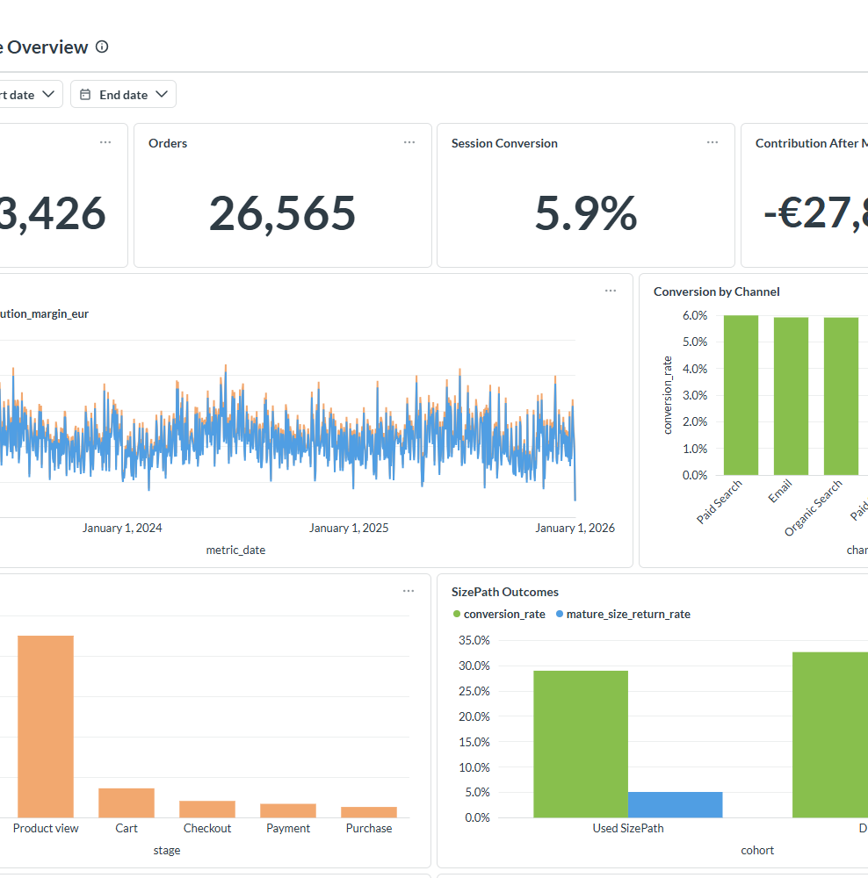
RIDER 360 / EXECUTIVE DECISION BRIEF
Fix conversion leakage before scaling growth
Three decisions from 450,000 synthetic sessions · 2023–2025
Fictional case study — no real customer or company data
1
Notes:
[Sources]
- docs/screenshots/metabase-hosted.png
- analyses/results/business_findings.json

Slide 2
Three decisions can reverse the biggest leaks
Decision order
Contain the verified checkout failure first, reset loss-making acquisition second, and test SizePath before scaling it.
−19.5 pp
−€27.85M
+1.59 pp
FR mobile payment
controlled change
Contribution after
marketing spend
Adjusted SizePath
association
2
Notes:
[Sources]
- analyses/results/business_findings.json
- analyses/results/sizepath_effects.json

Slide 3
French mobile checkout broke in March
Payment-to-purchase fell sharply after 10 March 2025 while desktop France and mobile controls remained comparatively stable.
−19.5 pp
−2.0 pp
Difference-in-
differences
FR desktop
change
3
Notes:
Action: Checkout PM rolls back or hotfixes the affected path before incremental traffic spend.
[Sources]
- analyses/funnel_investigation.sql
- analyses/results/funnel_investigation.csv

Slide 4
SizePath bias remains
+1.59 pp adjusted
95% CI: 1.44–1.74 pp across 450,000 eligible sessions
+1.20 pp truth
Integrated structural effect planted in the generator
0.39 pp residual bias
Latent intent remains after excellent observable balance
4
Notes:
Decision: randomize CTA prominence; do not claim completion itself is causal.
[Sources]
- analyses/sizepath_session_extract.sql
- analyses/results/sizepath_effects.json
- analyses/size_path_impact.ipynb

Slide 5
Acquisition spend is destroying contribution
Reset acquisition now
Paid Search and Paid Social account for most of the synthetic loss. Replace revenue-only ROAS with contribution after marketing and mature cohort value.
−€27.9M
€2,960
Total after
marketing
Paid Search
CAC
5
Notes:
Action: Growth Lead freezes marginal scale, resets bids, and reports contribution after marketing by channel.
[Sources]
- analyses/acquisition_quality.sql
- analyses/results/acquisition_quality.csv
- analyses/cohort_clv.sql
- analyses/results/cohort_clv.csv

Slide 6
Compatible bundles are a low-risk win
Peer-rate opportunity
Two under-merchandised bikes trail their same-wheel-size peers by 15–18 pp. Closing the gap implies about 698 additional compatible attach orders and roughly €15K illustrative contribution.
Owner: Merchandising · Test compatible bundles and product-page placement.
Ridge 24
8.1% vs 25.7% peer
Drift 20
8.3% vs 23.4% peer
381 incremental attach orders
Compatibility-aware denominator
Measure contribution per bundle
317 incremental attach orders
Compatibility-aware denominator
Hold checkout conversion harmless
6
Notes:
The €15K figure assumes €22 incremental contribution per compatible accessory order.
[Sources]
- analyses/product_opportunity.sql
- analyses/results/product_opportunity.csv

Slide 7
Execute in sequence: contain, learn, then scale
0–2 WEEKS
2–6 WEEKS
6–12 WEEKS
Contain
Fix FR mobile checkout. Freeze marginal paid scale. Establish daily guardrails.
Learn
Launch persistent-user SizePath test. Ship compatible bundle placements.
Scale
Read ITT conversion and mature return guardrail. Reallocate spend by contribution.
7
Notes:
Decision requested: approve owners, sequencing, and the randomized SizePath test.
[Sources]
- docs/executive_recommendations.md
- docs/experiment_spec.md
- analyses/results/business_findings.json

