Slide 1
MongoDb

Slide 2
Agenda
PRE-REQUISITES
Course Outline
Introduction

Slide 3
Pre-Requisites
you should have a basic understanding of database, text editor and execution of programs, etc. Because we are going to develop high performance database, so it will be good if you have an understanding on the basic concepts of Database (RDBMS).

Slide 4
Course Outline
Node Js

Slide 5
Course Outline
Overview
Advantages
Environment SetUp
Create Database
Drop Database
Create Collection
Drop Collection
Data Types
Insert Document

Slide 6
Introduction

Slide 7
MongoDb
MongoDB is an open-source document database and leading NoSQL database. MongoDB is written in C++
MongoDB is a cross-platform, document oriented database that provides, high performance, high availability, and easy scalability. MongoDB works on concept of collection and document.

Slide 8
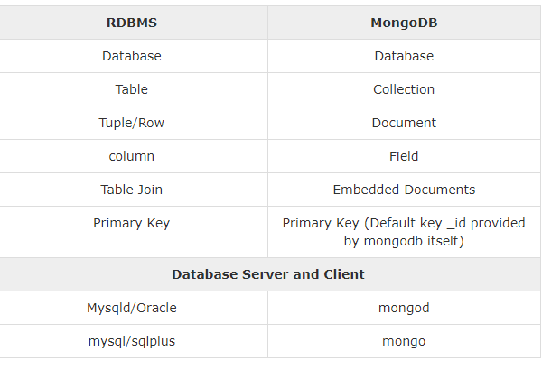
MongoDb

Slide 9
Advantages of MongoDB over RDBMS
https://www.tutorialspoint.com/mongodb/mongodb_advantages.htm
Why Use MongoDB?
Document Oriented Storage − Data is stored in the form of JSON style documents.
Index on any attribute
Replication and high availability
Auto-sharding
Rich queries
Fast in-place updates
Professional support by MongoDB

Slide 10
Wher to Use Mongo Db
Big Data
Content Management and Delivery
Mobile and Social Infrastructure
User Data Management
Data Hub

Slide 11
Installation?
Install MongoDB On Windows
https://www.mongodb.org/downloads

Slide 12
Installation?
Install MongoDB On Windows
https://www.mongodb.org/downloads
Create Database (Command)
use dataBaseName

Slide 13
Installation?
Install MongoDB On Windows
https://www.mongodb.org/downloads
Create Database (Command)
use dataBaseName

Slide 14
Create Dabase and Check
To check your currently selected database, use the command db
2.Use database (For Create Db)
If you want to check your databases list, use the command show dbs.
Check Db
show dbs

Slide 15
Drop Db
Drop Database
db.dropDatabase()
This will delete the selected database. If you have not selected any database, then it will delete default 'test' database.

Slide 16
createCollection() Method
MongoDB db.createCollection(name, options) is used to create collection
db.createCollection(name, options)
db.createCollection('Students')
db.createCollection('employess')
Insert Recode

Slide 17
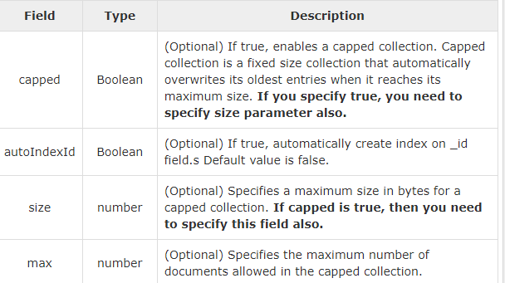

Slide 18
Drop Collections
MongoDB's db.collection.drop() is used to drop a collection from the database.
db.employess.drop()
check the list of collections into database.
show collections

Slide 19
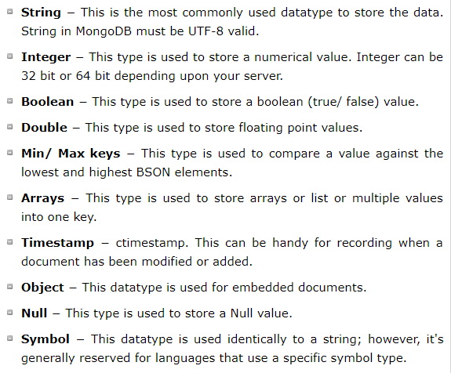
Data Type

Slide 20
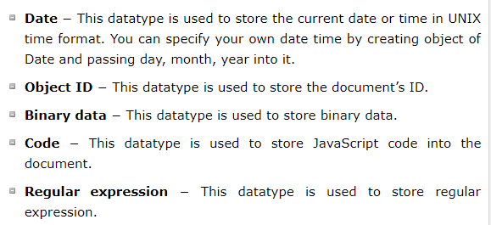
Data Type

Slide 21
Data Type

Slide 22
Insert Documents
db.COLLECTION_NAME.insert(document)

Slide 23
Thank You

