Slide 1
4102165:
Full Stack Web Development Fundamentals
Spring 2019
簡立仁 Li-Ren Chien
ccumouse@gmail.com

Slide 2
Schedule
Today
MongoDB
Servers and MongoDB
Next
Web application architecture
Authentication

Slide 3
MongoDB installation
This lecture assumes you have installed MongoDB:
https://fullstackccu.github.io/install-mongodb

Slide 4
MongoDB

Slide 5
MongoDB

Slide 6
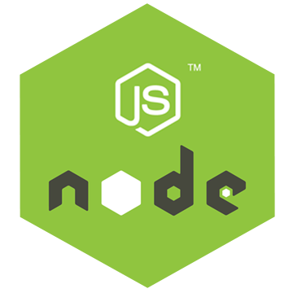


MongoDB is another software program running on the computer, alongside our NodeJS server program.
It is also known as the MongoDB server.

Slide 7
There are MongoDB libraries we can use in NodeJS to communicate with the MongoDB Server, which reads and writes data in the database it manages.

Slide 8
Data
The database the MongoDB Server manages might be local to the server computer...

Slide 9
(Routing, etc…)
Or it could be stored on other server computer(s)
("cloud storage").

Slide 10

System overview
$ node server.js
$ mongod
Data
For development, we will have 2 processes running:
node will run the main server program on port 3000
mongod will run the database server on a port 27017

Slide 11
System overview
$ node server.js
$ mongod
Data
For development, we will have 2 processes running:
node will run the main server program on port 3000
mongod will run the database server on a port 27017

Slide 12
System overview
$ node server.js
$ mongod
Data
For development, we will have 2 processes running:
node will run the main server program on port 3000
mongod will run the database server on a port 27017

Slide 13
MongoDB concepts
Database:
A container of MongoDB collections
Collection:
A group of MongoDB documents.
(Table in a relational database)
Document:
A JSON-like object that represents one instance of a collection (Row in a relational database)
Also used more generally to refer to any set of key-value pairs.

Slide 14
MongoDB example
Documents:
{ "_id" : ObjectId("5922b8a186ebd73e42b1b53c"), "style" : "july4", "message" : "Dear Chip,\n\nHappy 4th of July!\n\n❤️Dale" }
Database:
ecards-db
Collection:
card
{ "_id" : ObjectId("5922acf09e76403b3a7549ec"), "style" : "graduation", "message" : "Hi Pooh,\n\n🎉 Congrats!!! 🎉\n\n<3 Piglet" }
{ "_id" : ObjectId("5922b90d86ebd73e42b1b53d"), "style" : "fathersday", "message" : "HFD" }
The document keys are called fields

Slide 15
mongod: Database process
$ mongod
When you install MongoDB, it will come with the mongod command-line program. This launches the MongoDB database management process and binds it to port 27017:
$ mongod [--smallfiles]

Slide 16
mongo: Command-line interface
$ mongod
You can connect to the MongoDB server through the mongo shell:
$ mongo

Slide 17
mongo shell commands
> show dbs
Displays the databases on the MongoDB server
> use databaseName
Switches current database to databaseName
The databaseName does not have to exist already
  It will be created the first time you write data to it
> show collections
Displays the collections for the current database

Slide 18
mongo shell commands
> db.collection
Variable referring to the collection collection
> db.collection.find(query)
Prints the results of collection matching the query
The query is a MongoDB Document (i.e. a JSON object)
  To get everything in the collection use db.collection.find()
  To get everything in the collection that matches x=foo, db.collection.find({x: 'foo'})

Slide 19
mongo shell commands
> db.collection.findOne(query)
Prints the first result of collection matching the query
> db.collection.insertOne(document)
Adds document to the collection
document can have any structure
> db.test.insertOne({ name: 'dan' })
> db.test.find()
{ "_id" : ObjectId("5922c0463fa5b27818795950"), "name" : "dan" }
MongoDB will automatically add a unique _id to every document in a collection.

Slide 20
mongo shell commands
> db.collection.deleteOne(query)
Deletes the first result of collection matching the query
> db.collection.deleteMany(query)
Delete multiple documents from collection.
To delete all documents, db.collection.deleteMany()
> db.collection.drop()
Removes the collection from the database

Slide 21
mongo shell
When should you use the mongo shell?
Adding test data
Deleting test data

Slide 22
NodeJS and MongoDB

Slide 23
NodeJS
Recall: NodeJS can be used for writing scripts in JavaScript, completely unrelated to servers.
simple-script.js
function printPoem() {
console.log('Roses are red,');
console.log('Violets are blue,');
console.log('Sugar is sweet,');
console.log('And so are you.');
console.log();
}
printPoem();
printPoem();

Slide 24
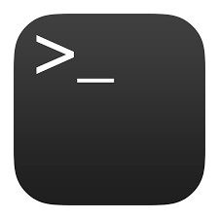
Mongo JS scripts
Before we start manipulating MongoDB from the server, let's just write some JavaScript files that will query MongoDb.
$ npm start
Data
Our Node script prints to console
No web servers are involved yet!

Slide 25
NodeJS Driver
To read and write to the MongoDB database from Node we'll be using the 'mongodb' library.
We will install via npm:
$ npm install --save mongodb
On the MongoDB website, this library is called the "MongoDB NodeJS Driver"

Slide 26
mongodb objects
The mongodb Node library provides objects to manipulate the database, collections, and documents:
Db: Database; can get collections using this object
Collection: Can get/insert/delete documents from this collection via calls like insertOne, find, etc.
Documents are not special classes; they are just JavaScript objects

Slide 27
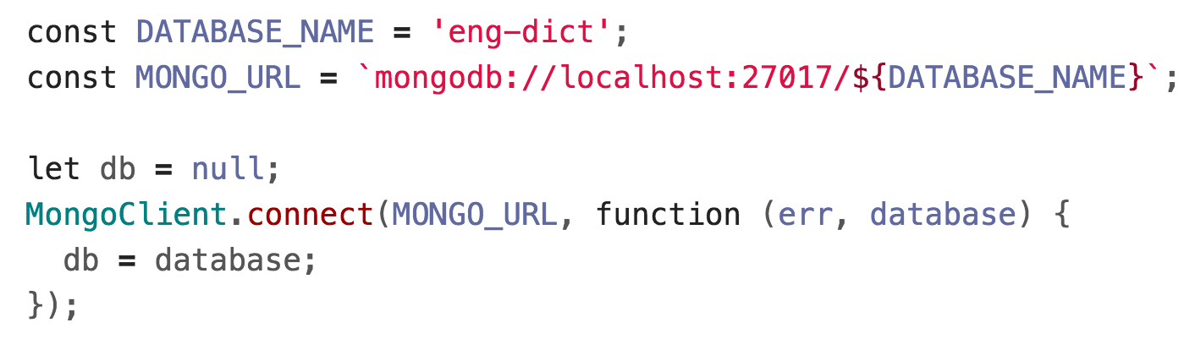
Getting a Db object
You can get a reference to the database object by using the MongoClient.connect(url, callback) function:
url is the connection string for the MongoDB server
callback is the function invoked when connected
  database parameter: the Db object

Slide 28
Connection string
The URL is to a MongoDB server, which is why it begins with mongodb:// and not http://
The MongoDB server is running on our local machine, which is why we use localhost
The end of the connection string specifies the database name we want to use.
  If a database of that name doesn't already exist, it will be created the first time we write to it.
MongoDB Connection string format

Slide 29
Callbacks and Promises
Every asynchronous MongoDB method has two versions:
Callback
Promise
The callback version of MongoClient.connect is:

Slide 30
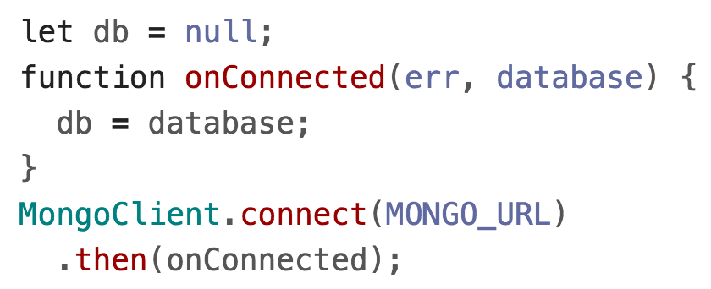
Callbacks and Promises
Every asynchronous MongoDB method has two versions:
Callback
Promise
The Promise version is:

Slide 31
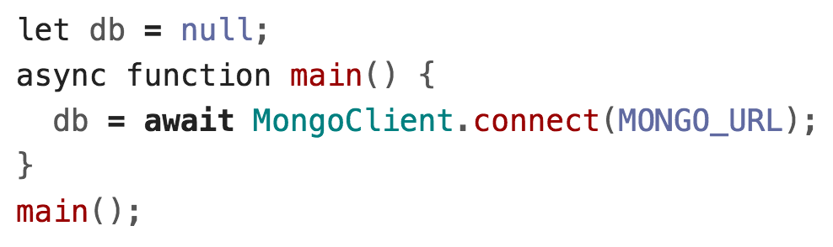
Callbacks and Promises
Every asynchronous MongoDB method has two versions:
Callback
Promise
The Promise + async/await version is:

Slide 32
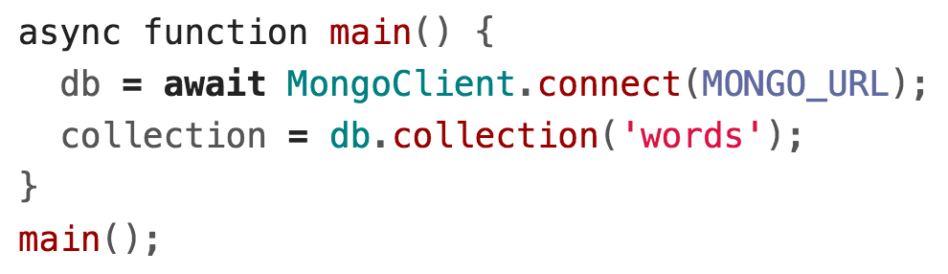
Using a collection
const coll = db.collection(collectionName);
Obtains the collection object named collectionName and stores it in coll
You do not have to create the collection before using it
  It will be created the first time we write to it
This function is synchronous

Slide 33
collection.insertOne (Callback)
collection.insertOne(doc, callback);
Adds one item to the collection
doc is a JavaScript object representing the key-value pairs to add to the collection
The callback fires when it has finished inserting
  The first parameter is an error object
  The second parameter is a result object, where result.insertedId will contain the id of the object that was created

Slide 34
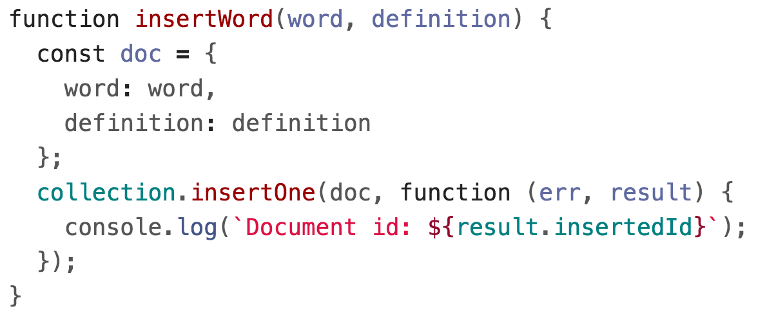
Callback version

Slide 35
collection.insertOne (Promise)
const result = await collection.insertOne(doc);
Adds one item to the collection
doc is a JavaScript object representing the key-value pairs to add to the collection
Returns a Promise that resolves to a result object when the insertion has completed
  result.insertedId will contain the id of the object that was created

Slide 36
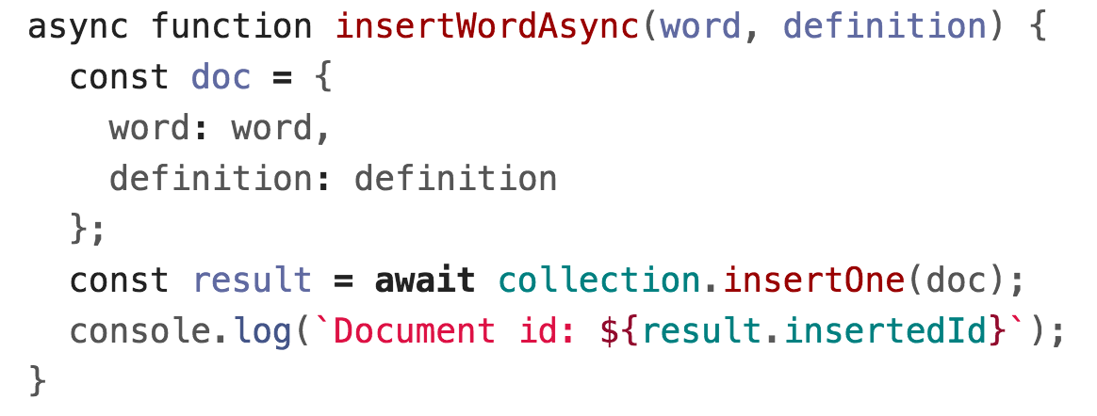
Promise version
We will be using the Promise + async/await versions of all the MongoDB asynchronous functions, as it will help us avoid callback hell

Slide 37
collection.findOne
const doc = await collection.findOne(query);
Finds the first item in the collection that matches the query
query is a JS object representing which fields to match on
Returns a Promise that resolves to a document object when findOne has completed
  doc will be the JS object, so you can access a field via doc.fieldName, e.g. doc._id
  If nothing is found, doc will be null

Slide 38
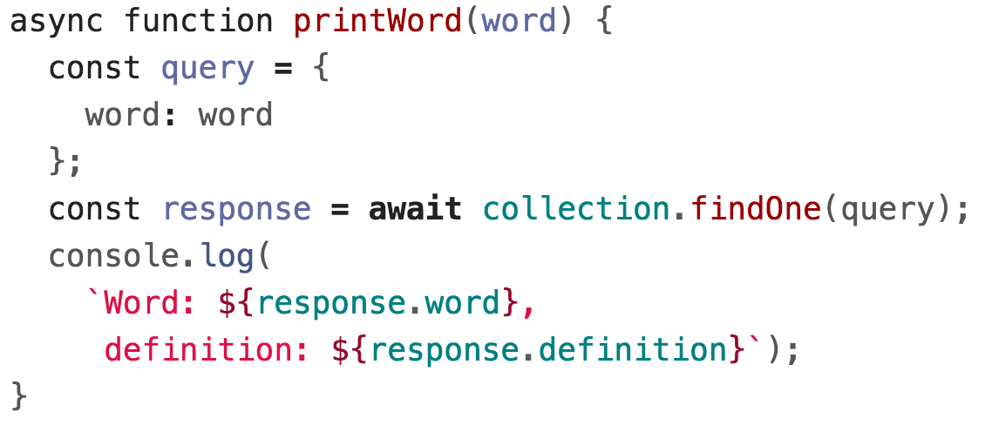
collection.findOne

Slide 39
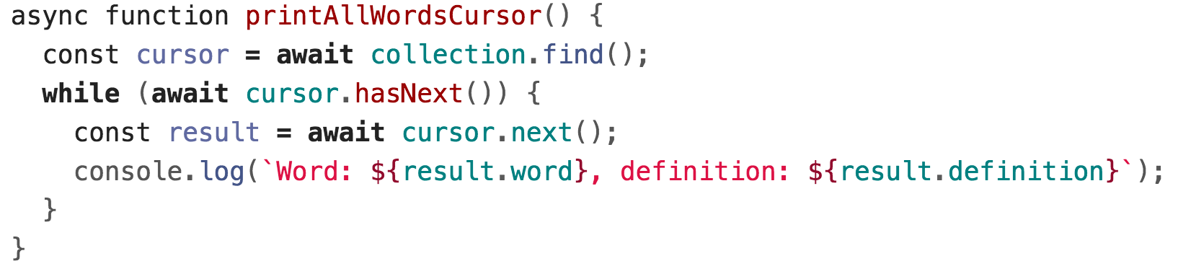
collection.find()
const cursor = await collection.find(query);
Returns a Cursor to pointing to the first entry of a set of documents matching the query
You can use hasNext and next to iterate through the list:
(This is an example of something that is a lot easier to do with async/await)

Slide 40
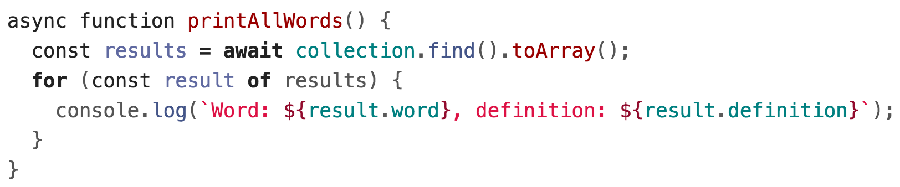
collection.find().toArray()
const cursor = await collection.find(query);
const list = await cursor.toArray();
Cursor also has a toArray() function that converts the results to an array

Slide 41
collection.update
await collection.update(query, newEntry);
Replaces the item matching query with newEntry
  (Note: This is the simplest version of update. There are more complex versions of update that we will address later.)

Slide 42
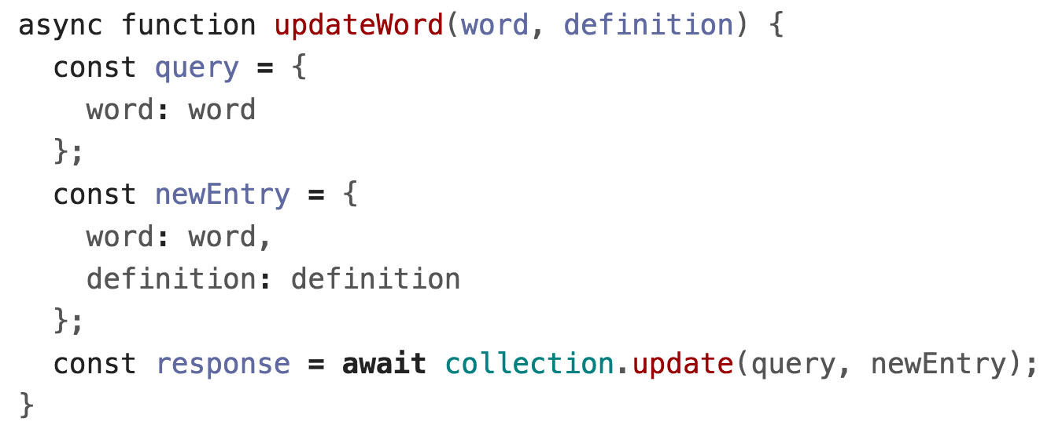
collection.update

Slide 43
"Upsert" with collection.update
MongoDB also supports "upsert", which is
Update the entry if it already exists
Insert the entry if it doesn't already exist
const params = { upsert: true };
await collection.update(query, newEntry, params);

Slide 44
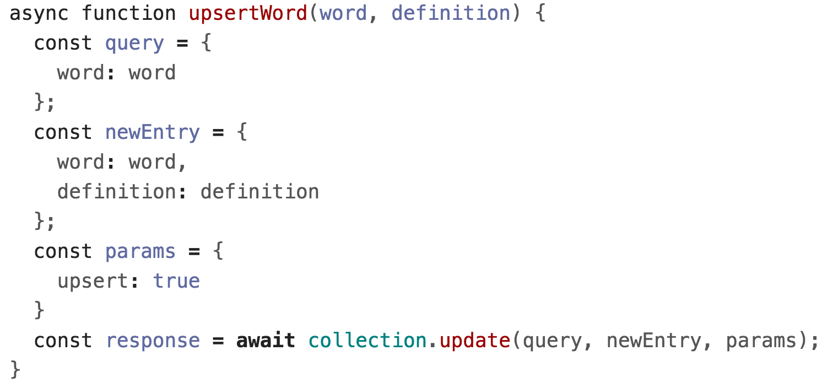
"Upsert" with collection.update

Slide 45
collection.deleteOne/Many
const result = await collection.deleteOne(query);
Deletes the first the item matching query
result.deletedCount gives the number of docs deleted
const result = await collection.deleteMany(query);
Deletes all items matching query
result.deletedCount gives the number of docs deleted
Use collection.deleteMany() to delete everything

Slide 46
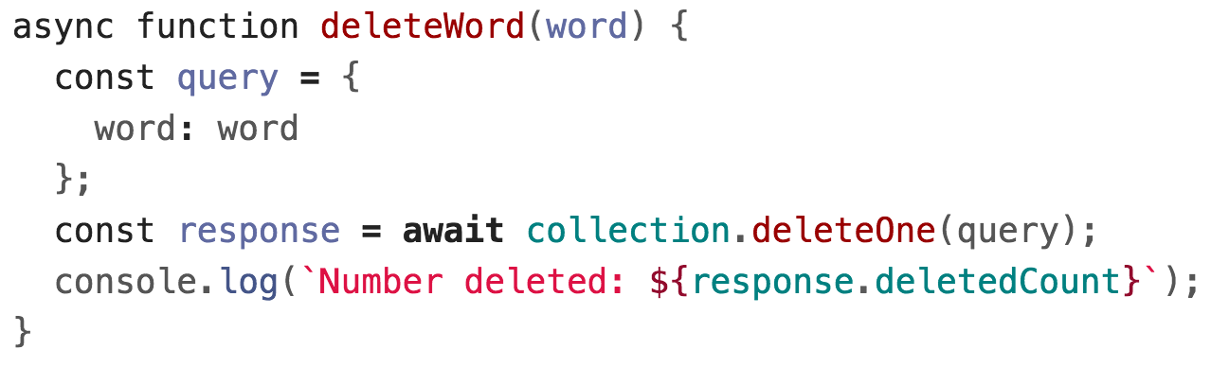
collection.deleteOne

Slide 47
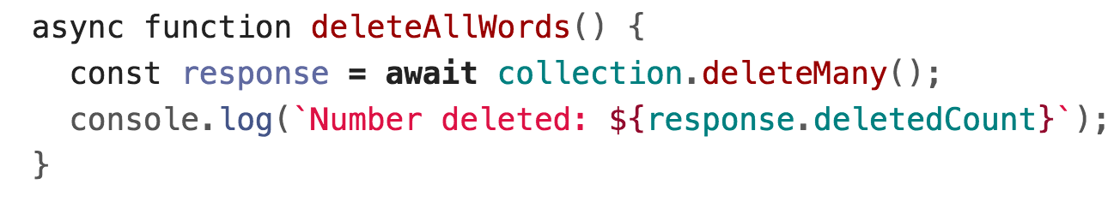
collection.deleteMany

Slide 48
Advanced queries
MongoDB has a very powerful querying syntax that we did not cover in these examples.
For more complex queries, check out:
Querying
  Query selectors and projection operators
  db.collection('inventory').find({ qty: { $lt: 30 } });
Updating
  Update operators
db.collection('words').updateOne(
{ word: searchWord },
{ $set: { definition: newDefinition }})

Slide 49
Using MongoDB in a server

Slide 50
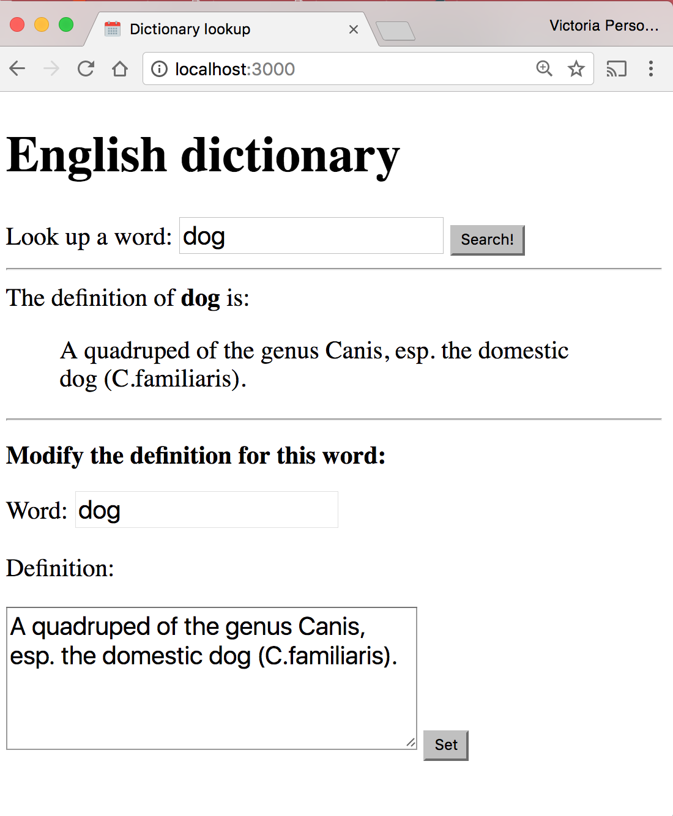
Dictionary with MongoDB
Let's change our Dictionary example to use a MongoDB backend instead of dictionary.json.

Slide 51
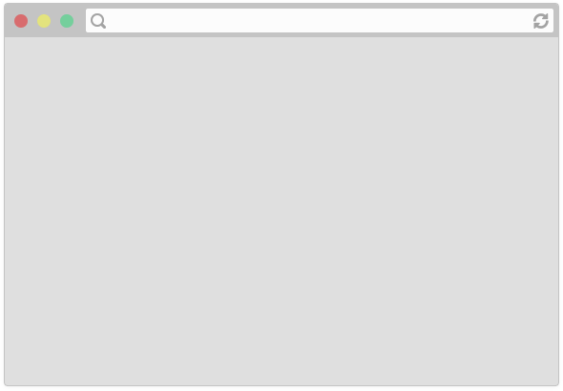

Review system
1
Server
Client
2
(Routing, etc…)
If we deployed our dictionary web app to abc.com:
The user navigates to abc.com
The browser makes an HTTP GET request for abc.com

Slide 52
Review system
Client
Server
3
(Routing, etc…)
4
3. The server computer that is located at abc.com receives the HTTP GET request
4. The server computer gives the NodeJS server process the HTTP GET request message

Slide 53

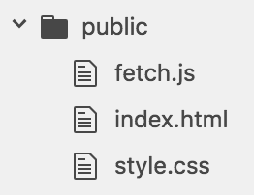
Review system
Server
"Does the 'public' folder have an 'index.html' file?
4
Our NodeJS server code has app.use(express.static('public')); so it will first look to see if an index.html file exists in the public directory.

Slide 54
Review system
Server
"Does the 'public' folder have an 'index.html' file?
Yes
5
5. Since there is an index.html file, our NodeJS server will respond with the index.html file

Slide 55
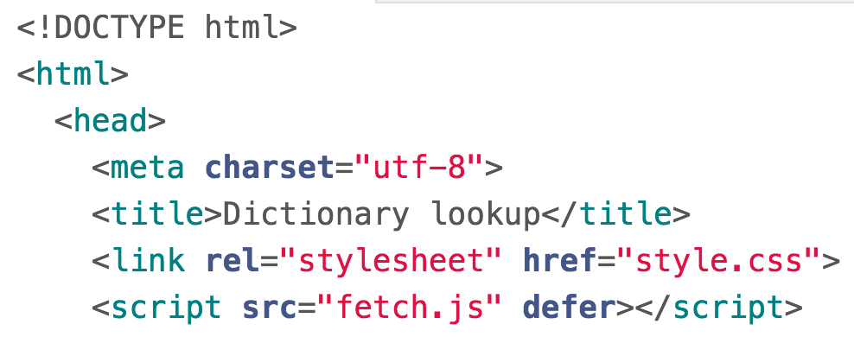
Review system
Client
Server
7
7
6
6
(Routing, etc…)
5
5. Our Node server program replies with the index.html file
6. The server computer sends back the index.html file
7. The browser receives the index.html file and begins to render it

Slide 56
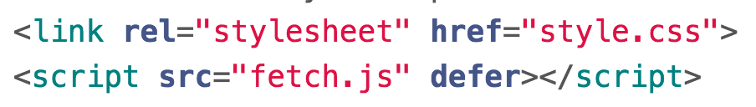
Review system
Client
8. In rendering the HTML, the browser sees it needs style.css and fetch.js

Slide 57
Review system
Client
Server
1
(Routing, etc…)
So the browser makes two more HTTP GET requests:
One for style.css
One for script.js

Slide 58
Review system
Client
Server
2
(Routing, etc…)
3
2. These GET requests get routed to the server computer
3. The server computer sends the GET requests to our NodeJS process

Slide 59
Review system
Server
4
4. Our NodeJS server code finds fetch.js and style.css in the public directory, so it responds with those files

Slide 60
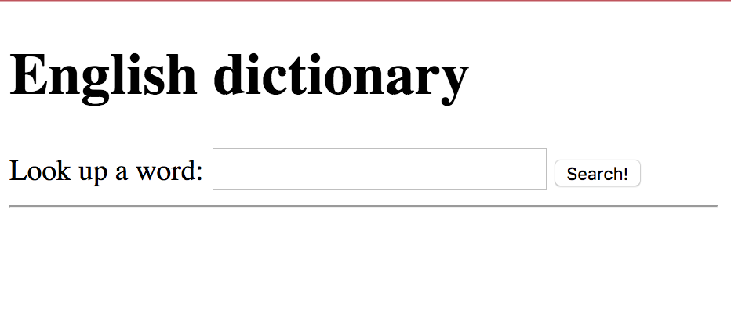
Review system
Client
Server
6
6
5
5
(Routing, etc…)
4
4. Our Node server program replies with the style.css and fetch.js files
5. The server computer sends these files back to the client
6. The browser receives the files and continues rendering index.html

Slide 61
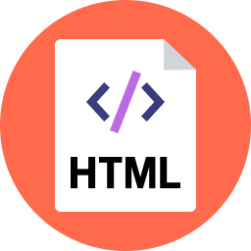
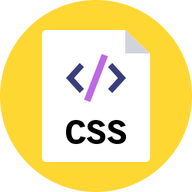
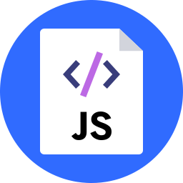
Review system
Client
Server
(Routing, etc…)
In this picture, there are two copies of index.html, style.css, and fetch.js:
The server computer has these files stored in its file system
The browser has just downloaded the files from the server

Slide 62
Review system
Client
Server
(Routing, etc…)
The server computer provided the files.
But the client computer is going to execute the files.
So the code in fetch.js is going to be run on the client, not on the server.

Slide 63
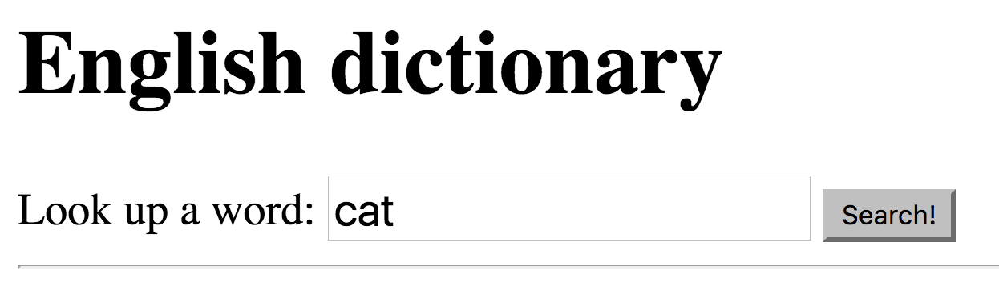
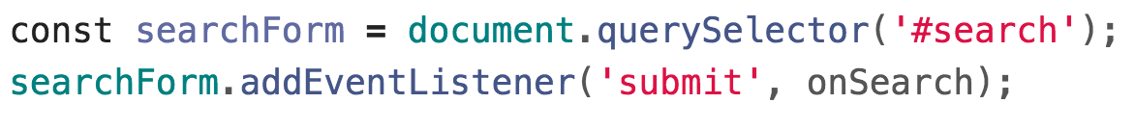
Review system
1
Client
The client has rendered the page and ran the JavaScript in fetch.js to attach the event listeners.
Then, when we enter a word and hit "Search"...

Slide 64
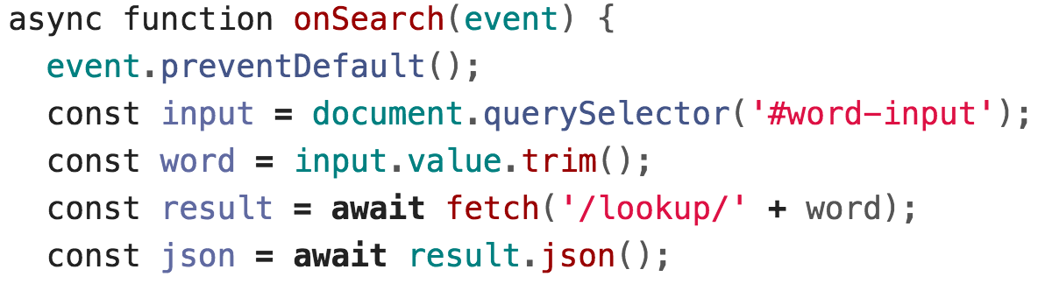
Review system
2
Client
2. ...the onSearch function is executed on the client.

Slide 65
Review system
3
Client
3. Our onSearch function includes a call to fetch(), which is going to trigger another HTTP GET request, this time for abc.com/lookup/cat.

Slide 66
Review system
Client
Server
4
(Routing, etc…)
4. Because of the call to fetch(), the browser makes an HTTP GET request for abc.com/lookup/cat.

Slide 67
Review system
Client
Server
5
(Routing, etc…)
7
5. These GET requests get routed to the server computer
6. The server computer sends the GET requests to our NodeJS process

Slide 68
Review system
7
Server
7. Our NodeJS server code first tries to see whether there's an "lookup/cat/index.html" in the public directory.

Slide 69
Review system
Server
8
8. "public/lookup/cat/index.html" doesn't exist, so now it sees whether there's a route that matches GET "/lookup/cat":
'/lookup/:word' matches, so onLookupWord is executed on the server

Slide 70
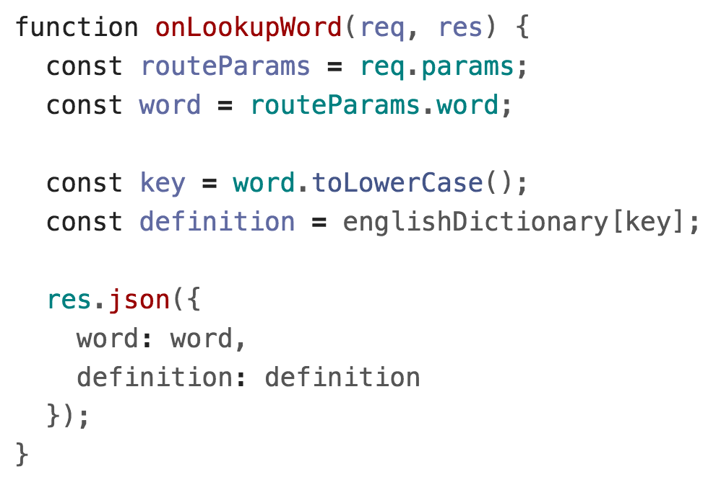
Review system
Server
9
9. In the version we wrote before, we get the definition from the JSON dictionary file that's also located on the server.
We'll change this to query MongoDB instead.

Slide 71
Review system
Client
12
Server
11
(Routing, etc…)
10
10. Our Node server program replies with JSON
11. The server computer sends JSON back to the client
12. The browser receives the JSON and continues executing the JavaScript

Slide 72
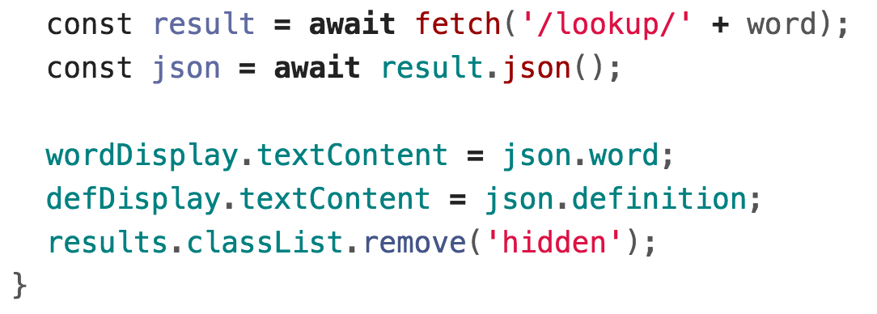
Review system
13
Client
13. The onSearch function continues executing with the JSON results and updates the client page.

Slide 73
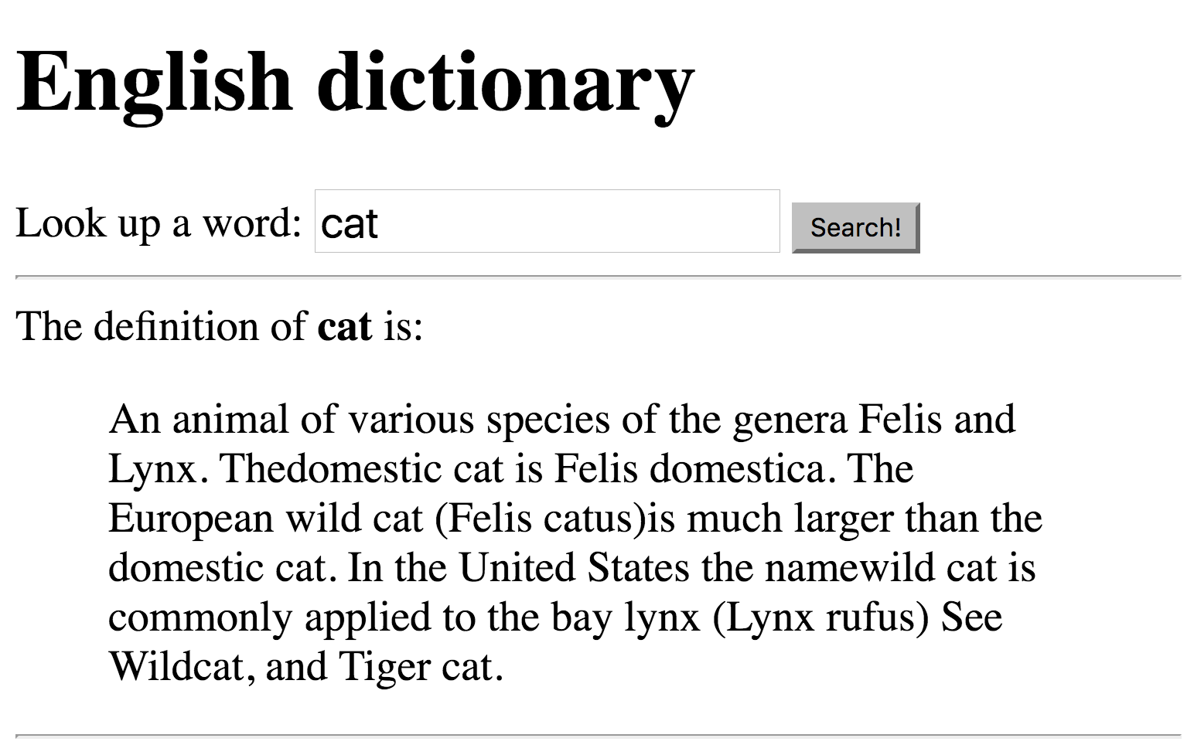
Review system
Client

Slide 74
Review system
Client
Server
(Routing, etc…)
The server generated the JSON with the word and definition.
The client consumed the JSON with the word and definition.

Slide 75
Using MongoDB in a server

Slide 76
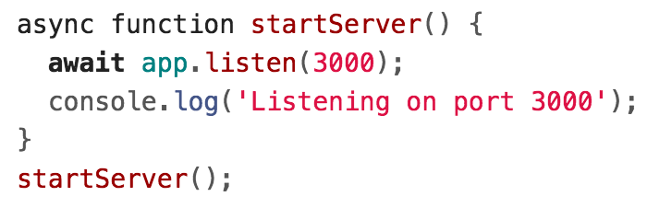
Starting a server: Before
(Previous code: This doesn't use MongoDB)

Slide 77
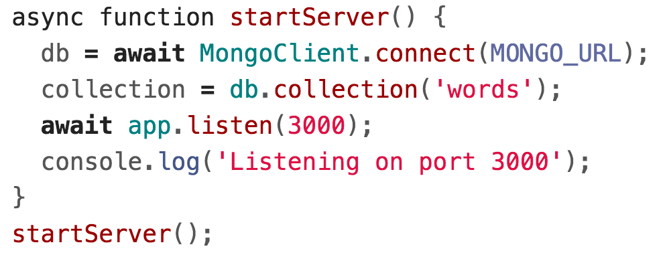
Starting a server: After

Slide 78
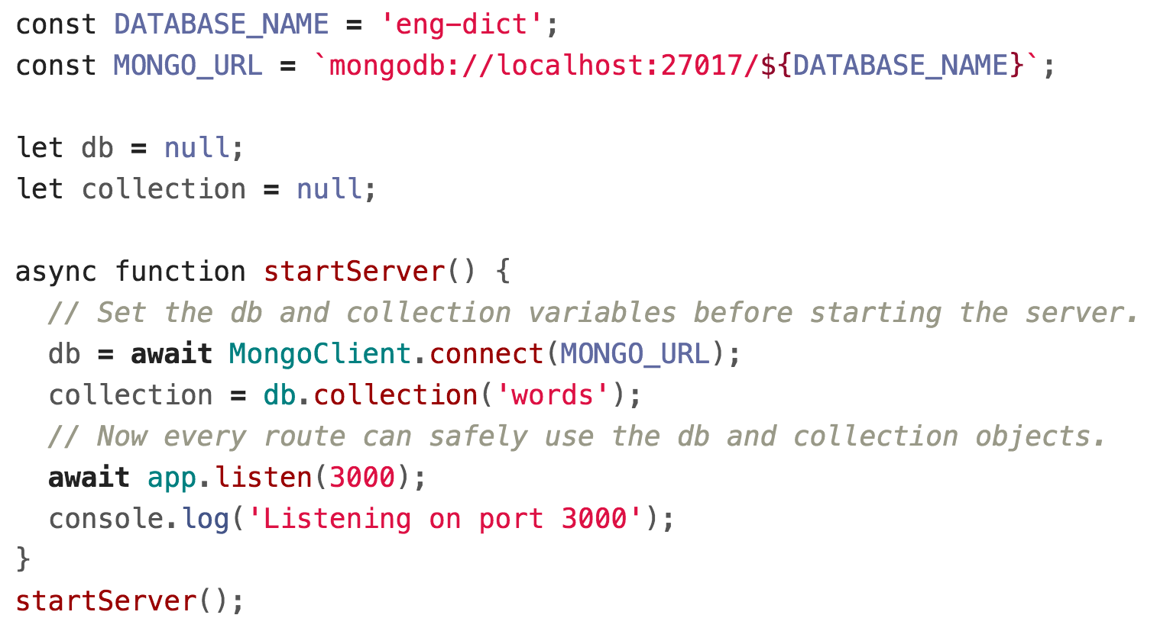
Starting a server: After

Slide 79
Example: Dictionary
We want our server to load definitions from the dictionary...

Slide 80
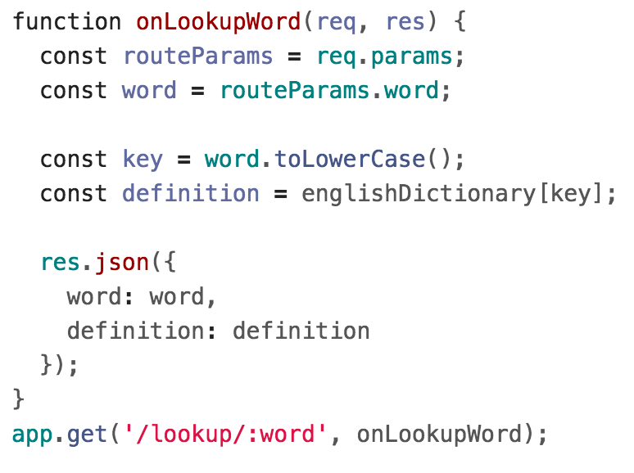
JSON Dictionary lookup
(Previous code: This doesn't use MongoDB)

Slide 81
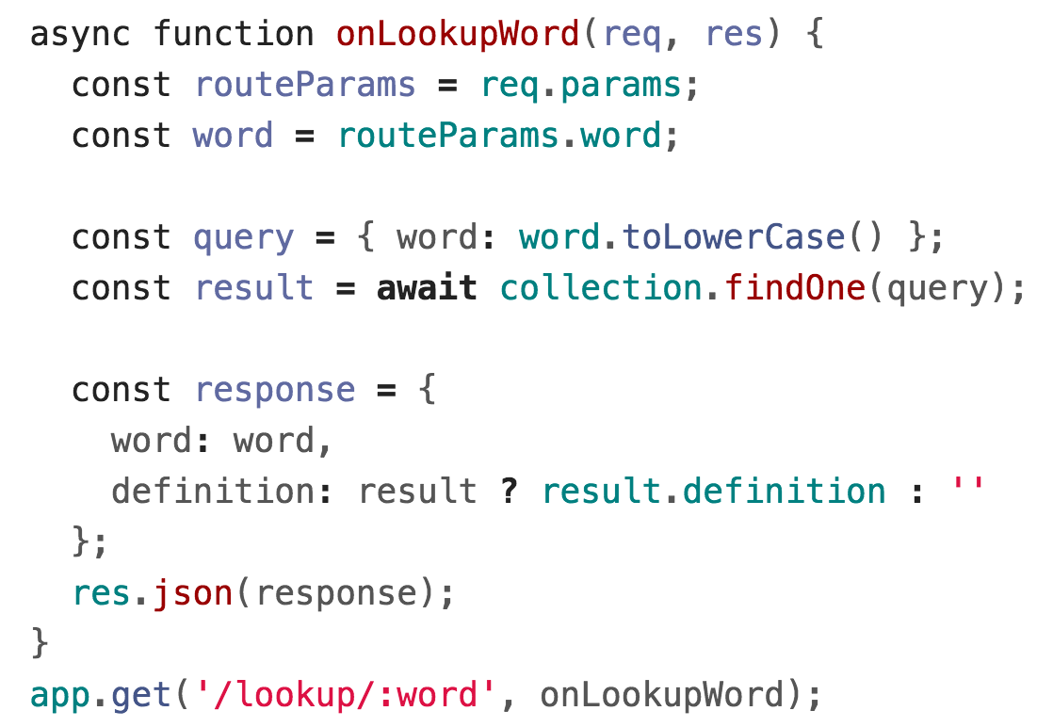
MongoDB Dictionary lookup

Slide 82
Dictionary with MongoDB
And we want to modify definitions in the dictionary:

Slide 83
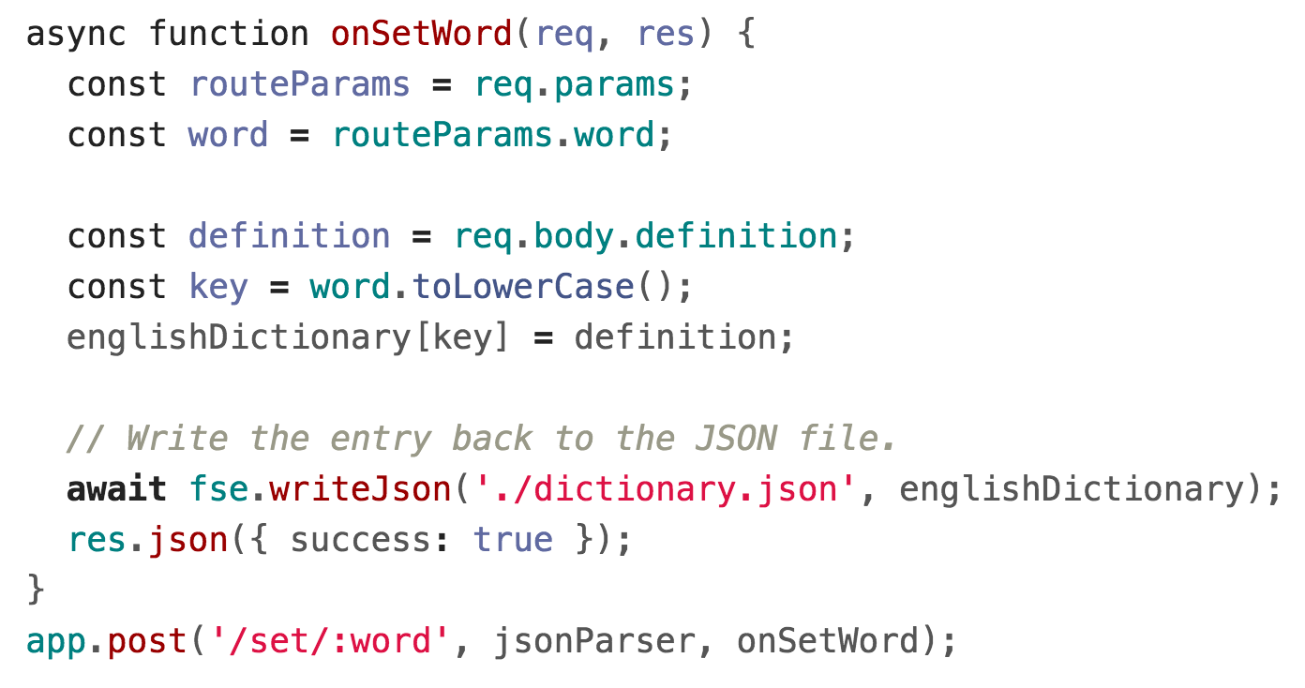
JSON Dictionary write
(Previous code: This doesn't use MongoDB)

Slide 84
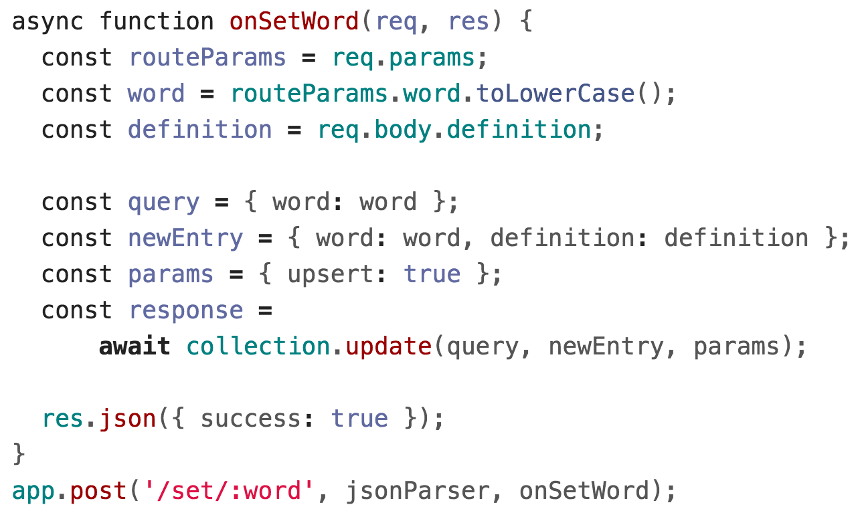
MongoDB Dictionary write

