Slide 1
4102165:
Full Stack Web Development Fundamentals
Spring 2019
簡立仁 Li-Ren Chien
ccumouse@gmail.com

Slide 2
var, let, const
Declare a variable in JS with one of three keywords:
Function scope variable:
var x = 15;
Block scope variable:
let fruit = 'banana';
Block scope constant (cannot be reassigned):
const isHungry = true;

Slide 3
What's a "block"?
In the context of programming languages, a block is a group of 0 or more statements, usually surrounded by curly braces. (wiki / mdn)
Also known as a compound statement
Not JavaScript-specific; exists in most languages (C++, Java, Python, etc)
Has absolutely nothing to do with the HTML/CSS notion of "block", i.e. block elements

Slide 4
What's a "block"?
For example, the precise definition of an if-statement might look like:
if (expression) statement
And a block might look like
{
console.log('Hello, world!');
console.log('Today is a good day.');
}
A "block" or compound statement is a type of statement, which is why we can execute multiple statements when the condition is true.

Slide 5
Blocks and scope
Most languages that include blocks also tie scoping rules to blocks, i.e. via "block scope":
// C++ code, not JS:
if (...) {
int x = 5;
...
}
// can't access x here
This is the behavior of Java, C++, C, etc.

Slide 6
Blocks and scope
This is also the behavior of JavaScript variables so long as you use const and let:
if (...) {
let x = 5;
...
}
// can't access x here

Slide 7
Blocks and scope
But if you use var, the variable exists for the entirety of the function, completely independent of blocks:
if (...) {
var x = 5;
...
}
// x is 5 here
This is the same behavior as Python, which also has function scope.
* Note that variable hoisting and function scope are not the same thing, either.

Slide 8
Blocks and scope
But if you use var, the variable exists for the entirety of the function, completely independent of blocks:
if (...) {
var x = 5;
...
}
// x is 5 here
This is the same behavior as Python, which also has function scope.
* Note that variable hoisting and function scope are not the same thing, either.
For more details, come to office hours!
In 193X we encourage you
to always use let and const,
so you don't need to understand
var very deeply anyway.

Slide 9
JavaScript language tour

Slide 10
Arrays
Arrays are Object types used to create lists of data.
// Creates an empty list
let list = [];
let groceries = ['milk', 'cocoa puffs'];
groceries[1] = 'kix';
0-based indexing
Mutable
Can check size via length property (not function)

Slide 11
Looping through an array
You can use the familiar for-loop to iterate through a list:
let groceries = ['milk', 'cocoa puffs', 'tea'];
for (let i = 0; i < groceries.length; i++) {
console.log(groceries[i]);
}
Or use a for-each loop via for...of (mdn):
(intuition: for each item of the groceries list)
for (let item of groceries) {
console.log(item);
}

Slide 12
Maps through Objects
Every JavaScript object is a collection of property-value pairs. (We'll talk about this more later.)
Therefore you can define maps by creating Objects:
// Creates an empty object
const prices = {};
const scores = {
'peach': 100,
'mario': 88,
'luigi': 91
};
console.log(scores['peach']); // 100

Slide 13
Maps through Objects
FYI, string keys do not need quotes around them.
Without the quotes, the keys are still of type string.
// This is the same as the previous slide.
const scores = {
peach: 100,
mario: 88,
luigi: 91
};
console.log(scores['peach']); // 100

Slide 14
Maps through Objects
There are two ways to access the value of a property:
objectName[property]
objectName.property
(2 only works for string keys.)
const scores = {
peach: 100,
mario: 88,
luigi: 91
};
console.log(scores['peach']); // 100
console.log(scores.luigi); // 91

Slide 15
Maps through Objects
There are two ways to access the value of a property:
objectName[property]
objectName.property
(2 only works for string keys.)
const scores = {
peach: 100,
mario: 88,
luigi: 91
};
console.log(scores['peach']); // 100
scores.luigi = 87;
console.log(scores.luigi); // 91
Generally prefer style (2), unless the property is stored in a variable, or if the property is not a string.

Slide 16
Maps through Objects
To add a property to an object, name the property and give it a value:
const scores = {
peach: 100,
mario: 88,
luigi: 91
};
scores.toad = 72;
let name = 'wario';
scores[name] = 102;
console.log(scores);

Slide 17
Maps through Objects
To remove a property to an object, use delete:
const scores = {
peach: 100,
mario: 88,
luigi: 91
};
scores.toad = 72;
let name = 'wario';
scores[name] = 102;
delete scores.peach;
console.log(scores);

Slide 18
Iterating through Map
Iterate through a map using a for...in loop (mdn):
(intuition: for each key in the object)
for (key in object) {
// … do something with object[key]
}
for (let name in scores) {
console.log(name + ' got ' + scores[name]);
}
You can't use for...in on lists; only on object types
You can't use for...of on objects; only on list types

Slide 19
Events

Slide 20

Event-driven programming
Most JavaScript written in the browser is event-driven:
The code doesn't run right away, but it executes after some event fires.
Example:
Here is a UI element that the user can interact with.
Click Me!

Slide 21
Event-driven programming
Most JavaScript written in the browser is event-driven:
The code doesn't run right away, but it executes after some event fires.
Click Me!
When the user clicks the button...

Slide 22
Event-driven programming
Most JavaScript written in the browser is event-driven:
The code doesn't run right away, but it executes after some event fires.
EVENT!
Click Me!
...the button emits an "event," which is like an announcement that some interesting thing has occurred.

Slide 23
Event-driven programming
Most JavaScript written in the browser is event-driven:
The code doesn't run right away, but it executes after some event fires.
EVENT!
function onClick() {
...
}
Click Me!
Any function listening to that event now executes. This function is called an "event handler."

Slide 24
Quick aside…
Let's learn some input-related
HTML elements

Slide 25



A few more HTML elements
Buttons:
Single-line text input:
Multi-line text input:

Slide 26

Using event listeners
Let's print "Clicked" to the Web Console when the user clicks the given button:
We need to add an event listener to the button...
Q: How do we access an element in HTML from JavaScript?

Slide 27
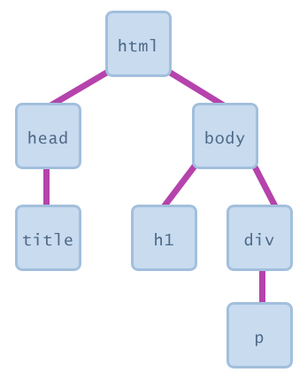
The DOM
Every element on a page is accessible in JavaScript through the DOM: Document Object Model
<html>
<head>
<title></title>
</head>
<body>
<h1></h1>
<div>
<p></p>
</div>
</body>
</html>

Slide 28
The DOM
The DOM is a tree of node objects corresponding to the HTML elements on a page.
JS code can examine these nodes to see the state of an element
  (e.g. to get what the user typed in a text box)
JS code can edit the attributes of these nodes to change the attributes of an element
  (e.g. to toggle a style or to change the contents of an <h1> tag)
JS code can add elements to and remove elements from a web page by adding and removing nodes from the DOM

Slide 29
How do we access a DOM object from JavaScript?

Slide 30
Getting DOM objects
We can access an HTML element's corresponding DOM node in JavaScript via the querySelector function:
document.querySelector('css selector');
Returns the first element that matches the given CSS selector.
And via the querySelectorAll function:
document.querySelectorAll('css selector');
Returns all elements that match the given CSS selector.

Slide 31
Getting DOM objects
// Returns the DOM object for the HTML element
// with id="button", or null if none exists.
let element = document.querySelector('#button');
// Returns a list of DOM objects containing all
// elements that have a "quote" class AND all
// elements that have a "comment" class.
let elementList =
document.querySelectorAll('.quote, .comment');

Slide 32
Adding event listeners
Each DOM object has the following method defined:
addEventListener(event name, function name);
event name is the string name of the JavaScript event you want to listen to
  Common ones: click, focus, blur, etc
function name is the name of the JavaScript function you want to execute when the event fires

Slide 33
Removing event listeners
To stop listening to an event, use removeEventListener:
removeEventListener(event name, function name);
event name is the string name of the JavaScript event to stop listening to
function name is the name of the JavaScript function you no longer want to execute when the event fires

Slide 34
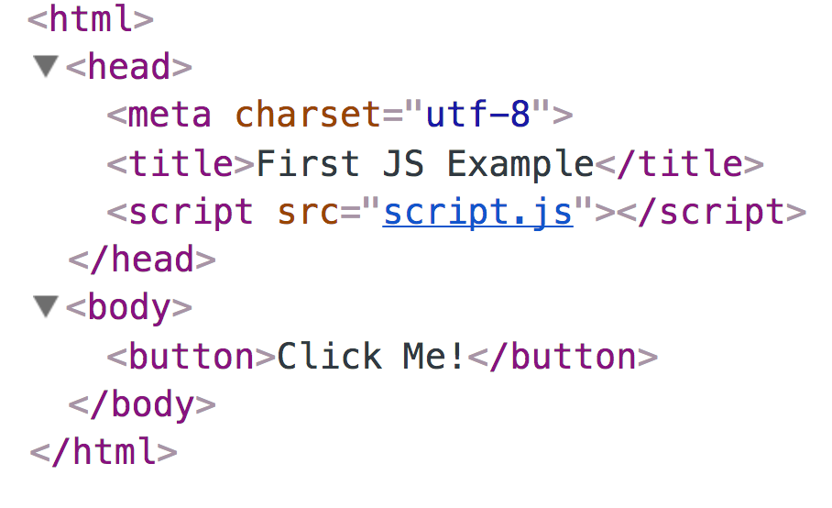
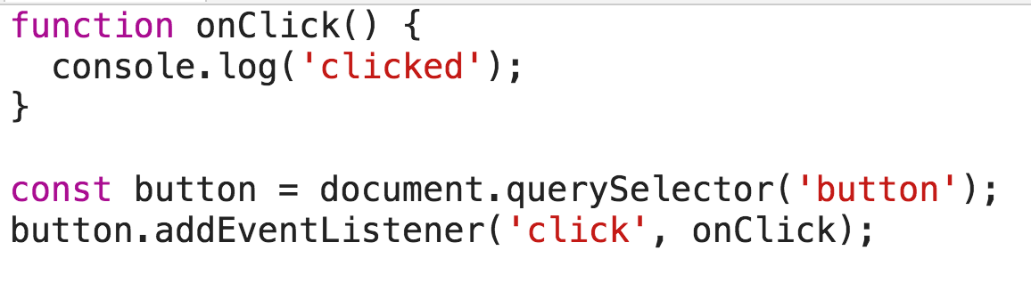

Slide 35
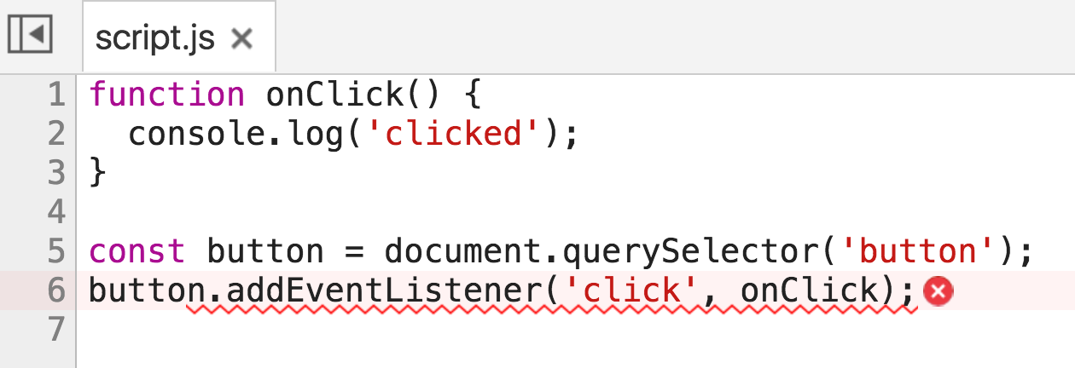
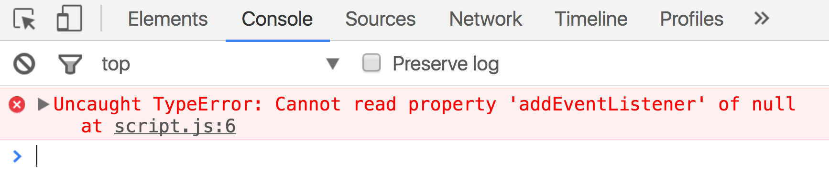
Error! Why?

Slide 36

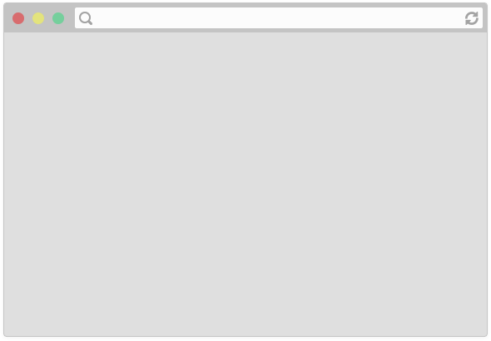

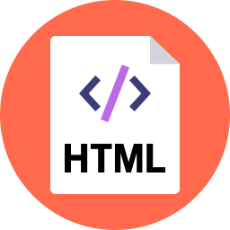
<head>
<title>CS 193X</title>
<link rel="stylesheet" href="style.css" />
<script src="script.js"></script>
</head>

Slide 37
<head>
<title>CS 193X</title>
<link rel="stylesheet" href="style.css" />
<script src="script.js"></script>
</head>

Slide 38
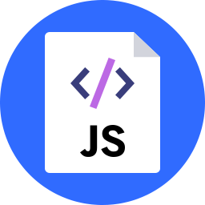
<head>
<title>CS 193X</title>
<link rel="stylesheet" href="style.css" />
<script src="script.js"></script>
</head>

Slide 39
<head>
<title>CS 193X</title>
<link rel="stylesheet" href="style.css" />
<script src="script.js"></script>
</head>
function onClick() {
console.log('clicked');
}
const button = document.querySelector('button');
button.addEventListener('click', onClick);

Slide 40
<head>
<title>CS 193X</title>
<link rel="stylesheet" href="style.css" />
<script src="script.js"></script>
</head>
function onClick() {
console.log('clicked');
}
const button = document.querySelector('button');
button.addEventListener('click', onClick);

Slide 41
<head>
<title>CS 193X</title>
<link rel="stylesheet" href="style.css" />
<script src="script.js"></script>
</head>
function onClick() {
console.log('clicked');
}
const button = document.querySelector('button');
button.addEventListener('click', onClick);
We are only at the <script> tag, which is at the top of the document… so the <button> isn't available yet.

Slide 42
<head>
<title>CS 193X</title>
<link rel="stylesheet" href="style.css" />
<script src="script.js"></script>
</head>
function onClick() {
console.log('clicked');
}
const button = document.querySelector('button');
button.addEventListener('click', onClick);
Therefore querySelector returns null, and we can't call addEventListener on null.

Slide 43
Use defer
You can add the defer attribute onto the script tag so that the JavaScript doesn't execute until after the DOM is loaded (mdn):
<script src="script.js" defer></script>

Slide 44
Use defer
You can add the defer attribute onto the script tag so that the JavaScript doesn't execute until after the DOM is loaded (mdn):
<script src="script.js" defer></script>
Other old-school ways of doing this (don't do these):
Put the <script> tag at the bottom of the page
Listen for the "load" event on the window object
You will see tons of examples on the internet that do this. They are out of date. defer is widely supported and better.

Slide 45
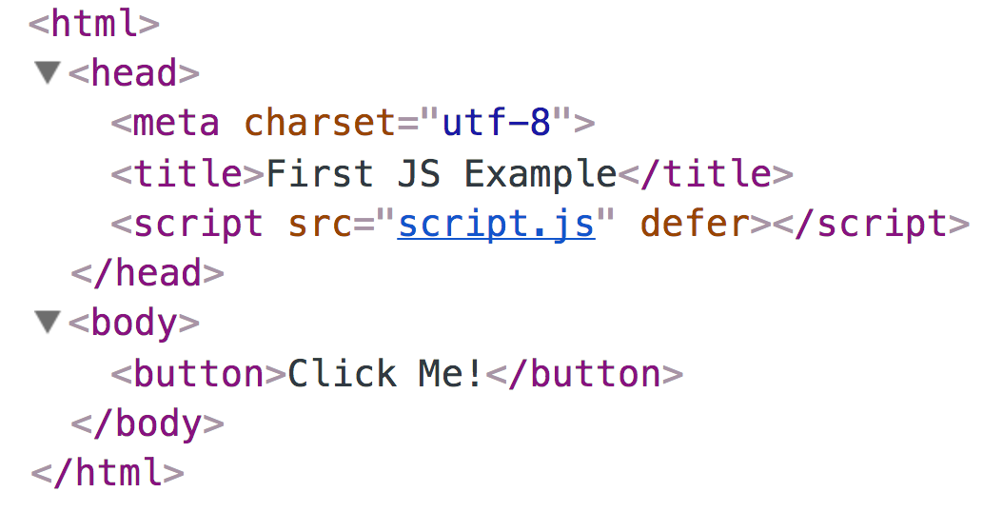
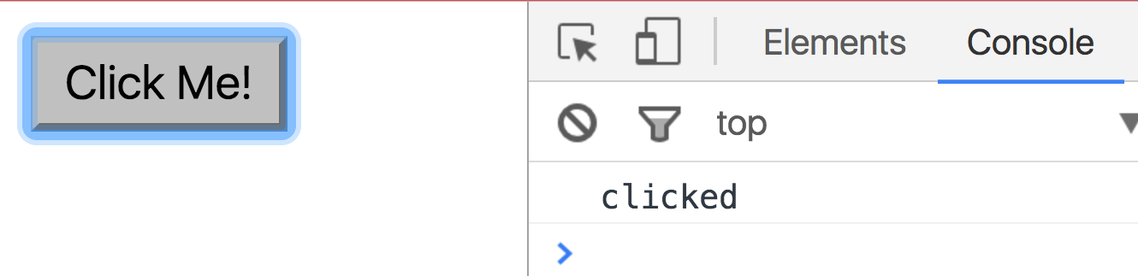

Slide 46
Log messages aren't so interesting...

Slide 47
How do we interact with the page?

Slide 48
Attributes and DOM properties
Roughly every attribute on an HTML element is a property on its respective DOM object...
HTML
<img src="puppy.png" />
JavaScript
const element = document.querySelector('img');
element.src = 'bear.png';
(But you should always check the JavaScript spec to be sure. In this case, check the HTMLImageElement.)

Slide 49
A few technical details
The DOM objects that we retrieve from querySelector and querySelectorAll have types:
Every DOM node is of general type Node (an interface)
Element implements the Node interface
(FYI: This has nothing to do with NodeJS, if you've heard of that)
Each HTML element has a specific Element derived class, like HTMLImageElement

Slide 50
Adding and removing classes
You can control classes applied to an HTML element via classList.add and classList.remove:
const image = document.querySelector('img');
// Adds a CSS class called "active".
image.classList.add('active');
// Removes a CSS class called "hidden".
image.classList.remove('hidden');
(More on classList)

Slide 51
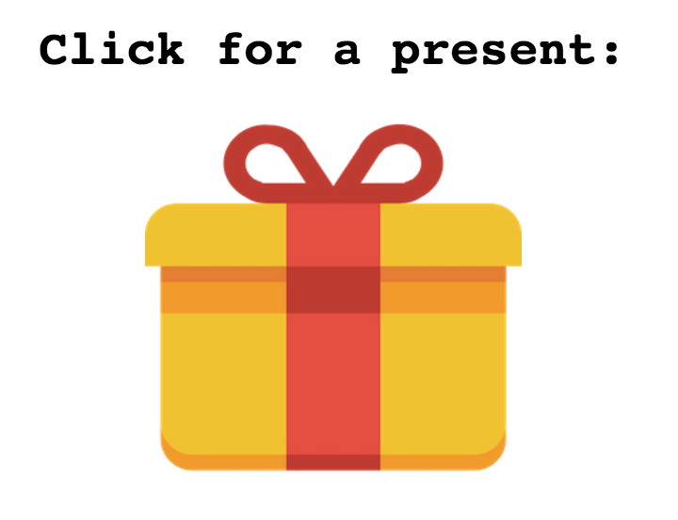
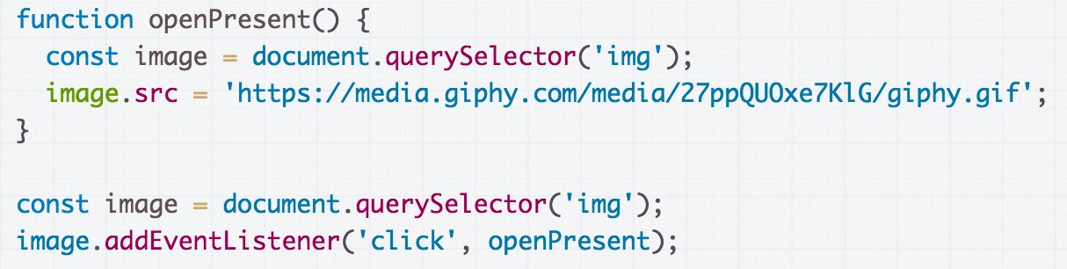
Example: Present
See the CodePen -
much more exciting!

Slide 52
Finding the element twice...
This redundancy is unfortunate.
Q: Is there a way to fix it?

Slide 53
Finding the element twice...
This redundancy is unfortunate.
Q: Is there a way to fix it? CodePen

Slide 54
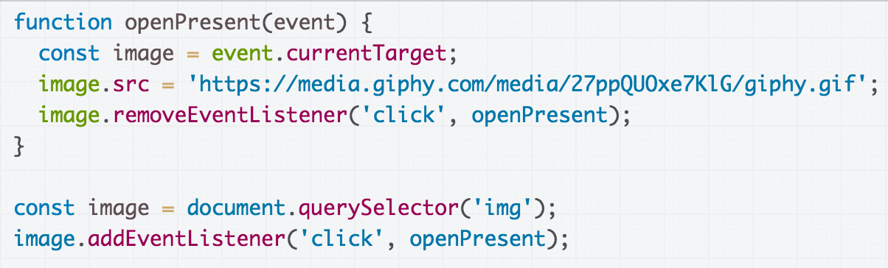
Event.currentTarget
An Event element is passed to the listener as a parameter:
The event's currentTarget property is a reference to the object that we attached to the event, in this case the <img>'s Element to which we added the listener.

Slide 55
Psst.. Not to be confused with Event.target
(Note: Event has both:
event.target: the element that was clicked / "dispatched the event" (might be a child of the target)
event.currentTarget: the element that the original event handler was attached to)

Slide 56

Example: Present
It would be nice to change the text after the present is "opened"...

Slide 57
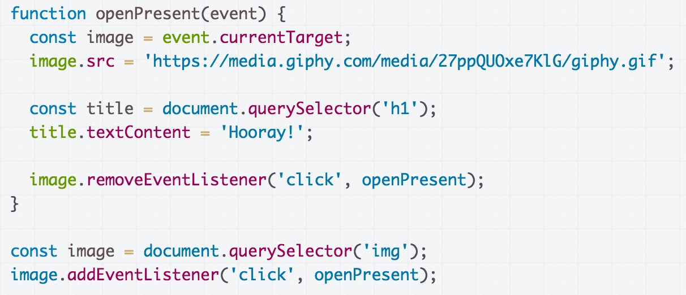
We can select the h1 element then set its textContent to change what is displayed in the h1. (CodePen)

Slide 58
Another approach:
Changing the elements

Slide 59
Add elements via DOM
We can create elements dynamically and add them to the web page via createElement and appendChild:
document.createElement(tag string)
element.appendChild(element);
Technically you can also add elements to the webpage via innerHTML, but it poses a security risk.
// Try not to use innerHTML like this:
element.innerHTML = '<h1>Hooray!</h1>';

Slide 60
Remove elements via DOM
We can also call remove elements from the DOM by calling the remove() method on the DOM object:
element.remove();
And actually setting the innerHTML of an element to an empty string is a fine way of removing all children from a parent node:
// This is fine and poses no security risk.
element.innerHTML = '';

Slide 61
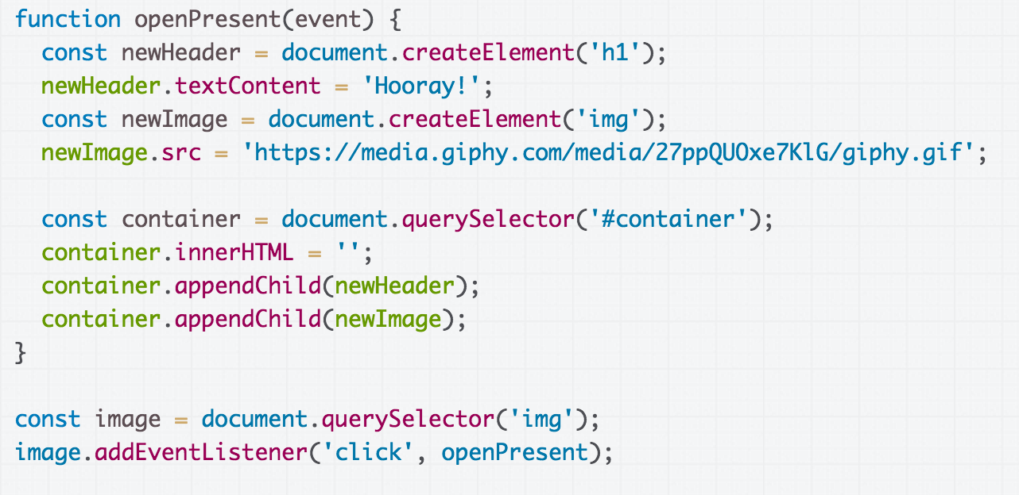
CodePen

Slide 62

Hmm, the effect is slightly janky though:
The text changes faster than the image loads.
Q: How do we fix this issue?

Slide 63
display: none;
There is yet another super helpful value for display:
display: block;
display: inline;
display: inline-block;
display: flex;
display: none;
display: none; turns off rendering for the element and all its children. It's treated as if the element were not in the document at all...

Slide 64
display: none;
There is yet another super helpful value for display:
display: block;
display: inline;
display: inline-block;
display: flex;
display: none;
display: none; turns off rendering for the element and all its children. It's treated as if the element were not in the document at all…
...but the content (such as the images) is still loaded.

Slide 65
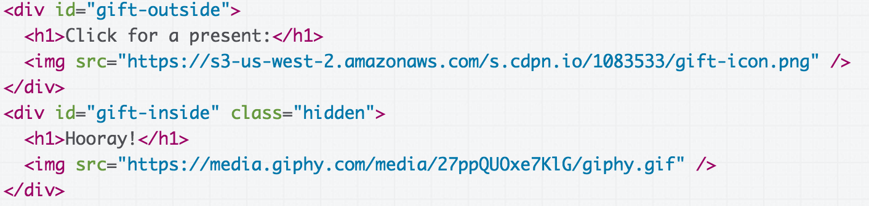
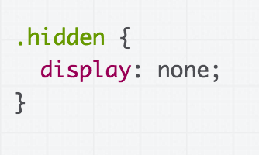
We can add both views to the HTML, with one view hidden by default… (CodePen)

Slide 66
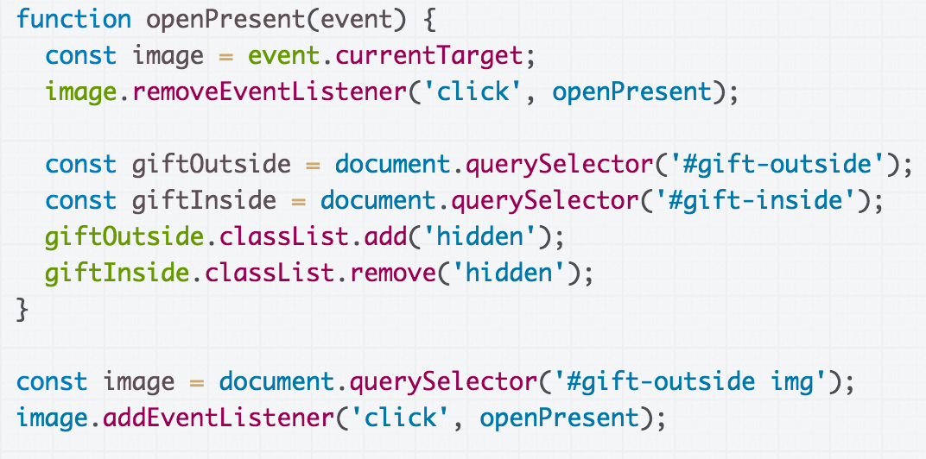
Then we toggle the display state of the containers by adding/removing the hidden class.
(CodePen)

Slide 67
Recap
Several strategies for updating HTML elements in JS:
1. Change content of existing HTML elements in page:
Good for simple text updates
2. Add elements via createElement and appendChild
Needed if you're adding a variable number of elements
3. Put all "views" in the HTML but set inactive ones to hidden, then update display state as necessary.
Good when you know ahead of time what element(s) you want to display
Can be used in conjunction with (1) and/or (2)

