Slide 1
4102165:
Full Stack Web Development Fundamentals
Spring 2019
簡立仁 Li-Ren Chien
ccumouse@gmail.com

Slide 2
Today's schedule
Today
JS Events, again
Finish Tic-Tac-Toe
DOM revisited
Hacks and mischief
Next (probably)
Animations
Mobile events
Next Next (probably)
Classes and objects in JavaScript
this keyword and bind

Slide 3
JavaScript events in detail

Slide 4
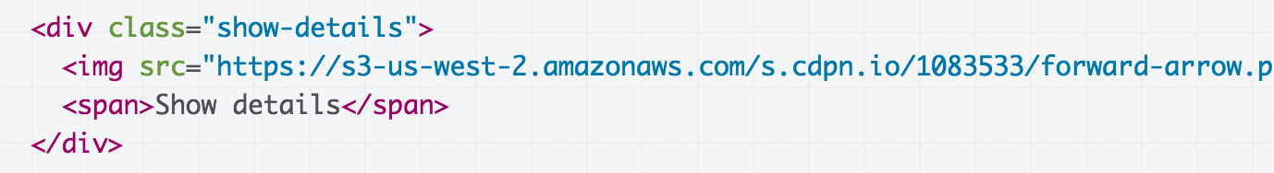
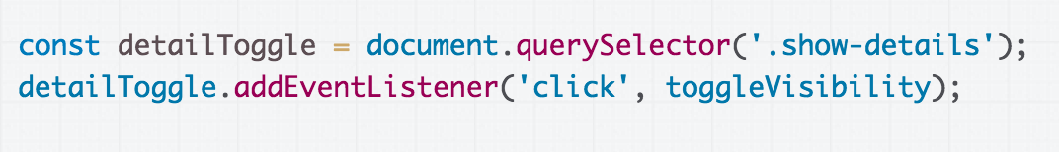
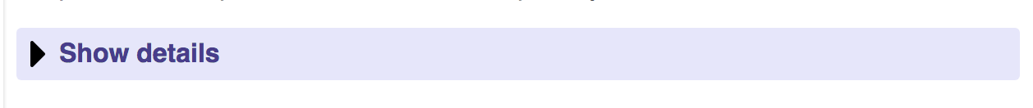
Events in JavaScript
If you put a "click" event listener on an element, what happens if the user clicks a child of that element?

Slide 5
Events in JavaScript
Example: If you click on the <img>, will the toggleVisibility function fire? (CodePen)

Slide 6

Events in JavaScript
Yes, a click event set on an element will fire if you click on a child of that element
If you put a click event listener on the div, and the user clicks on the img inside that div, then the event listener will still fire.
(CodePen)

Slide 7
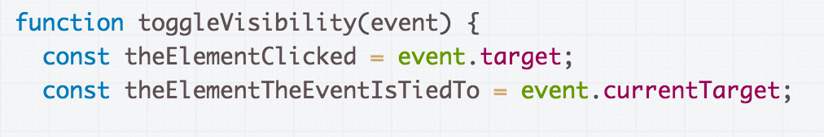
Event.currentTarget vs target
You can access either the element clicked or the element to which the event listener was attached:
event.target: the element that was clicked / "dispatched the event" (might be a child of the target)
event.currentTarget: the element that the original event handler was attached to

Slide 8
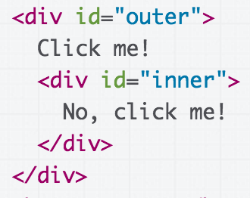
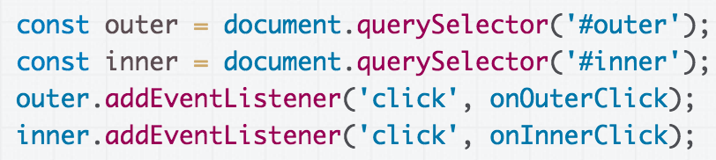
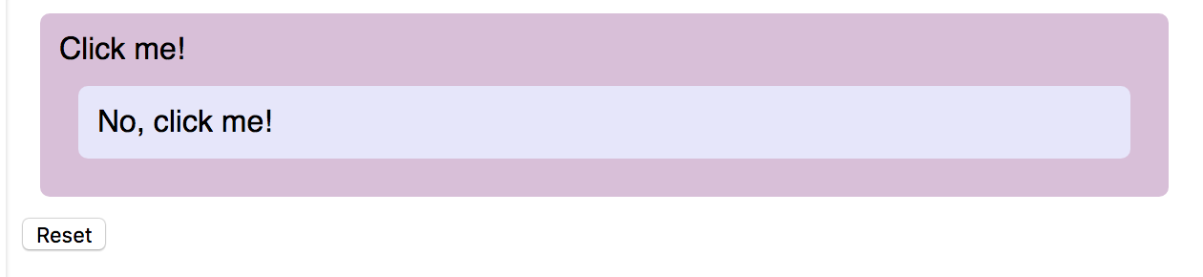
Multiple event listeners
What if you have event listeners set on both an element and a child of that element?
Do both fire?
Which fires first?
(Codepen)

Slide 9
Event bubbling
Both events fire if you click the inner element
By default, the event listener on the inner-most element fires first
div id="outer"
div id="inner"
This event ordering (inner-most to outer-most) is known as bubbling. (CodePen)

Slide 10
Event bubbling
Both events fire if you click the inner element
By default, the event listener on the inner-most element fires first
div id="outer"
div id="inner"
This event ordering (inner-most to outer-most) is known as bubbling. (CodePen)

Slide 11
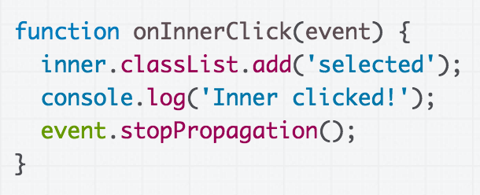
stopPropagation()
We can stop the event from bubbling up the chain of ancestors by using event.stopPropagation():
See default behavior vs with stopPropagation

Slide 12
Event capturing
To make event propagation go the opposite direction, add a 3rd parameter to addEventListener:
event.addEventListener(
'click', onClick, { capture: true} );
div id="outer"
div id="inner"
This event ordering (outer-most to inner-most) is known as capturing. (CodePen)

Slide 13
Event capturing
To make event propagation go the opposite direction, add a 3rd parameter to addEventListener:
event.addEventListener(
'click', onClick, { capture: true} );
div id="outer"
div id="inner"
This event ordering (outer-most to inner-most) is known as capturing. (CodePen)

Slide 14
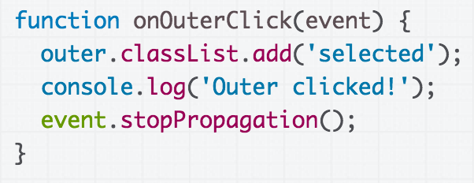
stopPropagation()
We can also use event.stopPropagation() in capture-order:
See default behavior vs with stopPropagation

Slide 15
Some technical details...

Slide 16
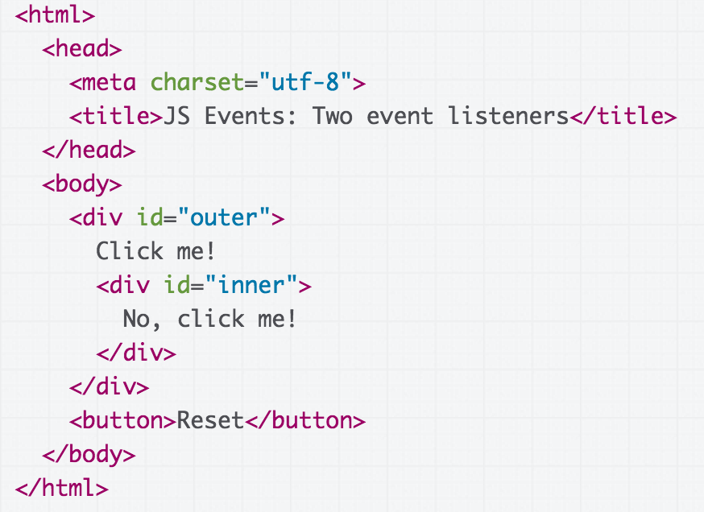
Behind the scenes
Technically, the browser will go through both a capture phase and a bubbling phase when an event occurs:
If we click on the div with id="inner"...

Slide 17
Behind the scenes
The browser creates the target's"propagation path," or the list of its ancestors up to root (w3c)
(target meaning the thing you clicked; not necessarily the element the event listener is attached to)
html
html
html
body
div id="outer"
div id="inner"

Slide 18
"Capture phase"
The browser begins at the top of the propagation path and invokes any event listeners that have capture="true", in path order until it gets to the target. This is the "capture phase" (w3c)
html
body
div id="outer"
div id="inner"

Slide 19
"Target phase"
Then the browser invokes any event listener that was set on the target itself. This is the "target phase" (w3c)
html
html
html
body
div id="outer"
div id="inner"

Slide 20
"Bubble phase"
If the event type has bubbles=true (see click, e.g.) the browser goes back up the propagation path in reverse order and invokes any event listener that wasn't supposed to fire on capture. This is the "bubble phase" (w3c)
html
html
html
body
div id="outer"
div id="inner"

Slide 21
stopPropagation()
Therefore stopPropagation() actually stops the rest of the 3-phase dispatch from executing
html
html
html
body
div id="outer"
div id="inner"

Slide 22
In Practice
Don't worry about:
You never need to use capture order - you can always use bubbling
You don't really need to know how the browser goes through "capture phase", "target phase", then "bubble phase"
Do worry about:
You do need to understand bubbling, though
stopPropagation() also comes in handy

Slide 23
Case Study: Tic-Tac-Toe

Slide 24

Example: Tic Tac Toe
Let's try to implement a game of Tic-Tac-Toe. (finished)

Slide 25
Tic Tac Toe plan
Every time we click on an empty space, change the empty space in an "X" by adding an image of an "x" into the empty <div>
After our turn, the computer puts an "O" in a random empty space
When there are 3 Xs or 3 Os in a row, declare a winner: We need to understand where the clicked element is logically positioned in the game
Step 2 complete

Slide 26
Distinguishing boxes
When the click event fires, how do we know where in the board the event's currentTarget is positioned?
?

Slide 27
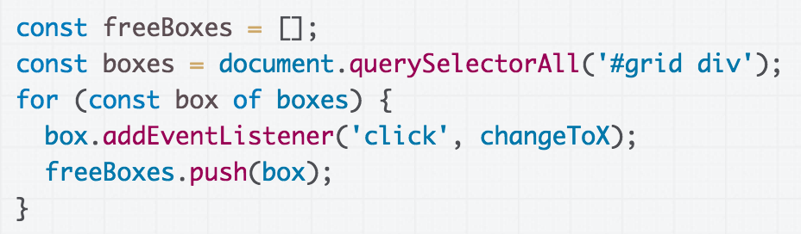
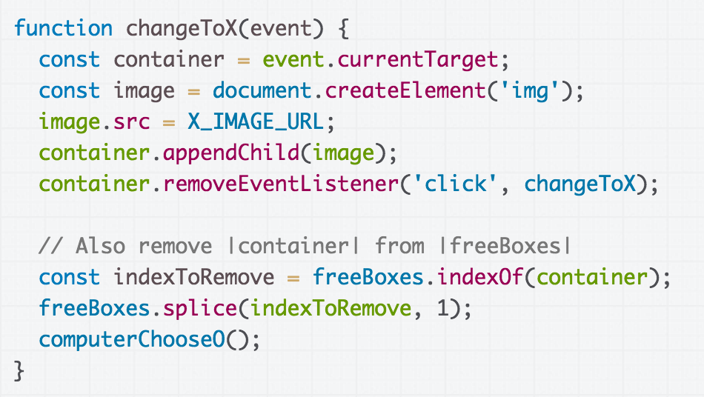
Distinguishing boxes
The same event handler is called for each element...

Slide 28
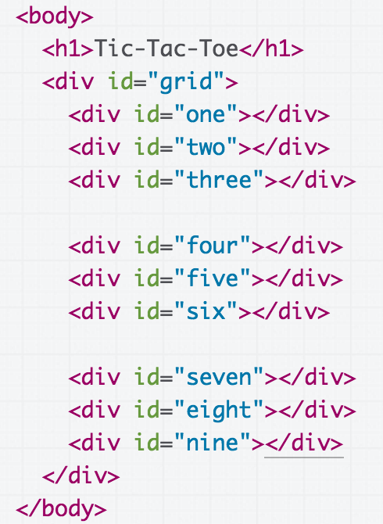
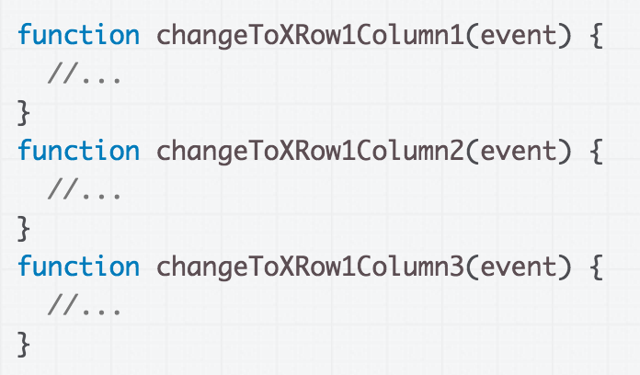
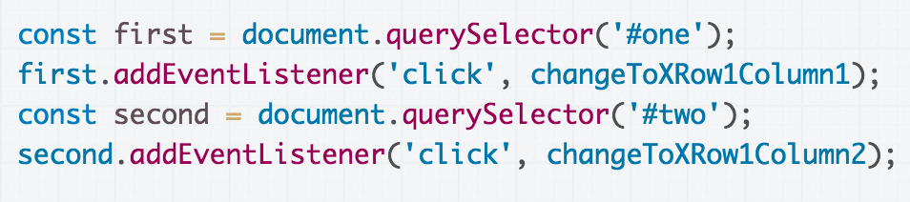
Terrible idea: 9 event handlers

Slide 29
Uniquely identifying items
But this idea of uniquely identifying squares is a good one!

Slide 30
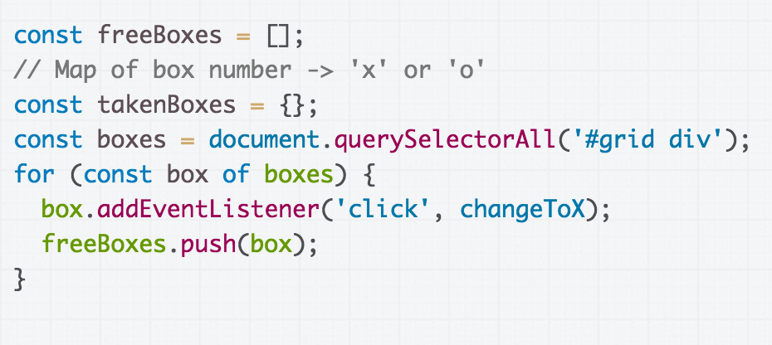
Solution
Add another state variable, takenBoxes, that maps box number to who owns the box

Slide 31
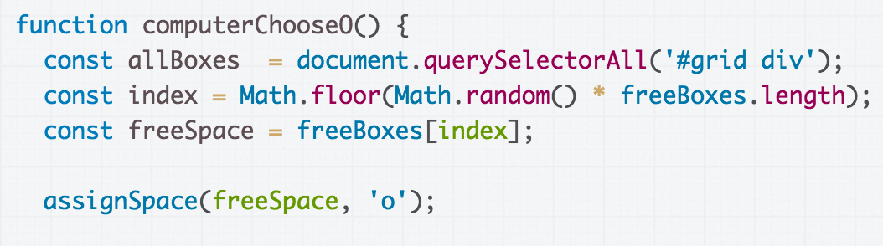
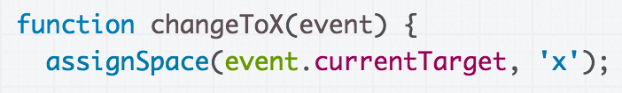
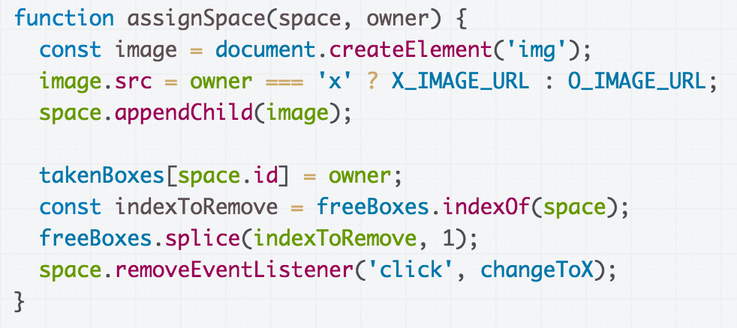
Update takenBoxes with the owner each time a space is assigned.

Slide 32
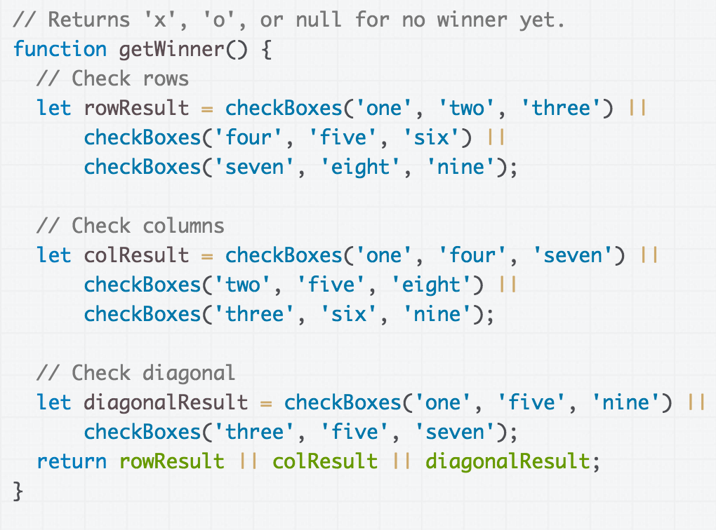
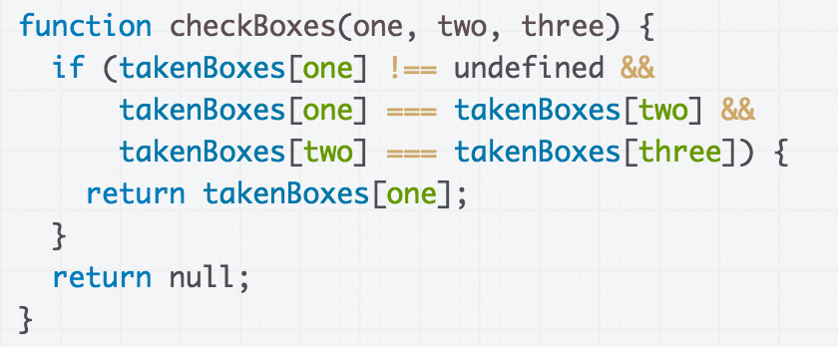
Find winner by checking rows, columns and diagonal spaces
(CodePen)

Slide 33
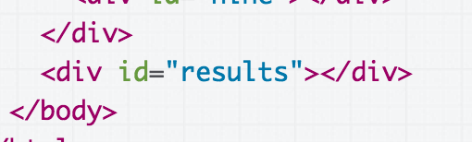
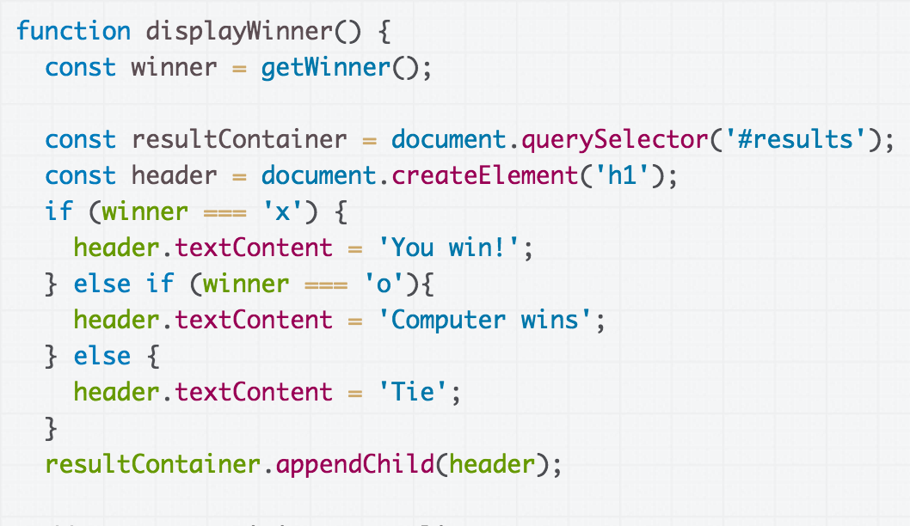
Create a results div and add results to the div (CodePen)

Slide 34
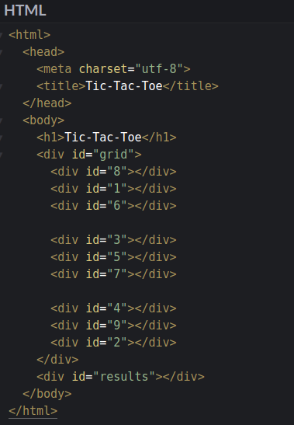
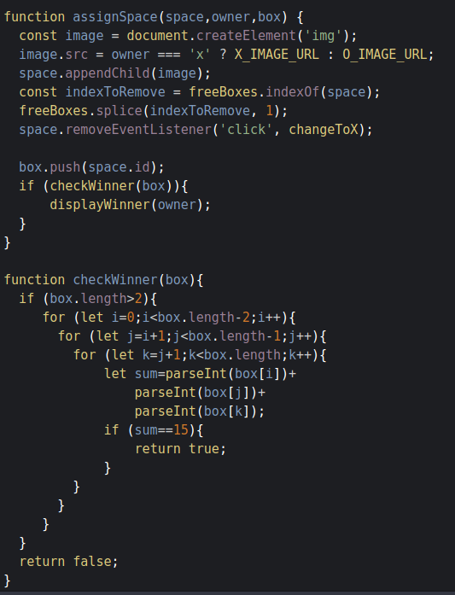
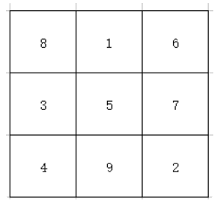
Solution – Magic Number 15
Codepen

Slide 35
Attach "data" to divs?
Wouldn't it be nicer if we could operate on numbers instead of string ids?
But we can't have numeric IDs…
Is there some way to attach additional "data" to an element?

Slide 36
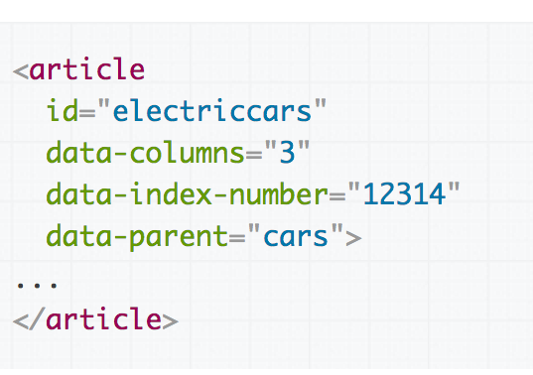
Data attributes
You can assign special data-* attributes to HTML elements to give associate additional data with the element.
data-your-name="Your Value"

Slide 37
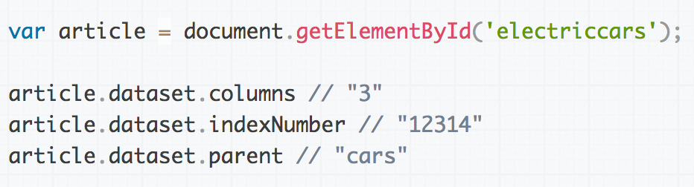
Data attributes in JavaScript
You can access your custom-defined data attributes via the dataset object on the DOM object:
Dash-separated words turn to camel case, e.g. data-index-number in HTML is dataset.indexNumber in JS
Aside: Data attributes are returned as strings, but you can cast them to Number via parseInt

Slide 38
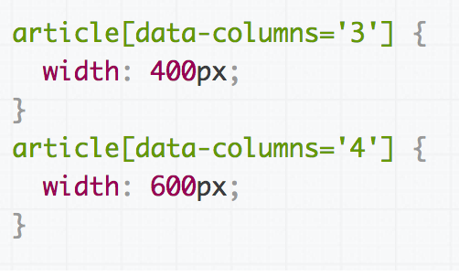
Data attributes in CSS
You can also style data attributes in CSS:
[data-variable-name] or
[data-variable-name='value'] or
element[data-variable-name] etc

Slide 39
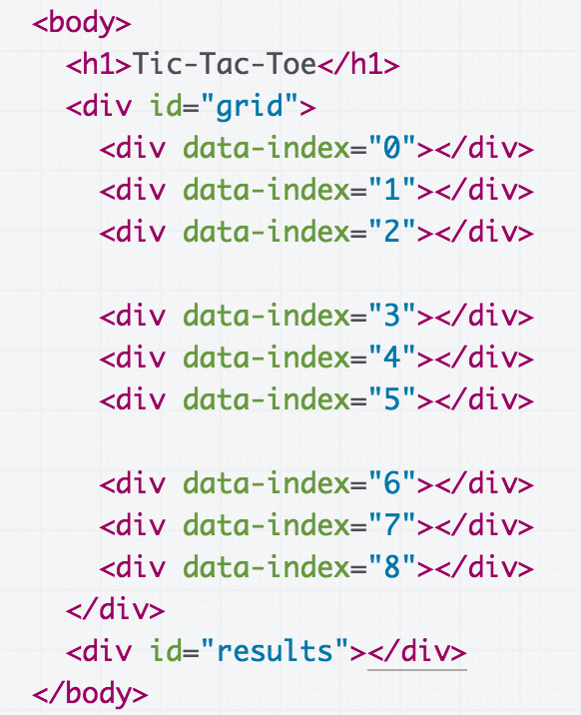
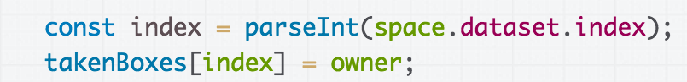
Final Solution Codepen

Slide 40
Understanding the DOM

Slide 41
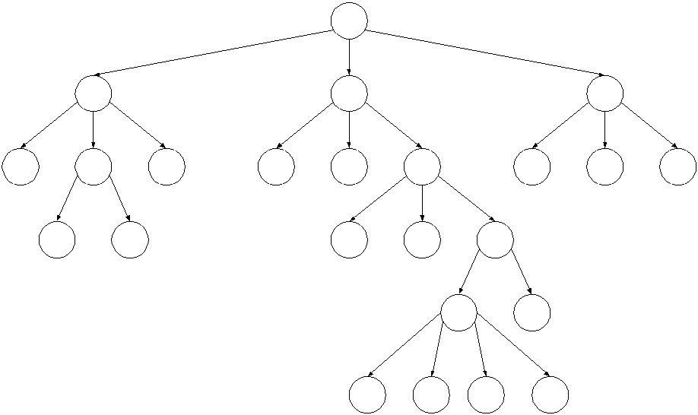
DOM Nodes
If the DOM is a tree composed of Nodes…
Q: Does that mean a Node in the DOM has child pointers like the trees?

Slide 42
DOM Nodes
If the DOM is a tree composed of Nodes…
Q: Does that mean a Node in the DOM has child pointers like the trees?

Slide 43
Node properties
Property | Description
textContent | The text content of a node and its descendants. (This property is writeable)
childNodes | An array of this node's children (empty if a leaf)
parentNode | A reference to this node's parent Node
<body>
<h1>My favorites</h1>
<section>
<p>Strawberries</p>
<p>Chocolate</p>
</section>
</body>
What's the parentNode of <section>?

Slide 44
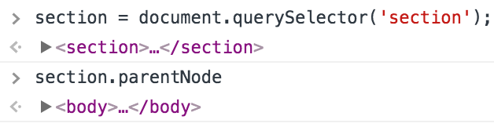
parentNode
<body>
<h1>My favorites</h1>
<section>
<p>Strawberries</p>
<p>Chocolate</p>
</section>
</body>
The parentNode of <section> is <body>.
What are the childNodes of <section>?

Slide 45
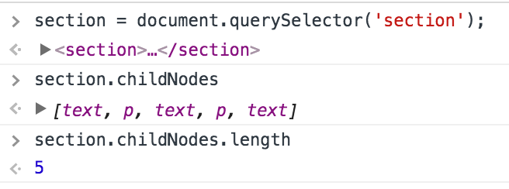
childNodes
???
<body>
<h1>My favorites</h1>
<section>
<p>Strawberries</p>
<p>Chocolate</p>
</section>
</body>
Why does section have 5 children, not 2?!

Slide 46
TextNode
In addition to Element nodes, the DOM also contains Text nodes. All text present in the HTML, including whitespace, is contained in a text node:
<body>
<h1>My favorites</h1>
<section>
<p>Strawberries</p>
<p>Chocolate</p>
</section>
</body>

Slide 47
TextNode
In addition to Element nodes, the DOM also contains Text nodes. All text present in the HTML, including whitespace, is contained in a text node:
<body>
<h1>My favorites</h1>
<section>
<p>Strawberries</p>
<p>Chocolate</p>
</section>
</body>

Slide 48
DOM and Text nodes
The DOM is composed of Nodes, and there are several subtypes of Node.
Element: HTML (or SVG) elements in the DOM
Text: Text content in the DOM, including whitespace
  Text nodes cannot contain children (are always leafs)
Comment: HTML comments
(more)
The type of a node is stored in the nodeType property

Slide 49
Traversing the DOM
Q: How would we print out all nodes in the DOM?

Slide 50
What's the point?
If we have document.querySelector that lets us get elements in the DOM…
And if we can change the HTML as necessary to add classes/ids/elements/etc to select the right things…
Q: When would we ever want to traverse the DOM?

Slide 51

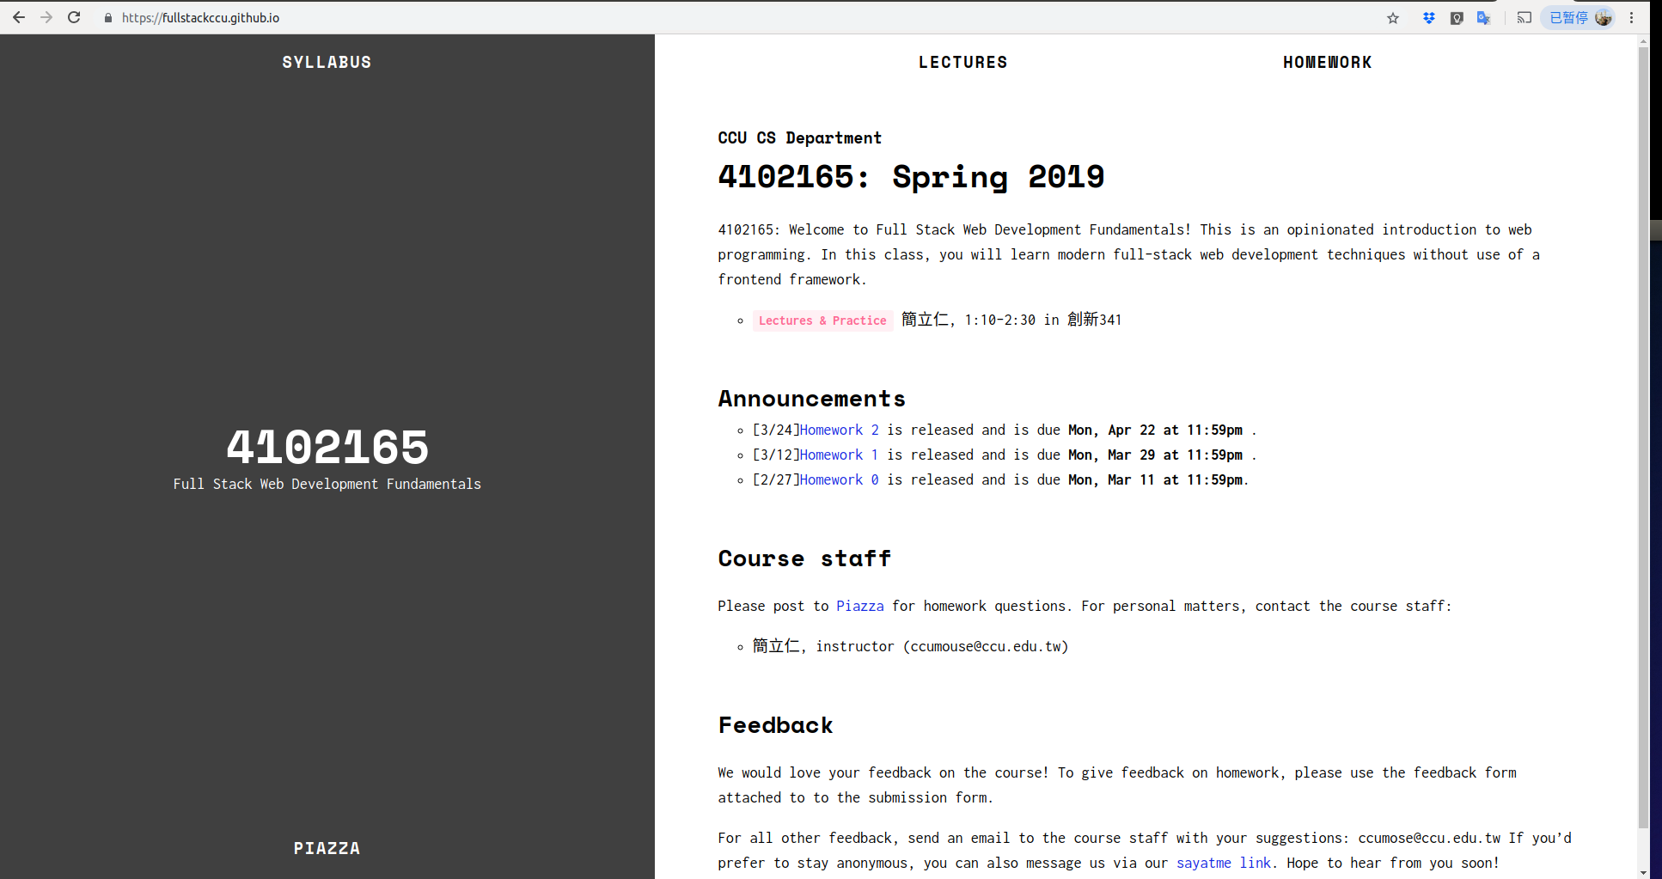
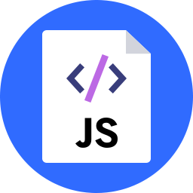
Browser extensions
Add-on that extends the functionality of the browser
A piece of JavaScript that is injected into the webpage before or after it has loaded

Slide 52
Content scripts
A type of extension that runs in the context of a web browser, meaning it can access the DOM of the page on which it's loaded
  Concept is the same in Chrome, Firefox, probably other browsers
Usually composed of:
manifest.json: Contains title, settings, etc for the script
page.js: The extension file
We are using a content script in HW2, Part 2

Slide 53
Example manifest.json
{
"name": "Empty Chrome Extension",
"version": "1.0",
"description": "",
"content_scripts": [
{
"matches": ["<all_urls>"],
"js": ["page.js"]
}
],
"icons": {
"16": "pizza.png",
"48": "pizza.png",
"128": "pizza.png"
},
"manifest_version": 2
}

Slide 54
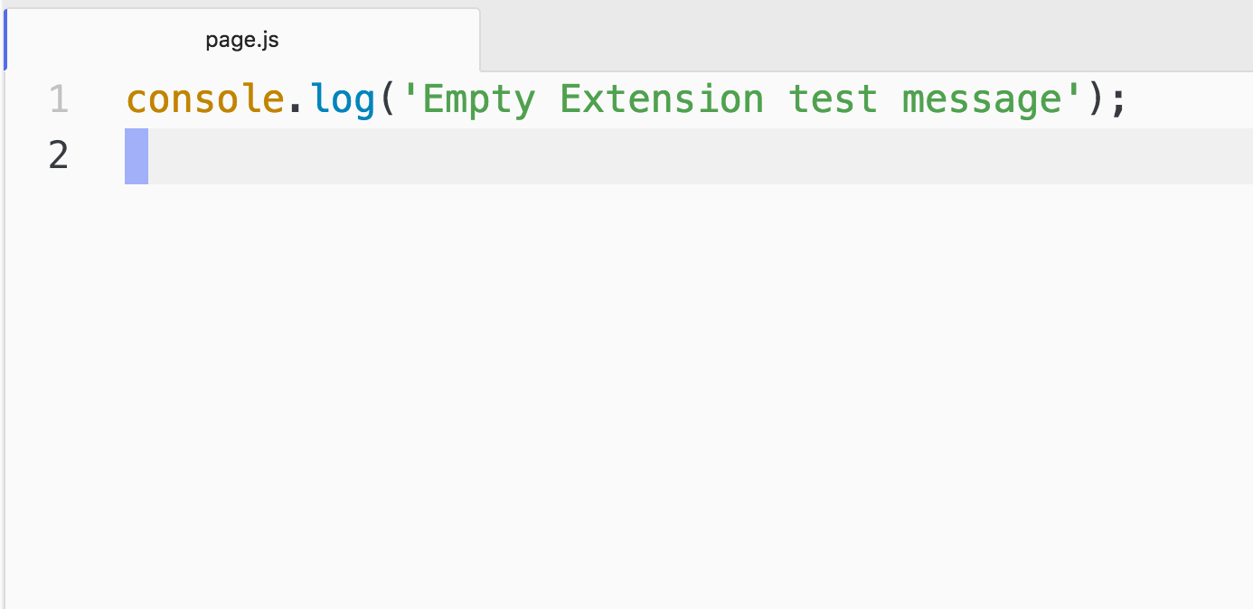
Example page.js

Slide 55
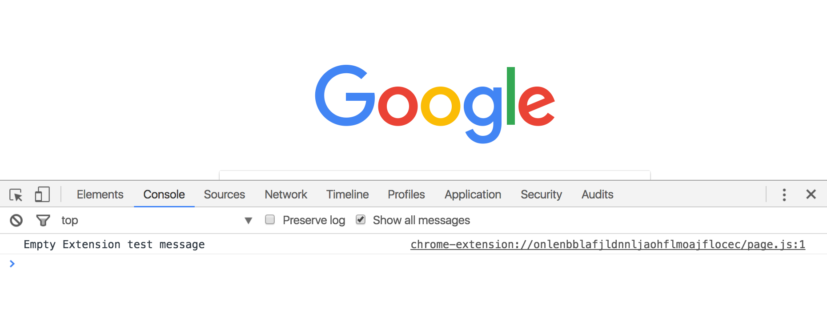
Result
When this extension is loaded, the console message appears in the Web Inspector for every page:

Slide 56
Hacks and Mischief

Slide 57
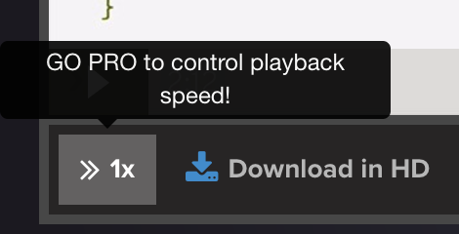
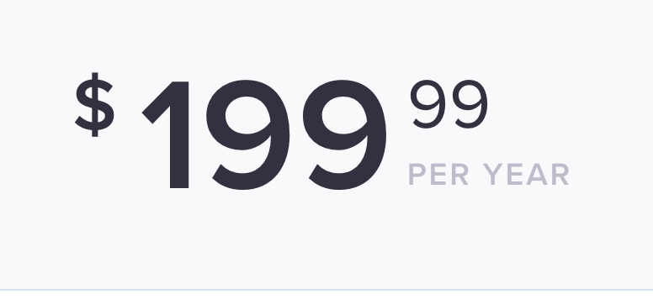
Example: Egghead
Dan Abromov's Redux videos

Slide 58
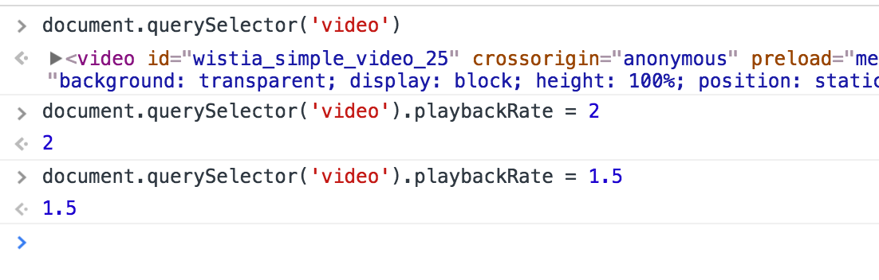
Example: Egghead
We can access the DOM via querySelector in the Web Inspector. Useful for debugging, and for speeding up videos.
(MDN for playbackRate)

Slide 59
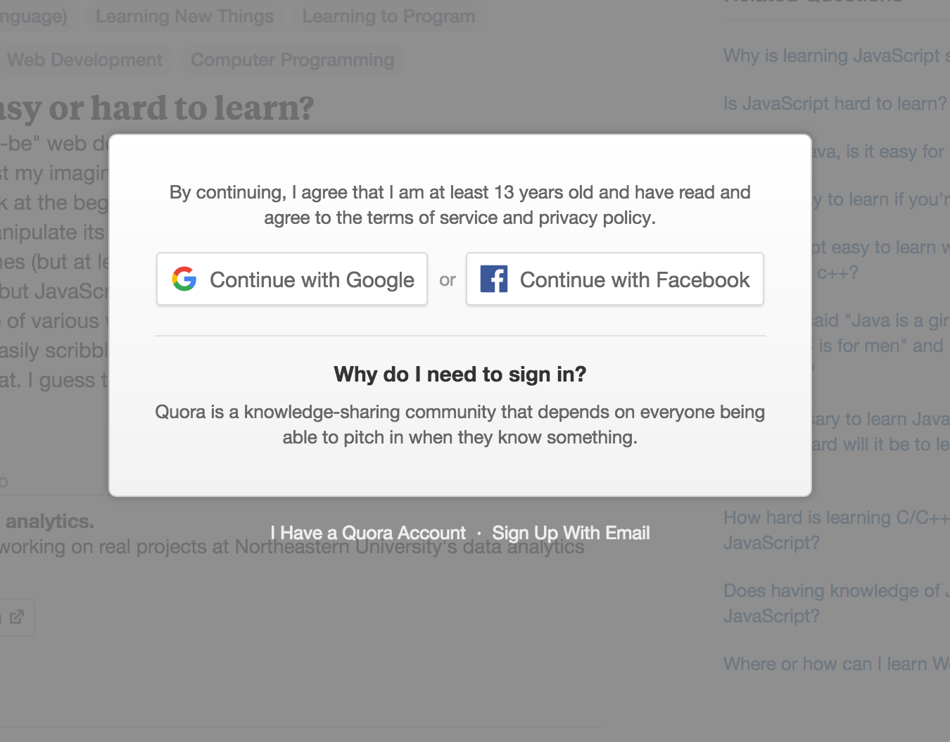
Example: Quora signin wall
https://www.quora.com/Why-is-learning-JavaScript-so-hard

Slide 60
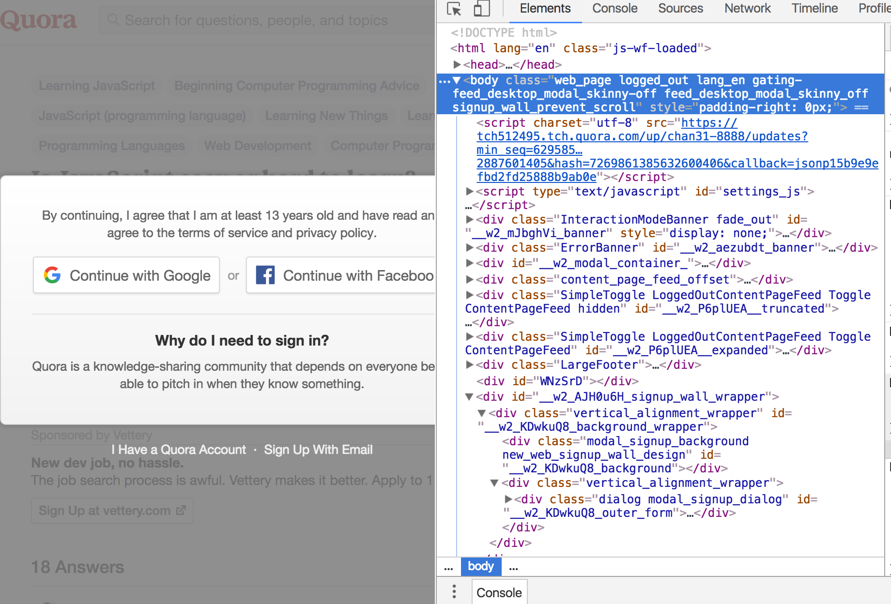

Slide 61
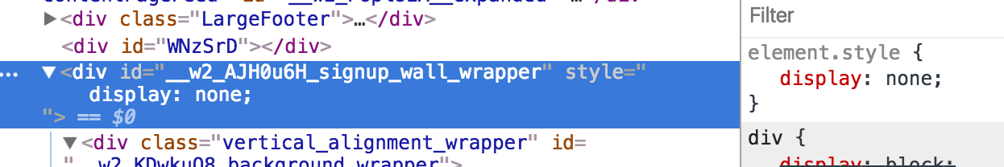
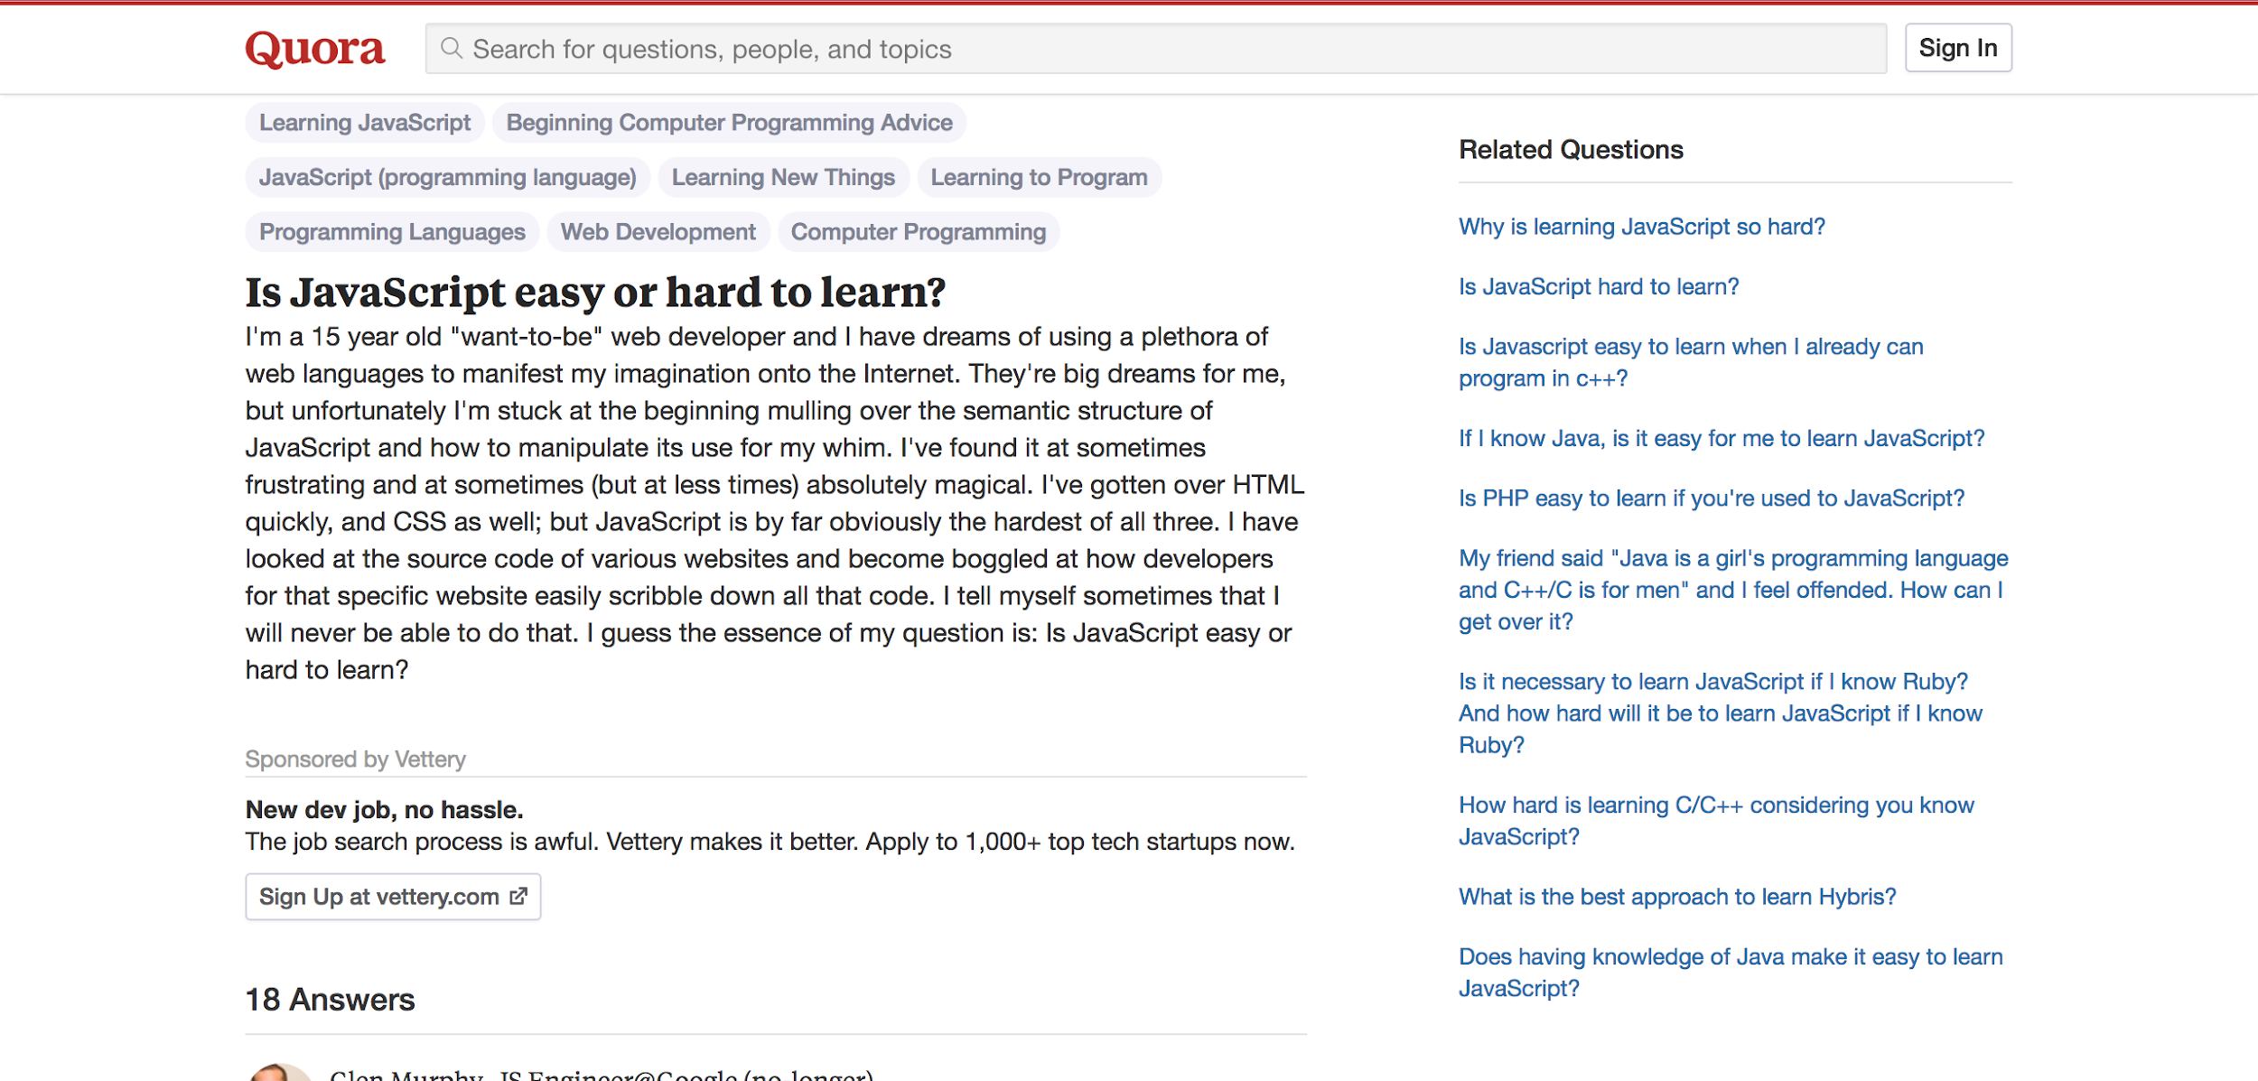

Slide 62
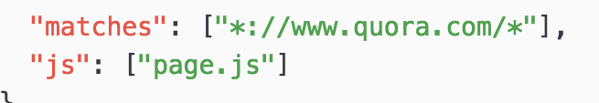
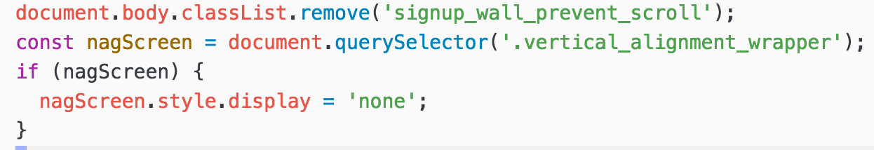
Quora Chrome Extension
You can make a Chrome extension to automate this:
manifest.json
page.js

Slide 63
Aside: style attribute
Every HTMLElement also has a style attribute that lets you set a style directly on the element:
nagScreen.style.display = 'none';
Generally you should not use this property, as adding and removing classes via classList is a better way to change the style of an element via JavaScript
(But for extensions/hacking, style can be useful!)

Slide 64

Example: Adblock block
http://www.ondemandkorea.com/kpop-star-season-6-seoul-qualifier.html

Slide 65
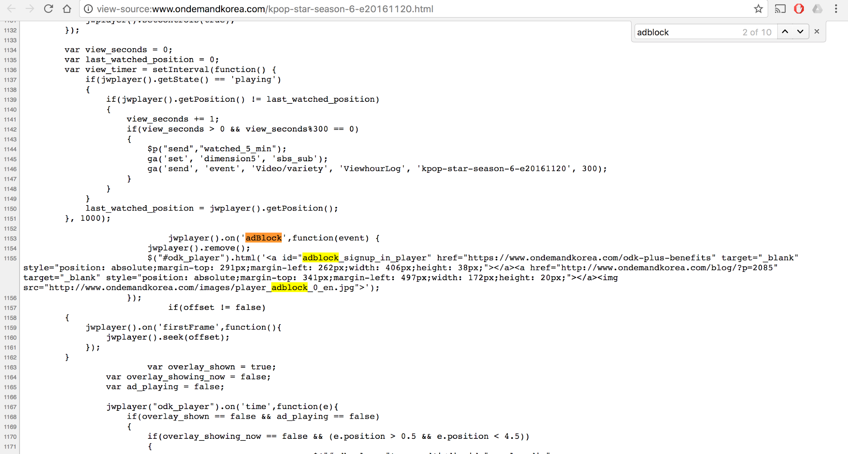
View-source, search for "adblock"...

Slide 66
Lol global scope
jwplayer().on('adBlock', function(event) {
jwplayer().remove();
$("#odk_player").html('<a id="adblock_signup_in_player" href="https://www.ondemandkorea.com/odk-plus-benefits" target="_blank" style="position: absolute;margin-top: 291px;margin-left: 262px;width: 406px;height: 38px;"></a><a href="http://www.ondemandkorea.com/blog/?p=2085" target="_blank" style="position: absolute;margin-top: 341px;margin-left: 497px;width: 172px;height: 20px;"></a><img src="http://www.ondemandkorea.com/images/player_adblock_0_en.jpg">');
});
Note that this is using the jQuery library

Slide 67
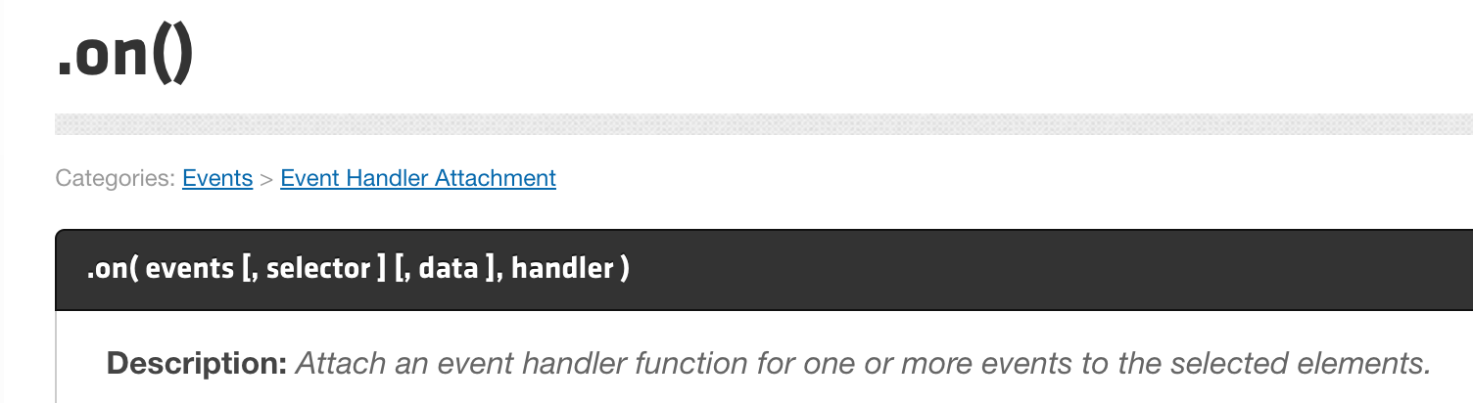
jQuery on?
We see that .on() is essentially addEventListener

Slide 68
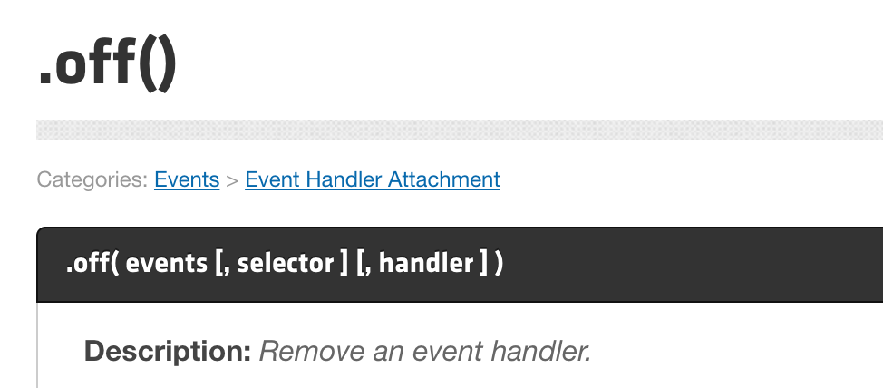
jQuery off
And .off() is essentially removeEventListener

Slide 69

Lol global scope
What if we try this...

Slide 70
Aside: inline <script>
You can put JavaScript directly in your HTML by adding it to the body of a <script> tag:
<script>console.log('hello');</script>
Generally you should not use do this, as it's a violation of Separation of Concerns, mixing behavior (JS) in content (HTML)
(But for extensions/hacking, adding JavaScript directly in a <script> tag can be useful!)

Slide 71

Success!

