Slide 1
4102165:
Full Stack Web Development Fundamentals
Spring 2019
簡立仁 Li-Ren Chien
ccumouse@gmail.com

Slide 2
Schedule
Today:
Servers, generally
NodeJS
npm
Express
fetch() to localhost
If we have time:
Single-threaded asynchrony
  JS Event loop

Slide 3
Lecture code
All lecture code is in this zip:
https://fullstackccu.github.io/lectures/19/lecture19.zip
You will need to run the commands we show in lecture to run the server code!
Node installation instructions:
https://fullstackccu.github.io/install-node/

Slide 4
Servers

Slide 5
Server-side programming
The type of web programming we have been doing so far in course is called "client-side" programming:
The code we write gets run in a browser on the user's (client's) machine
Today we will begin to learn about server-side programming:
The code we write gets run on a server.
Servers are computers run programs to generate web pages and other web resources.

Slide 6
Let's take another look at how clients and servers work...

Slide 7


CLIENT: You type a URL in the address bar and hit "enter"
http://www.cs.ccu.edu.tw

Slide 8
Browser sends an HTTP GET request saying "Please GET me the index.html file at http://www.cs.ccu.edu.tw"
Let's take a deeper look at this process...

Slide 9
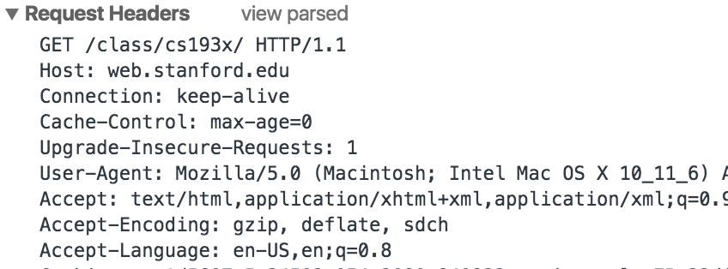

Browser C++ code creates an array of bytes that is formatted in using HTTP request message format
Browser asks operating system, "Hey, can you send this HTTP Get request message to http://www.cs.ccu.edu.tw/"?

Slide 10
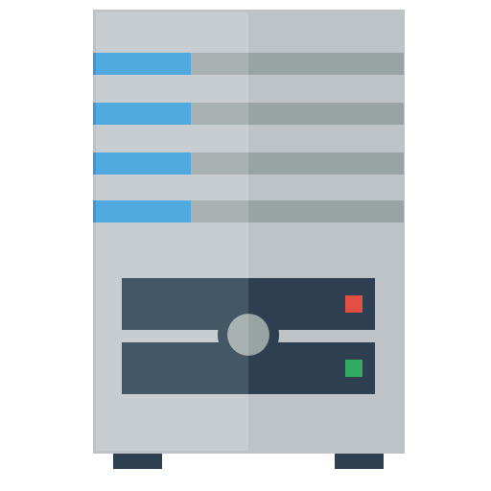
Operating system sends a DNS query to look up the IP
address of "http://www.cs.ccu.edu.tw/"
DNS Server
(Routing, etc…)
DNS server replies with the IP address, e.g. 140.123.101.3
DNS: Domain Name System: Translate domain names to IP address of the computer associated with that address.
IP address: Numerical unique identifier for every computer connected to the internet.

Slide 11
Operating system opens a TCP connection with the computer at
140.123.101.3
140.123.101.3
(Routing, etc…)
After the TCP connection is established, the OS can send the HTTP message to 140.123.101.3 through the TCP connection.
TCP: Transmission Control Protocol, defines the data format for sending information over the wire. (Can be used for HTTP, FTP, etc)

Slide 12
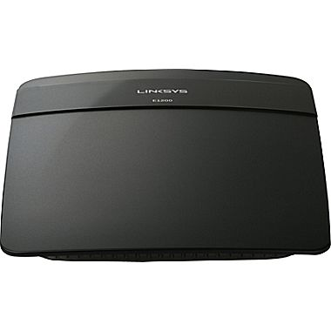
140.123.101.3
(Routing, etc…)
SERVER: There is a computer that is connected to the internet at IP address 140.123.101.3.

Slide 13
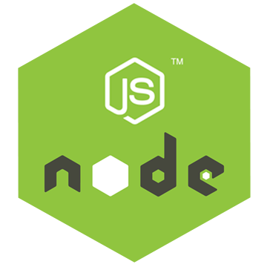
140.123.101.3
On this computer is a web server program:
The web server program is listening for incoming messages that are sent to it.
The web server program can respond to messages that are sent to it.
Node: The platform we will use to create a web server program that will receive and respond to HTTP requests.
Also known as "NodeJS"; these terms are synonyms

Slide 14
Aside: "Server"
The definition of server is overloaded:
Sometimes "server" means the machine/computer that runs the server software.
Sometimes "server" means the software running on the machine/computer.
You have to use context to know which is being meant.

Slide 15
Aside: Sockets
Q: What does it mean for a program to be "listening" for messages?
When the server first runs, it executes code to create a socket that allows it to receive incoming messages from the OS.
A socket is one end of a communication channel. You can send and receive data on sockets.
However, NodeJS will abstract this away so we don't have to think about sockets.

Slide 16
140.123.101.3
Client
(Routing, etc…)
Server
A TCP connection is established between the client and the server, so now the client and server can send messages directly to teach other.

Slide 17
OS to server program:
"Hey, here's a message that was sent to me."
140.123.101.3
Now the operating system is receiving TCP packets from the wire, and the operating system begins sending the contents of the request to the server program.

Slide 18
OS to server program:
"Hey, here's a message that was sent to me."
140.123.101.3
Server program to OS:
"OK, can you send this message back to the client?"
The server software parses the HTTP request and then decides what message it wants to send in response. It formats this message in HTTP, then asks the OS to send this response message over TCP back to the sender.

Slide 19
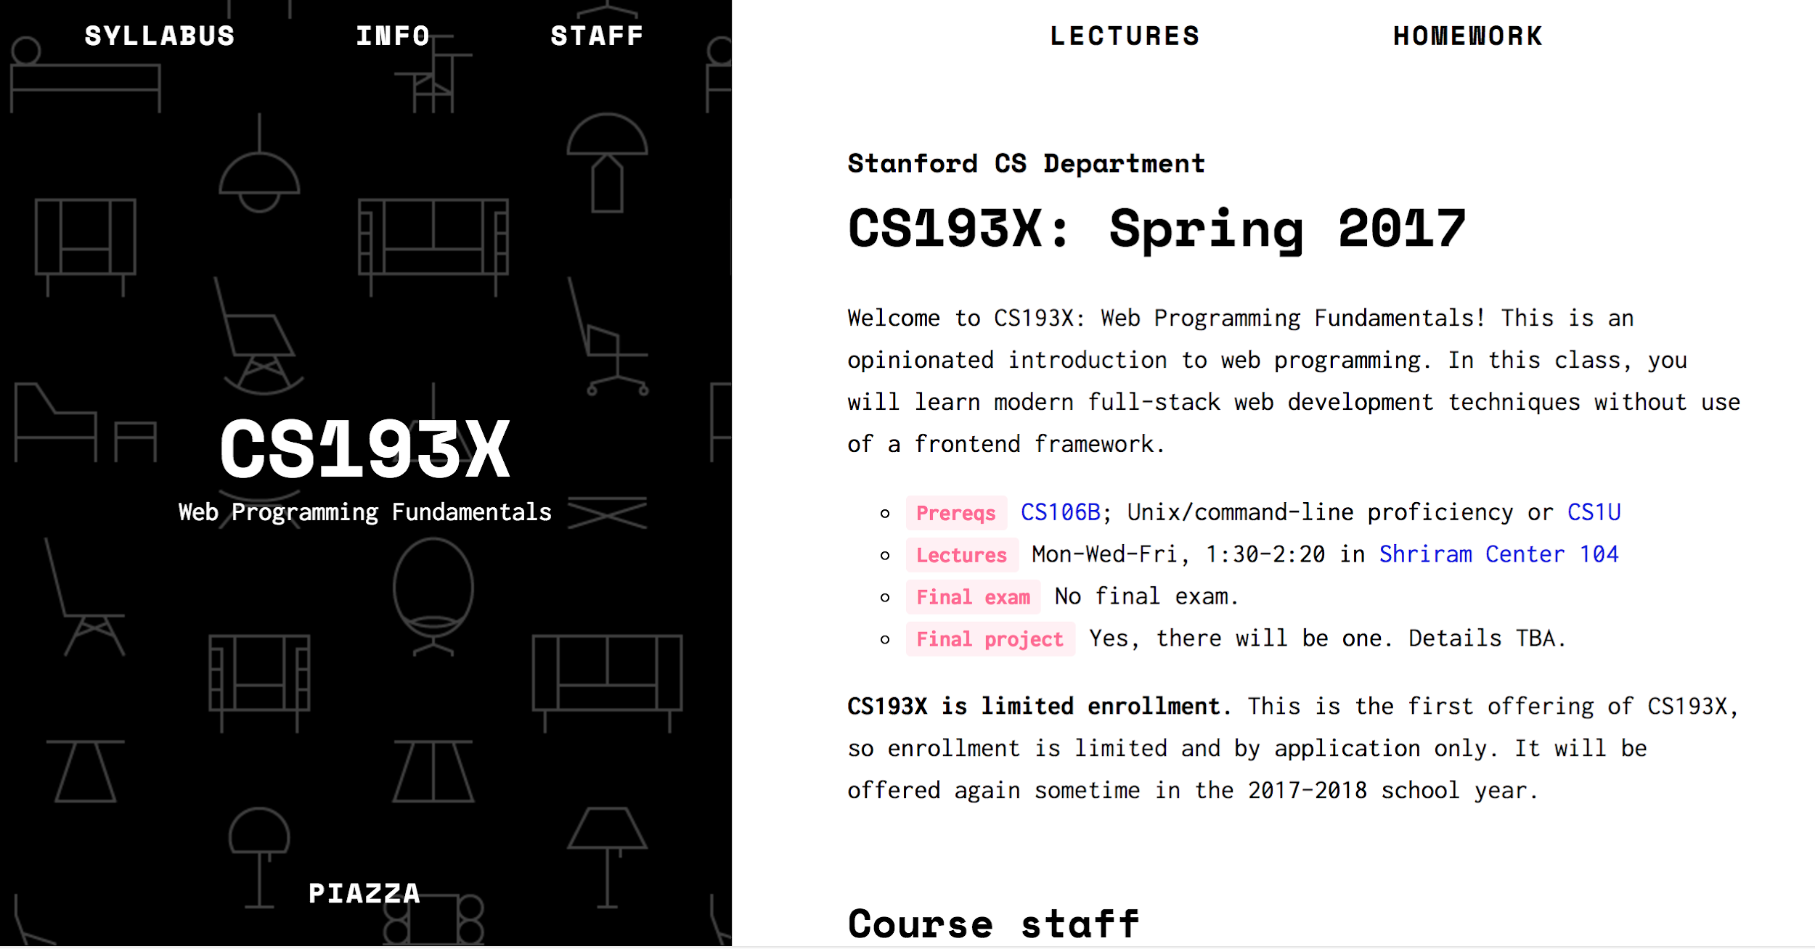
(Routing, etc…)
This HTTP response is then sent back to the client's OS, which notifies the browser of the HTTP response, and then the browser displays the web page.

Slide 20
Summary
When you navigate to a URL:
Browser creates an HTTP GET request
Operating system sends the GET request to the server over TCP
When a server computer receives a message:
The server's operating system sends the message to the server software (via a socket)
The server software then parses the message
The server software creates an HTTP response
The server OS sends the HTTP response to the client over TCP
Client
Server
(Routing, etc…)

Slide 21
Learn more
For more on basic server design, sockets and TCP/IP:
Principles of Computer Systems
For more on computer networks:
Introduction to Computer Networking (Prereq: CS110)
Client
Server
(Routing, etc…)

Slide 22
NodeJS

Slide 23
NodeJS
NodeJS:
A JavaScript runtime written in C++.
Can interpret and execute JavaScript.
Includes support for the NodeJS API.
NodeJS API:
A set of JavaScript libraries that are useful for creating server programs.
V8 (from Chrome):
The JavaScript interpreter ("engine") that NodeJS uses to interpret, compile, and execute JavaScript code

Slide 24
NodeJS
NodeJS:
A JavaScript runtime written in C++.
Can interpret and execute JavaScript.
Includes support for the NodeJS API.
NodeJS API:
A set of JavaScript libraries that are useful for creating server programs.
V8 (from Chrome):
The JavaScript interpreter ("engine") that NodeJS uses to interpret, compile, and execute JavaScript code
Q: What does this mean?

Slide 25
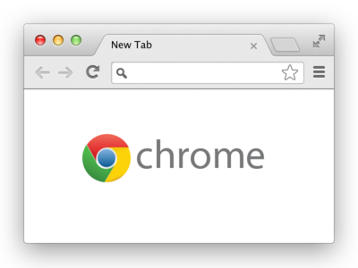
First: Chrome
Chrome:
A browser written in C++.
Can interpret and execute JavaScript code.
Includes support for the DOM APIs.
DOM APIs:
JavaScript libraries to interact with a web page
V8:
The JavaScript interpreter ("engine") that Chrome uses to interpret, compile, and execute JavaScript code

Slide 26


Chrome, V8, DOM
DOM API Implementation
Parser
JavaScript runtime
(Call stack, memory, etc.)
Execution Engine
Garbage Collector

Slide 27
DOM API Implementation
Parser
JavaScript runtime
(Call stack, memory, etc.)
Execution Engine
Garbage Collector
const name = 'V8';

Slide 28
"Please execute console.log()"
DOM API Implementation
Parser
JavaScript runtime
(Call stack, memory, etc.)
Execution Engine
Garbage Collector
console.log('V8');

Slide 29

NodeJS, V8, NodeJS APIs
NodeJS API Implementation
Parser
JavaScript runtime
(Call stack, memory, etc.)
Execution Engine
Garbage Collector

Slide 30
NodeJS API Implementation
Parser
JavaScript runtime
(Call stack, memory, etc.)
Execution Engine
Garbage Collector
const x = 15;
x++;

Slide 31
"Please execute http
.createServer()"
NodeJS API Implementation
Parser
JavaScript runtime
(Call stack, memory, etc.)
Execution Engine
Garbage Collector
http.createServer();

Slide 32
NodeJS API Implementation
Parser
JavaScript runtime
(Call stack, memory, etc.)
Execution Engine
Garbage Collector
What if you tried to call document.querySelector('div');
in the NodeJS runtime?

Slide 33
NodeJS API Implementation
Parser
JavaScript runtime
(Call stack, memory, etc.)
Execution Engine
Garbage Collector
document.querySelector('div');
ReferenceError: document is not defined

Slide 34
NodeJS API Implementation
Parser
JavaScript runtime
(Call stack, memory, etc.)
Execution Engine
Garbage Collector
What if you tried to call console.log('nodejs');
in the NodeJS runtime?

Slide 35
"Please execute console.log()"
NodeJS API Implementation
Parser
JavaScript runtime
(Call stack, memory, etc.)
Execution Engine
Garbage Collector
console.log('nodejs');
(NodeJS API implemented their own console.log)

Slide 36
NodeJS
NodeJS:
A JavaScript runtime written in C++.
Can interpret and execute JavaScript.
Includes support for the NodeJS API.
NodeJS API:
A set of JavaScript libraries that are useful for creating server programs.
V8 (from Chrome):
The JavaScript interpreter ("engine") that NodeJS uses to interpret, compile, and execute JavaScript code

Slide 37
Installation
NOTE: The following slides assume you have already installed NodeJS.
Node installation instructions:
https://fullstackccu.github.io/install-node/

Slide 38
node command
Running node without a filename runs a REPL (Read-Eval-Print Loop) loop
Similar to the JavaScript console in Chrome, or when you run "python"
$ node
> let x = 5;
undefined
> x++
5
> x
6

Slide 39
NodeJS
NodeJS can be used for writing scripts in JavaScript, completely unrelated to servers.
simple-script.js
function printPoem() {
console.log('Roses are red,');
console.log('Violets are blue,');
console.log('Sugar is sweet,');
console.log('And so are you.');
console.log();
}
printPoem();
printPoem();

Slide 40
node command
The node command can be used to execute a JS file:
$ node fileName
$ node simple-script.js
Roses are red,
Violets are blue,
Sugar is sweet,
And so are you.
Roses are red,
Violets are blue,
Sugar is sweet,
And so are you.

Slide 41
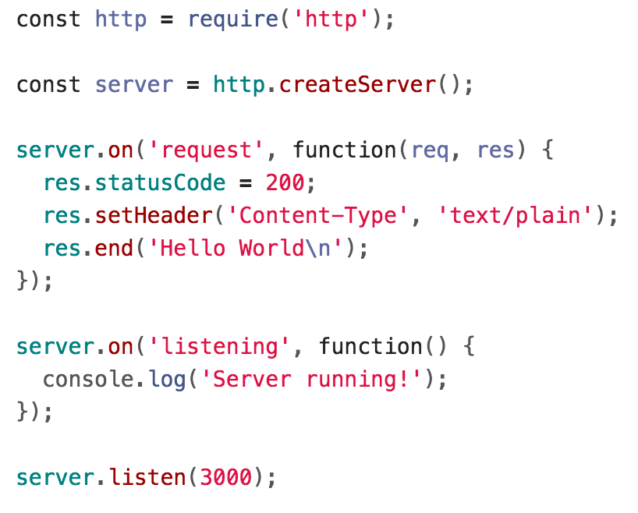
Node for servers
Here is a very basic server written for NodeJS:
(WARNING: We will not actually be writing servers like this!!! We will be using ExpressJS to help, but we haven't gotten there yet.

Slide 42
require()
The NodeJS require() statement loads a module, similar to import in Java or include in C++.
We can require() modules included with NodeJS, or modules we've written ourselves.
In this example, 'http' is referring to the HTTP NodeJS module

Slide 43
require()
The http variable returned by require('http') can be used to make calls to the HTTP API:
http.createServer() creates a Server object

Slide 44
Emitter.on
The on() function is the NodeJS equivalent of addEventListener.

Slide 45
Emitter.on
The request event is emitted each time there is a new HTTP request for the NodeJS program to process.
Server

Slide 46
Emitter.on
The req parameter gives information about the incoming request, and the res parameter is the response parameter that we write to via method calls.
statusCode: Sets the HTTP status code.
setHeader(): Sets the HTTP headers.
end(): Writes the message to the response body then signals to the server that the message is complete.

Slide 47
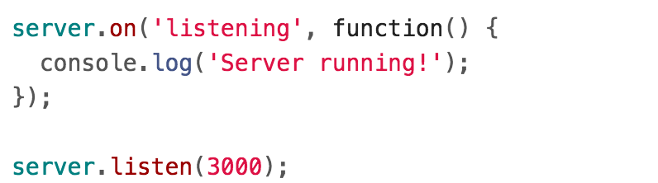
listen() and listening
The listen() function will make the program start accepting messages sent to the given port number.
The listening event will be emitted when the server has been bound to a port.
Q: What's a port? What is binding?

Slide 48
Ports and binding
port: In the context of networking, a "logical" (as opposed to a physical) connection place
A number from 0 to 65535 (16-bit unsigned integer)
When you start running a server process, you tell the operating system what port number to associate with it. This is called binding.

Slide 49
Operating system opens a TCP connection on port 80
of the computer at
140.123.101.3.
140.123.101.3
(Routing, etc…)
The server process running on port 80
Is responding to requests.
A TCP connection requires an IP address and a port number.
If no port number is specified, 80 is the default for HTTP requests.

Slide 50
Ports defaults
There are many well-known ports, i.e. the ports that will be used by default for particular protocols:
21: File Transfer Protocol (FTP)
22: Secure Shell (SSH)
23: Telnet remote login service
25: Simple Mail Transfer Protocol (SMTP)
53: Domain Name System (DNS) service
80: Hypertext Transfer Protocol (HTTP) used in the World Wide Web
110: Post Office Protocol (POP3)
119: Network News Transfer Protocol (NNTP)
123: Network Time Protocol (NTP)
143: Internet Message Access Protocol (IMAP)
161: Simple Network Management Protocol (SNMP)
194: Internet Relay Chat (IRC)
443: HTTP Secure (HTTPS)

Slide 51
Development server
For our development server, we can choose whatever port number we want. In this example, we've chosen 3000.

Slide 52
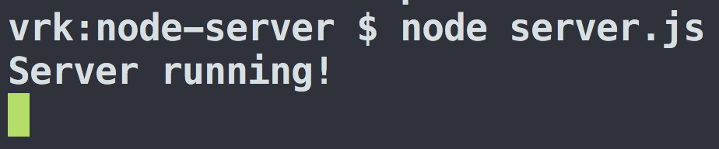
Running the server
When we run node server.js in the terminal, we see the following:
The process does not end after we run the command, as it is now waiting for HTTP requests on port 3000.
Q: How do we send an HTTP request on port 3000?

Slide 53
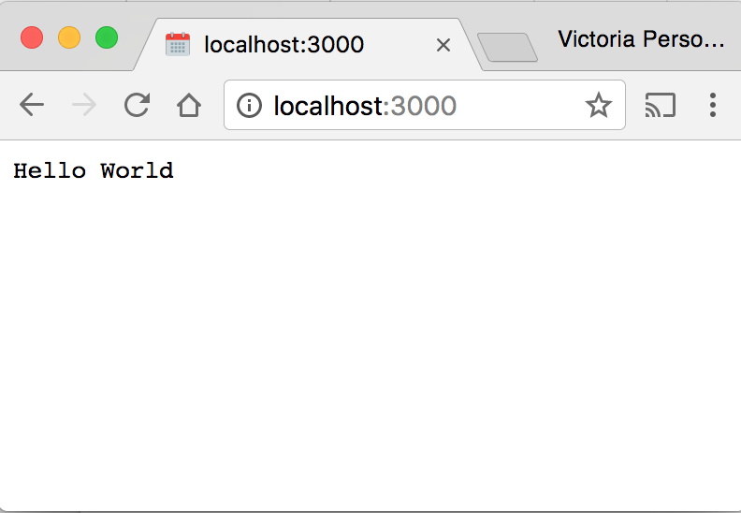
Localhost
We can send an HTTP GET request running on one of the ports on the local computer using the URL:
http://localhost:portNumber, e.g.
http://localhost:3000
Localhost is a hostname that means "this computer."

Slide 54
Server response
Here is the result of the request to our HTTP server:

Slide 55
Node for servers
This server returns the same response no matter what the request is.

Slide 56
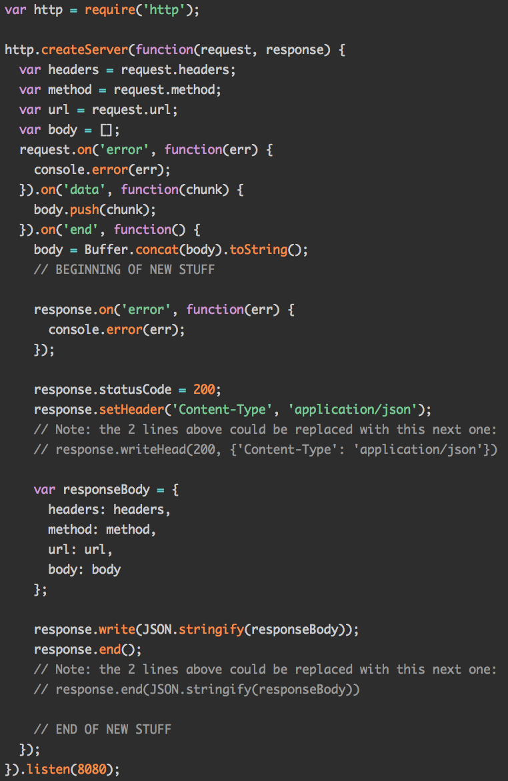
Node for servers
The NodeJS server APIs are actually pretty low-level:
You build the request manually
You write the response manually
There's a lot of tedious processing code

Slide 57
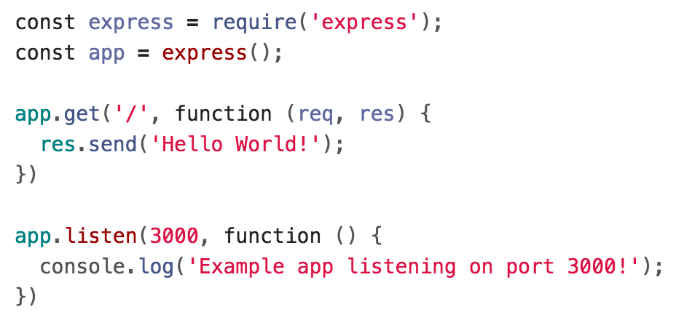
ExpressJS
We're going to use a library called ExpressJS on top of NodeJS:

Slide 58
Express routing

Slide 59
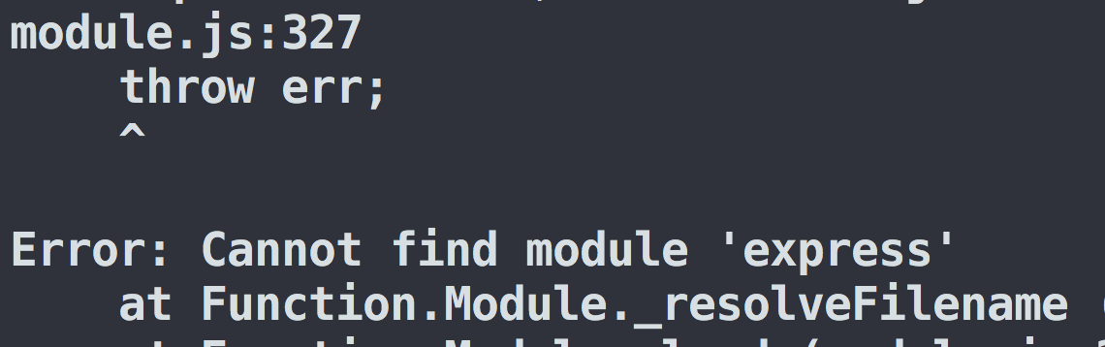
ExpressJS
However, Express is not part of the NodeJS APIs.
If we try to use it like this, we'll get an error:
We need to install Express via npm.

Slide 60

npm
When you install NodeJS, you also install npm:
npm: Node Package Manager*:
Command-line tool that lets you install packages (libraries and tools) written in JavaScript and compatible with NodeJS
Can find packages through the online repository:
https://www.npmjs.com/

Slide 61
npm install and uninstall
npm install package-name
This downloads the package-name library into a node_modules folder.
Now the package-name library can be included in your NodeJS JavaScript files.
npm uninstall package-name
This removes the package-name library from the node_modules folder, deleting the folder if necessary

Slide 62
Express example
$ npm install express
$ node server.js
Example app listening on port 3000!

Slide 63
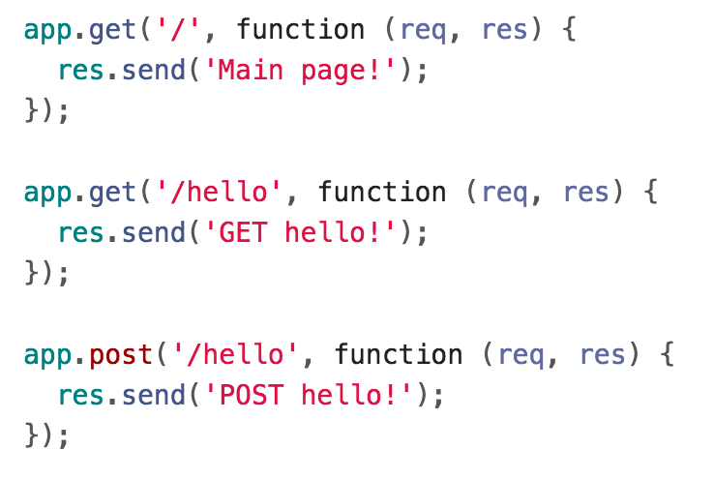
Express routes
You can specify routes in Express:

Slide 64
Express routes
app.method(path, handler)
Specifies how the server should handle HTTP method requests made to URL/path
This example is saying:
  When there's a GET request to http://localhost:3000/hello, respond with the text "GET hello!"

Slide 65
Handler parameters
Express has its own Request and Response objects:
req is a Request object
res is a Response object
res.send() sends an HTTP response with the given content
  Sends content type "text/html" by default

Slide 66
Querying our server
Here are three ways to send HTTP requests to our server:
Navigate to http://localhost:3000/<path> in our browser
  Can only do GET requests
Call fetch() in web page
  We've done GET requests so far, but can send any type of HTTP request
curl command-line tool
  Debug tool we haven't seen yet

Slide 67
curl
curl: Command-line tool to send and receive data from a server (Manual)
curl --request METHOD url
e.g.
$ curl --request PUT http://localhost:3000/hello

Slide 68
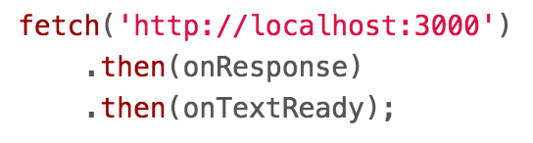
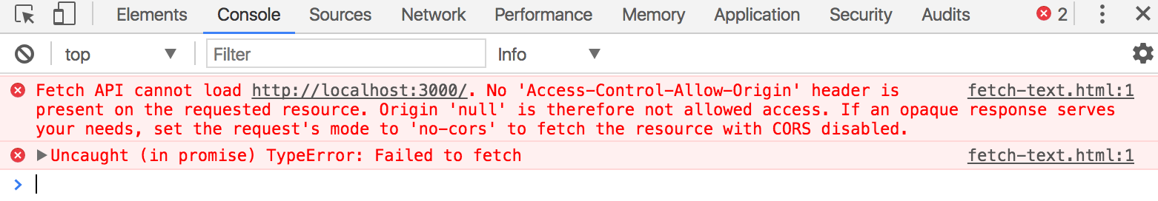
fetch() to localhost
If we try fetching to localhost from file://
We get this CORS error:

Slide 69
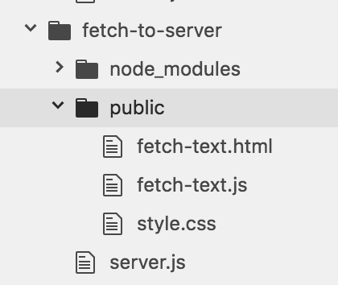
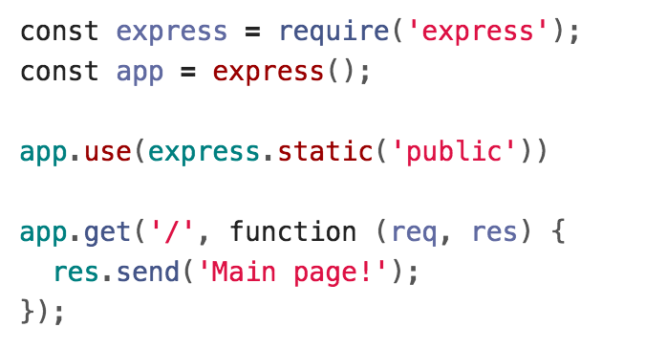
Server static data
We can instead serve our HTML/CSS/JS statically from the same server:

Slide 70
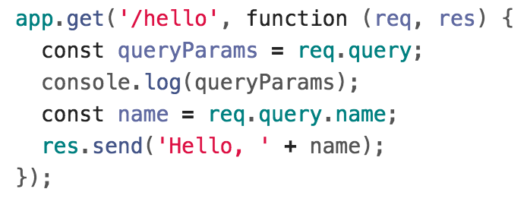
GET query params in Express
Query parameters are saved in req.query.

Slide 71
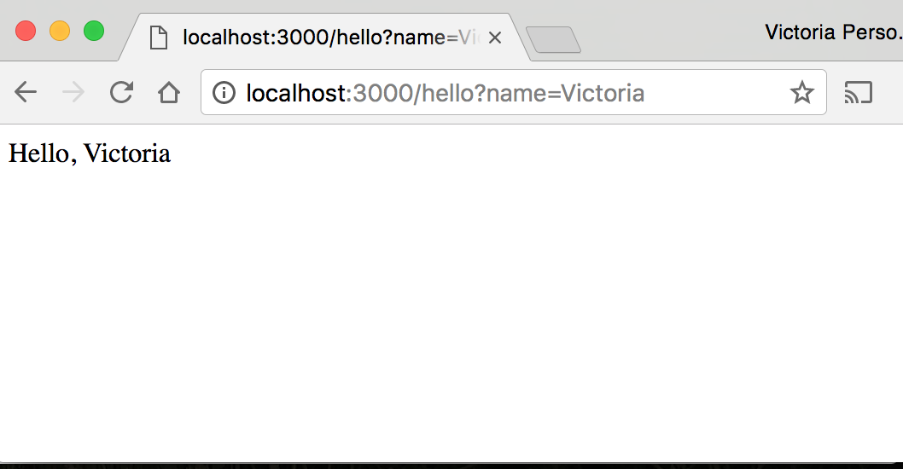
GET query params in Express

Slide 72
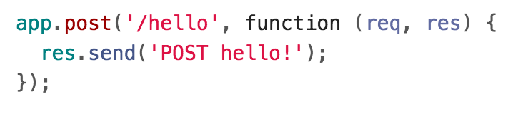
fetch() with POST
On the server-side, you define your handler in app.post() to handle POST requests.

Slide 73
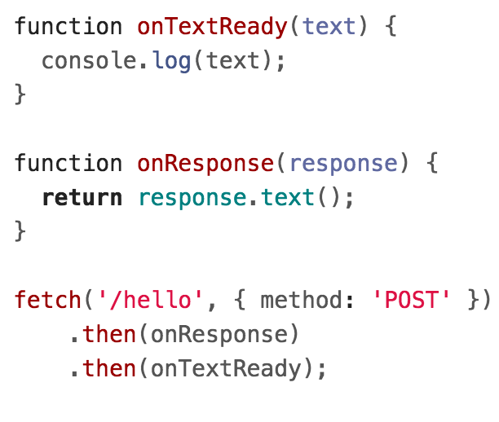
fetch() with POST

Slide 74
fetch() with POST

Slide 75
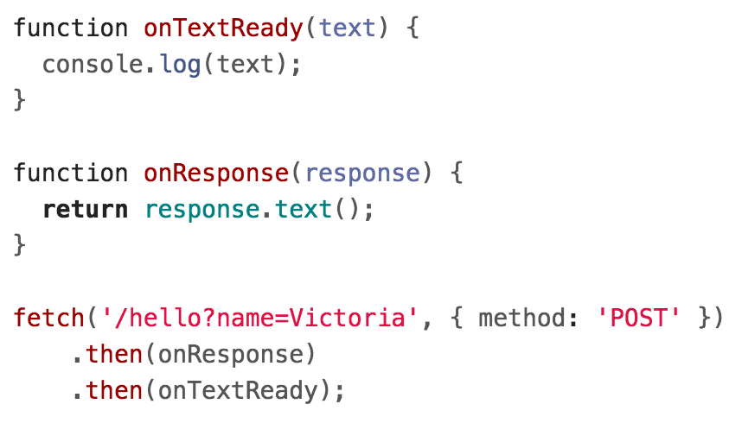
Query params with POST
You can send query parameters via POST as well:
(WARNING: We will not be making POST requests like this!
We will be sending data in the body of the request instead of via query params.)

Slide 76
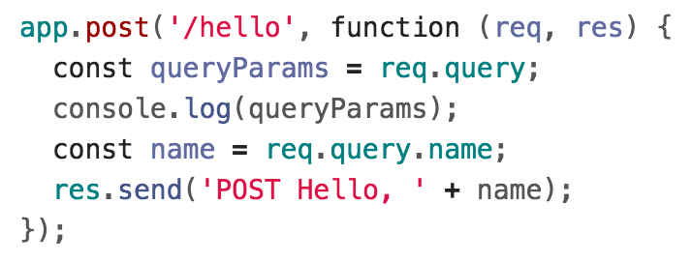
Query params with POST
These parameters are accessed the same way:
(WARNING: We will not be making POST requests like this!
We will be sending data in the body of the request instead of via query params.)

Slide 77
Overflow (will cover if time)

Slide 78
Single-threaded asynchrony

Slide 79
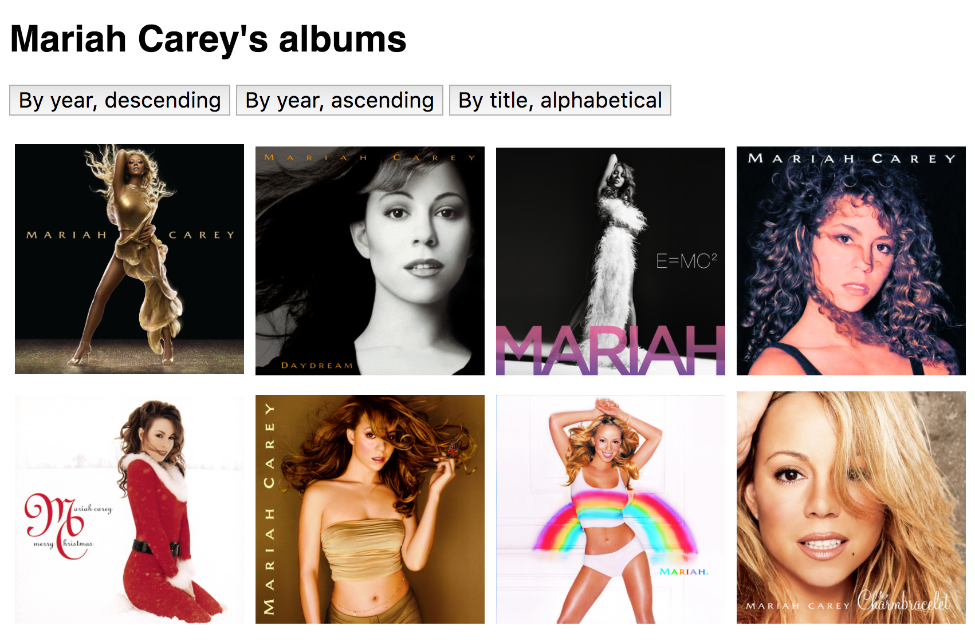
Recall: Discography page
We wrote a web page that lists the Mariah Carey albums stored in albums.json and lets us sort the albums:
(CodePen)

Slide 80
Asynchronous events
We have written our code in a way that assumes fetch() will complete before clicking, but on a slow connection, that's not a safe assumption.
script.js
App
albums.json
Fetch finishes!
SortButton
Click event!

Slide 81
General problem
The problem stated generically:
There are 2+ events that can occur at unpredictable times, and the two events are dependent on each other in some way
(Some people call this a "race condition", though other people reserve the term for multiple threads only.)
Click
event!
Fetch finishes!

Slide 82
Solutions
You can either "force" loading to occur before button click, for example:
Disable buttons until the JSON loads
OR: Don't show buttons until the JSON loads
OR: Don't show the UI at all until the JSON completes

Slide 83
Single-threaded asynchrony

Slide 84
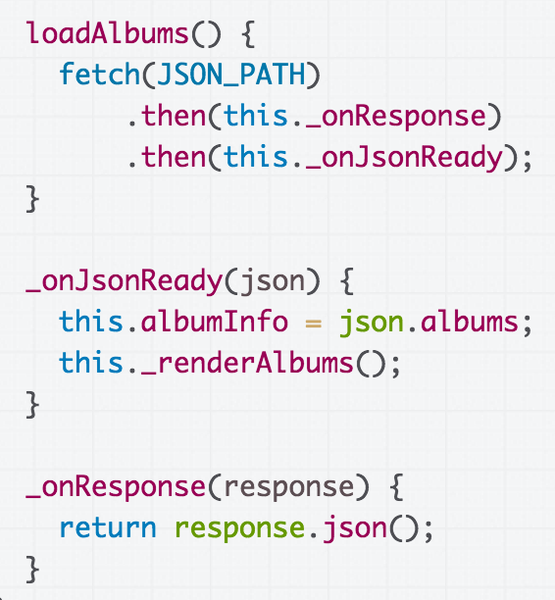
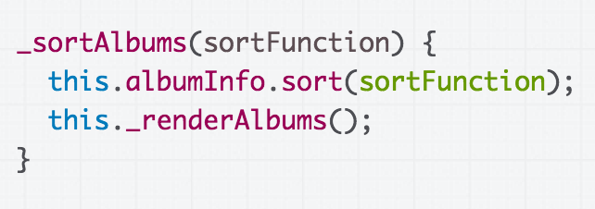
Is it possible for the _onJsonReady function to fire *in the middle* of sortAlbums?

Slide 85
Solutions
You can either "force" loading to occur before button click, for example:
Disable buttons until the JSON loads
OR: Don't show buttons until the JSON loads
OR: Don't show the UI at all until the JSON completes

Slide 86
...
The browser is fetching albums.json...

Slide 87

...
User clicks a button, so the event handler is running

Slide 88
...
Is it possible that while the click handler is still running (still on the call stack), the fetch() callback also fires?

Slide 89
...
The answer is No, because JavaScript is single-threaded.

Slide 90
Single-threaded?
Some hand-wavy definitions:
Single-threaded:
  When your computer processes one command at a time
  There is one call stack
Multi-threaded
  When your computer processes multiple commands simultaneously
  There is one call stack per thread
thread: a linear sequence of instructions; an executable container for instructions

Slide 91
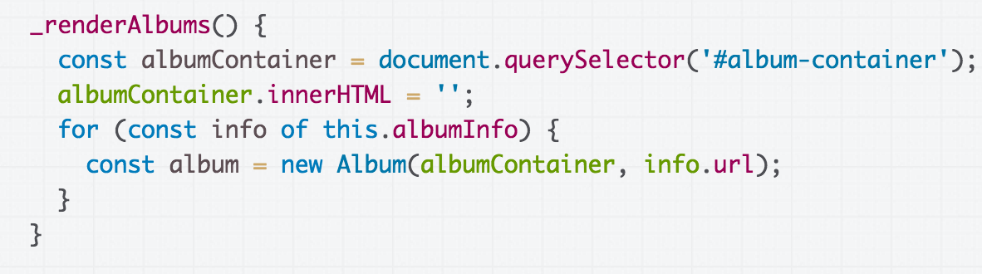
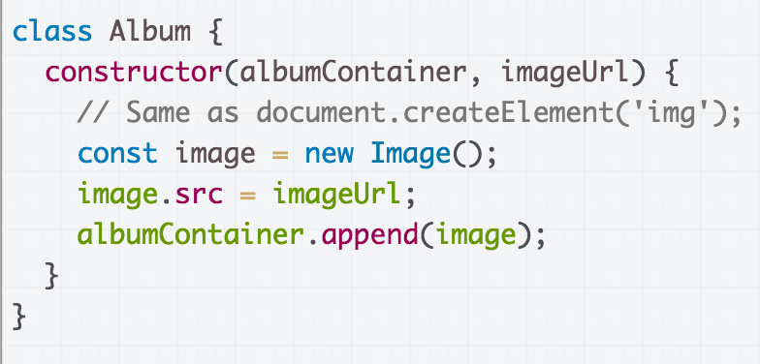
Single-threaded JS
We create a new Album for each album in the JSON file
For each album, we create a new DOM Image
Q: If in JavaScript, only one thing happens at a time, does that mean only one image loads at a time?

Slide 92
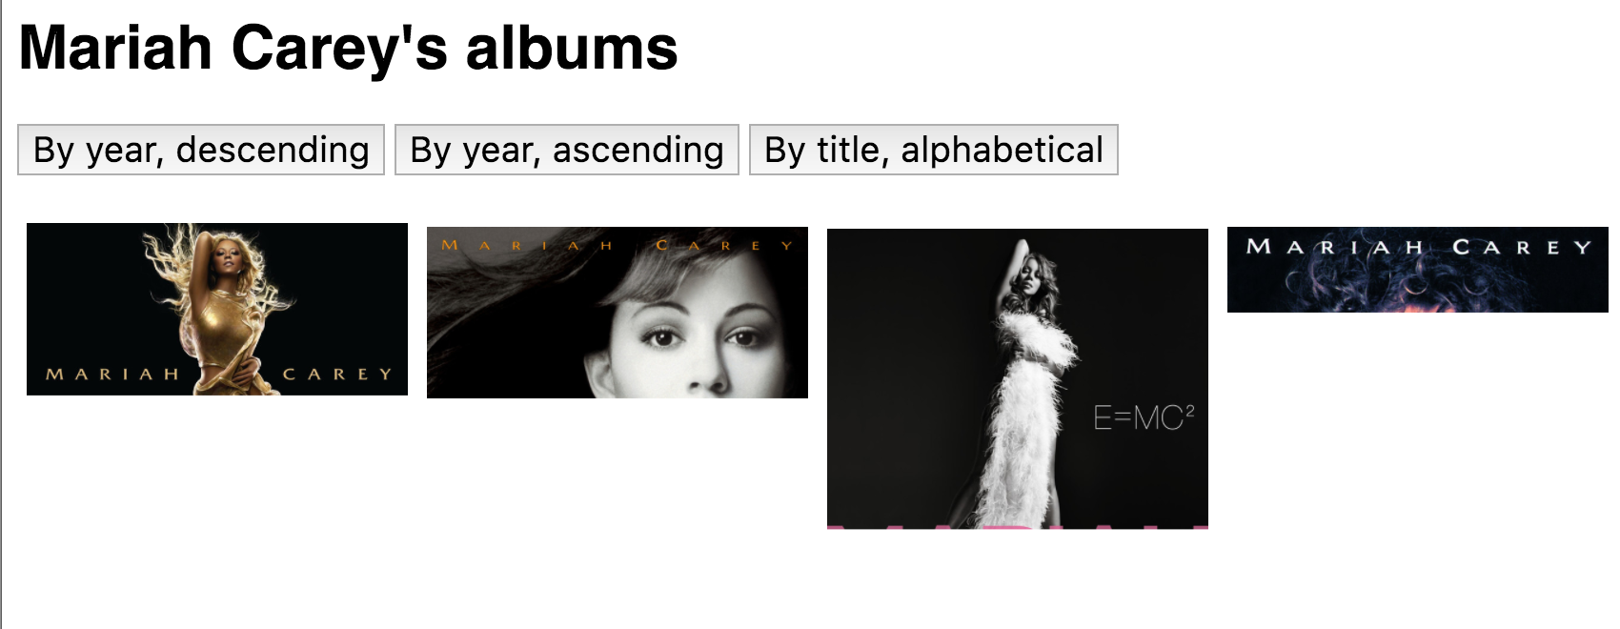
Image loading
Empirically, that doesn't seem to be the case:

Slide 93
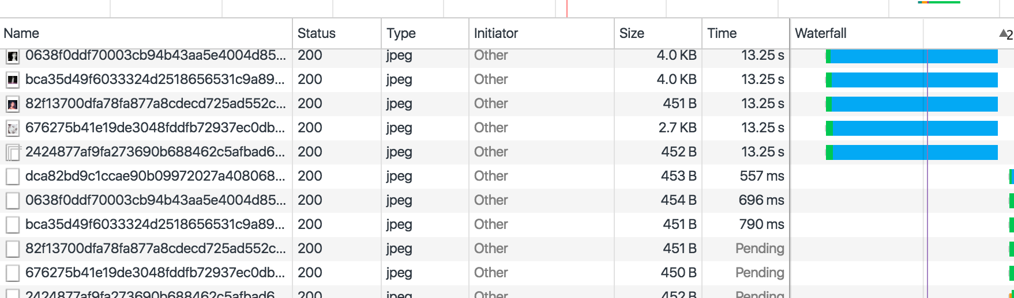
Network tab
If we look at Chrome's Network tab, we see there are several images being loaded simultaneously:
Q: If JavaScript is single-threaded, i.e. if only one thing happens at a time, how can images be loaded in parallel?

Slide 94
JavaScript event loop

Slide 95
Note: see talk!
(For a perfectly great talk on this, see Philip Roberts' talk: https://www.youtube.com/watch?v=8aGhZQkoFbQ&t=1s
And for a perfectly great deep dive on this, see Jake Archibald's blog post:
https://jakearchibald.com/2015/tasks-microtasks-queues-and-schedules/
These slides are inspired by these resources!)

Slide 96
setTimeout
To help us understand the event loop better, let's learn about a new command, setTimeout:
setTimeout(function, delay);
function will fire after delay milliseconds
CodePen example

Slide 97
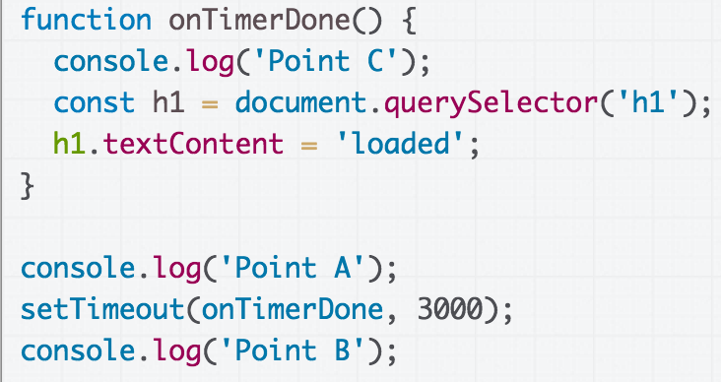
Call stack + setTimeout
Call Stack
(global function)

Slide 98
Call stack + setTimeout
Call Stack
(global function)

Slide 99
Call stack + setTimeout
Call Stack
(global function)

Slide 100
Call stack + setTimeout
Call Stack
(global function)

Slide 101
Call stack + setTimeout
Call Stack
(global function)

Slide 102
Call stack + setTimeout
Call Stack
(global function)

Slide 103
Call stack + setTimeout
Call Stack
(global function)

Slide 104
Call stack + setTimeout
Call Stack
(global function)

Slide 105
Call stack + setTimeout
Call Stack
(global function)

Slide 106
Call stack + setTimeout
Call Stack
(global function)

Slide 107
Call stack + setTimeout
Call Stack
(global function)

Slide 108
Call stack + setTimeout
Call Stack
(global function)

Slide 109
Call stack + setTimeout
Call Stack
(global function)

Slide 110
Call stack + setTimeout
Call Stack
(global function)

Slide 111
Call stack + setTimeout
Call Stack
(global function)

Slide 112
Call stack + setTimeout
Call Stack
(global function)

Slide 113
Call stack + setTimeout
Call Stack
(global function)

Slide 114
Tasks, Micro-tasks, and the Event Loop

Slide 115
Tasks and the Event Loop
Call Stack
The JavaScript runtime can do only one thing at a time...
setTimeout()
(global function)

Slide 116
Tasks and the Event Loop
Call Stack
The JavaScript runtime can do only one thing at a time...
setTimeout()
(global function)

Slide 117


Browser internal implementation
Call Stack
setTimeout()
Task Queue
(global function)
Event loop
Micro-task queue
Here's a picture of the major pieces involved in executing JavaScript code in the browser.

Slide 118
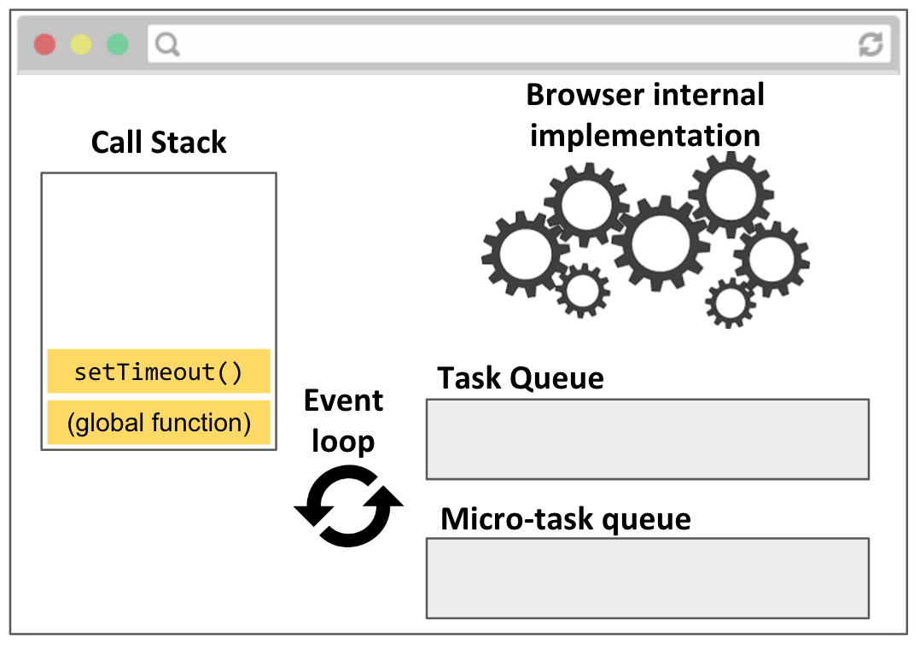
JS execution
Call stack: JavaScript runtime call stack. Executes the JavaScript commands, functions.
Browser internal implementation: The C++ code that executes in response to native JavaScript commands, e.g. setTimeout, element.classList.add('style'), etc.

Slide 119
JS execution
Call stack: JavaScript runtime call stack. Executes the JavaScript commands, functions.
Browser internal implementation: The C++ code that executes in response to native JavaScript commands, e.g. setTimeout, element.classList.add('style'), etc.

Slide 120
JS execution
Call stack: JavaScript runtime call stack. Executes the JavaScript commands, functions.
Browser internal implementation: The C++ code that executes in response to native JavaScript commands, e.g. setTimeout, element.classList.add('style'), etc.

Slide 121
JS execution
Call stack: JavaScript runtime call stack. Executes the JavaScript commands, functions.
Browser internal implementation: The C++ code that executes in response to native JavaScript commands, e.g. setTimeout, element.classList.add('style'), etc.

Slide 122
JS execution
Call stack: JavaScript runtime call stack. Executes the JavaScript commands, functions.
Browser internal implementation: The C++ code that executes in response to native JavaScript commands, e.g. setTimeout, element.classList.add('style'), etc.

Slide 123
Demo
Philip Roberts wrote a nice visualizer for the JS event loop:
setTimeout
With click

