Slide 1
4102165:
Full Stack Web Development Fundamentals
Spring 2019
簡立仁 Li-Ren Chien
ccumouse@gmail.com

Slide 2
Schedule
Today:
npm
Express
fetch() to localhost
package.json
HW4 due
HW5 released
Next:
Saving and retrieving data

Slide 3
Node installation; lecture code
NOTE: The following slides assume you have already installed NodeJS.
Node installation instructions:
https://fullstackccu.github.io/install-node/
All lecture code is in this zip:
https://fullstackccu.github.io/lectures/19/lecture19.zip
https://fullstackccu.github.io/lectures/20/lecture20.zip

Slide 4
NodeJS

Slide 5
NodeJS
NodeJS:
A JavaScript runtime written in C++.
Can interpret and execute JavaScript.
Includes support for the NodeJS API.
NodeJS API:
A set of JavaScript libraries that are useful for creating server programs.
V8 (from Chrome):
The JavaScript interpreter ("engine") that NodeJS uses to interpret, compile, and execute JavaScript code

Slide 6
node command
Running node without a filename runs a REPL loop
Similar to the JavaScript console in Chrome, or when you run "python"
$ node
> let x = 5;
undefined
> x++
5
> x
6

Slide 7
node command
The node command can be used to execute a JS file (Code):
$ node fileName
$ node simple-script.js
Roses are red,
Violets are blue,
Sugar is sweet,
And so are you.
Roses are red,
Violets are blue,
Sugar is sweet,
And so are you.

Slide 8
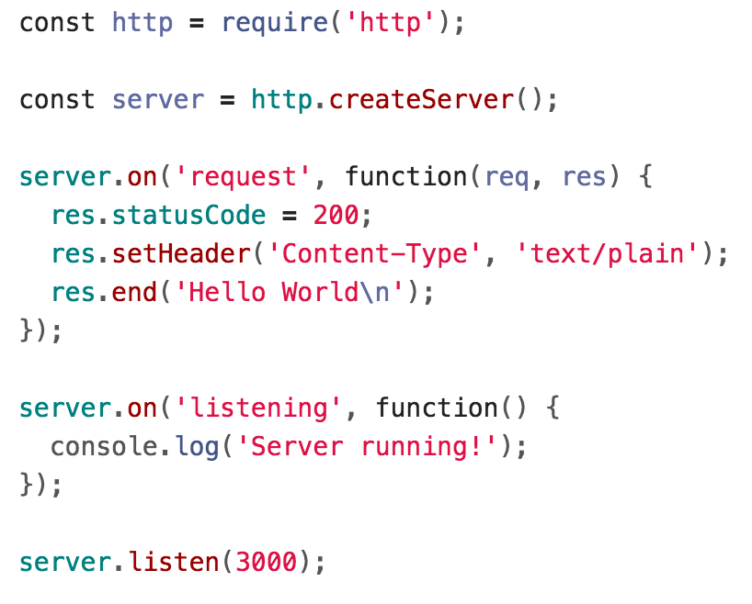
Node for servers
server.js (Code):

Slide 9
Node for servers
Include the HTTP NodeJS library
When the server gets a request, send back "Hello World" in plain text
When the server is started, print a log message
Start listening for messages!

Slide 10
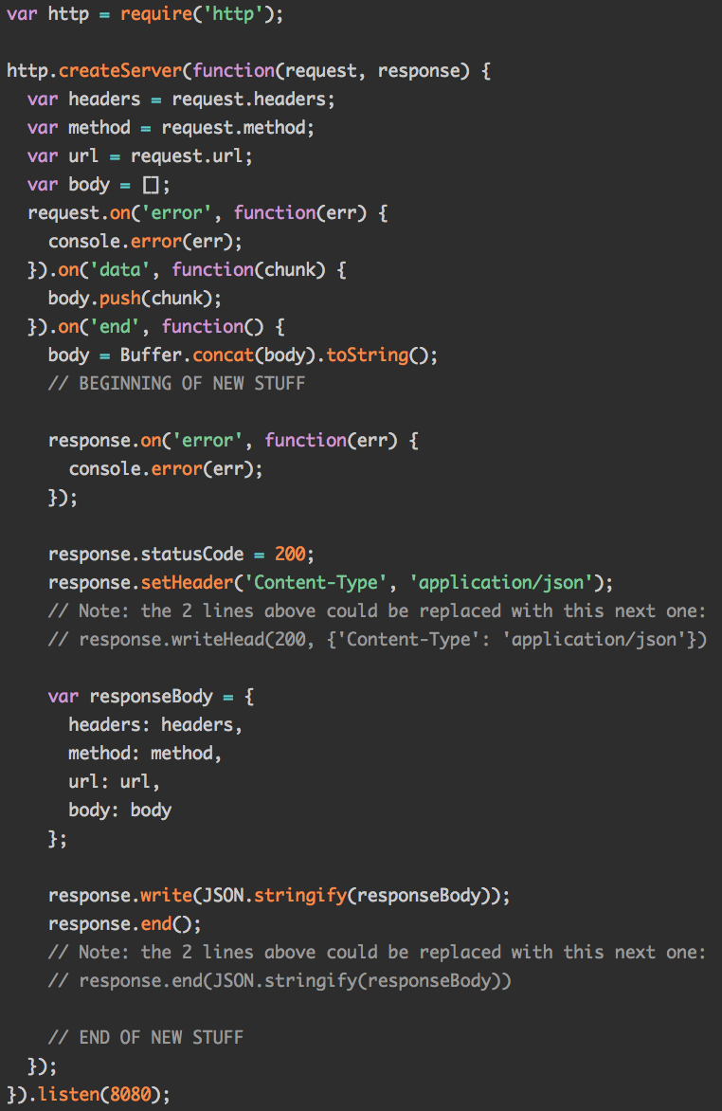
Node for servers
The NodeJS server APIs are actually pretty low-level:
You build the request manually
You write the response manually
There's a lot of tedious processing code

Slide 11
ExpressJS

Slide 12
Node for servers
We're going to use a library called ExpressJS on top of NodeJS. Here's our server code without Express (Code):

Slide 13
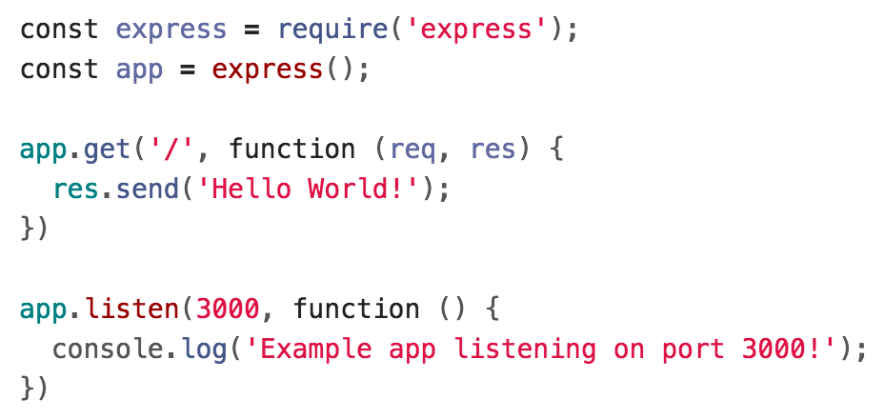
ExpressJS
And with Express (Code):

Slide 14
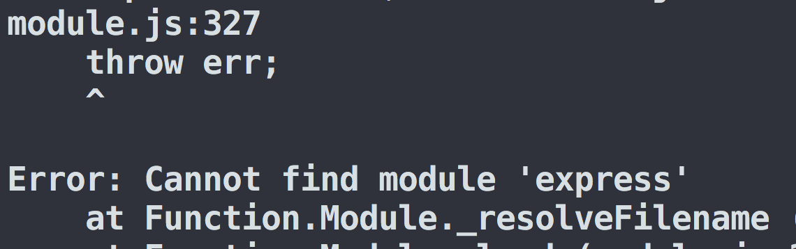
ExpressJS
Express is not part of the NodeJS APIs.
If we try to use it, we'll get an error:
We need to install Express via npm.

Slide 15

npm
When you install NodeJS, you also install npm:
npm: Node Package Manager*:
Command-line tool that lets you install packages (libraries and tools) written in JavaScript and compatible with NodeJS
Can find packages through the online repository:
https://www.npmjs.com/

Slide 16
npm install and uninstall
npm install package-name
This downloads the package-name library into a node_modules folder.
Now the package-name library can be included in your NodeJS JavaScript files.
npm uninstall package-name
This removes the package-name library from the node_modules folder, deleting the folder if necessary

Slide 17
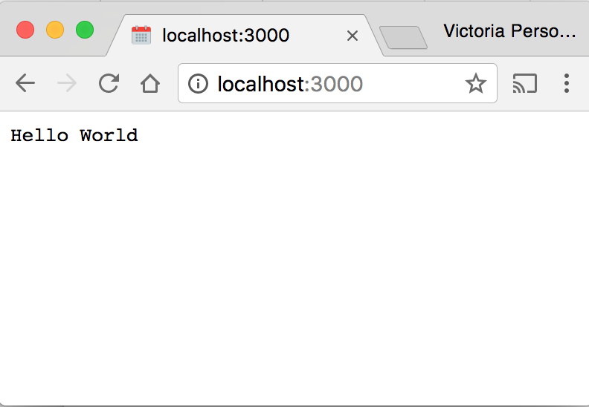
Express example
$ npm install express
$ node server.js
Example app listening on port 3000!

Slide 18
Understanding localhost

Slide 19


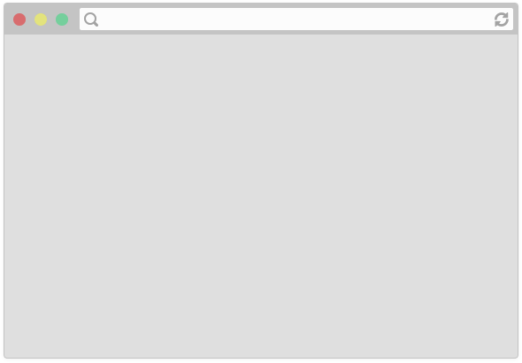
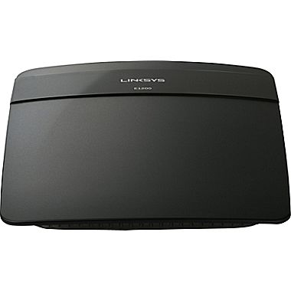
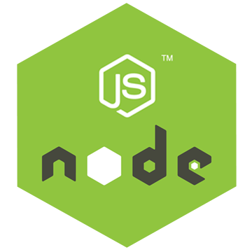
Local server?
The client/server diagrams shown in previous lectures have always involved two separate machines:
Client
Server
(Routing, etc…)
But when we run our server locally, isn't there only one computer involved?

Slide 20
Local server?
The client/server diagrams shown in previous lectures have always involved two separate machines:
Client
Server
(Routing, etc…)
But when we run our server locally, isn't there only one computer involved? A: Yes, when we execute our Node server and access it via localhost, our laptop is both the client and the server machine.

Slide 21
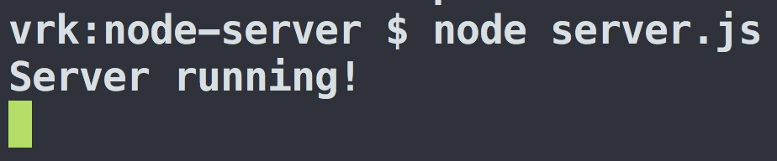
Running a server
When we run $ node server.js which runs server.listen(3000), our laptop becomes a server:
Server
When our laptop's operating system receives HTTP messages sent to port 3000, it will send those messages to our Node server.

Slide 22
Running a server
Q: If our laptop became a server as soon as we ran "node server.js", can other computers connect to our server?
Server

Slide 23
Running a server
Q: If our laptop became a server as soon as we ran "node server.js", can other computers connect to our server?
Server
A: Yes, if we configure our machine correctly. Instead of doing this ourselves, we'll use a tool called localtunnel to help us.

Slide 24
localtunnel
Localtunnel is a command-line tool that is also distributed via npm.
npm install -g package-name
We can install packages globally using the -g switch
Only used for command-line tools
To install localtunnel, we run:
$ npm install -g localtunnel
We can now run the lt command via command-line.

Slide 25
Installing tools with npm
$ npm install package-name
Downloads the package-name library and puts the source code for the library in a node_modules directory.
Used for libraries or command-line tools that will only work in the directory you've installed it.
$ sudo npm install -g package-name
Installs the command-line tools that are provided by package-name.
You will probably need superuser (sudo) privileges.
Only used for command-line tools

Slide 26
localtunnel
If you start your server in one terminal window:
$ node server.js
And you run localtunnel in a different window, using the port number your server is bound to (3000 in our case):
$ lt --port 3000
Localtunnel will reply with a URL that anyone can use to access your locally running server.
Note: This should only be done for development/demos and should *not* be how you deploy services!

Slide 27
localtunnel setup
Node server program: Listening for messages from the OS
Localtunnel.me: Will forward HTTP requests to vrktest.localtunnel.me to Victoria's laptop
(Routing, etc…)
OS: Listening for HTTP messages sent to port 3000
This is the state of the world before anyone connects to vrktest.localtunnel.me...
Server
(jj's laptop)

Slide 28
localtunnel request
"Hey, send this GET request to port 3000"
"GET vrktest.localtunnel.me"
(Routing, etc…)
(Routing, etc…)
"Hey, send this GET request to port 3000"
"GET vrktest.localtunnel.me"
"Hey NodeJS process running on port 3000, here's this GET request"
vrktest.localtunnel.me
Client
(your laptop)

Slide 29
localtunnel response
"The response is 'Hello World'"
"The response is 'Hello World'"
(Routing, etc…)
(Routing, etc…)
"My response is 'Hello World'"
"The response is 'Hello World'"
"OK, my response is 'Hello World'"
vrktest.localtunnel.me
Client
(your laptop)

Slide 30
localtunnel demo
Notice:
If I kill my "node server.js" process, the URL no longer works (will timeout)
If a bunch of people access the URL at the same time, my server handles each response one at a time
If I am doing other stuff on my computer (surfing the web; using PhotoShop) it'll hinder the performance of my server

Slide 31
"Real" servers
Therefore, most "real" servers are setup like this:
Instead of running on a random laptop, servers run on dedicated machines that only runs the server software
Server computers are installed with a different OS that is optimized for running server software
There are backup server computers running in case one dies (software crashes; power goes out; hardware fails; etc)
There are multiple computers with identical server programs running if you have a lot of traffic
  Since each computer can only receive requests one at a time, to receive more requests simultaneously, you need multiple machines

Slide 32
"Real" servers
Veeeeery general rule of thumb: A single-machine server should be able to handle ~1000 to 10,000 simultaneous requests
It will receive each request one at a time
It may process the requests in parallel
(In other words: Unless you are a) expecting >1000 simultaneous requests to your web server, and b) picky about exactly how those requests are served, you really don't need to be deploying your server via AWS, Google Cloud Platform, or other IaaS. It's not that AWS/GCP isn't worth learning; it's just not the first thing you need to learn.)

Slide 33
localtunnel on local machine
(Routing, etc…)
I can also navigate to:
vrktest.localtunnel.me
from my own laptop.
In this scenario, my laptop is both the server and the client.
Server
(jj's laptop)

Slide 34
localtunnel request
"Hey, send this GET request to port 3000"
(Routing, etc…)
"Hey here's this GET request"
(Routing, etc…)
"GET vrktest.localtunnel.me"
vrktest.localtunnel.me
Server
(jj's laptop)
Client
(also jj's laptop)

Slide 35
localtunnel response
"The response is 'Hello World'"
(Routing, etc…)
"OK, my response is 'Hello World'"
(Routing, etc…)
"The response is 'Hello World'"
vrktest.localtunnel.me
Server
(jj's laptop)
Client
(also jj's laptop)

Slide 36
localtunnel is not needed
(Routing, etc…)
(Routing, etc…)
vrktest.localtunnel.me
But since the client and the server are on the same machine… this routing/proxying step is unnecessary.

Slide 37
localhost
localhost:3000
Instead you can query the process running on port 3000 using http://localhost:3000

Slide 38
Localhost request
Browser: "Hey Operating System, send a GET request to localhost:3000"
OS: "Hey Node, you're the thing running on my own port 3000. Here's this GET request."
localhost:3000

Slide 39
Localhost response
OS: "Hey Browser, the response is 'Hello World'"
Node server program: "OK Operating System, my response is 'Hello World'"
localhost:3000

Slide 40
Back to Express

Slide 41
ExpressJS
Here's our server written using NodeJS and Express (Code:
Let's examine what's going on more carefully...

Slide 42
ExpressJS
The require() lets us load the ExpressJS module.
The module actually contains a function that creates a new Express Application object.

Slide 43
ExpressJS
The ExpressJS listen() is identical to the NodeJS listen() function:
This binds the server process to the given port number.
Now messages sent to the OS's port 3000 will be routed to this server process.
The function parameter is a callback that will execute when it starts listening for HTTP messages (when the process has been bound to port 3000)

Slide 44
ExpressJS
app.method(path, handler)
Specifies how the server should handle HTTP method requests made to URL/path
The function callback will fire every time there's a new response.
This example is saying: When there's a GET request to http://localhost:3000/, respond with the text "Hello World!"

Slide 45
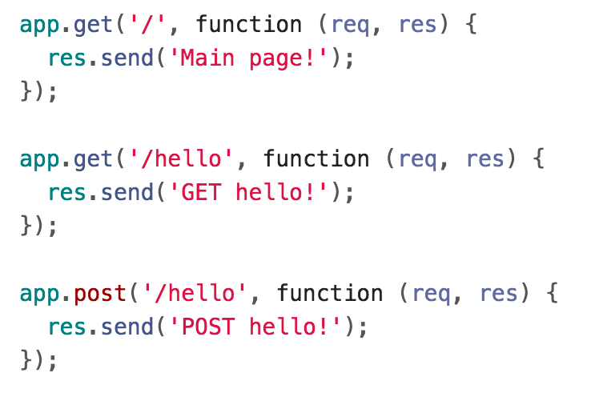
More routes
Here are some other routes in Express:

Slide 46
Handler parameters
Express has its own Request and Response objects:
req is a Request object
res is a Response object
res.send() sends an HTTP response with the given content
  Sends content type "text/html" by default

Slide 47
Hello world server
Here's how we put it all together again:

Slide 48
Querying our server

Slide 49
HTTP requests
Our server is written to respond to HTTP requests (Code):
Q: How do we sent HTTP requests to our server?

Slide 50
Querying our server
Here are three ways to send HTTP requests to our server:
Navigate to http://localhost:3000/<path> in our browser
  Caveat: Can only do GET requests
Call fetch() in web page
  We've done GET requests so far, but can send any type of HTTP request
curl command-line tool
  Debug tool we haven't seen yet

Slide 51
curl
curl: Command-line tool to send and receive data from a server (Manual)
curl --request METHOD url
e.g.
$ curl --request POST http://localhost:3000/hello

Slide 52
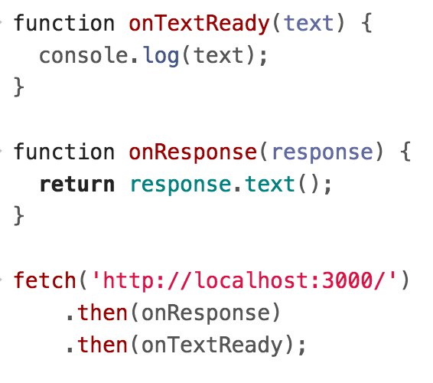
Querying with fetch()
We can try querying our server the same way we've queried the Spotify or Giphy servers, i.e. via the fetch() command:

Slide 53
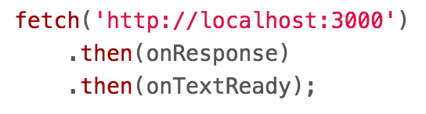
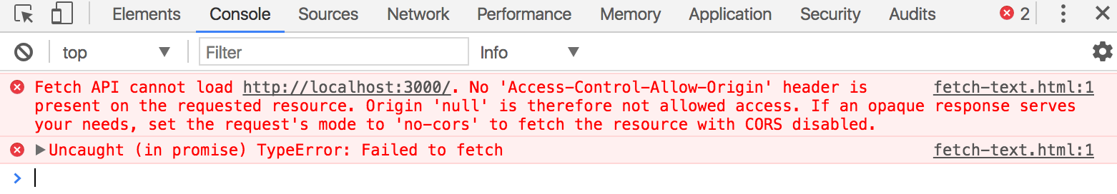
fetch() to localhost
But if we try fetching to localhost from file://
We get this CORS error:

Slide 54
Recall: CORS
CORS: Cross-Origin Resource Sharing (wiki)
Browser policies for what resources a web page can load
You cannot make cross-origin requests by default for:
  Resources loaded via fetch() or XHR
The problem is that we are trying to fetch()
http://localhost:3000 from file:///
Since the two resources have different origins, this is disallowed by default CORS policy

Slide 55
Cross-origin solutions
The problem is that we are trying to fetch()
http://localhost:3000 from file:///
Two ways to solve this:
Change the server running on localhost:3000 to allow cross-origin requests, i.e. to allow requests from different origins (such as file:///)
Preferred solution: Load the frontend code statically from the same server, so that the request is from the same origin

Slide 56
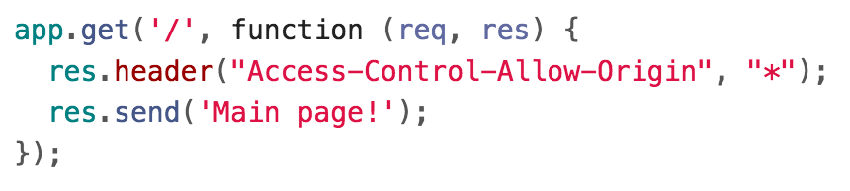
Solution 1: Enable CORS
You can set an Access-Control-Allow-Origin HTTP header before sending your response.
This is the server saying to the browser in its response: "Hey browser, I'm totally fine with websites of any origin requesting this file."

Slide 57
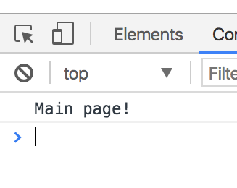
Solution 1: Enable CORS
Now the fetch will succeed (GitHub):

Slide 58
Cross-origin solutions
However, you wouldn't have to enable CORS at all if you were making requests from the same origin.
Preferred solution: Load the frontend code statically from the same server, so that the request is from the same origin.

Slide 59
Recall: Web services
Sometimes when you type a URL into your browser, the URL represents an API endpoint.
That is, the URL represents a parameterized request, and the web server dynamically generates a response to that request.
That's how our NodeJS server treats routes defined like this:

Slide 60
Recall: File servers
Other times when you type a URL in your browser, the URL is a path to a file on the hard drive of the server:
The web server software grabs that file from the server's local file system, and sends back its contents to you
We can make our NodeJS server also sometimes serve files "statically," meaning instead of treating all URLs as API endpoints, some URLs will be treated as file paths.

Slide 61
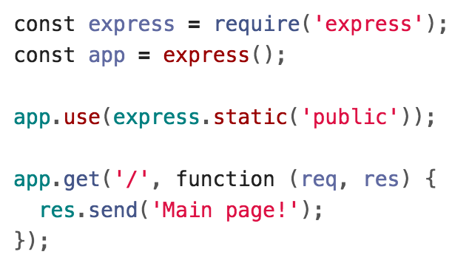
Solution 2: Statically served files
This line of code makes our server now start serving the files in the 'public' directory directly.

Slide 62
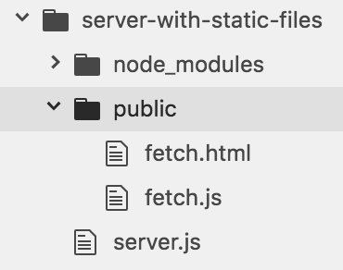
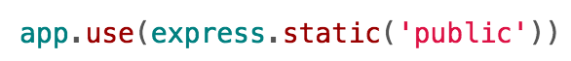
Server static data
Now Express will serve:
http://localhost:3000/fetch.html
http://localhost:3000/fetch.js
Express looks up the files relative to the static directory, so the name of the static directory ("public" in this case) is not part of the URL (Github)

Slide 63
Different fetch() methods

Slide 64
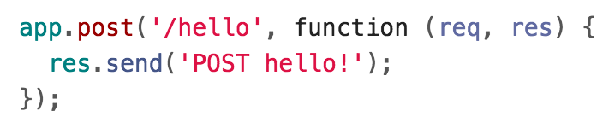
fetch() with POST
On the server-side, we have defined a function in app.post() to handle POST requests to /hello.
Q: How do we make a POST request via fetch()?

Slide 65
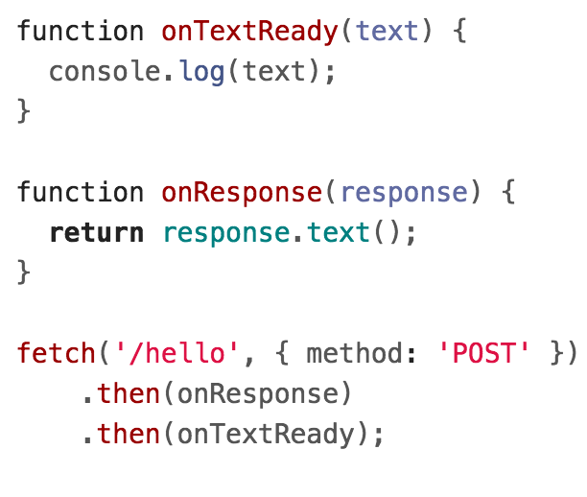
Changing the fetch() method
Q: How do we make a POST request via fetch()?
A: We can change the HTTP method via a second parameter to fetch(), which specifies an options object:
method: specifies the HTTP request method, e.g. POST, PUT, PATCH, DELETE, etc.
  GET is the default value.

Slide 66
fetch() with POST
GitHub

Slide 67
Sending data to the server

Slide 68
Route parameters
When we used the Spotify API, we saw a few ways to send information to the server via our fetch() request.
Example: Spotify Album API
https://api.spotify.com/v1/albums/7aDBFWp72Pz4NZEtVBANi9
The last part of the URL is a parameter representing the album id, 7aDBFWp72Pz4NZEtVBANi9
A parameter defined in the URL of the request is often called a "route parameter."

Slide 69
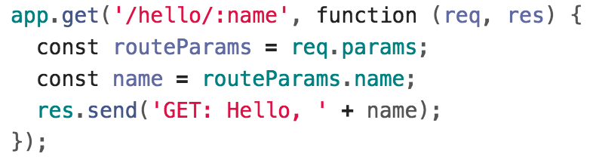
Route parameters
Q: How do we read route parameters in our server?
A: We can use the :variableName syntax in the path to specify a route parameter (Express docs):
We can access the route parameters via req.params.

Slide 70
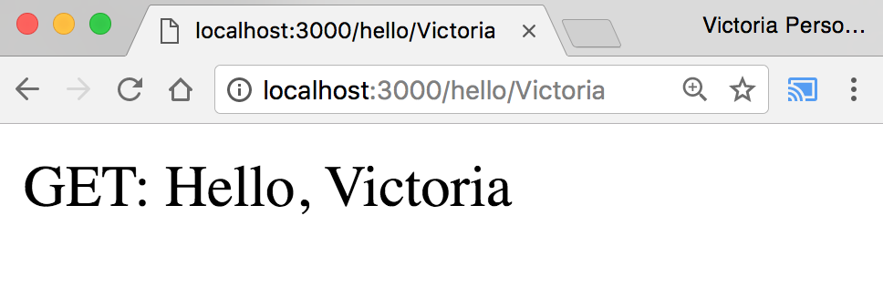
Route parameters
GitHub

Slide 71
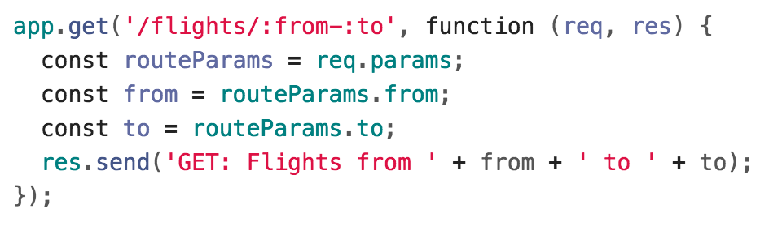
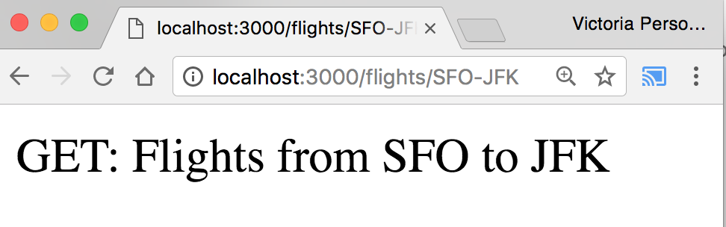
Route parameters
You can define multiple route parameters in a URL (docs):
GitHub

Slide 72
Query parameters
The Spotify Search API was formed a little differently:
Example: Spotify Search API
https://api.spotify.com/v1/search?type=album&q=beyonce
There were two query parameters sent to the Spotify search endpoint:
  type, whose value is album
  q, whose value is beyonce

Slide 73
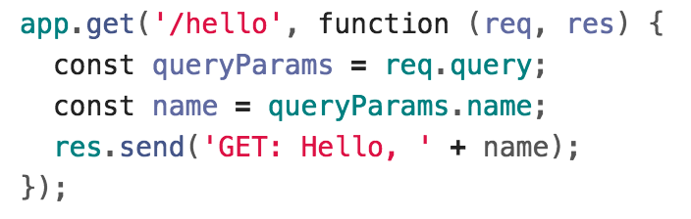
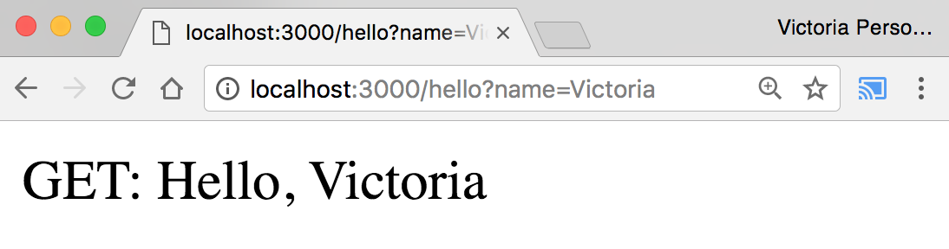
Query parameters
Q: How do we read query parameters in our server?
A: We can access query parameters via req.query:
GitHub

Slide 74
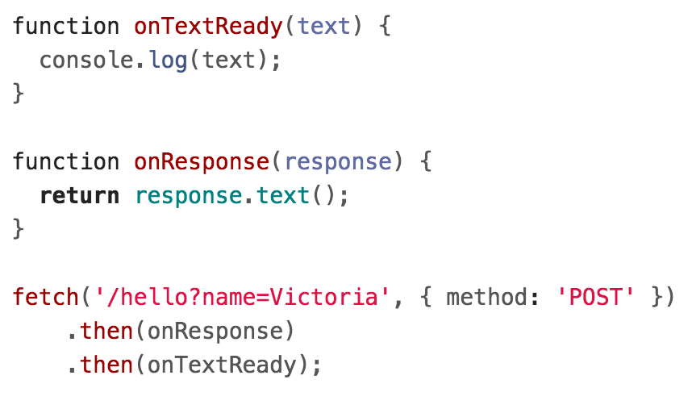
Query params with POST
You can send query parameters via POST as well:
(WARNING: We will not be making POST requests like this!
We will be sending data in the body of the request instead of via query params.)

Slide 75
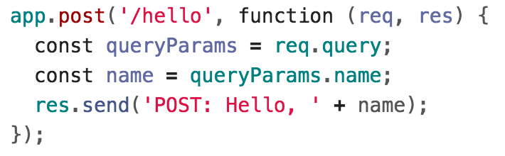
Query params with POST
These parameters are accessed the same way:
GitHub
(WARNING: We will not be making POST requests like this!
We will be sending data in the body of the request instead of via query params.)

Slide 76
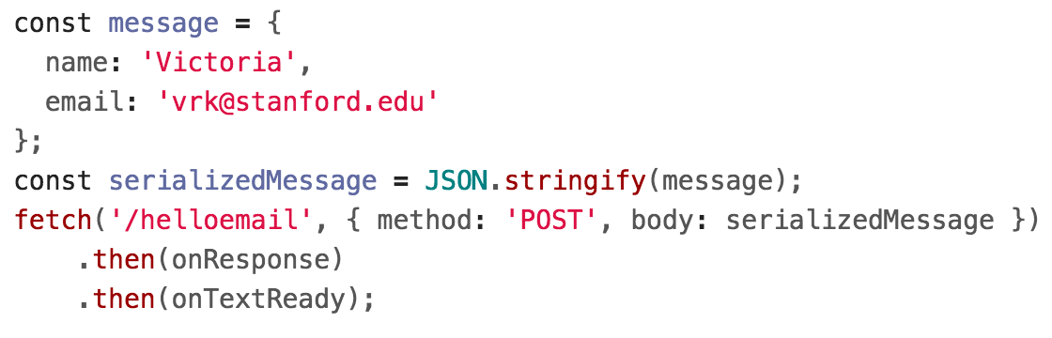
POST message body
However, generally it is poor style to send data via query parameters in a POST request.
Instead, you should specify a message body in your fetch() call:

Slide 77
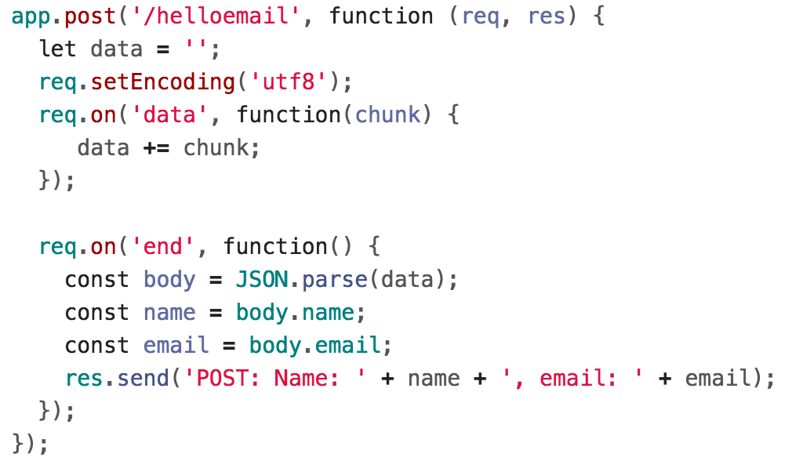
POST message body
Handling the message body in NodeJS/Express is a little messy (GitHub):

Slide 78
body-parser
We can use the body-parser library to help:
This is not a NodeJS API library, so we need to install it:
$ npm install body-parser

Slide 79

body-parser
We can use the body-parser library to help:
This creates a JSON parser stored in jsonParser, which we can then pass to routes whose message bodies we want parsed as JSON.

Slide 80
POST message body
Now instead of this code:

Slide 81
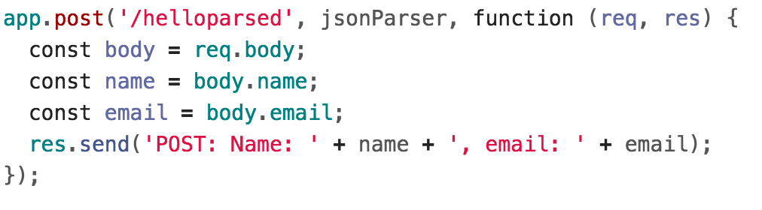
POST message body
We can access the message body through req.body:
GitHub

Slide 82
POST message body
We can access the message body through req.body:
GitHub
Note that we also had to add the jsonParser as a parameter when defining this route.

Slide 83
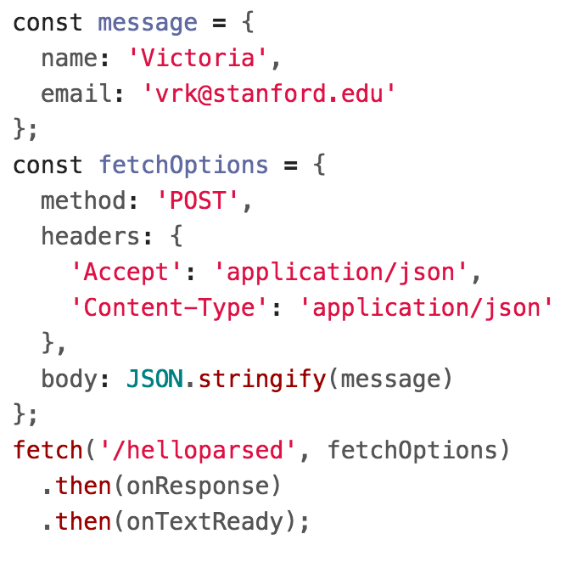
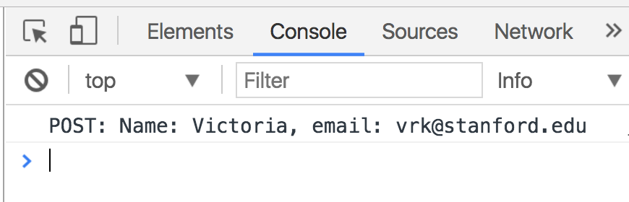
POST message body
Finally, we need to add JSON content-type headers on the fetch()-side (GitHub):

Slide 84
Recap
You can deliver parameterized information to the server in the following ways:
Route parameters
GET request with query parameters
(DISCOURAGED: POST with query parameters)
POST request with message body
Q: When do you use route parameters vs query parameters vs message body?

Slide 85
GET vs POST
Use GET requests for retrieving data, not writing data
Use POST requests for writing data, not retrieving data
You can also use more specific HTTP methods:
  PATCH: Updates the specified resource
  DELETE: Deletes the specified resource
There's nothing technically preventing you from breaking these rules, but you should use the HTTP methods for their intended purpose.

Slide 86
Route params vs Query params
Generally follow these rules:
Use route parameters for required parameters for the request
Use query parameters for:
  Optional parameters
  Parameters whose values can have spaces
These are conventions and are not technically enforced, nor are they followed by every REST API.

Slide 87
Example: Spotify API
The Spotify API mostly followed these conventions:
https://api.spotify.com/v1/albums/7aDBFWp72Pz4NZEtVBANi9
The Album ID is required and it is a route parameter.
https://api.spotify.com/v1/search?type=album&q=the%20weeknd&limit=10
q is required but might have spaces, so it is a query parameter
limit is optional and is a query parameter
type is required but is a query parameter (breaks convention)
Notice both searches are GET requests, too

Slide 88
package.json

Slide 89
Installing dependencies
In our examples, we had to install the express and body-parser npm packages.
$ npm install express
$ npm install body-parser
These get written to the node_modules directory.

Slide 90
Uploading server code
When you upload NodeJS code to a GitHub repository (or any code repository), you should not upload the node_modules directory:
You shouldn't be modifying code in the node_modules directory, so there's no reason to have it under version control
This will also increase your repo size significantly
Q: But if you don't upload the node_modules directory to your code repository, how will anyone know what libraries they need to install?

Slide 91
Managing dependencies
If we don't include the node_modules directory in our repository, we need to somehow tell other people what npm modules they need to install.
npm provides a mechanism for this: package.json

Slide 92
package.json
You can put a file named package.json in the root directory of your NodeJS project to specify metadata about your project.
Create a package.json file using the following command:
$ npm init
This will ask you a series of questions then generate a package.json file based on your answers.

Slide 93
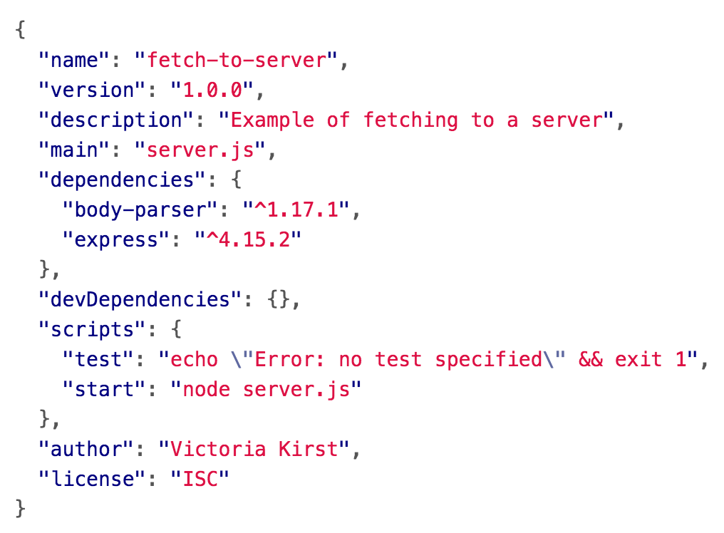
Auto-generated package.json
GitHub

Slide 94
Saving deps to package.json
Now when you install packages, you should pass in the --save parameter:
$ npm install --save express
$ npm install --save body-parser
This will also add an entry for this library in package.json.

Slide 95
Saving deps to package.json
If you remove the node_modules directory:
$ rm -rf node_modules
You can install your project dependencies again via:
$ npm install
This also allows people who have downloaded your code from GitHub to install all your dependencies with one command instead of having to install all dependencies individually.

Slide 96
npm scripts
Your package.json file also defines scripts:
You can run these scripts using $ npm scriptName
E.g. the following command runs "node server.js"
$ npm start

