Slide 1
4102165: Full Stack Web Development Fundamentals
Spring 2019
簡立仁 Li-Ren Chien
ccumouse@gmail.com

Slide 2
Schedule
Today:
Functional JavaScript
Anonymous functions
Currying
Closures
Loading data from files
Fetch API
Promises - High-level!
JSON
HW3 due extend to 10, May
HW4 out

Slide 3
Prereq: Command line
We will start using the command line in class in last few weeks.
We will not be teaching how to use a command line interface.
Please make sure you know how to:
Navigate between directories in a command line
Open / edit files via command-line
Execute scripts via command-line

Slide 4
Practical Functional JavaScript

Slide 5
Example: findIndex
list.findIndex(callback, thisArg):
Returns the index of an element.
callback is a function with the following parameters:
element: The current element being processed.
index: The index of the current element being processed in the array.
array: the array findIndex was called upon.
callback is called for every element in the array, and returns true if found, false otherwise.
thisArg is the value of this in callback

Slide 6
findIndex
const flavors =
['vanilla', 'chocolate', 'strawberry', 'green tea'];
Q: How can we use findIndex to see whether or not 'strawberry' is in the flavors list?

Slide 7
findIndex
const flavors =
['vanilla', 'chocolate', 'strawberry', 'green tea'];
Define a testing function, to be called on each element in the list. (Returns true if it passes the test.)
function isStrawberry(element) {
return element === 'strawberry';
}
The testing function can take element, index, and array as parameters, but we are only using element.

Slide 8
findIndex
const flavors =
['vanilla', 'chocolate', 'strawberry', 'green tea'];
2. Pass the testing function into findIndex.
function isStrawberry(element) {
return element === 'strawberry';
}
const indexOfStrawberry = flavors.findIndex(isStrawberry);

Slide 9
findIndex
const flavors =
['vanilla', 'chocolate', 'strawberry', 'green tea'];
function isStrawberry(element) {
return element === 'strawberry';
}
const indexOfStrawberry = flavors.findIndex(isStrawberry);
The isStrawberry function will fire for each element in the array.

Slide 10
findIndex
const flavors =
['vanilla', 'chocolate', 'strawberry', 'green tea'];
function isStrawberry(element) {
return element === 'strawberry';
}
const indexOfStrawberry = flavors.findIndex(isStrawberry);

Slide 11
findIndex
const flavors =
['vanilla', 'chocolate', 'strawberry', 'green tea'];
function isStrawberry(element) {
return element === 'strawberry';
}
const indexOfStrawberry = flavors.findIndex(isStrawberry);
Returns false, so keep searching.

Slide 12
findIndex
const flavors =
['vanilla', 'chocolate', 'strawberry', 'green tea'];
function isStrawberry(element) {
return element === 'strawberry';
}
const indexOfStrawberry = flavors.findIndex(isStrawberry);

Slide 13
findIndex
const flavors =
['vanilla', 'chocolate', 'strawberry', 'green tea'];
function isStrawberry(element) {
return element === 'strawberry';
}
const indexOfStrawberry = flavors.findIndex(isStrawberry);
Returns false, so keep searching.

Slide 14
findIndex
const flavors =
['vanilla', 'chocolate', 'strawberry', 'green tea'];
function isStrawberry(element) {
return element === 'strawberry';
}
const indexOfStrawberry = flavors.findIndex(isStrawberry);

Slide 15
findIndex
const flavors =
['vanilla', 'chocolate', 'strawberry', 'green tea'];
function isStrawberry(element) {
return element === 'strawberry';
}
const indexOfStrawberry = flavors.findIndex(isStrawberry);
Returns true, so stop searching.

Slide 16
findIndex
const flavors =
['vanilla', 'chocolate', 'strawberry', 'green tea'];
function isStrawberry(element) {
return element === 'strawberry';
}
const indexOfStrawberry = flavors.findIndex(isStrawberry);
findIndex returns 2, since the first element to pass the testing function was found at index 2. (CodePen)

Slide 17
findIndex
const flavors =
['vanilla', 'chocolate', 'strawberry', 'green tea'];
function isStrawberry(element) {
return element === 'strawberry';
}
const indexOfStrawberry = flavors.findIndex(isStrawberry);
Let's clean this up a little bit...

Slide 18
Anonymous functions

Slide 19
Anonymous functions
We do not need to give an identifier to functions.
When we define a function without an identifier, we call it an anonymous function
Also known as a function literal, or a lambda function
We can define our test function directly in findIndex:
function isStrawberry(element) {
return element === 'strawberry';
}
const index = flavors.findIndex(isStrawberry);

Slide 20
Anonymous functions
We do not need to give an identifier to functions.
When we define a function without an identifier, we call it an anonymous function
Also known as a function literal, or a lambda function
We can define our test function directly in findIndex:
const index = flavors.findIndex(
function(element) { return element === 'strawberry'; });

Slide 21
Arrow functions
We can use the arrow function syntax for defining functions:
const index = flavors.findIndex(
function(element) { return element === 'strawberry'; });

Slide 22
Arrow functions
We can use the arrow function syntax for defining functions:
const index = flavors.findIndex(
(element) => { return element === 'strawberry'; });

Slide 23
Concise arrow functions
We can use the concise version of the arrow function:
You can omit the parentheses if there is only one parameter
You can omit the curly braces if there's only one statement in the function, and it's a return statement
const index = flavors.findIndex(
(element) => { return element === 'strawberry'; });

Slide 24
Concise arrow functions
We can use the concise version of the arrow function:
You can omit the parentheses if there is only one parameter
You can omit the curly braces if there's only one statement in the function, and it's a return statement
const index = flavors.findIndex(
element => element === 'strawberry');

Slide 25
Case-insensitive search
If we wanted to make this case insensitive, we could do:
const index = flavors.findIndex(
element => element.toLowerCase() === 'strawberry');

Slide 26
Case-insensitive search
If we wanted to make this case insensitive, we could do:
const index = flavors.findIndex(
element => element.toLowerCase() === 'strawberry');
This is a lot more elegant than the for-loop approach!
for (let i = 0; i < flavors.length; i++) {
if (flavors[i].toLowerCase() === 'strawberry') {
break;
} }
const index = i;

Slide 27
Currying

Slide 28
isFlavor
What if instead of checking specifically for strawberry...
function isStrawberry(element) {
return element === 'strawberry';
}

Slide 29
isFlavor
...we wanted to create a generic isFlavor checker?
function isFlavor(flavor, element) {
return element === flavor;
}

Slide 30
isFlavor
const flavors =
['vanilla', 'chocolate', 'strawberry', 'green tea'];
function isFlavor(element) {
// ERROR: flavor is undefined!
return element === flavor;
}
const indexOfFlavor = flavors.findIndex(isFlavor);
The problem is there's no way to pass in the flavor parameter in the callback for findIndex...

Slide 31
Currying
const flavors =
['vanilla', 'chocolate', 'strawberry', 'green tea'];
function createFlavorTest(flavor) {
function isFlavor(element) {
return element === flavor;
}
return isFlavor;
}
const isStrawberry = createFlavorTest('strawberry');
const indexOfFlavor = flavors.findIndex(isStrawberry);
Solution: Create a function that takes a flavor parameter and creates a testing function for that parameter. (CodePen)

Slide 32
Aside: closure
const flavors =
['vanilla', 'chocolate', 'strawberry', 'green tea'];
function createFlavorTest(flavor) {
function isFlavor(element) {
return element === flavor;
}
return isFlavor;
}
const isStrawberry = createFlavorTest('strawberry');
const indexOfFlavor = flavors.findIndex(isStrawberry);
Aside: Any function that is declared within another function is called a closure. Closures can refer to variables in the outer function (flavor in this case).

Slide 33
Currying
function isFlavor(flavor, element) {
return element === flavor;
}
This idea is called currying: breaking down a function with multiple arguments by applying one at a time in a sequence of created functions.
function createFlavorTest(flavor) {
function isFlavor(element) {
return element === flavor;
}
return isFlavor;
}
flavors.findIndex(isFlavor);

Slide 34
Review: ES6 classes
ES6 classes mostly work the way you expect
this in a constructor: refers to the new object being created
this outside a constructor: refers to a different value depending on how the function is called
In response to a DOM event, this is the element that the event handler was tied to
When called in a method, this is the object that the method is called from
bind: sets the value of this for a function so it does not change depending on the context

Slide 35
Review: Functional JavaScript
Functions in JavaScript are first-class citizens:
Objects that can be passed as parameters
Can be created within functions:
Inner functions are called closures
Can be created without being saved to a variable
These are called anonymous functions, or function literals, or lambdas
Can be created and returned from functions
Constructing a new function that references part of the outer function's parameters is called currying

Slide 36
More Array functions
Function name | Description
list.forEach(function) | Executes the provided function once for each array element. (mdn)
list.filter(function) | Creates a new array with all elements that pass the test implemented by the provided function. (mdn)
list.every(function) | Tests whether all elements in the array pass the test implemented by the provided function. (mdn)
All Array functions

Slide 37
Loading data from files

Slide 38
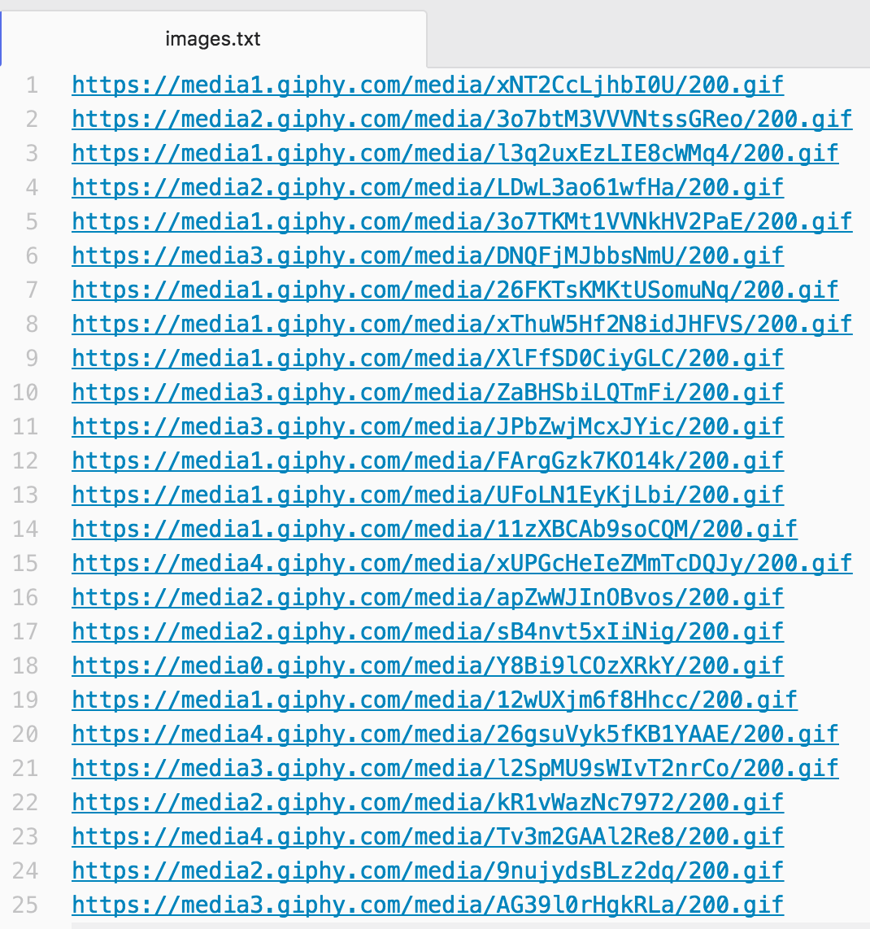
Loading data from a file
What if you had a list of images in a text file that you wanted to load in your web page?

Slide 39
Intuition: loadFromFile
If we wanted to have an API to load external files in JavaScript, it might look something like this:
// FAKE HYPOTHETICAL API.
// This is not real a JavaScript function!
const contents = loadFromFile('images.txt');

Slide 40
Intuition: loadFromFile
// FAKE HYPOTHETICAL API.
// This is not real a JavaScript function!
const contents = loadFromFile('images.txt');
A few problems with this hypothetical fake API:
We want to load the file asynchronously: the JavaScript should not block while we're loading the file
There's no way to check the status of the request. What if the resource didn't exist? What if we're not allowed to access the resource?

Slide 41
Intuition: loadFromFile
An asynchronous version of this API might look like this:
// FAKE HYPOTHETICAL API.
// This is not real a JavaScript function!
function onSuccess(response) {
const body = response.text;
...
}
loadFromFile('images.txt', onSuccess, onFail);
Where onSuccess and onFail are callback functions that should fire if the request succeeded or failed, respectively.

Slide 42
Fetch API

Slide 43
Fetch API: fetch()
The Fetch API is the API to use to load external resources (text, JSON, etc) in the browser.
The Fetch API is made up of one function, and its syntax is is concise and easy to use:
fetch('images.txt');
Note: XMLHttpRequest ("XHR") is the old API for loading resources from the browser. XHR still works, but is clunky and harder to use.

Slide 44
Fetch API: fetch()
The Fetch API is the API to use to load external resources (text, JSON, etc) in the browser.
The Fetch API is made up of one function, and its syntax is is concise and easy to use:
fetch('images.txt');
The fetch() method takes the string path to the resource you want to fetch as a parameter
It returns a Promise

Slide 45
Fetch API: fetch()
The Fetch API is the API to use to load external resources (text, JSON, etc) in the browser.
The Fetch API is made up of one function, and its syntax is is concise and easy to use:
fetch('images.txt');
The fetch() method takes the string path to the resource you want to fetch as a parameter
It returns a Promise
What the heck is a Promise?

Slide 46
Promises: Another conceptual odyssey

Slide 47
Promises and .then()
A Promise:
An object used to manage asynchronous results
Has a then() method that lets you attach functions to execute onSuccess or onError
Allows you to build chains of asynchronous results.
Promises are easier to use than to define...

Slide 48
Simple example: getUserMedia
There is an API called getUserMedia that allows you get the media stream from your webcam.
There are two versions of getUserMedia:
navigator.getUserMedia (deprecated)
Uses callbacks
navigator.mediaDevices.getUserMedia
Returns a Promise

Slide 49
getUserMedia with callbacks
const video = document.querySelector('video');
function onCameraOpen(stream) {
video.srcObject = stream;
}
function onError(error) {
console.log(error);
}
navigator.getUserMedia({ video: true },
onCameraOpen, onError);
CodePen

Slide 50
getUserMedia with Promise
const video = document.querySelector('video');
function onCameraOpen(stream) {
video.srcObject = stream;
}
function onError(error) {
console.log(error);
}
navigator.mediaDevices.getUserMedia({ video: true })
.then(onCameraOpen, onError);
CodePen

Slide 51
Hypothetical Fetch API
// FAKE HYPOTHETICAL API.
// This is not how fetch is called!
function onSuccess(response) {
...
}
function onFail(response) {
...
}
fetch('images.txt', onSuccess, onFail);

Slide 52
Real Fetch API
function onSuccess(response) {
...
}
function onFail(response) {
...
}
fetch('images.txt').then(onSuccess, onFail);

Slide 53
Promise syntax
Q: How does this syntax work?
fetch('images.txt').then(onSuccess, onFail);

Slide 54
Promise syntax
Q: How does this syntax work?
fetch('images.txt').then(onSuccess, onFail);
The syntax above is the same as:
const promise = fetch('images.txt');
promise.then(onSuccess, onFail);

Slide 55
Promise syntax
const promise = fetch('images.txt');
promise.then(onSuccess, onFail);
The object fetch returns is of type Promise.
A promise is in one of three states:
pending: initial state, not fulfilled or rejected.
fulfilled: the operation completed successfully.
rejected: the operation failed.
You attach handlers to the promise via .then()

Slide 56
Promise syntax
const promise = fetch('images.txt');
promise.then(onSuccess, onFail);
The object fetch returns is of type Promise.
A promise is in one of three states:
pending: initial state, not fulfilled or rejected.
fulfilled: the operation completed successfully.
rejected: the operation failed.
You attach handlers to the promise via .then()
(We'll think about this more deeply in a later lecture.)
(Right now we will just use Promises.)

Slide 57
Using Fetch
function onSuccess(response) {
console.log(response.status);
}
fetch('images.txt').then(onSuccess);
The success function for Fetch gets a response parameter:
response.status: Contains the status code for the request, e.g. 200 for HTTP success
HTTP status codes

Slide 58
Fetch attempt
function onSuccess(response) {
console.log(response.status);
}
function onError(error) {
console.log('Error: ' + error);
}
fetch('images.txt')
.then(onSuccess, onError);

Slide 59
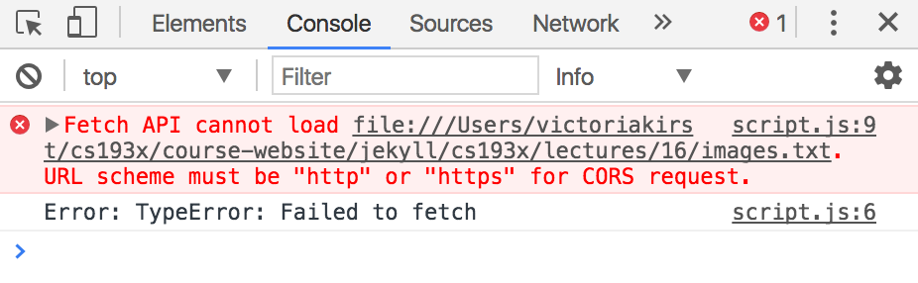
Fetch error
If we try to load this in the browser, we get the following JavaScript error:
Notice that our onError function was also called.

Slide 60
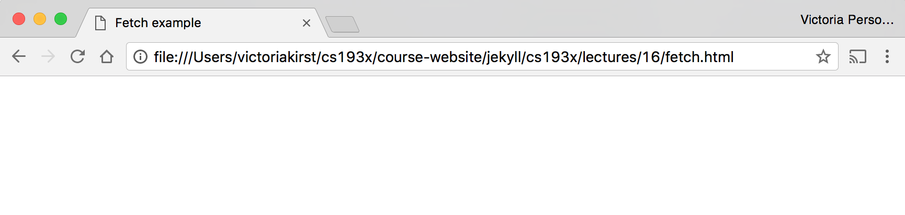
Local files
When we load a web page in the browser that is saved on our computer, it is served via file:// protocol:
We are not allowed to load files in JavaScript from the file:// protocol, which is why we got the error.

Slide 61
Serve over HTTP
We can run a program to serve our local files over HTTP:
$ python -m SimpleHTTPServer
Serving HTTP on 0.0.0.0 port 8000 ...
This now starts up a server that can load the files in the current directory over HTTP.
We can access this server by navigating to:
http://localhost:8000/

Slide 62
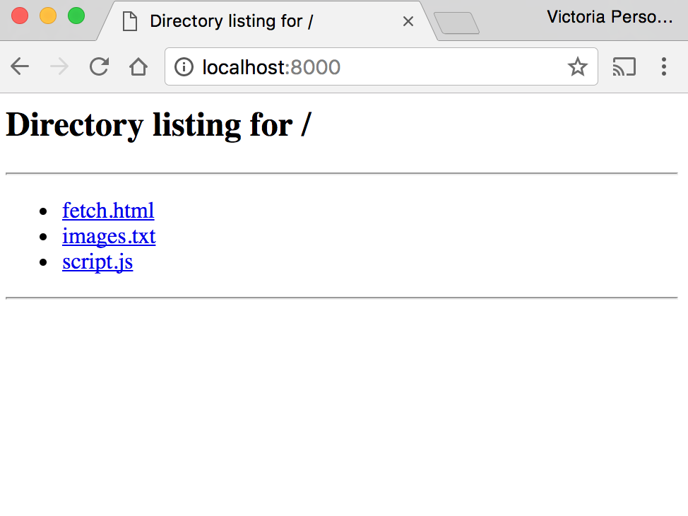
$ python -m SimpleHTTPServer
Serving HTTP on 0.0.0.0 port 8000 ...

Slide 63
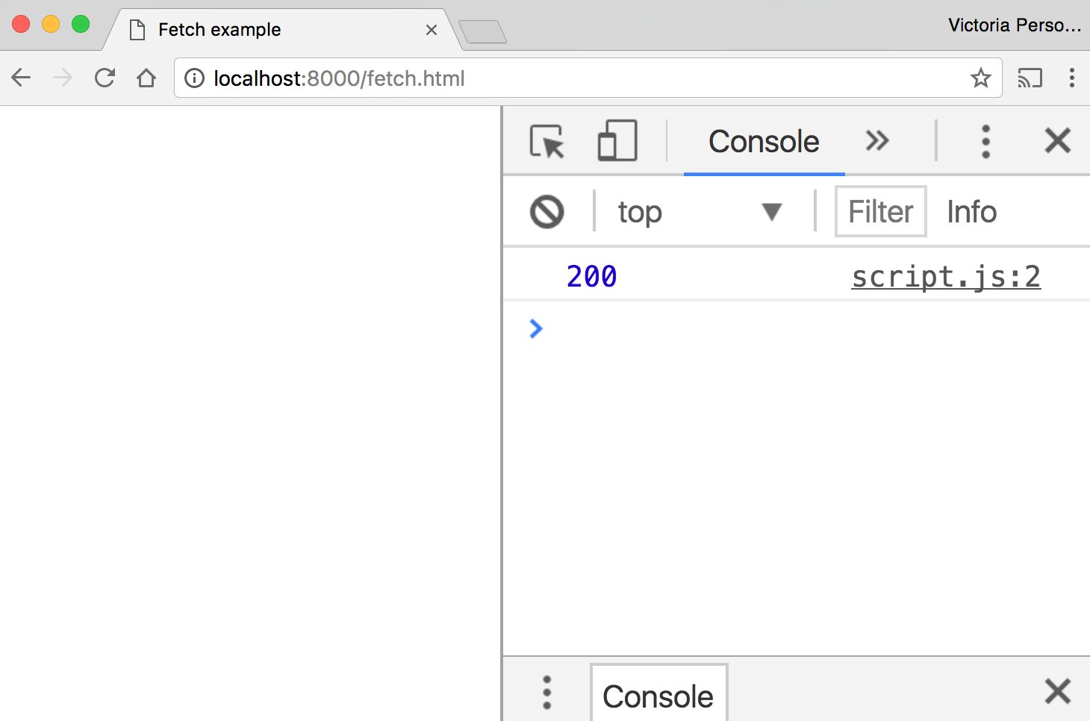
We got HTTP response 200, which is success! (codes)

Slide 64
How do we get the data from fetch()?

Slide 65
Using Fetch
function onSuccess(response) {
..
}
fetch('images.txt').then(onSuccess);
response.status: Status code for the request
response.text():
Asynchronously reads the response stream
Returns a Promise that resolves with the string containing the response stream data.

Slide 66
text() Promise
Q: How do we change the following code to print out the response body?
function onSuccess(response) {
console.log(response.status);
}
function onError(error) {
console.log('Error: ' + error);
}
fetch('images.txt')
.then(onSuccess, onError);

Slide 67
function onStreamProcessed(text) {
console.log(text);
}
function onResponse(response) {
console.log(response.status);
response.text().then(onStreamProcessed);
}
function onError(error) {
console.log('Error: ' + error);
}
fetch('images.txt').then(onResponse, onError);

Slide 68
Chaining Promises
We want the following asynchronous actions to be completed in this order:
When the fetch completes, run onResponse
When response.text() completes, run onStreamProcessed
function onStreamProcessed(text) { … }
function onResponse(response) {
response.text().then(onStreamProcessed);
}
fetch('images.txt').then(onResponse, onError);

Slide 69
We can rewrite this:
function onStreamProcessed(text) {
console.log(text);
}
function onResponse(response) {
response.text().then(onStreamProcessed);
}
function onError(error) {
console.log('Error: ' + error);
}
fetch('images.txt').then(onResponse, onError);

Slide 70
We can rewrite this:
function onStreamProcessed(text) {
console.log(text);
}
function onResponse(response) {
return response.text();
}
function onError(error) {
console.log('Error: ' + error);
}
fetch('images.txt')
.then(onResponse, onError)
.then(onStreamProcessed);

Slide 71
Chaining Promises
function onStreamProcessed(text) {
console.log(text);
}
function onResponse(response) {
return response.text();
}
fetch('images.txt')
.then(onResponse, onError)
.then(onStreamProcessed);

Slide 72
Chaining Promises
function onStreamProcessed(text) {
console.log(text);
}
function onResponse(response) {
return response.text();
}
const responsePromise = fetch('images.txt')
.then(onResponse, onError)
responsePromise.then(onStreamProcessed);
The Promise returned by onResponse is effectively* the Promise returned by fetch. (*Not actually what's happening, but that's how we'll think about it for right now.)

Slide 73
Chaining Promises
function onStreamProcessed(text) {
console.log(text);
}
function onResponse(response) {
return response.text();
}
fetch('images.txt')
.then(onResponse, onError)
.then(onStreamProcessed);
If we don't think about it too hard, the syntax is fairly intuitive.
We'll think about this more deeply later!

Slide 74
Completed example
function onStreamProcessed(text) {
const urls = text.split('\n');
for (const url of urls) {
const image = document.createElement('img');
image.src = url;
document.body.append(image);
}
}
function onSuccess(response) {
response.text().then(onStreamProcessed)
}
function onError(error) {
console.log('Error: ' + error);
}
fetch('images.txt').then(onSuccess, onError);

Slide 75
JSON

Slide 76
JavaScript Object Notation
JSON: Stands for JavaScript Object Notation
Created by Douglas Crockford
Defines a way of serializing JavaScript objects
to serialize: to turn an object into a string that can be deserialized
to deserialize: to turn a serialized string into an object
JSON.stringify(object) returns a string representing object serialized in JSON format
JSON.parse(jsonString) returns a JS object from the jsonString serialized in JSON format

Slide 77
JSON.stringify()
We can use the JSON.stringify() function to seralize a JavaScript object:
const bear = { name: 'Ice Bear',
hobbies: ['knitting', 'cooking', 'dancing'] };
const serializedBear = JSON.stringify(bear);
console.log(serializedBear);
CodePen

Slide 78
JSON.parse()
We can use the JSON.parse() function to deseralize a JavaScript object:
const bearString = '{"name":"Ice Bear","hobbies":["knitting","cooking","dancing"]}';
const bear = JSON.parse(bearString);
console.log(bear);
CodePen

Slide 79
Why JSON?
JSON is a useful format for storing data that we can load into a JavaScript API via fetch().
Let's say we had a list of Songs and Titles.
If we stored it as a text file, we would have to know how we are separating song name vs title, etc
If we stored it as a JSON file, we can just deserialize the object.

Slide 80
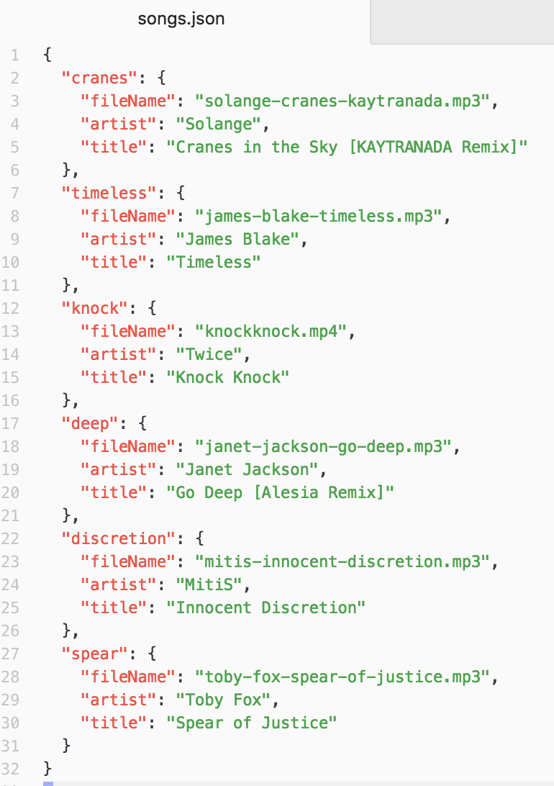
JSON

Slide 81
Fetch API and JSON
The Fetch API also has built-in support for json:
function onStreamProcessed(json) {
console.log(json);
}
function onResponse(response) {
return response.json();
}
fetch('songs.json')
.then(onResponse, onError)
.then(onStreamProcessed);

