Slide 1
4102165:
Full Stack Web Development Fundamentals
Spring 2019
簡立仁 Li-Ren Chien
ccumouse@gmail.com

Slide 2
Today's schedule
Our last lecture!
Next steps: General advice
Important ideas we didn't cover
Libraries and frameworks
Final advice

Slide 3
The #1 question

Slide 4

How do I stay up to date??
There are so many changing technologies…
How do I know which ones to use?
How do I learn about new libraries?
Won't everything I learn be obsolete in 2 months?!?!
(Note: not a real article)

Slide 5
Q: How do I stay up to date??
A: This is the wrong question to ask.
Staying "up to date" is not that important.
Tech doesn't fundamentally change very often or very fast.

Slide 6
New tech: Helpful, not necessary
Most new web technology makes your life easier but is not necessary.
Examples:
const and let
async / await
CSS variables, etc
Everything* you want to do can already be done with the web technology available not just today, but 10 years ago.
*You know, within reason

Slide 7
Fundamentals don't change
Tech doesn't change that quickly
Much of Facebook is still written in PHP
Most of Google is written in Java and C++
You will not (and should not) totally rewrite your codebase every year
Tons of parallel problems, patterns, etc across tech
Personal anecdote:
I learned web programming 20 years ago then didn't use it professionally for many years
It took me 1 week to "catch up" on new stuff… because they were all solutions to old problems

Slide 8
The real question to ask
Also: Many new libraries are bad.
Literally anyone can post a library on npm - there is no
Most libraries on npm are therefore garbage
Even popular libraries can be poorly written.
So the real question to ask:
How do I distinguish good web technology from bad web technology?

Slide 9

Choosing good tools
Either:
You have enough knowledge to be able to decide whether a tool or technology is beneficial

Slide 10
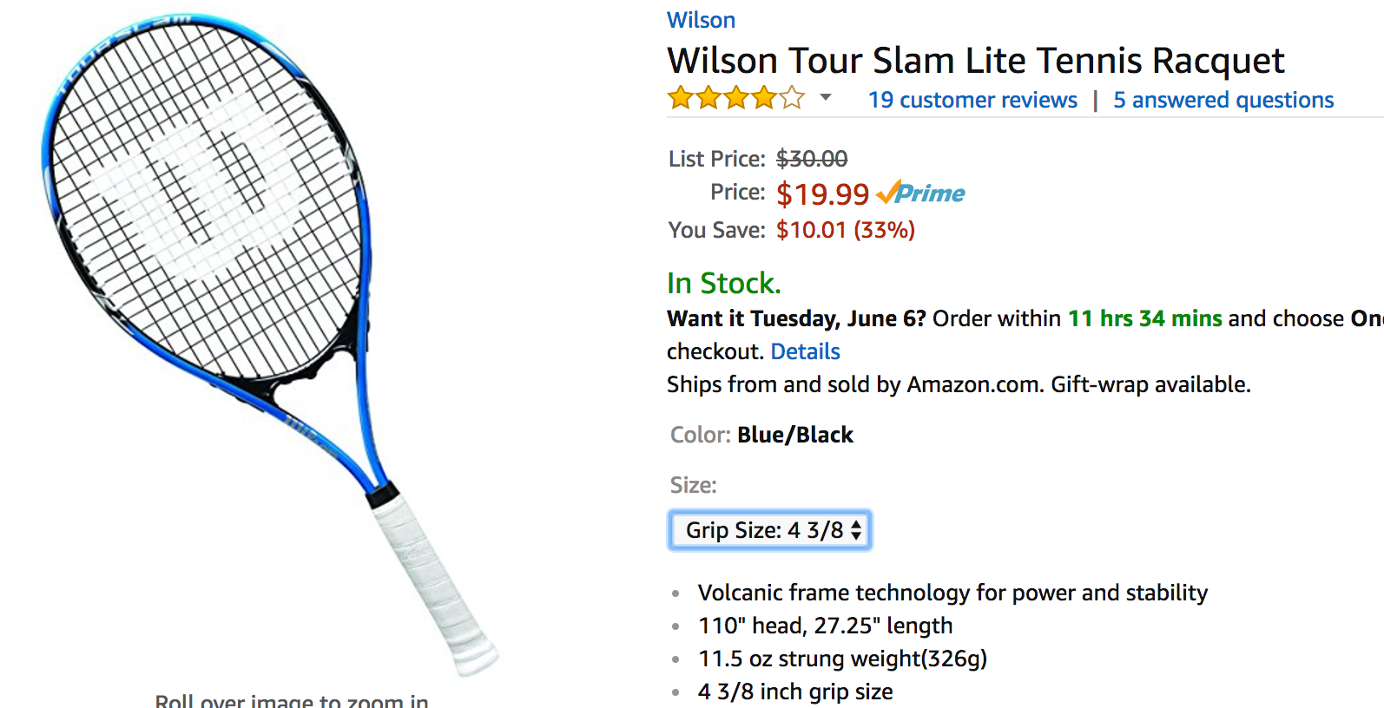
Choosing good tools
Or:
You don't have enough knowledge to tell the difference
Therefore it doesn't really matter
And you should choose the simplest / cheapest thing that other people say is good

Slide 11
Choosing good tools
If you keep getting better at tennis, someday you'll look back at your first racquet and think
"OMG how was I using this terrible racquet" or,
"Lol I had a $300 racquet and had no idea how to use it", or
"Huh, that cheap one was actually pretty good"
But the ability to choose good tools takes expertise and experience that you don't have as a beginner.

Slide 12




Choosing good tools
And sometimes there's just a bit of personal preference

Slide 13
General advice
Focus on becoming a good engineer.
Learn how to build good software in any language, frontend, backend, web, iOS, Android, data pipelines, anything.
Work as a full-time software engineer for N years with other (good) people.
Even after 1 year working full-time, your engineering skills will improve immensely
This is how you will develop and hone your own technical judgement.

Slide 14
General advice
Don't be afraid or intimidated by new technology.
When you confront a new web thing, like a library or framework, one of two things will happen:
You will be excited by it, and you will want to use it.
You will not be excited by it, and you can safely ignore it.
Simpler is always better.
ALWAYS delete code if you can
ALWAYS remove a library if you can
ALWAYS remove a framework if you can

Slide 15
Helpful CS classes
Recommended CS classes:
Databases
As many systems classes as you can take
  Networking
  Operating Systems
Compilers
Programming languages

Slide 16
With that context...

Slide 17
What next?
4102165 is a fundamentals course, meaning we covered the critical stuff, but we just scratched the surface.
We'll do a quick tour of the following:
Topics you really-really-really ought to know
Topics you might find handy
Opinions on libraries
Final suggestions

Slide 18
Topics you really-really-really ought to know

Slide 19
Testing

Slide 20
Missed topic: Robustness
The code we wrote in course is extremely fragile:
No tests
  Especially dangerous on backend… we can accidentally delete the entire database with one line of code.
No type checking
No backups for databases
Doesn't work on older browsers
Etc

Slide 21
Spot the difference
What's the difference between the following code snippets?
// A
const query = { _id: ObjectID(id) };
userData.deleteOne(query);
// B
const query = { };
userData.deleteOne(query);

Slide 22
Spot the difference
What's the difference between the following code snippets?
// A: Deletes the specified document (or
// does nothing if not found).
const query = { _id: ObjectID(id) };
userData.deleteOne(query);
// B: Deletes the first document.
const query = { };
userData.deleteOne(query);

Slide 23
MUST: Server-side Testing
If you write production server code, you must write tests.
Q: What are tests?
A test is a type of software that verifies the code you wrote works
Tests help you:
  Verify everything works before you launch your product
  Catch regressions as you modify code

Slide 24
MUST: Server-side Testing
You should probably write tests for all your code, but server is especially important
Check out:
MochaJS: A popular JavaScript test framework that works on frontend and backend (NodeJS) code
Jest: Facebook's JS test framework
Chai: Helper library to write easier-to-read tests
  Used with Mocha, Jest, etc
Warning: Setting up tests for the first time always sucks.

Slide 25
Module bundlers

Slide 26
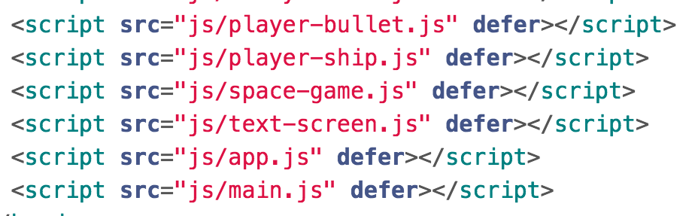
Missed topic: Bundling
Our frontend JavaScript includes look ridiculous:
Have to define JavaScript includes in HTML
Have to remember the include order
  Can't specify dependencies, e.g. PlayerBullet must be included before PlayerShip, but is independent of TextScreen

Slide 27
SHOULD: JavaScript modules
We want a module system for our frontend JavaScript.
Recall: NodeJS has a module system using require()
Tooling option: Module bundlers
Browserify
WebPack
Not ready yet: A native JavaScript option
ES6 modules and import

Slide 28

Browserify
Lets you use require() in frontend JavaScript,
exactly like how it would work in NodeJS.
You can write your own modules and require them
You can download NodeJS modules and require them
Browserify works by transpiling the code written using require() statements into code that can be executed in the browser.

Slide 29
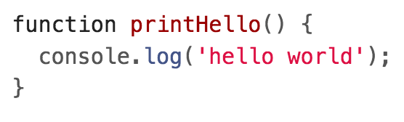

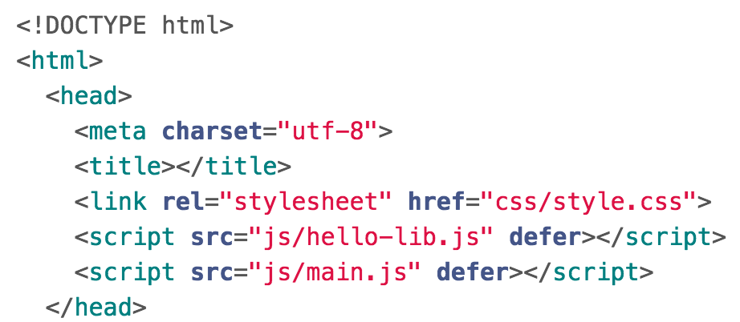
Before: Raw JS
hello-lib.js
main.js
index.html

Slide 30
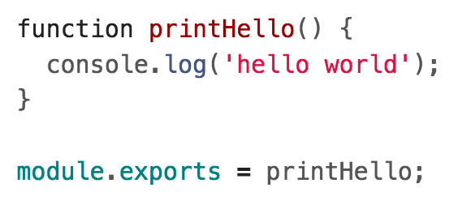
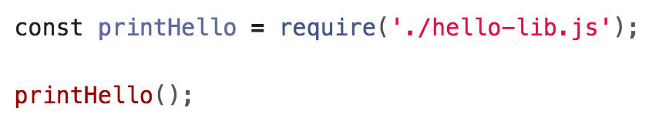
After: browserified
hello-lib.js
main.js

Slide 31
After: browserified
hello-lib.js
main.js
This code no longer runs natively in the browser, since browser don't support require()ing npm modules.
Instead, you must run the browserify command:
This will "transpile" the code into JavaScript the the browser can run.
It will be "bundled" into a single script.js file.

Slide 32
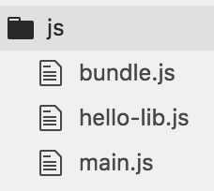
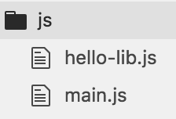
Browserify
$ sudo npm install -g browserify
$ browserify js/* -o js/bundle.js
This will create a file called bundle.js, which contains the code for main.js and the hello-lib.js file that it requires.
You need to include bundle.js in your HTML file

Slide 33
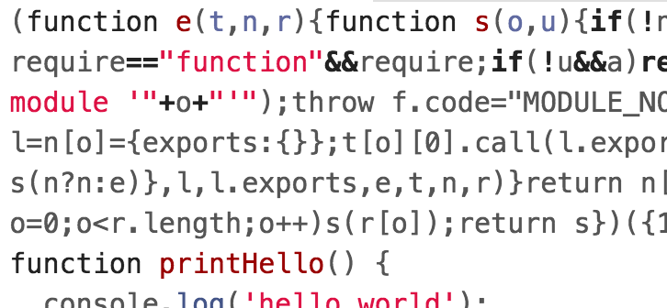
After: browserified
hello-lib.js
main.js
browserify js/* -o js/bundle.js
bundle.js

Slide 34
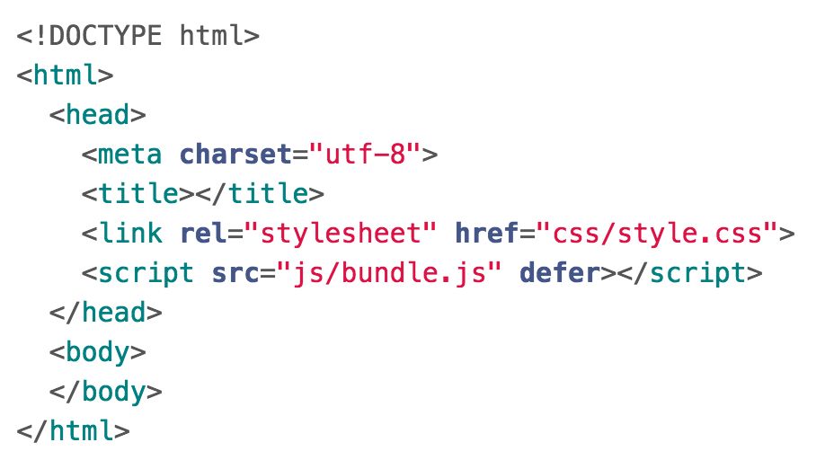
After: browserified
bundle.js
index.html

Slide 35
Browserify recap
Lets you use require() in frontend JavaScript
You can write your own modules and require them
You can download NodeJS modules and require them
You must transpile your JavaScript code in order to run it
Use the browserify command to generate bundle.js
Include the single bundle.js file in your HTML
This idea of transpiling JavaScript is very common for modern JavaScript tools and libraries!

Slide 36


See also: WebPack and import
WebPack: A more sophisticated JS module bundler
Newer than Browserify
More complicated than Browserify
Can do more than Browserify
Not ready yet: A native JavaScript option
ES6 modules and import
Keep an eye out for this! (CanIUse)

Slide 37
Older browser support

Slide 38
Older browsers?
We used JavaScript features that worked on the latest version of each major browser.
But sometimes you need to support older browsers.
What do you do?
Don't use the new stuff until it's ready? But when will that be?
Write multiple versions of your code? But that's time-consuming and annoying
Write polyfill fallback code? Also super annoying

Slide 39

BabelJS
Solution:BabelJS
Babel is a JavaScript compiler for the latest features of EcmaScript, including ES6+
  If the browser supports ES6 natively, babel does nothing
  If the browser does not support ES6 natively, babel provides a polyfill
Use BabelJS so that you can:
Write code with the latest features in JavaScript
Support older browsers without having to rewrite anything

Slide 40
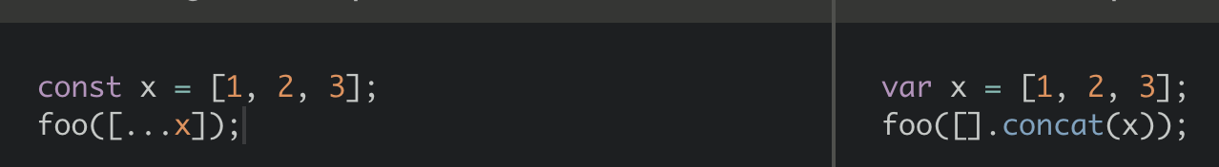
Compiling with Babel
ES6 code
JavaScript that works on older browser
Babel can be used with Browserify, WebPack, etc:
$ browserify script.js -t babelify -o bundle.js
Use Babel!

Slide 41
Type checking

Slide 42
Missed topic: Type checking
JavaScript is loosely typed, meaning you do not declare the data types of variables.
Sometimes loose typing a great thing, e.g. when you are starting a project from scratch, prototyping, etc.
But loose typing gets to be a pain as your code base grows.

Slide 43
Type checking
There are ways to essentially add type checking to JS:
TypeScript: A different programming that is a superset of JavaScript. Write TypeScript code and transpile it to raw JavaScript.
Flow: A static type checker for JavaScript. Write annotated JavaScript code and transpile it to raw JavaScript.
Closure Compiler: An early bundler, code minimizer, and static type checker for JavaScript. Type definitions are done in comments and doesn't require transpiling.

Slide 44

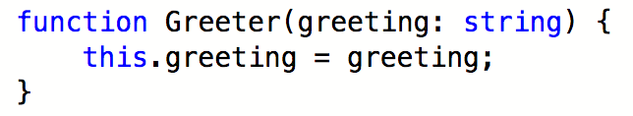
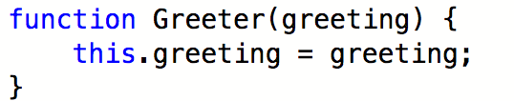
TypeScript (2012)
TypeScript is a programming language by Microsoft
It is a superset of JavaScript that includes static typing.
Browsers can only execute JavaScript, so you must transpile TypeScript to JavaScript
TypeScript
JavaScript

Slide 45

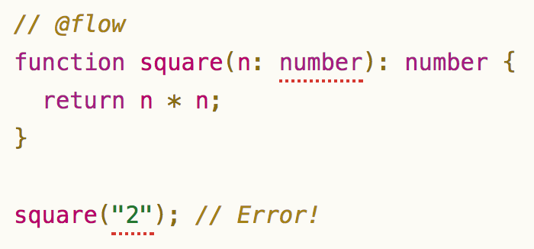
Flow (2014)
Flow is a static type checker by Facebook.
It is not a full programming language, but it involves a adding a combination of non-standard annotations and comments to your JavaScript.
Browsers can only execute JavaScript, so you must transpile Flow-annotated code to JavaScript

Slide 46

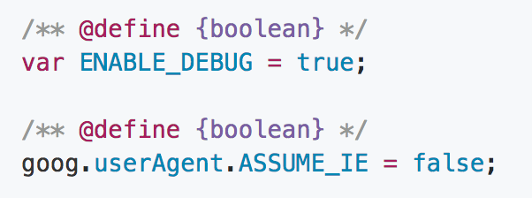
Closure compiler (2009)
Closure Compiler is a command-line tool by Google
Transforms valid JavaScript into more efficient valid JavaScript.
Type information (closure annotations) is specified in comments

Slide 47
Accessibility

Slide 48
Missed topic: Accessible tech
Technology should be accessible to everyone, regardless of their abilities or disabilities.
Accessibility (a11y): design of products, devices, services, or environments for people who experience disabilities
The web is designed to be accessible, if you use it correctly.
For example:
Using <h1>Heading</h1> instead of <div class="heading">Heading</div> will help a screenreader create an audio outline for the page, since a visually impaired person may not be able to skim

Slide 49
Making tech accessible
Resources for accessibility:
MDN accessibility
  ARIA: Accessible Rich Internet Applications
Google accessibility
Teach Access / Tutorial
Udacity course
Accessibility dev tools extension

Slide 50
What next?
4102165 is a fundamentals course, meaning we covered the critical stuff, but we just scratched the surface.
We'll do a quick tour of the following:
Topics you really-really-really ought to know
Topics you might find handy
Libraries and frameworks
Final suggestions

Slide 51
Topics you might find handy

Slide 52
Misc web topics
A few other topics that might be useful for you:
<canvas>
Allows you to draw graphics in a <canvas> tag
Uses more traditional, lower level graphics commands
3d support with WebGL
Simple demo; complex demo
Canonical examples: Games; complex visualizations
WebSockets / Socket.io
Used for server -> client messages
Canonical examples: Chat client; gaming; anything that has live updating

Slide 53
Misc web topics
CSS grid layout
The final missing piece for CSS layout!
Not quite ready yet, but should be within the next year
Progressive web apps
An alternative to server-side rendering, single-page-app, and isometric web apps:
  Design an "app shell" that loads first
  Use Service Workers to cache content
Complex, but huge potential benefits

Slide 54
Publishing tools

Slide 55
Publishing static web pages
Domain name registration:
Reserves a custom URL: myawesomesite.com
But doesn't usually include web hosting; all you own is the name.
Web hosting:
Provides a location on the internet to upload files
Usually with some crummy URL, like http://bucket.s3-website-us-west-2.amazonaws.com/
Domain name registration and web hosting are sometimes provided by the same company, but not always.

Slide 56
Publishing static web pages
You can register your own domain name through many companies:
Google Domains: Only domain name registration
Amazon S3: Only web hosting
Dreamhost: Domain name and web hosting options
GoDaddy: Domain name and web hosting options
Pchome: Domain name
Domain name registration is usually ~$12/year
Web hosting is usually ~$10/month
Amazon S3 is significantly cheaper (virtually free for low-traffic websites) but more complicated to set up

Slide 57
Publishing server-side code
If you want to host both a frontend and a backend, you need a web host that allows you to configure a server.
There are an immense number of options, with different levels of configuration. Here are some:
Heroku: Super easy to use, but offers less control. Also a lot more expensive.
AWS: Cheap, lots of options, but more complicated
Google Cloud: Basically the Target brand of AWS: Cheaper than AWS; as complex as AWS; fewer products than AWS

Slide 58
What next?
4102185 is a fundamentals course, meaning we covered the critical stuff, but we just scratched the surface.
We'll do a quick tour of the following:
Topics you really-really-really ought to know
Topics you might find handy
Libraries and frameworks
Final suggestions

Slide 59
Libraries and frameworks

Slide 60
Web libraries and frameworks
A JavaScript library:
Code that is written by someone who is not you
Code that you import and call from your code
Course examples: ExpressJS, dancer.js, gsa-sheets,etc
A web framework:
A way of writing and deploying web applications
Usually involves a combination of command-line tools and libraries
Bigger than a library
We didn't use a framework in course

Slide 61
Some web frameworks
Libraries:
jQuery
Frameworks:
AngularJS
Backbone.js
Bootstrap
Ember.js
ReactJS
Vue.js
Flask (backend)
Ruby on Rails (backend)
Django (backend)

Slide 62
Using a framework
In 4102165, we wrote frontends using raw, modern JavaScript.
Q: Should I use a framework or write apps using raw JavaScript?

Slide 63
Using a framework
In 4102165, we wrote frontends using raw, modern JavaScript.
Q: Should I use a framework or write apps using raw JavaScript?
A: Depends on what it is.
Small apps don't need a framework.
Now that you know how to write apps without a framework, I suggest you learn how to use a framework.

Slide 64
Suggestion: Learn a framework!
In 4102165, we learned how to write frontends without a framework.
Sometimes that's the right choice
Sometimes a framework is the right choice
Suggestion: Your next step after 4102165 should be to learn a web framework.

Slide 65
Q: How do I learn how to use a framework?

Slide 66
A: Pick one and try.

Slide 67
Just try it out
General advice:
Go to the official website
Use the official website's tutorials
  Like, actually follow along; don't just skim the docs
Then build a small app of your own on the framework
  The only way to "learn" a framework is to build something using it, beyond just following a tutorial
  Suggestion: Choose something you could build in 24 hours using the tech you already know
Most well-known frameworks have tutorials, excellent documentation, strong developer communities, etc.

Slide 68
Q: Which framework do I pick??

Slide 69
A: Doesn't really matter right now.
(If you've never used a framework, using *literally any of them* will be educational.)

Slide 70

jQuery: Don't use
jQuery was built in 11 years ago when the web was in a much worse state
But now most of jQuery's features have native JS equivalents
document.querySelector
classList
ES6 classes
CSS animations
etc.

Slide 71
jQuery: Don't use
jQuery also provides cross-browser compatibility, but you should prefer babel for that.
Suggestion:
Only use jQuery if you're forced to, i.e. if you're working in a code base that already uses jQuery and you can't change it.

Slide 72

Bootstrap: Don't use
Bootstrap is a *really heavyweight*, not-very-flexible set of default CSS styles and JavaScript components
Bootstrap is nice for what the name implies: bootstrapping a pretty, generic-looking website
However, Bootstrap is often used as a crutch by people who don't want to learn CSS.

Slide 73
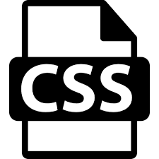
Bootstrap: Don't use
Suggestion:
Avoid Bootstrap:
  It is *really* hard to debug
Learn and use raw CSS:
  Use CSS flexbox
  Use CSS grid when it's ready
Hire a designer to make your
website look nice

Slide 74

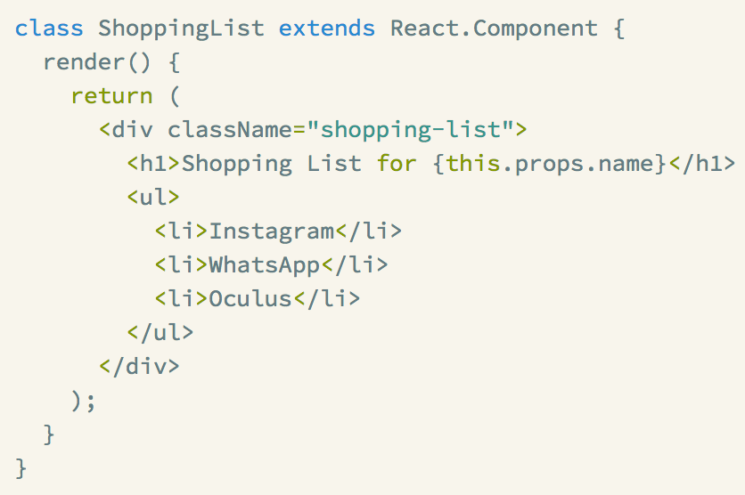

ReactJS: Good with some issues
ReactJS is a fairly lightweight frontend framework.
Uses JSX, which mixes JavaScript and HTML-looking syntax:

Slide 75
ReactJS: Good with some issues
Overall take:
ReactJS is very good!
But there are some major open issues
  E.g.: How to deal with global state (Redux is a very popular library to use in conjunction with ReactJS, but it counteracts React's state model)
Suggestion:
Learn ReactJS and make your own judgement
Use create-react-app
If you decide to use Redux, watch the A+ video series and don't try to read the indecipherable documentation

Slide 76

Ruby on Rails:
Overall take:
Ruby on Rails is great for what it is
But it is very heavyweight: not much room for customization
Prefer lighter weight server-side frameworks, as do most developers these days
Suggestion:
Low-priority: Try a tutorial for RoR or one of its many clones (Django, etc)

Slide 77
Recap
MUST-dos:
Learn server-side testing, if you are ever going to launch a server
SHOULD-dos:
Use browserify or WebPack for JS bundling
Use babeljs with browserify or WebPack for older browser support
SHOULD-try:
Pick a web framework and learn it

Slide 78
Recap
DON'T-dos:
Don't use jQuery
Don't use Bootstrap
Don't unnecessarily complicate your tech stack
Don't be afraid of new libraries/tools/frameworks.
  If they are good, they make your life easier, not harder!

Slide 79
On the horizon
Keep an eye out for:
Public / private fields in ES6 classes
ES6 Modules / import
Custom elements
  More broadly: Web components
Watch the discussions around web app architecture:
Isometric / universal websites
Progressive web apps
Progressive loading

Slide 80
Everyone's 2nd favorite question for the web:

Slide 81
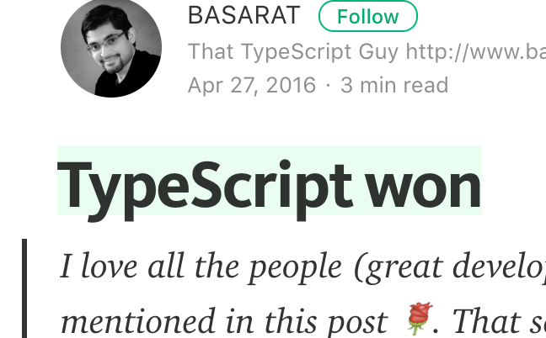





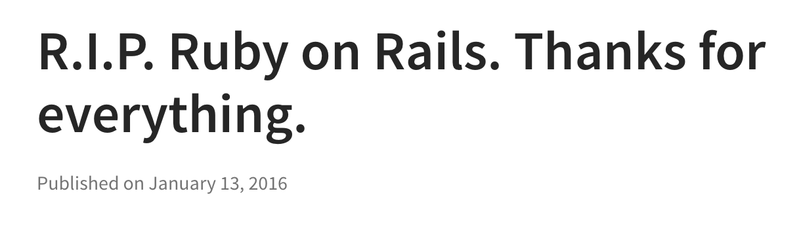
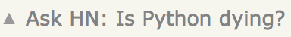

Slide 82
Q: Which library/tool/language/platform is going to win?????

Slide 83
A: Wrong question.

Slide 84
CS is not a competitive sport.
Not everything is a dominance hierarchy.
Not everything is a dominance hierarchy.
Not everything is a dominance hierarchy.
Not everything is a dominance hierarchy.
Not everything is a dominance hierarchy.
JavaScript libraries are not at war.
Multiple things can be good.
Learning any good library is valuable, even if it's not in its absolute height of popularity.
  A great way to improve your software engineering skills: Studying other people's designs

Slide 85
Better questions
Does this library solve the problems that I care about?
Is this library production-ready?
  Does it have prominent clients?
  Does it work at scale?
  Has it worked out most of its bugs?
Is this library under active development?
  Does it need work?
How easy is it to find documentation/StackOverflow results for this library?
  Does it need documentation/help pages?

Slide 86
Final advice

Slide 87
Staying up to date
With all the caveats aside:
Q: "How do you stay up to date on web stuff?"

Slide 88
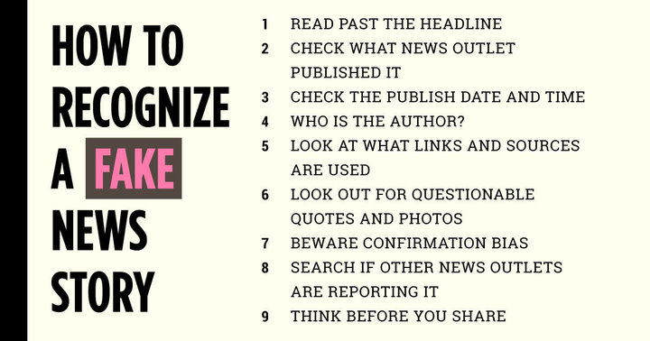
Staying up to date
With all the caveats aside:
Q: "How do you stay up to date on web stuff?"
A: Read the internet! But tread carefully:

Slide 89

Garbage piles
Do not trust:
Comment sections of Reddit
Comment sections of Hacker News
Comment sections of any website
Medium articles by randos
In my experience, these are far too often full of posturing, gross misinformation, terrible opinions based on little-to-no facts, etc.

Slide 90
Hit-and-miss
Usually works, but sometimes poor style / not best practice
StackOverflow answers
W3C schools
Programming YouTube videos
Better opinions than most, but sometimes still trash
Quora answers

Slide 91
Good web resources
Reliable websites
Google Web Fundamentals
Mozilla hacks
Prominent JavaScript accounts/people on Twitter, e.g.
NodeJS, Sarah Drasner, Suz Hinton, Sebastian Markbåge, Henry Zhu, Dan Abramov, David Walsh
Official documentation:
HTML WHATWG spec / HTML W3C spec
EcmaScript status / spec

Slide 92
Write code
The only way to get better at web programming is to write lots and lots of code.
Become a software engineer
Work with software engineers who are better than you
Write simple side projects to learn new tech
  Suggestion: Choose a project you know you could finish in 1 day - 1 week
You can do it!

Slide 93
Thank you!

