Slide 1
4102165:
Full Stack Web Development Fundamentals
Spring 2019
簡立仁 Li-Ren Chien
ccumouse@gmail.com

Slide 2
Today's schedule
Today
position
Random helpful CSS
  calc, variables, background properties
Mobile layouts
  em and rem
NEXT
Intro to JavaScript

Slide 3
"I can think of 12 different ways to implement this!
Which one is best?"

Slide 4
Simplicity above all else
Always prefer simplicity.
Other tips:
Separation of concerns: HTML should contain content NOT style, CSS should contain style NOT content
Descriptive HTML tags: Make your HTML more readable by using e.g. <header> instead of <div> when appropriate
Reduce redundancy: Try grouping styles, using descendant selectors to reduce redundancy (see past slides for details)

Slide 5
Last time
More flexbox stuff:
flex-shrink
  Default value is 1 (on by default)
  This CSS property is on the flex item, not container
flex-grow
  Default value is 0 (off by default)
  This CSS property is on the flex item, not container
vh / vw / box-sizing

Slide 6
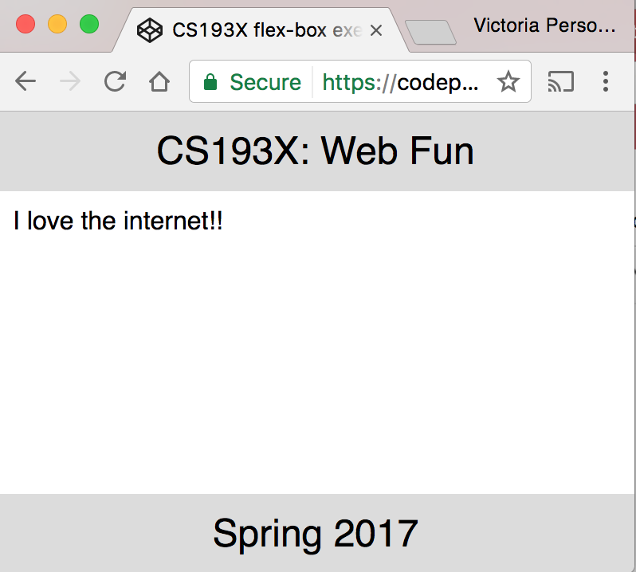
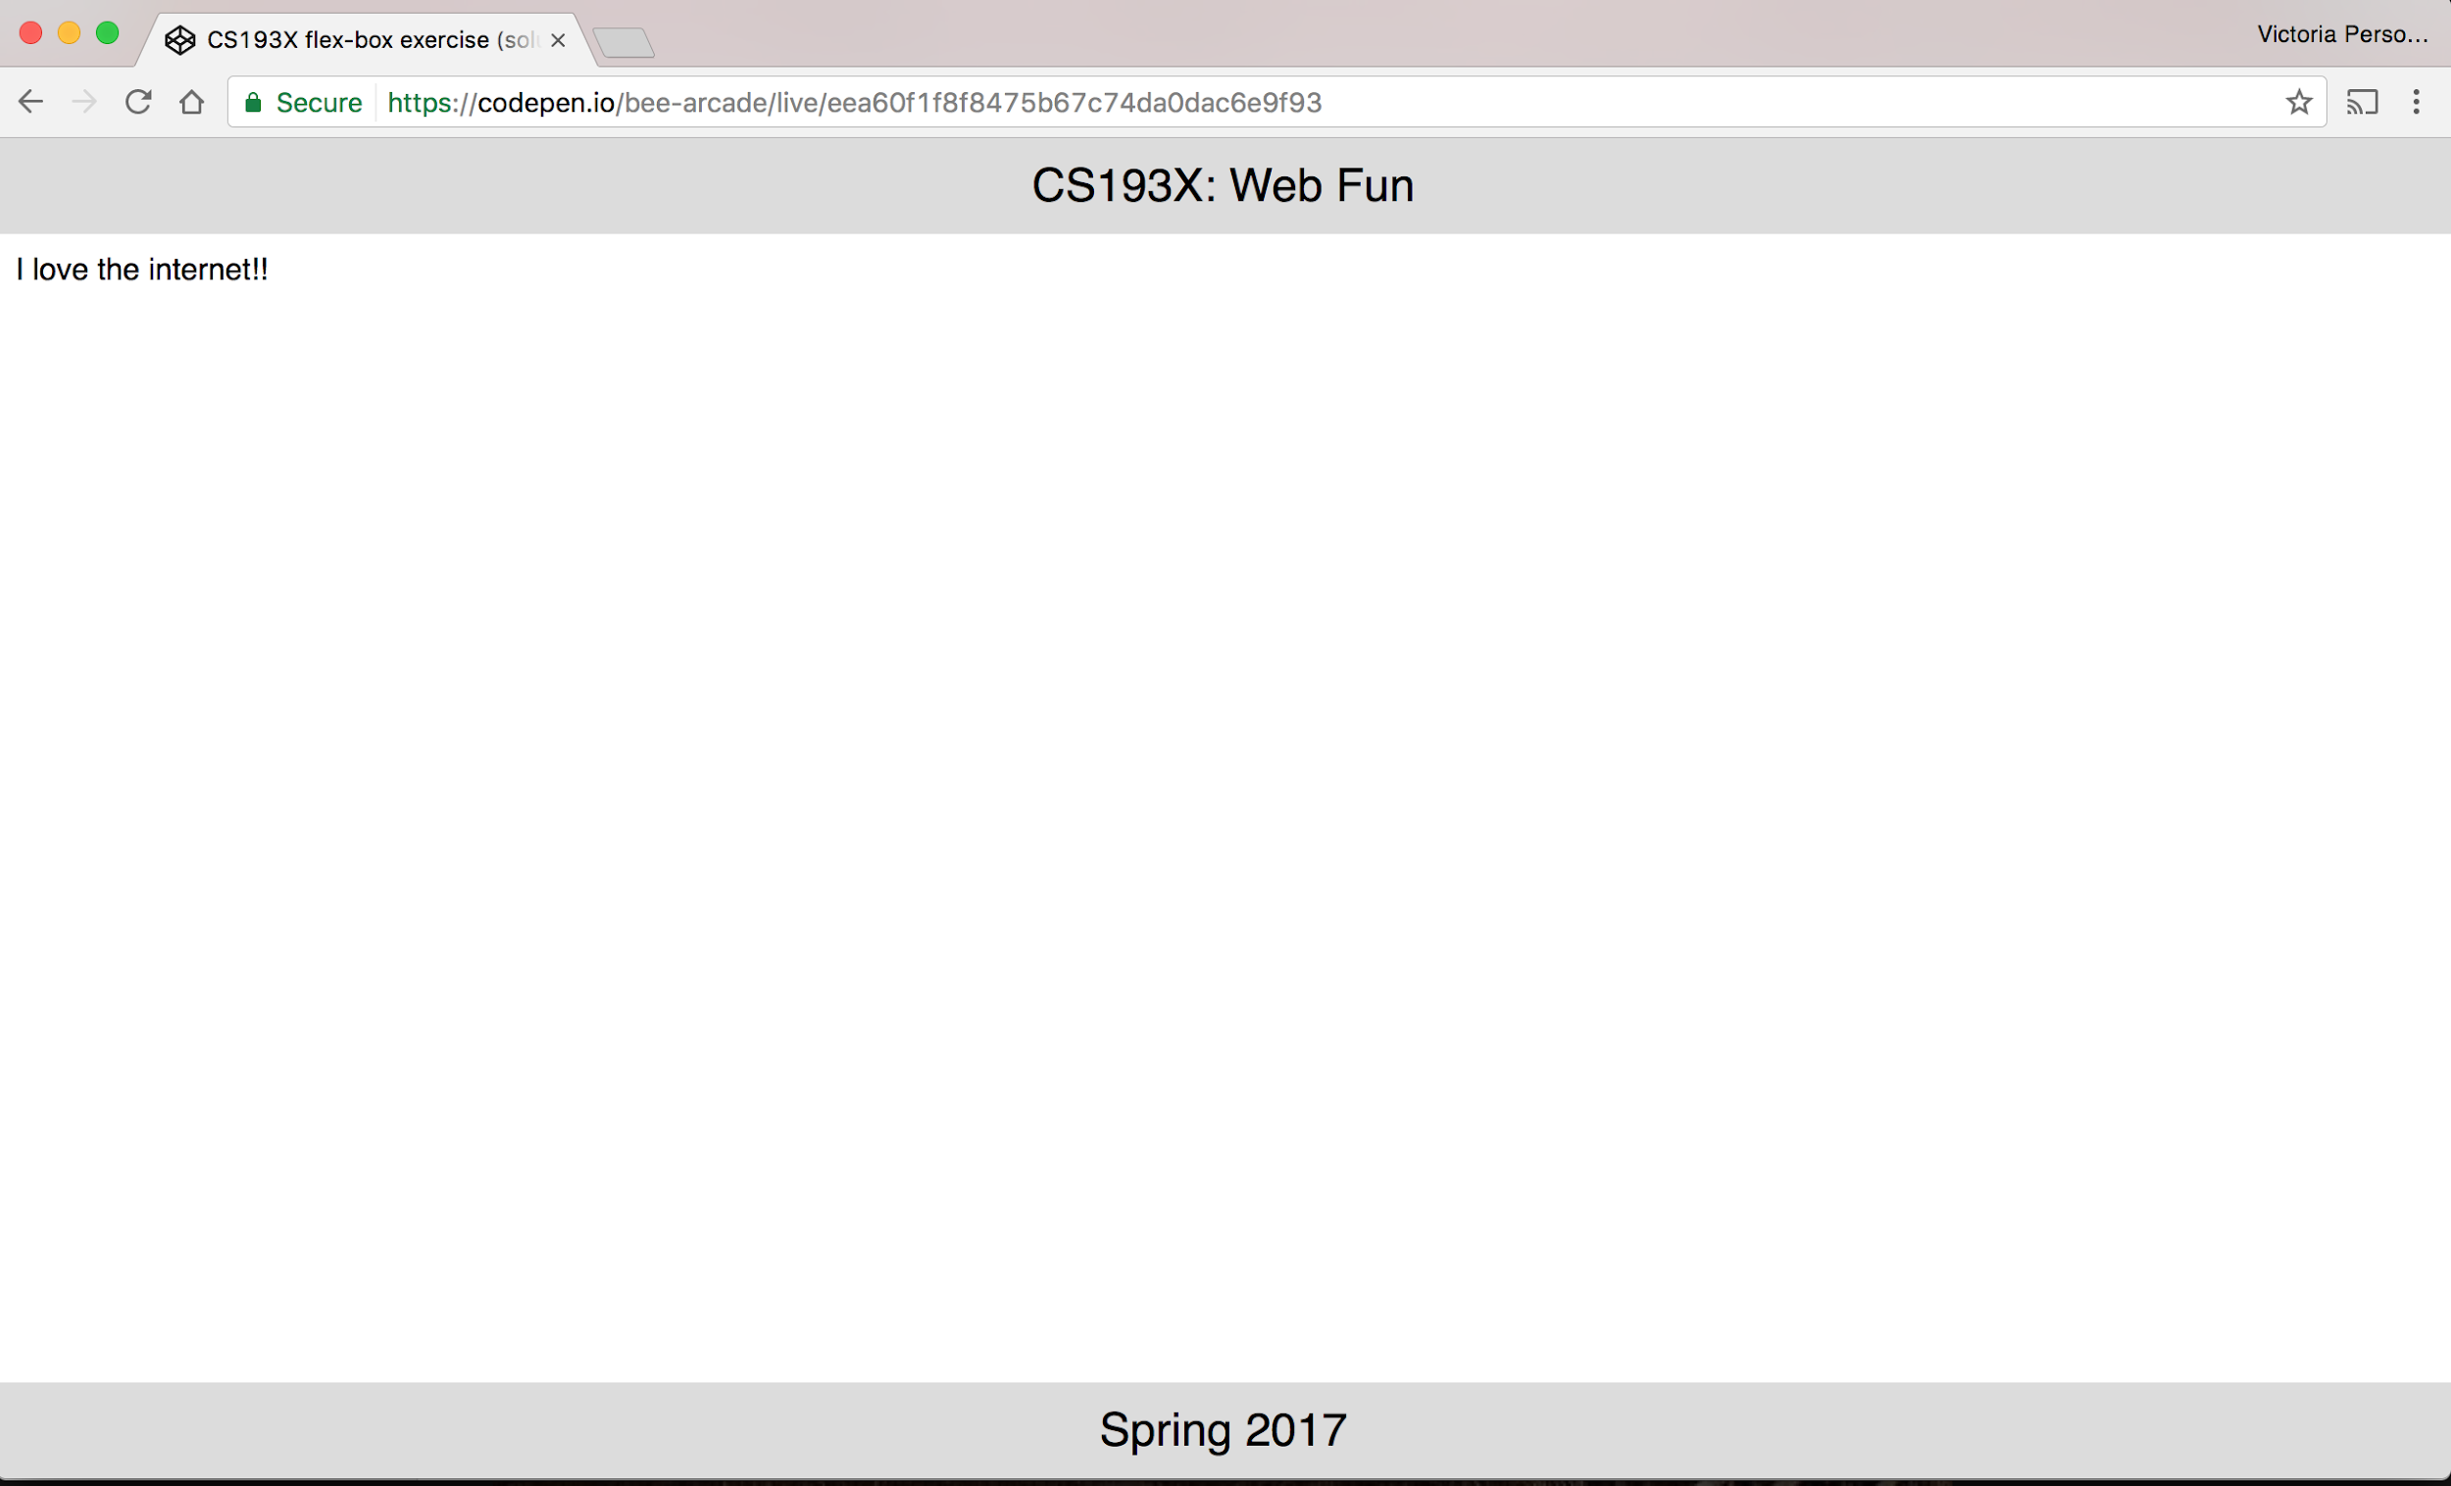
Flexbox example
How do we make a layout that looks like this? (Codepen)
The header and footer stay at the top and bottom of the viewport. (Live example)

Slide 7
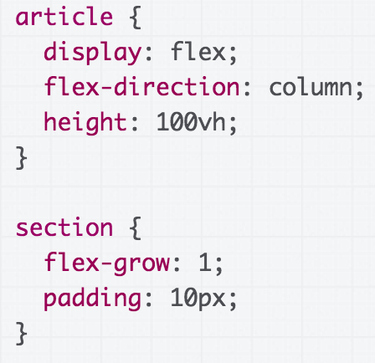
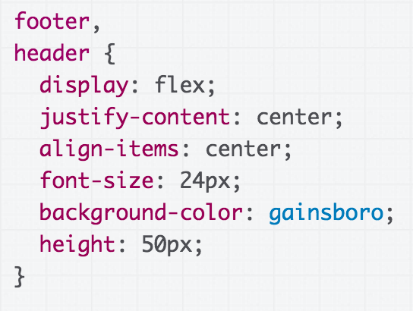
Flexbox example solution

Slide 8
Another rendering mode: position

Slide 9
Moving things with position
Positioned layout lets you define precisely where an element should be in the page (mdn).
You can use positioned layout doing the following:
Define a position method:
Static, fixed, absolute, relative
Define offsets: top, left, bottom, and right
(optional) Define z-index for overlapping layers (mdn)
Let's check it out!

Slide 10
Moving things with position
To specify exactly where an element goes, set its top, left, bottom, and/or right offset.
The meaning of these offset values depend on the reference point set by position:
static: no reference point; static block can't move (this is the default style for every element)
fixed: a fixed position within the viewport
absolute: a fixed position within its "containing element"
relative: offset from its normal static position

Slide 11
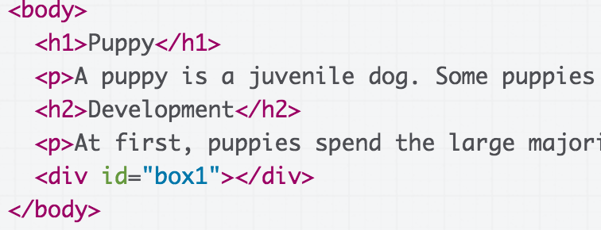
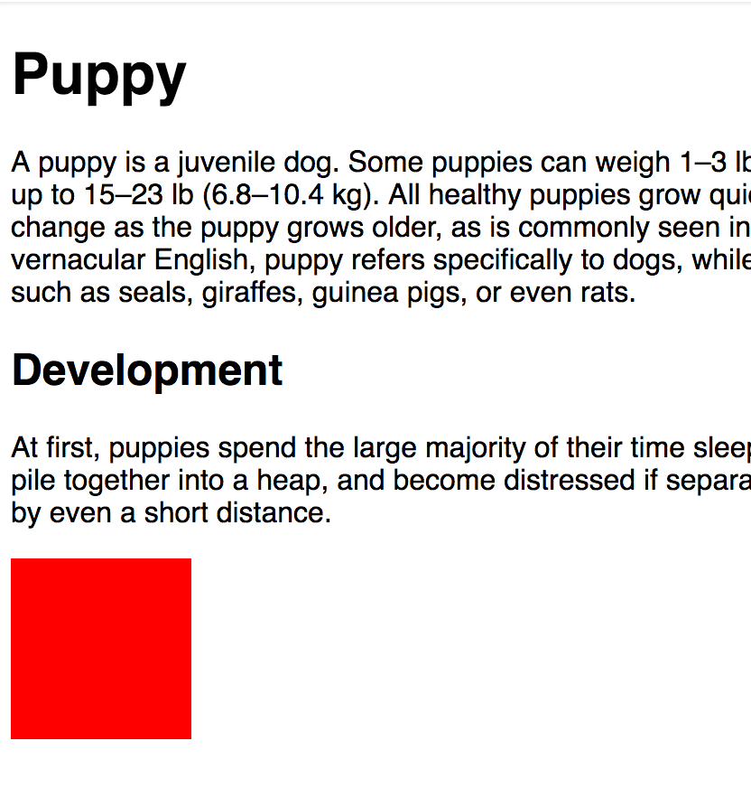
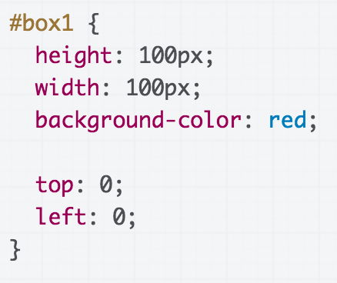
position: static
(nothing happens!)
static is the default value for position
If you use top / left / bottom / right without setting a non-static position, nothing will happen
(CodePen)

Slide 12
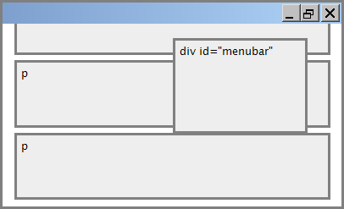
position: fixed
#menubar {
position: fixed;
top: 50px;
right: 100px;
}
50px
For fixed positioning, the offset is the distance positioned relative to the viewport.
The element does not move when scrolled.
Element is removed from normal document flow, positioned on its own layer
100px
Often used to implement UIs; control bars that shouldn't go away

Slide 13
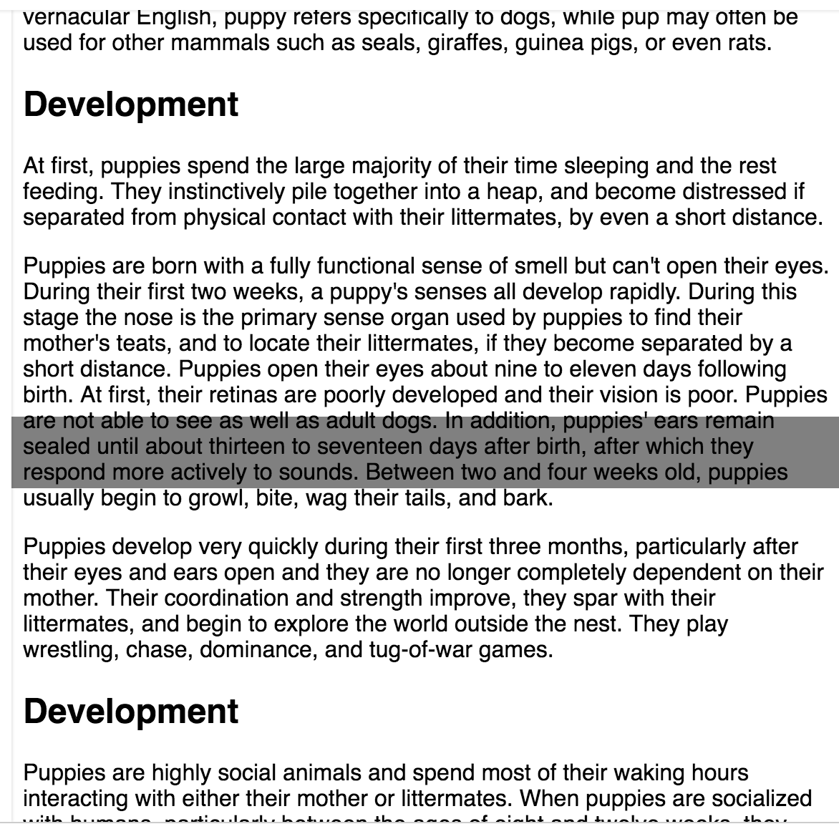
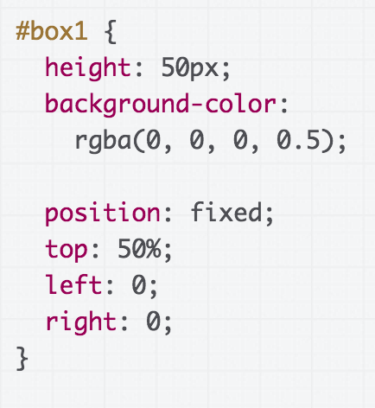
position: fixed
(CodePen)

Slide 14
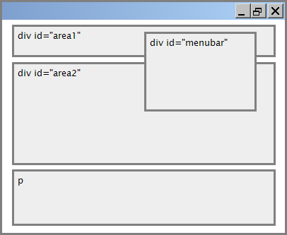
position: absolute
#menubar {
position: absolute;
left: 400px;
top: 50px;
}
50px
400px
For absolute positioning, the offset is the distance from the "containing element", which is the html element by default
Element is removed from normal document flow, positioned on its own layer

Slide 15
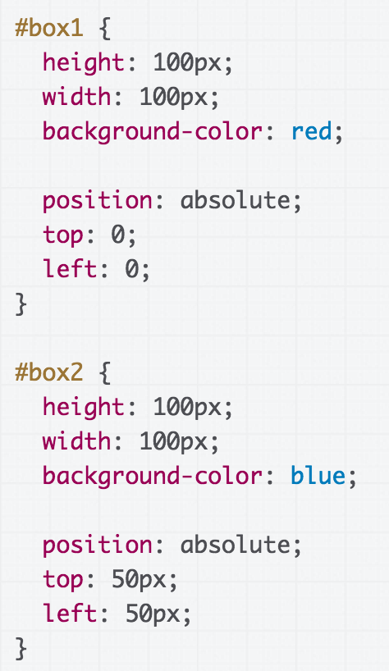
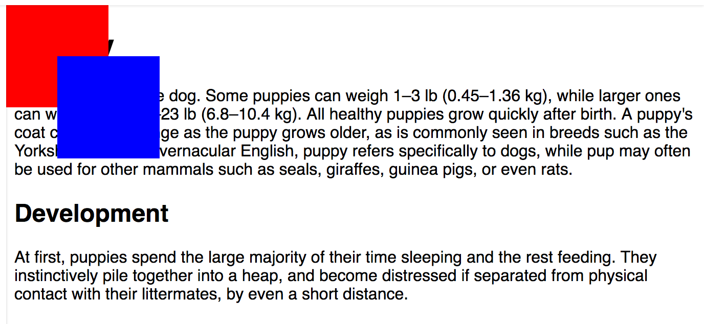
position: absolute
(CodePen)

Slide 16
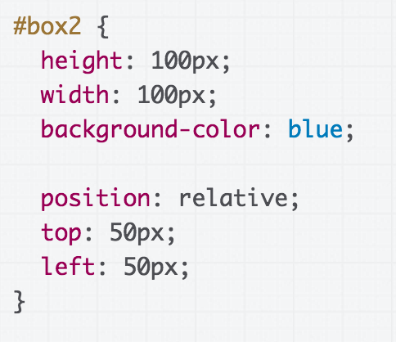
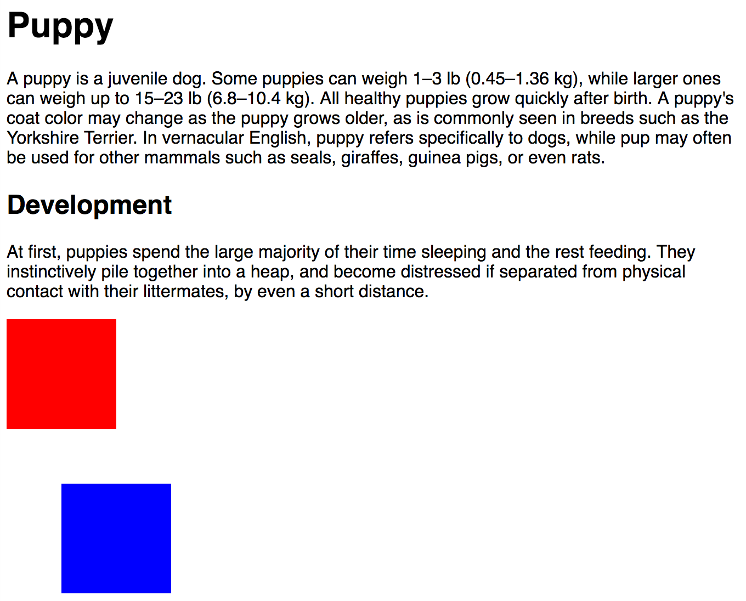
position: relative
For position: relative; the element is placed where it would normally be placed in the layout of the page, but shifted by the top / left / bottom / right values.
(CodePen)

Slide 17
Relative absolute positioning
Let's revisit the definition of absolute positioning:
absolute: a fixed position within its "containing element"
The containing element is the viewport by default
You can change the containing element by setting "position: relative;" on some parent of your absolutely positioned element!

Slide 18
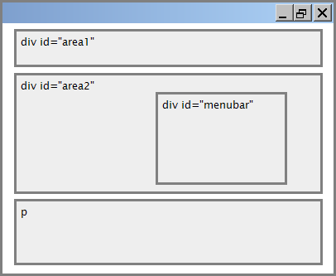
Relative absolute positioning
#area2 {
position: relative;
}
50px
#menubar {
position: absolute;
left: 400px;
top: 50px;
}
400px
Offsets are relative to the first parent element that has position: relative which in this case is #area2

Slide 19
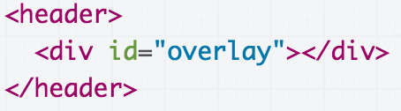
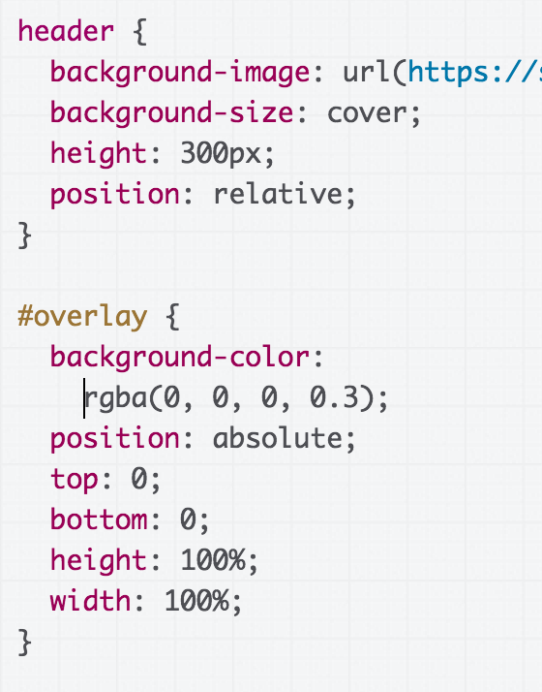

Common use case: Overlay
(CodePen)

Slide 20
Let's revisit Squarespace again!
(link to solution)

Slide 21
Random useful CSS

Slide 22
calc
You can use the calc CSS function to define numeric values in terms of expressions:
width: calc(50% - 10px);
width: calc(100% / 6);
(MDN details of calc)

Slide 23
CSS variables
Variables are a brand-new CSS feature (caniuse).
:root {
--primary-color: hotpink;
}
h1 {
background-color: var(--primary-color);
}
(MDN details of CSS variables)

Slide 24
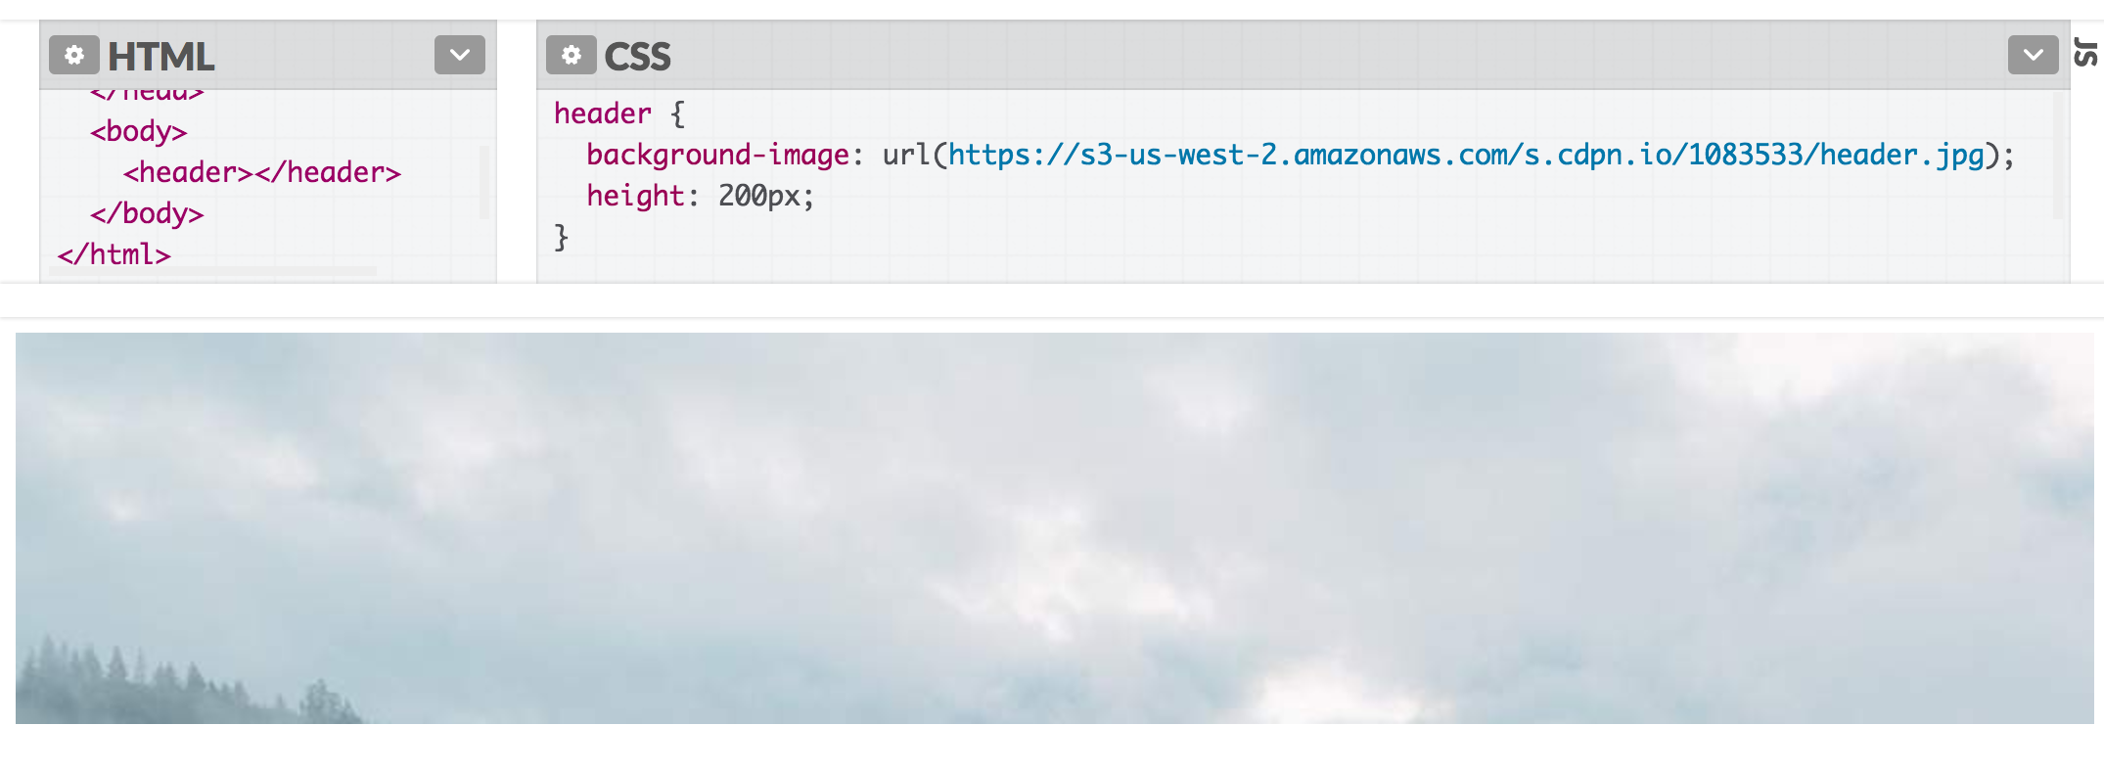
background properties
An easy way to render images stretched and cropped to a given size: set it as a background image for an element.
background-image: url(background.png);
(CodePen)

Slide 25
background properties
You can then use additional background properties to further style it:
background-size: cover;
background-size: contain;
background-repeat: no-repeat;
background-position: top;
background-position: center;
(CodePen: Try resizing the window)

Slide 26
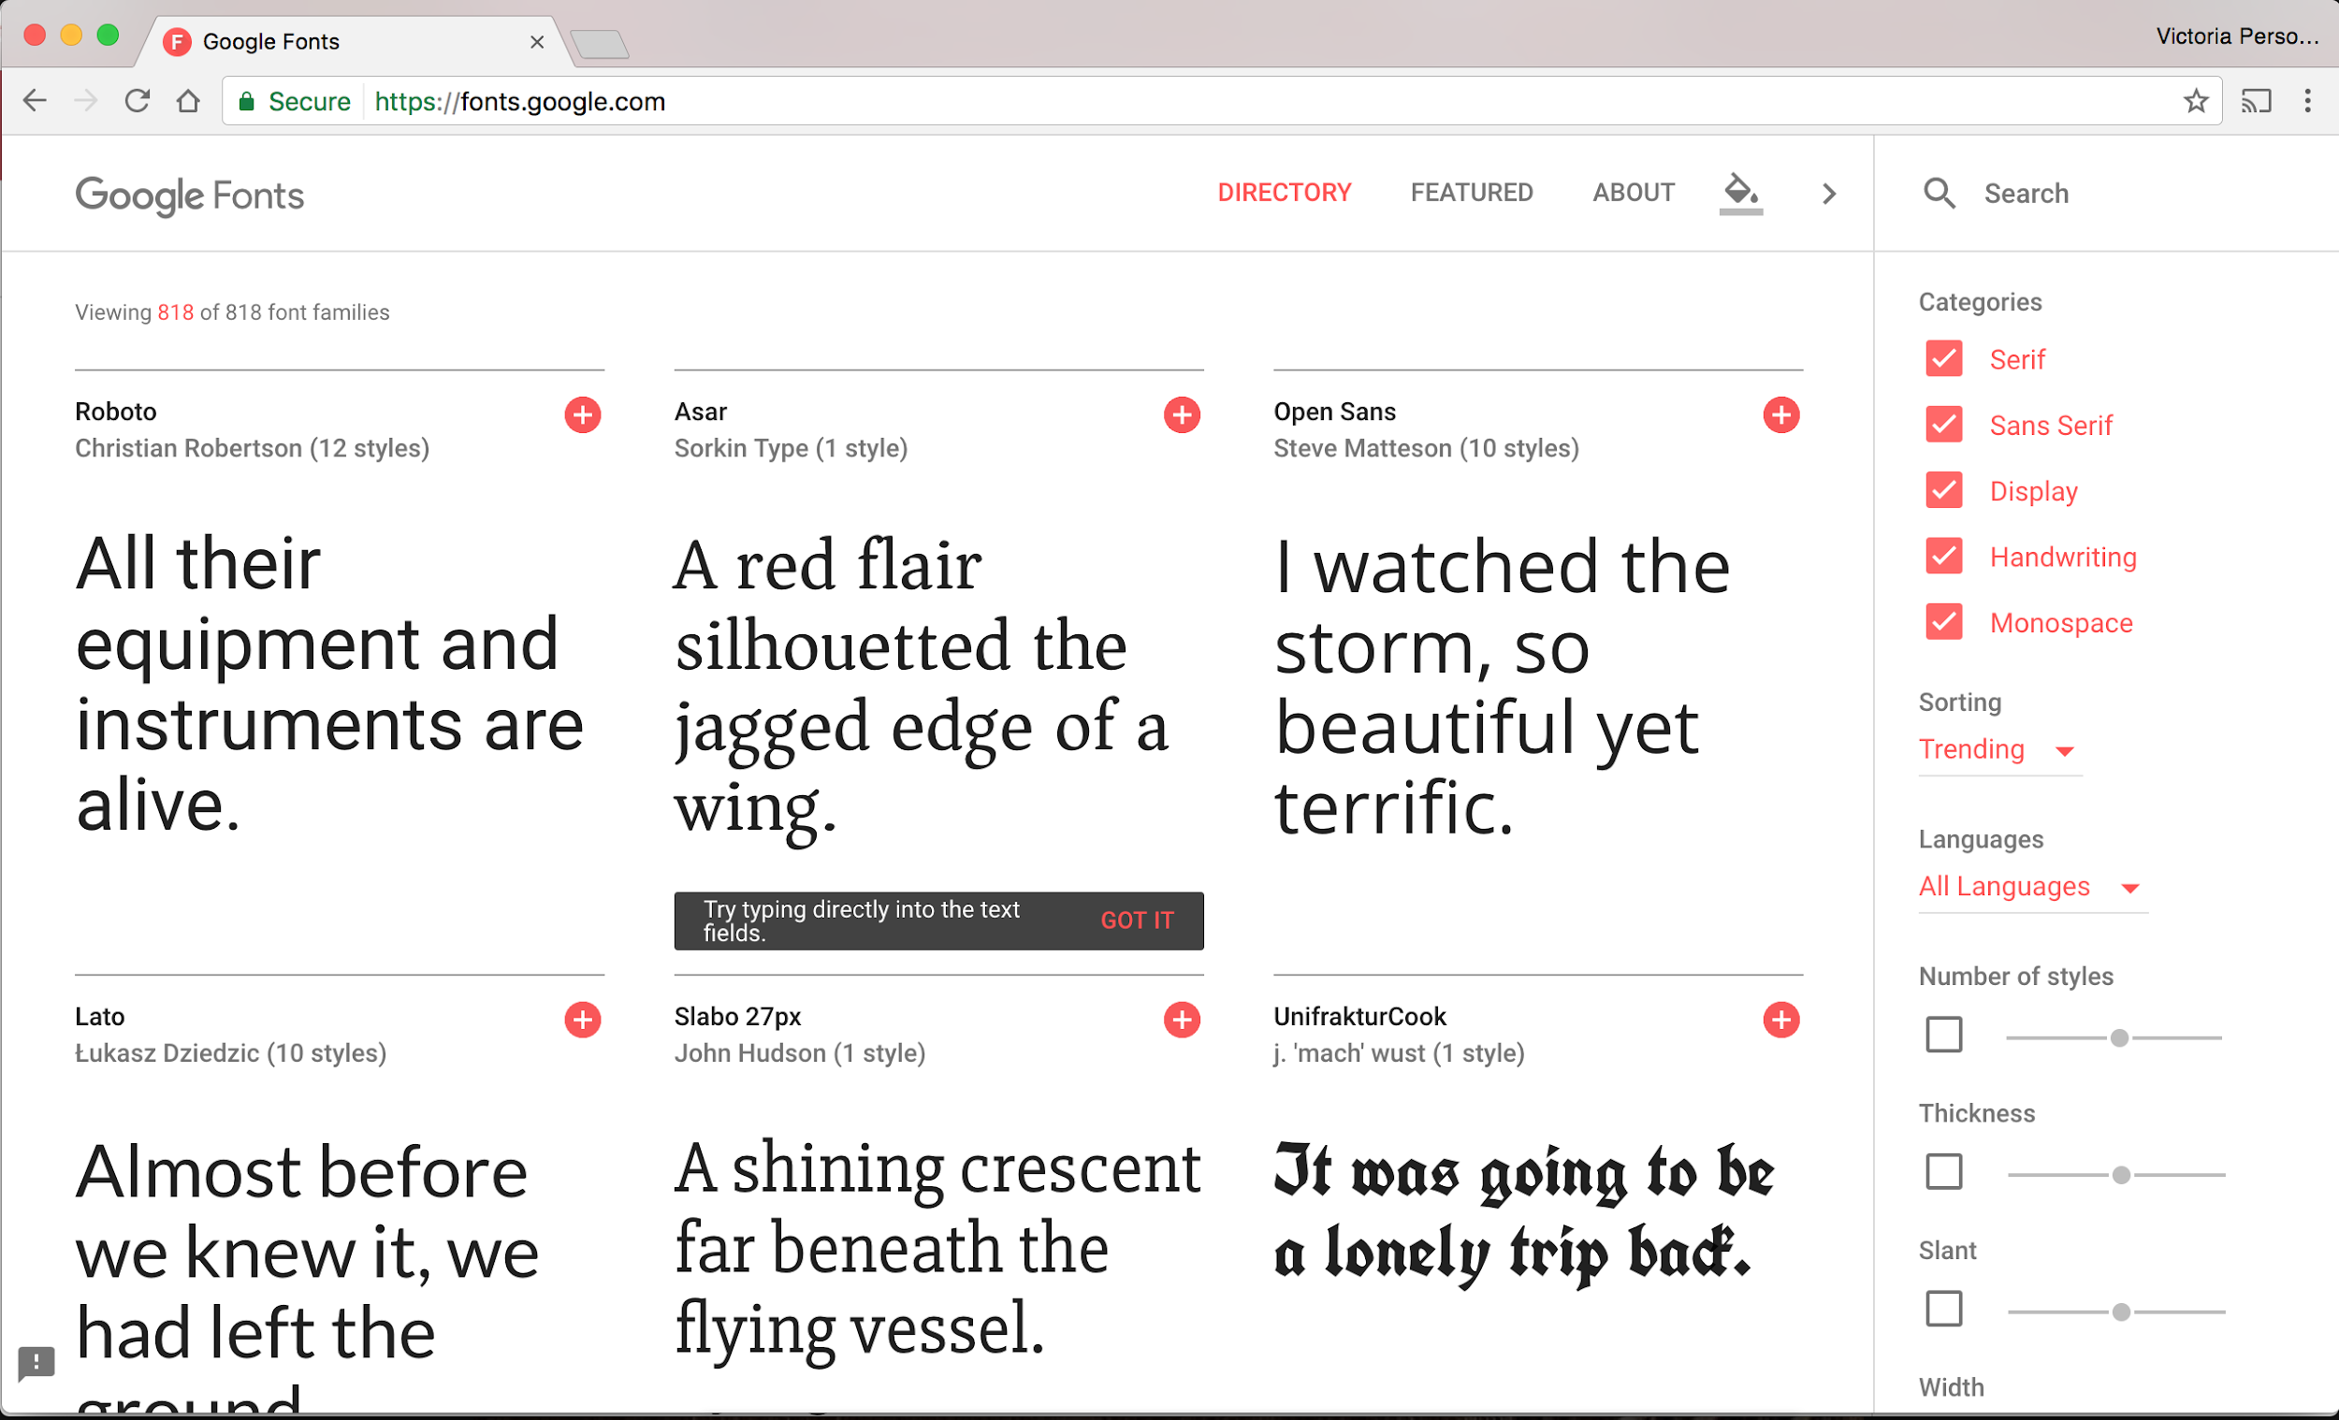
Web Fonts
You can use Google Fonts to choose from better fonts:

Slide 27
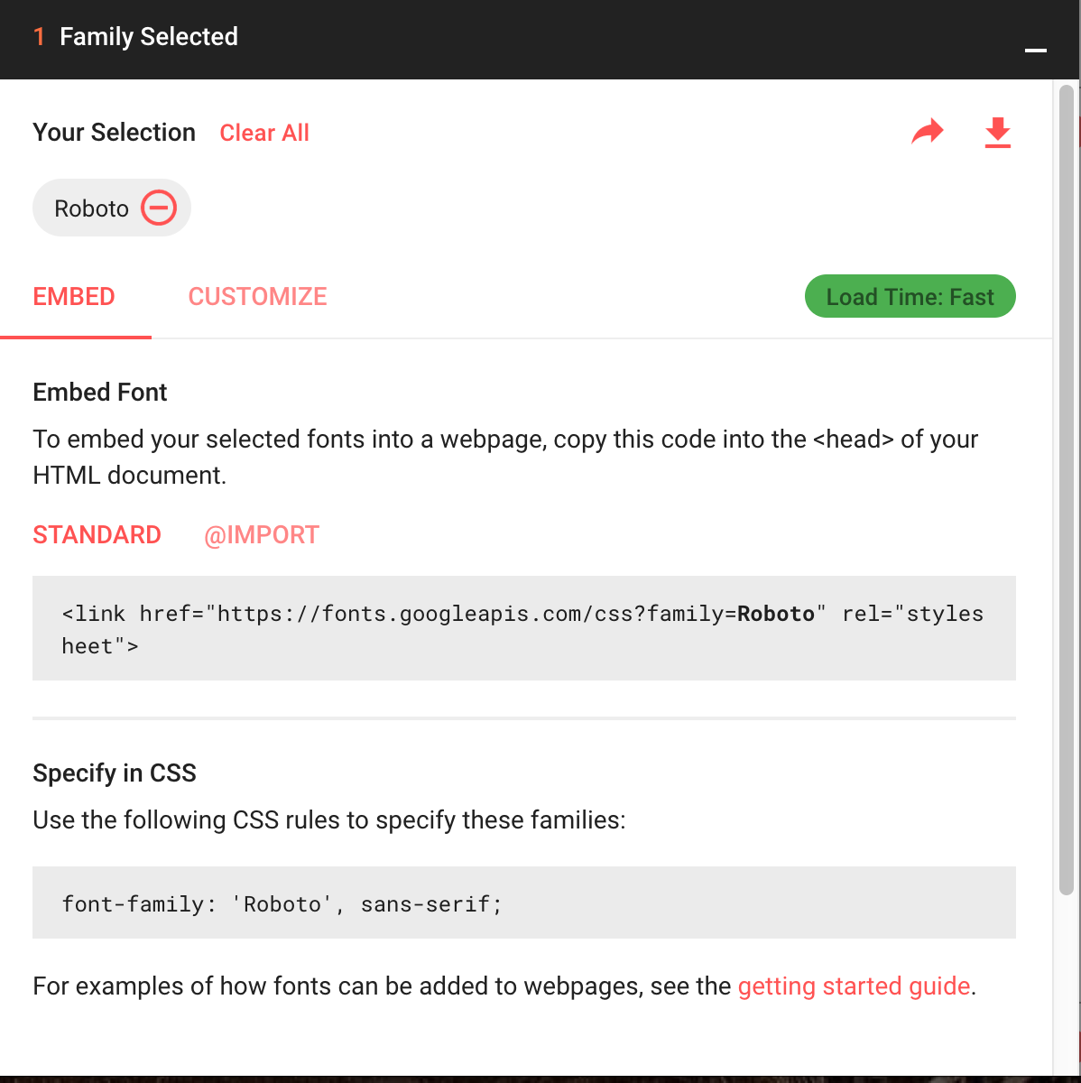
Web Fonts
You can use Google Fonts to choose from better fonts:
The instructions are pretty self-explanatory:
Basically, add the given <link> tag into the <head> section of your page alongside your other CSS files.

Slide 28
Aside: Fallback fonts
Notice that the Google Font example shows a comma-separated list of values for font-family:
Each successive font listed is a fallback, i.e. the font that will be loaded if the previous font could not be loaded
There are also six generic font names, which allows the browser to choose the font based on intent + fonts available on the OS.
It's good practice to list a generic font at the end of all your font-family declarations.

Slide 29
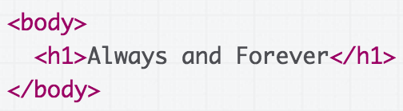

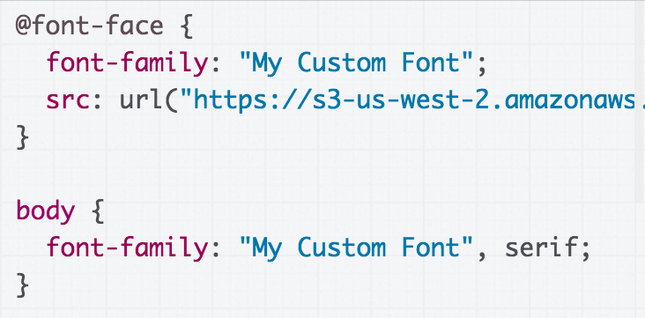
Hosted fonts with @font-face
You can also load your own font via @font-face:
Give it your own font name
Link to where the font file is found
Codepen

Slide 30
Mobile web

Slide 31
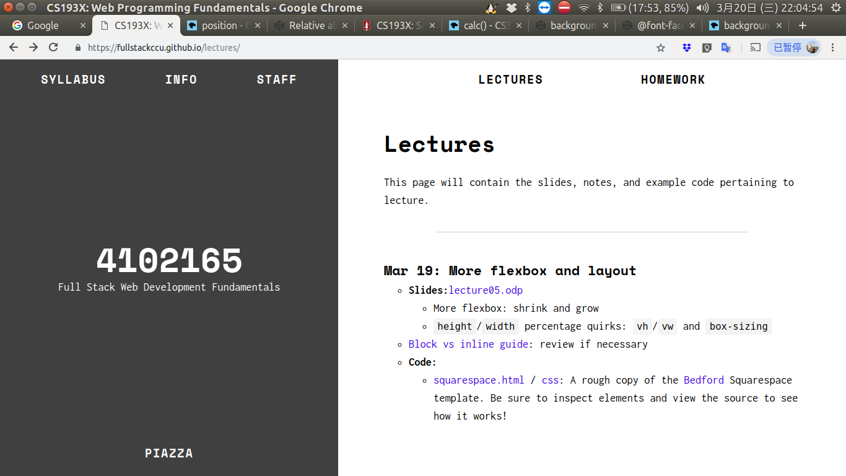
Say you have the following website:
Q: What does it look like on a phone?

Slide 32


Not terrible… but pretty small and hard to read.

Slide 33
Responsive web design
(回應式網頁設計)
We want to write our CSS in a way that can look nice in a wide range of screen sizes:
27" desktop monitor
Macbook Air
Samsung Galaxy S7
iPhone 7
iPad
Q: How do we do this?
Do we need to write totally different
CSS for every screen size?!

Slide 34
Mobile sizing
Unless directed otherwise via HTML or CSS cues, mobile browsers render web pages at a desktop screen width (~1000px), then "zooms out" until the entire page fits on screen.
(That's why you sometimes get web pages with teeny-tiny font on your phone: these webpages have not added support for mobile.)
(Read more on how this works)

Slide 35
Meta viewport tag
To prevent phone browsers from rendering the page at desktop width and zooming out, use the meta viewport tag:
<meta name="viewport"
content="width=device-width, initial-scale=1">
This belongs in the <head> section of your HTML.
(Same section as the <title>, <link>, and other metadata elements.)

Slide 36
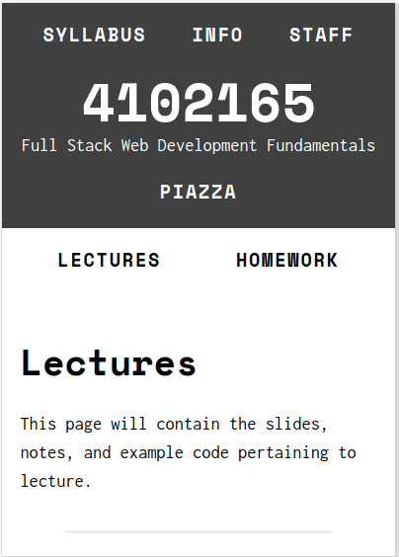
Meta viewport tag
Without the meta viewport tag
With the meta viewport tag

Slide 37
Meta viewport tag
<meta name="viewport"
content="width=device-width, initial-scale=1">
name=viewport: "Browser, I am going to tell you how I want the viewport to look."
width=device-width: "The viewport's width should always start at the device's width." (i.e., don't do that thing on mobile where you render the page at the desktop's width)
initial-scale=1: "Start at zoom level of 100%."

Slide 38
Meta viewport tag
<meta name="viewport"
content="width=device-width, initial-scale=1">
(You should pretty much always
include this tag in your HTML.)

Slide 39
Making adjustments
The meta viewport tag gets us almost all the way there, but we want to make a few adjustments.
For example, the margin seems a tad too big on mobile. Can we set a different margin property for mobile?

Slide 40
CSS media queries
You can define a CSS media query in order to change style rules based on the characteristics of the device:
@media (max-width: 500px) {
article {
margin: 0 2px;
}
}
You can create much more complex media queries as well.

Slide 41
Development strategies
Practical question: How do you test mobile layouts?
Do you upload your HTML+CSS somewhere online and navigate to that URL on your phone?
Is there a way to connect your phone to your local device?
Do you run it in an Android/iOS emulator?
Other?!

Slide 42
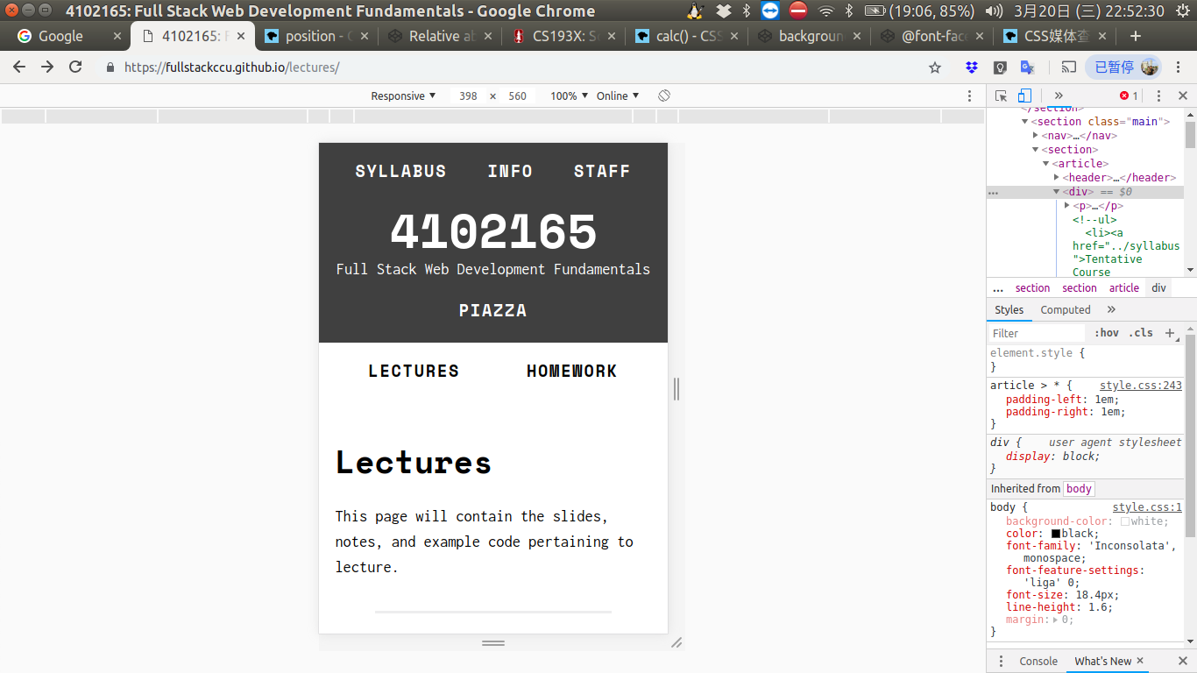
Chrome device mode
You can simulate a web page in a mobile layout via Chrome device mode:

Slide 43
Chrome device mode
You can simulate a web page in a mobile layout via Chrome device mode:

Slide 44
Chrome device mode
Advantages of Chrome device mode:
Super convenient
Mostly accurate
Disadvantages of Chrome device mode:
Not always accurate - iPhone particularly an issue
A little buggy
Doesn't simulate performance issues
You should always test on real devices, too.

Slide 45
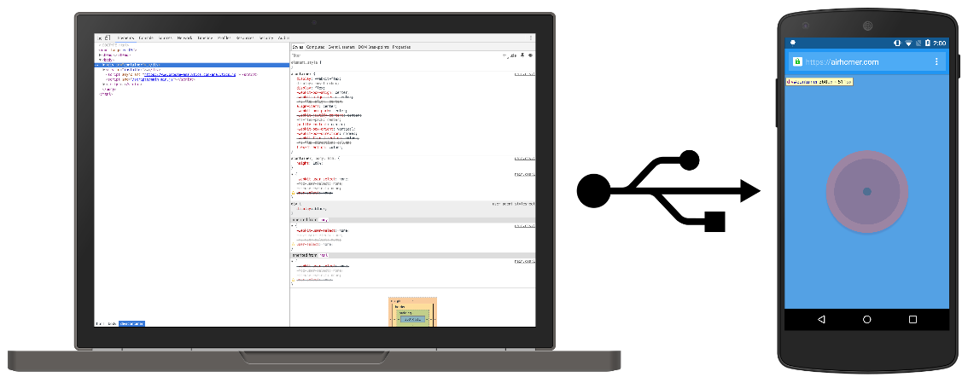
Chrome remote debugging
If you have an Android phone, you can debug web pages on your phone via Chrome remote debugging.
(You can also load a server running locally on your laptop, on your phone via port forwarding.
But we haven't talked about servers yet.)

Slide 46
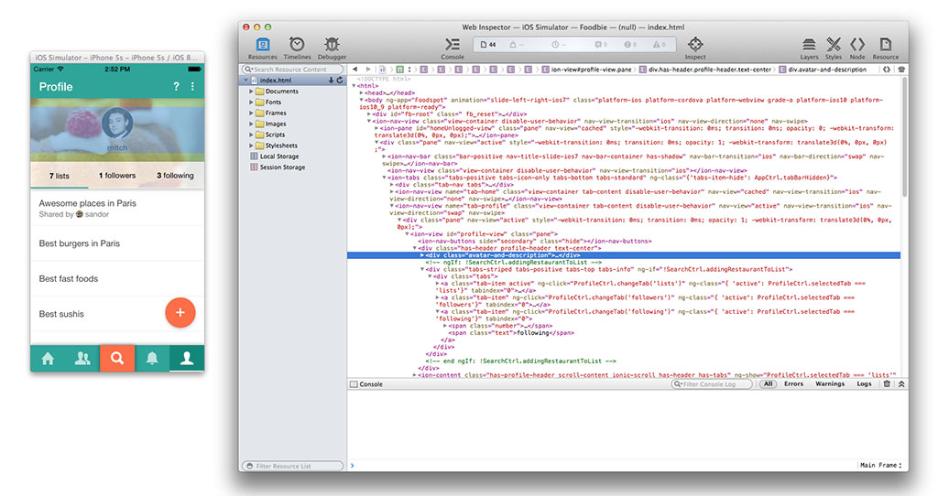
Safari remote debugging
If you have an iPhone, you can debug web pages on your phone via Safari remote debugging.

Slide 47
Relative font sizes: percent, em, rem

Slide 48
Relative units
Whenever possible, it's best to use relative units (like percentage) instead of absolute units (like px).
Advantages:
More likely to work on different screen sizes
Easier to reason about; fewer magic numbers
10% / 80% / 10% vs 122px / 926px / 122px
Q: Should we be using relative units on font-size?

Slide 49
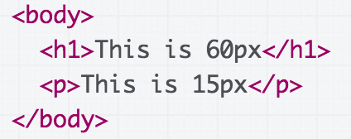
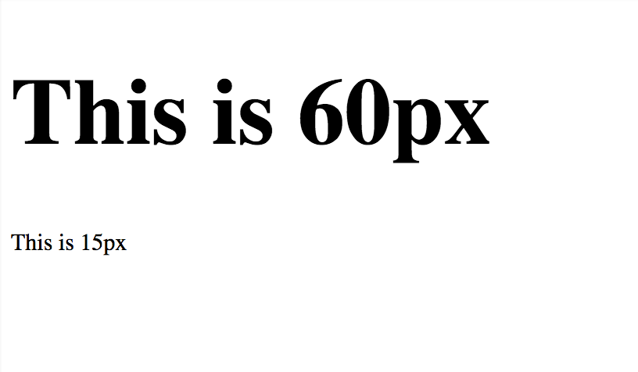
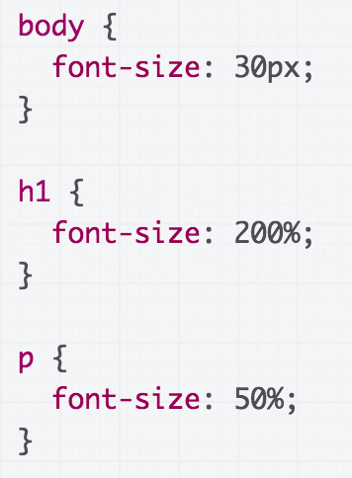
Relative font sizes: percent
You can define font sizes in terms of percentage:
(CodePen)

Slide 50
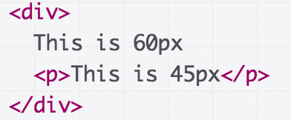
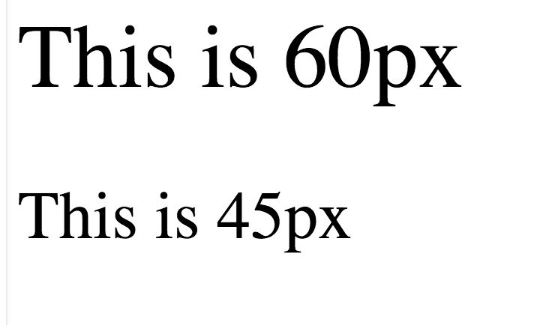
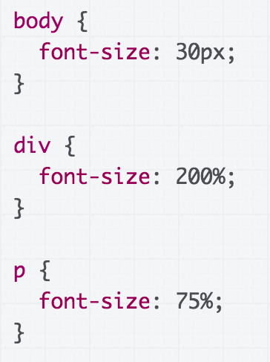
Relative font sizes: percent
Percent on font-size behaves exactly like percentage on width and height, in that it's relative to the parent:
(CodePen)

Slide 51
Relative font sizes: percent
Percent on font-size behaves exactly like percentage on width and height, in that it's relative to the parent:
p is 75% of its parent, which is 200% of 30px.
p's size: .75*2*30 = 45px
(CodePen)

Slide 52
Relative font sizes: em
But instead of percentages, relative font sizes are usually defined in terms of em:
em represents the calculated font-size of the element
  1em = the inherited font size
  2em = 2 times the inherited font size
In other words,
font-size: 1em; is the same as font-size: 100%;

Slide 53
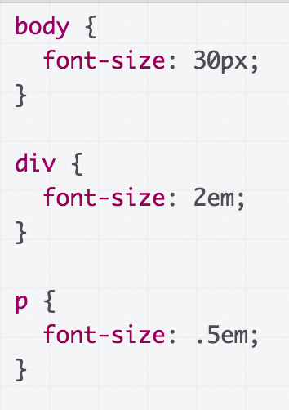
Relative font sizes: em
(CodePen)

Slide 54
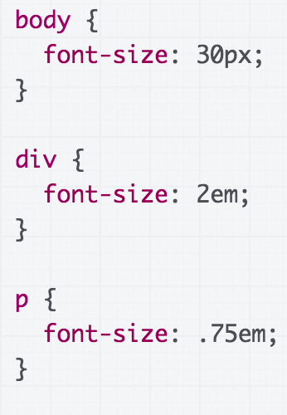
Relative font sizes: em
(CodePen)

Slide 55
Relative font sizes: em
p's inherited font size is 2em, which is 60px. So 0.75em is 0.75*60 = 45px.
(CodePen)

Slide 56
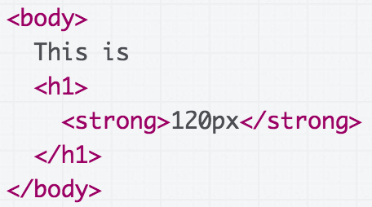
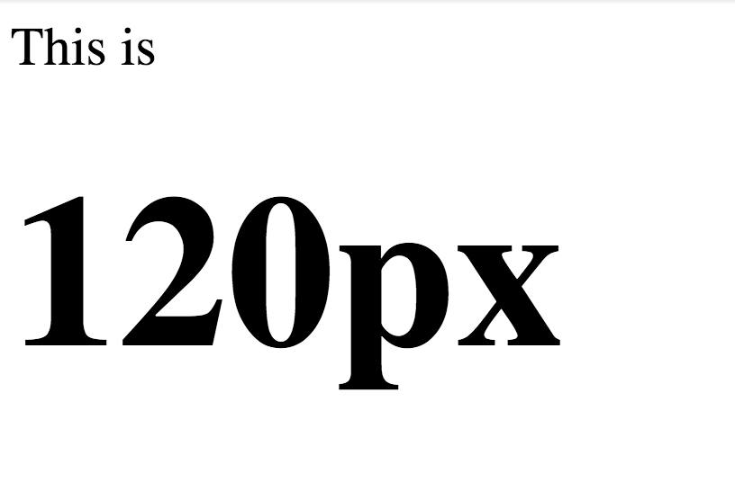
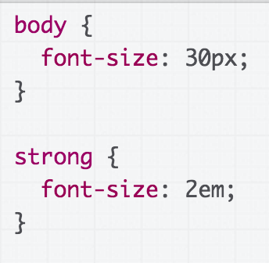
Wait, why is <strong> 120px and not 60px?

Slide 57
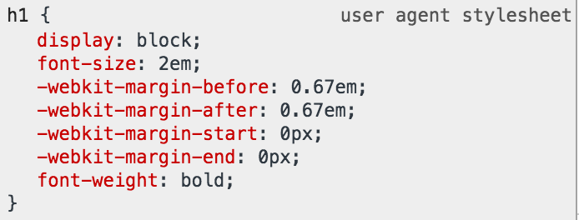
(CodePen)
In the Chrome Inspector, we see the default browser font-size for h1 is 2em. So it's 30*2*2 = 120px.

Slide 58
Relative font sizes: rem
If you do not want your relative font sizes to compound through inheritance, use rem:
rem represents the font-size of the root element
  1rem = the root (html tag) font size
  2rem = 2 times root font size

Slide 59
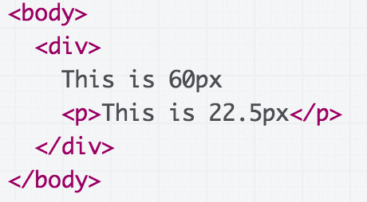
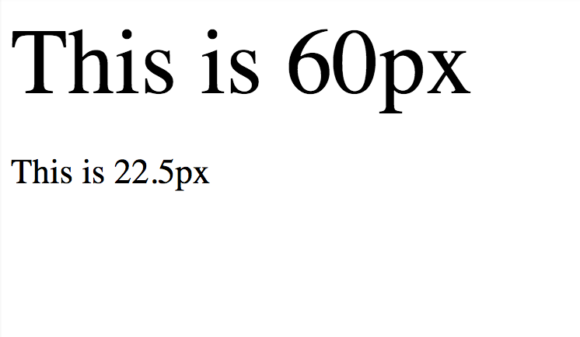
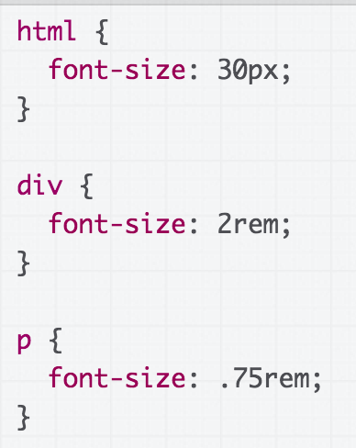
Relative font sizes: rem
(CodePen)

Slide 60
Relative font sizes: rem
font-size is set on the html element, not body (or any other tag)
(CodePen)

Slide 61
Relative font sizes: rem
.75em is calculated from the root, which is 30px, so 30*.75 = 22.5px.
(CodePen)

Slide 62
Relative font conclusions
Use relative fonts for the same purpose as using relative heights and widths:
Prefer em and rem over percentages
  Not for any deep reason, but em is meant for font so it's semantically cleaner
Use rem to avoid compounding sizes
In addition to font-size, consider em/rem for:
  line-height
  margin-top
  margin-bottom

Slide 63
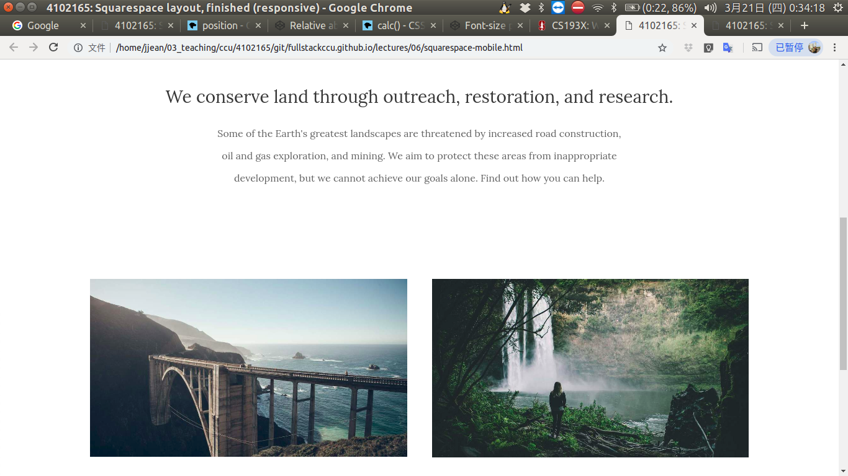
What does our Squarespace layout look like in a phone
with the meta viewport tag?

Slide 64
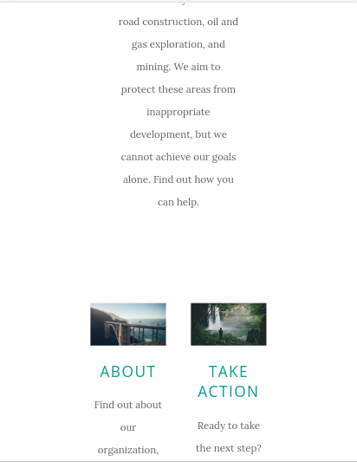

Without the meta viewport tag
With the meta viewport tag

Slide 65
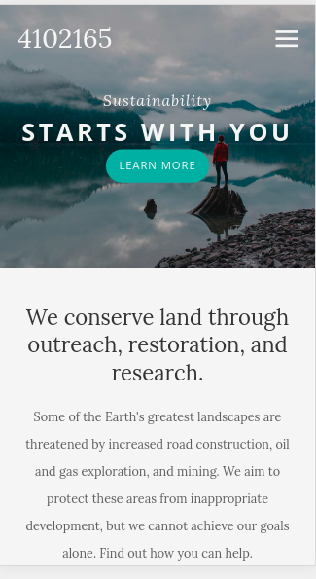

Completed mobile layout

Slide 66
Mobile summary
Always add the meta viewport tag
Use @media queries to add styles for devices with certain characteristics, such as screen width
Use the Chrome Device Mode to simulate mobile rendering on desktop
For height and width, prefer percentages
For fonts, prefer em and rem
Try to minimize dependent rules (Changing the width of one container force you to change 15 other properties to look right)
More on responsive web design

Slide 67
CSS wrap-up
Even though we're "done" with CSS, we will be using CSS all quarter in homework and examples.
Later this quarter:
More flexbox patterns
  More practice with flexbox / game
CSS animations
Possibly grid

