Slide 1
4102165:
Full Stack Web Development Fundamentals
Spring 2019
簡立仁 Li-Ren Chien
ccumouse@gmail.com

Slide 2
Today's schedule
Today
Squarespace Layout
  Single row/column flexbox
vh / vw / box-sizing
Next
position
Random helpful CSS
Mobile layouts
CSS wrap-up

Slide 3

Announcements
Homework 1 deadline extended!
Due Mon Mar 25!
Details here
Homework 2 will go out Tue Mar 26 as well.

Slide 4
Font-related CSS review
Name | Description
font-family | Font face (mdn)
color | Font color (and always font color) (mdn)
font-size | Font size (mdn)
line-height | Line height (mdn)
text-align | Alignment of text (mdn)

Slide 5
More font-related CSS
Name | Description
text-decoration | Can set underline, line-through (strikethrough) or none (e.g. to unset underline on hyperlinks) (mdn)
text-transform | Can change font case, i.e. uppercase, lowercase, capitalize, none (mdn)
font-style | Can set to italic or normal (e.g. to unset italic on <em>) (mdn)
font-weight | Can set to bold or normal (e.g. to unset bold on h1 - h6) (mdn)
letter-spacing | Controls the space between letters (mdn)

Slide 6
Flexbox

Slide 7
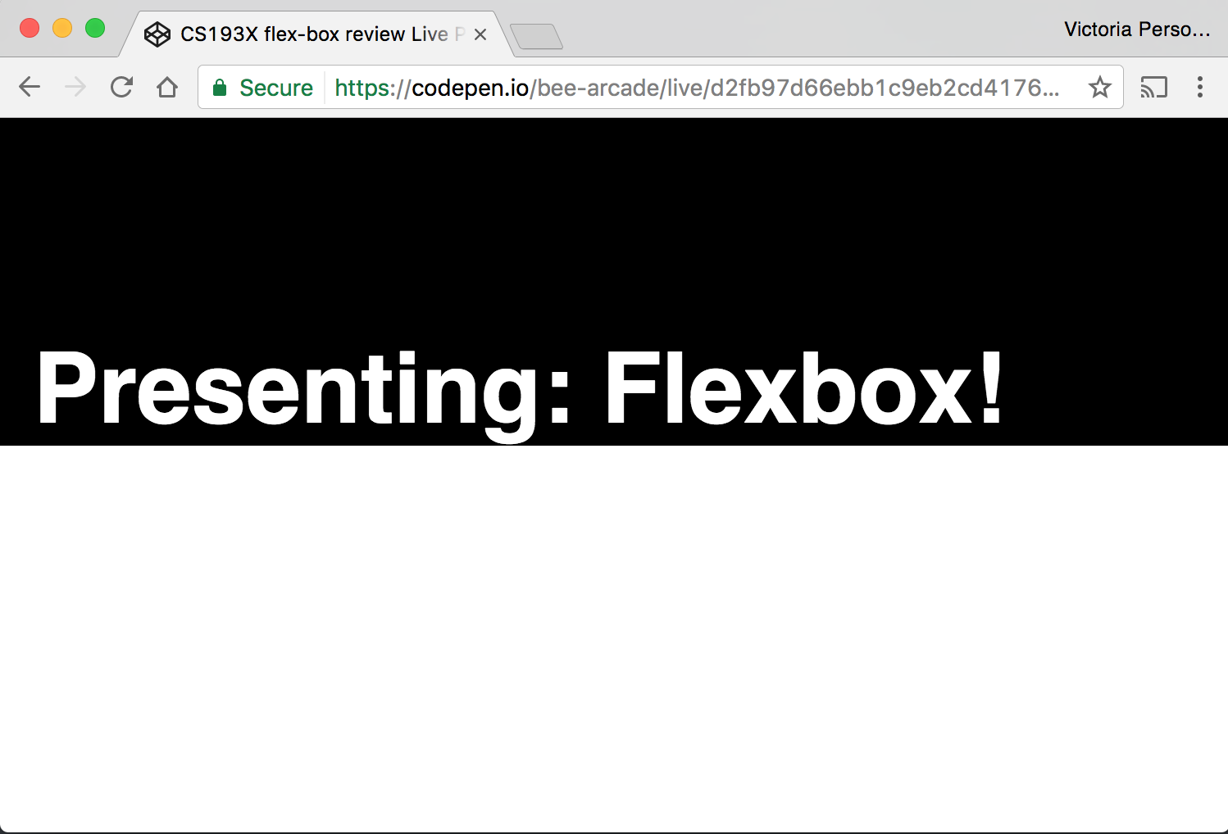
Review: Flexbox
How do we create this look? (Codepen)

Slide 8
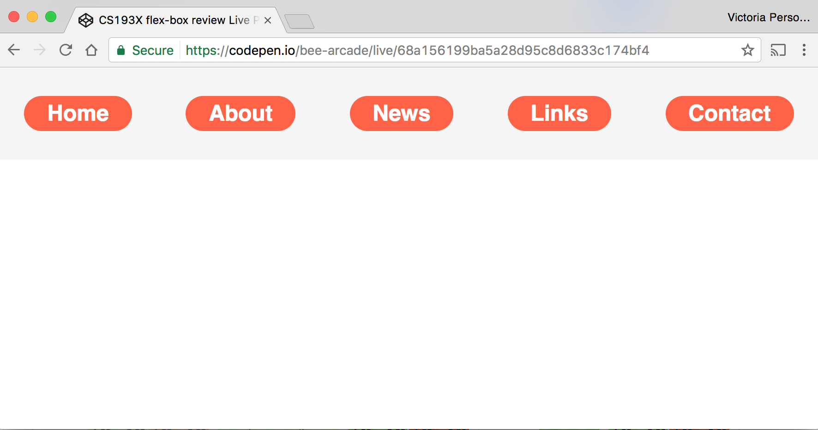
Review: Flexbox
How do we create this look? (Codepen)

Slide 9
Continuing where we left off!

Slide 10

Goal
We were trying to create a layout that looks sort of like this:

Slide 11
Status
We broke up the layout into a bunch of colored boxes:
And we got kind of stuck trying to position the orange boxes.

Slide 12
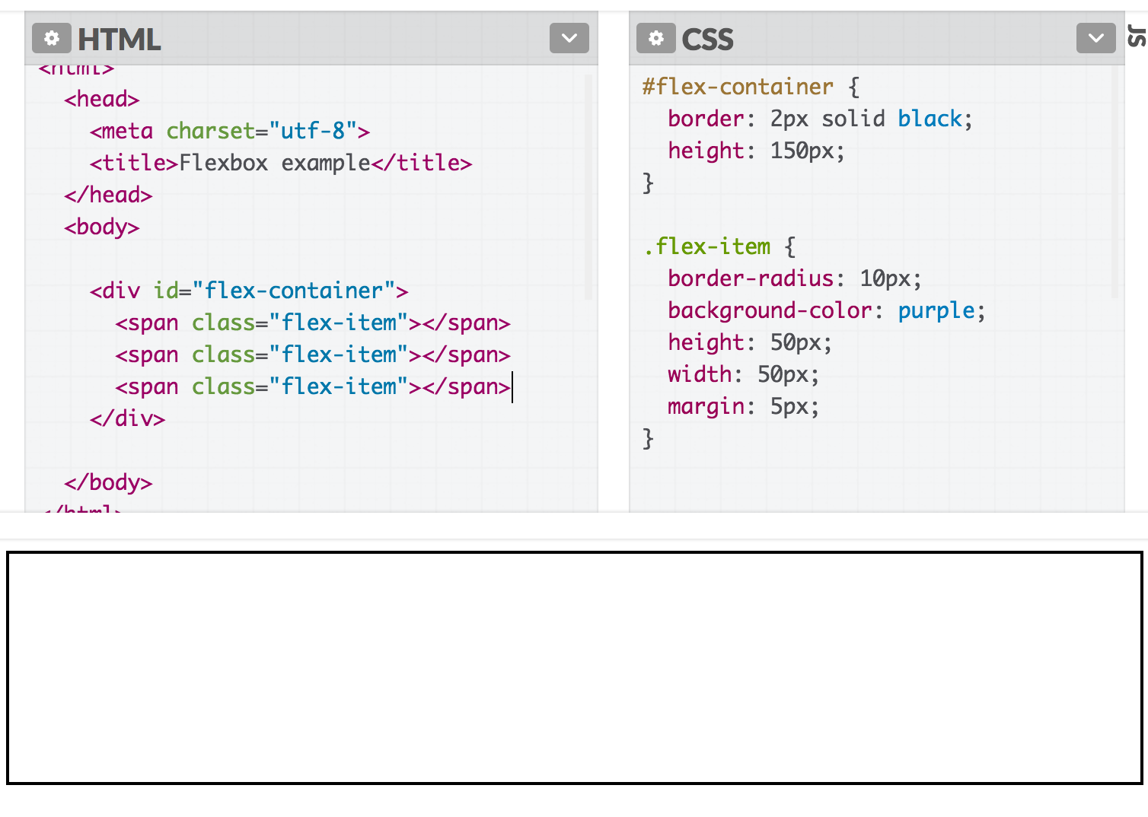
Recall: block layouts
If #flex-container was not display: flex:
Then the span flex-items would not show up because span elements are inline, which don't have a height and width

Slide 13
(Review block and inline!)
(Please make sure you completely understand why the <span> elements do not show up!)
Check out block vs inline guide

Slide 14
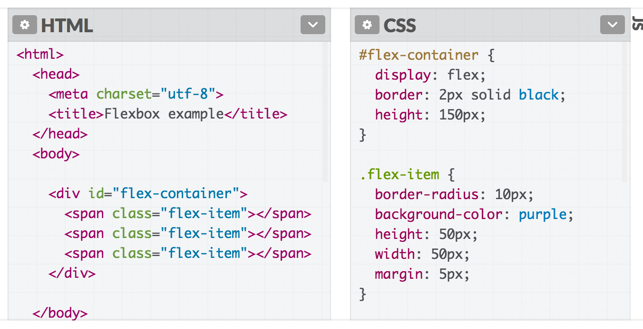
What happens if the flex item is an inline element?

Slide 15
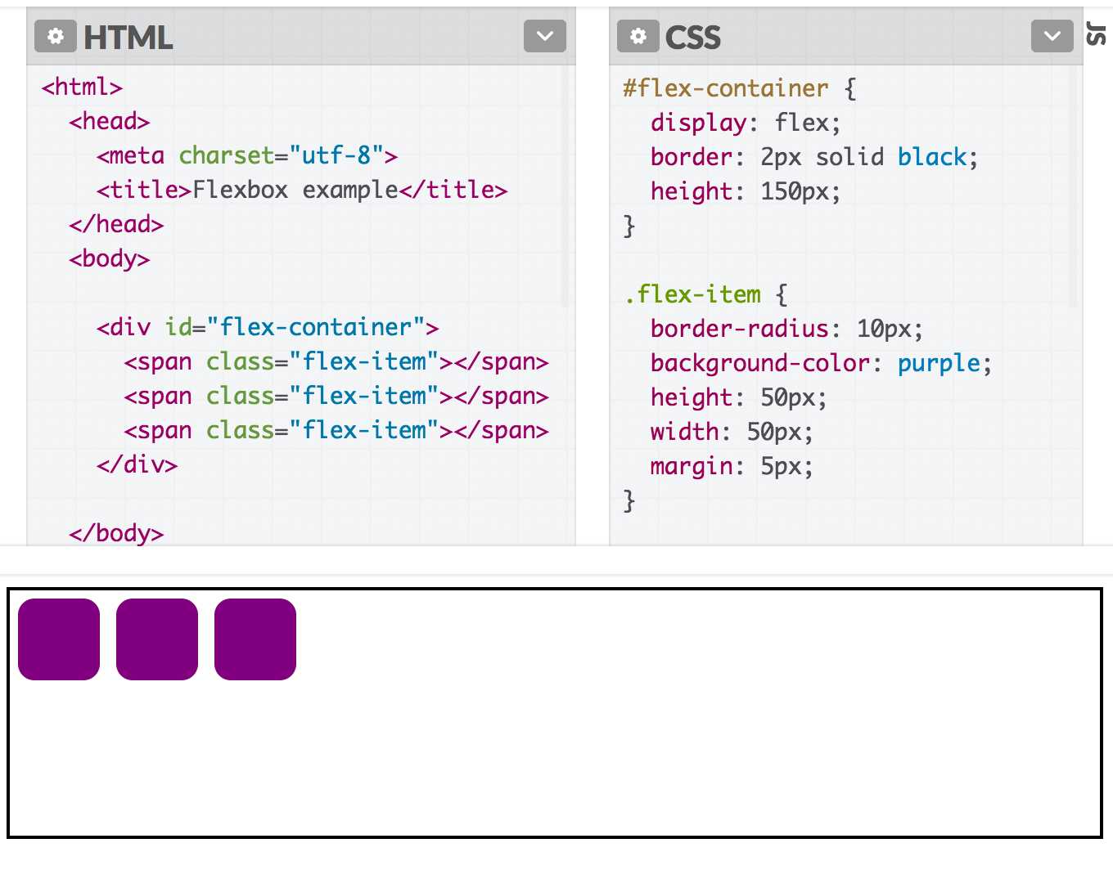
???

Slide 16
Flex layouts
Why does this change when display: flex?
Why do inline elements suddenly seem to have height and width?

Slide 17
Flex: A different rendering mode
When you set a container to display: flex, the direct children in that container are flex items and follow a new set of rules.
Flex items are not block or inline; they have different rules for their height, width, and layout.
  The contents of a flex item follow the usual block/inline rules, relative to the flex item's boundary.
The height and width of flex items are… complicated.
Follow along on CodePen

Slide 18
Flex item sizing

Slide 19
Flex basis
Flex items have an initial width*, which, by default is either:
The content width, or
The explicitly set width property of the element, or
The explicitly set flex-basis property of the element
This initial width* of the flex item is called the flex basis.
*width in the case of rows
height in the case of columns

Slide 20
Flex basis
Flex items have an initial width*, which, by default is either:
The content width, or
The explicitly set width property of the element, or
The explicitly set flex-basis property of the element
This initial width* of the flex item is called the flex basis.
The explicit width* of a flex item is respected for all flex items, regardless of whether the flex item is inline, block, or inline-block.
*width in the case of rows; height in the case of columns

Slide 21
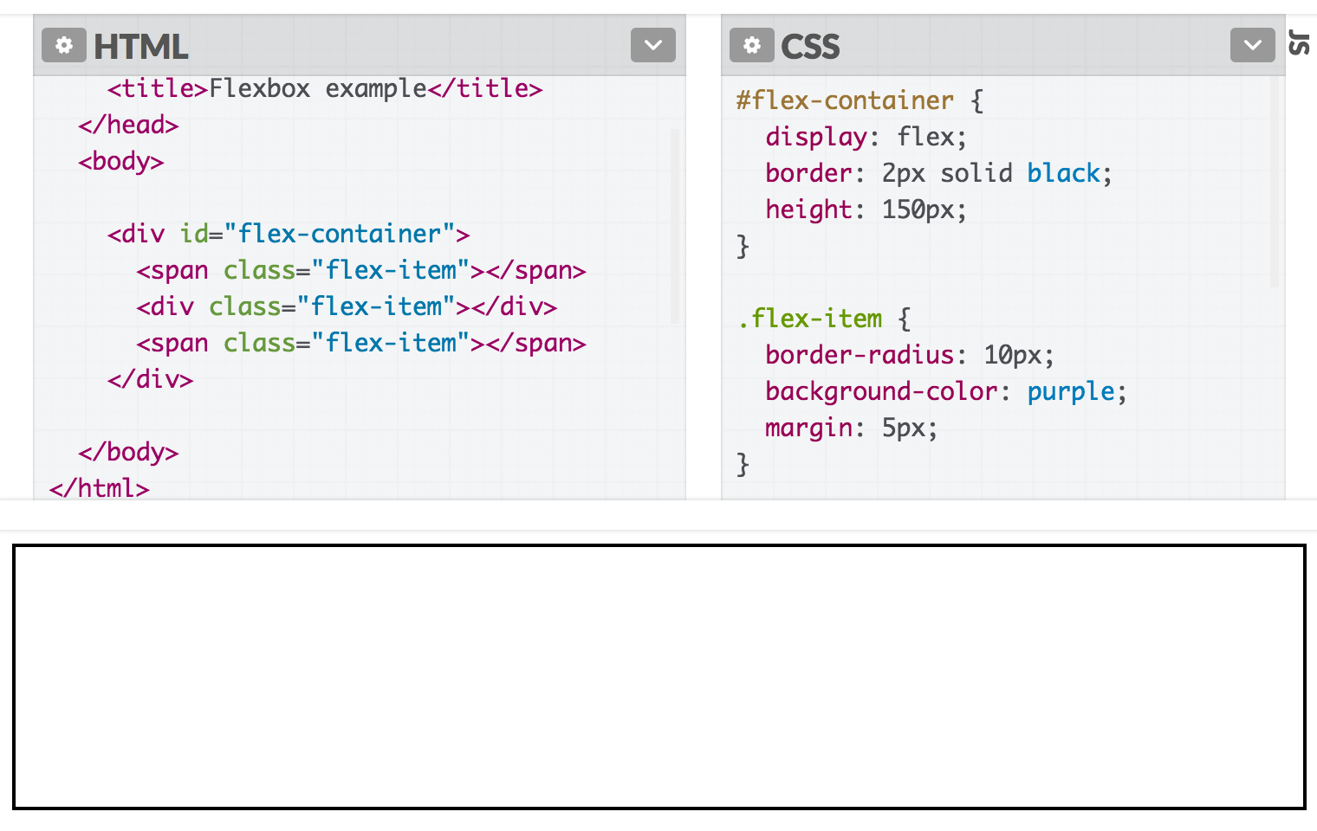
Flex basis
If we unset the height and width, our flex items disappears, because the flex basis is now the content size, which is empty:

Slide 22
flex-shrink
The width* of the flex item can automatically shrink smaller than the flex basis via the flex-shrink property:
flex-shrink:
If set to 1, the flex item shrinks itself as small as it can in the space available.
If set to 0, the flex item does not shrink.
Flex items have flex-shrink: 1 by default.

Slide 23
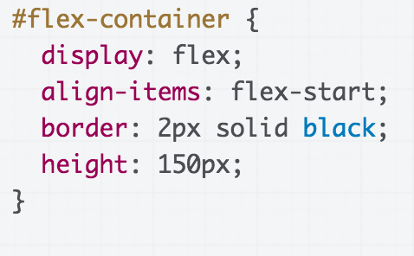
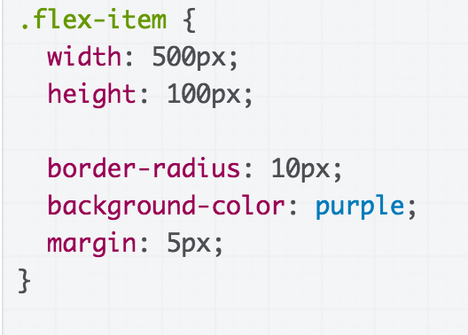
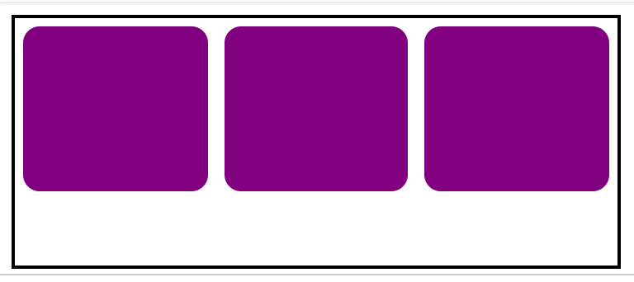
The flex items' widths all shrink to fit within the container.

Slide 24
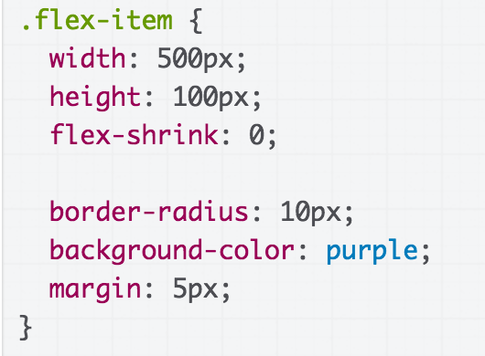
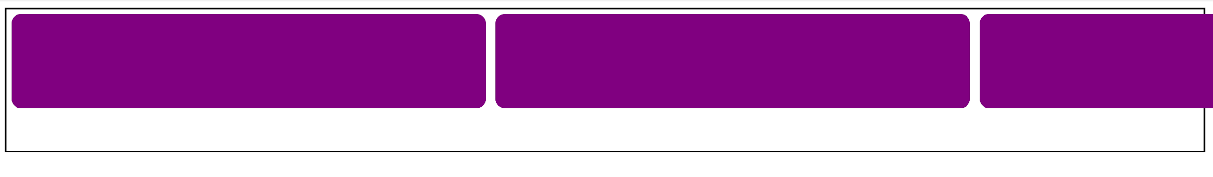
Setting flex-shrink: 0; undoes the shrinking behavior, and the flex items do not shrink in any circumstance:

Slide 25
flex-grow
The width* of the flex item can automatically grow larger than the flex basis via the flex-grow property:
flex-grow:
If set to 1, the flex item grows itself as large as it can in the space remaining.
If set to 0, the flex-item does not grow.
Flex items have flex-grow: 0 by default.
*width in the case of rows; height in the case of columns

Slide 26
flex-grow example
Let's unset the height and width of our flex items again:

Slide 27
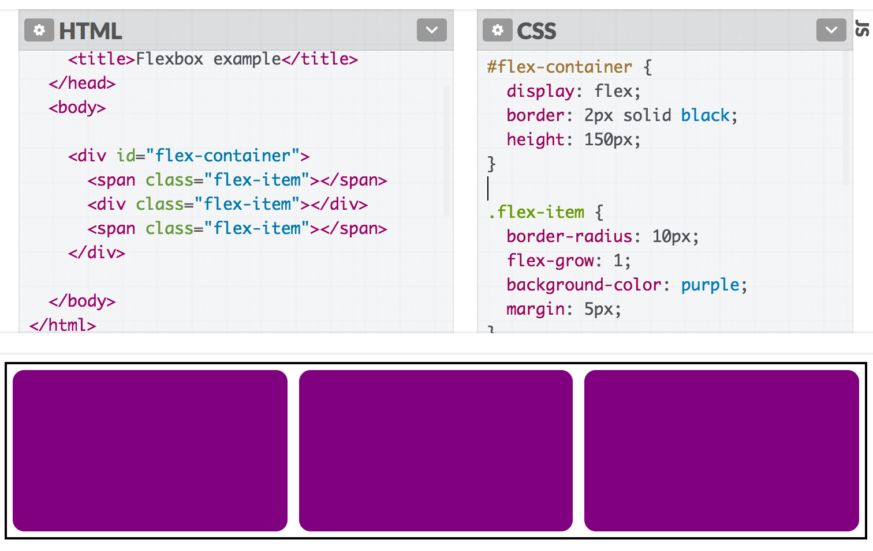
flex-grow example
If we set flex-grow: 1, the flex items fill the empty space:

Slide 28
Flex item height**?!
Note that flex-grow only controls width*.
So why does the height** of the flex items seem to "grow" as well?
*width in the case of rows; height in the case of columns
**height in the case of rows; width in the case of columns

Slide 29
align-items: stretch;
The default value of align-items is stretch, which means every flex item grows vertically* to fill the container by default.
(This will not happen if the height on the flex item is set)
*vertically in the case of rows; horizontally in the case of columns

Slide 30
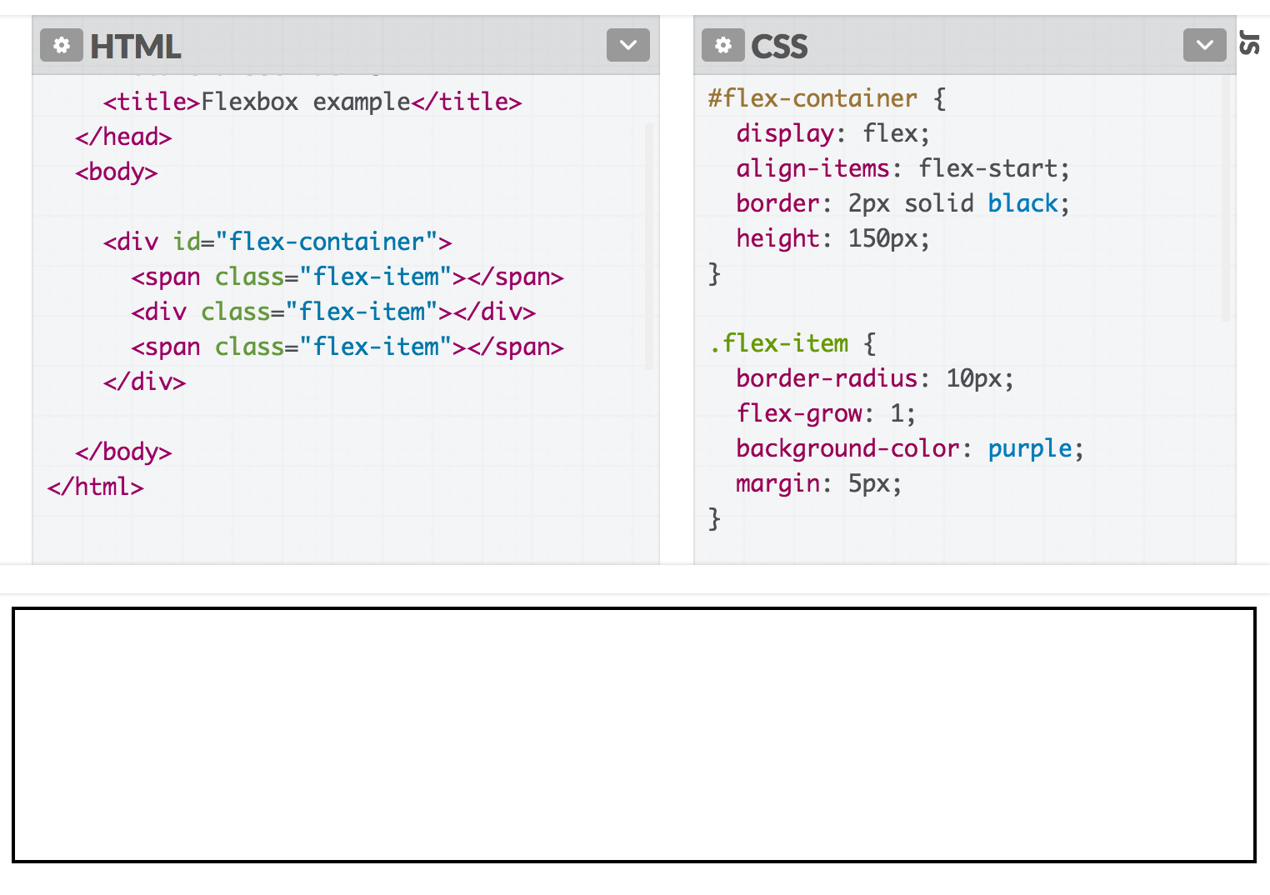
align-items: stretch;
If we set another value for align-items, the flex items disappear again because the height is now content height, which is 0:

Slide 31
Flex layout recap
If you set display: flex, the element is now a flex container and its direct children are flex items.
The items in a flex container will layout in a row or column depending on the flex-direction of the container.

Slide 32
Flex layout recap
justify-contents distributes the items horizontally for flex-direction: row, vertically for column
align-items distributes the items vertically for flex-direction: row, horizontally for column

Slide 33
Flex layout recap
For flex-direction: row:
The flex basis is the initial width of a flex item
  This is either the explicitly set width, the explicitly set flex-basis, or the content width
The width of a flex item will shrink to fit the container if flex-shrink is set to 1 (disabled if 0)
The width of a flex item will grow to fit the remaining space if flex-grow is set to 1 (disabled if 0)

Slide 34
Flex layout recap
For flex-direction: row:
The height of a flex item is either:
  the explicitly set height on the item, or
  the content height on the item, or
  the height of the container if the container's align-items: stretch;

Slide 35
Flex layout recap
For flex-direction: column:
The flex basis is the initial height of a flex item
  This is either the explicitly set height, the explicitly set flex-basis, or the content height
The height of a flex item will shrink to fit the container if flex-shrink is set to 1 (disabled if 0)
The height of a flex item will grow to fit the remaining space if flex-grow is set to 1 (disabled if 0)

Slide 36
Flex layout recap
For flex-direction: column:
The width of a flex item is either:
  the explicitly set width on the item, or
  the content width on the item,
  or
  the width of the container if the container's align-items: stretch;

Slide 37
That's still just scratching the surface of flex box...

Slide 38
...but we now know enough to continue our layout!
Follow along on Codepen

Slide 39
Height and width quirks: vh, vw, box-sizing

Slide 40
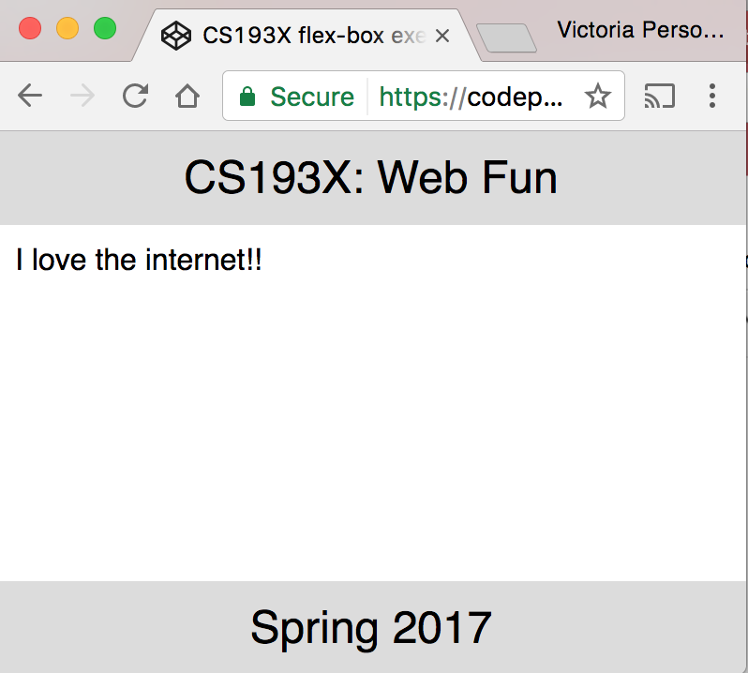
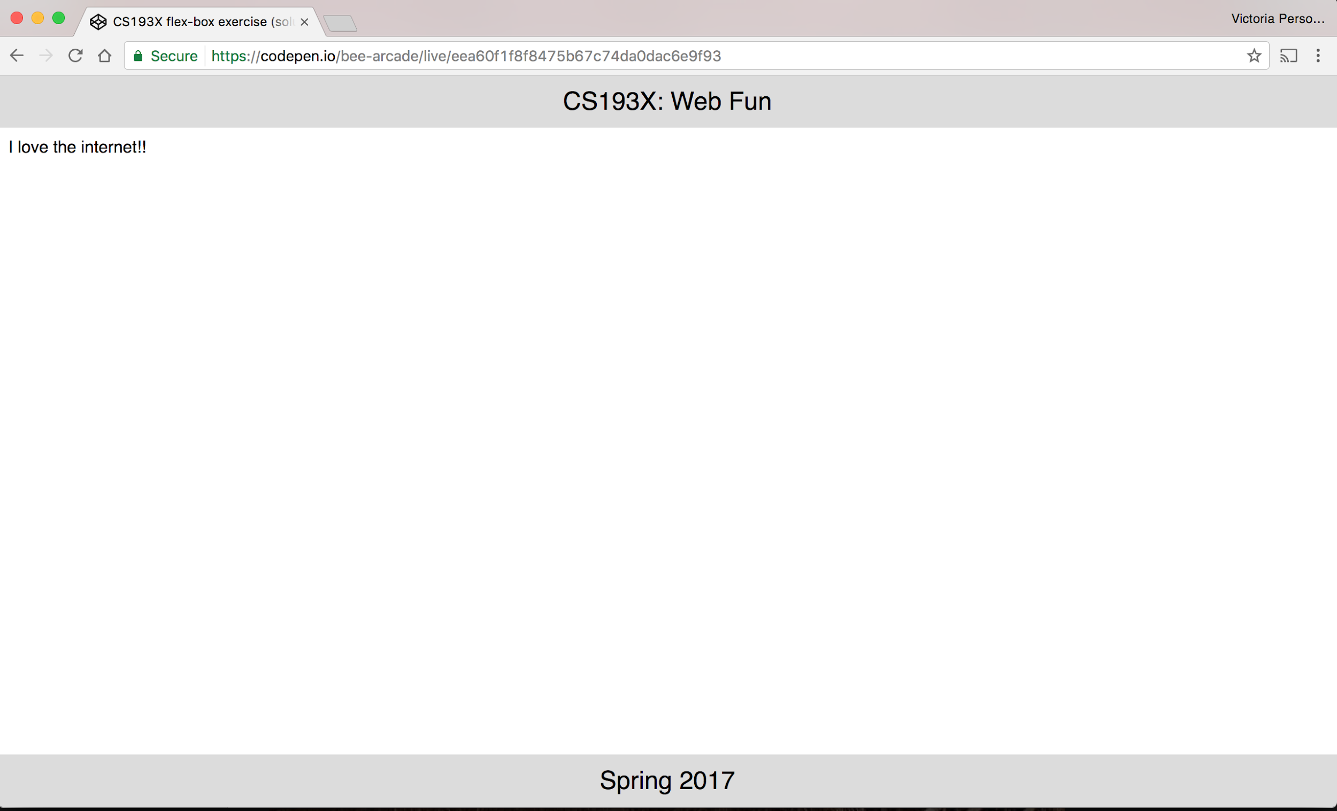
Flexbox example
How do we make a layout that looks like this? (Codepen)
The header and footer stay at the top and bottom of the viewport. (Live example)

Slide 41
height and width percentages
When width is defined as a percentage:
width is specified as a percentage of the containing block's width.
When height is defined as a percentage:
height is specified as a percentage of the containing block's height.
In other words, height and width are defined relative to their parent element when defined as a percentage.

Slide 42
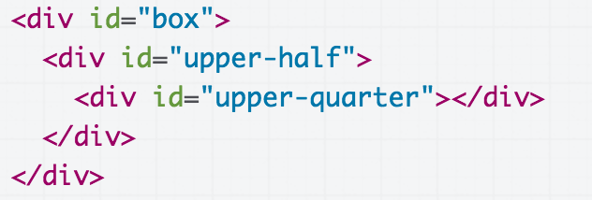
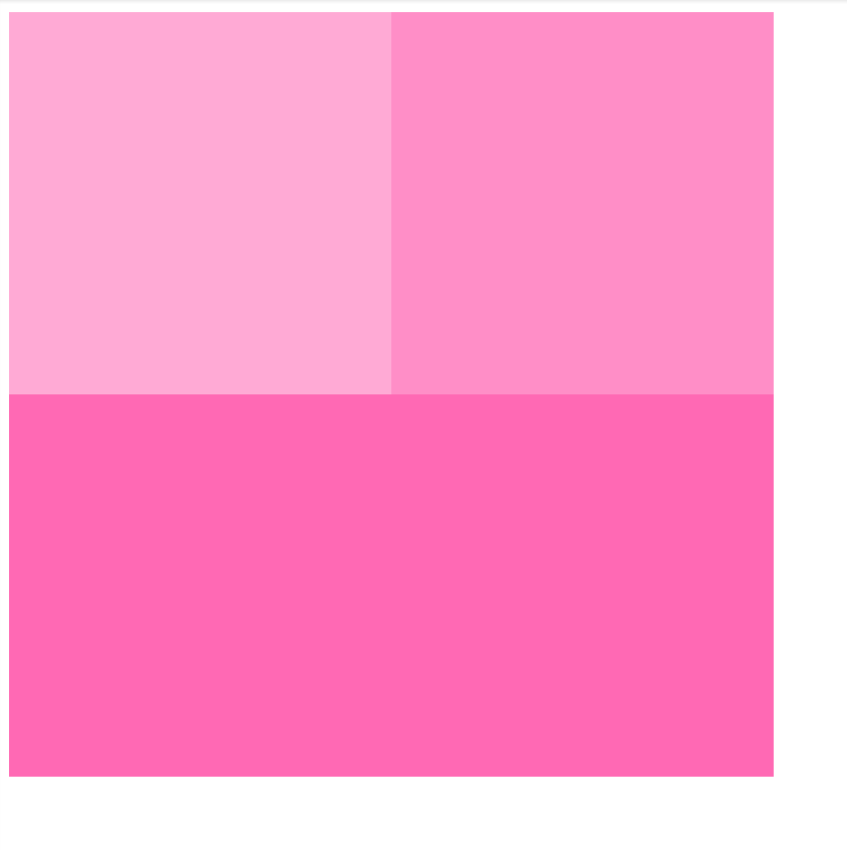
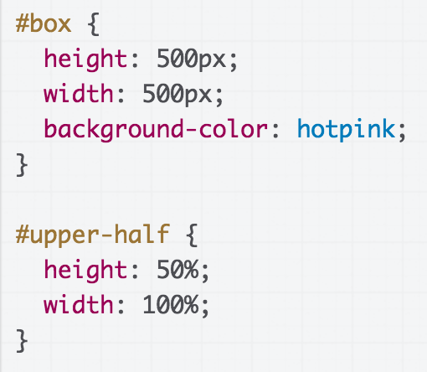
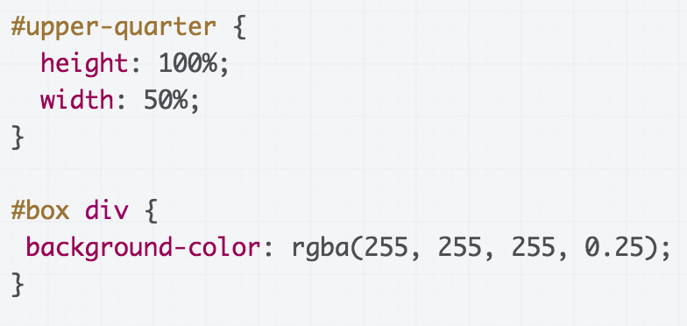
height and width percentages
HTML
OUTPUT
CSS
(Codepen)

Slide 43
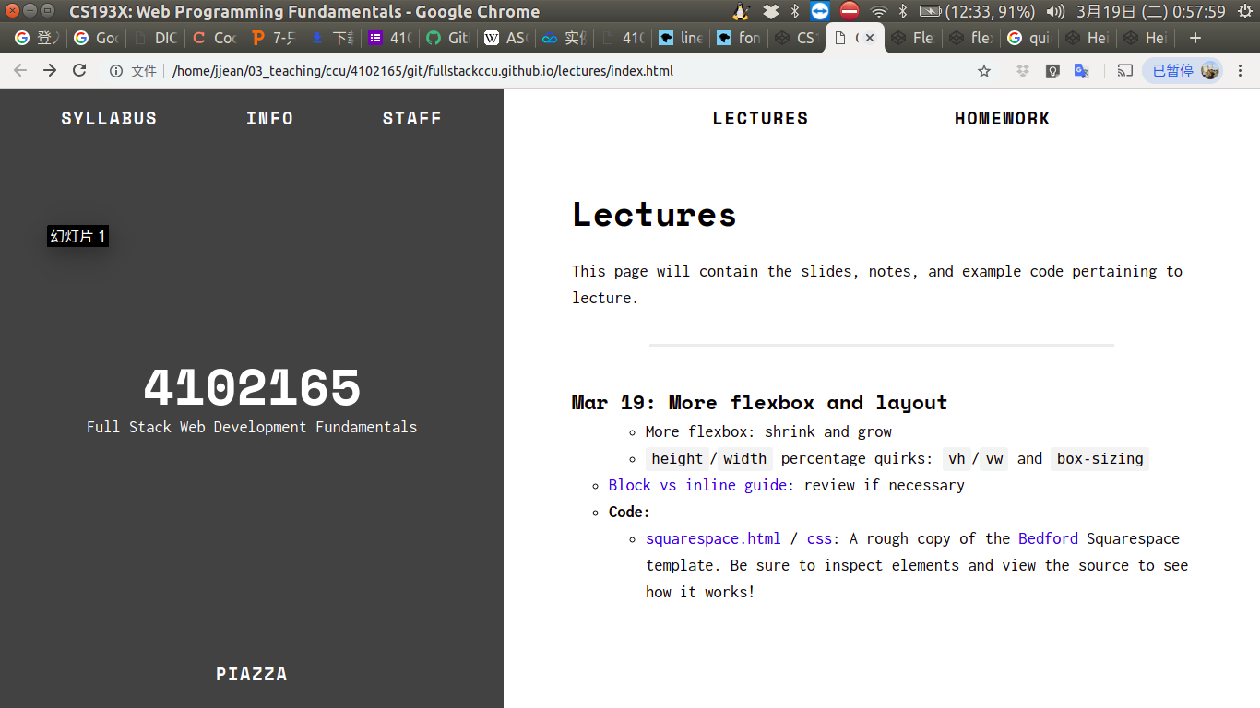
Viewport?
Browser vocabulary:
viewport: the rectangle where the webpage shows up, scrollable via a scrollbar
chrome: all the UI that's not the webpage, i.e. everything but the viewport

Slide 44
Viewport?
Browser vocabulary:
viewport: the rectangle where the webpage shows up, scrollable via a scrollbar
chrome: all the UI that's not the webpage, i.e. everything but the viewport
The viewport

Slide 45
Viewport?
Browser vocabulary:
viewport: the rectangle where the webpage shows up, scrollable via a scrollbar
chrome: all the UI that's not the webpage, i.e. everything but the viewport
The chrome

Slide 46
vh and vw
You can define height and width in terms of the viewport
Use units vh and vw to set height and width to the percentage of the viewport's height and width, respectively (mdn)
1vh = 1/100th of the viewport height
1vw = 1/100th of the viewport width
Example:
height: 100vh;
width: 100vw;

Slide 47
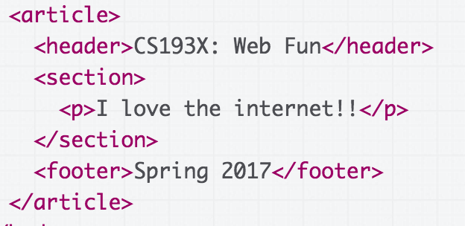
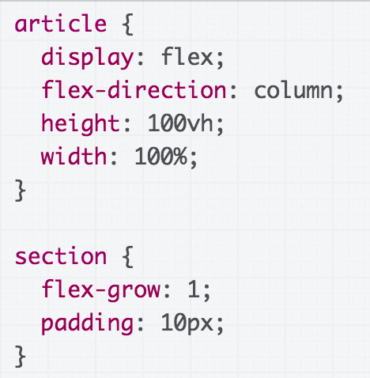
Flexbox example, solved
HTML
CSS
(CodePen)

Slide 48
Aside: sizing
Q: What happens if we add a border to #upper-half?
(rest of the css)

Slide 49
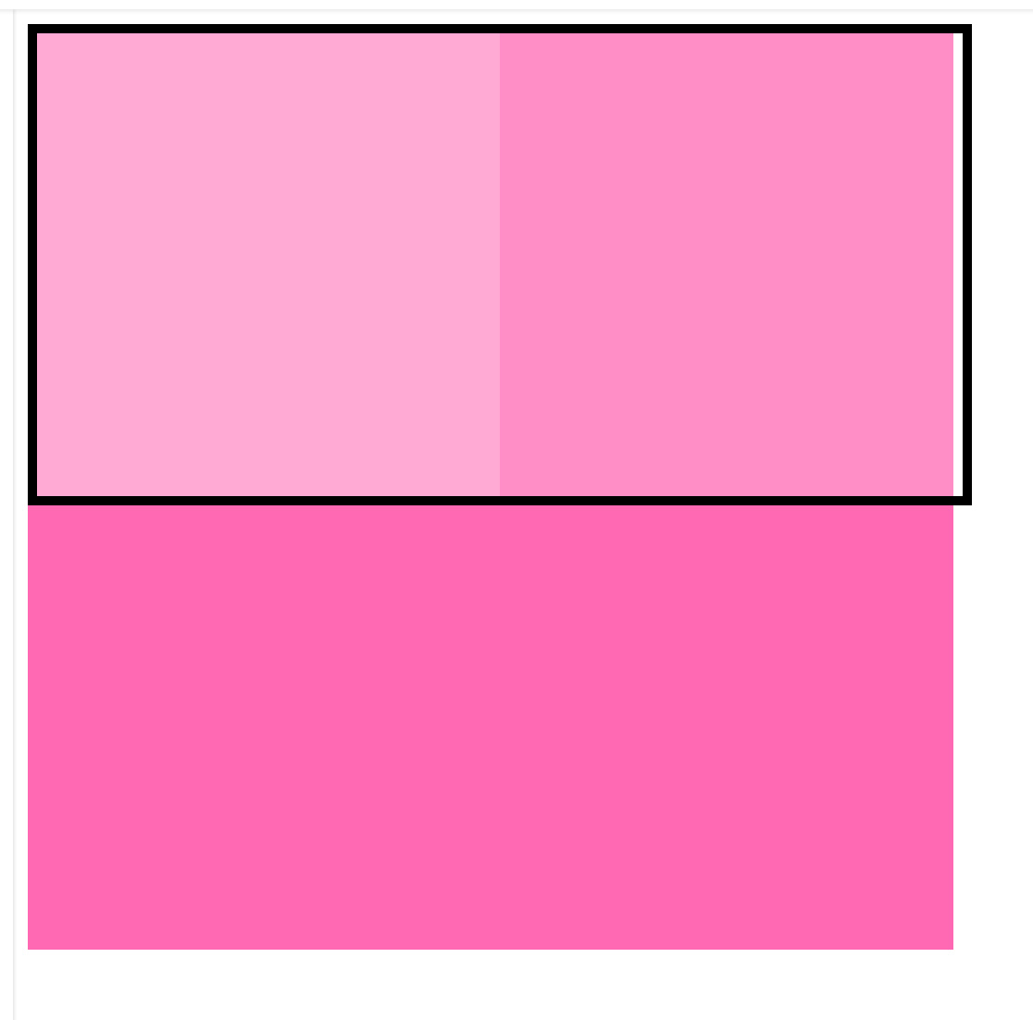
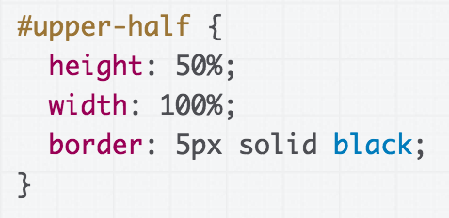
???
(rest of the CSS)

Slide 50
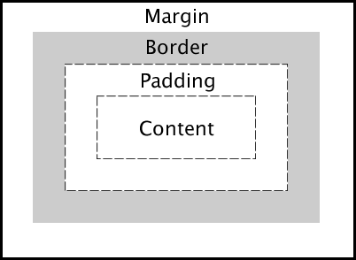
CSS box model width and height
The box model defines CSS width and height properties to refer to the element's content width and height:

Slide 51
box-sizing
If you want to have width and height refer to the element's border width and height, use box-sizing:
box-sizing: border-box;
Note: Using border-box will include padding in the width and height as well.
Note: You cannot select padding-box or margin-box.

Slide 52
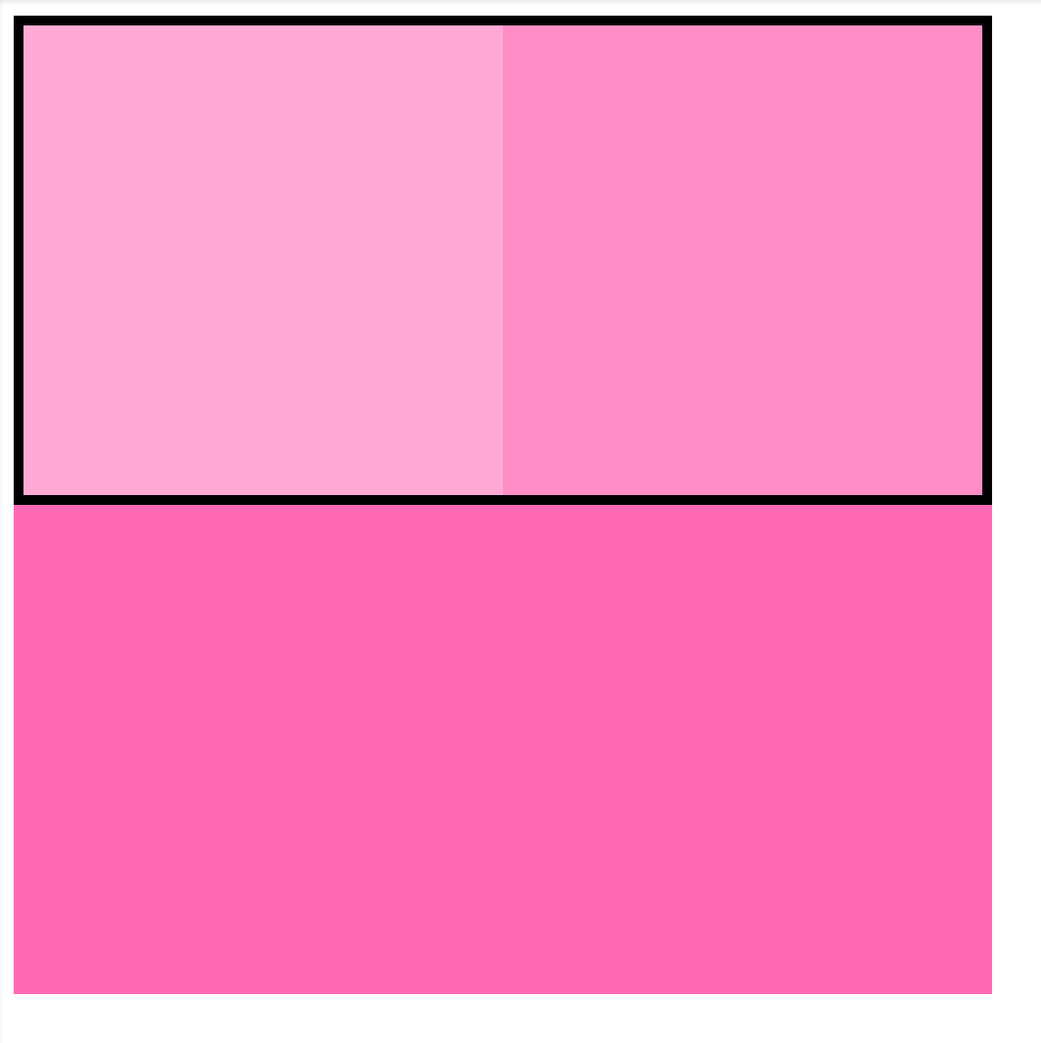
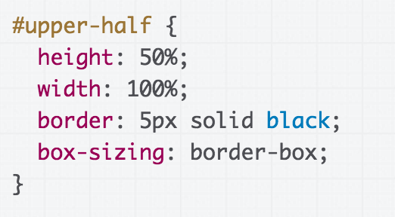
Fixed example
( rest of the CSS )

Slide 53
Another rendering mode: position
Next time!

