Slide 1
4102165:
Full Stack Web Development Fundamentals
Spring 2019
簡立仁 Li-Ren Chien
ccumouse@gmail.com

Slide 2
Today's schedule
Today
Finish up gift example
Case study: Tic-Tac-Toe
DOM revisited

Slide 3
Forgot last time: List operations
Method | Description
list.push(element) | Add element to back
list.unshift(element) | Add element to front
Method | Description
list.pop() | Remove from back
list.shift() | Remove from front
Method | Description
list.indexOf(element) | Returns numeric index for element or -1 if none found

Slide 4
Forgot last time: splice
Add/remove element at index: splice
list.splice(startIndex, deleteCount, item1, item2, ...)
Remove one element at index 3:
list.splice(3, 1);
Add element at index 2:
list.splice(2, 0, element);

Slide 5
Back to events, etc...

Slide 6

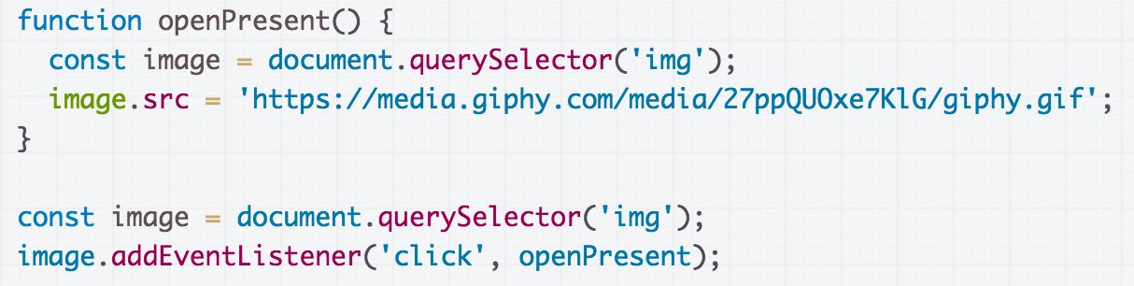
Example: Present
See the CodePen -
much more exciting!

Slide 7
Finding the element twice...
This redundancy is unfortunate.
Q: Is there a way to fix it?

Slide 8
Finding the element twice...
This redundancy is unfortunate.
Q: Is there a way to fix it?
CodePen

Slide 9
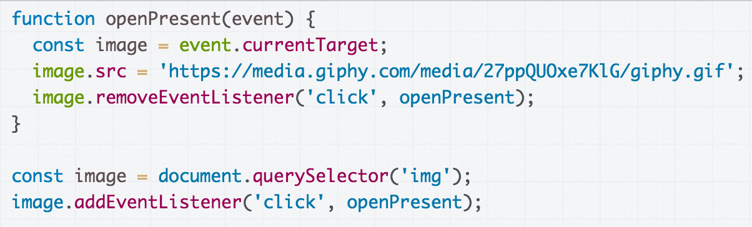
Event.currentTarget
An Event element is passed to the listener as a parameter:
The event's currentTarget property is a reference to the object that we attached to the event, in this case the <img>'s Element to which we added the listener.

Slide 10
Psst.. Not to be confused with Event.target
(Note: Event has both:
event.target: the element that was clicked / "dispatched the event" (might be a child of the target)
event.currentTarget: the element that the original event handler was attached to)
Codepen

Slide 11

Example: Present
It would be nice to change the text after the present is "opened"...

Slide 12
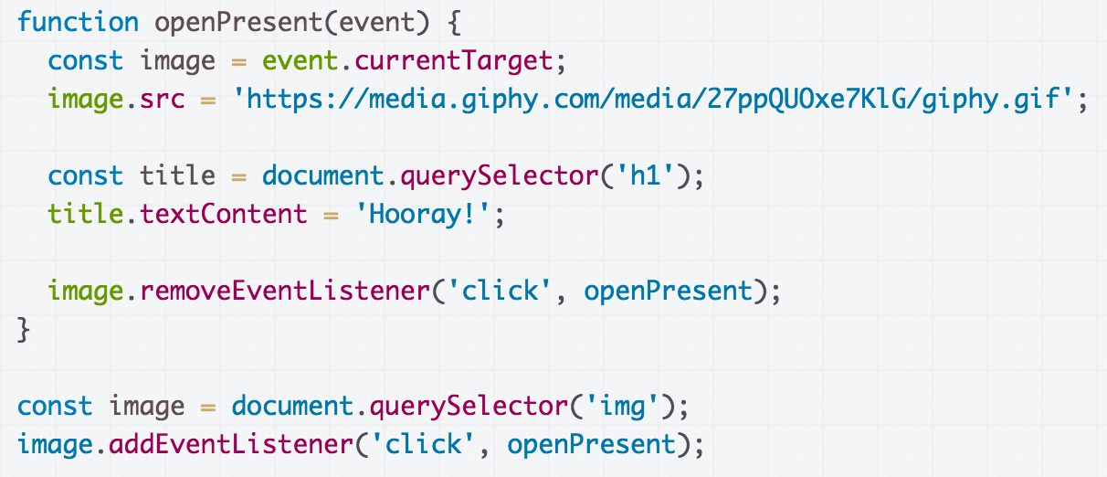
We can select the h1 element then set its textContent to change what is displayed in the h1. (CodePen)

Slide 13
Another approach:
Changing the elements

Slide 14
Add elements via DOM
We can create elements dynamically and add them to the web page via createElement and appendChild:
document.createElement(tag string)
element.appendChild(element);
Technically you can also add elements to the webpage via innerHTML, but it poses a security risk.
// Try not to use innerHTML like this:
element.innerHTML = '<h1>Hooray!</h1>';

Slide 15
Remove elements via DOM
We can also call remove elements from the DOM by calling the remove() method on the DOM object:
element.remove();
And actually setting the innerHTML of an element to an empty string is a fine way of removing all children from a parent node:
// This is fine and poses no security risk.
element.innerHTML = '';

Slide 16
Remove elements via DOM
We can also call remove elements from the DOM by calling the remove() method on the DOM object:
element.remove();
And actually setting the innerHTML of an element to an empty string is a fine way of removing all children from a parent node:
// This is fine and poses no security risk.
element.innerHTML = '';

Slide 17
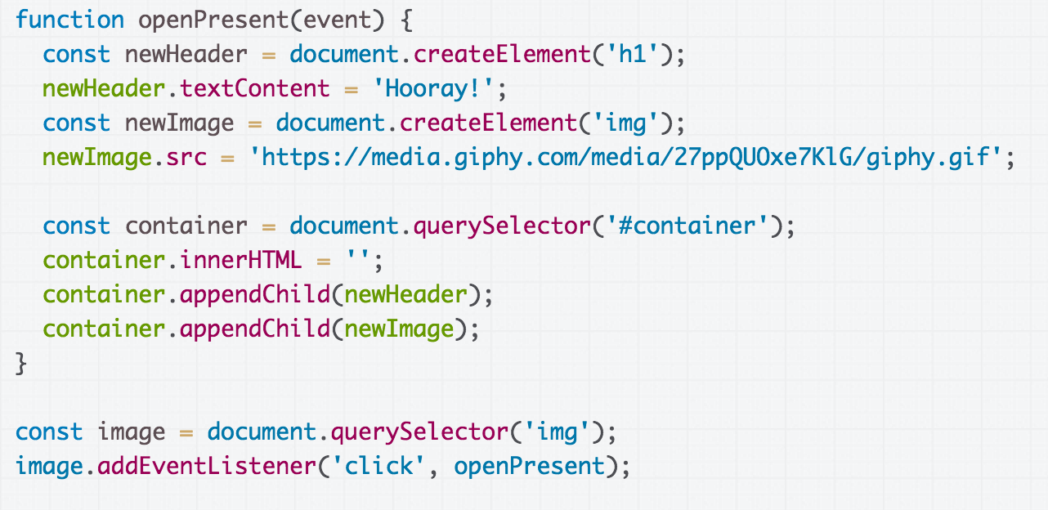
CodePen

Slide 18

Hmm, the effect is slightly janky though:
The text changes faster than the image loads.
Q: How do we fix this issue?

Slide 19
display: none;
There is yet another super helpful value for display:
display: block;
display: inline;
display: inline-block;
display: flex;
display: none;
display: none; turns off rendering for the element and all its children. It's treated as if the element were not in the document at all...

Slide 20
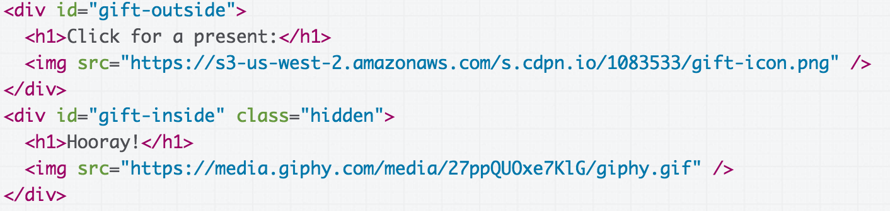
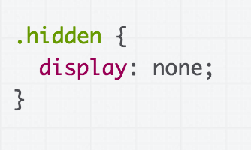
We can add both views to the HTML, with one view hidden by default… (CodePen)

Slide 21
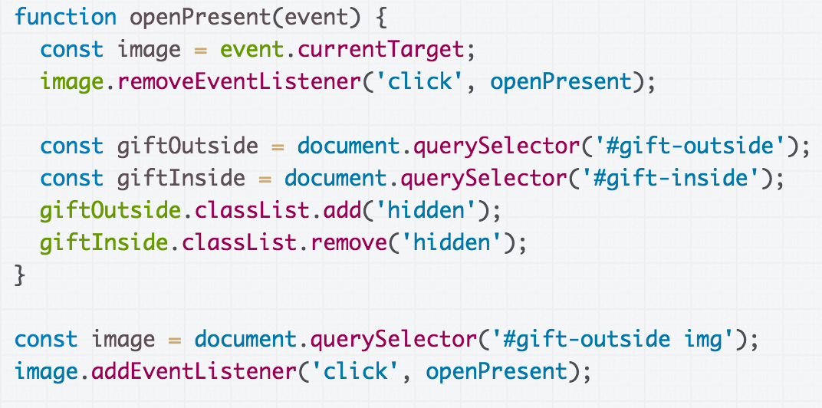
Then we toggle the display state of the containers by adding/removing the hidden class.
(CodePen)

Slide 22
CodePen

Slide 23
Recap
Several strategies for updating HTML elements in JS:
1. Change content of existing HTML elements in page:
Good for simple text updates
2. Add elements via createElement and appendChild
Needed if you're adding a variable number of elements
3. Put all "views" in the HTML but set inactive ones to hidden, then update display state as necessary.
Good when you know ahead of time what element(s) you want to display
Can be used in conjunction with (1) and/or (2)

Slide 24
Case Study: A longer JS example

Slide 25

Example: Tic Tac Toe
Let's try to implement a game of Tic-Tac-Toe. (finished)

Slide 26
Tic Tac Toe plan
Every time we click on an empty space, change the empty space in an "X" by adding an image of an "x" into the empty <div>
After our turn, the computer puts an "O" in a random empty space
When there are 3 Xs or 3 Os in a row, declare a winner
Codepen starter

Slide 27
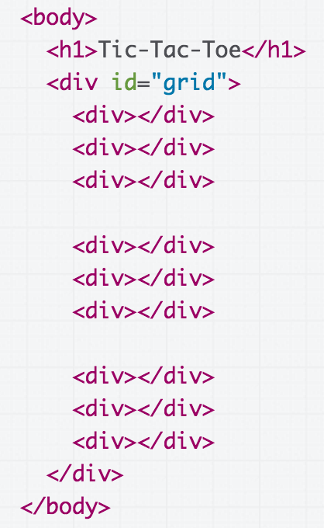
Empty square -> X
First we need to make all div children of #grid clickable… how do we do that?

Slide 28
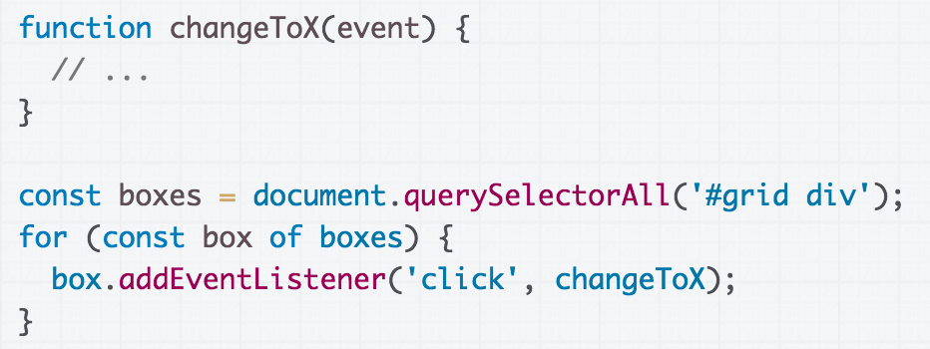
Empty square -> X
In changeToX, we need to add an <img> tag into the clicked element…
How do we do that?

Slide 29
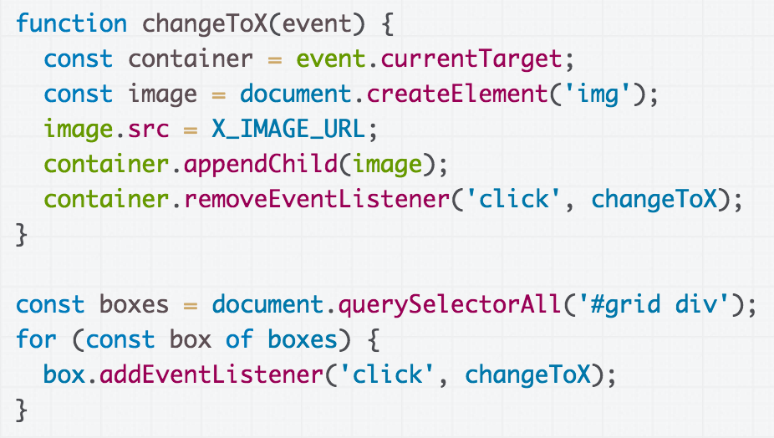
Empty square -> X
Step 1 Complete: CodePen

Slide 30
Tic Tac Toe plan
Every time we click on an empty space, change the empty space in an "X" by adding an image of an "x" into the empty <div>
After our turn, the computer puts an "O" in a random empty space
When there are 3 Xs or 3 Os in a row, declare a winner

Slide 31
Aside: Random in JS
Inconveniently, JavaScript only has one* random generator: Math.random()
Math.random() returns a random floating point number between [0, 1) (0 inclusive, 1 exclusive)
To get a random number from 0 inclusive to max exclusive:
Math.floor(Math.random() * max);
(Intuition: It's like a random percentage of max…
so if max is 5, then [0, 0.2) maps to 0, [0.2, 0.4) maps to 1, [0.4, 0.6) maps to 2,
[0.6, 0.8) maps to 3, [0.8, 1) maps to 4)
*aside from crypto libraries

Slide 32
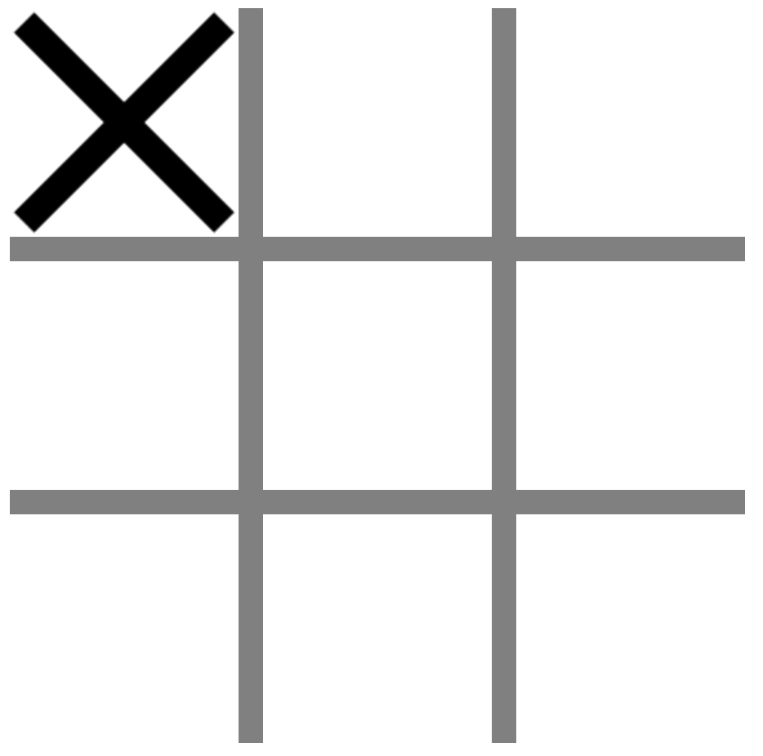
How do we figure out an empty space?

Slide 33
Empty space: DOM approach
Maybe something like:
For each #grid div
  See if it has an img child
Note that querySelector can also be used on an element, not just document:
const sectionElement = document.querySelector('section');
// All h1s that are children of sectionElement:
const headers = sectionElement.querySelector('h1');

Slide 34
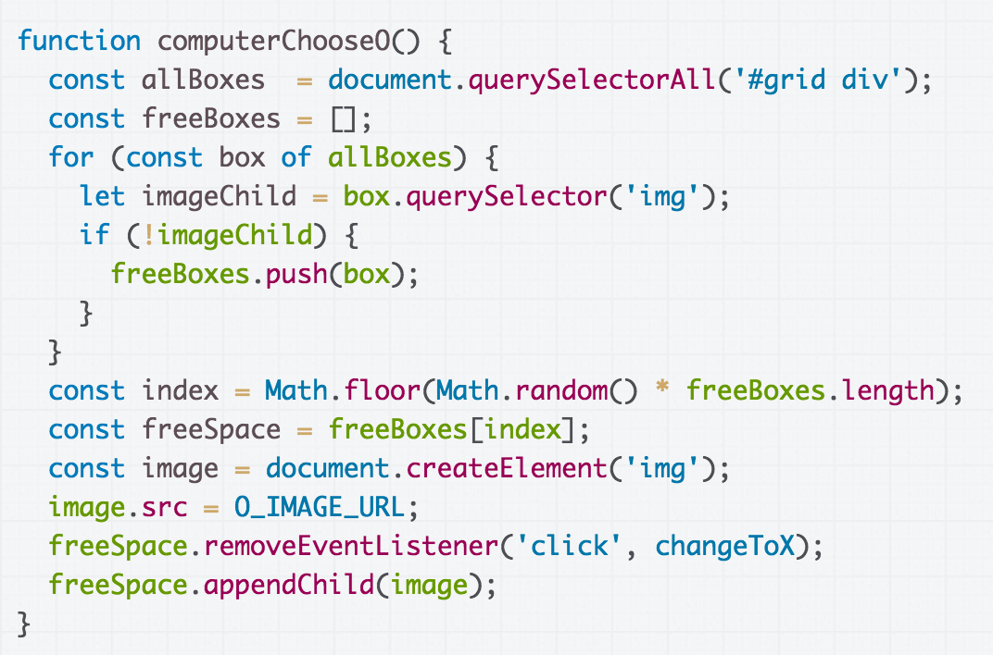
Anything wrong with this approach?
(CodePen)

Slide 35
Don't query UI for state
We're querying the UI state to understand the game state.
This is not a great software engineering technique:
Couples your "view" and your "model"
Can lead to hard-to-find bugs:
  What if we later decide to display X's and O's using background-image instead of an <img> tag?
Code is also a little hard to read
  What do "img" tags have to do with a free space?
Better to keep track of state separately from UI!

Slide 36
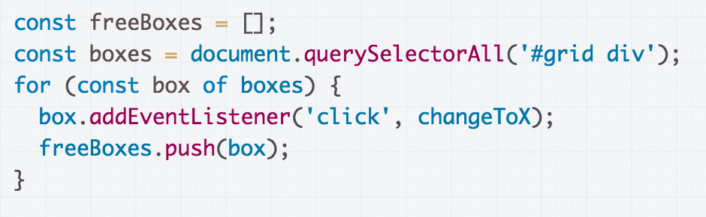
Better(?) approach: Global Variable
We can instead store the game state in a global variable:
freeBoxes is our array that contains the available boxes

Slide 37
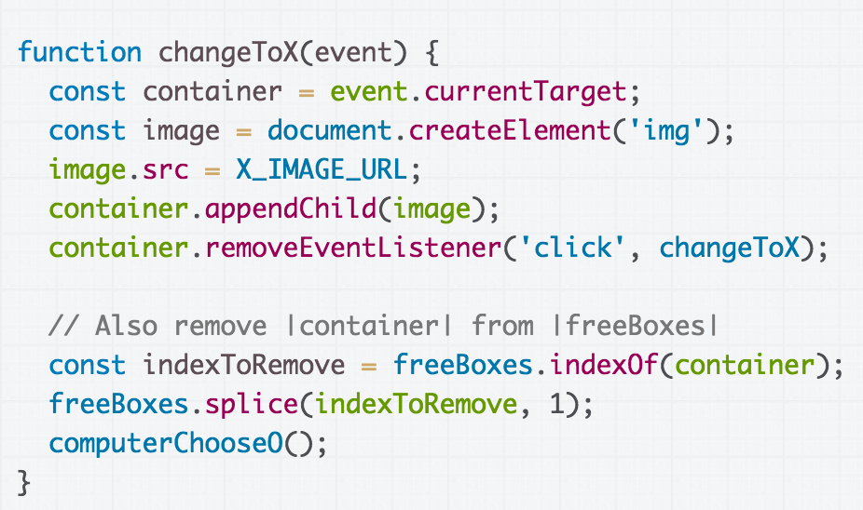
Better(?) approach: Global Variable
Then we update the freeBoxes state when we add an X...

Slide 38
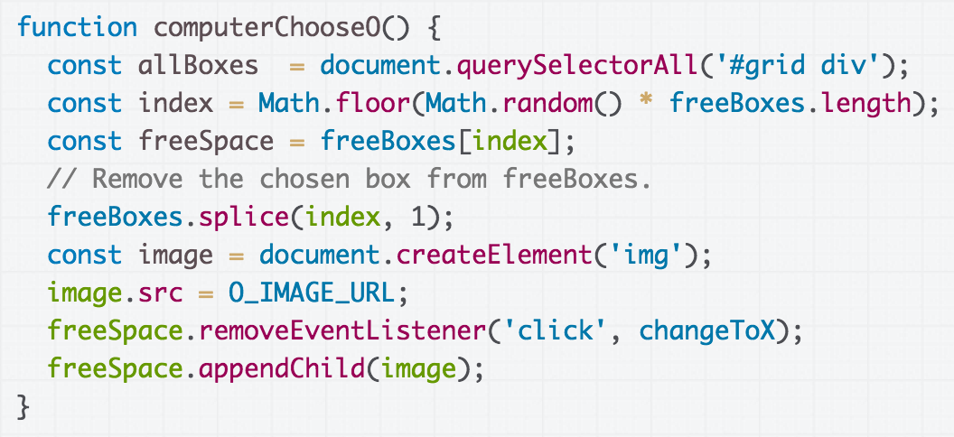
Better(?) approach: Global Variable
...And when the computer add an O. (CodePen)

Slide 39
Is that really better?!
What's wrong with that solution?
Aren't we still coupling UI with state a little bit?
  We are storing references to UI elements in freeBoxes to track which ones are free...
Aren't global variables bad?!
  We aren't supposed to create global variables in other programming contexts...

Slide 40
Is that really better?!
What's wrong with that solution?
Aren't we still coupling UI with state a little bit?
  We are storing references to UI elements in freeBoxes to track which ones are free...
Aren't global variables bad?!
  We aren't supposed to create global variables in other programming contexts…
(We'll deal with these problems next week)
(Basically we want classes)

Slide 41
Tic Tac Toe plan
Every time we click on an empty space, change the empty space in an "X" by adding an image of an "x" into the empty <div>
After our turn, the computer puts an "O" in a random empty space
When there are 3 Xs or 3 Os in a row, declare a winner

Slide 42
Distinguishing boxes
The same event handler is called for each element.
How do we distinguish between elements?

Slide 43
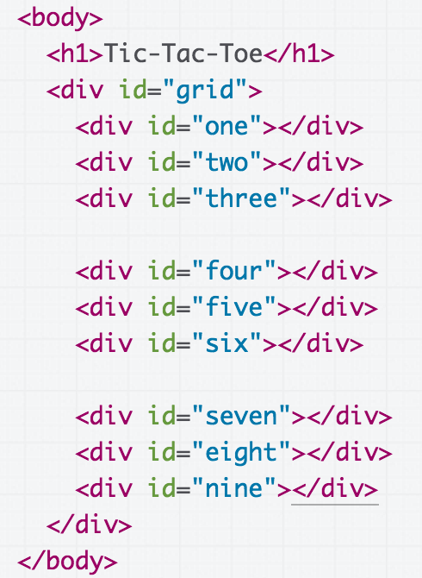
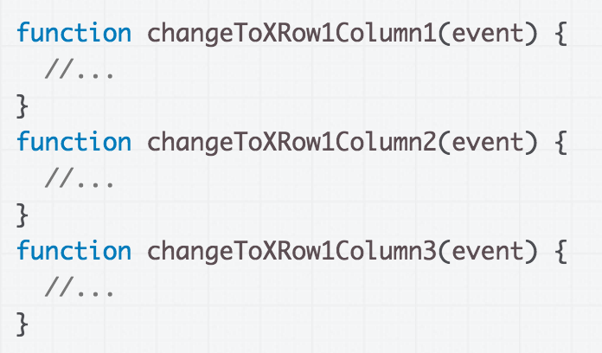
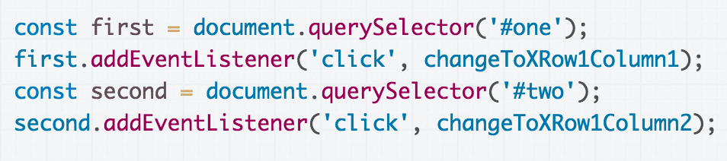
Terrible idea: 9 event handlers

Slide 44
Uniquely identifying items
But this idea of uniquely identifying squares is a good one!

Slide 45
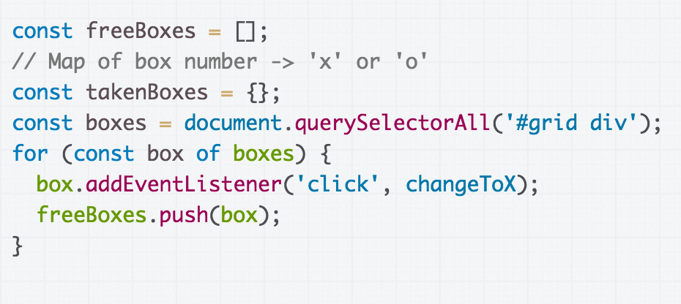
Solution
Add another state variable, takenBoxes, that maps box number to who owns the box

Slide 46
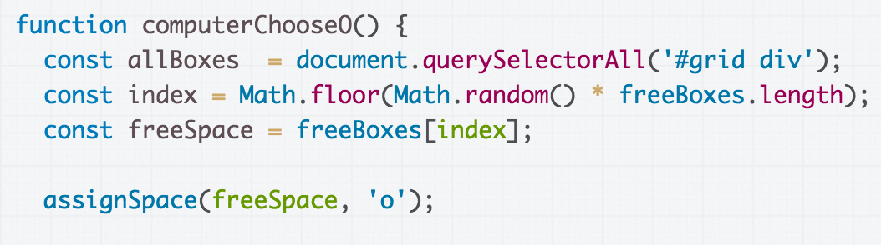
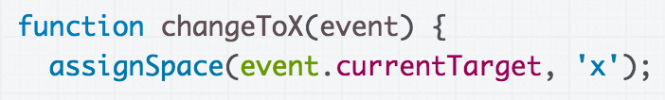
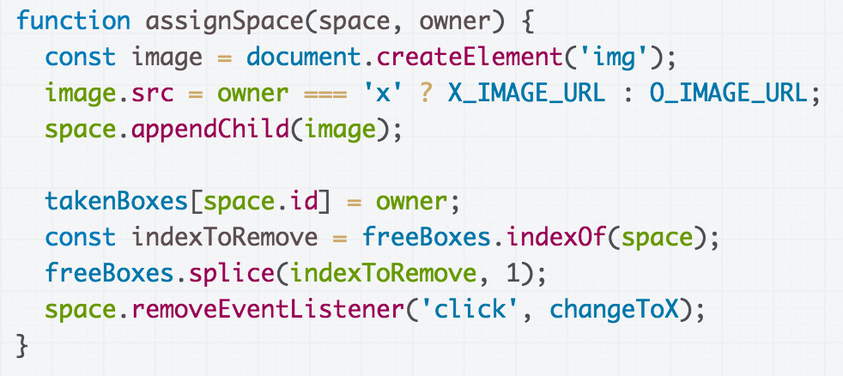
Update takenBoxes with the owner each time a space is assigned.

Slide 47
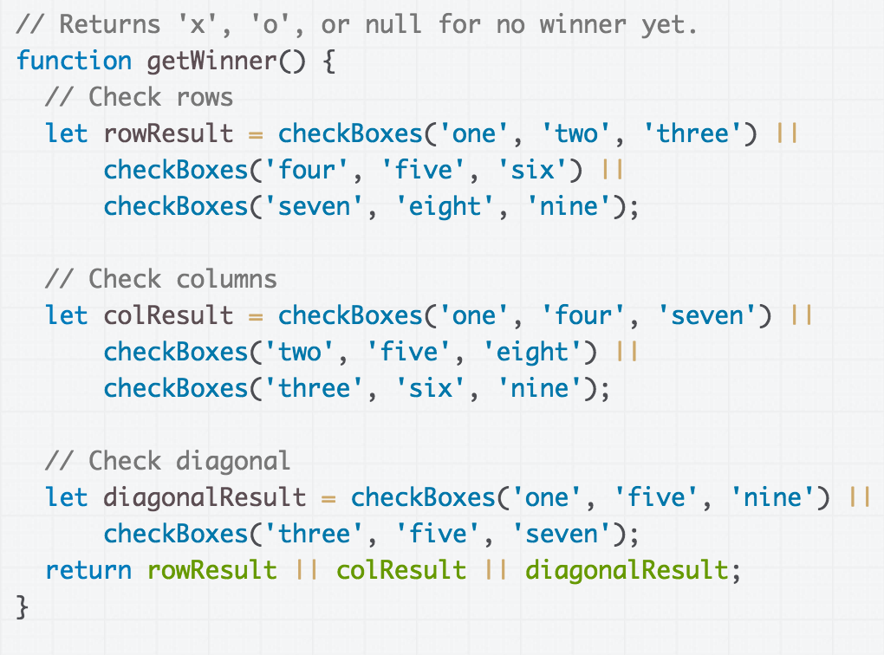
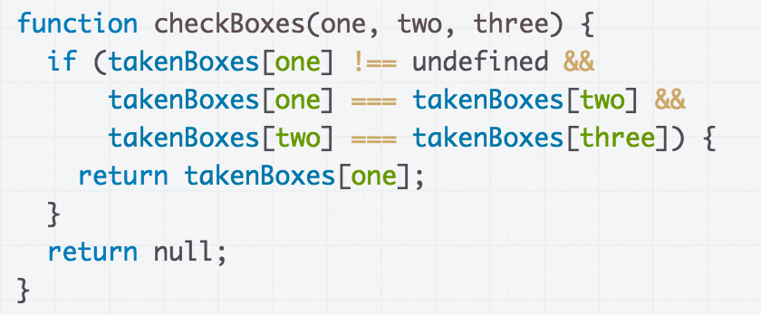
Find winner by checking rows, columns and diagonal spaces
(CodePen)

Slide 48
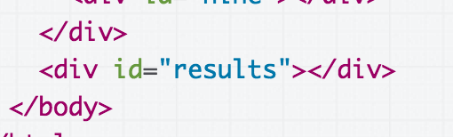
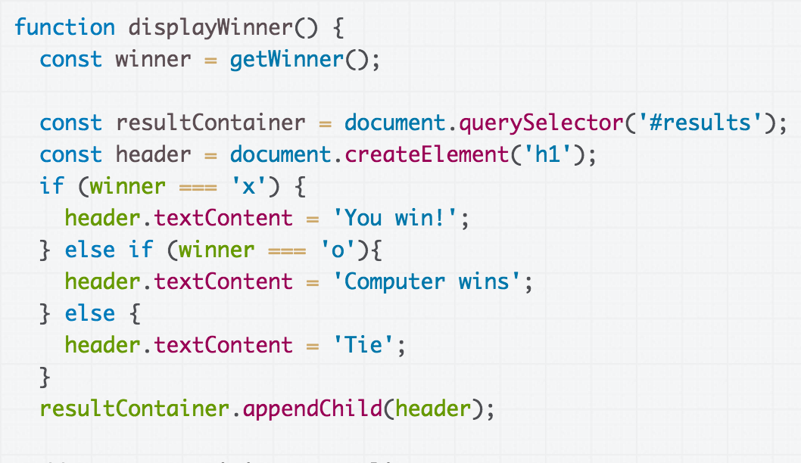
Create a results div and add results to the div (CodePen)

Slide 49
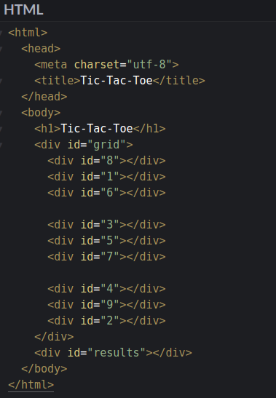
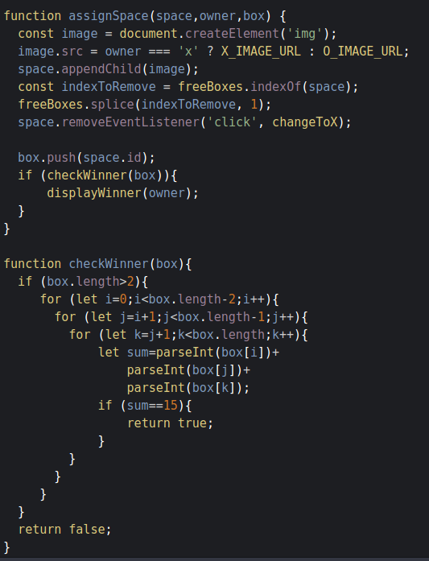
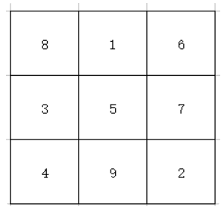
Solution – Magic Number 15
Codepen

Slide 50
Attach "data" to divs?
Wouldn't it be nicer if we could operate on numbers instead of string ids?
But we can't have numeric IDs…
Is there some way to attach additional "data" to an element?

Slide 51
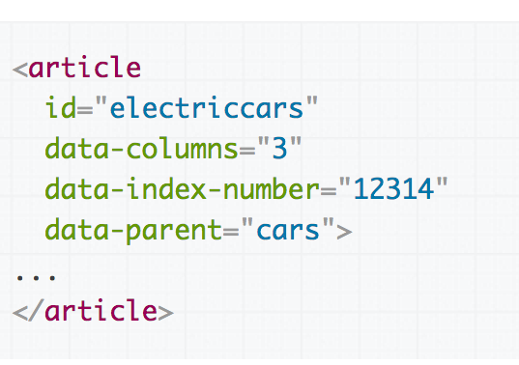
Data attributes
You can assign special data-* attributes to HTML elements to give associate additional data with the element.
data-your-name="Your Value"

Slide 52
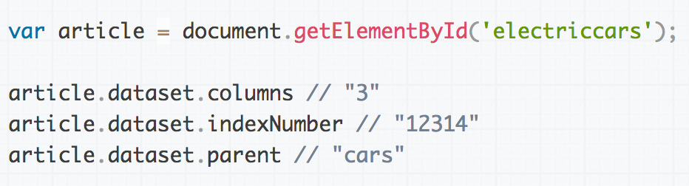
Data attributes in JavaScript
You can access your custom-defined data attributes via the dataset object on the DOM object:
Dash-separated words turn to camel case, e.g. data-index-number in HTML is dataset.indexNumber in JS
Aside: Data attributes are returned as strings, but you can cast them to Number via parseInt

Slide 53
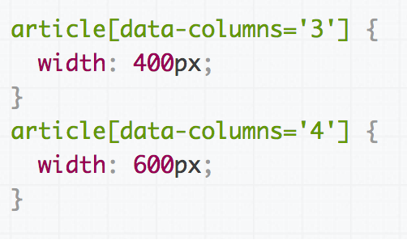
Data attributes in CSS
You can also style data attributes in CSS:
[data-variable-name] or
[data-variable-name='value'] or
element[data-variable-name] etc

Slide 54
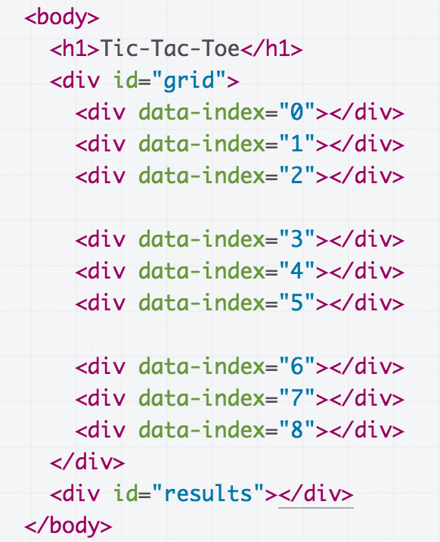
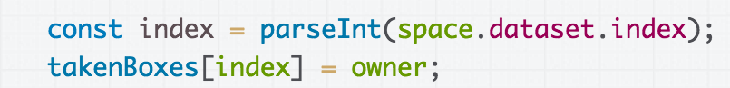
Final Solution Codepen

Slide 55
Understanding the DOM

Slide 56
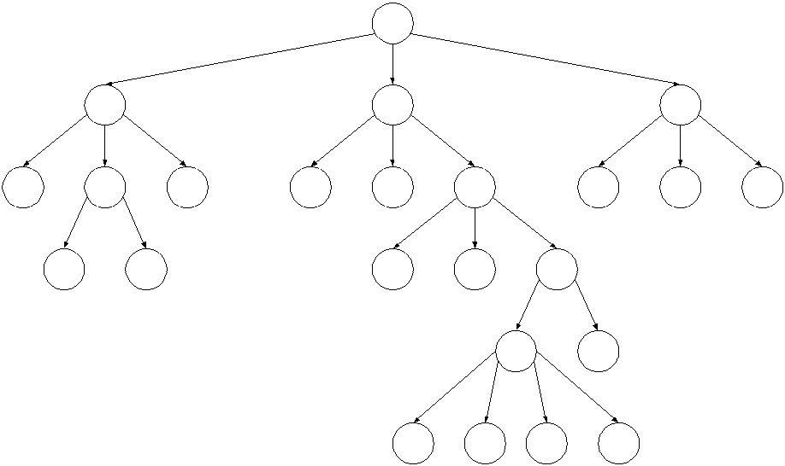
DOM Nodes
If the DOM is a tree composed of Nodes…
Q: Does that mean a Node in the DOM has child pointers like the trees?

Slide 57
DOM Nodes
If the DOM is a tree composed of Nodes…
Q: Does that mean a Node in the DOM has child pointers like the trees?
A: Yes!

Slide 58
Node properties
Property | Description
textContent | The text content of a node and its descendants. (This property is writeable)
childNodes | An array of this node's children (empty if a leaf)
parentNode | A reference to this node's parent Node
<body>
<h1>My favorites</h1>
<section>
<p>Strawberries</p>
<p>Chocolate</p>
</section>
</body>
What's the parentNode of <section>?

Slide 59
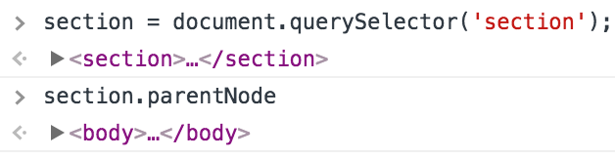
parentNode
<body>
<h1>My favorites</h1>
<section>
<p>Strawberries</p>
<p>Chocolate</p>
</section>
</body>
The parentNode of <section> is <body>.
What are the childNodes of <section>?

Slide 60
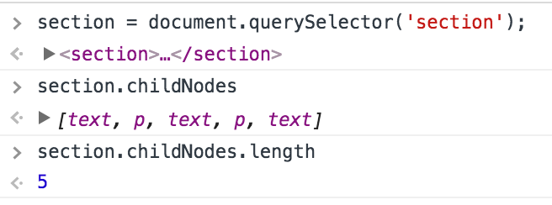
childNodes
???
<body>
<h1>My favorites</h1>
<section>
<p>Strawberries</p>
<p>Chocolate</p>
</section>
</body>
Why does section have 5 children, not 2?!

Slide 61
TextNode
In addition to Element nodes, the DOM also contains Text nodes. All text present in the HTML, including whitespace, is contained in a text node:
<body>
<h1>My favorites</h1>
<section>
<p>Strawberries</p>
<p>Chocolate</p>
</section>
</body>

Slide 62
TextNode
All text present in the HTML, including whitespace, is contained in a Text node:
<body>
<h1>My favorites</h1>
<section>
<p>Strawberries</p>
<p>Chocolate</p>
</section>
</body>

Slide 63
DOM and Text nodes
The DOM is composed of Nodes, and there are several subtypes of Node.
Element: HTML (or SVG) elements in the DOM
Text: Text content in the DOM, including whitespace
  Text nodes cannot contain children (are always leafs)
Comment: HTML comments
(more)
The type of a node is stored in the nodeType property

Slide 64
Traversing the DOM
Q: How would we print out all nodes in the DOM?

Slide 65
Traversing the DOM
Q: How would we print out all nodes in the DOM?
A: Recursively walk the DOM tree:
function walkTree(root, level) {
if (root.nodeType === Node.TEXT_NODE) {
console.log(level + 'text:' + root.textContent);
} else {
console.log(level + root.nodeName);
}
for (const child of root.childNodes) {
walkTree(child, level + " ");
}
}
walkTree(document.querySelector('html'), "");

Slide 66
What's the point?
If we have document.querySelector that lets us get elements in the DOM…
And if we can change the HTML as necessary to add classes/ids/elements/etc to select the right things…
Q: When would we ever want to traverse the DOM?

Slide 67
What's the point?
If we have document.querySelector that lets us get elements in the DOM…
And if we can change the HTML as necessary to add classes/ids/elements/etc to select the right things…
Q: When would we ever want to traverse the DOM?
A: Pretty much only in browser extensions
or the Web Console
(i.e. manipulating someone else's page)

Slide 68
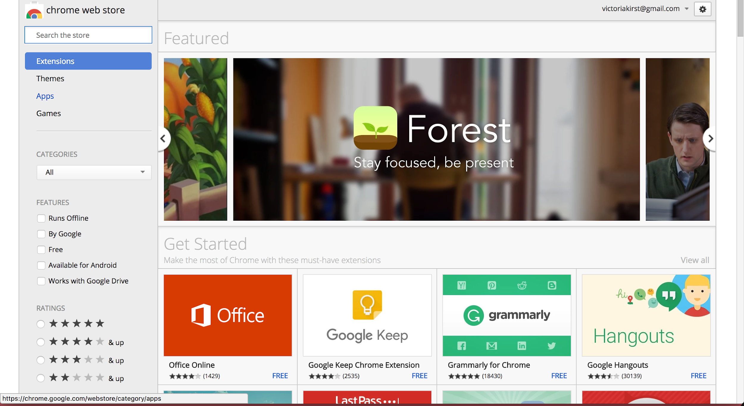
Browser extensions
Add-on that extends the functionality of the browser
A piece of JavaScript that is injected into the webpage before or after it has loaded

Slide 69
Hacks and Mischief

Slide 70
More next time!

Slide 71
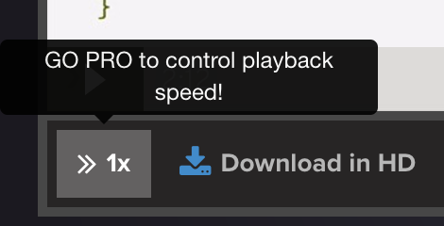
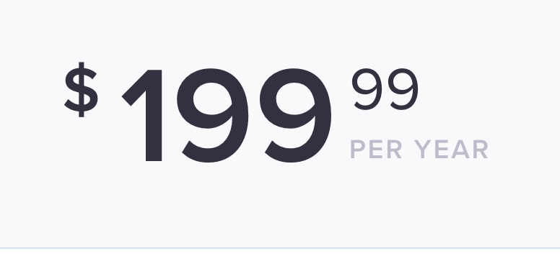
Example: Egghead
Dan Abromov's Redux videos

Slide 72
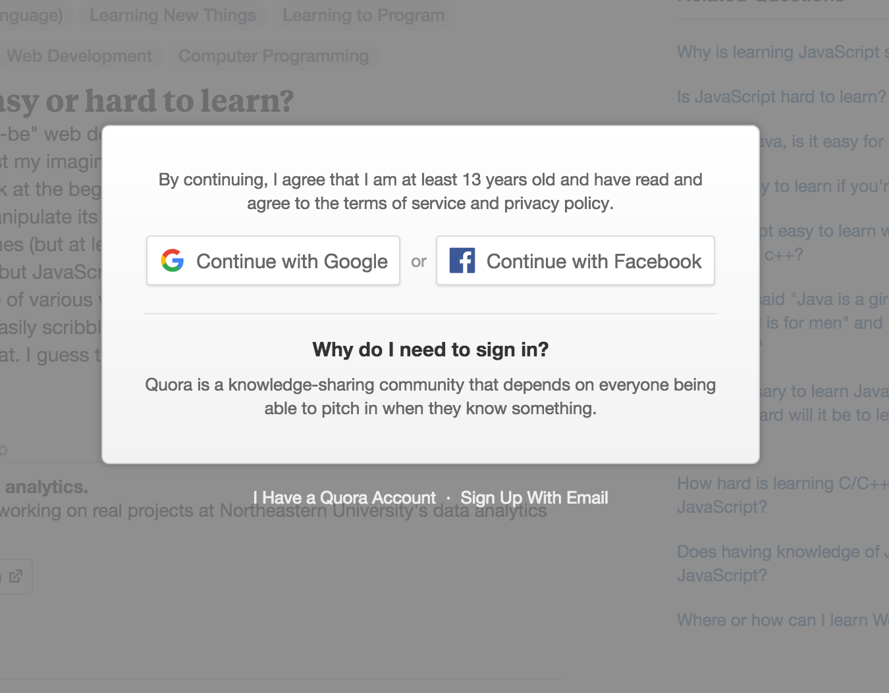
Example: Quora signin wall
https://www.quora.com/Why-is-learning-JavaScript-so-hard

Slide 73

Example: Adblock block
http://www.ondemandkorea.com/kpop-star-season-6-seoul-qualifier.html

