Slide 1
4102165:
Full Stack Web Development Fundamentals
Spring 2019
簡立仁 Li-Ren Chien
ccumouse@gmail.com

Slide 2
Schedule
Today:
async/await: A JavaScript language feature
Not Node-specific!
Sending data to the server
Returning JSON
package.json
HW5 released
Due June 3, but please try to complete the setup steps by May 27

Slide 3
Lecture code
The lecture code has been uploaded to this GitHub:
https://github.com/fullstackccu/lectures/21/lecture21.zip

Slide 4
async/await

Slide 5
Two types of asynchrony
We have been working with two broad types of asynchronous events:
Inherently asynchronous events
Example: addEventListener('click'). There is no such thing as a synchronous click event.
Annoyingly asynchronous events
Example: fetch(). This function would be easier to use if it were synchronous, but for performance reasons it's asynchronous

Slide 6
Asynchronous fetch()
The usual asynchronous fetch() looks like this:
function onJsonReady(json) {
console.log(json);
}
function onResponse(response) {
return response.json();
}
fetch('albums.json')
.then(onResponse)
.then(onJsonReady);

Slide 7
Synchronous fetch()?
A hypothetical synchronous fetch() might look like this:
// THIS CODE DOESN'T WORK
const response = fetch('albums.json');
const json = response.json();
console.log(json);
This is a lot cleaner code-wise!!
However, a synchronous fetch() would freeze the browser as the resource was downloading, which would be terrible for performance.

Slide 8
async / await
What if we could get the best of both worlds?
Synchronous-looking code
That actually ran asynchronously
// THIS CODE DOESN'T WORK
const response = fetch('albums.json');
const json = response.json();
console.log(json);

Slide 9
async / await
What if we could get the best of both worlds?
Synchronous-looking code
That actually ran asynchronously
// But this code does work:
async function loadJson() {
const response = await fetch('albums.json');
const json = await response.json();
console.log(json);
}
loadJson();

Slide 10
async / await
What if we could get the best of both worlds?
Synchronous-looking code
That actually ran asynchronously
// But this code does work:
async function loadJson() {
const response = await fetch('albums.json');
const json = await response.json();
console.log(json);
}
loadJson();
???

Slide 11
async functions
A function marked async has the following qualities:
It will behave more or less like a normal function if you don't put await expression in it.
An await expression is of form:
await promise

Slide 12
async functions
A function marked async has the following qualities:
If there is an await expression, the execution of the function will pause until the Promise in the await expression is resolved.
Note: The browser is not blocked; it will continue executing JavaScript as the async function is paused.
Then when the Promise is resolved, the execution of the function continues.
The await expression evaluates to the resolved value of the Promise.

Slide 13
function onJsonReady(json) {
console.log(json);
}
function onResponse(response) {
return response.json();
}
fetch('albums.json')
.then(onResponse)
.then(onJsonReady);
The methods in purple return Promises.
async function loadJson() {
const response = await fetch('albums.json');
const json = await response.json();
console.log(json);
}
loadJson();

Slide 14
function onJsonReady(json) {
console.log(json);
}
function onResponse(response) {
return response.json();
}
fetch('albums.json')
.then(onResponse)
.then(onJsonReady);
The variables in blue are the values that the Promises "resolve to".
async function loadJson() {
const response = await fetch('albums.json');
const json = await response.json();
console.log(json);
}
loadJson();

Slide 15
async functions
async function loadJson() {
const response = await fetch('albums.json');
const json = await response.json();
console.log(json);
}
loadJson();

Slide 16
async functions
async function loadJson() {
const response = await fetch('albums.json');
const json = await response.json();
console.log(json);
}
loadJson();

Slide 17
async functions
async function loadJson() {
const response = await fetch('albums.json');
const json = await response.json();
console.log(json);
}
loadJson();
Since we've reached an await statement, two things happen:
fetch('albums.json'); runs
The execution of the loadJson function is paused here until fetch('albums.json'); has completed.

Slide 18
async functions
async function loadJson() {
const response = await fetch('albums.json');
const json = await response.json();
console.log(json);
}
loadJson();
console.log('after loadJson');
At the point, the JavaScript engine will return from loadJson() and it will continue executing where it left off.

Slide 19
async functions
async function loadJson() {
const response = await fetch('albums.json');
const json = await response.json();
console.log(json);
}
loadJson();
console.log('after loadJson');

Slide 20
async functions
async function loadJson() {
const response = await fetch('albums.json');
const json = await response.json();
console.log(json);
}
loadJson();
console.log('after loadJson');

Slide 21
async functions
async function loadJson() {
const response = await fetch('albums.json');
const json = await response.json();
console.log(json);
}
loadJson();
console.log('after loadJson');

Slide 22
async functions
async function loadJson() {
const response = await fetch('albums.json');
const json = await response.json();
console.log(json);
}
loadJson();
console.log('after loadJson');
If there are other events, like if a button was clicked and we had a event handler for it, JavaScript will continue executing those events.

Slide 23
async functions
async function loadJson() {
const response = await fetch('albums.json');
const json = await response.json();
console.log(json);
}
loadJson();
console.log('after loadJson');
When the fetch() completes, the JavaScript engine will resume execution of loadJson().

Slide 24
Recall: fetch() resolution
function onResponse(response) {
return response.json();
}
fetch('albums.json')
.then(onResponse)
Normally when fetch() finishes, it executes the onResponse callback, whose parameter will be response.
In Promise-speak:
The return value of fetch() is a Promise that resolves to the response object.

Slide 25
async functions
async function loadJson() {
const response = await fetch('albums.json');
const json = await response.json();
console.log(json);
}
loadJson();
console.log('after loadJson');
The value of the await expression is the value that the Promise resolves to, in this case response.

Slide 26
async functions
async function loadJson() {
const response = await fetch('albums.json');
const json = await response.json();
console.log(json);
}
loadJson();
console.log('after loadJson');

Slide 27
async functions
async function loadJson() {
const response = await fetch('albums.json');
const json = await response.json();
console.log(json);
}
loadJson();
Since we've reached an await statement, two things happen:
response.json(); runs
The execution of the loadJson function is paused here until response.json(); has completed.

Slide 28
async functions
async function loadJson() {
const response = await fetch('albums.json');
const json = await response.json();
console.log(json);
}
loadJson();
If there are other events, like if a button was clicked and we had a event handler for it, JavaScript will continue executing those events.

Slide 29
async functions
async function loadJson() {
const response = await fetch('albums.json');
const json = await response.json();
console.log(json);
}
loadJson();

Slide 30
async functions
async function loadJson() {
const response = await fetch('albums.json');
const json = await response.json();
console.log(json);
}
loadJson();
When the response.json() completes, the JavaScript engine will resume execution of loadJson().

Slide 31
Recall: json() resolution
function onJsonReady(jsObj) {
console.log(jsObj);
}
function onResponse(response) {
return response.json();
}
fetch('albums.json')
.then(onResponse)
.then(onJsonReady);
Normally when json() finishes, it executes the onJsonReady callback, whose parameter will be jsObj.
In Promise-speak:
The return value of json() is a Promise that resolves to the jsObj object.

Slide 32
async functions
async function loadJson() {
const response = await fetch('albums.json');
const json = await response.json();
console.log(json);
}
loadJson();
The value of the await expression is the value that the Promise resolves to, in this case json.

Slide 33
async functions
async function loadJson() {
const response = await fetch('albums.json');
const json = await response.json();
console.log(json);
}
loadJson();

Slide 34
async functions
async function loadJson() {
const response = await fetch('albums.json');
const json = await response.json();
console.log(json);
}
loadJson();

Slide 35
async functions
async function loadJson() {
const response = await fetch('albums.json');
const json = await response.json();
console.log(json);
}
loadJson();
Note that the JS execution does *not* return back to the call site, since the JS execution already did that when we saw the first await expression.

Slide 36
Returning from async
Q: What happens if we return a value from an async function?
async function loadJson() {
const response = await fetch('albums.json');
const json = await response.json();
console.log(json);
return true;
}
loadJson();

Slide 37
Returning from async
A: async functions must always return a Promise.
async function loadJson() {
const response = await fetch('albums.json');
const json = await response.json();
console.log(json);
return true;
}
loadJson();
If you return a value that is not a Promise (such as true), then the JavaScript engine will automatically wrap the value in a Promise that resolves to the value you returned.

Slide 38
Returning from async
function loadJsonDone(value) {
console.log('loadJson complete!');
// Prints "value: true"
console.log('value: ' + value);
}
async function loadJson() {
const response = await fetch('albums.json');
const json = await response.json();
console.log(json);
return true;
}
loadJson().then(loadJsonDone)
console.log('after loadJson');

Slide 39
More async
Constructors cannot be marked async
But you can pass async functions as parameters to:
addEventListener (Browser)
on (NodeJS)
get/put/delete/etc (ExpressJS)
Wherever you can pass a function as a parameter

Slide 40
Why async now?!

Slide 41
Because you'll use it on HW5!

Slide 42
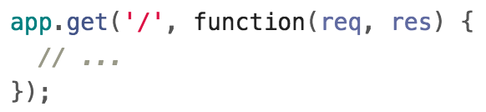
Recall: ExpressJS routes
We've been seeing ExpressJS routes that look like this, with an anonymous function parameter:

Slide 43
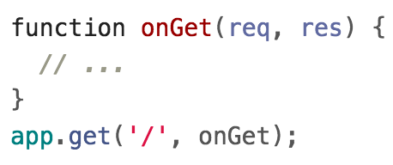
ExpressJS routes
Of course, they can also be written like this, with a named function parameter:

Slide 44
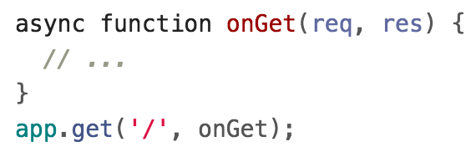
ExpressJS routes
In HW5, the starter code defines an async function parameter:
Which works about the same as a non-async function, except when you write an await inside of it.

Slide 45
gsa-sheets library
You will need to use the provided gsa-sheets library, whose functions all return Promises:
Method name | Description
getRows() | Returns a Promise that resolves to the non-empty rows of the spreadsheet.
appendRow(row) | Adds the given row to the end of the spreadsheet. Returns a Promise that resolves when complete.
deleteRow(index) | Deletes the given row in the spreadsheet. Returns a Promise that resolves when complete.
(see more details in the HW5 spec)

Slide 46
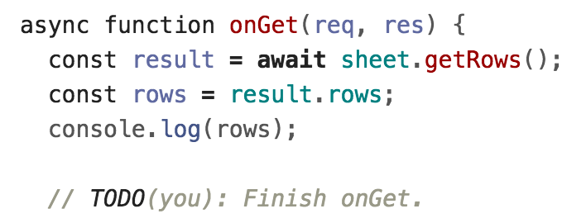
ExpressJS routes
You should use await expression with these method calls:
This will essentially let you work with the gsa-sheets methods as if they returned values instead of Promises.

Slide 47
async / await availability
Browsers:
All major browsers support async /await
NodeJS:
async /await available in v7.5+
(FYI, underneath the covers async/await is implemented by generator functions, another functional programming construct)

Slide 48
One more random thing: Template Literals

Slide 49
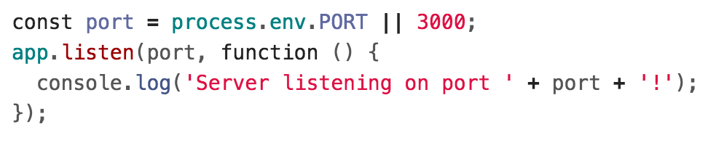
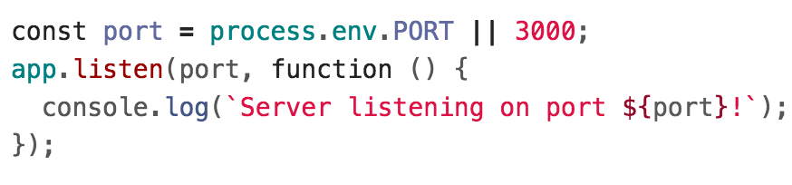
Template literals
Template literals allow you to embed expressions in JavaScript strings:

Slide 50
Sending data to the server

Slide 51
Route parameters
When we used the Spotify API, we saw a few ways to send information to the server via our fetch() request.
Example: Spotify Album API
https://api.spotify.com/v1/albums/7aDBFWp72Pz4NZEtVBANi9
The last part of the URL is a parameter representing the album id, 7aDBFWp72Pz4NZEtVBANi9
A parameter defined in the URL of the request is often called a "route parameter."

Slide 52
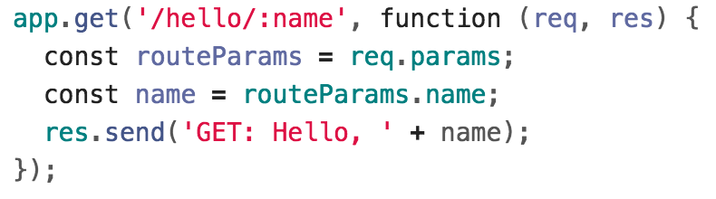
Route parameters
Q: How do we read route parameters in our server?
A: We can use the :variableName syntax in the path to specify a route parameter (Express docs):
We can access the route parameters via req.params.

Slide 53
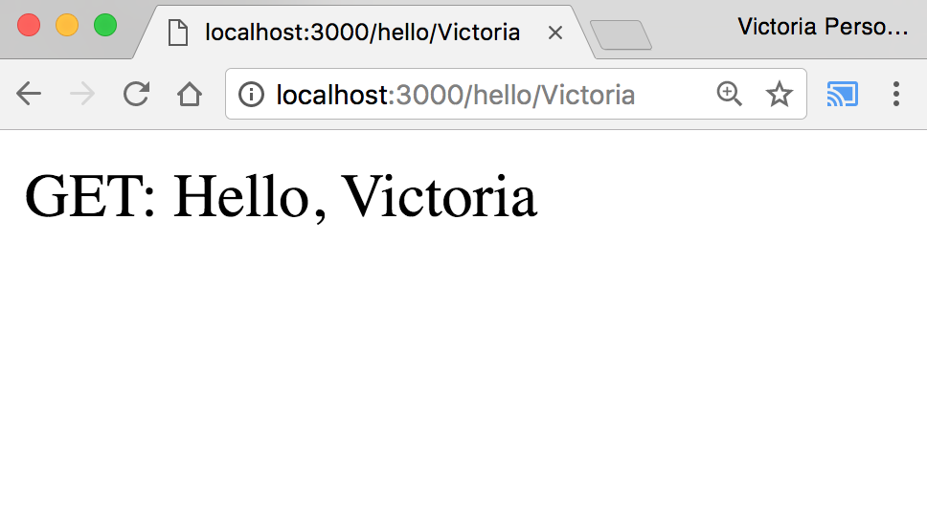
Route parameters
GitHub

Slide 54
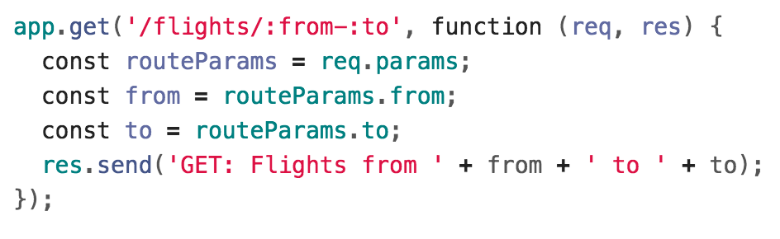
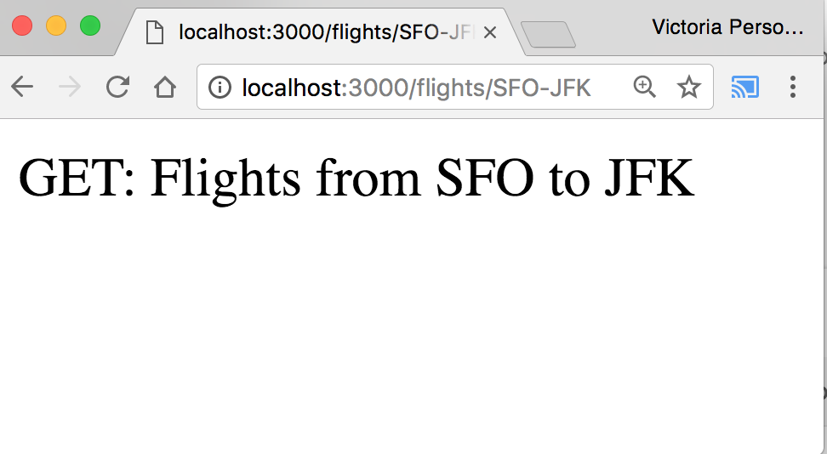
Route parameters
You can define multiple route parameters in a URL (docs):
GitHub

Slide 55
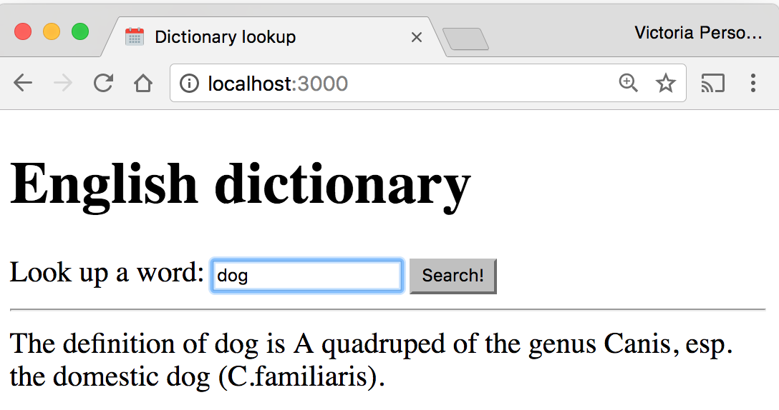
Example: Dictionary
Given a dictionary.json file of word/value pairs, a dictionary app that lets you look up the definition of the word:

Slide 56
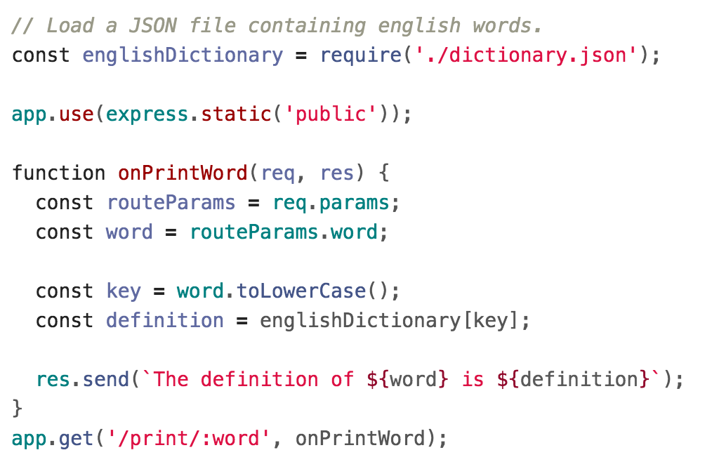
Dictionary lookup

Slide 57
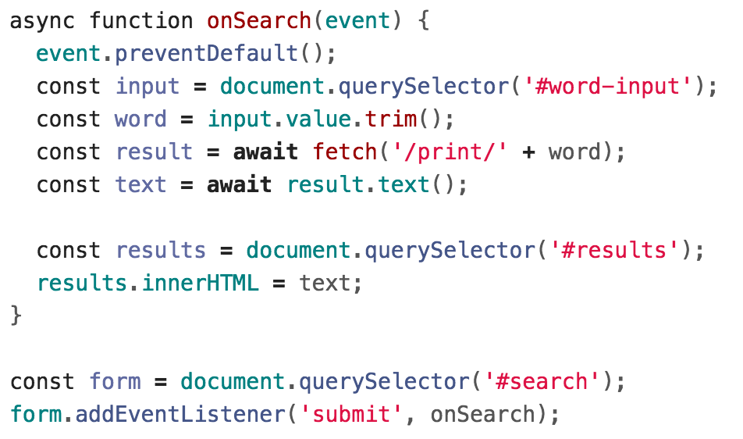
Dictionary fetch

Slide 58
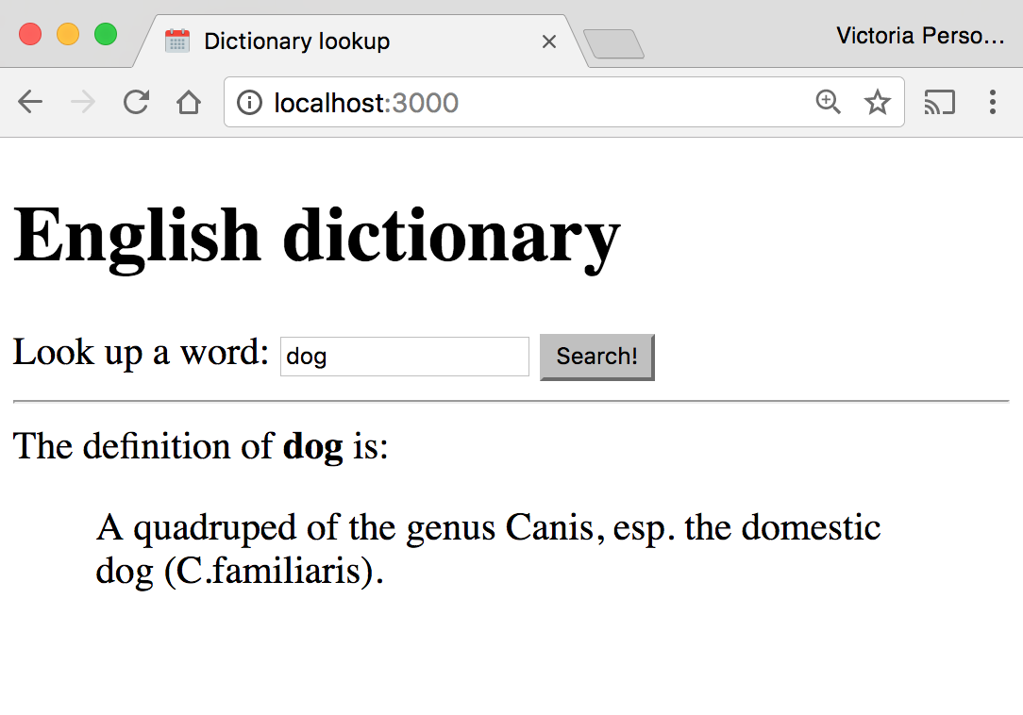
Example: Dictionary
It'd be nice to have some flexibility on the display of the definition:

Slide 59
Returning JSON from the server

Slide 60
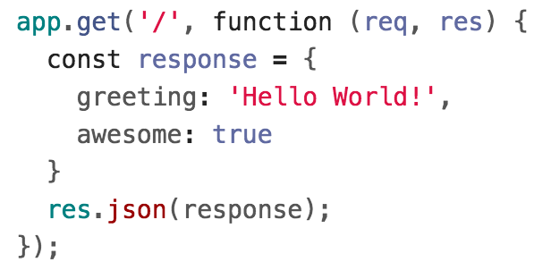
JSON response
If we want to return a JSON response, we should use res.json(object) instead:
The parameter we pass to res.json() should be a JavaScript object.

Slide 61
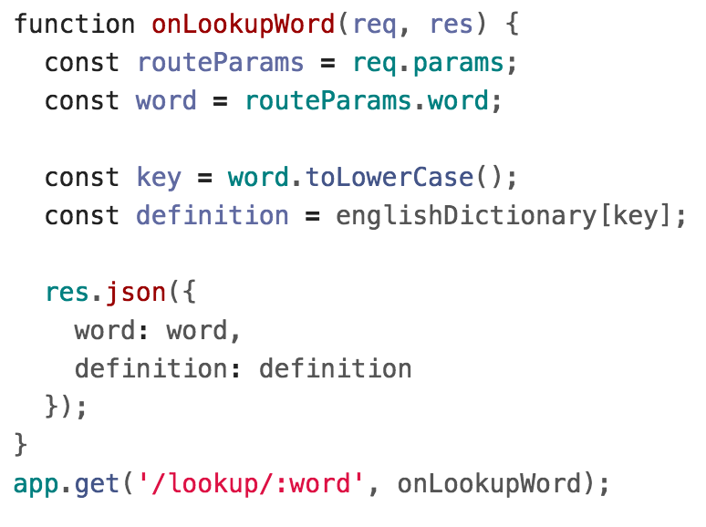
Example: Dictionary lookup

Slide 62
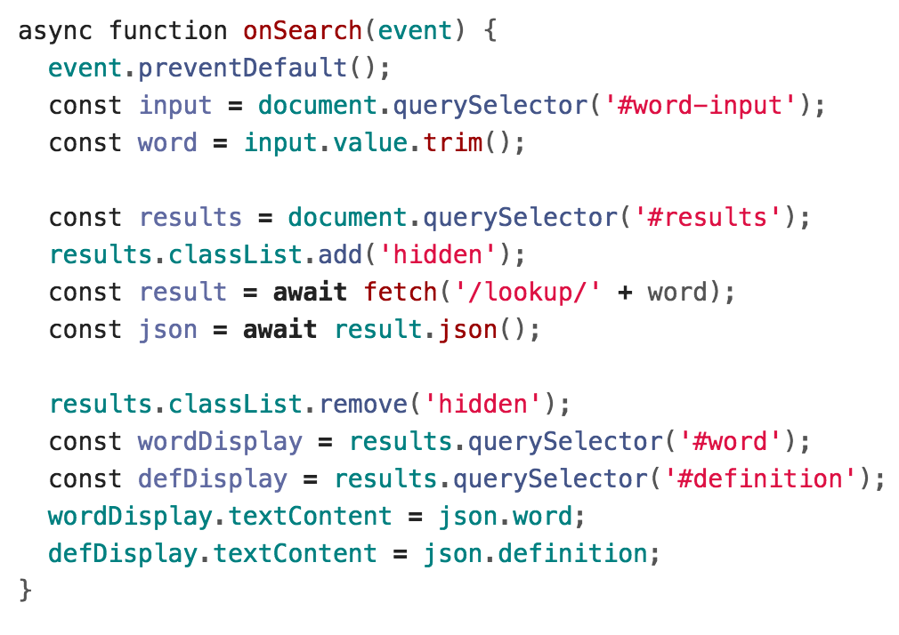
Example: Dictionary fetch

Slide 63
Result

Slide 64
Saving data

Slide 65
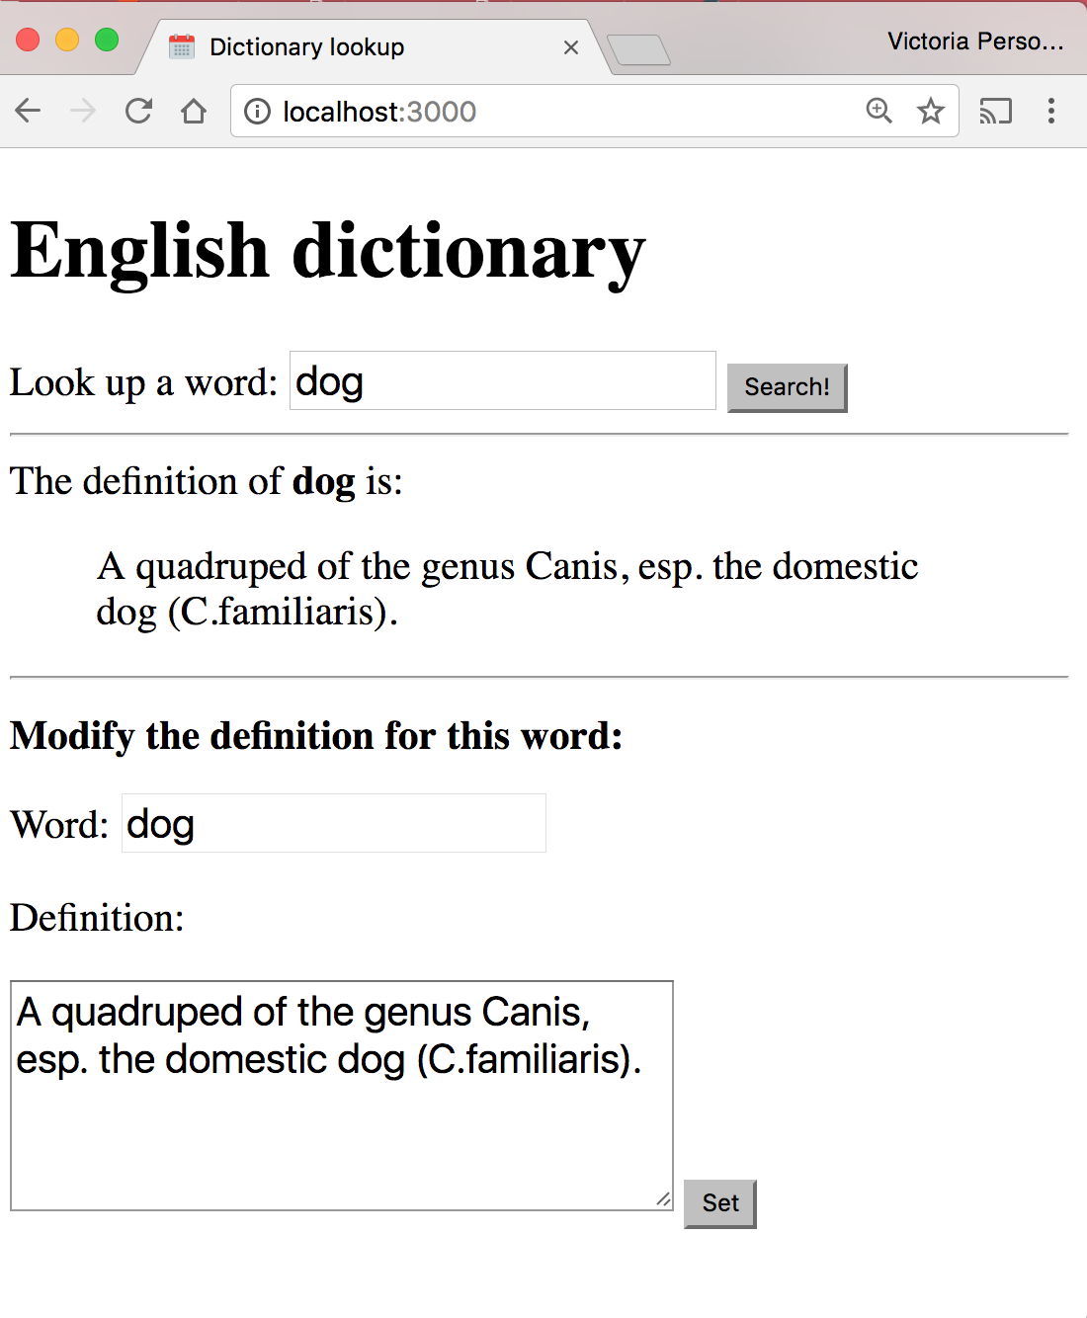
Example: Dictionary
What if we want to modify the definitions of words as well?

Slide 66
Posting data

Slide 67
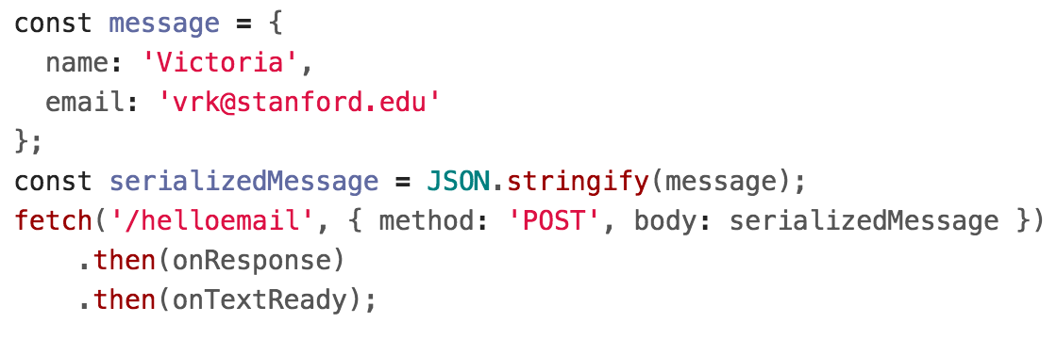
POST message body: fetch()
Client-side:
You should specify a message body in your fetch() call:

Slide 68
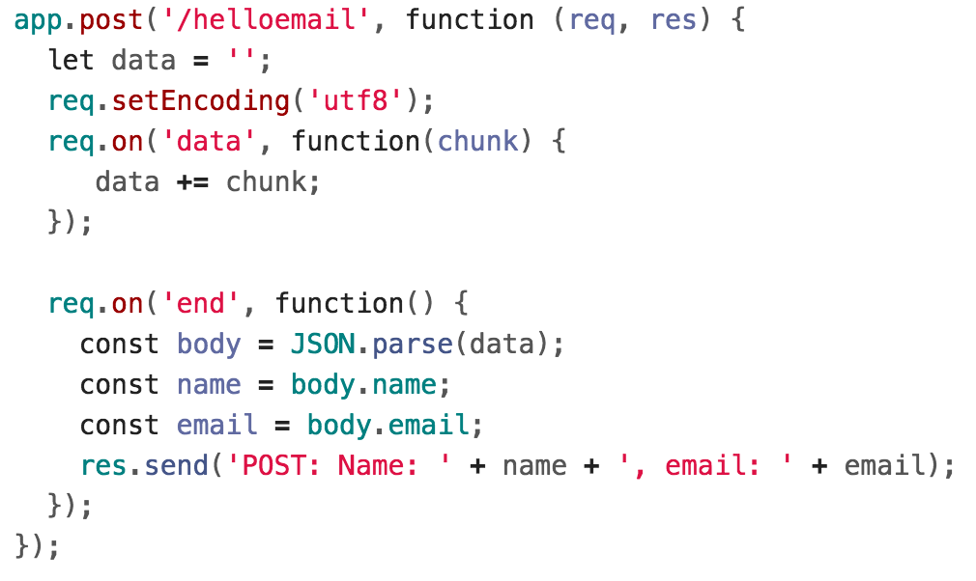
Server-side
Server-side: Handling the message body in NodeJS/Express is a little messy (GitHub):

Slide 69
body-parser
We can use the body-parser library to help:
This is not a NodeJS API library, so we need to install it:
$ npm install body-parser

Slide 70

body-parser
We can use the body-parser library to help:
This creates a JSON parser stored in jsonParser, which we can then pass to routes whose message bodies we want parsed as JSON.

Slide 71
POST message body
Now instead of this code:

Slide 72
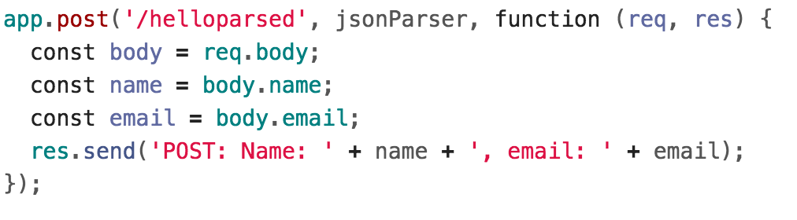
POST message body
We can access the message body through req.body:
GitHub

Slide 73
POST message body
We can access the message body through req.body:
GitHub
Note that we also had to add the jsonParser as a parameter when defining this route.

Slide 74
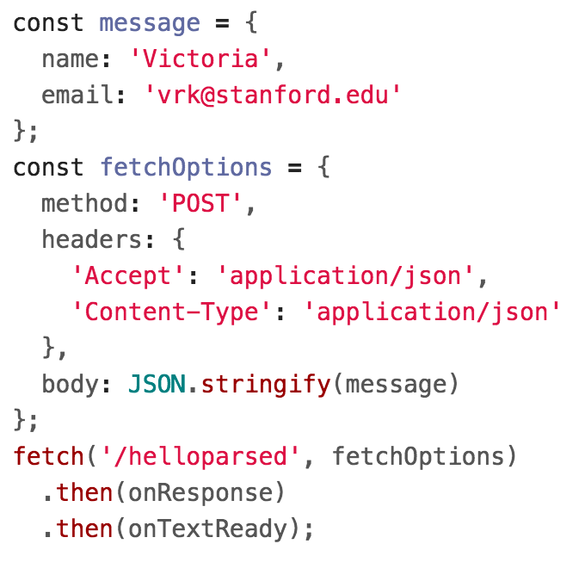
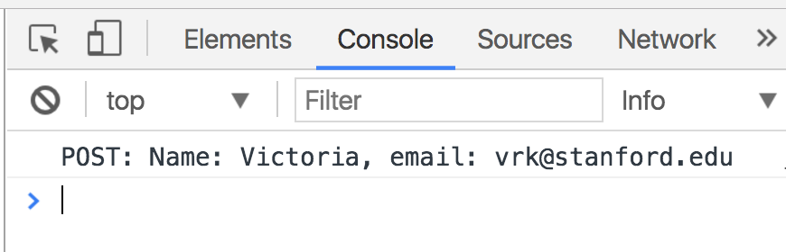
POST message body
Finally, we need to add JSON content-type headers on the fetch()-side (GitHub):

Slide 75
Example: Dictionary
We will modify the dictionary example to POST the contents of the form.

Slide 76
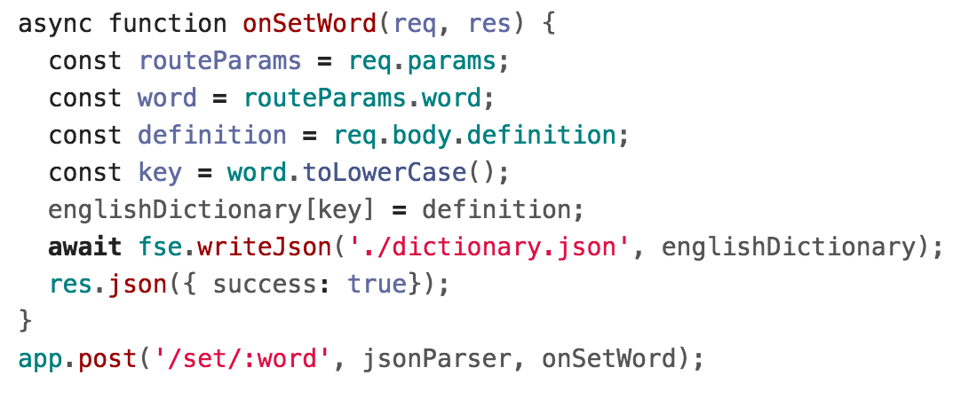
Example: server-side

Slide 77
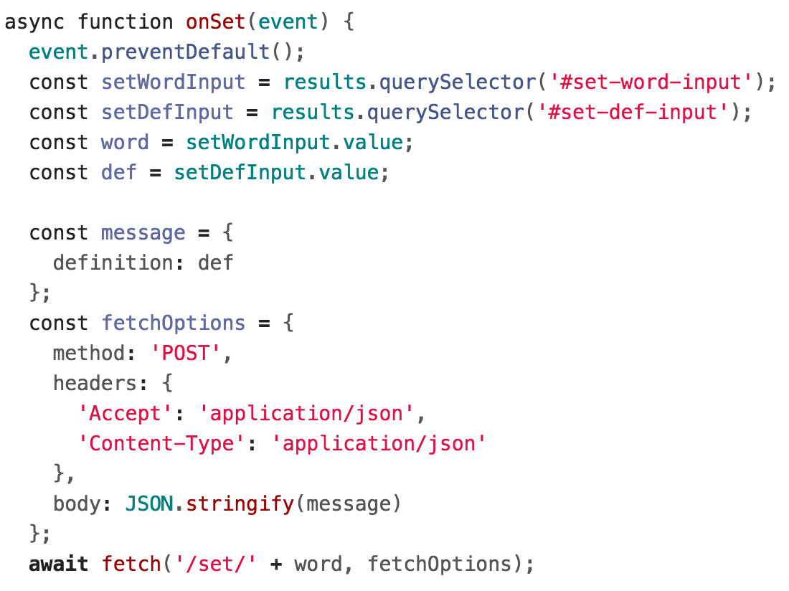
Example: fetch()

Slide 78
Query parameters

Slide 79
Query parameters
The Spotify Search API was formed using query parameters:
Example: Spotify Search API
https://api.spotify.com/v1/search?type=album&q=beyonce
There were two query parameters sent to the Spotify search endpoint:
type, whose value is album
q, whose value is beyonce

Slide 80
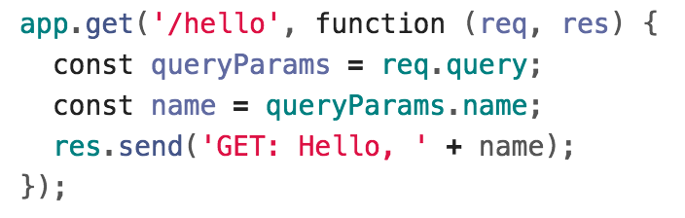
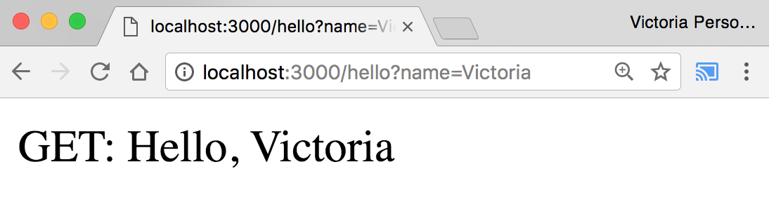
Query parameters
Q: How do we read query parameters in our server?
A: We can access query parameters via req.query:
GitHub

Slide 81
Recap
You can deliver parameterized information to the server in the following ways:
Route parameters
GET request with query parameters
(DISCOURAGED: POST with query parameters)
POST request with message body
Q: When do you use route parameters vs query parameters vs message body?

Slide 82
GET vs POST
Use GET requests for retrieving data, not writing data
Use POST requests for writing data, not retrieving data
You can also use more specific HTTP methods:
PATCH: Updates the specified resource
DELETE: Deletes the specified resource
There's nothing technically preventing you from breaking these rules, but you should use the HTTP methods for their intended purpose.

Slide 83
Route params vs Query params
Generally follow these rules:
Use route parameters for required parameters for the request
Use query parameters for:
Optional parameters
Parameters whose values can have spaces
These are conventions and are not technically enforced, nor are they followed by every REST API.

Slide 84
Example: Spotify API
The Spotify API mostly followed these conventions:
https://api.spotify.com/v1/albums/7aDBFWp72Pz4NZEtVBANi9
The Album ID is required and it is a route parameter.
https://api.spotify.com/v1/search?type=album&q=the%20weeknd&limit=10
q is required but might have spaces, so it is a query parameter
limit is optional and is a query parameter
type is required but is a query parameter (breaks convention)
Notice both searches are GET requests, too

Slide 85
package.json

Slide 86
Installing dependencies
In our examples, we had to install the express and body-parser npm packages.
$ npm install express
$ npm install body-parser
These get written to the node_modules directory.

Slide 87
Uploading server code
When you upload NodeJS code to a GitHub repository (or any code repository), you should not upload the node_modules directory:
You shouldn't be modifying code in the node_modules directory, so there's no reason to have it under version control
This will also increase your repo size significantly
Q: But if you don't upload the node_modules directory to your code repository, how will anyone know what libraries they need to install?

Slide 88
Managing dependencies
If we don't include the node_modules directory in our repository, we need to somehow tell other people what npm modules they need to install.
npm provides a mechanism for this: package.json

Slide 89
package.json
You can put a file named package.json in the root directory of your NodeJS project to specify metadata about your project.
Create a package.json file using the following command:
$ npm init
This will ask you a series of questions then generate a package.json file based on your answers.

Slide 90
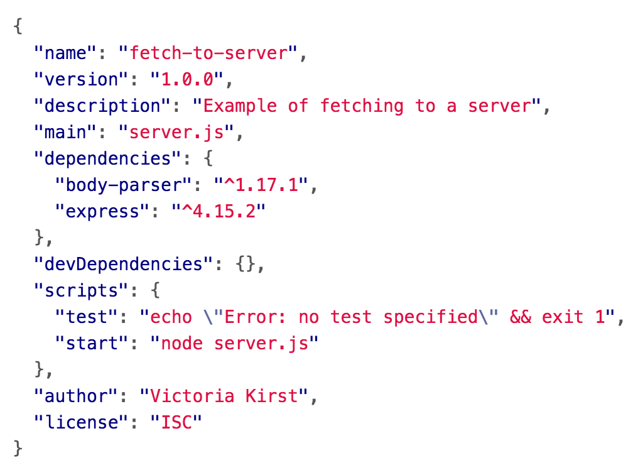
Auto-generated package.json
GitHub

Slide 91
Saving deps to package.json
Now when you install packages, you should pass in the --save parameter:
$ npm install --save express
$ npm install --save body-parser
This will also add an entry for this library in package.json.

Slide 92
Saving deps to package.json
If you remove the node_modules directory:
$ rm -rf node_modules
You can install your project dependencies again via:
$ npm install
This also allows people who have downloaded your code from GitHub to install all your dependencies with one command instead of having to install all dependencies individually.

Slide 93
npm scripts
Your package.json file also defines scripts:
You can run these scripts using $ npm scriptName
E.g. the following command runs "node server.js"
$ npm start

