Slide 1
4102165:
Full Stack Web Development Fundamentals
Spring 2019
簡立仁 Li-Ren Chien
ccumouse@gmail.com

Slide 2
Schedule
This week:
Saving data; MongoDB
Authentication
Final project assigned Friday
Next:
HW5 due Tuesday at 11:59pm
Server-side polish

Slide 3
Today's schedule
Today:
Saving data
POST body
body-parser
Databases
MongoDB
System overview
mongo
mongod
mongodb

Slide 4
Last time: async / await
What if we could get:
Synchronous-looking code
That actually ran asynchronously?
// THIS CODE DOESN'T WORK
const response = fetch('albums.json');
const json = response.json();
console.log(json);

Slide 5
async / await
What if we could get the best of both worlds?
Synchronous-looking code
That actually ran asynchronously
// But this code does work:
async function loadJson() {
const response = await fetch('albums.json');
const json = await response.json();
console.log(json);
}
loadJson();

Slide 6
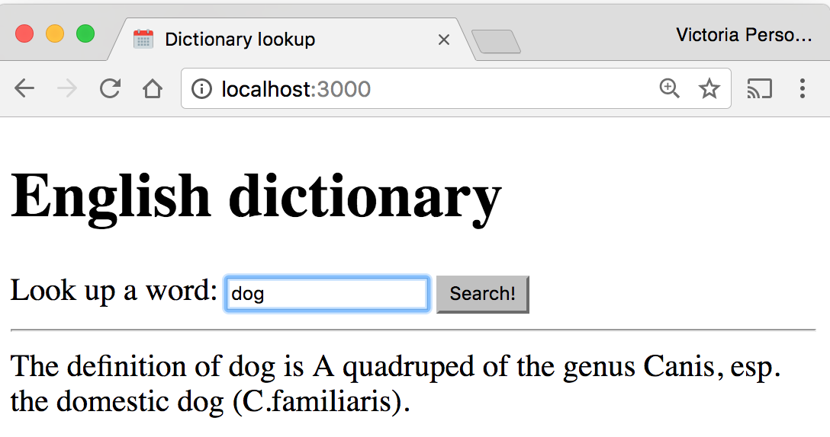
Example: Dictionary
Given a dictionary.json file of word/value pairs, a dictionary app that lets you look up the definition of the word:

Slide 7
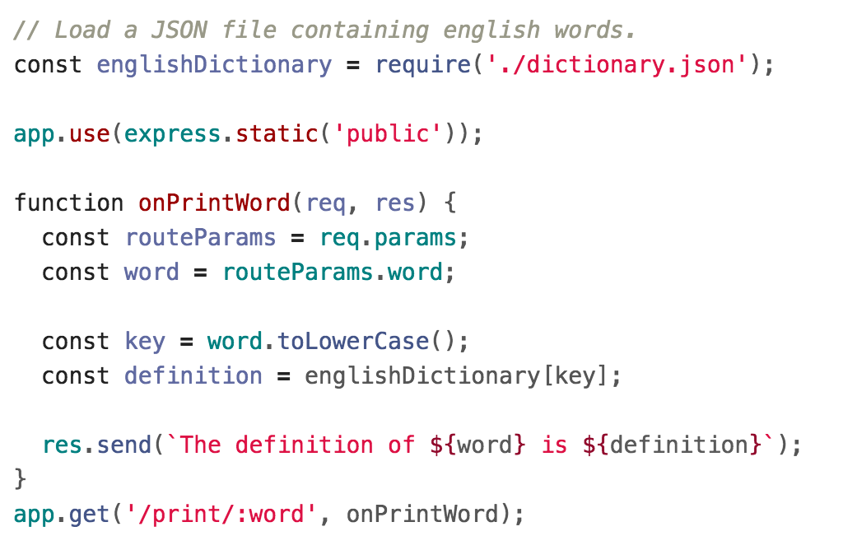
Dictionary lookup

Slide 8
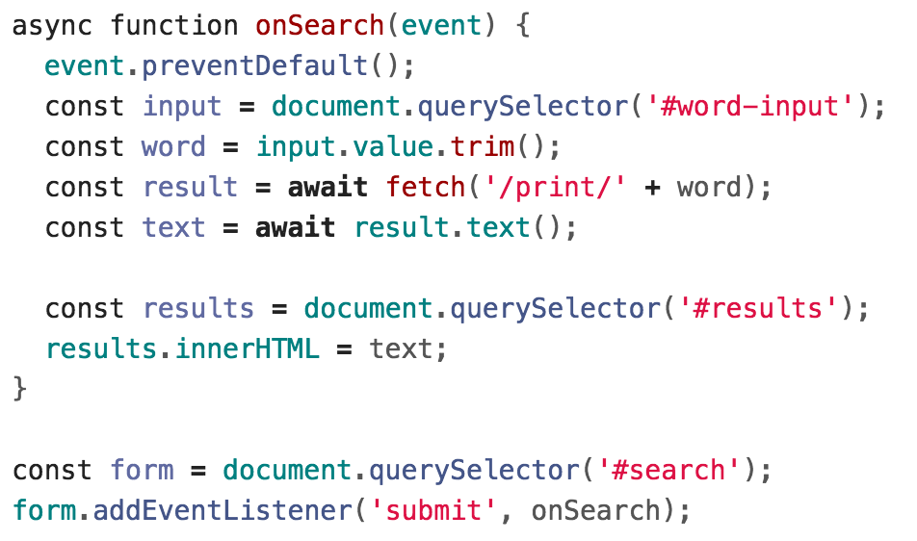
Dictionary fetch

Slide 9
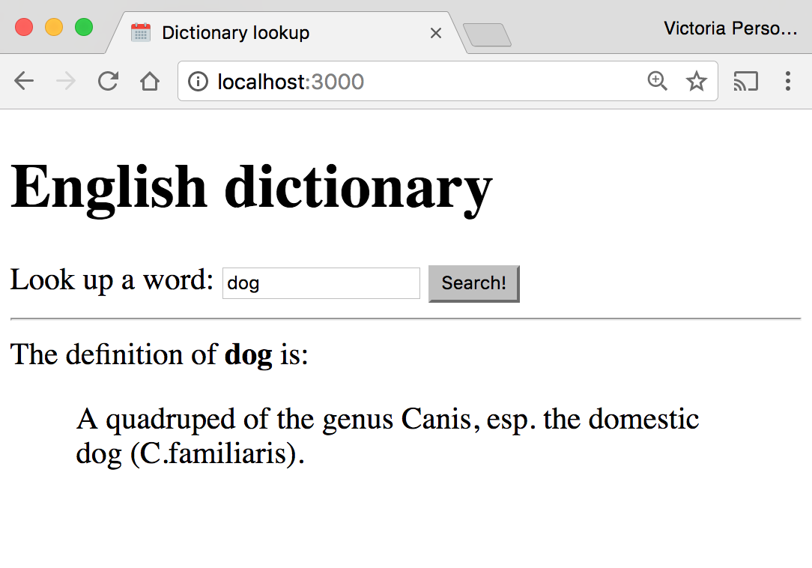
Example: Dictionary
It'd be nice to have some flexibility on the display of the definition:

Slide 10
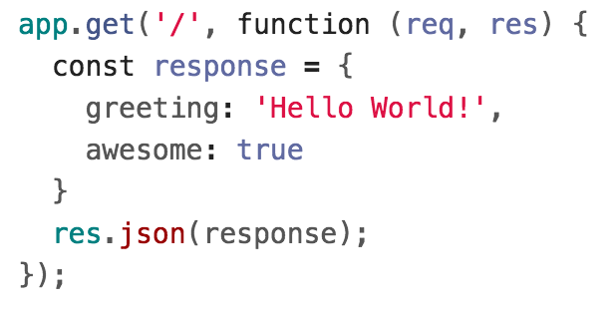
JSON response
If we want to return a JSON response, we should use res.json(object) instead:
The parameter we pass to res.json() should be a JavaScript object.

Slide 11
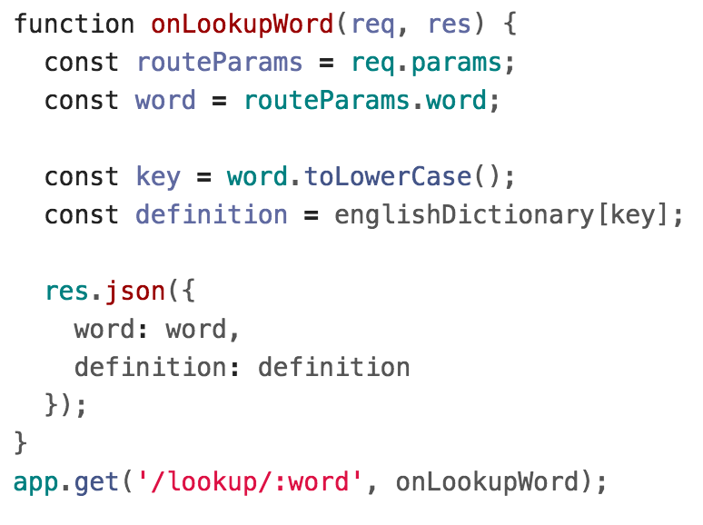
Example: Dictionary lookup

Slide 12
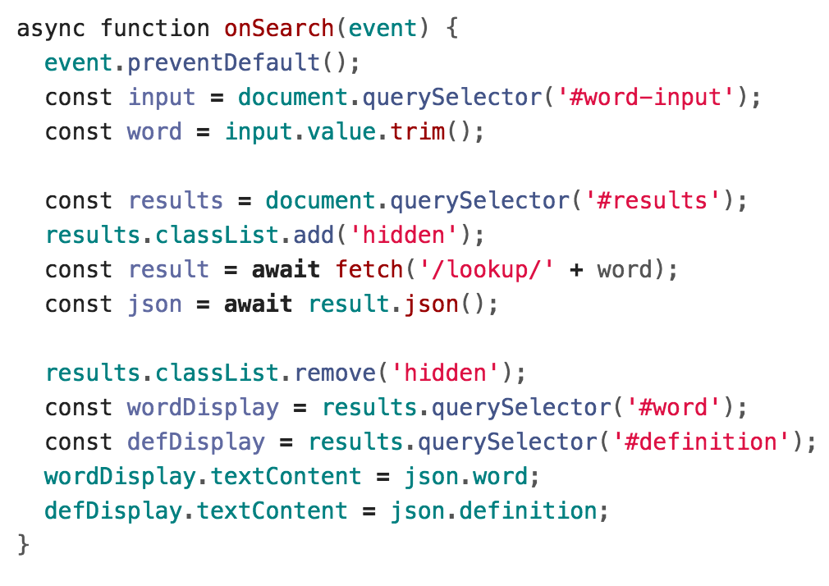
Example: Dictionary fetch

Slide 13
Result

Slide 14
Saving data

Slide 15
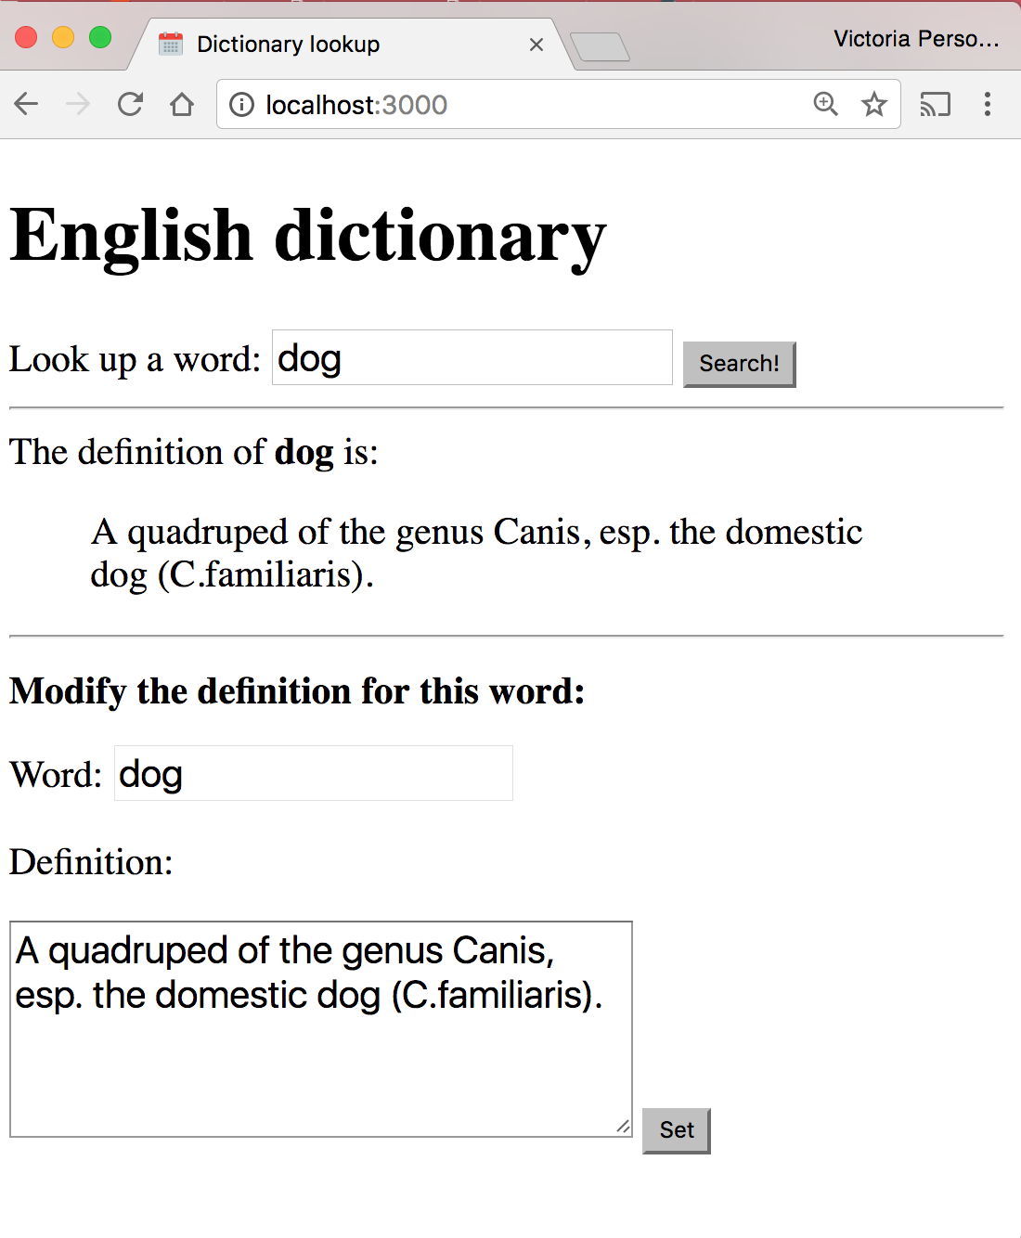
Example: Dictionary
What if we want to modify the definitions of words as well?

Slide 16
Posting data

Slide 17
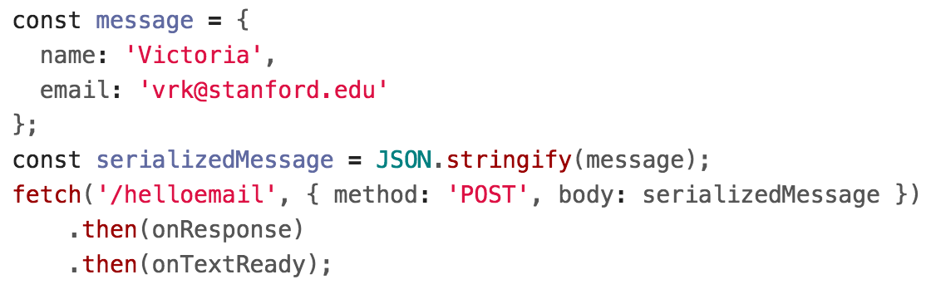
POST message body: fetch()
Client-side:
You should specify a message body in your fetch() call:

Slide 18
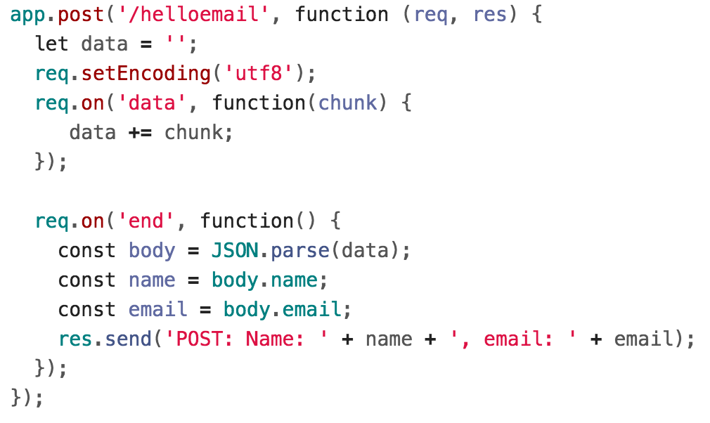
Server-side
Server-side: Handling the message body in NodeJS/Express is a little messy (GitHub):

Slide 19
body-parser
We can use the body-parser library to help:
This is not a NodeJS API library, so we need to install it:
$ npm install body-parser

Slide 20

body-parser
We can use the body-parser library to help:
This creates a JSON parser stored in jsonParser, which we can then pass to routes whose message bodies we want parsed as JSON.

Slide 21
POST message body
Now instead of this code:

Slide 22
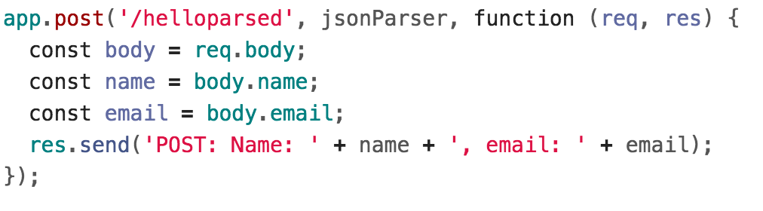
POST message body
We can write this code:
GitHub

Slide 23
POST message body
We can access the message body through req.body:
GitHub

Slide 24
POST message body
We can access the message body through req.body:
GitHub
Note that we also had to add the jsonParser as a parameter when defining this route.

Slide 25
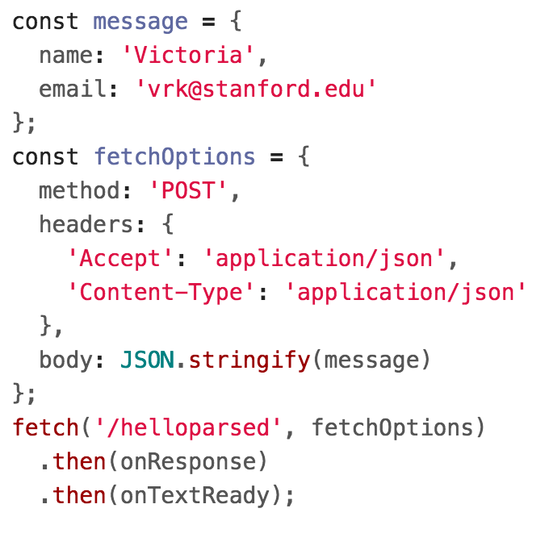
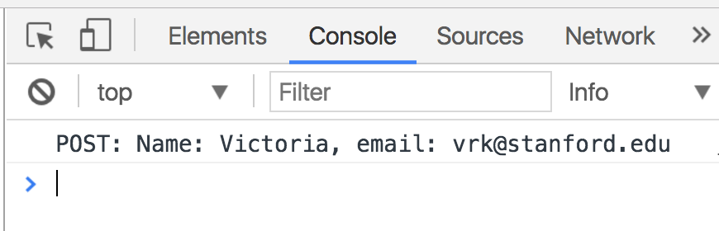
POST message body
Finally, we need to add JSON content-type headers on the fetch()-side (GitHub):

Slide 26
Example: Dictionary
We will modify the dictionary example to POST the contents of the form.

Slide 27
fs-extra
We'll use the fs-extra library to write our change back to the dictionary.json file.
fs: NodeJS API library
Uses callbacks
fs-extra: npm library
Uses callbacks OR promises
fs.writeJson(fileName, object)

Slide 28
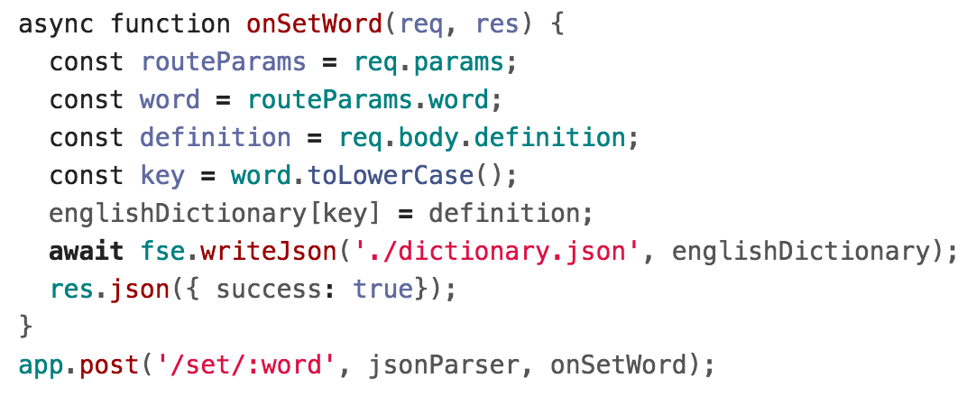
Example: server-side

Slide 29
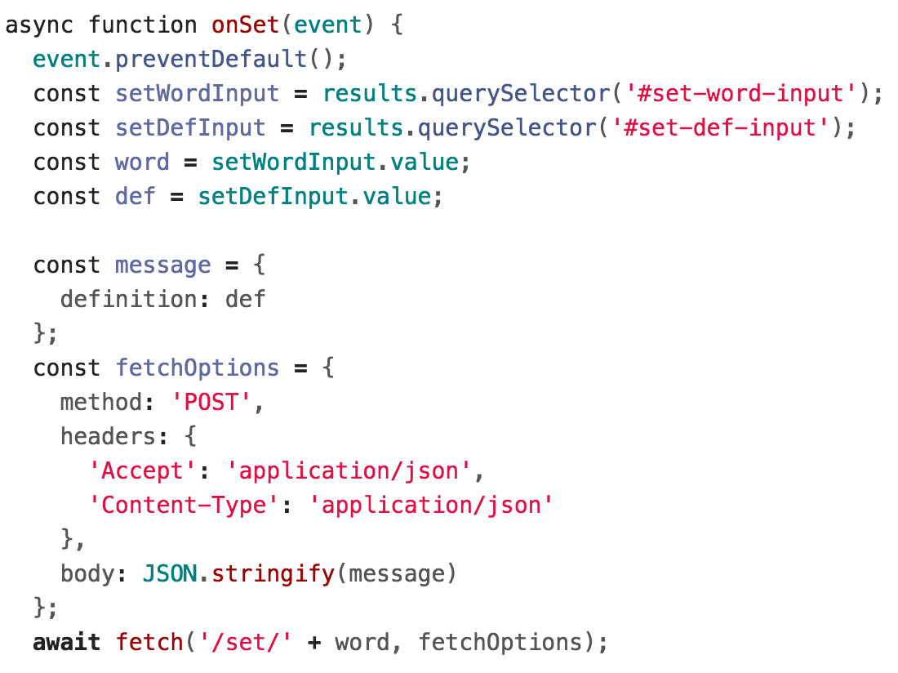
Example: fetch()

Slide 30
Query parameters

Slide 31
Query parameters
The Spotify Search API was formed using query parameters:
Example: Spotify Search API
https://api.spotify.com/v1/search?type=album&q=beyonce
There were two query parameters sent to the Spotify search endpoint:
type, whose value is album
q, whose value is beyonce

Slide 32
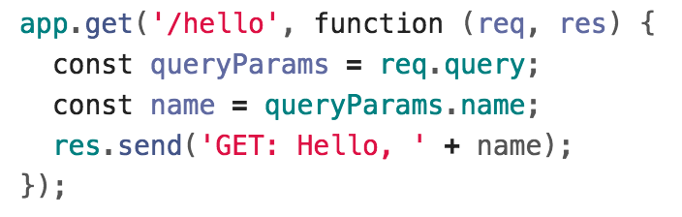
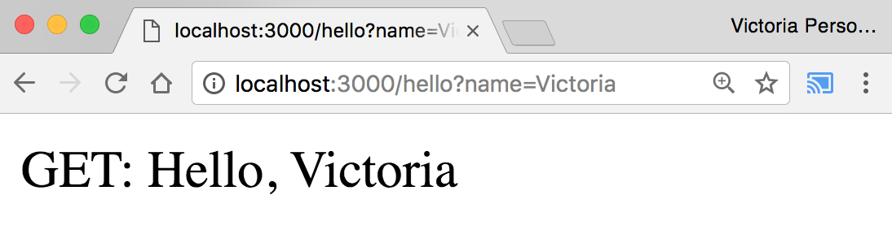
Query parameters
Q: How do we read query parameters in our server?
A: We can access query parameters via req.query:
GitHub

Slide 33
Recap
You can deliver parameterized information to the server in the following ways:
Route parameters
GET request with query parameters
(DISCOURAGED: POST with query parameters)
POST request with message body
Q: When do you use route parameters vs query parameters vs message body?

Slide 34
GET vs POST
Use GET requests for retrieving data, not writing data
Use POST requests for writing data, not retrieving data
You can also use more specific HTTP methods:
PATCH: Updates the specified resource
DELETE: Deletes the specified resource
There's nothing technically preventing you from breaking these rules, but you should use the HTTP methods for their intended purpose.

Slide 35
Route params vs Query params
Generally follow these rules:
Use route parameters for required parameters for the request
Use query parameters for:
Optional parameters
Parameters whose values can have spaces
These are conventions and are not technically enforced, nor are they followed by every REST API.

Slide 36
Example: Spotify API
The Spotify API mostly followed these conventions:
https://api.spotify.com/v1/albums/7aDBFWp72Pz4NZEtVBANi9
The Album ID is required and it is a route parameter.
https://api.spotify.com/v1/search?type=album&q=the%20weeknd&limit=10
q is required but might have spaces, so it is a query parameter
limit is optional and is a query parameter
type is required but is a query parameter (breaks convention)
Notice both searches are GET requests, too

Slide 37
package.json

Slide 38
Installing dependencies
In our examples, we had to install the express and body-parser npm packages.
$ npm install express
$ npm install body-parser
These get written to the node_modules directory.

Slide 39
Uploading server code
When you upload NodeJS code to a GitHub repository (or any code repository), you should not upload the node_modules directory:
You shouldn't be modifying code in the node_modules directory, so there's no reason to have it under version control
This will also increase your repo size significantly
Q: But if you don't upload the node_modules directory to your code repository, how will anyone know what libraries they need to install?

Slide 40
Managing dependencies
If we don't include the node_modules directory in our repository, we need to somehow tell other people what npm modules they need to install.
npm provides a mechanism for this: package.json

Slide 41
package.json
You can put a file named package.json in the root directory of your NodeJS project to specify metadata about your project.
Create a package.json file using the following command:
$ npm init
This will ask you a series of questions then generate a package.json file based on your answers.

Slide 42
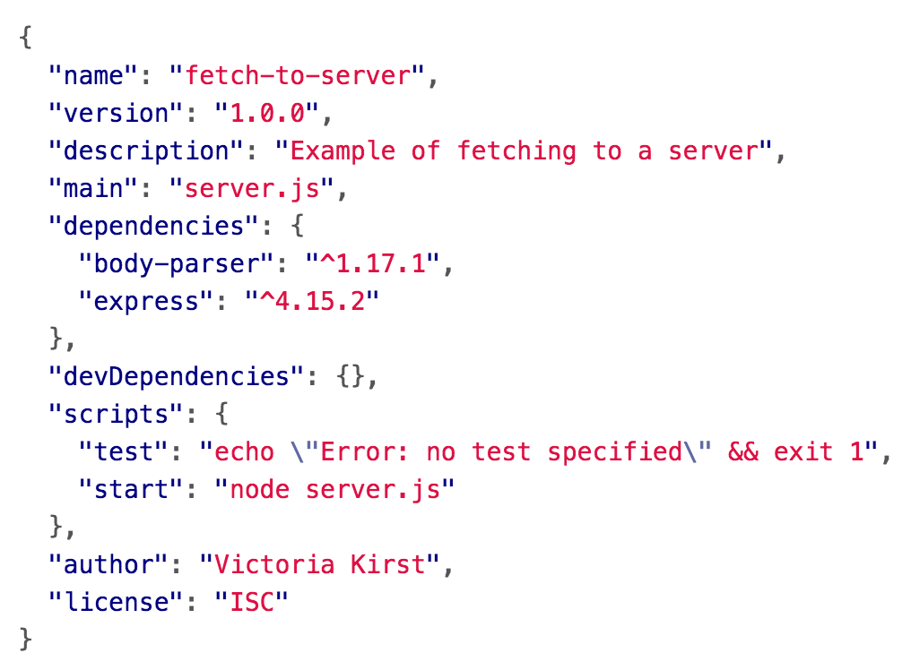
Auto-generated package.json
GitHub

Slide 43
Saving deps to package.json
Now when you install packages, you should pass in the --save parameter:
$ npm install --save express
$ npm install --save body-parser
This will also add an entry for this library in package.json.

Slide 44
Saving deps to package.json
If you remove the node_modules directory:
$ rm -rf node_modules
You can install your project dependencies again via:
$ npm install
This also allows people who have downloaded your code from GitHub to install all your dependencies with one command instead of having to install all dependencies individually.

Slide 45
npm scripts
Your package.json file also defines scripts:
You can run these scripts using $ npm scriptName
E.g. the following command runs "node server.js"
$ npm start

Slide 46
Databases and DBMS

Slide 47
Database definitions
A database (DB) is an organized collection of data.
In our dictionary example, we used a JSON file to store the dictionary information.
By this definition, the JSON file can be considered a database.
A database management system (DBMS) is software that handles the storage, retrieval, and updating of data.
Examples: MongoDB, MySQL, PostgreSQL, etc.
Usually when people say "database", they mean data that is managed through a DBMS.

Slide 48
Why use a database/DBMS
Why use a DBMS instead of saving to a JSON file?
fast: can search/filter a database quickly compared to a file
scalable: can handle very large data sizes
reliable: mechanisms in place for secure transactions, backups, etc.
built-in features: can search, filter data, combine data from multiple sources
abstract: provides layer of abstraction between stored data and app(s)
Can change where and how data is stored without needing to change the code that connects to the database.

Slide 49
Why use a database/DBMS
Why use a DBMS instead of saving to a JSON file?
Also: Some services like Heroku will not permanently save files, so using fs or fs-extra will not work

Slide 50
Disclaimer
Databases and DBMS is a huge topic in CS with multiple courses dedicated to it:
Introduction to Databases
Database System Principles
Database System Implementation
We will cover only the very basics:
How one particular DBMS works (MongoDB)
How to use MongoDB with NodeJS
(later) Basic DB design

Slide 51
MongoDB

Slide 52
MongoDB
MongoDB: A popular open-source DBMS
A document-oriented database as opposed to a relational database
Relational database:
Document-oriented DB:
Name | School | Employer | Occupation
Lori | null | Self | Entrepreneur
Malia | Harvard | null | null
{
name: "Lori",
employer: "Self",
occupation: "Entrepreneur"
}
{
name: "Malia",
school: "Harvard"
}
Relational databases have fixed schemas; document-oriented databases have flexible schemas

Slide 53
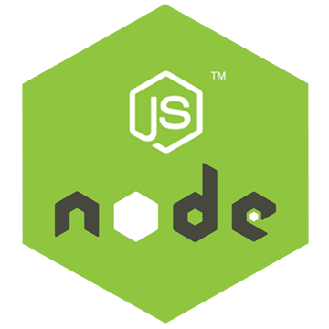


MongoDB is another software program running on the computer, alongside our NodeJS server program.
It is also known as the MongoDB server.

Slide 54
There are MongoDB libraries we can use in NodeJS to communicate with the MongoDB Server, which reads and writes data in the database it manages.

Slide 55
Data
The database the MongoDB Server manages might be local to the server computer...

Slide 56
(Routing, etc…)
Or it could be stored on other server computer(s) ("cloud storage").

Slide 57

System overview
$ node server.js
$ mongod
Data
For development, we will have 2 processes running:
node will run the main server program on port 3000
mongod will run the database server on a port 27017

Slide 58
System overview
$ mongod
Data
The mongod server will be bound to port 27017 by default
The mongod process will be listening for messages to manipulate the database: insert, find, delete, etc.

Slide 59
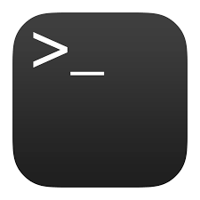
System overview
$ mongo
$ node server.js
$ mongod
We will be using two ways of communicating to the MongoDB server:
NodeJS libraries
mongo command-line tool

Slide 60
MongoDB concepts
Database:
A container of MongoDB collections
Collection:
A group of MongoDB documents.
(Table in a relational database)
Document:
A JSON-like object that represents one instance of a collection (Row in a relational database)
Also used more generally to refer to any set of key-value pairs.

Slide 61
MongoDB example
Documents:
{ "_id" : ObjectId("5922b8a186ebd73e42b1b53c"), "style" : "july4", "message" : "Dear Chip,\n\nHappy 4th of July!\n\n❤️Dale" }
Database:
ecards-db
Collection:
card
{ "_id" : ObjectId("5922acf09e76403b3a7549ec"), "style" : "graduation", "message" : "Hi Pooh,\n\n🎉 Congrats!!! 🎉\n\n<3 Piglet" }
{ "_id" : ObjectId("5922b90d86ebd73e42b1b53d"), "style" : "fathersday", "message" : "HFD" }
The document keys are called fields

Slide 62
mongod: Database process
$ mongod
When you install MongoDB, it will come with the mongod command-line program. This launches the MongoDB database management process and binds it to port 27017:
$ mongod

Slide 63
mongo: Command-line interface
$ mongod
You can connect to the MongoDB server through the mongo shell:
$ mongo

Slide 64
More next time!

