Slide 1
4102165:
Full Stack Web Development Fundamentals
Spring 2019
簡立仁 Li-Ren Chien
ccumouse@gmail.com

Slide 2
4102165 Structure
"Homework 0" + 5 homeworks
Each homework will be a standalone web page or a very small standalone web app
1 final project
Choice of open-ended OR structured
  Basically you can do HW6 for your final project
~2 week in scope; individual project; no groups
0 exams
No final, no midterm, no exams

Slide 3
Classes in JavaScript

Slide 4
Public methods
class ClassName {
constructor(params) {
...
}
methodName() {
...
}
methodName() {
...
}
}
constructor is optional.
Parameters for the constructor and methods are defined in the same they are for global functions.
You do not use the function keyword to define methods.

Slide 5
Public methods
class ClassName {
constructor(params) {
...
}
methodOne() {
this.methodTwo();
}
methodTwo() {
...
}
}
Within the class, you must always refer to other methods in the class with the this. prefix.

Slide 6
Public methods
class ClassName {
constructor(params) {
...
}
methodName() {
...
}
methodName() {
...
}
}
All methods are public, and you cannot specify private methods… yet.

Slide 7
Public methods
class ClassName {
constructor(params) {
...
}
methodName() {
...
}
methodName() {
...
}
}
As far as I can tell, private methods aren't in the language only because they are still figuring out the spec for it. (They will figure out private fields first.)

Slide 8
Public fields
class ClassName {
constructor(params) {
this.fieldName = fieldValue;
this.fieldName = fieldValue;
}
methodName() {
this.fieldName = fieldValue;
}
}
Define public fields by setting this.fieldName in the constructor… or in any other function.
(This is slightly hacky underneath the covers and there is a draft to add public fields properly to ES.)

Slide 9
Public fields
class ClassName {
constructor(params) {
this.someField = someParam;
}
methodName() {
const someValue = this.someField;
}
}
Within the class, you must always refer to fields with the this. prefix.

Slide 10
Public fields
class ClassName {
constructor(params) {
this.fieldName = fieldValue;
this.fieldName = fieldValue;
}
methodName() {
this.fieldName = fieldValue;
}
}
You cannot define private fields… yet.
(Again, there are plans to add add private fields to ES once the spec is finalized.)

Slide 11
Instantiation
Create new objects using the new keyword:
class SomeClass {
...
someMethod() { … }
}
const x = new SomeClass();
const y = new SomeClass();
y.someMethod();

Slide 12
Why classes?
Why are we even doing this?
Why do we need to use classes when web programming?
Why can't we just keep doing things the way we've been doing things, with global functions and global variables?

Slide 13
Why classes?
A: All kinds of reasons
For a sufficiently small task, globals variables, functions, etc. are fine
But for a larger website, your code will be hard to understand and easy to break if you do not organize it
Using classes and object-oriented design is the most common strategy for organizing code
E.g. in the global scope, it's hard to know at a variable called "name" would be referring to, and any function could accidentally write to it.
But when defined in a Student class, it's inherently clearer what "name" means, and it's harder to accidentally write that value

Slide 14
Organizing code
Well-engineered software is well-organized software:
Software engineering is all about knowing
What to change
Where to change it
You can read an existing codebase better if it is well-organized
  "Why do I need to read a codebase?" Because you need to modify the codebase to add features and fix bugs

Slide 15
Other problems with globals
Having a bunch of loose variables in the global scope is asking for trouble
Much easier to hack
  Can access via extension or Web Console
  Can override behaviors
Global scope gets polluted
  What if you have two functions with the same name? One definition is overridden without error
Very easy to modify the wrong state variable
All these things are much easier to avoid with classes

Slide 16

Example: Present
Let's create a Present class inspired by our present example from last week.

Slide 17
How to design classes
You may be wondering:
How do I decide what classes to write?
How do I decide what methods to add to my class?

Slide 18
Disclaimer
This is not a software engineering class, and this is not an object-oriented design class.
As such, we will not grade your OO design skills.
However, this also means we won't spend too much time explaining how to break down your app into well-composed objects.
(It takes practice and experience to get good at this.)

Slide 19
One general strategy
"Component-based" approach: Use classes to add functionality to HTML elements ("components")
Each component:
Has exactly one container element / root element
Handles attaching/removing event listeners
Can own references to child components / child elements
(Similar strategy to ReactJS, Custom Elements, many other libraries/frameworks/APIs before them)

Slide 20
Container element
One pattern:
<div id="present-container"></div>
const element =
document.querySelector('#present-container');
const present = new Present(element);
// Immediately renders the present

Slide 21
Container element
A similar pattern:
<div id="present-container"></div>
const element =
document.querySelector('#present-container');
const present = new Present();
// Renders with explicit call
present.renderTo(element);

Slide 22
Web: Almost total freedom
Unlike most app platforms (i.e. Android or iOS), you have almost total freedom over exactly how to organize your code
Pros:
Lots of control!
Cons:
Lots and lots and lots of decisions to make

Slide 23
Web: Almost total freedom
Unlike most app platforms (i.e. Android or iOS), you have almost total freedom over exactly how to organize your code
Pros:
Lots of control!
Cons:
Lots and lots and lots of decisions to make
This is why Web Frameworks are so common: A web framework just make a bunch of software engineer decisions for you ahead of time (+provides starter code)

Slide 24
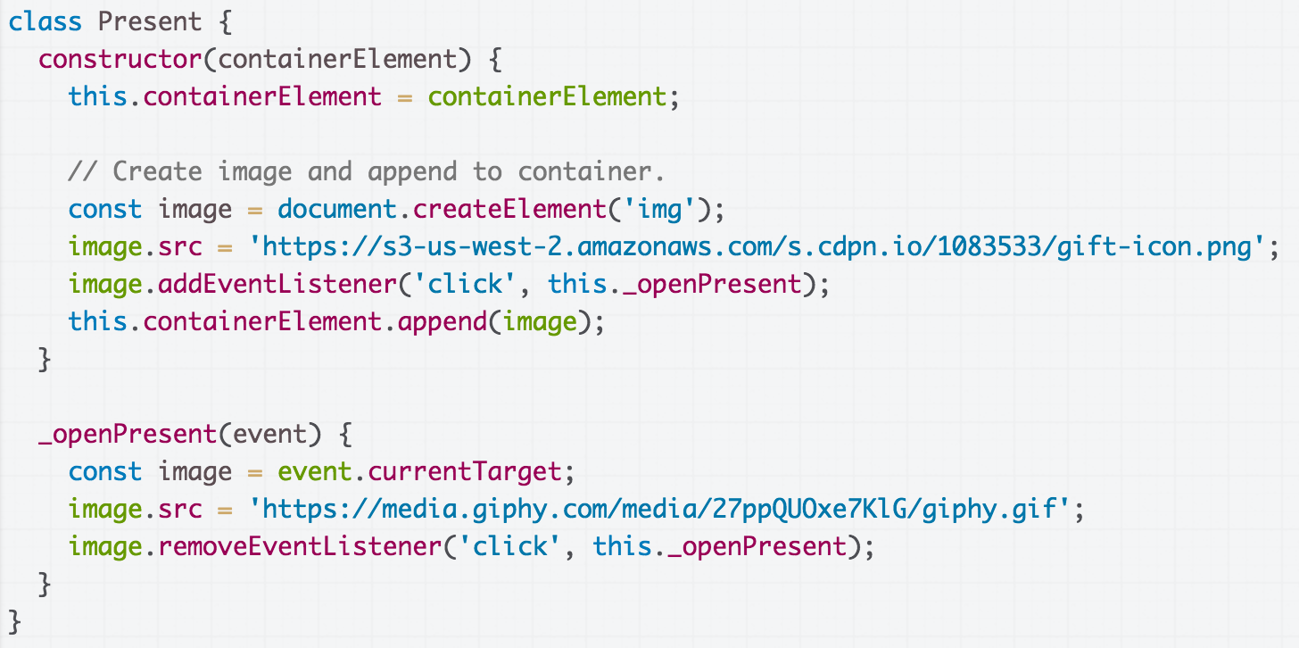
Don't forget this
If the event handler function you are passing to addEventListener is a method in a class, you must pass "this.functionName" (finished)

Slide 25
"Private" with _
A somewhat common JavaScript coding convention is to add an underscore to the beginning or end of private method names:
_openPresent() {
...
}
I'll be doing this in this class for clarity, but note that it's frowned upon by some.

Slide 26
Solution: Present
CodePen finished

Slide 27
this in event handler
Right now we access the image we create in the constructor in _openPresent via event.currentTarget.

Slide 28
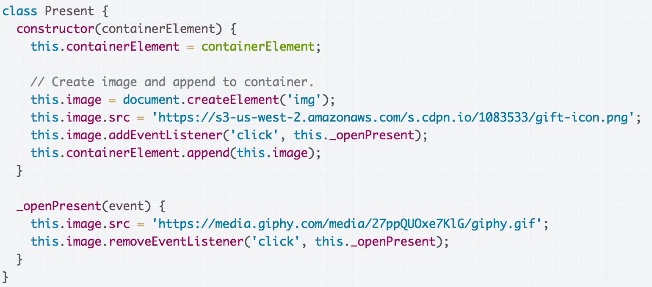
this in event handler
Q: What if we make the image a field and access it _openPresent via this.image instead of event.currentTarget?

Slide 29
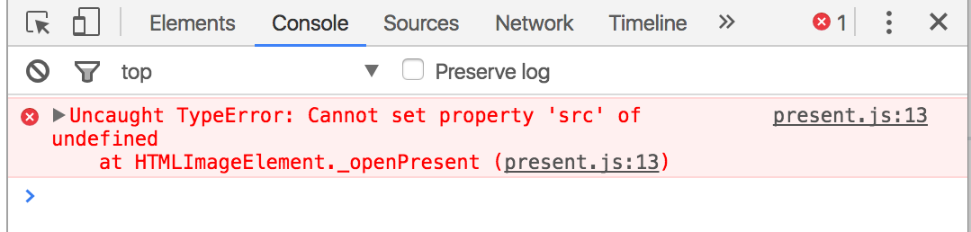
this in event handler
Error message!
CodePen
What's going on?

Slide 30
JavaScript this
The this keyword in JavaScript is dynamically assigned, or in other words: this means different things in different contexts (mdn list)
In our constructor, this refers to the instance
When called in an event handler, this refers to… the element that the event handler was attached to (mdn).

Slide 31
this in event handler
That means this refers to the <img> element, not the instance variable of the class...
...which is why we get this error message.

Slide 32
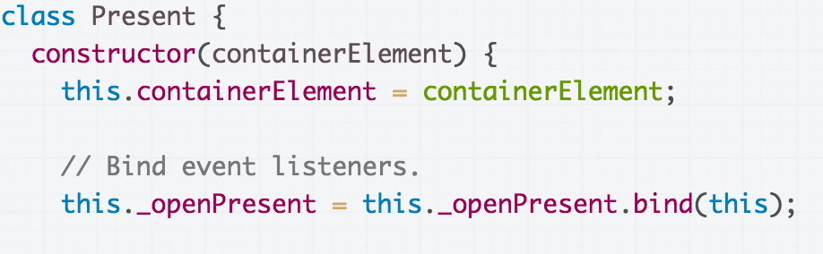
Solution: bind
To make this always refer to the instance object for a method in the class (i.e. to get this to behave as you'd expect), you can add the following line of code in the constructor:
this.methodName = this.methodName.bind(this);

Slide 33
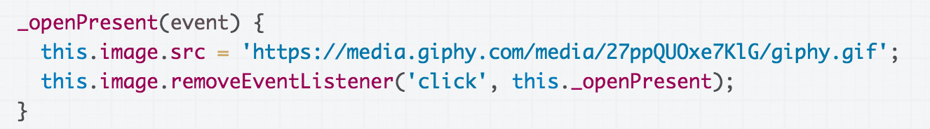

Solution: bind
Now this in the _openPresent method refers to the instance object (CodePen):
Moral of the story:
Don't forget to bind()
event listeners in your constructor!!

Slide 34
Communicating between classes

Slide 35

Multiple classes
Let's say that we have multiple presents now (Live):

Slide 36
Multiple classes
And we have implemented this with two classes:
App: Represents the entire page
  Present: Represents a single present
App
Has a list of Presents
Code.
Present
Present
Present
Present
Present

Slide 37

Communicating btwn classes
What if we want to change the title when all present have been opened? (Code)

Slide 38
Communication btwn classes
Communicating from App → Present is easy, since App has a list of the Present objects.
App
App can just call methods on Present:
present.doWhatever();
Has a list of Presents
Present
Present
Present
Present
Present

Slide 39
Communication btwn classes
However, communicating Present → App is not as easy, because Presents do not have a reference to App
App
Has a list of Presents
Present
Present
Present
Present
Present

Slide 40
Communicating btwn classes
You have three general approaches:
Add a reference to App in Photo
This is poor software engineering, though we will allow it on the homework because this is not an OO design class
Fire a custom event
OK (don't forget to bind)
Add onOpened "callback function" to Present
Best option (don't forget to bind)

Slide 41
Terrible style: Presents own App
A naive fix is to just give Present a reference to App in its constructor: Code
App
Has a list of Presents
(Please don't do this.)
Has an App
Present
Present
Present
Present
Present

Slide 42
Terrible style: Presents own App
This is the easiest workaround, but it's terrible software engineering.
App
Logically doesn't make sense: a Present doesn't have an App
Gives Present way too much access to App
Especially bad in JS with no private fields/ methods yet
Has a list of Presents
Has an App
Present
Present
Present
Present
Present

Slide 43
Custom events

Slide 44
Custom Events
You can listen to and dispatch Custom Events to communicate between classes (mdn):
const event = new CustomEvent(
eventNameString, optionalParameterObject);
element.addEventListener(eventNameString);
element.dispatchEvent(eventNameString);
However, CustomEvent can only be listened to / dispatched on HTML elements, and not on arbitrary class instances.

Slide 45
Custom Events: Present example
Let's have the App listen for the 'present-open' event...
App listens for 'present-open'
When present-open has fired for each present, change the title.
App
Has a list of Presents
Present
Present
Present
Present
Present
Each present fires 'present-open' when clicked
App and Present: Custom Events WITH BUG: No bind

Slide 46
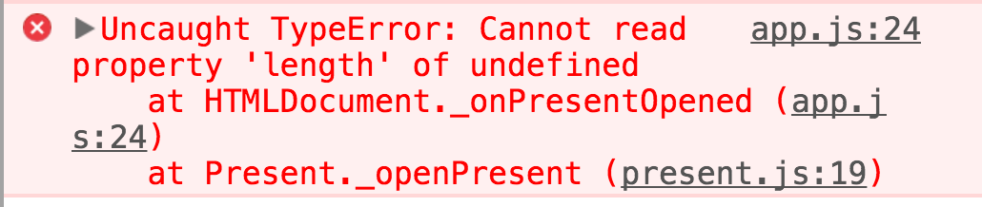
this in event handler
Our first attempt at solution results in errors again!
App and Present: Custom Events WITH BUG: No bind

Slide 47
Solution: bind
To make this always refer to the instance object for a method in the class (i.e. to get this to behave as you'd expect), you can add the following line of code in the constructor:
this.methodName = this.methodName.bind(this);
CodePen solution

Slide 48
First-class functions

Slide 49
Recall: addEventListener
Over the last few weeks, we've been using functions as a parameter to addEventListener:
dragon.addEventListener(
'pointerdown', onDragStart);
image.addEventListener(
'click', this._openPresent);

Slide 50
First-class functions
JavaScript is a language that supports first-class functions, i.e. functions are treated like variables of type Function:
Can be passed as parameters
Can be saved in variables
Can be defined without a name / indentifier
  Also called an anonymous function
  Also called a lambda function
  Also called a function literal value

Slide 51
Function variables
You can declare a function in several ways:
function myFunction(params) {
}
const myFunction = function(params) {
};
const myFunction = (params) => {
};

Slide 52
Function variables
function myFunction(params) {
}
const myFunction = function(params) {
};
const myFunction = (params) => {
};
Functions are invoked in the same way, regardless of how they were declared:
myFunction();

Slide 53
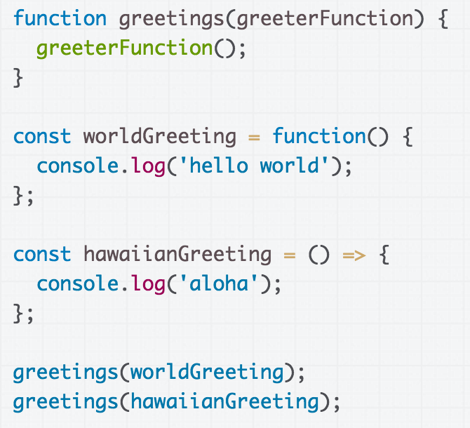
Simple, contrived example
CodePen

Slide 54
A real example: Callbacks
Another way we can communicate between classes is through callback functions:
Callback: A function that's passed as a parameter to another function, usually in response to something.

Slide 55
Callback: Present example
Let's have Presents communicate with App via callback parameter: (CodePen attempt)
App has _onPresentOpened method
When App is constructing Presents, pass its this._onPresentOpened method as parameter to Present constructor
App
Has a list of Presents
Present
Present
Present
Each Present saves an onOpenCallback parameter in the constructor
When the present is opened, fire the callback
Present
Present

Slide 56
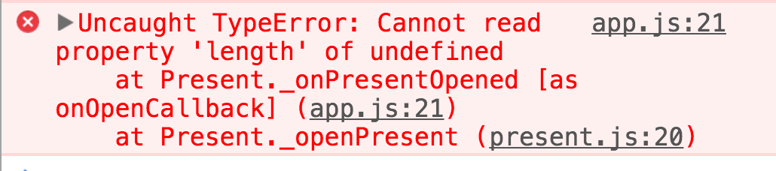
this in event handler
Say, it's another error in our event handler...

Slide 57
Solution: bind
Unless explicitly bound, "this" refers to the object that owns the method being called.
To make this always refer to the instance object for a method in the class (i.e. to get this to behave as you'd expect), you can add the following line of code in the constructor:
this.methodName = this.methodName.bind(this);
CodePen solution

Slide 58
Object-oriented photo album
Let's look at an object-oriented version of the photo album: CodePen / Debug
Album
Has a list of Thumbnails
Has a ModalScreen
Thumbnail
ModalScreen
Thumbnail
Thumbnail
Thumbnail
Thumbnail
Has a ModalPhoto
ModalPhoto

