Slide 1
4102165:
Full Stack Web Development Fundamentals
Spring 2019
簡立仁 Li-Ren Chien
ccumouse@gmail.com

Slide 2
CS193X schedule
Today
Servers and MongoDB
Web application architecture
  Server-side rendering with Handlebars
  Single-page web app
Final Project Assigned
HW5 due Mon 6/2

Slide 3
MongoDB installation
This lecture assumes you have installed MongoDB:
https://fullstackccu.github.io/install-mongodb

Slide 4
MongoDB and NodeJS

Slide 5
MongoDB concepts
Database:
A container of MongoDB collections
Collection:
A group of MongoDB documents.
(Table in a relational database)
Document:
A JSON-like object that represents one instance of a collection (Row in a relational database)
Also used more generally to refer to any set of key-value pairs.

Slide 6
mongodb objects
The mongodb Node library provides objects to manipulate the database, collections, and documents:
Db: Database; can get collections using this object
Collection: Can get/insert/delete documents from this collection via calls like insertOne, find, etc.
Documents are not special classes; they are just JavaScript objects

Slide 7
collection.insertOne (Promise)
const result = await collection.insertOne(doc);
Adds one item to the collection
doc is a JavaScript object representing the key-value pairs to add to the collection
Returns a Promise that resolves to a result object when the insertion has completed
  result.insertedId will contain the id of the object that was created

Slide 8
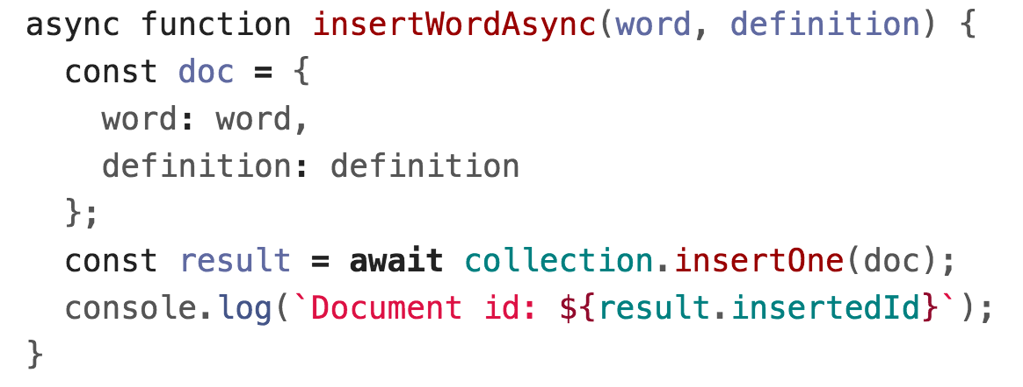
Promise version
We will be using the Promise + async/await versions of all the MongoDB asynchronous functions, as it will help us avoid callback hell

Slide 9
collection.findOne
const doc = await collection.findOne(query);
Finds the first item in the collection that matches the query
query is a JS object representing which fields to match on
Returns a Promise that resolves to a document object when findOne has completed
  doc will be the JS object, so you can access a field via doc.fieldName, e.g. doc._id
  If nothing is found, doc will be null

Slide 10
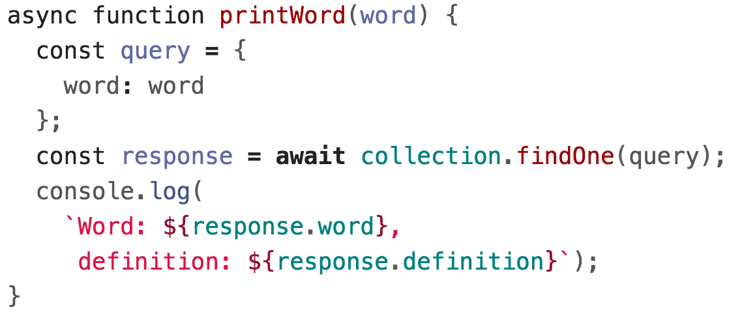
collection.findOne

Slide 11
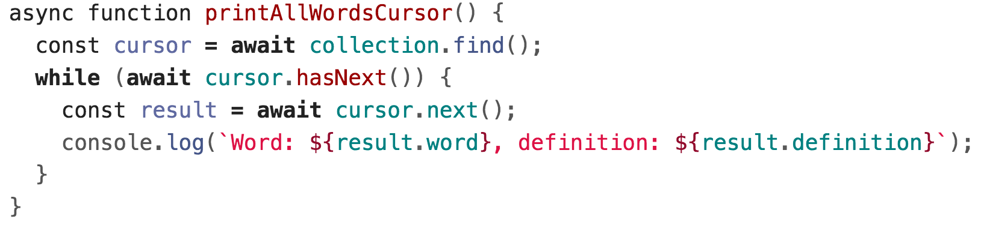
collection.find()
const cursor = await collection.find(query);
Returns a Cursor to pointing to the first entry of a set of documents matching the query
You can use hasNext and next to iterate through the list:
(This is an example of something that is a lot easier to do with async/await)

Slide 12
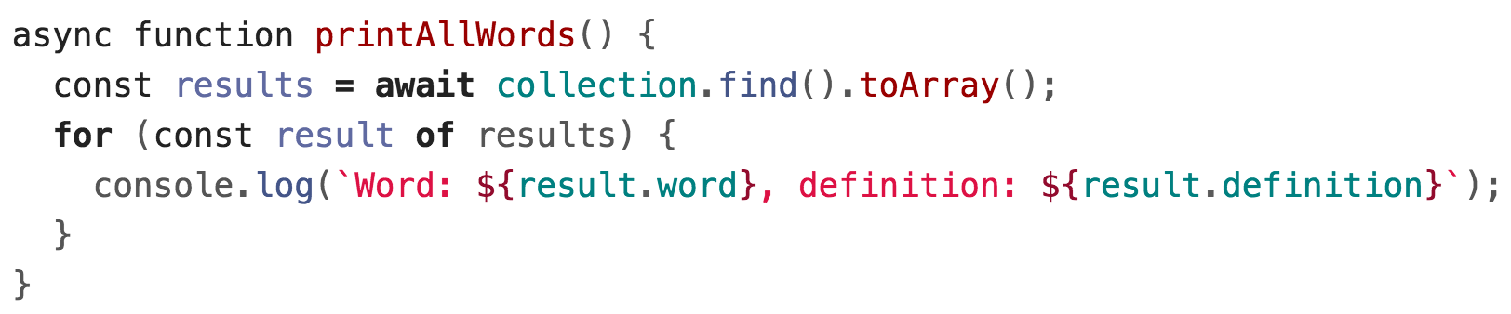
collection.find().toArray()
const cursor = await collection.find(query);
const list = await cursor.toArray();
Cursor also has a toArray() function that converts the results to an array

Slide 13
collection.update
await collection.update(query, newEntry);
Replaces the item matching query with newEntry
  (Note: This is the simplest version of update. There are more complex versions of update that we will address later.)

Slide 14
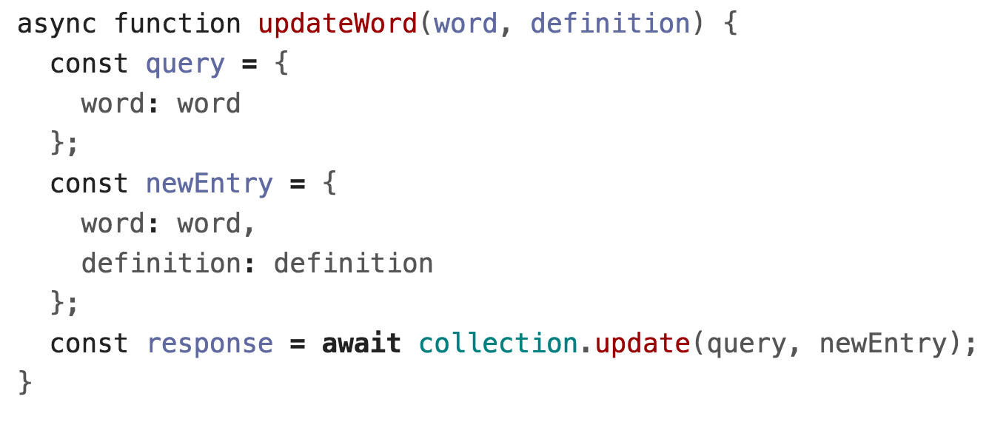
collection.update

Slide 15
"Upsert" with collection.update
MongoDB also supports "upsert", which is
Update the entry if it already exists
Insert the entry if it doesn't already exist
const params = { upsert: true };
await collection.update(query, newEntry, params);

Slide 16
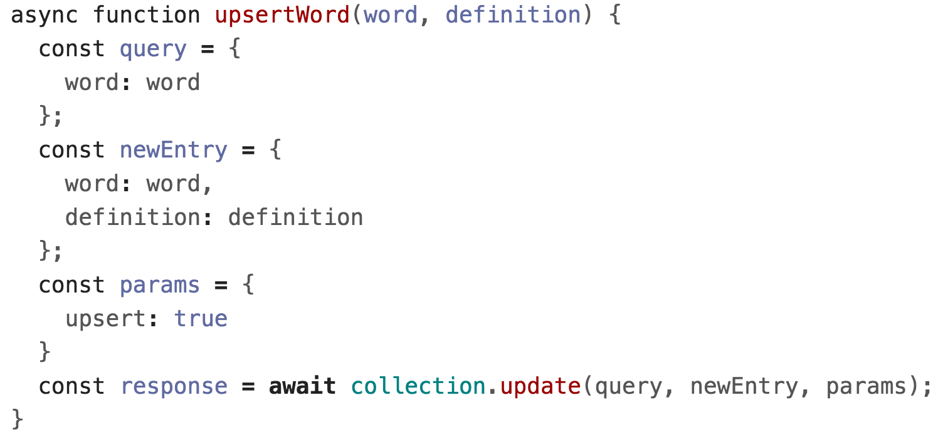
"Upsert" with collection.update

Slide 17
collection.deleteOne/Many
const result = await collection.deleteOne(query);
Deletes the first the item matching query
result.deletedCount gives the number of docs deleted
const result = await collection.deleteMany(query);
Deletes all items matching query
result.deletedCount gives the number of docs deleted
Use collection.deleteMany() to delete everything

Slide 18
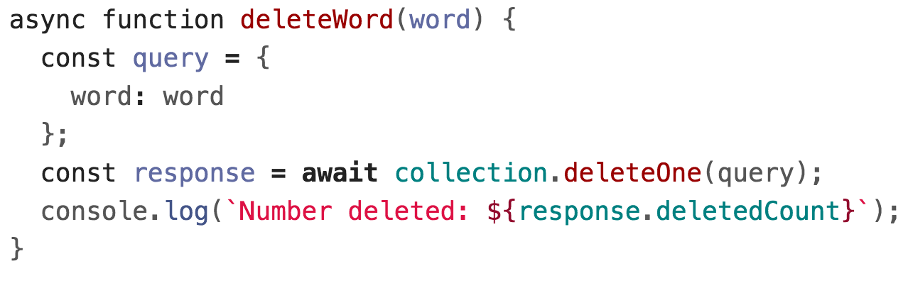
collection.deleteOne

Slide 19
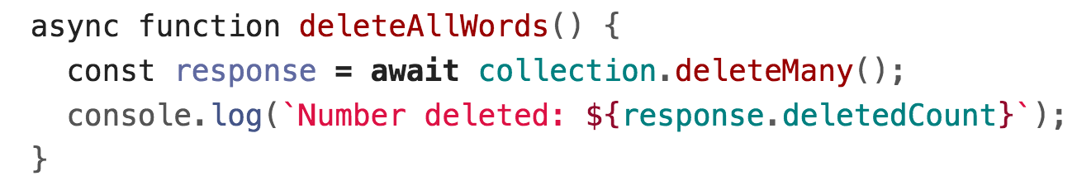
collection.deleteMany

Slide 20
Advanced queries
MongoDB has a very powerful querying syntax that we did
not cover in these examples.
For more complex queries, check out:
Querying
  Query selectors and projection operators
  db.collection('inventory').find({ qty: { $lt: 30 } });
Updating
  Update operators
db.collection('words').updateOne(
{ word: searchWord },
{ $set: { definition: newDefinition }})

Slide 21
Looking up documents by
MongoDB id (ObjectID )

Slide 22
MongoDB: _id
MongoDB creates a unique id for each doc it creates.
This is stored in a _id field and consists of a string stored in an ObjectID object.
Recall the id is returned after we've inserted a new document:
const result = await collection.insertOne(doc);
result.insertedId will contain the _id of the object that was created

Slide 23
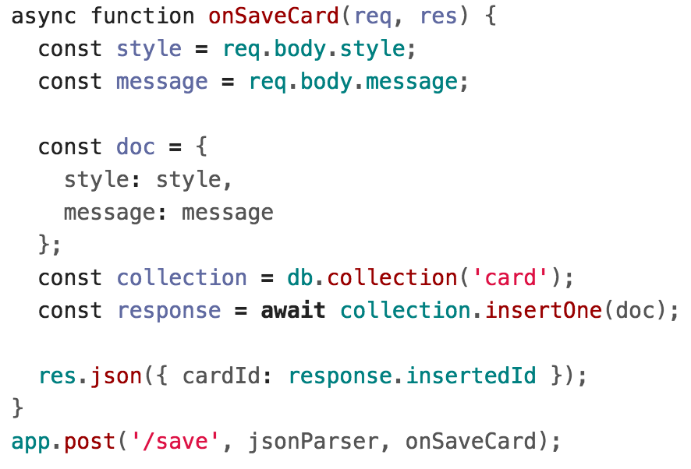
Find by Mongo ID: ObjectID
Let's say you have a route that creates documents:

Slide 24
Find by Mongo ID: ObjectID
Let's say you have a route that creates documents:
You are returning the MongoDB-generated unique ID for the document, for querying later.

Slide 25
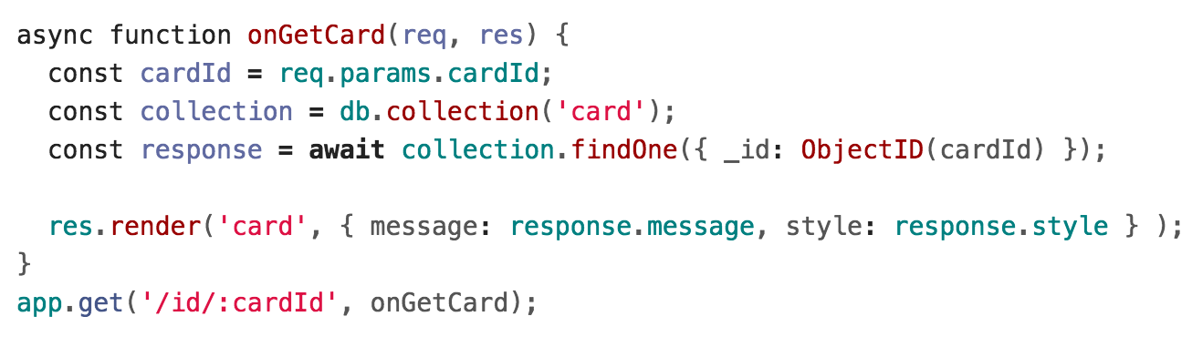
Find by Mongo ID: ObjectID
If you want to find a document by its MongoDB generated _id field, you must wrap the string id in an ObjectID.
You need to import the ObjectID class first.

Slide 26
Find by Mongo ID: ObjectID
If you want to find a document by its MongoDB generated _id field, you must wrap the string id in an ObjectID.
You need to import the ObjectID class first.

Slide 27
Using MongoDB in a server

Slide 28
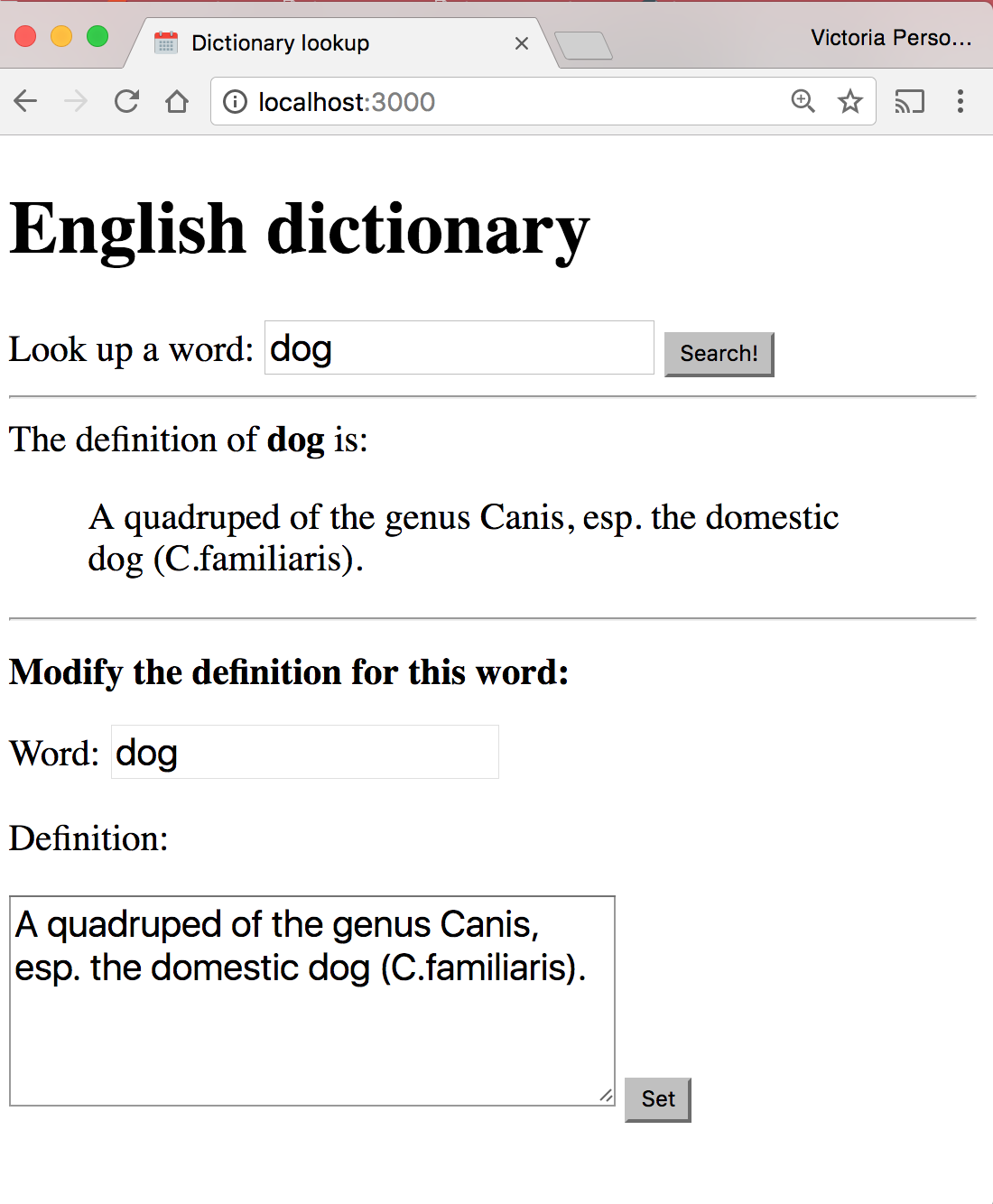
Dictionary with MongoDB
Let's change our Dictionary example to use a MongoDB backend instead of dictionary.json.

Slide 29
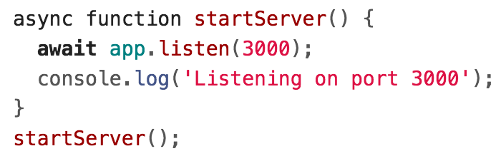
Starting a server: Before
(Previous code: This doesn't use MongoDB)

Slide 30
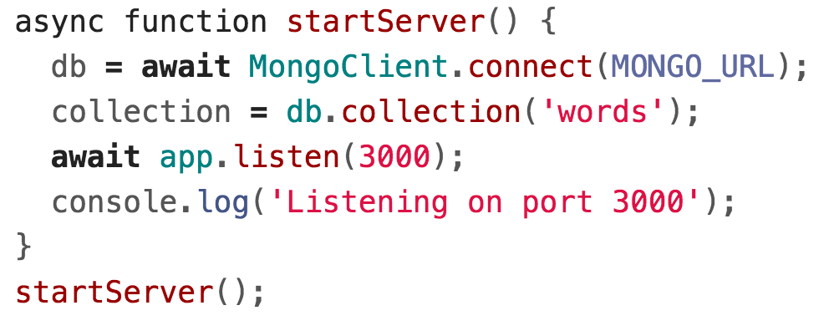
Starting a server: After

Slide 31
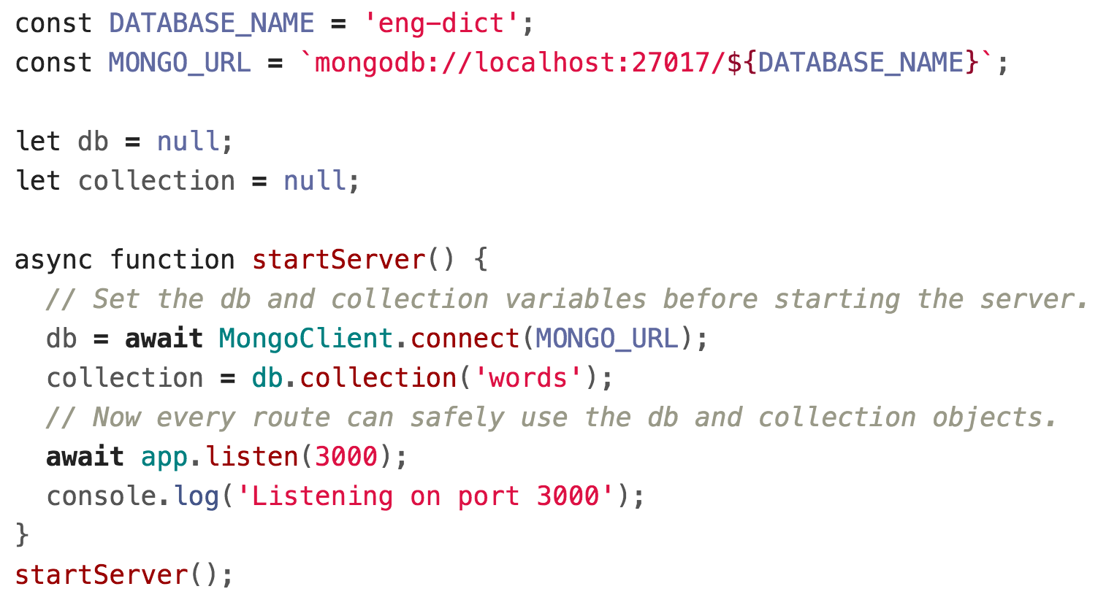
Starting a server: After

Slide 32
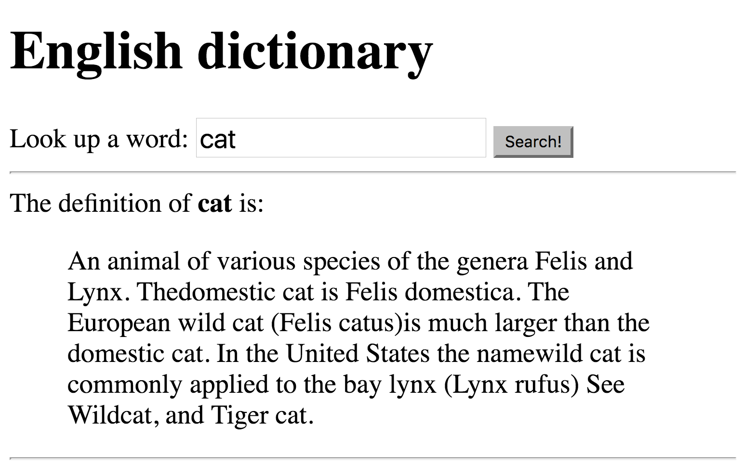
Example: Dictionary
We want our server to load definitions from the dictionary...

Slide 33
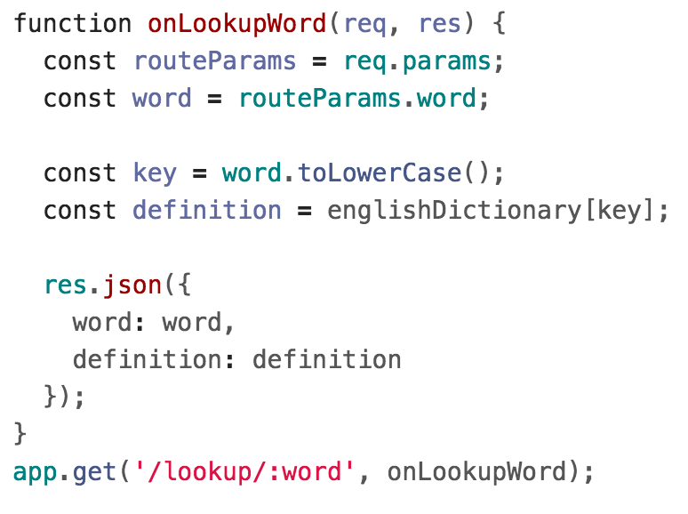
JSON Dictionary lookup
(Previous code: This doesn't use MongoDB)

Slide 34
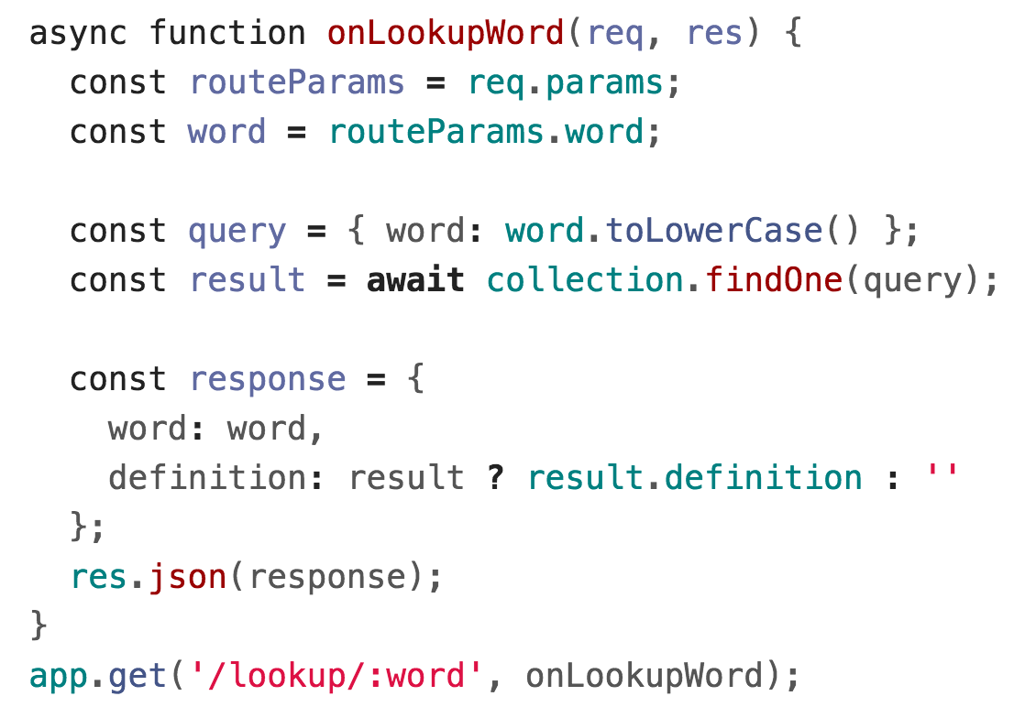
MongoDB Dictionary lookup

Slide 35
Dictionary with MongoDB
And we want to modify definitions in the dictionary:

Slide 36
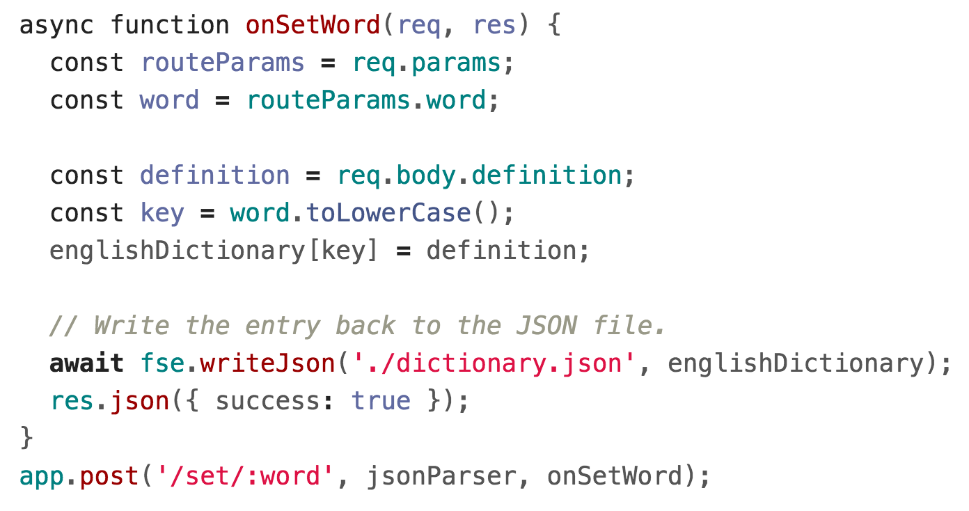
JSON Dictionary write
(Previous code: This doesn't use MongoDB)

Slide 37
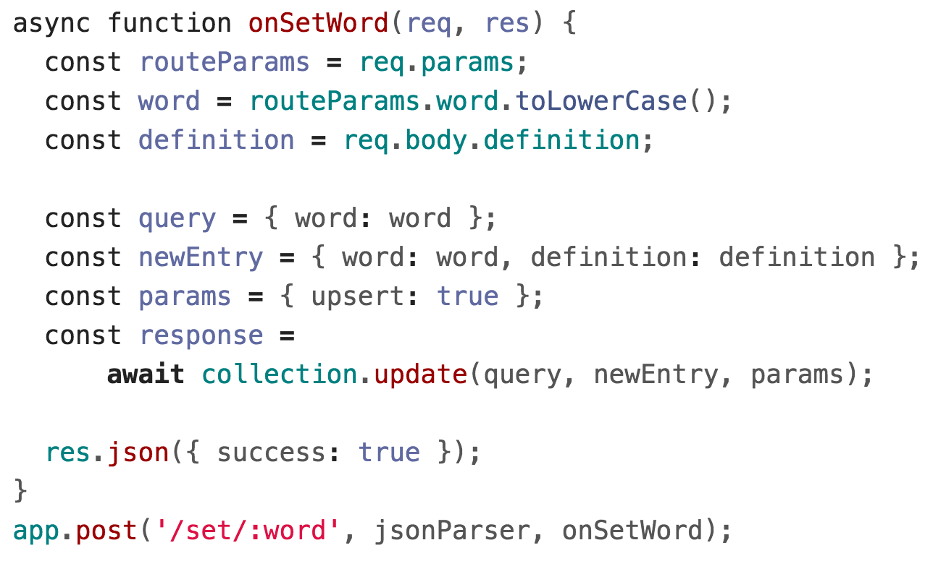
MongoDB Dictionary write

Slide 38
Using MongoDB in a server

Slide 39




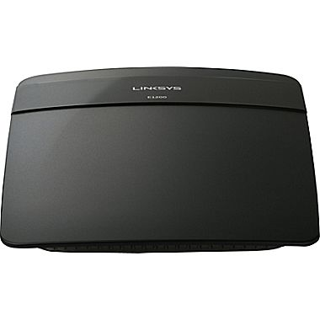
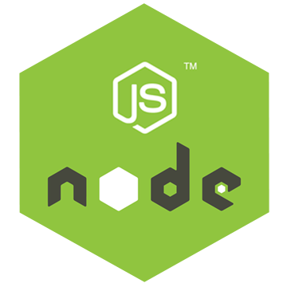
Review system
1
Server
Client
2
(Routing, etc…)
If we deployed our dictionary web app to abc.com:
The user navigates to abc.com
The browser makes an HTTP GET request for abc.com

Slide 40
Review system
Client
Server
3
(Routing, etc…)
4
3. The server computer that is located at abc.com receives the HTTP GET request
4. The server computer gives the NodeJS server process the HTTP GET request message

Slide 41

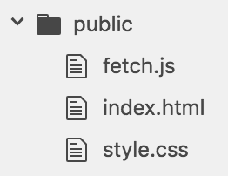
Review system
Server
"Does the 'public' folder have an 'index.html' file?
4
Our NodeJS server code has app.use(express.static('public')); so it will first look to see if an index.html file exists in the public directory.

Slide 42
Review system
Server
"Does the 'public' folder have an 'index.html' file?
Yes
5
5. Since there is an index.html file, our NodeJS server will respond with the index.html file

Slide 43
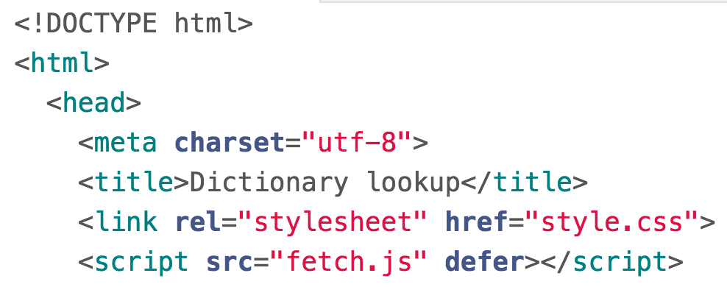
Review system
Client
Server
7
7
6
6
(Routing, etc…)
5
5. Our Node server program replies with the index.html file
6. The server computer sends back the index.html file
7. The browser receives the index.html file and begins to render it

Slide 44
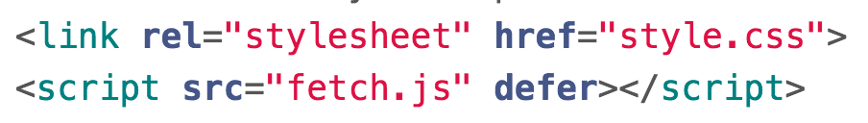
Review system
Client
8. In rendering the HTML, the browser sees it needs style.css and fetch.js

Slide 45
Review system
Client
Server
1
(Routing, etc…)
So the browser makes two more HTTP GET requests:
One for style.css
One for script.js

Slide 46
Review system
Client
Server
2
(Routing, etc…)
3
2. These GET requests get routed to the server computer
3. The server computer sends the GET requests to our NodeJS process

Slide 47
Review system
Server
4
4. Our NodeJS server code finds fetch.js and style.css in the public directory, so it responds with those files

Slide 48
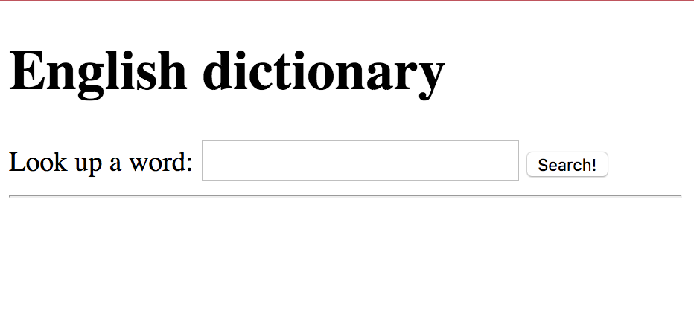
Review system
Client
Server
6
6
5
5
(Routing, etc…)
4
4. Our Node server program replies with the style.css and fetch.js files
5. The server computer sends these files back to the client
6. The browser receives the files and continues rendering index.html

Slide 49
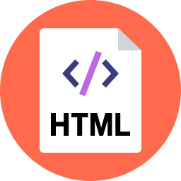
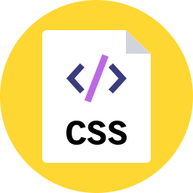
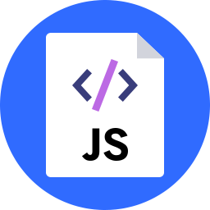
Review system
Client
Server
(Routing, etc…)
In this picture, there are two copies of index.html, style.css, and fetch.js:
The server computer has these files stored in its file system
The browser has just downloaded the files from the server

Slide 50
Review system
Client
Server
(Routing, etc…)
The server computer provided the files.
But the client computer is going to execute the files.
So the code in fetch.js is going to be run on the client, not on the server.

Slide 51
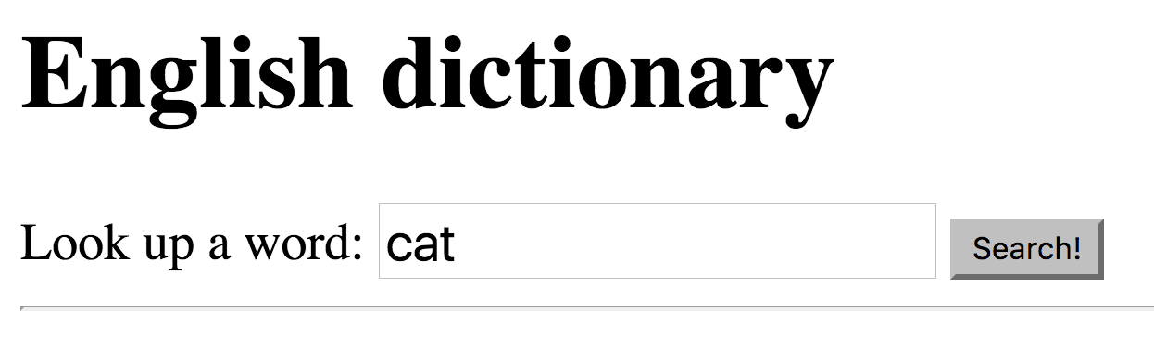
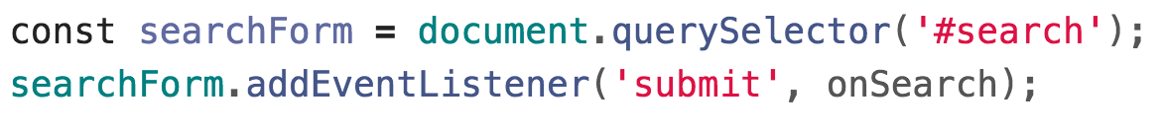
Review system
1
Client
The client has rendered the page and ran the JavaScript in fetch.js to attach the event listeners.
Then, when we enter a word and hit "Search"...

Slide 52
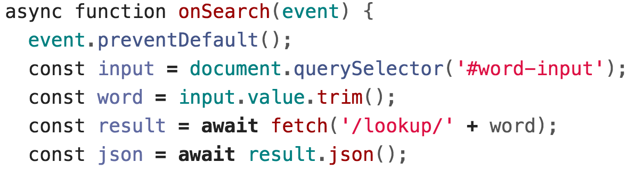
Review system
2
Client
2. ...the onSearch function is executed on the client.

Slide 53
Review system
3
Client
3. Our onSearch function includes a call to fetch(), which is going to trigger another HTTP GET request, this time for abc.com/lookup/cat.

Slide 54
Review system
Client
Server
4
(Routing, etc…)
4. Because of the call to fetch(), the browser makes an HTTP GET request for abc.com/lookup/cat.

Slide 55
Review system
Client
Server
5
(Routing, etc…)
7
5. These GET requests get routed to the server computer
6. The server computer sends the GET requests to our NodeJS process

Slide 56
Review system
7
Server
7. Our NodeJS server code first tries to see whether there's an "lookup/cat/index.html" in the public directory.

Slide 57
Review system
Server
8
8. "public/lookup/cat/index.html" doesn't exist, so now it sees whether there's a route that matches GET "/lookup/cat":
'/lookup/:word' matches, so onLookupWord is executed on the server

Slide 58
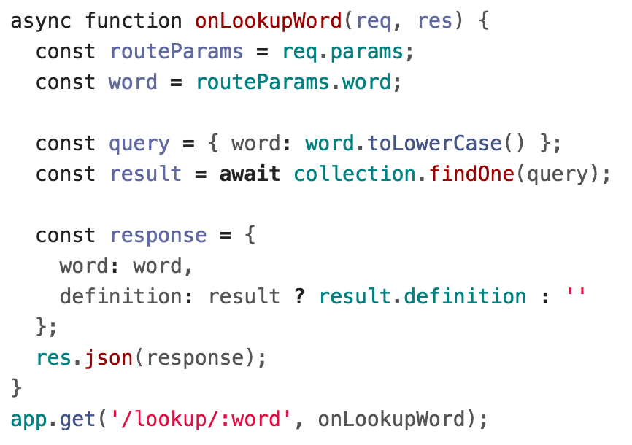
Review system
Server
9
9. We get the definition from the MongoDB database.

Slide 59
Review system
Client
12
Server
11
(Routing, etc…)
10
10. Our Node server program replies with JSON
11. The server computer sends JSON back to the client
12. The browser receives the JSON and continues executing the JavaScript

Slide 60
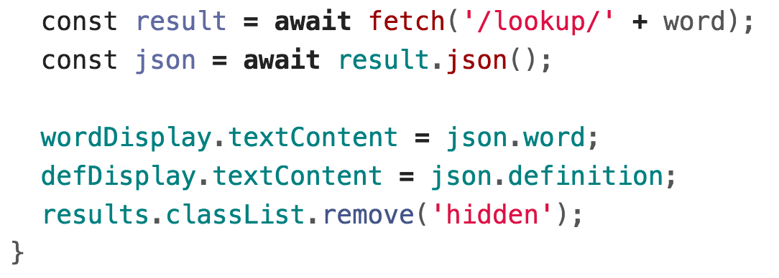
Review system
13
Client
13. The onSearch function continues executing with the JSON results and updates the client page.

Slide 61
Review system
Client

Slide 62
Review system
Client
Server
(Routing, etc…)
The server generated the JSON with the word and definition.
The client consumed the JSON with the word and definition.

Slide 63
Another example: E-cards

Slide 64
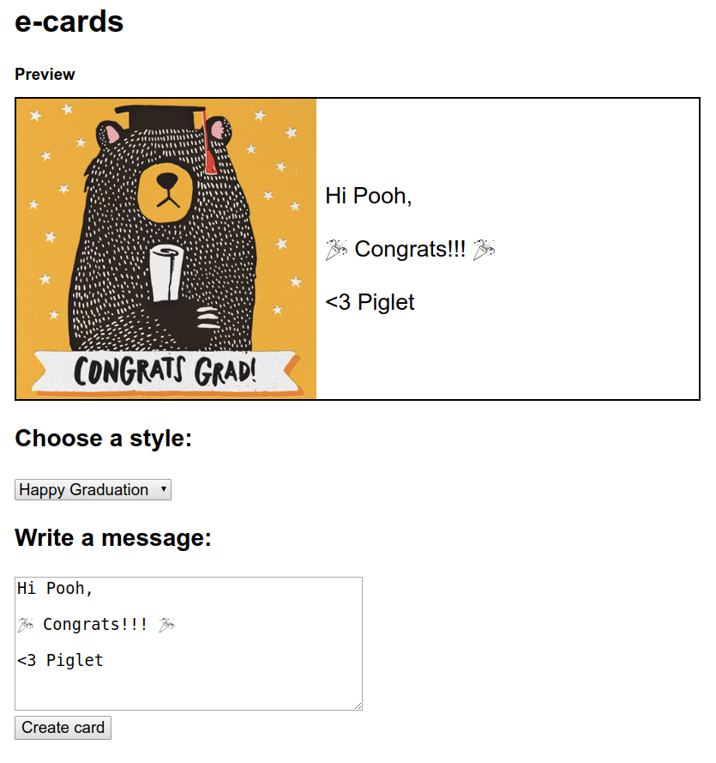
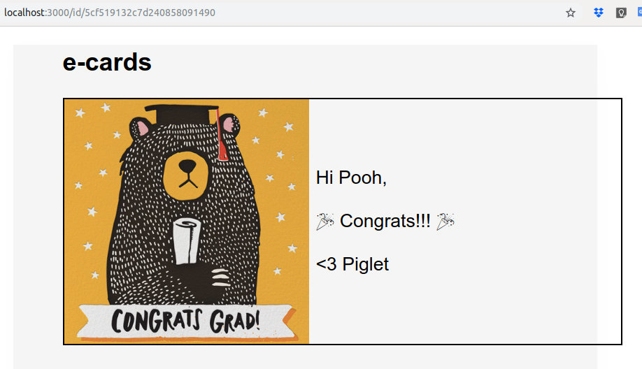
Example: E-cards
We'll be creating an e-card app, whose data is saved in a MongoDB database:

Slide 65
Example: E-cards
When the user loads to an index page, we want to present them with an E-Card Maker UI

Slide 66
Example: E-cards
When the user has created an e-card, we want it accessible via URL of this form:
/id/<ecard_id>

Slide 67
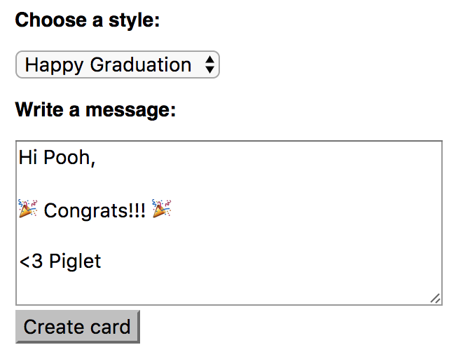
Step 1: Saving data
We'll need to save 3 pieces of data:
Card style
Card message
A unique id for each card

Slide 68
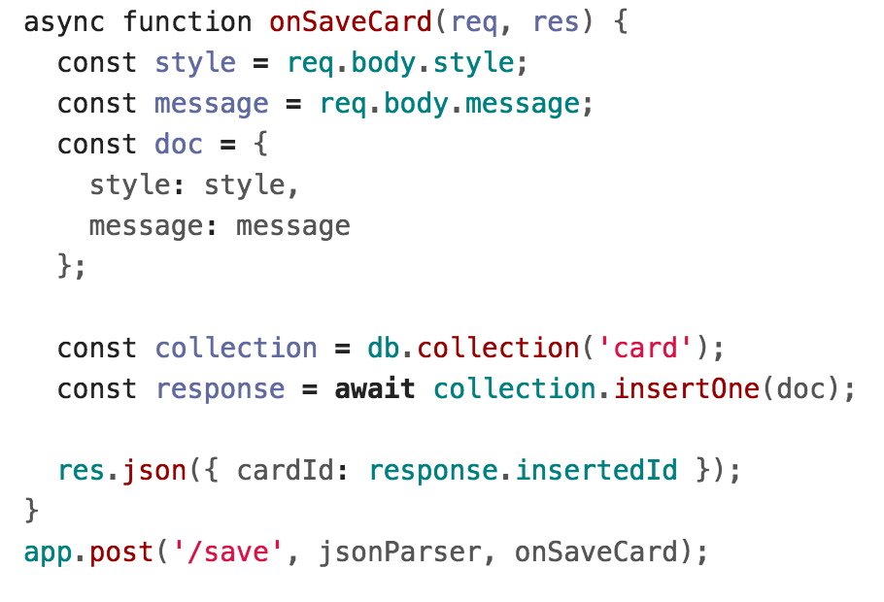
Example: E-card saving data

Slide 69
Step 2: Loading a card
When the user has created an e-card, we want it accessible via URL of this form:
/id/<ecard_id>

Slide 70
Web app architecture
How do we implement an app so that to show a different view depending on the URL path?
Create-a-card:
localhost:3000/
View card:
localhost:3000/id/<card_id>

Slide 71
Web app architectures

Slide 72
Structuring a web app
There are roughly 4 strategies for architecting a web application:
Server-side rendering:
Server sends a new HTML page for each unique path
Single-page application:
Server sends the exact same web page for every unique path (and the page runs JS to change what it look like)
Combination of 1 and 2 ("Isomorphic" / "Universal")
Progressive Loading

Slide 73
(Short take on these)
Server-side rendering:
We will show you how to do this
Single-page application:
We will show you how to do this
Combination of 1 and 2 ("Isomorphic" / "Universal")
This is probably the most common technique
We will talk about this but won't show you how to code it
Progressive Loading
This is probably the future (but it's complex)
We will talk about this but won't show you how to code it

Slide 74
Server-side rendering

Slide 75

Server-side rendering
Multi-page web app:
The server generates a different web page
Usually involves filling out and returning an HTML template in response to a request
  This is done by a templating engine: Jade, Handlebars, etc
HTML template
Server

Slide 76
Handlebars: Template engine
We will be showing the Handlebars template engine:
Handlebars lets you write templates in HTML
You can embed {{ placeholders }} within the HTML that get filled in.
Your templates are saved in .handlebars files
<div class="entry">
<h1>{{title}}</h1>
<div class="body">
{{body}}
</div>
</div>

Slide 77
Handlebars and NodeJS
You can setup Handlebars and NodeJS using the express-handlebars NodeJS library:
const exphbs = require('express-handlebars');
…
const app = express();
const hbs = exphbs.create();
app.engine('handlebars', hbs.engine);
app.set('view engine', 'handlebars');

Slide 78
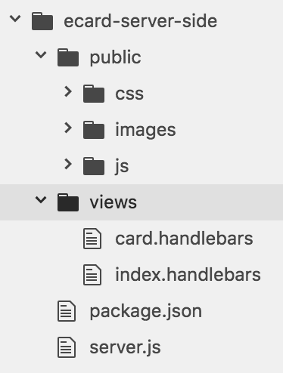
E-cards: Server-side rendering
We change our E-cards example to have 2 Handlebars templates:
card.handlebars
Index.handlebars
views/ is the default directory in which Handlebars will look for templates.
Note that there are no longer any HTML files in our public/ folder.

Slide 79
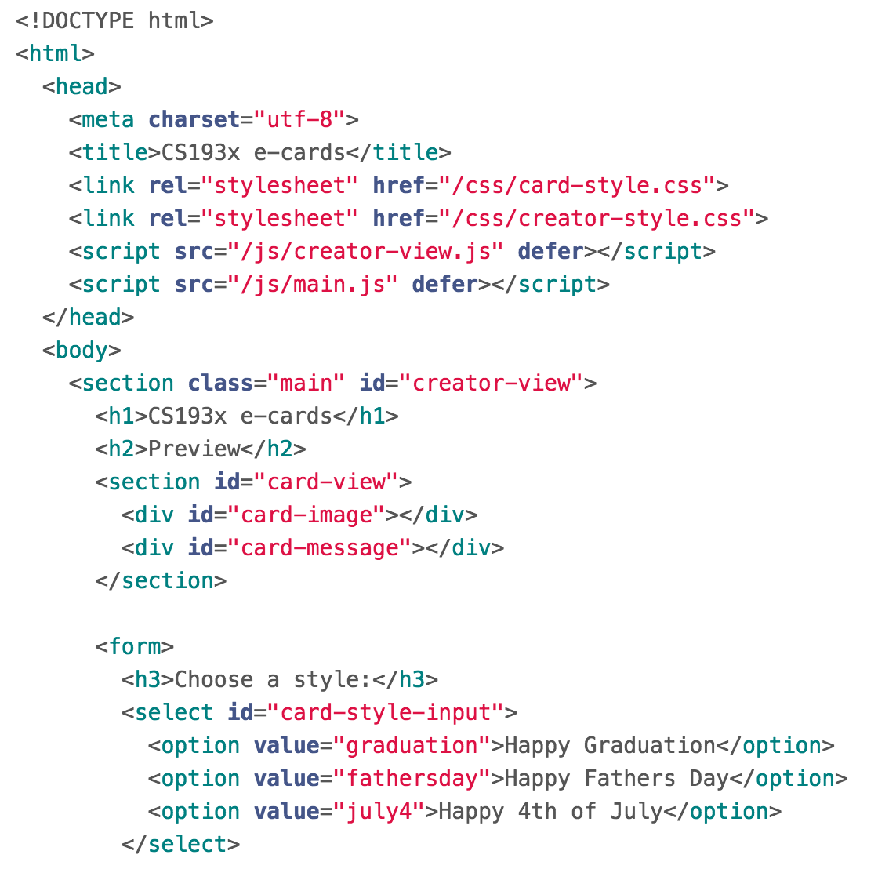
index.handlebars
This is the same contents of index.html with no placeholders, since there were no placeholders needed:

Slide 80
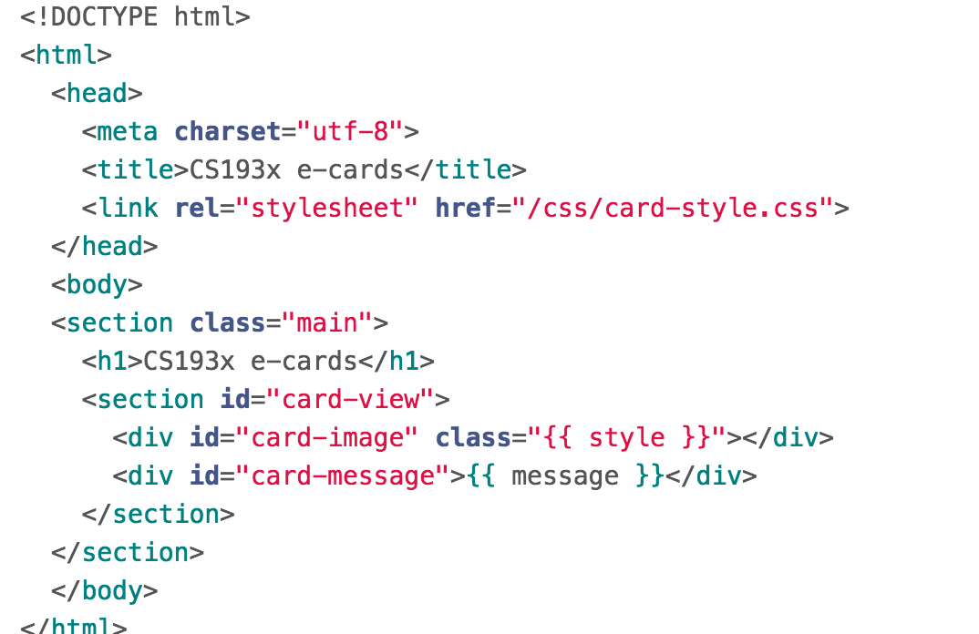
card.handlebars
But for the card-view, we want a different card style and message depending on the card:

Slide 81
card.handlebars
But for the card-view, we want a different card style and message depending on the card:

Slide 82
E-cards: Server-side rendering
Setting up NodeJS to use Handlebars and adding templates does nothing on its own. To use the templates, we need to call res.render:
function onGetMain(req, res) {
res.render('index');
}
app.get('/', onGetMain);
res.render(viewName, placeholderDefs)
Returns the HTML stored in "views/viewName.handlebars" after replacing the placeholders, if they exist

Slide 83
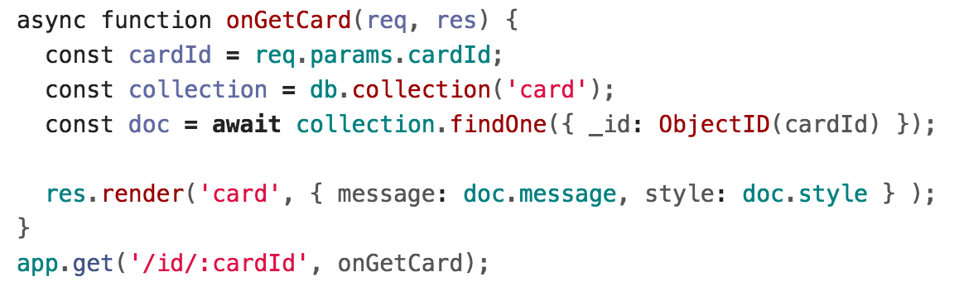
E-cards: Server-side rendering
For retrieving the card, we have placeholders we need to fill in, so we define the placeholder values in the second parameter:

Slide 84
Single-page web app

Slide 85
Single page web app
The server always sends the same one HTML file for all requests to the web server.
The server is configured so that requests to /id/<card_id> would still return e.g. index.html.
The client JavaScript parses the URL to get the route parameters and initialize the app.
GET localhost:3000/
index.html

Slide 86
Single page web app
The server always sends the same one HTML file for all requests to the web server.
The server is configured so that requests to /id/<card_id> would still return e.g. index.html.
The client JavaScript parses the URL to get the route parameters and initialize the app.
GET id/2338242394
index.html

Slide 87
Single page web app
Another way to think of it:
You configure several JSON routes for your server
You embed all your view into index.html
You use JavaScript to switch between the views
GET id/2338242394
index.html

