Slide 1
4102165: Full Stack Web Development Fundamentals
Spring 2019
簡立仁 Li-Ren Chien
ccumouse@gmail.com

Slide 2
Today's schedule
Today
Mobile events
Simple CSS animations
Classes and objects in JavaScript
this keyword and bind
HW2 due; HW3 assigned

Slide 3

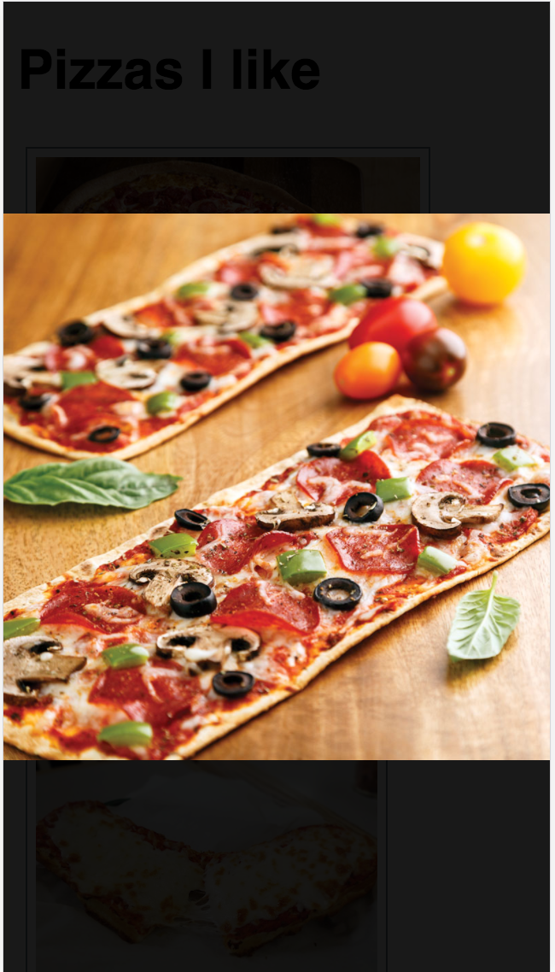
Custom swipe events
There are no gesture events in JavaScript (yet).
That means there is no "Left Swipe" or "Right Swipe" event we can listen to. (Note that drag does not do what we want, nor does it work on mobile)
To get this behavior, we must implement it ourselves.
Next
Previous

Slide 4
transform
transform is a strange but powerful CSS property that allow you to translate, rotate, scale, or skew an element.
transform: translate(x, y) | Moves element relative to its natural position by x and y
transform: translateX(x) | Moves element relative to its natural position horizontally by x
transform: translateY(y) | Moves element relative to its natural position vertically by y
transform: rotate(deg) | Rotates the element clockwise by deg
transform: rotate(10deg) translate(5px, 10px); | Rotates an element 10 degrees clockwise, moves it 5px down, 10px right
Examples

Slide 5
translate vs position
Can't you use relative or absolute positioning to get the same effect as translate? What's the difference?
translate is much faster
translate is optimized for animations
See comparison (article):
Absolute positioning (click "10 more macbooks")
transform: translate (click "10 more macbooks")

Slide 6

Dragon walk
Let's make it possible to drag this dragon across the sidewalk:
CodePen

Slide 7

preventDefault()
On desktop, there's a default behavior for dragging an image, which we need to disable with event.preventDefault():

Slide 8

Dragon walk bug (buggy code)
174px
Our dragon is already translated in the X direction by 174px...

Slide 9
Dragon walk bug (buggy code)
174px
100px
So if we drag again….
originX
event.clientX

Slide 10
Dragon walk bug (buggy code)
100px
Our buggy code moves our dragon from where it originally started, rather than from its newly translated position

Slide 11
Dragon walk bug fix
174px
100px
What we actually want to do is move our dragon 100px from where it was last dragged.

Slide 12
Dragon walk bug fix
174px
100px
What we actually want to do is move our dragon 100px from where it was last dragged.
Fixed code: CodePen

Slide 13
setPointerCapture()
To listen to pointer events that occur when the pointer goes offscreen, call setPointerCapture on the target you want to keep tracking:
event.currentTarget.setPointerCapture(event.pointerId);

Slide 14

2-D dragon walk
We can make our dragon move in both the X and Y direction using the same technique for the Y-direction:
Solved CodePen for 2-D walk

Slide 15
Back to our photo album example

Slide 16
style attribute
The style attribute has higher precedence than any CSS property.
To undo a style set via the style attribute, you can set it to the empty string:
element.style.transform = '';
Now the element will be styled according to any rules in the CSS file(s).

Slide 17
(requestAnimationFrame)
(We are missing one key piece of getting smooth dragging motion, which is: requestAnimationFrame
However, using requestAnimationFrame well requires us to know a little bit more about the JavaScript event loop. Functional programming also helps. We'll get there next week!)

Slide 18
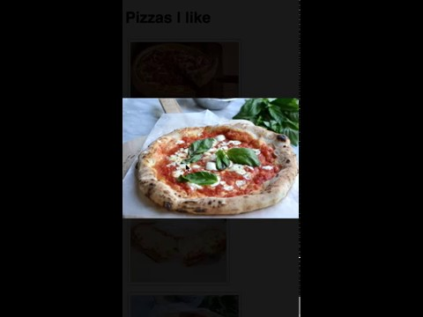
Photo album jerkiness
It feels a little jerky when we swipe through photos:

Slide 19
Softening the edges
This is mostly a perception issue. We can make the UI feel a little smoother if we added some animations.
The image should slide in from the left if we are going to the previous picture
The image should slide in from the right if we are going to the next picture
Next
Previous

Slide 20
CSS animations

Slide 21
CSS animations syntax
@keyframes animation-name { from {
CSS styles
}
to {
CSS styles
}
}
Then set the following CSS property:
animation: animation-name duration;
Examples

Slide 22
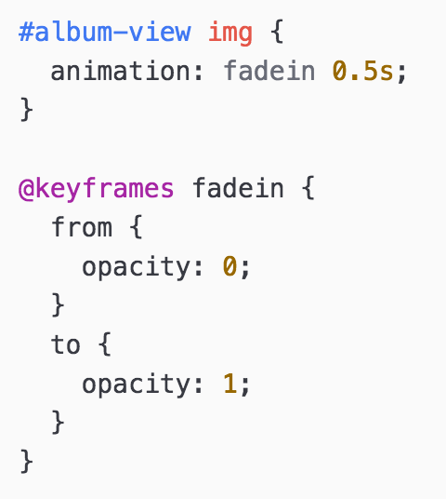
Example: Fade in

Slide 23
CSS animations events
You can listen to animation events (mdn):
animationstart: fires at the beginning of the animation
animationend: fires at the end of the animation
const image = document.querySelector('img');
image.addEventListener('animationstart', onStart);
image.addEventListener('animationend', onEnd);
image.classList.add('fade-grow');
CodePen example

Slide 24
CSS animations
There are all kinds of customizations (mdn):
Set multiple keyframes
Set keyframes by percentage
Make animations repeat
Make animations alternate
Change the timing function
Also note that not all CSS is animatable: see list
Fancy CodePen example
(credit CSS tricks -- check out their article for more details)

Slide 25
CSS transitions
You can also set a CSS transition on an element, which controls the animation speed of a changing CSS property (mdn)
transition: Ns;
CodePen example

Slide 26
Finished result: photo-mobile-finished.html

Slide 27
Classes in JavaScript

Slide 28
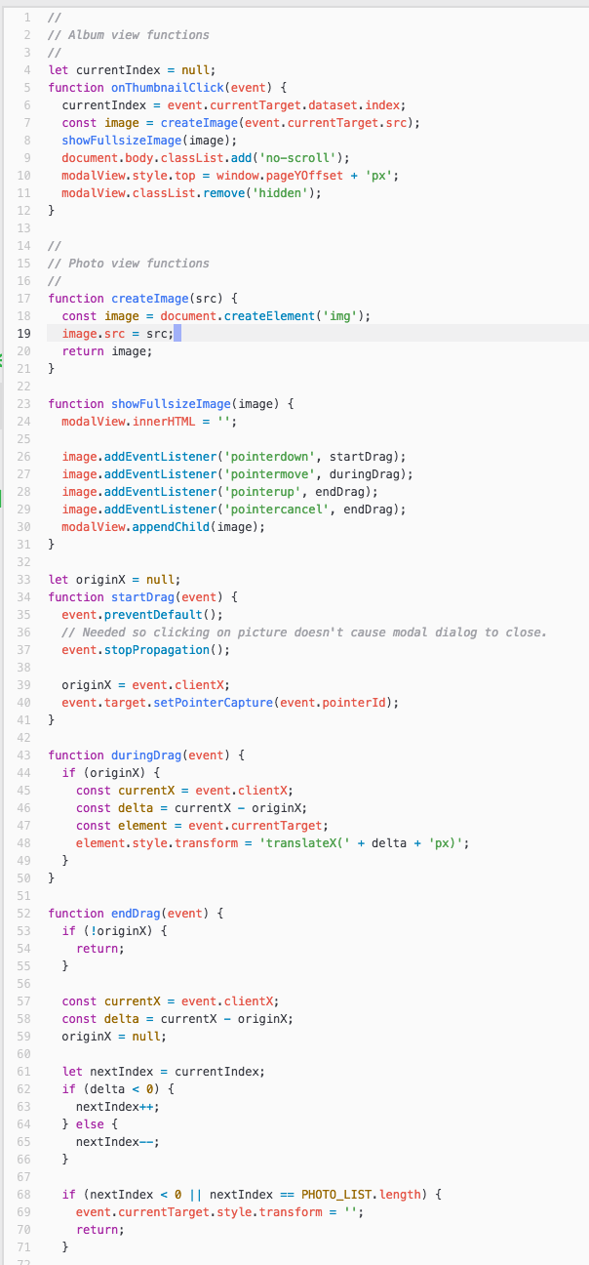
Amateur JavaScript
So far the JavaScript code we've been writing has looked like this:
Mostly all in one file
All global functions
Global variables to save state between events
It would be nice to write code in a modular way...

Slide 29
ES6 classes
We can define classes in JavaScript using a syntax that is similar to Java or C++:
class ClassName {
constructor(params) {
...
}
methodName() {
...
}
methodName() {
...
}
}
These are often called "ES6 classes" or "ES2015 classes" because they were introduced in the EcmaScript 6 standard, the 2015 release
Recall that EcmaScript is the standard; JavaScript is an implementation of the EcmaScript standard

Slide 30
Wait a minute...
Wasn't JavaScript created in 1995?
And classes were introduced… 20 years later in 2015?
Q: Was it seriously not possible to create classes in JavaScript before 2015?!

Slide 31
Objects in JavaScript
In JavaScript, there are several ways to create blueprints for objects. Two broad approaches:
Functional
This approach has existed since the creation of the JavaScript
Weird syntax for people used to languages like Java, C++, Python
Doesn't quite behave the same way as objects in Java, C++, Python
Classical
This is the approach that just got added to the language in 2015
Actually just "syntactic sugar" over the functional objects in JavaScript, so still a little weird
But syntax is much more approachable

Slide 32
Objects in JavaScript
In JavaScript, there are several ways to create blueprints for objects. Two broad approaches:
Functional
This approach has existed since the creation of the JavaScript
Weird syntax for people used to languages like Java, C++, Python
Doesn't quite behave the same way as objects in Java, C++, Python
Classical
This is the approach that just got added to the language in 2015
Actually just "syntactic sugar" over the functional objects in JavaScript, so still a little weird
But syntax is much more approachable
This approach is quite controversial.

Slide 33
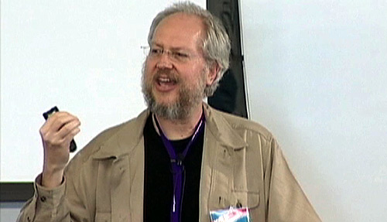
Class controversy
"There is one thing I am certain is a bad part, a very terribly bad part, and that is the new class syntax [in JavaScript]... [T]he people who are using class will go to their graves never knowing how miserable they were." (source)
-- Douglas Crockford, author of JavaScript: The Good Parts; prominent speaker on JavaScript; member of TC39 (committee that makes ES decisions)

Slide 34
Functional approach: next week!
Today:
We will check out ES6 classes.
Next week:
We will explore "functional JavaScript," allowing us to understand a way to create object factories without classes.
In this class:
We will use ES6 classes because the syntax is significantly simpler.

Slide 35
Back to classes!

Slide 36
Public methods
class ClassName {
constructor(params) {
...
}
methodName() {
...
}
methodName() {
...
}
}
constructor is optional.
Parameters for the constructor and methods are defined in the same they are for global functions.
You do not use the function keyword to define methods.

Slide 37
Public methods
class ClassName {
constructor(params) {
...
}
methodOne() {
this.methodTwo();
}
methodTwo() {
...
}
}
Within the class, you must always refer to other methods in the class with the this. prefix.

Slide 38
Public methods
class ClassName {
constructor(params) {
...
}
methodName() {
...
}
methodName() {
...
}
}
All methods are public, and you cannot specify private methods… yet.

Slide 39
Public methods
class ClassName {
constructor(params) {
...
}
methodName() {
...
}
methodName() {
...
}
}
As far as I can tell, private methods aren't in the language only because they are still figuring out the spec for it. (They will figure out private fields first.)

Slide 40
Public fields
class ClassName {
constructor(params) {
this.fieldName = fieldValue;
this.fieldName = fieldValue;
}
methodName() {
this.fieldName = fieldValue;
}
}
Define public fields by setting this.fieldName in the constructor… or in any other function.
(This is slightly hacky underneath the covers and there is a draft to add public fields properly to ES.)

Slide 41
Public fields
class ClassName {
constructor(params) {
this.someField = someParam;
}
methodName() {
const someValue = this.someField;
}
}
Within the class, you must always refer to fields with the this. prefix.

Slide 42
Public fields
class ClassName {
constructor(params) {
this.fieldName = fieldValue;
this.fieldName = fieldValue;
}
methodName() {
this.fieldName = fieldValue;
}
}
You cannot define private fields… yet.
(Again, there are plans to add add private fields to ES once the spec is finalized.)

Slide 43
Private class/fields
ES6 introduced classes to JavaScript, but they’re too simplistic for complex applications. Class fields (also referred to as class properties) aim to deliver simpler constructors with private and static members. The proposal is currently at TC39 stage 3: candidate and could appear in ES2019 (ES10).
Reference

Slide 44
Instantiation
Create new objects using the new keyword:
class SomeClass {
...
someMethod() { … }
}
const x = new SomeClass();
const y = new SomeClass();
y.someMethod();

Slide 45

Example: Present
Let's create a Present class inspired by our present example from last week.

Slide 46
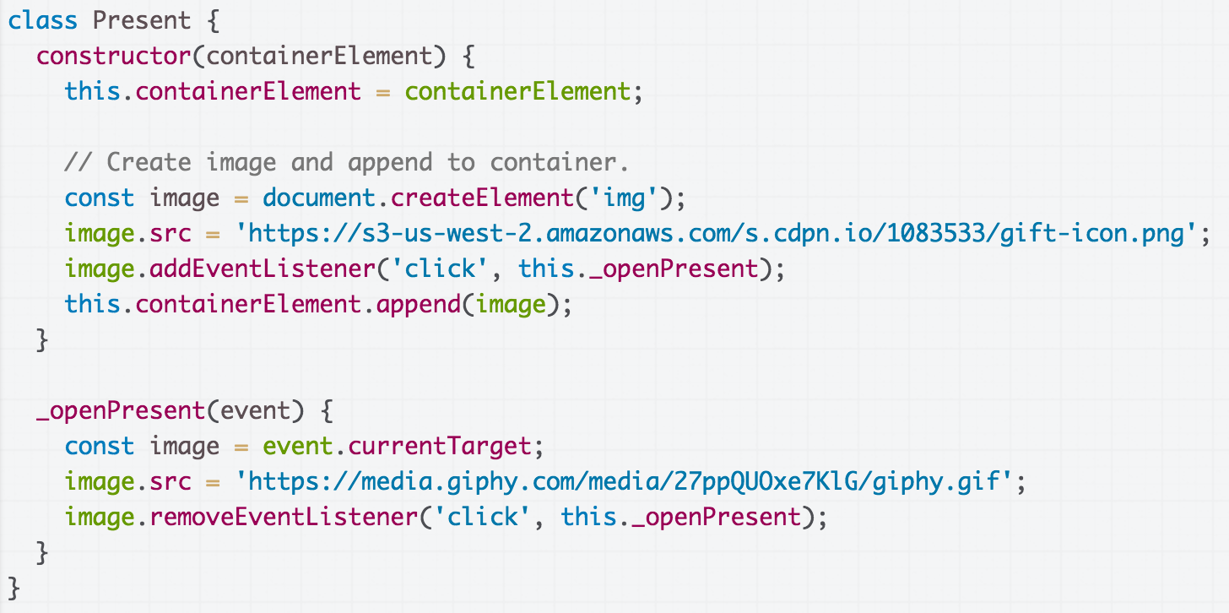
Present class
present.js

Slide 47
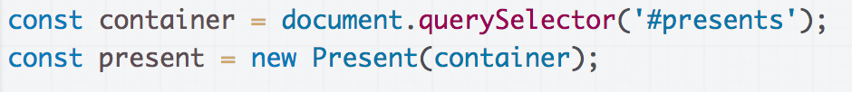
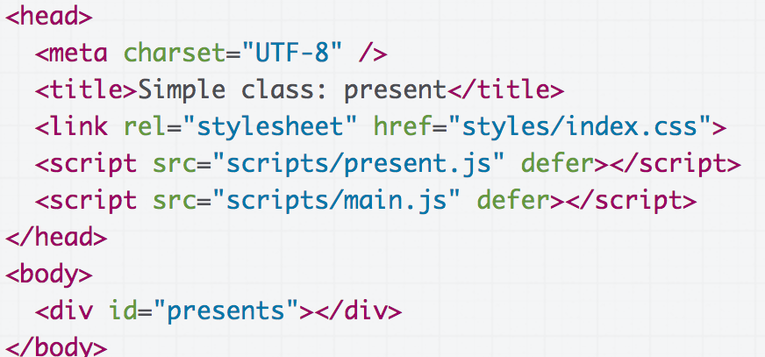
Present class
main.js
index.html

Slide 48
this in event handler
Right now we access the image we create in the constructor in _openPresent via event.currentTarget.

Slide 49
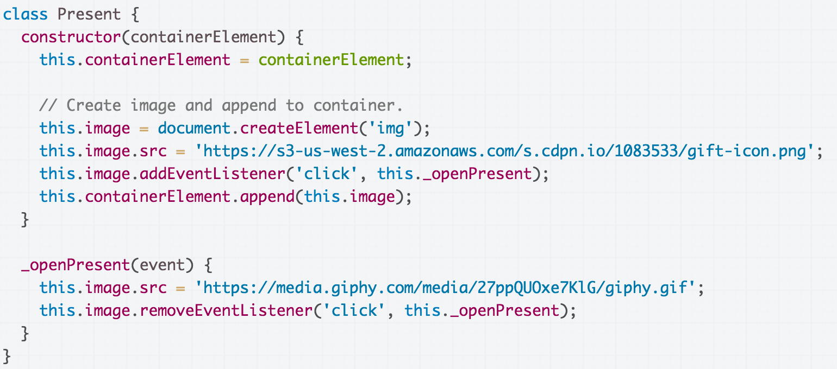
this in event handler
What if we make the image a field and access it _openPresent via this.image instead of event.currentTarget?

Slide 50
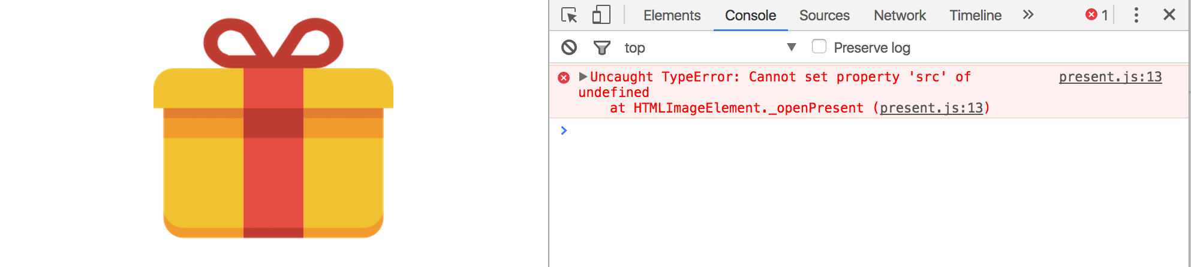
this in event handler
Error message!
CodePen / Debug
What's going on?

Slide 51
JavaScript this
The this keyword in JavaScript is dynamically assigned, or in other words: this means different things in different contexts (mdn list)
In our constructor, this refers to the instance
When called in an event handler, this refers to… the element that the event handler was attached to (mdn).

Slide 52
this in event handler
That means this refers to the <img> element, not the instance variable of the class...
...which is why we get this error message.

Slide 53
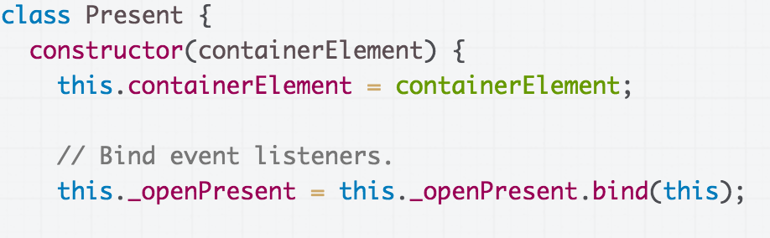
Solution: bind
To make this always refer to the instance object for a method in the class (i.e. to get this to behave as you'd expect), you can add the following line of code in the constructor:
this.methodName = this.methodName.bind(this);

Slide 54
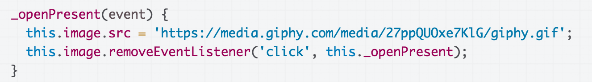

Solution: bind
Now this in the _openPresent method refers to the instance object (CodePen / Debug):
Moral of the story:
Don't forget to bind() event listeners in your constructor!!

Slide 55
One more time:
Don't forget to bind() event listeners in your constructor!!

Slide 56
Communicating between classes

Slide 57

Multiple classes
Let's say that we have multiple presents now (Live):

Slide 58
Multiple classes
And we have implemented this with two classes:
App: Represents the entire page
Present: Represents a single present
App
Has a list of Presents
Code.
Present
Present
Present
Present
Present

Slide 59

Communicating btwn classes
What if we want to change the title when all present have been opened? (Code)

Slide 60
Communicating btwn classes
You have three general approaches:
Move reference to App, static counter?? to Photo
DON'T go this route
Fire a custom event
OK (don't forget to bind)
Add onOpened "callback function" to Present
OK (don't foget to bind)

Slide 61
Custom Events
You can listen to and dispatch Custom Events to communicate between classes (mdn):
const event = new CustomEvent( eventNameString, optionalParameterObject);
element.addEventListener(eventNameString);
element.dispatchEvent(eventNameString);

Slide 62
Object-oriented photo album
Let's look at an object-oriented version of the photo album: CodePen / Debug
Album
Has a list of Thumbnails
Has a ModalScreen
Thumbnail
ModalScreen
Thumbnail
Thumbnail
Thumbnail
Thumbnail
Has a ModalPhoto
ModalPhoto

