Slide 1

iPhone Design Styleguide
Porsche Center Dubai – Virtual Promoter 18/07/2016

Slide 2
General definitions
Font for headlines, dividers: Franklin Gothic Condensed
Font for content elements: Arial Regular
Text color: #000000
Background color: #ffffff
Porsche red: #cc0000
Headline background color: #f8f8f8
Menu bar background color: #deeded
Divider lines, position indicator dots: #cccccc
Subheadline (e.g. price overview): #999999
only portrait mode is supported

Slide 3

Splash Screen
white background
big Porsche logo centered (vertically and horizontally)

Slide 4
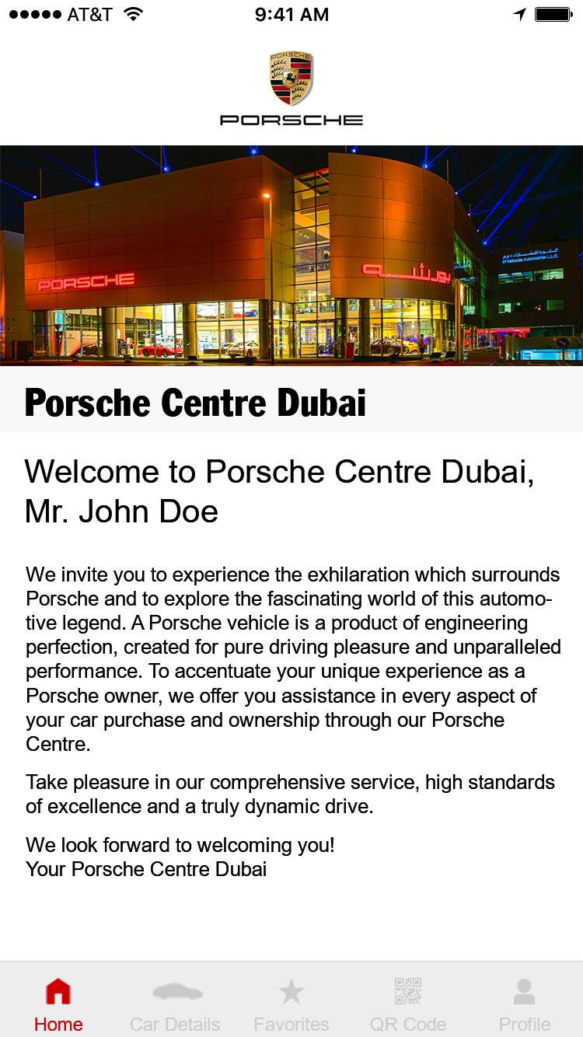
Home
centered on white #ffffff background
scaled to 100% width
Franklin Gothic Condensed, #000000
Background #f8f8f8
Background #ffffff
Arial Regular, #000000, left-aligned
Highlight color: #cc0000
Arial Regular
Color: #cccccc
Arial Regular
Background #deeded
Menu bar is positioned fixed

Slide 5
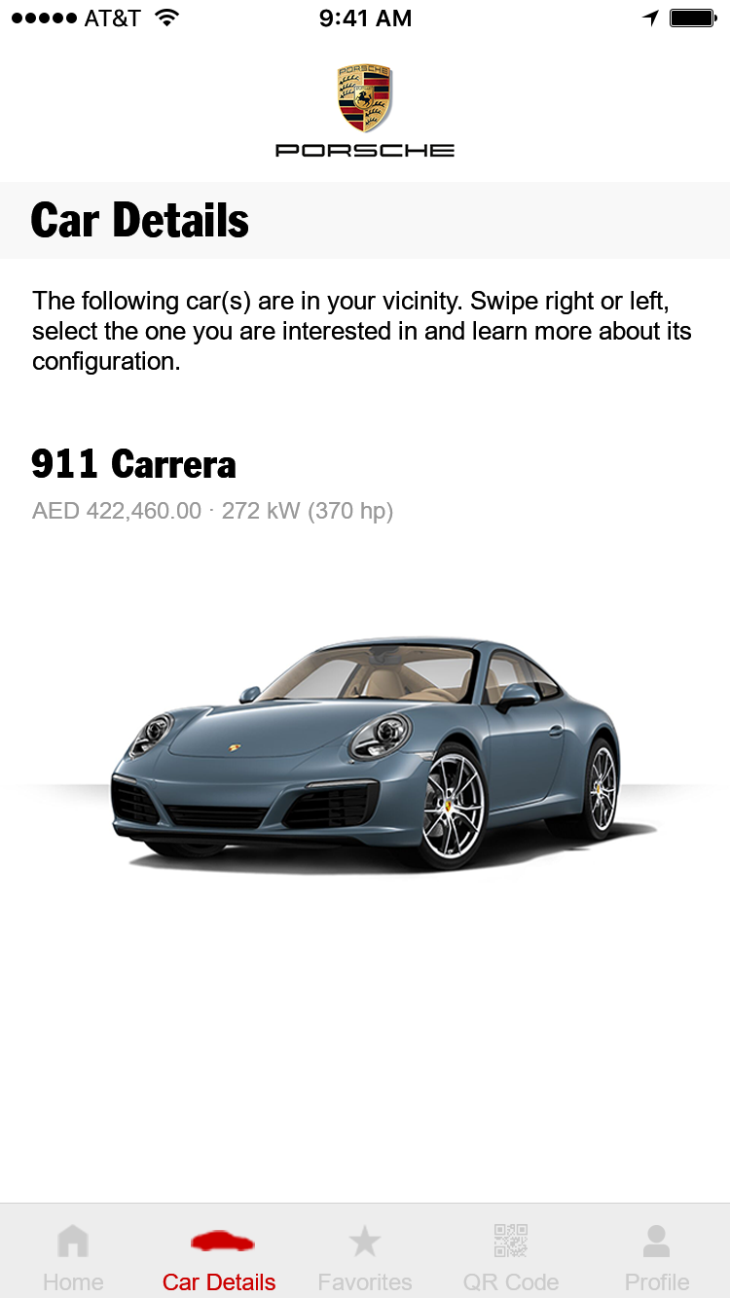
Car Details – Car Selection
Franklin Gothic Condensed, #000000
Background #f8f8f8
Arial Regular, #000000, left-aligned
Franklin Gothic Condensed, #000000
Arial Regular, #999999
scaled to 100% width
Background #ffffff
Note: if there is more than one car in the user‘s vicinity, then there is a pagination (see later in Favorites)

Slide 6
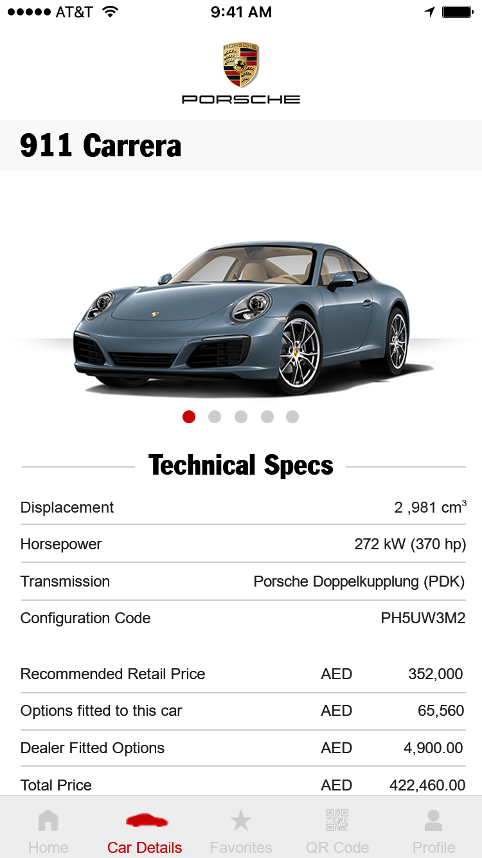
Car Details – Page 1
Franklin Gothic Condensed, #000000, fixed position
Background #f8f8f8
image: scaled to 100% width
background: #ffffff
Active dot: #cc0000, non-active dot: #cccccc
Line color: #cccccc
Franklin Gothic Condensed, #000000
Arial Regular, right-aligned, #000000
Arial Regular, left-aligned, #000000

Slide 7
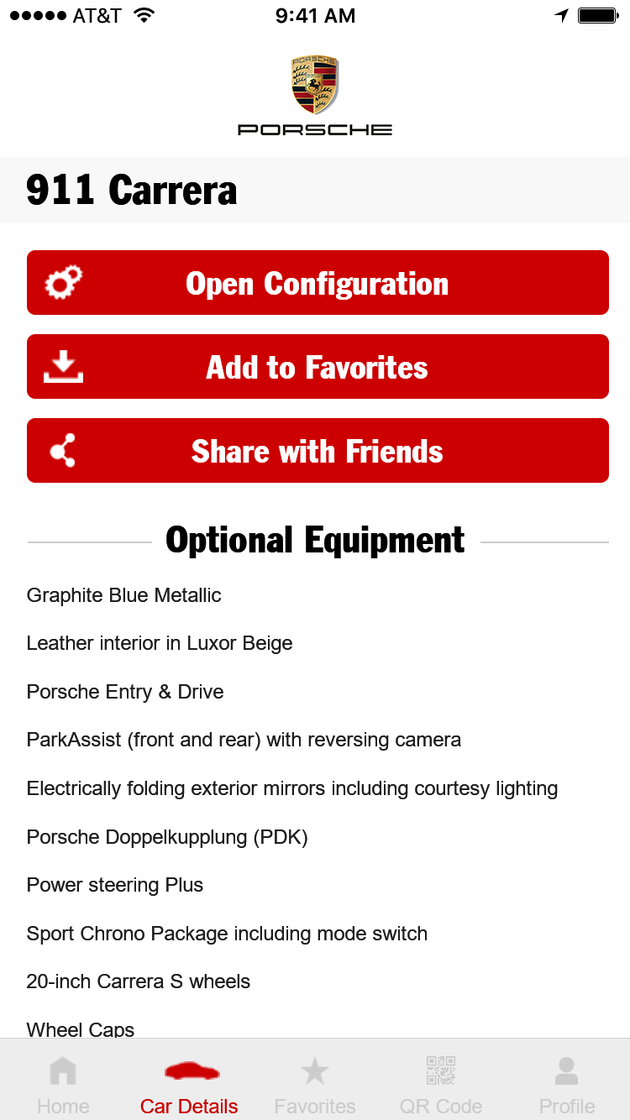
Car Details – Page 2
Franklin Gothic Condensed, #000000, fixed position
Background #f8f8f8
text: Franklin Gothic Condensed, #ffffff
background: #cc0000
rounded corners: 3px radius
Line color: #cccccc
Franklin Gothic Condensed, #000000
Arial Regular, left-aligned, #000000

Slide 8
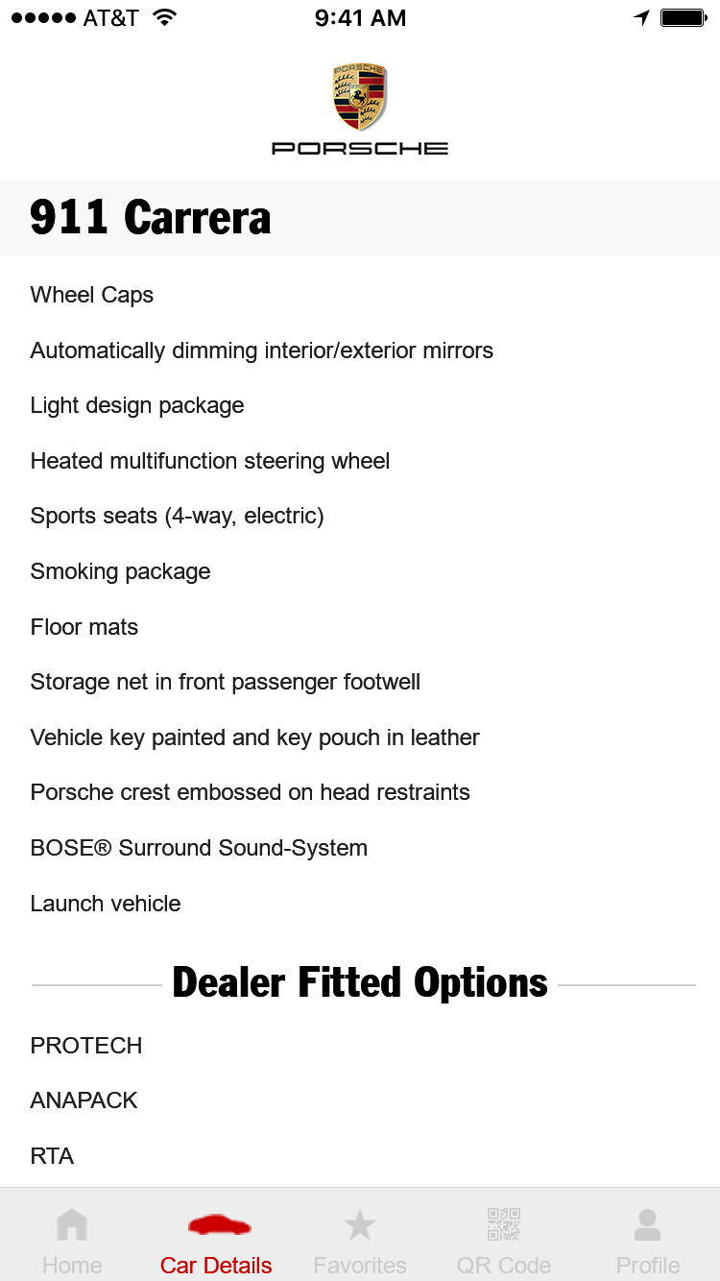
Car Details – Page 3
Franklin Gothic Condensed, #000000, fixed position
Background #f8f8f8
Arial Regular, left-aligned, #000000
Franklin Gothic Condensed, #000000
Line color: #cccccc
Arial Regular, left-aligned, #000000

Slide 9
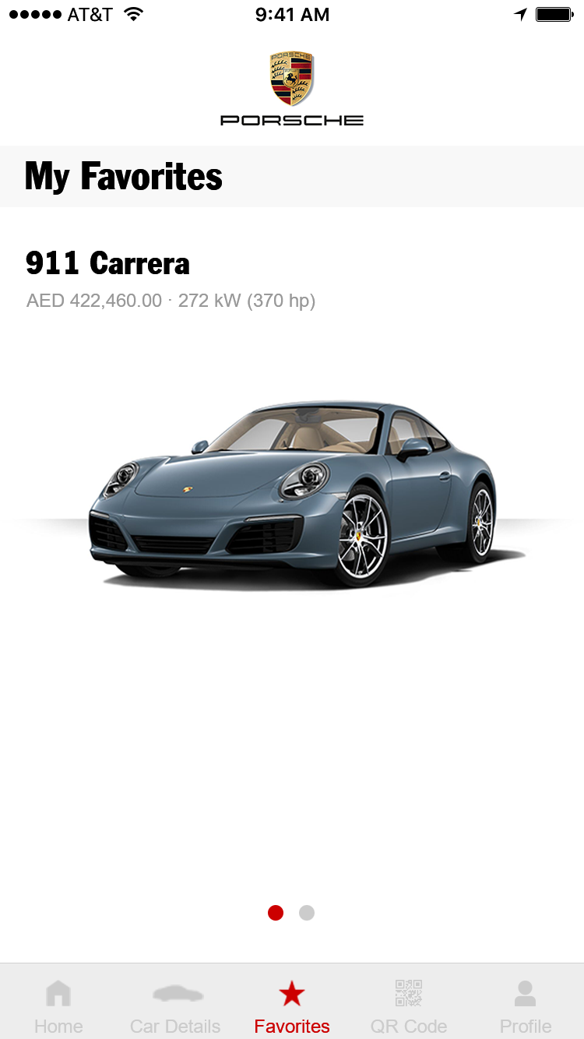
Favorites
Franklin Gothic Condensed, #000000, fixed position
Background #f8f8f8
Franklin Gothic Condensed, #000000
Arial Regular, #999999
scaled to 100% width
Active dot: #cc0000, non-active dot: #cccccc
Note: if the user has more than one favorite car, then there is a slider (left/right) with which the user can browser through the cars

Slide 10
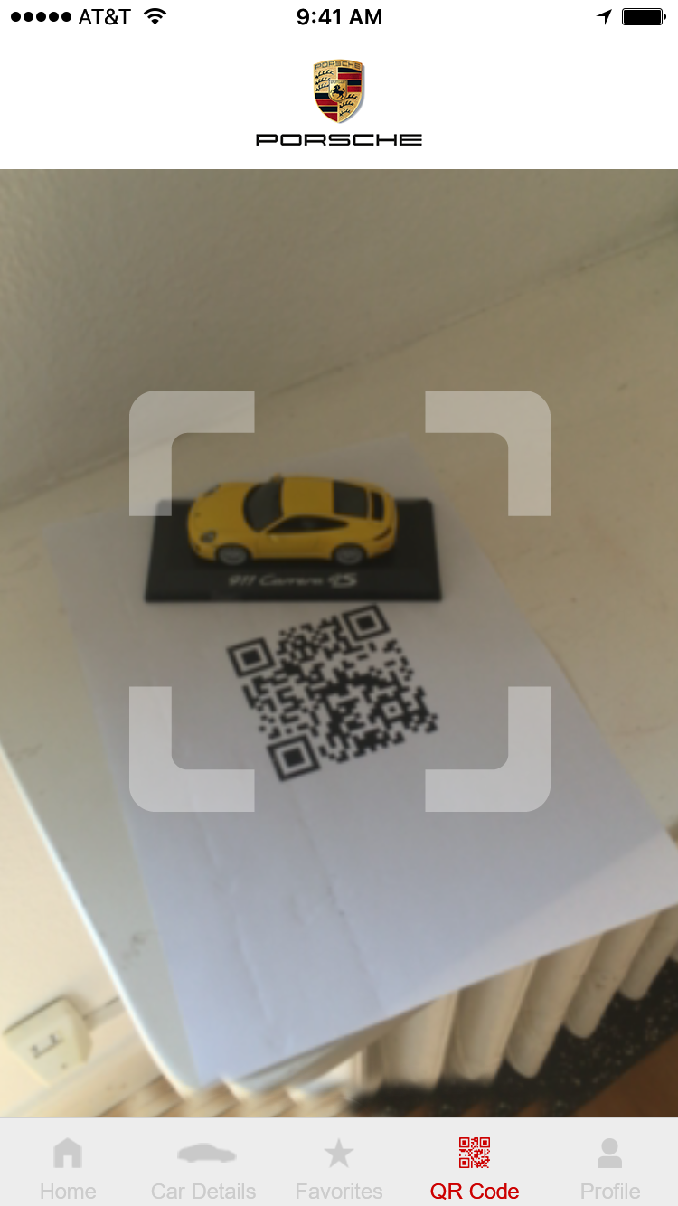
QR-Code Reader
device camera picture is shown in the middle
navigation and logo bar are fixed

Slide 11
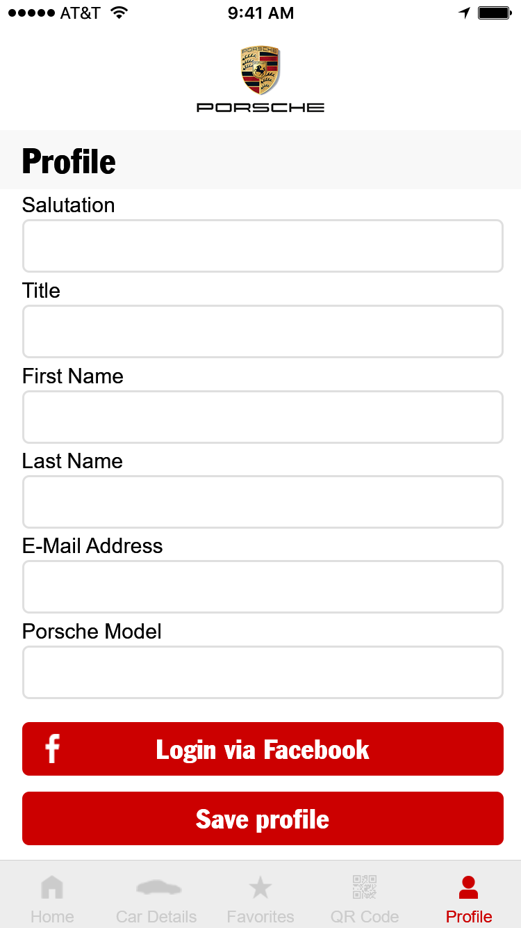
Profile – Page 1
Franklin Gothic Condensed, #000000, fixed position
Background #f8f8f8
Arial Regular, left-aligned, #000000
Input field: background #ffffff
border #dfdfdf, rounded corners with 3px radius
text: Franklin Gothic Condensed, #ffffff
background: #cc0000
rounded corners: 3px radius

Slide 12
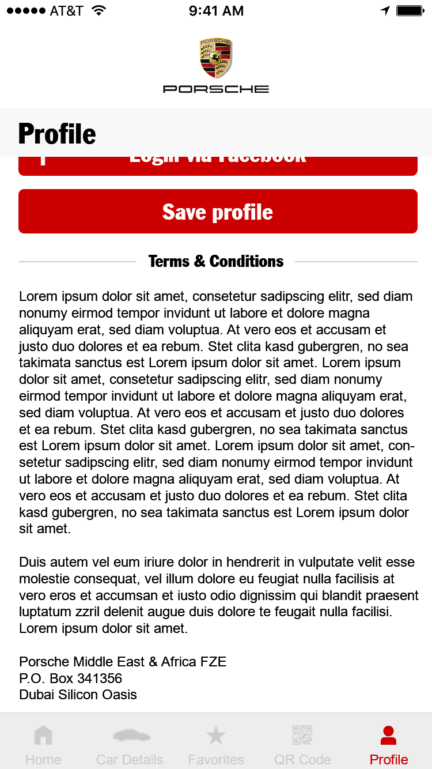
Profile – Page 2
Franklin Gothic Condensed, #000000, fixed position
Background #f8f8f8
Franklin Gothic Condensed, #000000
Line color: #cccccc
Arial Regular, left-aligned, #000000

Slide 13

Tutorial – Step 1
Arial Regular, #000000
Skip
Animation sequence (PNG or video)
Franklin Gothic Condensed, #000000
Arial Regular, centered, #000000
text: Franklin Gothic Condensed, #ffffff
background: #cc0000
rounded corners: 3px radius
Active dot: #cc0000, non-active dot: #cccccc
Background #ffffff

Slide 14
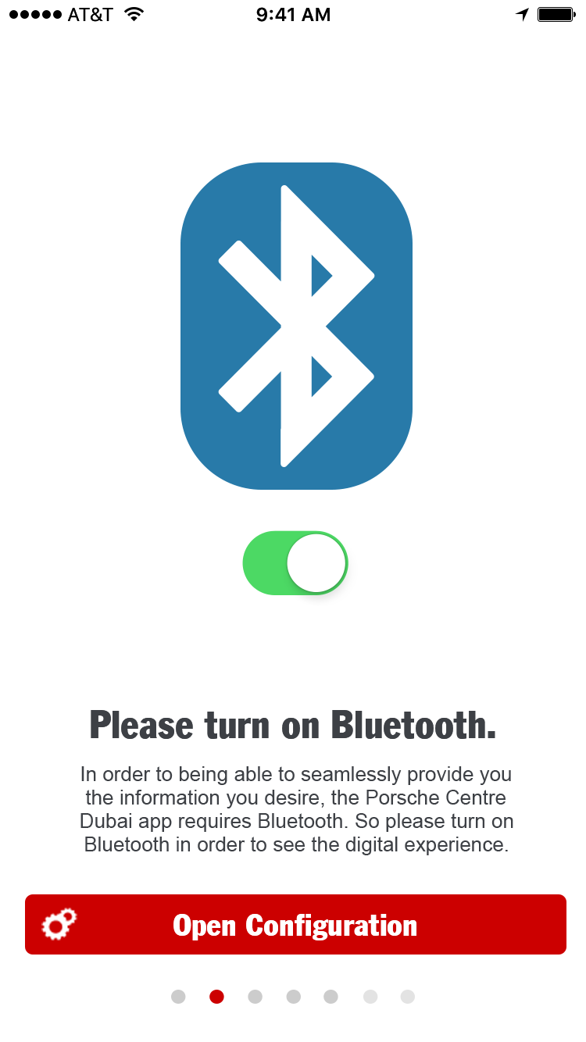
Tutorial – Step 2
Arial Regular, #000000
Skip
Animation sequence (PNG or video)
Franklin Gothic Condensed, #000000
Arial Regular, centered, #000000
text: Franklin Gothic Condensed, #ffffff
background: #cc0000
rounded corners: 3px radius
Active dot: #cc0000, non-active dot: #cccccc
Background #ffffff

Slide 15

Tutorial – Step 3
Arial Regular, #000000
Skip
Animation sequence (PNG or video)
Franklin Gothic Condensed, #000000
Arial Regular, centered, #000000
Active dot: #cc0000, non-active dot: #cccccc
Background #ffffff

Slide 16
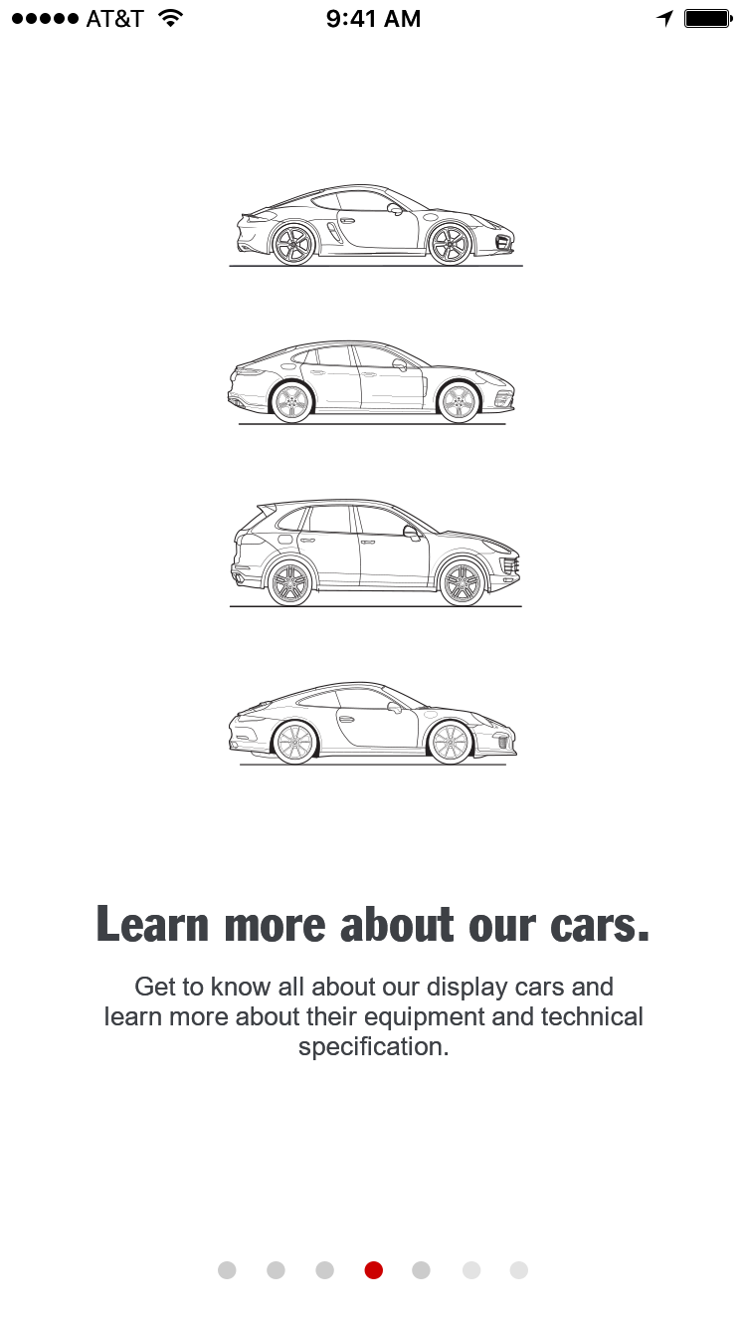
Tutorial – Step 4
Arial Regular, #000000
Skip
Animation sequence (PNG or video)
Franklin Gothic Condensed, #000000
Arial Regular, centered, #000000
Active dot: #cc0000, non-active dot: #cccccc
Background #ffffff

Slide 17
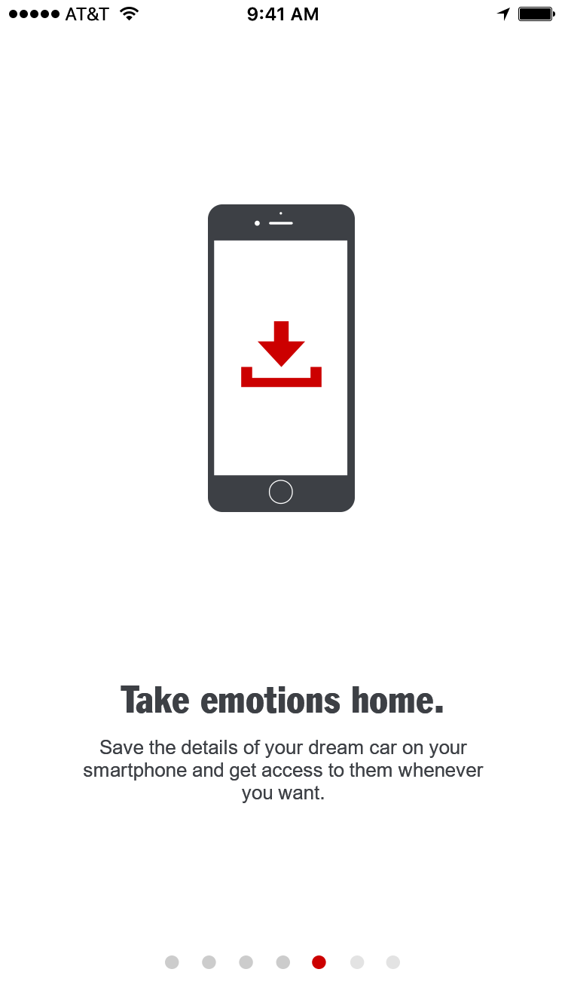
Tutorial – Step 5
Arial Regular, #000000
Skip
Animation sequence (PNG or video)
Franklin Gothic Condensed, #000000
Arial Regular, centered, #000000
Active dot: #cc0000, non-active dot: #cccccc
Background #ffffff

Slide 18
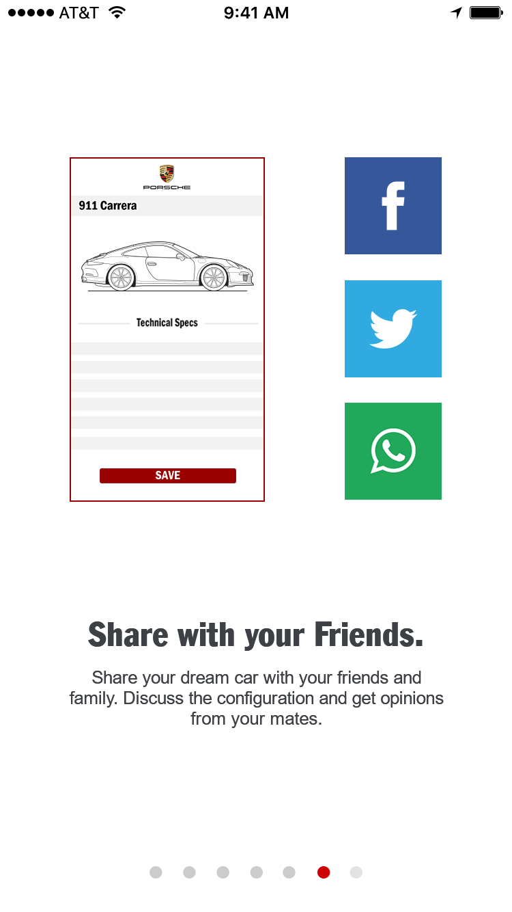
Tutorial – Step 6
Arial Regular, #000000
Skip
Animation sequence (PNG or video)
Franklin Gothic Condensed, #000000
Arial Regular, centered, #000000
Active dot: #cc0000, non-active dot: #cccccc
Background #ffffff

Slide 19
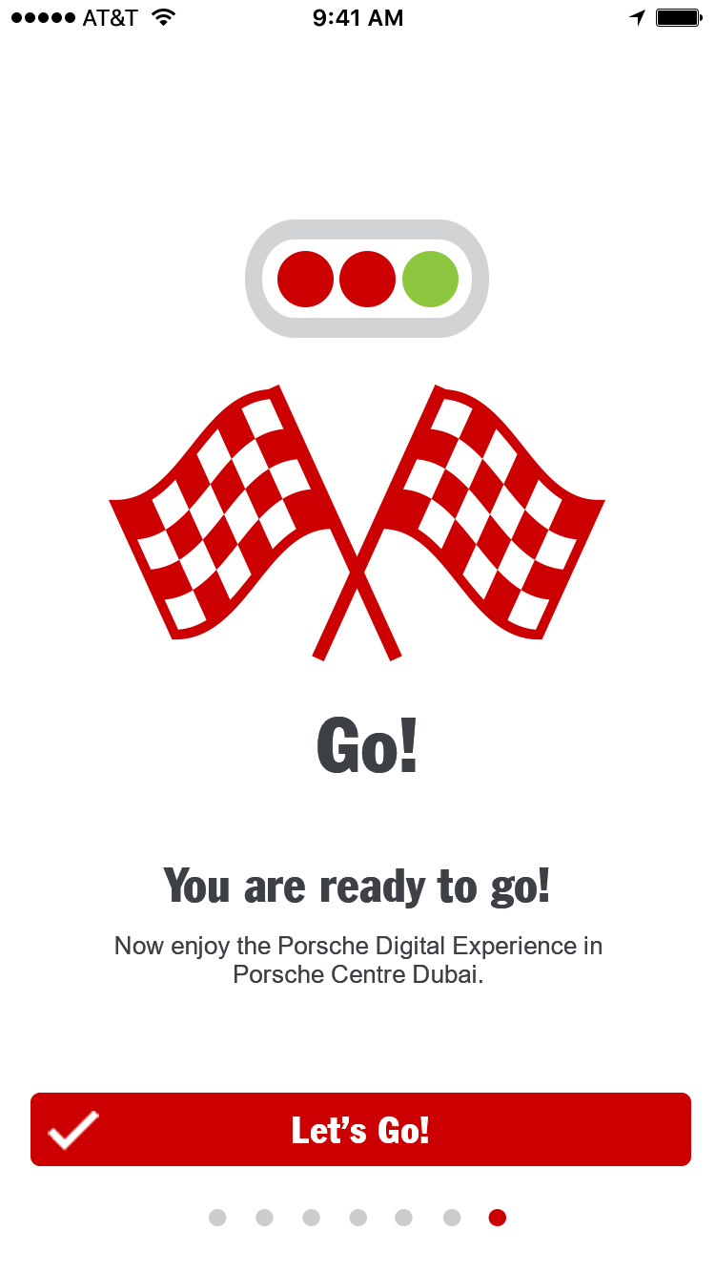
Tutorial – Step 7
Arial Regular, #000000
Skip
Animation sequence (PNG or video)
Franklin Gothic Condensed, #000000
Arial Regular, centered, #000000
text: Franklin Gothic Condensed, #ffffff
background: #cc0000
rounded corners: 3px radius
Active dot: #cc0000, non-active dot: #cccccc
Background #ffffff

