Slide 1


Slide 2


Slide 3
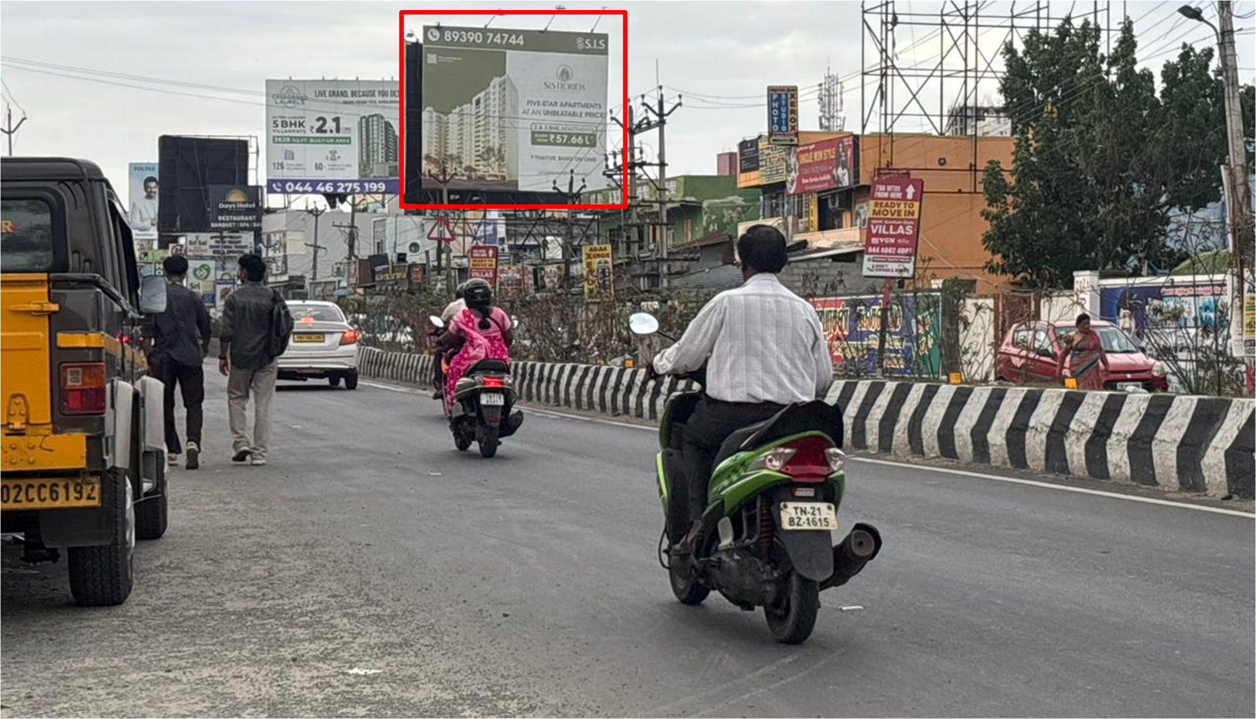
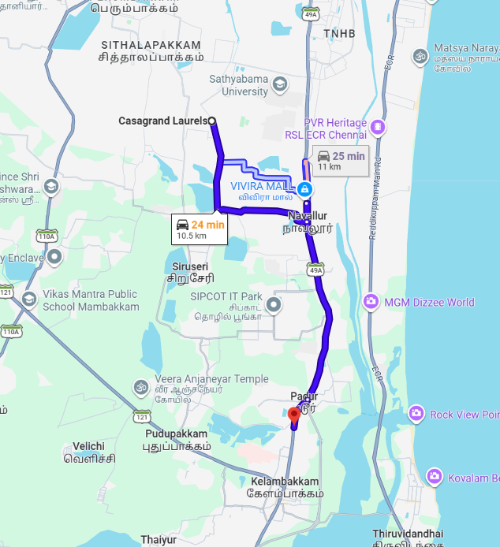


OMR Padur Nr. Hindustan College twds Solinganallur – 30x25

Slide 4
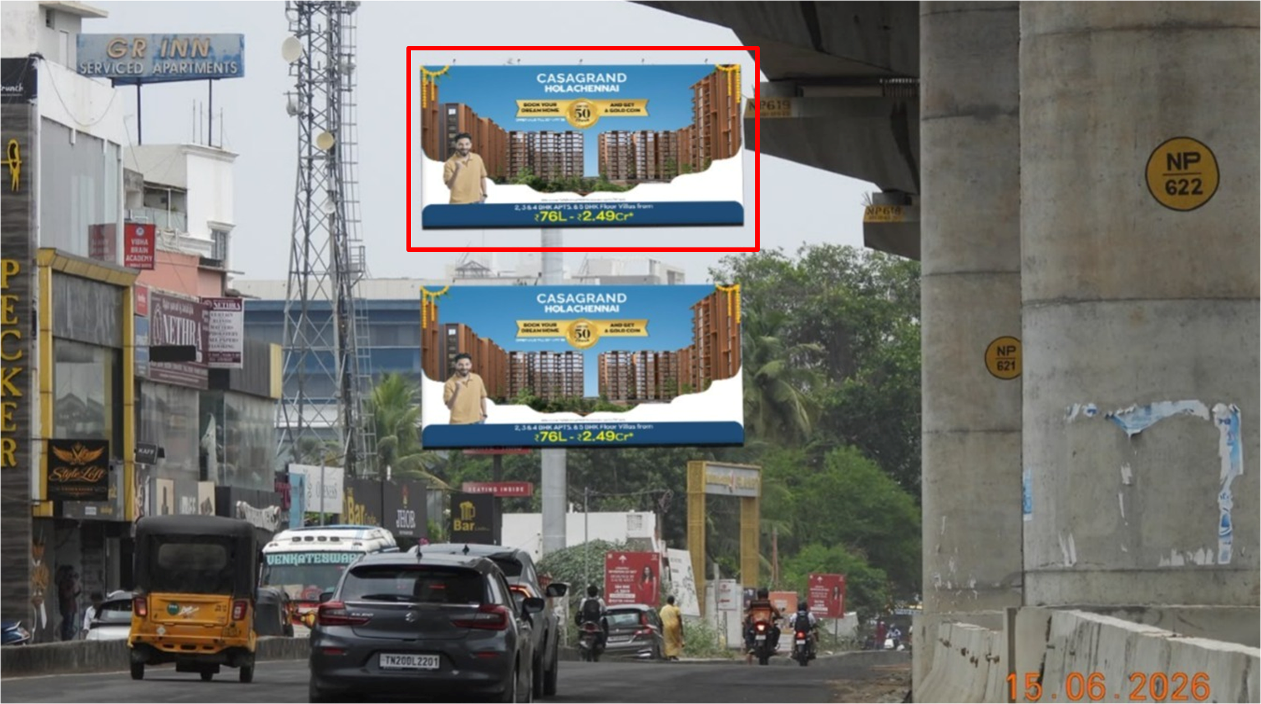
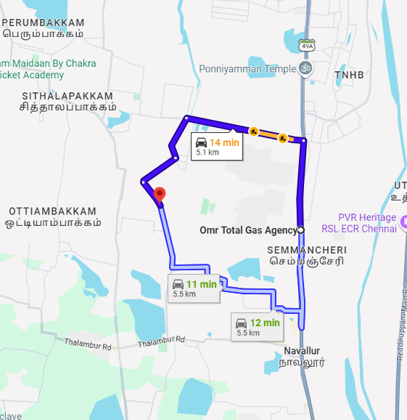
OMR Opp to Elite Grand Hotel towards Sholinganallur (Top)- 40x20

Slide 5


Our team is dedicated to providing the best
A swift response will help us ensure timely campaign execution.
Awaiting Your Approval...
Thank You!
With Regards
Adinn Outdoor Advertising

