Slide 1








OOH PROPOSAL
Date: Sep 14, 2026
Ajay
www.adinnoutdoors.com

Slide 2


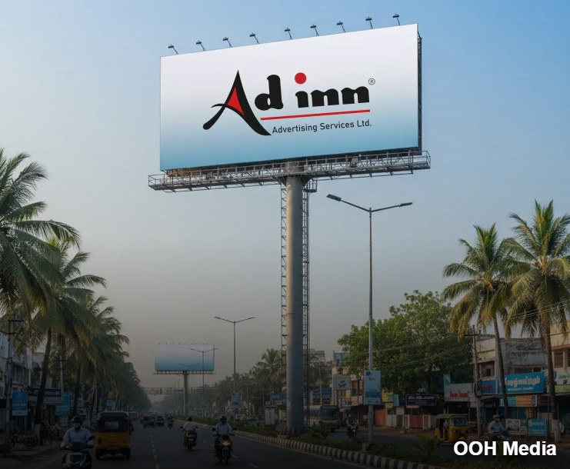

ABOUT US
Who we are
Adinn Outdoor owns over 550 outdoor ad spaces across Tamil Nadu and extends even outside the state. Our media network spans diverse formats from billboards to police booths and we have successfully amplified brand visibility and achieved tangible results. We make sure your brand is visible to the right people at the ideal time. With 25 Years of Excellence, we know where to put your ads to get the most impact. If you want to reach more people and expand the visibility of your ads, we’re here to help.

Slide 3


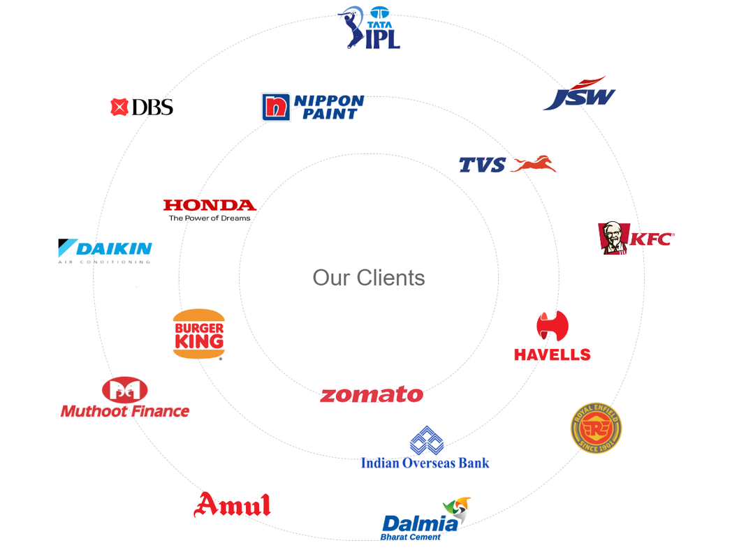




Why Leading Brands Choose Adinn Advertising
Prime, High-Impact Locations
Strategically positioned sites that maximize visibility and audience reach.
End-to-End Expertise
Seamless handling from planning and approvals to execution and maintenance.
Uncompromising Quality Standards
Premium materials and consistent upkeep that protect brand image.
Trusted Partnership
Clear pricing, timely delivery, and reliable communication throughout the campaign

Slide 4

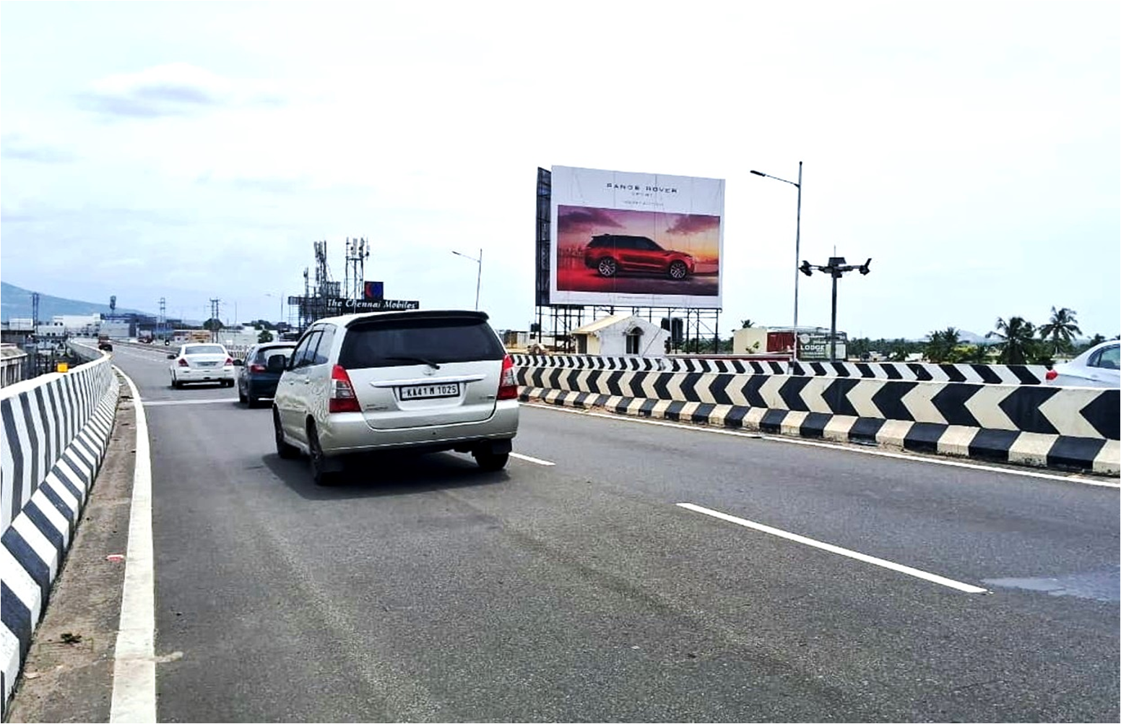
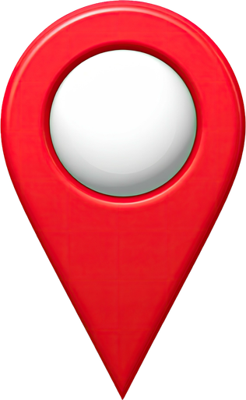
Sattur towards Madurai 40x25
Media Specifications
Who we are
City:
Sattur
Size:
40x25
Media type:
Unipole
Illumination:
Not Lit
Unit:
1

Slide 5
Sattur towards Tirunelveli 40x25
Media Specifications
Who we are
City:
Sattur
Size:
40x25
Media type:
Unipole
Illumination:
Not Lit
Unit:
1

Slide 6
ECR Road near Sri Sankars Vidayalaya Hr.Sec.School 40x25
Media Specifications
Who we are
City:
Pondicherry
Size:
40x25
Media type:
Hoarding
Illumination:
Not Lit
Unit:
1

Slide 7
Inside bus stand- Panrutti 20x20
Media Specifications
Who we are
City:
Panrutti
Size:
20x20
Media type:
Hoarding
Illumination:
Not Lit
Unit:
1

Slide 8
Palakodu 30x20
Media Specifications
Who we are
City:
Dharmapuri
Size:
30x20
Media type:
Hoarding
Illumination:
Not Lit
Unit:
1

Slide 9
Junjupalli Flyover towards Hosur 40x25
Media Specifications
Who we are
City:
Krishnagiri
Size:
40x25
Media type:
Unipole
Illumination:
Not Lit
Unit:
1

Slide 10



Our team is dedicated to providing the best
A swift response will help us ensure timely campaign execution.
Awaiting Your Approval...
Thank You!
With Regards
Adinn Outdoor Advertising
www.adinnoutdoors.com

