Slide 1




OOH PROPOSAL

Slide 2

Madurai

Slide 3
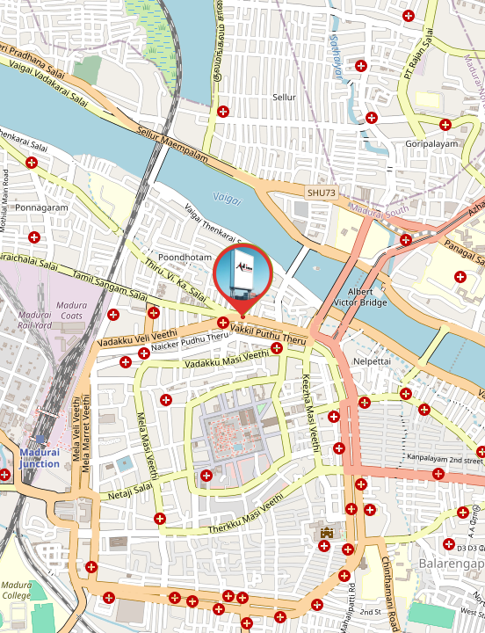

Queens Land 50x30

Slide 4


Our team is dedicated to providing the best A swift response will help us ensure timely campaign execution.
Awaiting Your Approval...
Thank You!
With Regards
Adinn Outdoor Advertising

