Slide 1


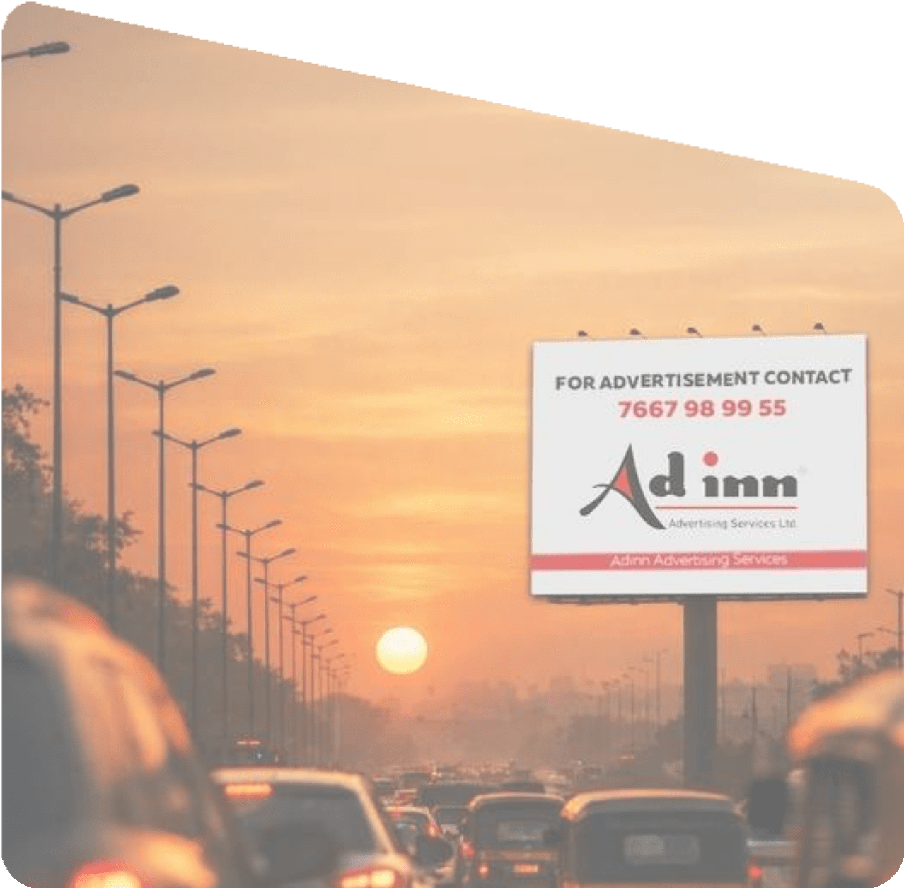

OOH PROPOSAL

Slide 2

Madurai

Slide 3
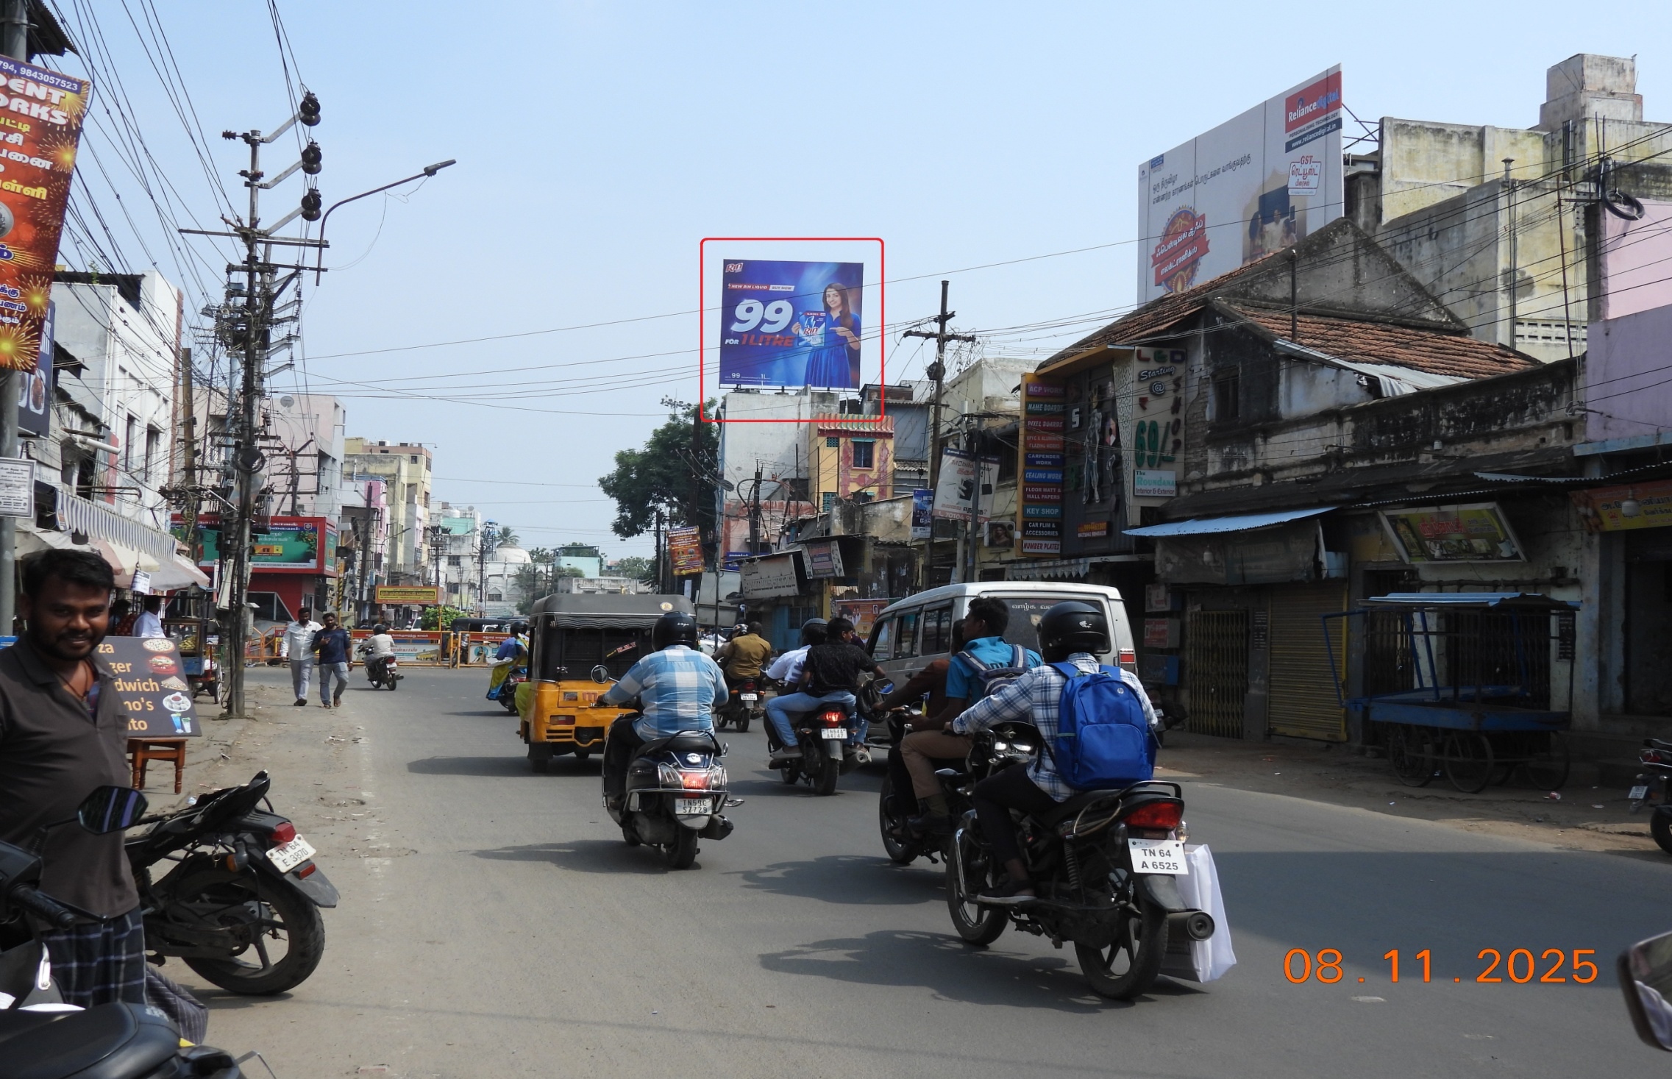
Yanaikkal junction 20x20

Slide 4
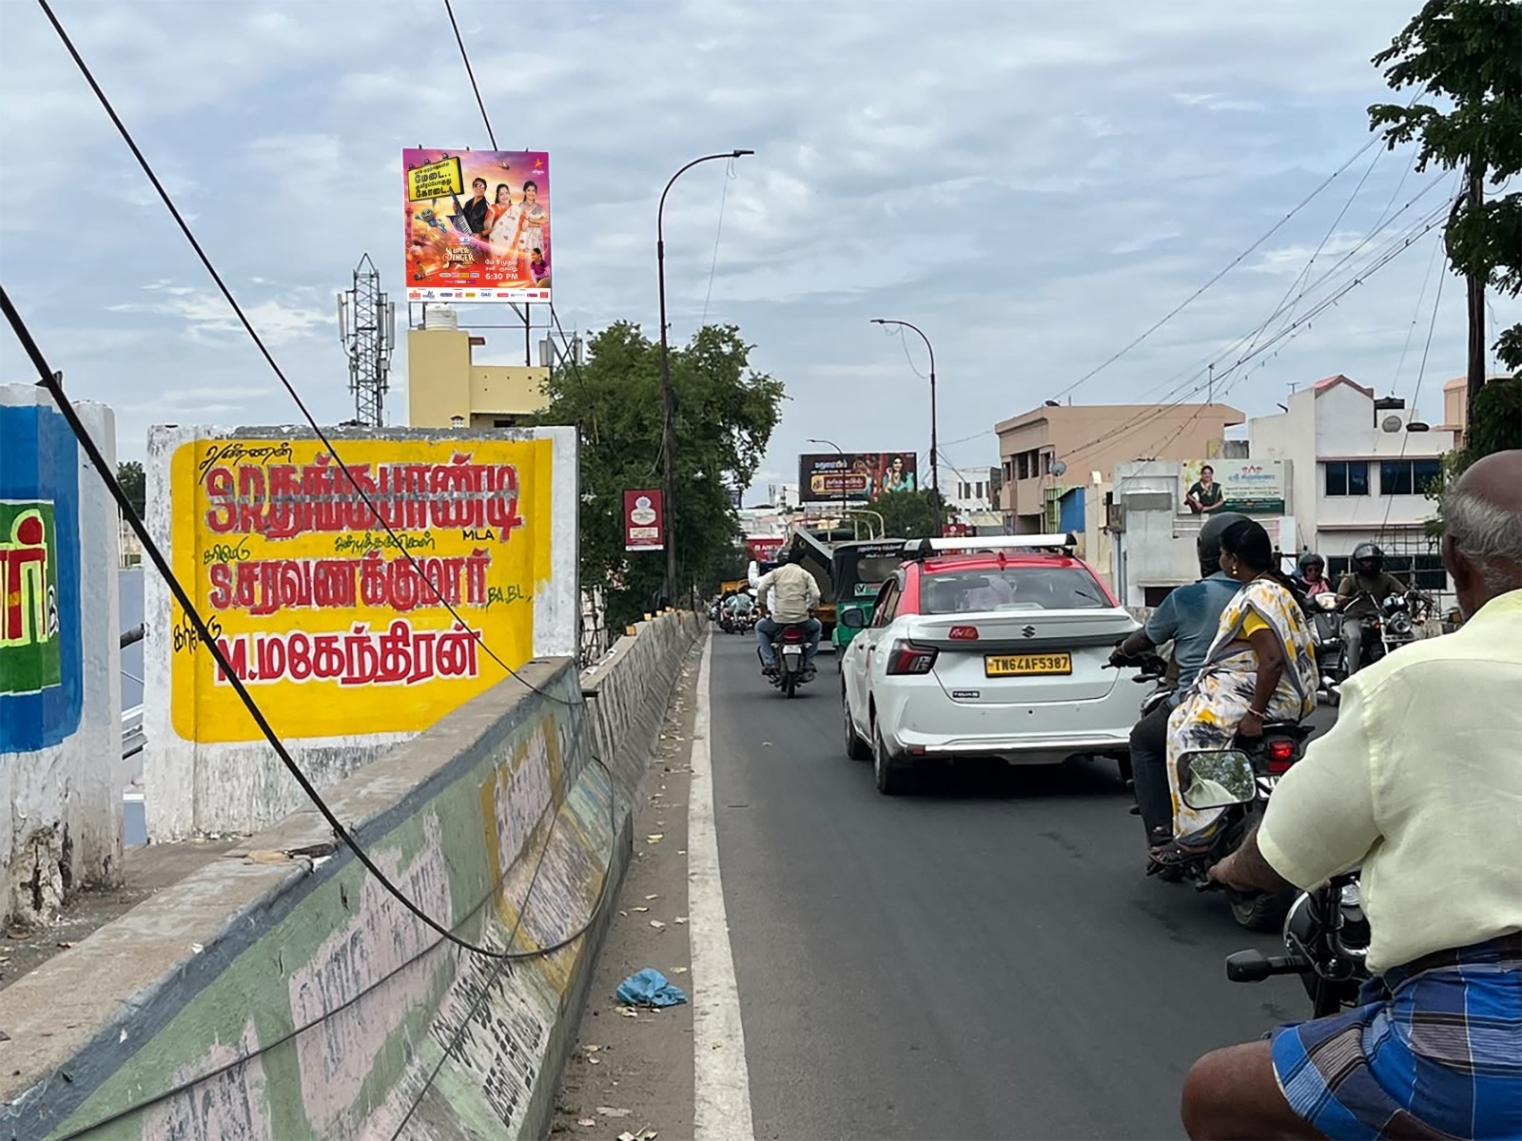
Simakkal Madura Coats Bridge towards Goripalayam 20X20

Slide 5
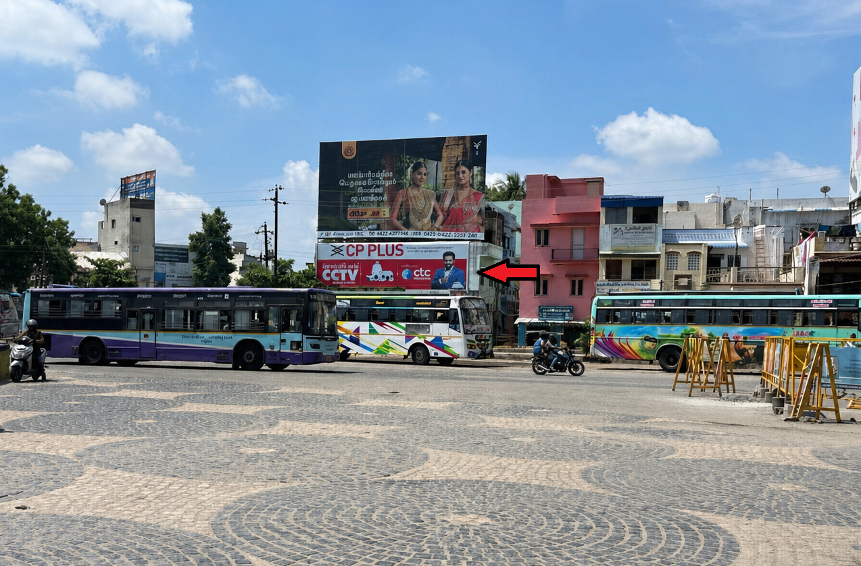
Arapalayam Bus stand 40X14

Slide 6
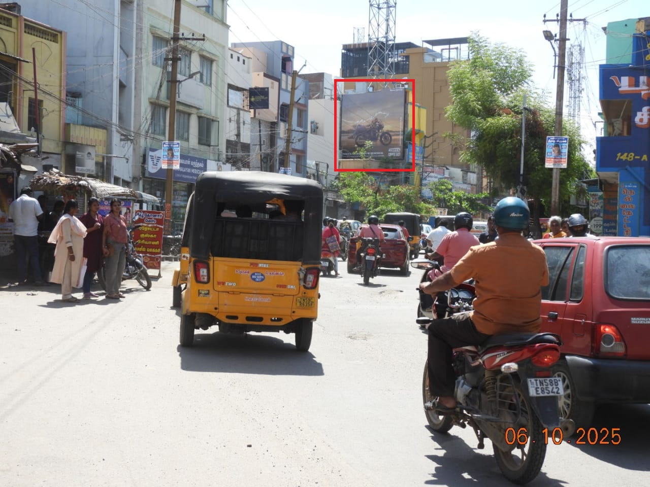
South Veli Street towards Periyar Bus Stand 20x20

Slide 7
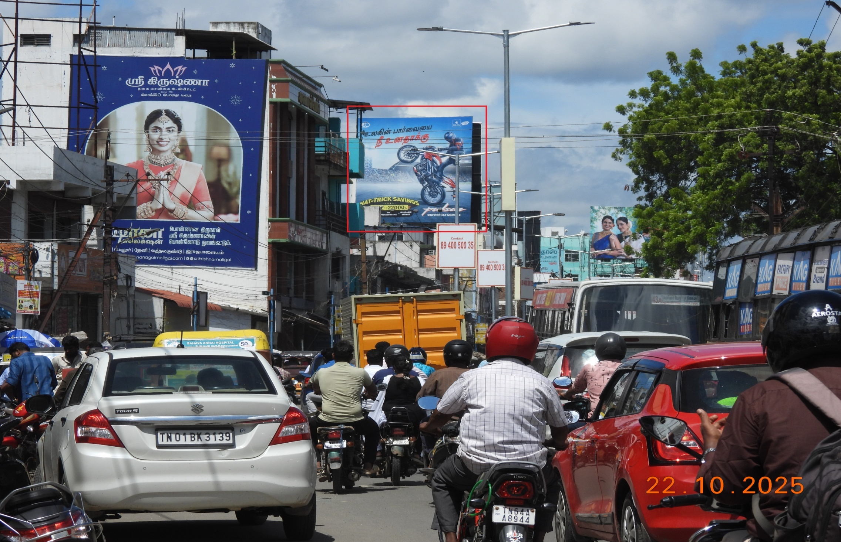
Arasaradi towards kalavasal Junction 25x25

Slide 8
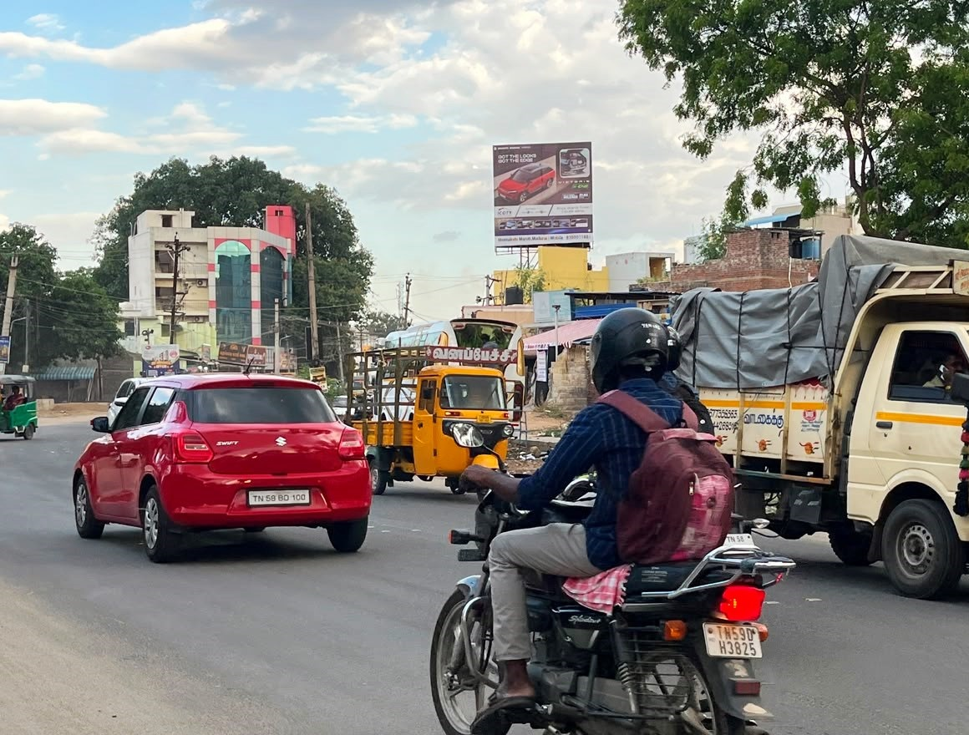
Nagamalai Pudhukottai(Virattipathu) towards Kalavasal 20X20

Slide 9
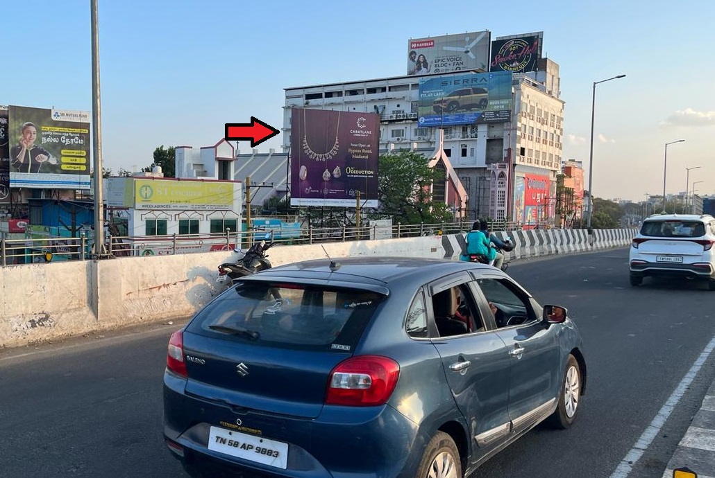
Kalavasal - Near Reliance Bazzar 25x25

Slide 10
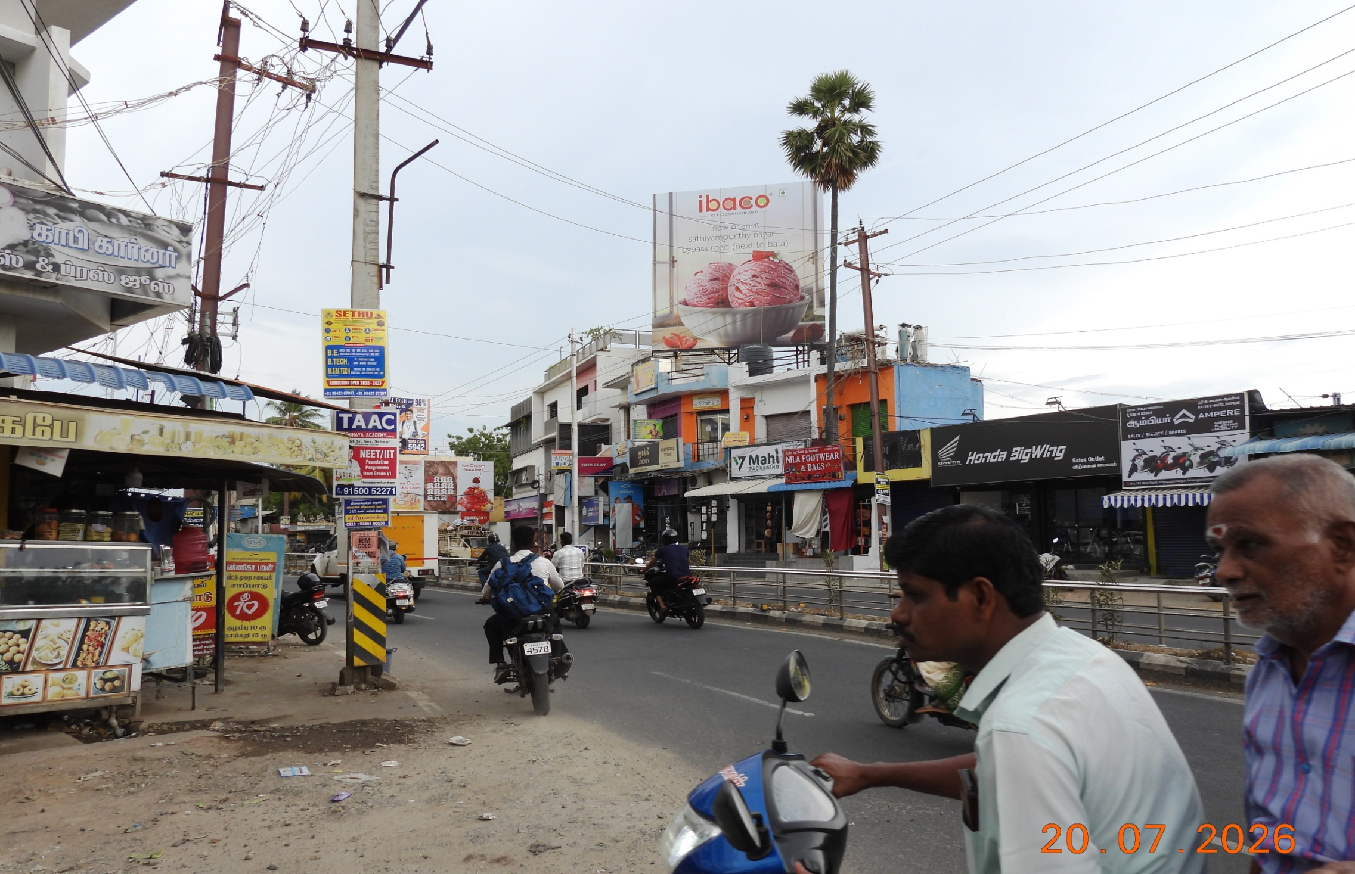
Alagappan Nagar towards Periyar 25X25

Slide 11
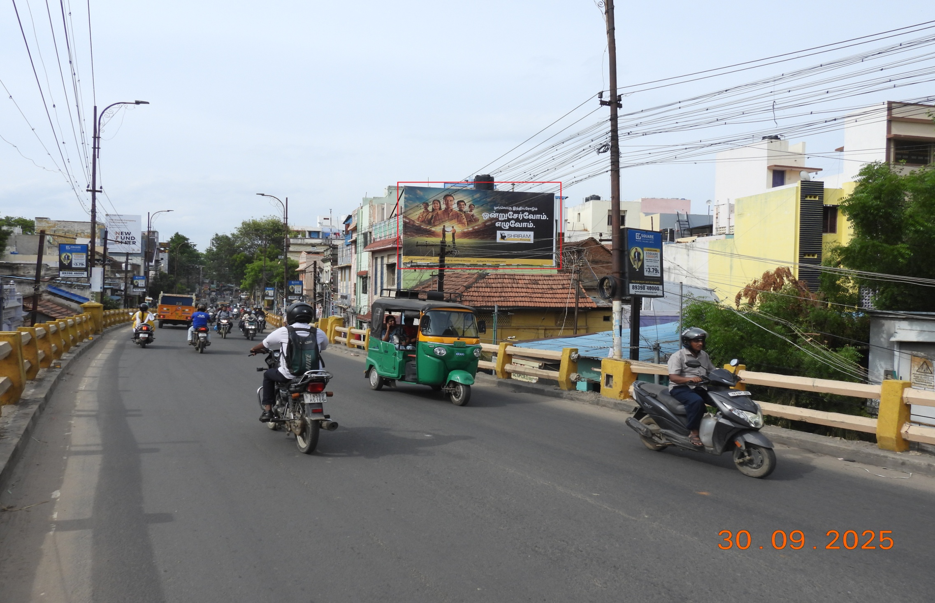
Southgate bridge 25x14

Slide 12
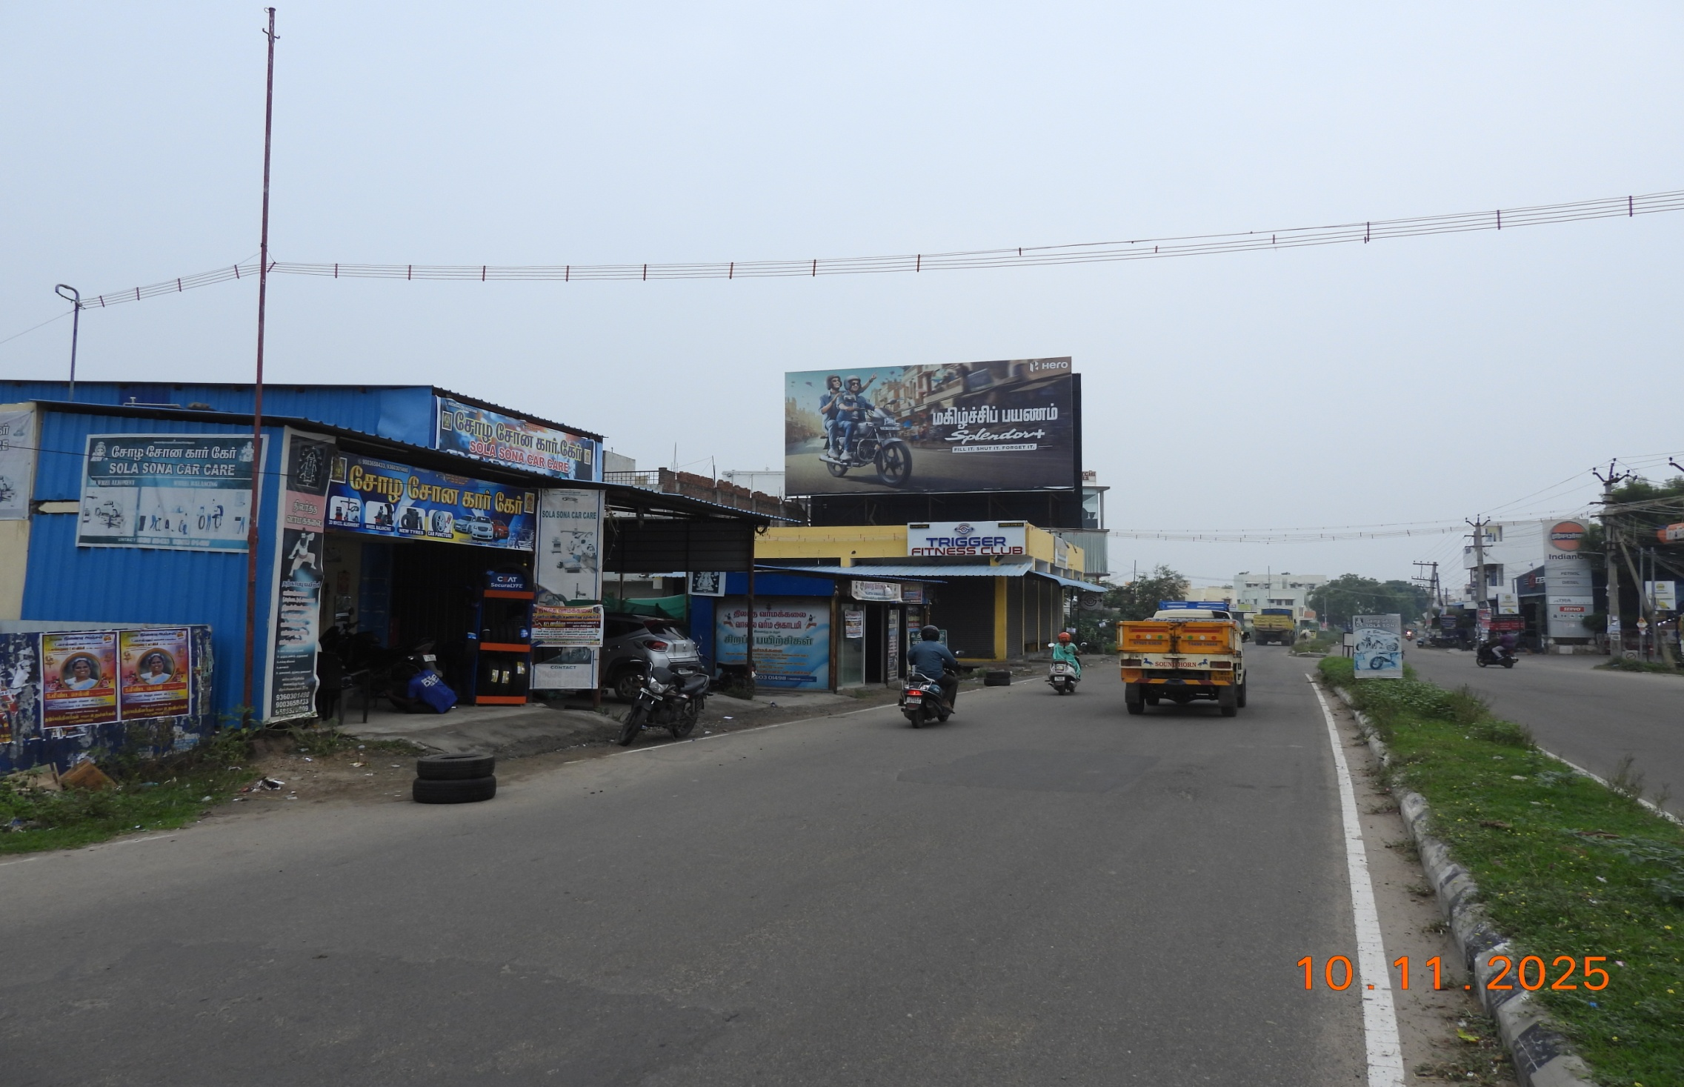
P&T Nagar towards Anaiyur 40X20

Slide 13
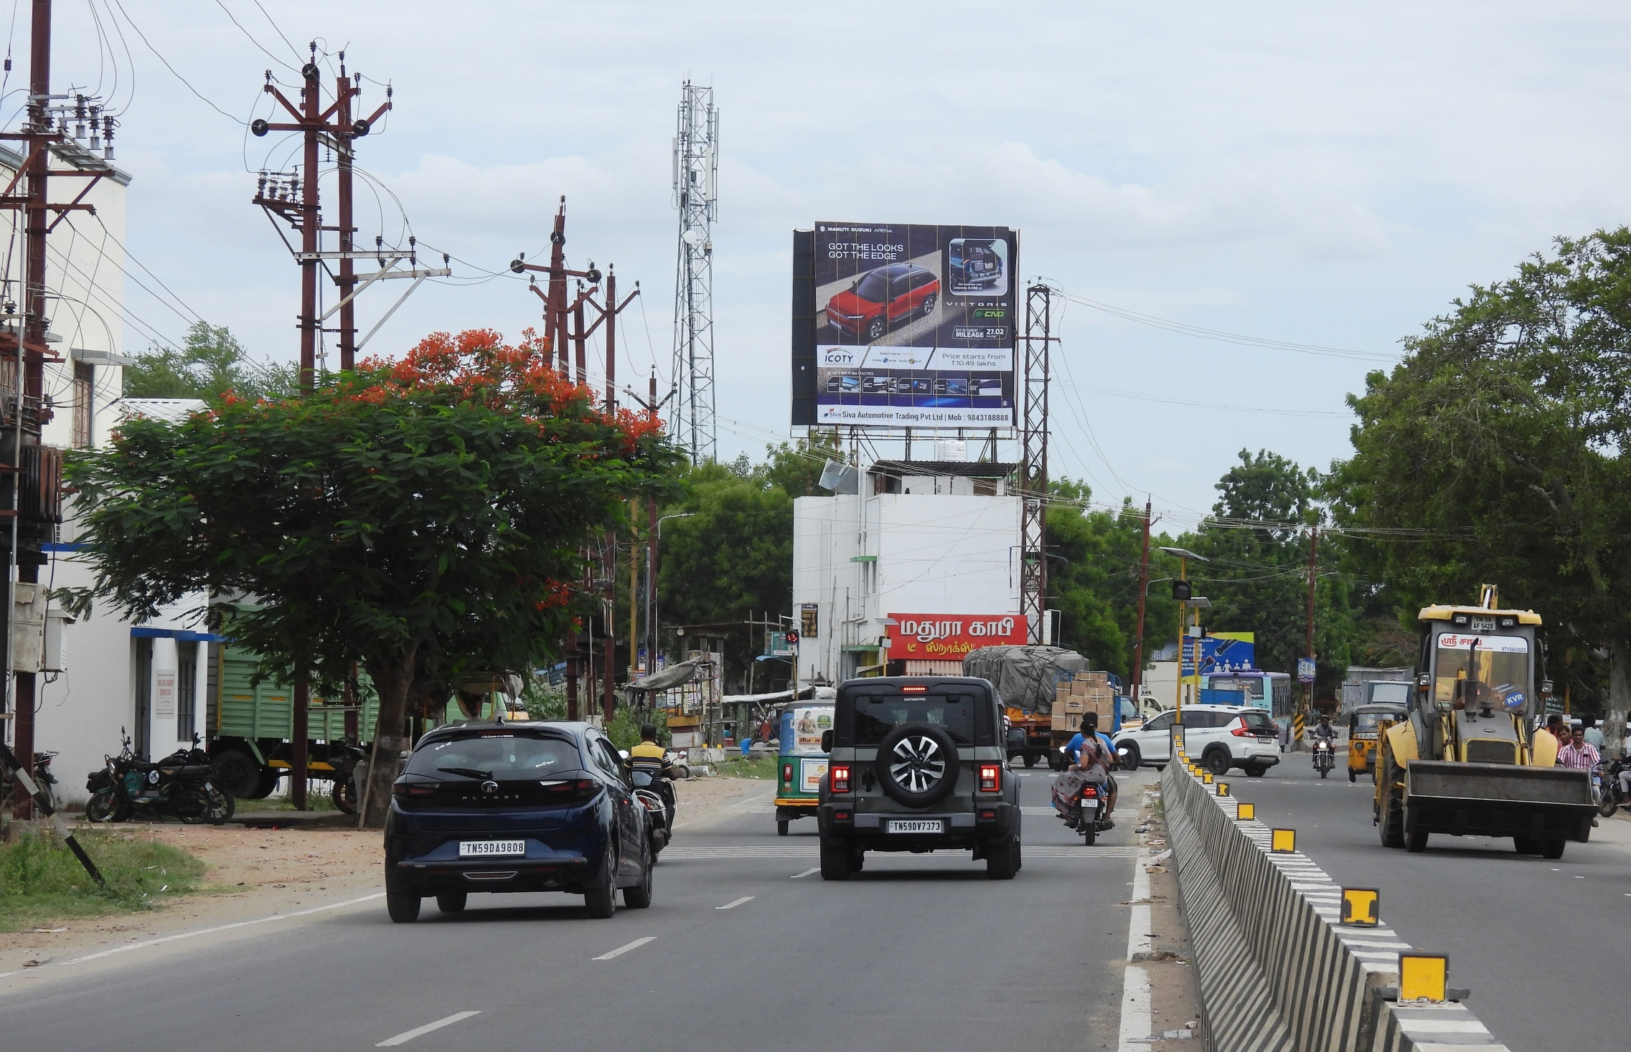
Avaniyapuram Near D Mart towards Airport 25X25

Slide 14


Our team is dedicated to providing the best A swift response will help us ensure timely campaign execution.
Awaiting Your Approval...
Thank You!
With Regards
Adinn Outdoor Advertising

