Slide 1



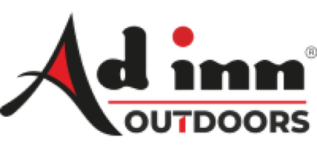


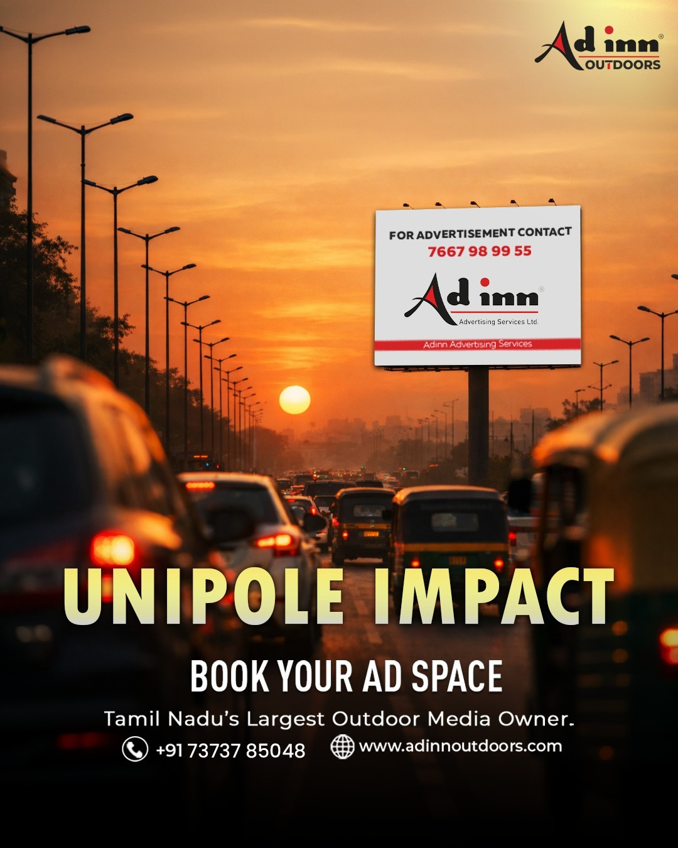


OOH PROPOSAL
Date: Aug 10, 2026
Maxi Vision Eye Hospital
www.adinnoutdoors.com

Slide 2



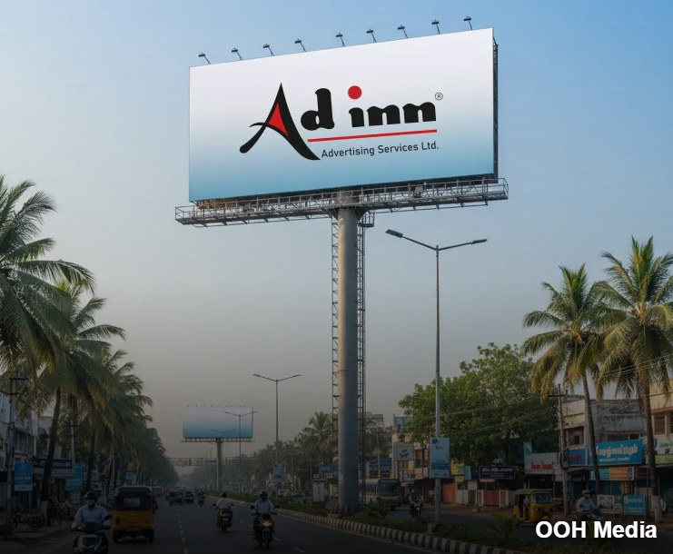
ABOUT US
Who we are
Adinn Outdoor owns over 550 outdoor ad spaces across Tamil Nadu and extends even outside the state. Our media network spans diverse formats from billboards to police booths and we have successfully amplified brand visibility and achieved tangible results. We make sure your brand is visible to the right people at the ideal time. With 25 Years of Excellence, we know where to put your ads to get the most impact. If you want to reach more people and expand the visibility of your ads, we’re here to help.

Slide 3


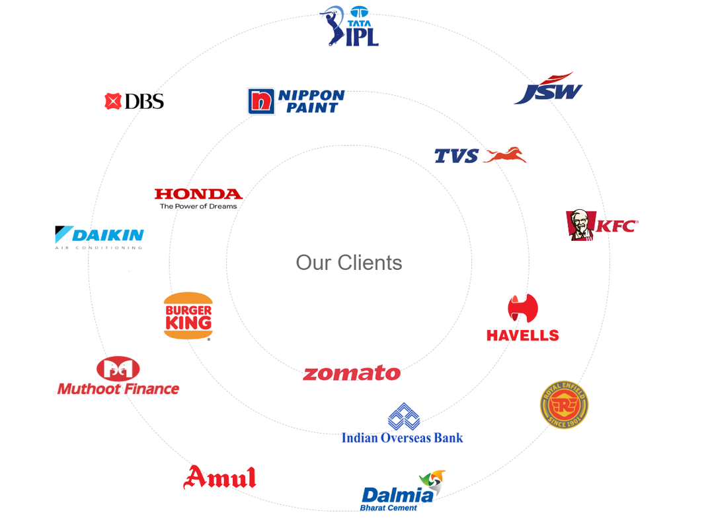




Why Leading Brands Choose Adinn Advertising
Prime, High-Impact Locations
Strategically positioned sites that maximize visibility and audience reach.
End-to-End Expertise
Seamless handling from planning and approvals to execution and maintenance.
Uncompromising Quality Standards
Premium materials and consistent upkeep that protect brand image.
Trusted Partnership
Clear pricing, timely delivery, and reliable communication throughout the campaign

Slide 4

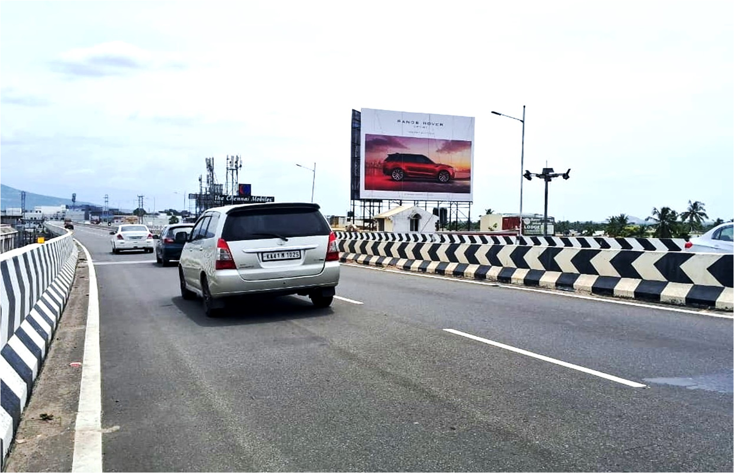
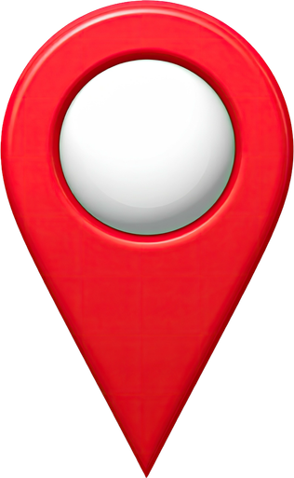
Periyanayakanpalayam bridge towards Mettupalayam 40x30
Media Specifications
Who we are
City:
Chennai
Size:
40x30
Media type:
Hoarding
Illumination:
Frontlit
Unit:
1
Click to View Site Location

Slide 5
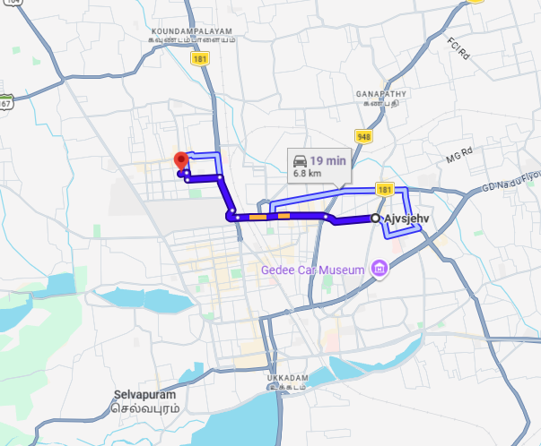
Periyanayakanpalayam bridge towards Mettupalayam 40x30

Slide 6



Our team is dedicated to providing the best
A swift response will help us ensure timely campaign execution.
Awaiting Your Approval...
Thank You!
With Regards
Adinn Outdoor Advertising
www.adinnoutdoors.com

