Slide 1
Coimbatore

Slide 2
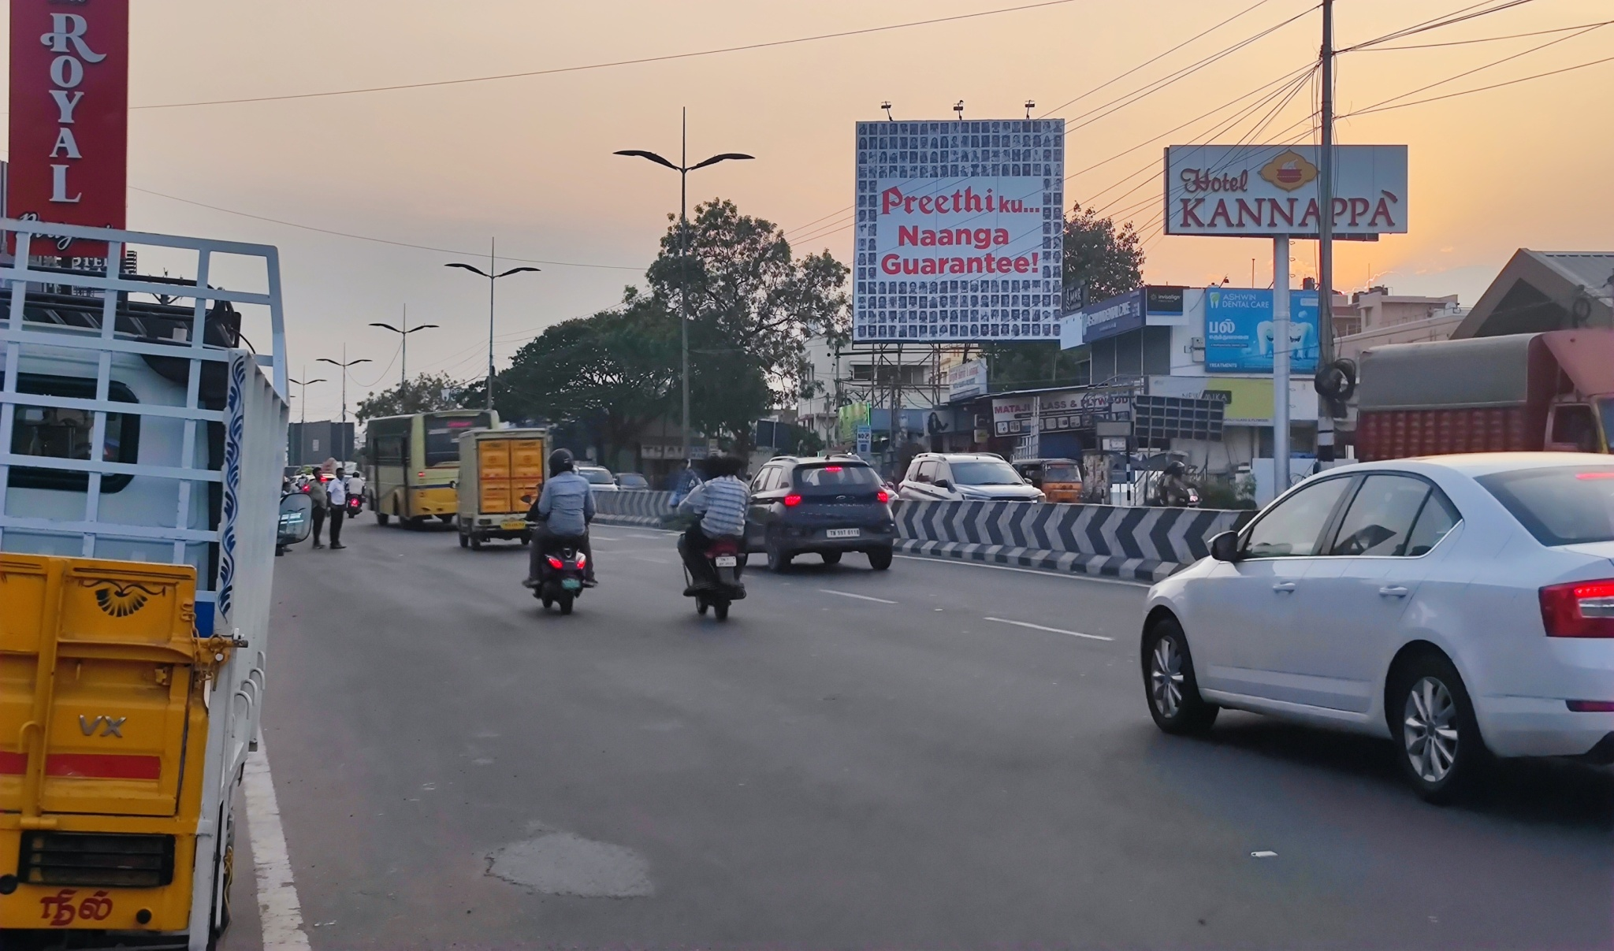
Avinashi Road Goldwins towards Airport -30x30

Slide 3
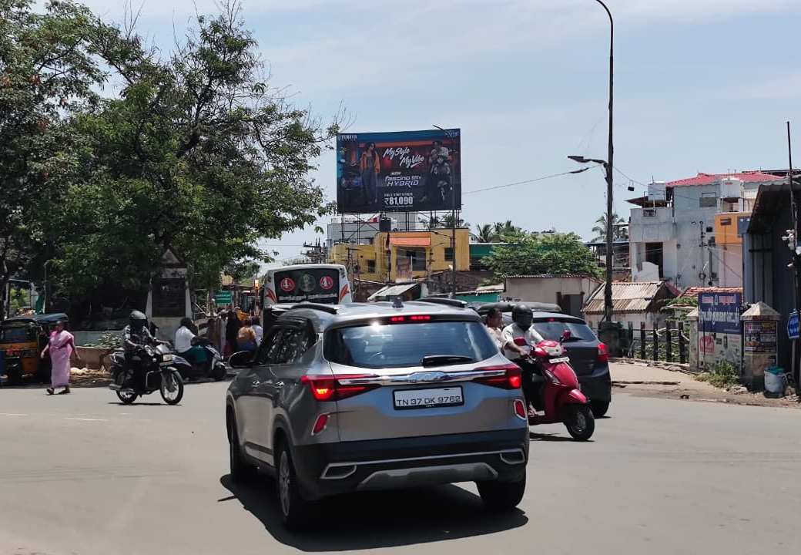
Sivanandha Colony towards Saibaba Colony (Sanganoor) 40X25

Slide 4
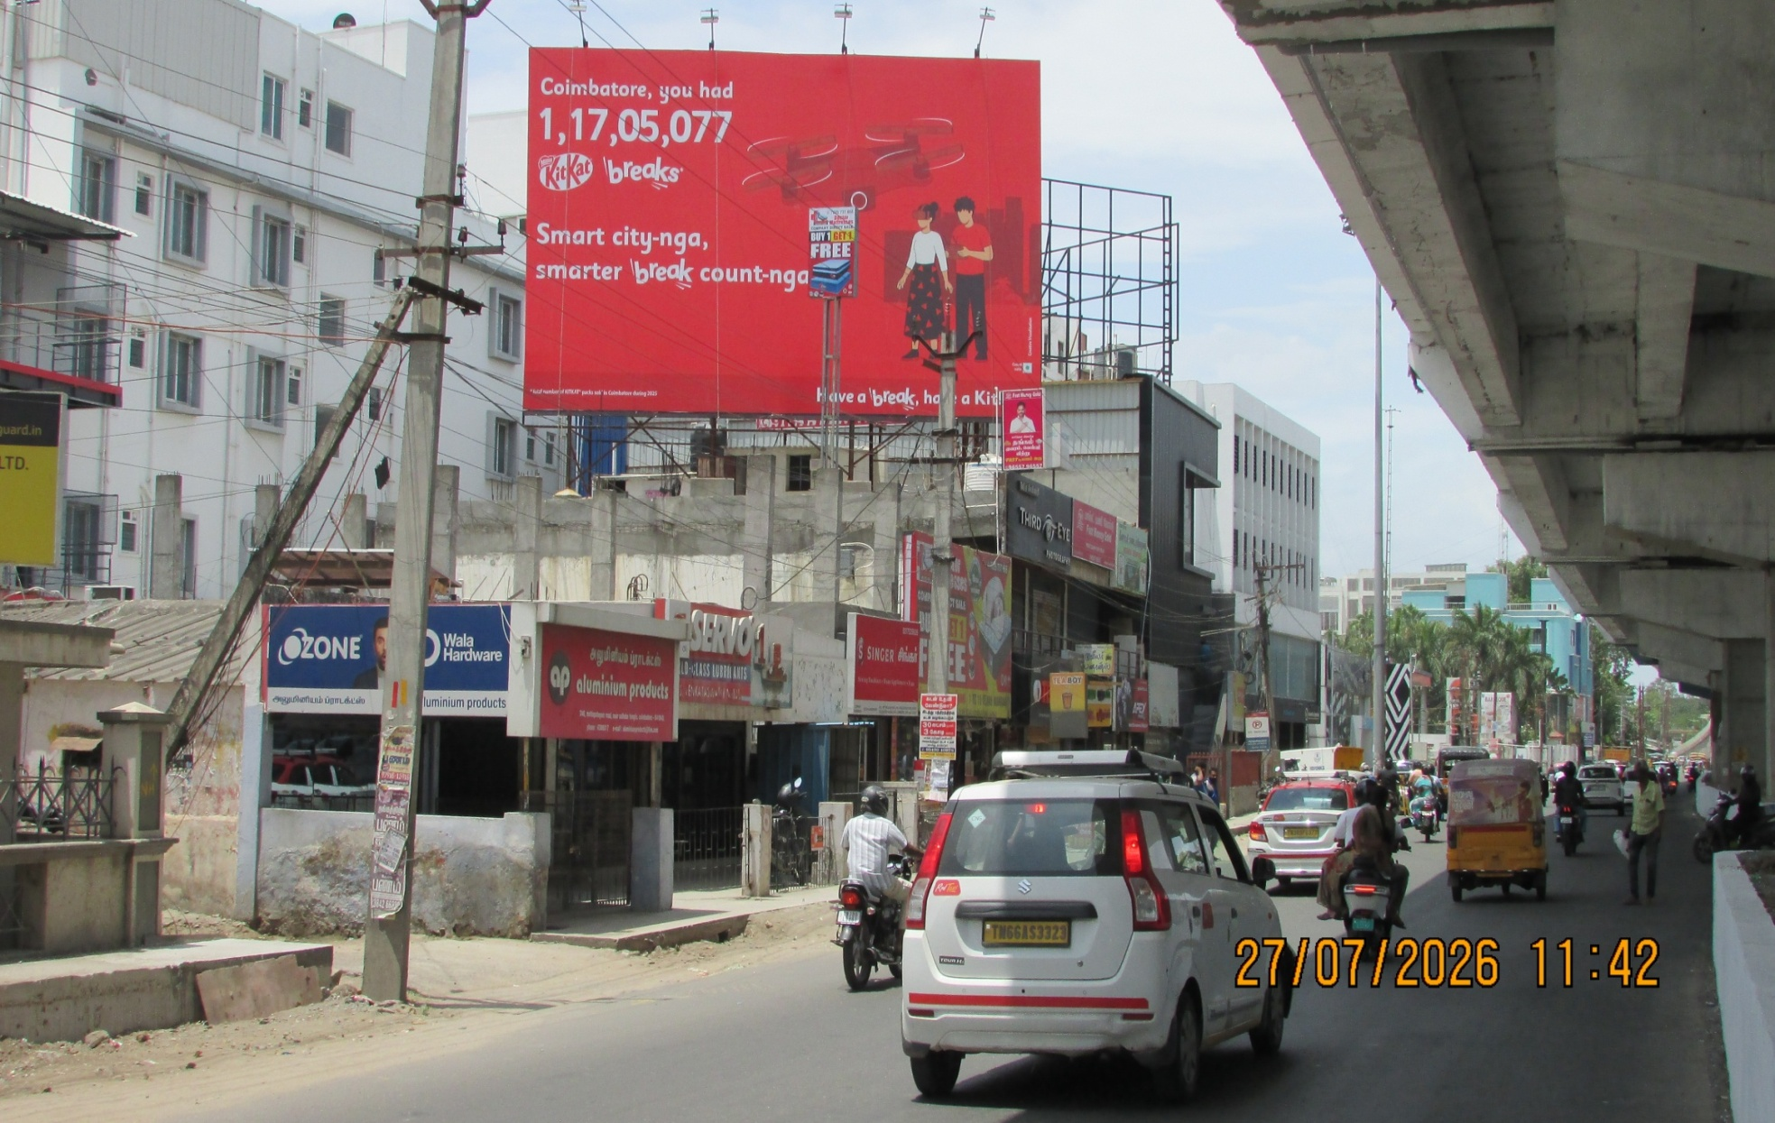
Saibaba Colony towards Gandhipuram 40X25

Slide 5
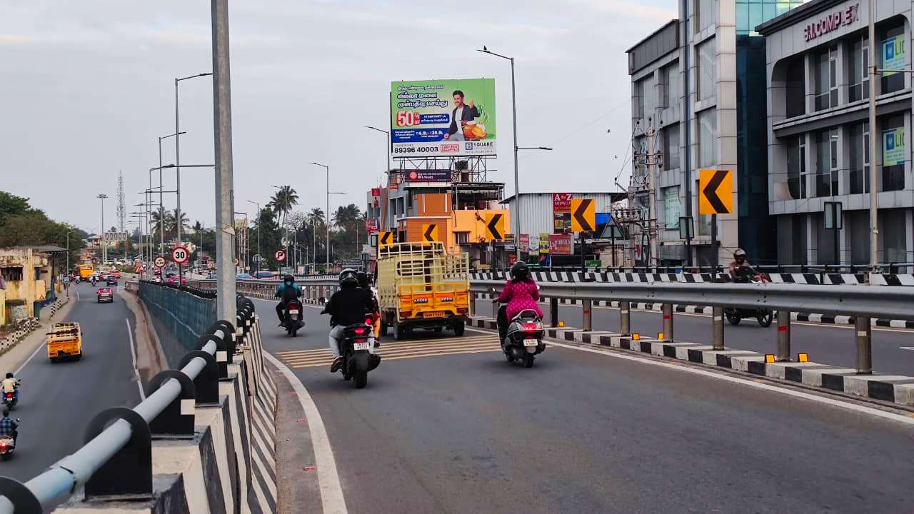
Ukkadam Bus Depo Opp towards Sungam 35X25

Slide 6
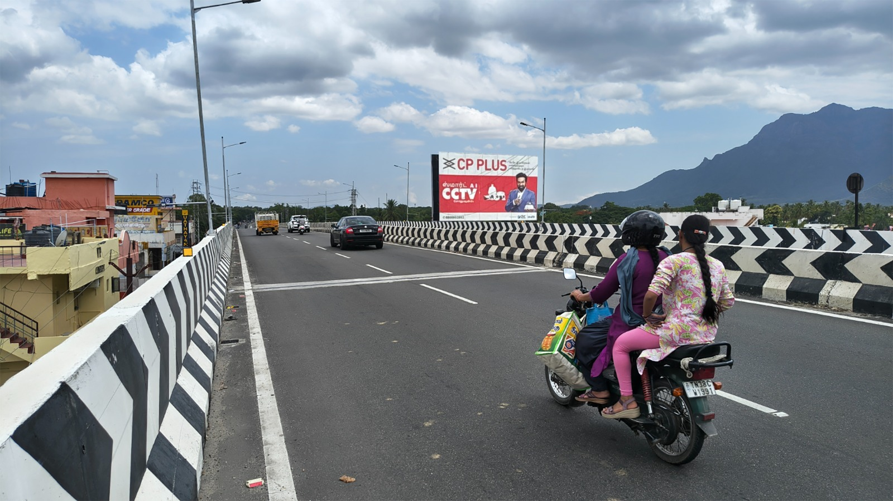
Periyanayakanpalayam bridge towards Coimbatore 50X30

