Slide 1

Jagran Engage

Slide 2
Chennai

Slide 3
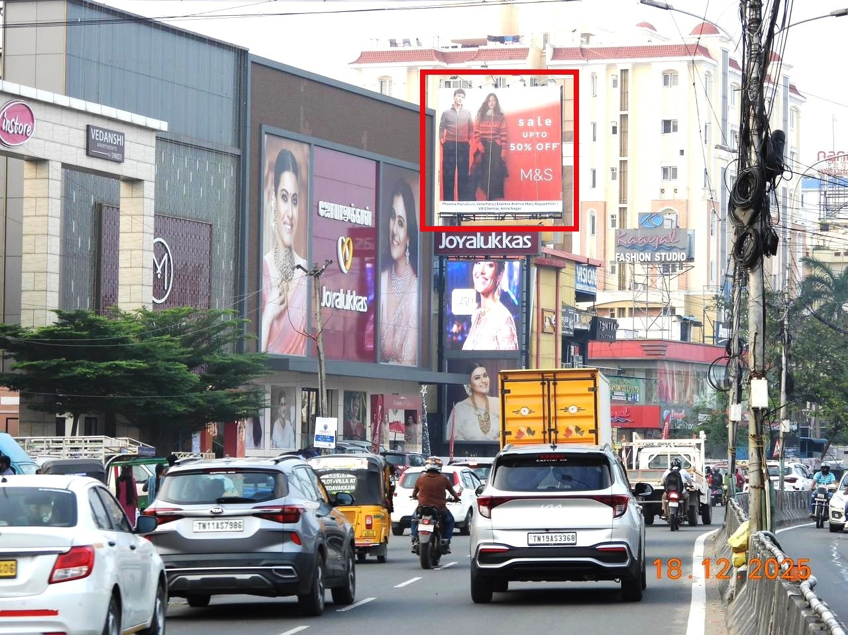
Velacherry 100 Ft Road Towards Phoenix Mall
Tamil Nadu
Chennai
Hoarding
Front Lit
20.00
20.00
30 Days

Slide 4
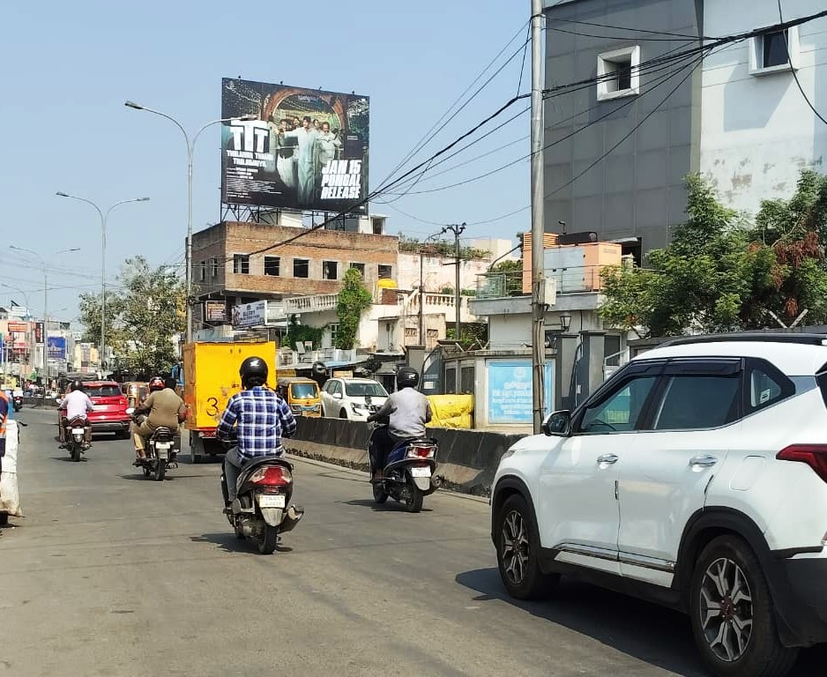
Porur EB Office towards Porur Signal
Tamil Nadu
Chennai
Hoarding
Not Lit
35.00
25.00
30 Days

Slide 5
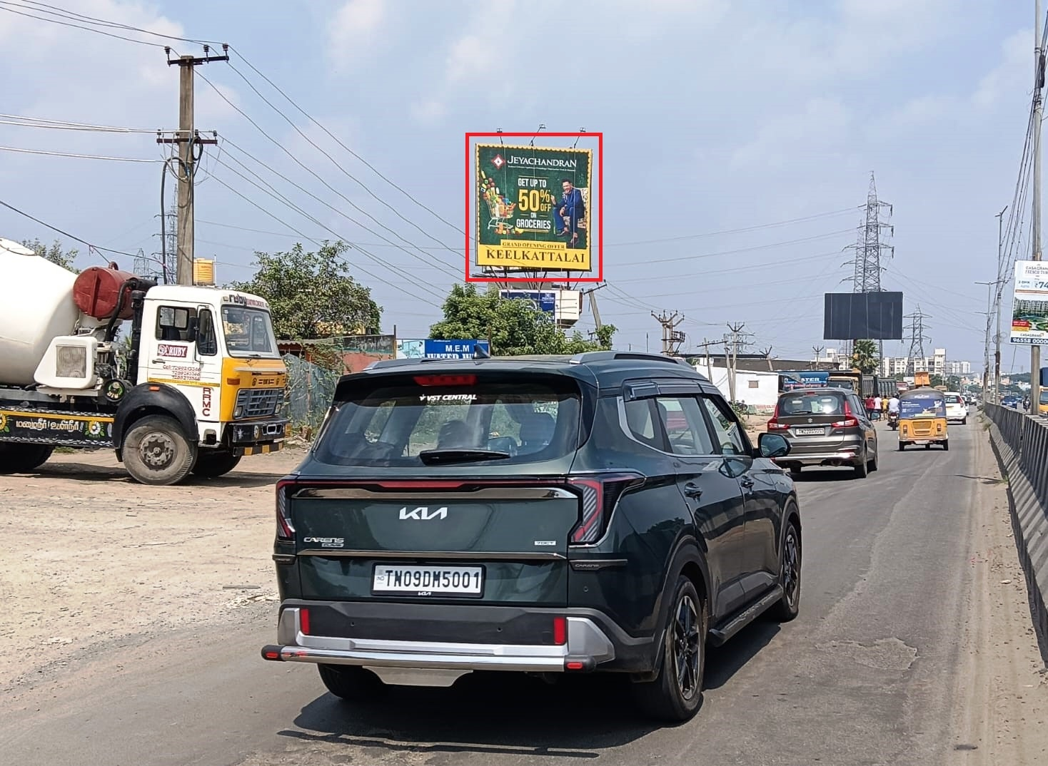
Medavakkam - Kovilancheri Towards Medavakkam & Thazhambur
Tamil Nadu
Chennai
Hoarding
Front Lit
25.00
25.00
30 Days

Slide 6
Coimbatore

Slide 7
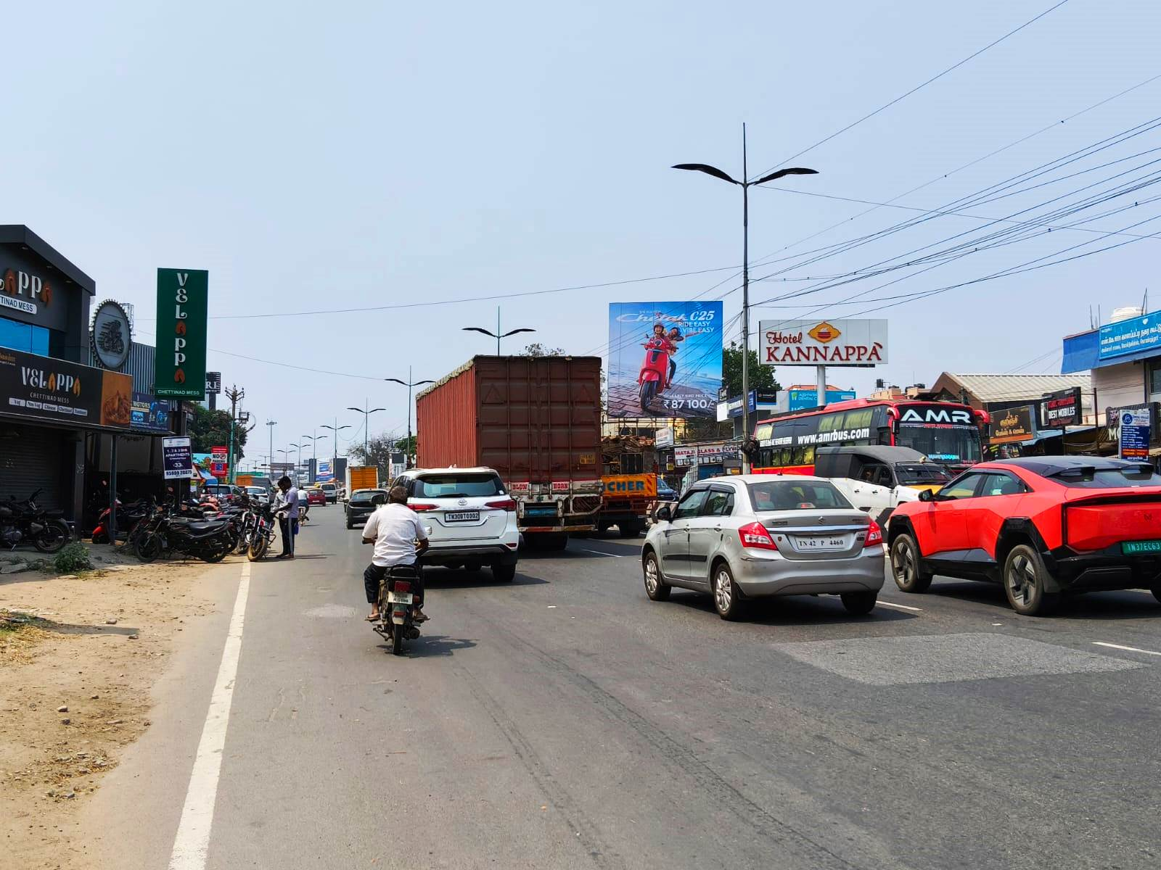
Avinashi Road Goldwins towards Airport
Tamil Nadu
Coimbatore
Hoarding
Front Lit
30.00
30.00
30 Days

Slide 8
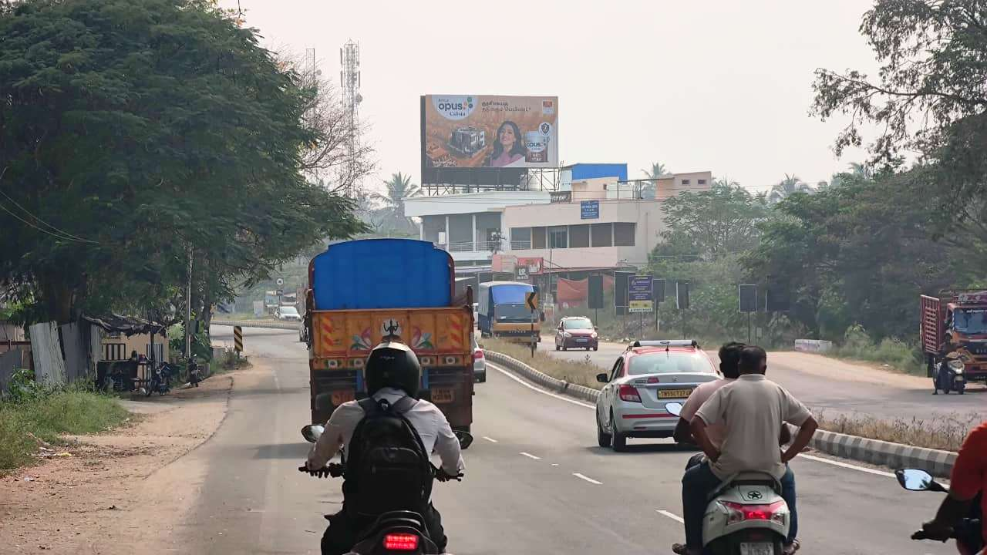
Mettupalayam Road Mathampalayam towards Coimbatore
Tamil Nadu
Coimbatore
Hoarding
Not Lit
40.00
25.00
30 Days

Slide 9
Cuddalore

Slide 10
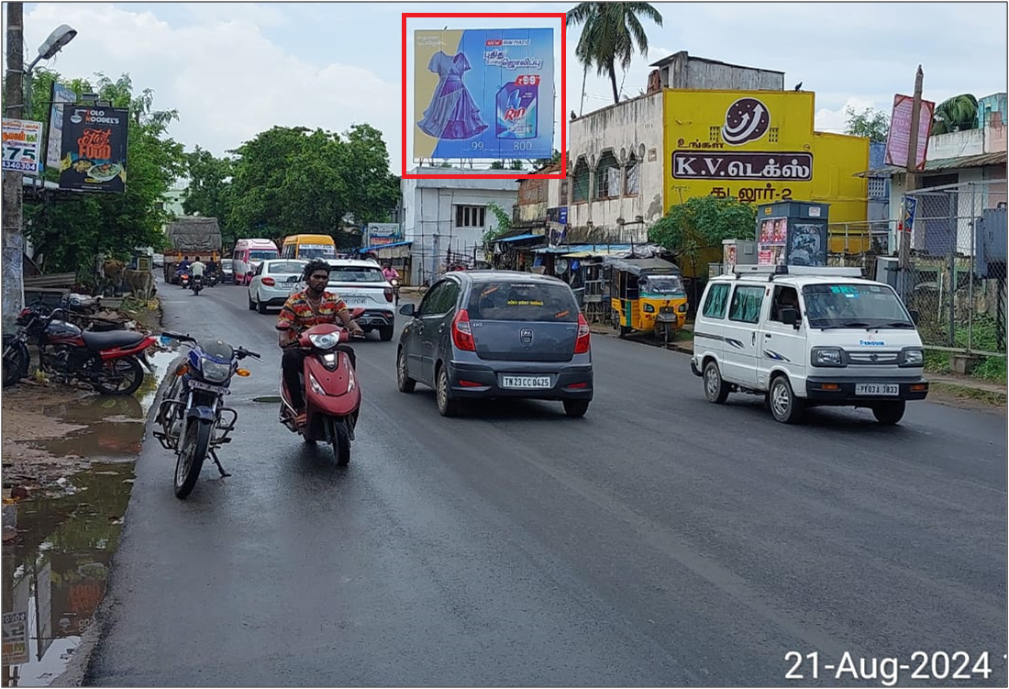
Cuddalore Old town
Tamil Nadu
Cuddalore
Hoarding
Not Lit
28.00
25.00
30 Days

Slide 11

Vadalour Road Flyover
Tamil Nadu
Cuddalore
Hoarding
Not Lit
40.00
25.00
30 Days

Slide 12
Dharmapuri

Slide 13
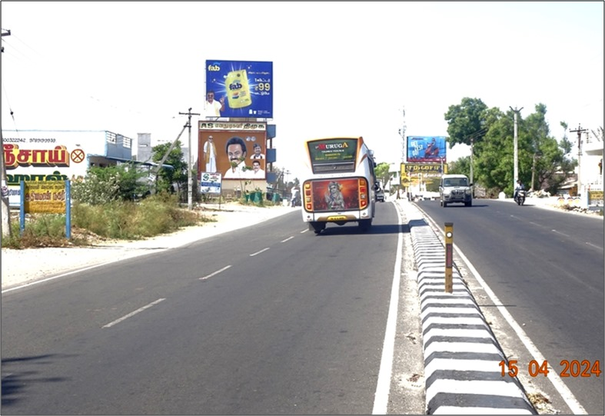
Athiyamankottai (L)
Tamil Nadu
Dharmapuri
Hoarding
Not Lit
30.00
25.00
30 Days

Slide 14
Bhavani

Slide 15
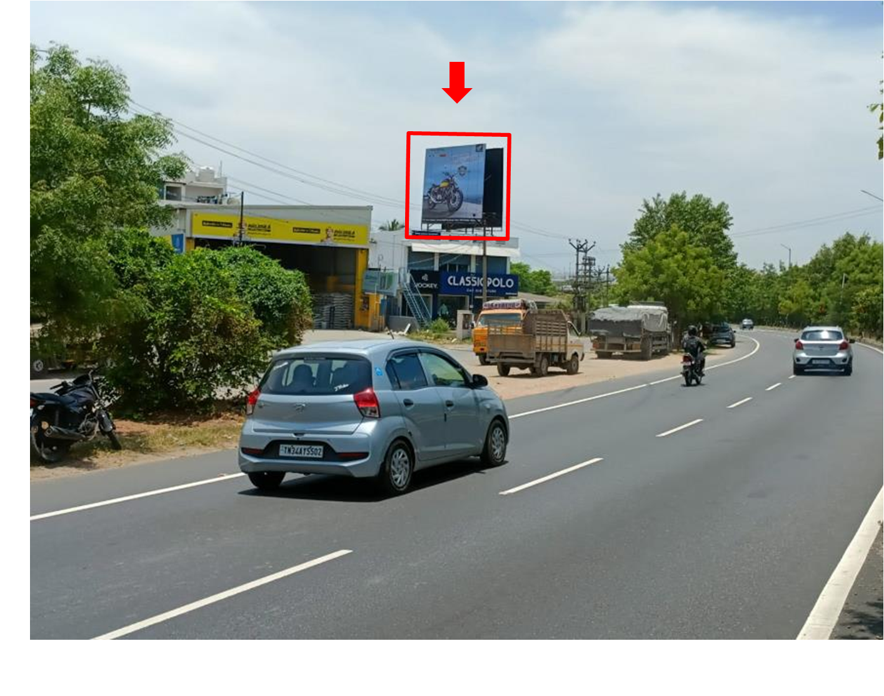
Bhavani - Lakshmi Nagar Bypass
Tamil Nadu
erode
Hoarding
Not Lit
20.00
20.00
30 Days

Slide 16
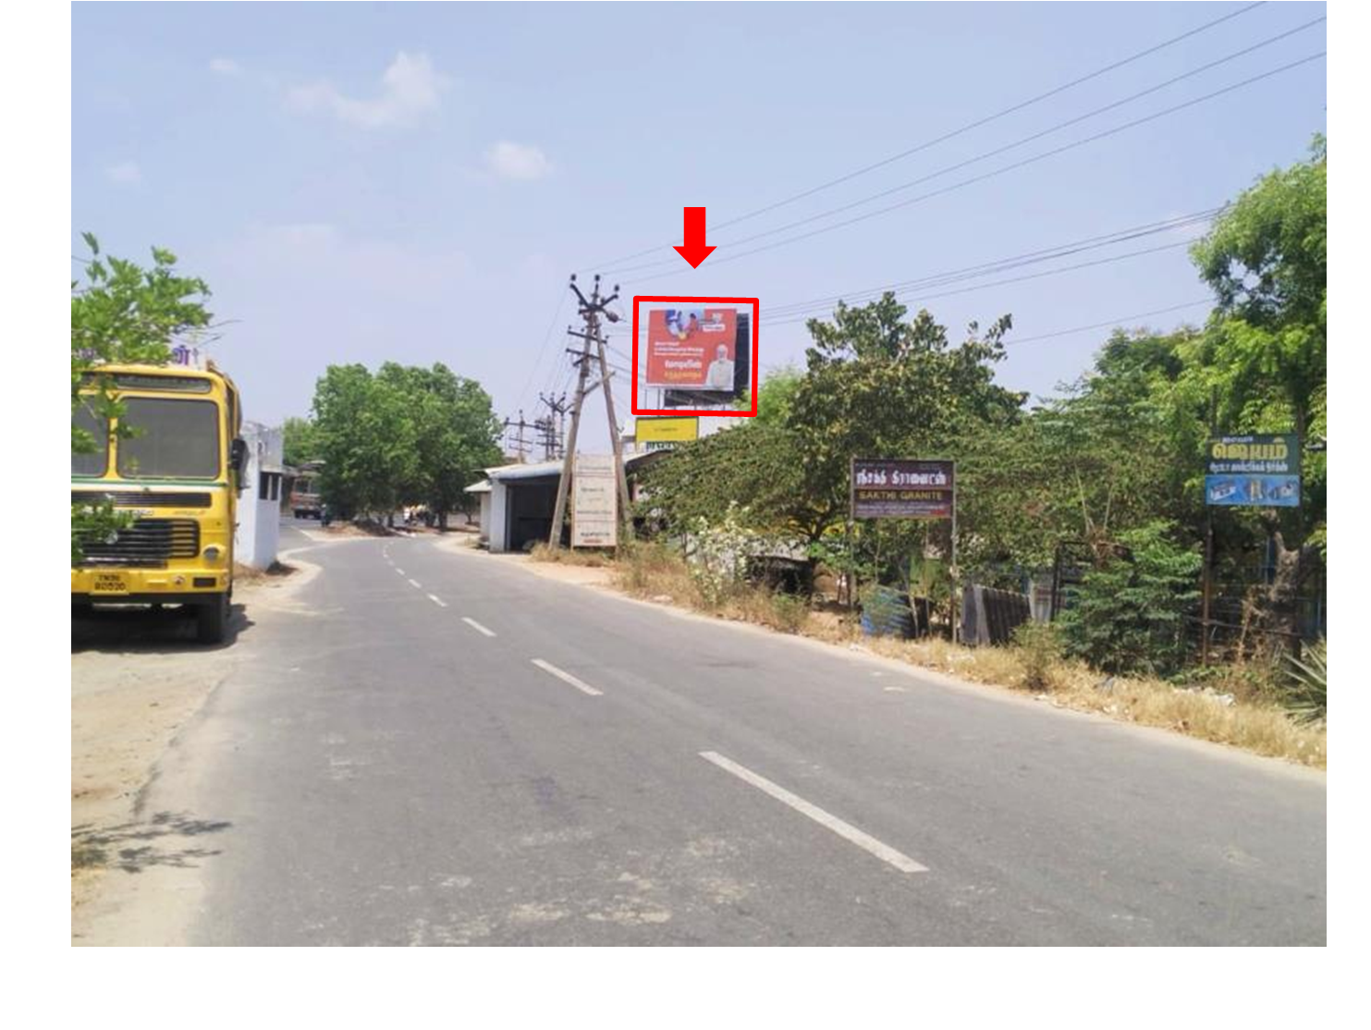
Bhavani - Lakshmi Nagar Bypass
Tamil Nadu
erode
Hoarding
Not Lit
20.00
20.00
30 Days

Slide 17
Thank you

