Slide 1
New Client
Plan – PPT

Slide 2
State – Tamil Nadu

Slide 3
Coimbatore

Slide 4
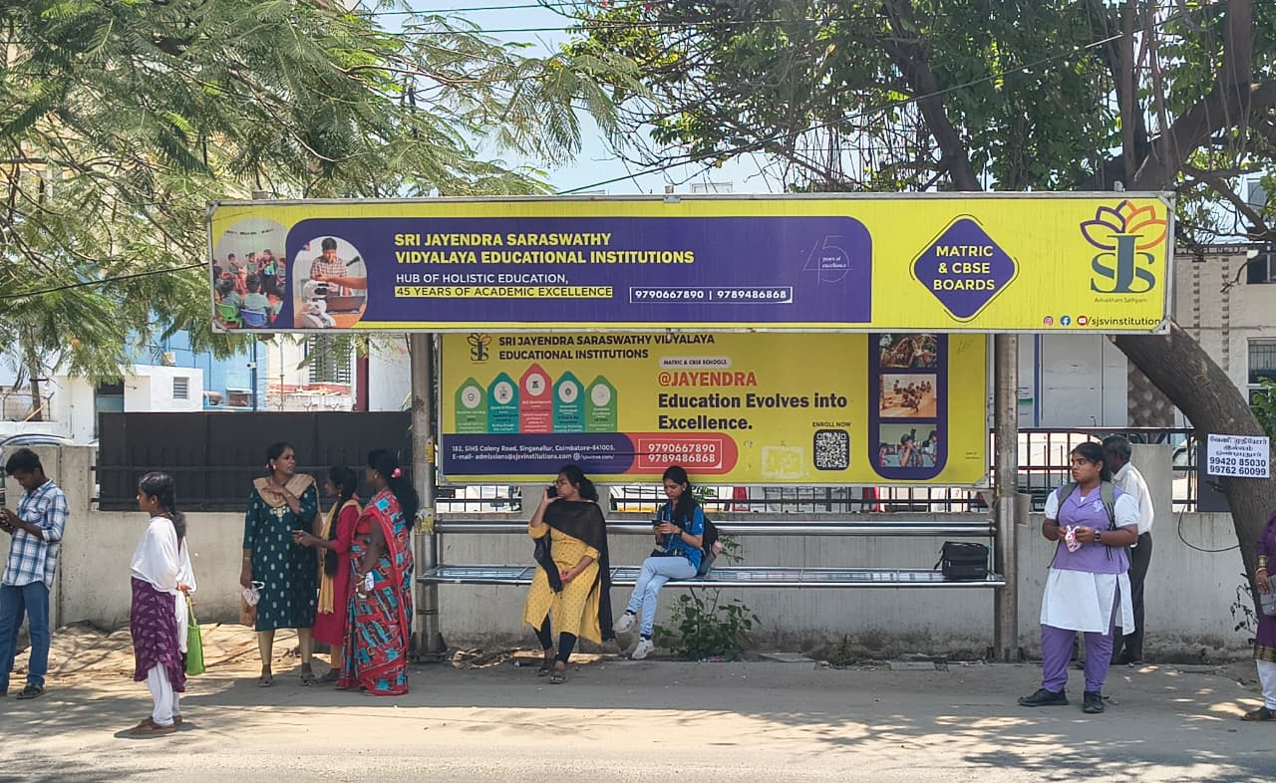
Trichy Road – Radha Rani Theatre Bus Stop

Slide 5
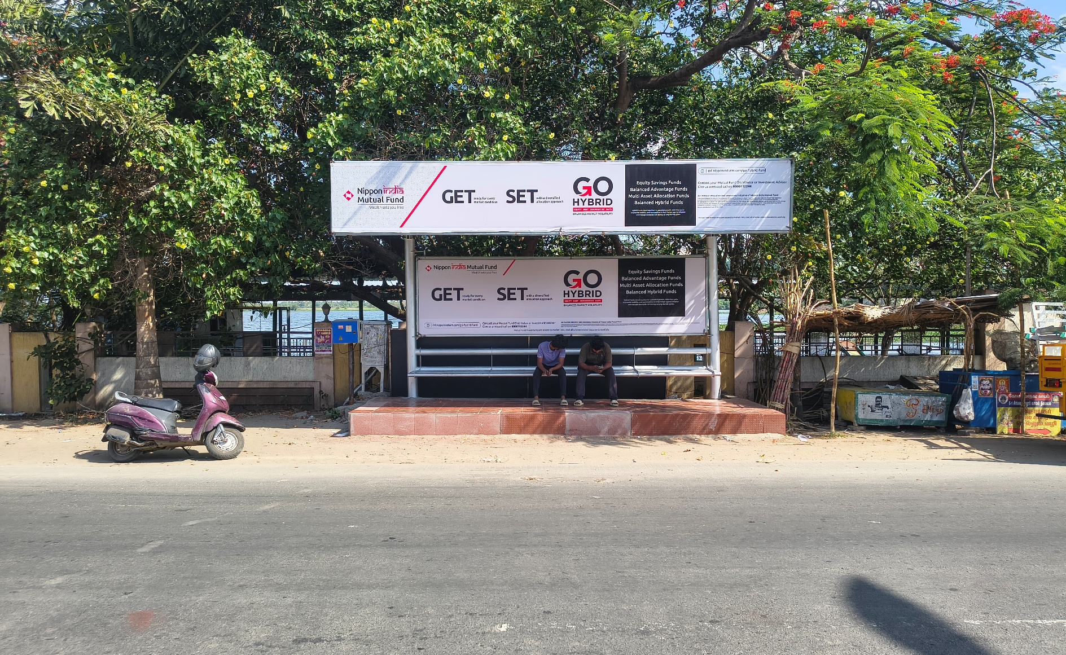
Trichy Road – Boat House Towards Ramanathapuram

Slide 6
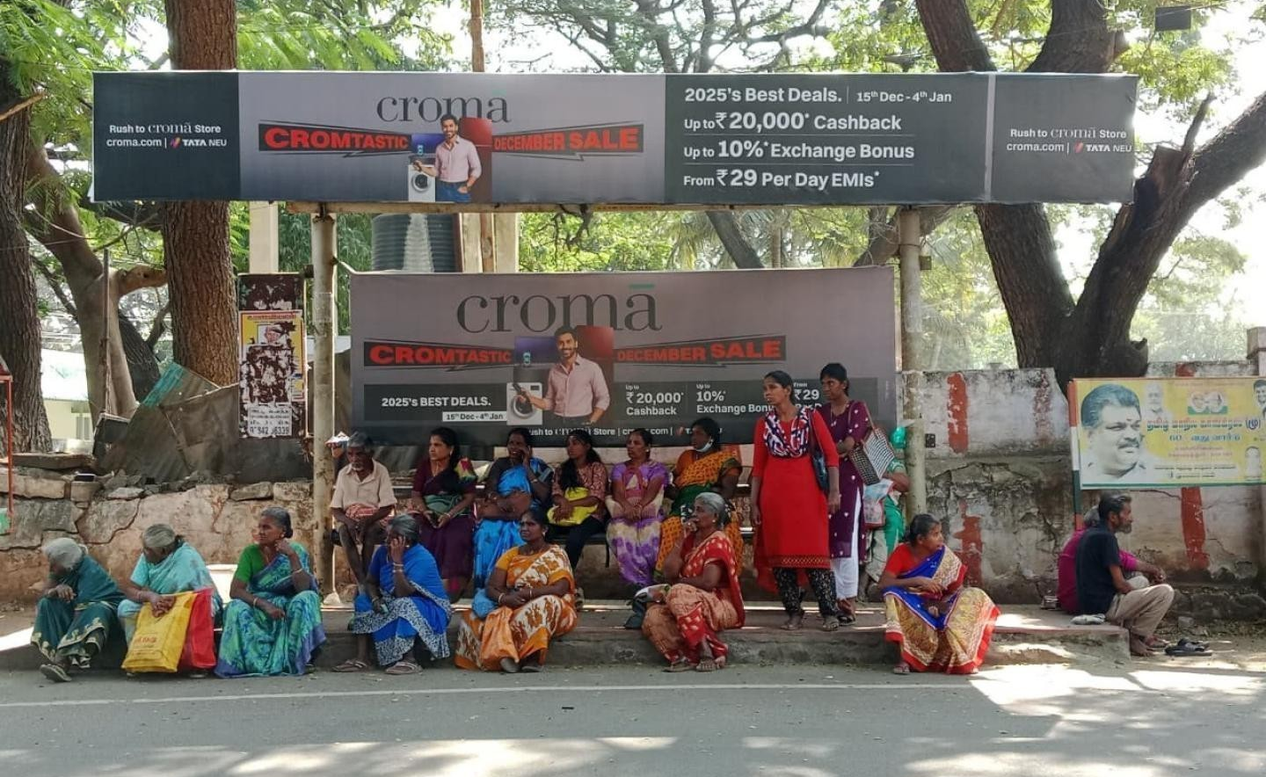
Uppilipalayam Junction Bus Stop Towards Puliyakulam

Slide 7
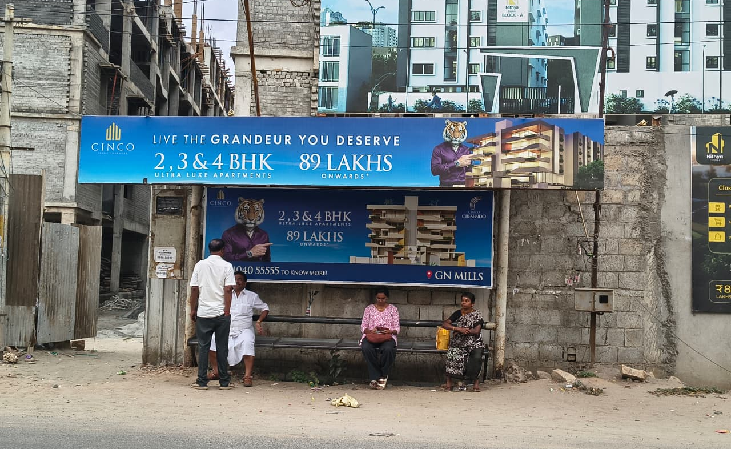
Sowripalayam Road – Meena Estate Bus Stop Towards Puliyakulam

Slide 8
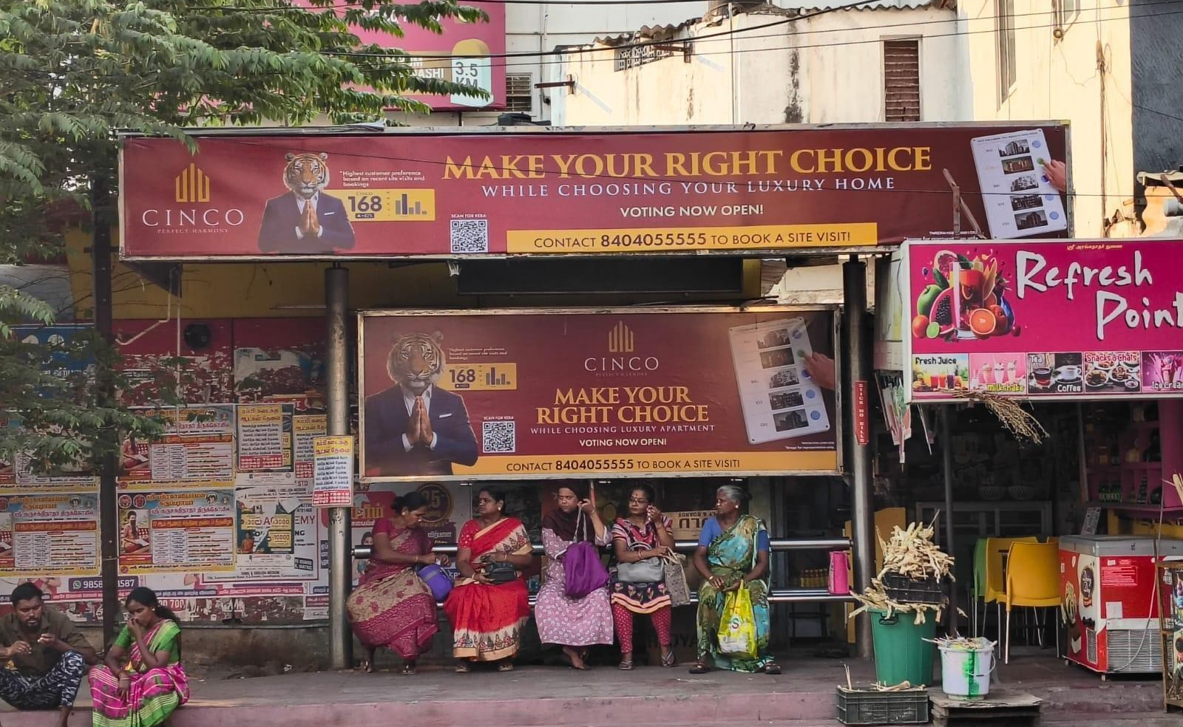
Gandhipark Towards Town Hall

Slide 9
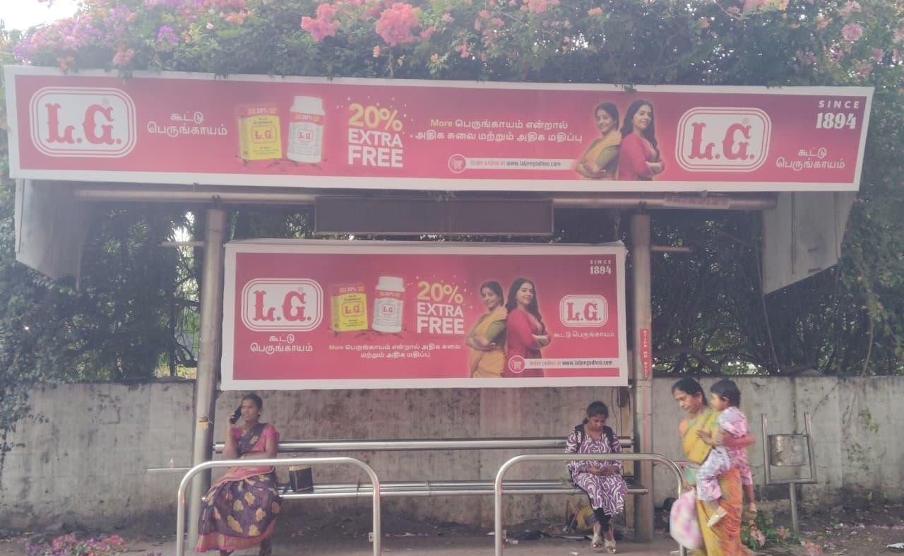
RS Puram – Abt Maruthi Suzuki Showroom

Slide 10
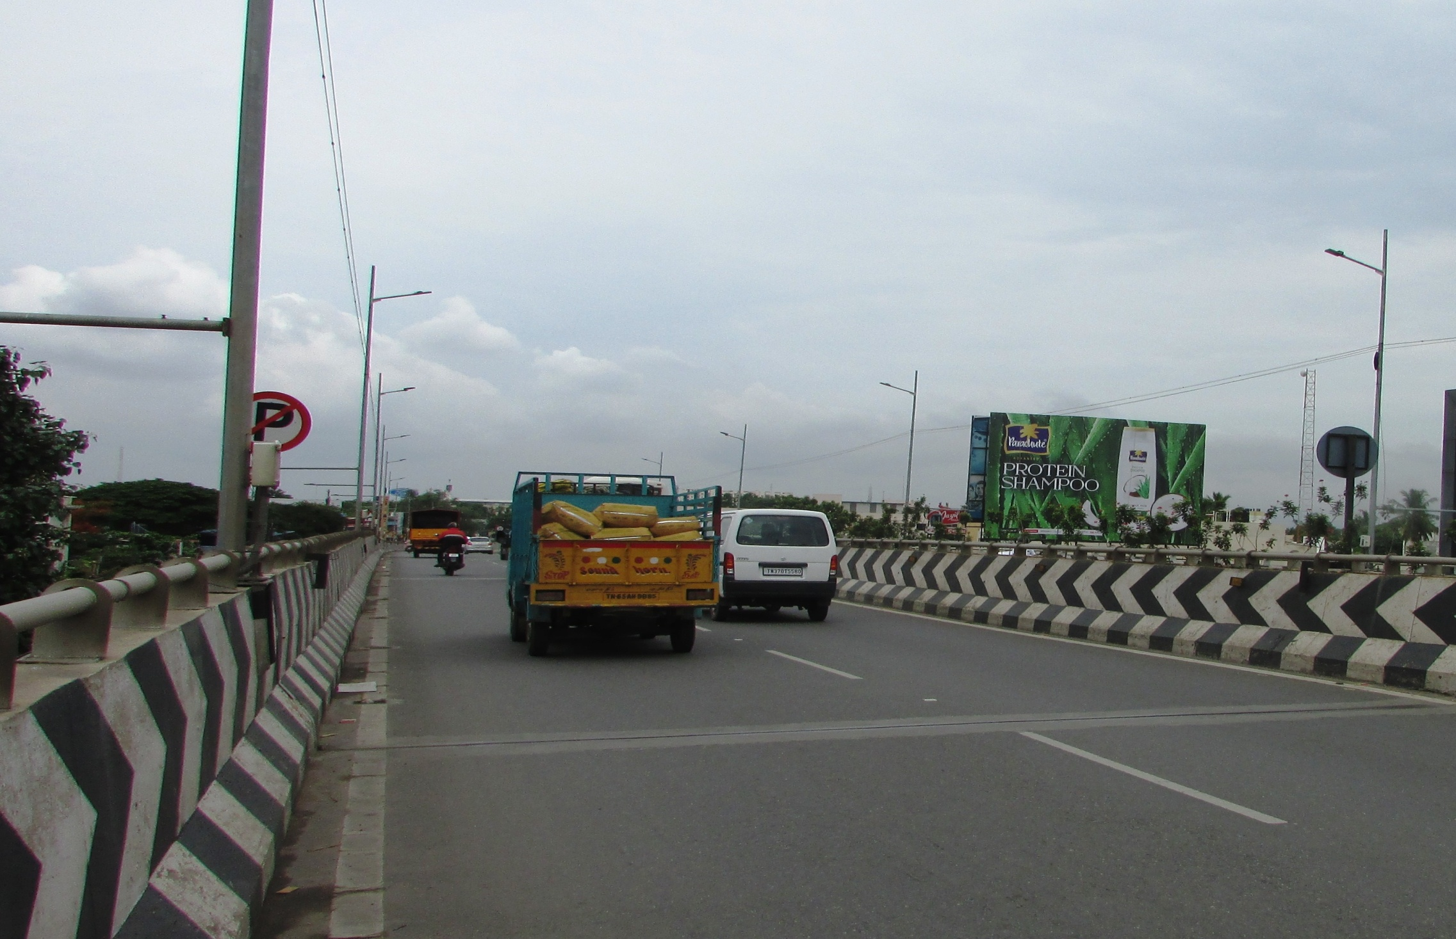
Gounder Mills toward Gandipuram 35X25

Slide 11
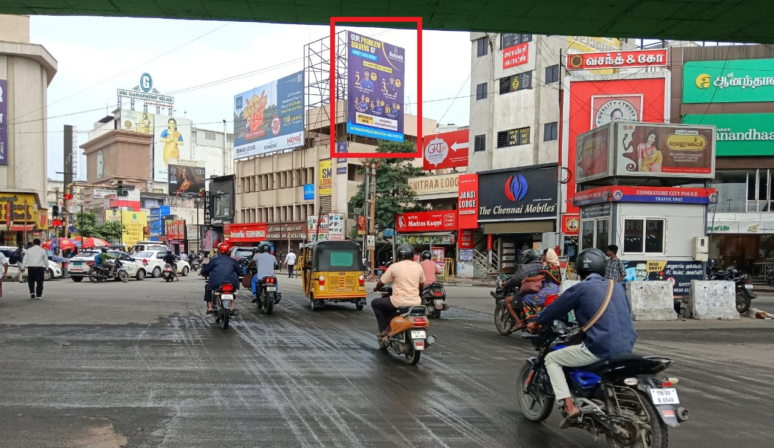
Cross Cut Road Junction (Right) 20X25

Slide 12
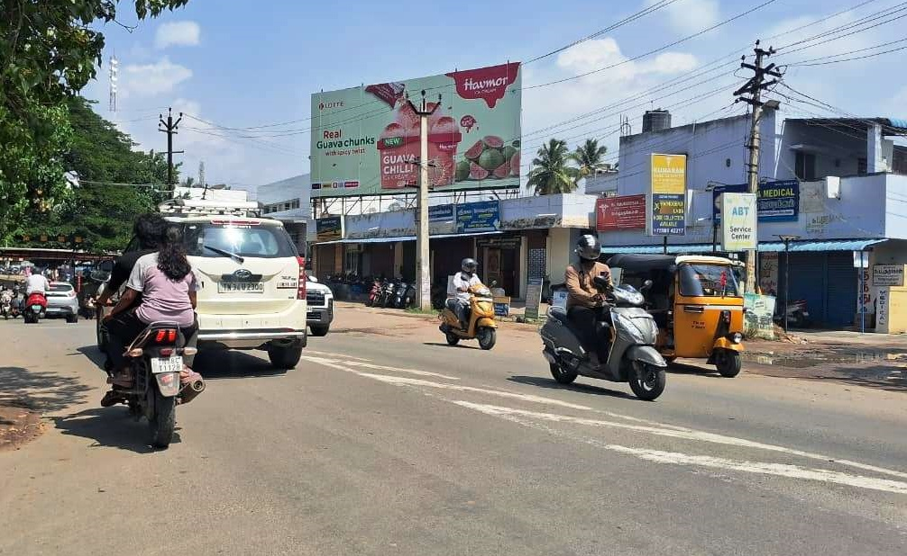
Sivanandha Colony towards Saibaba Colony 45X20

Slide 13
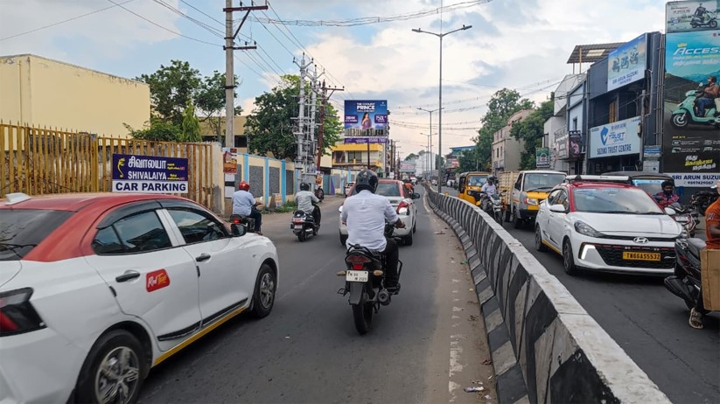
Selvapuram towards Town Hall 20X25

Slide 14
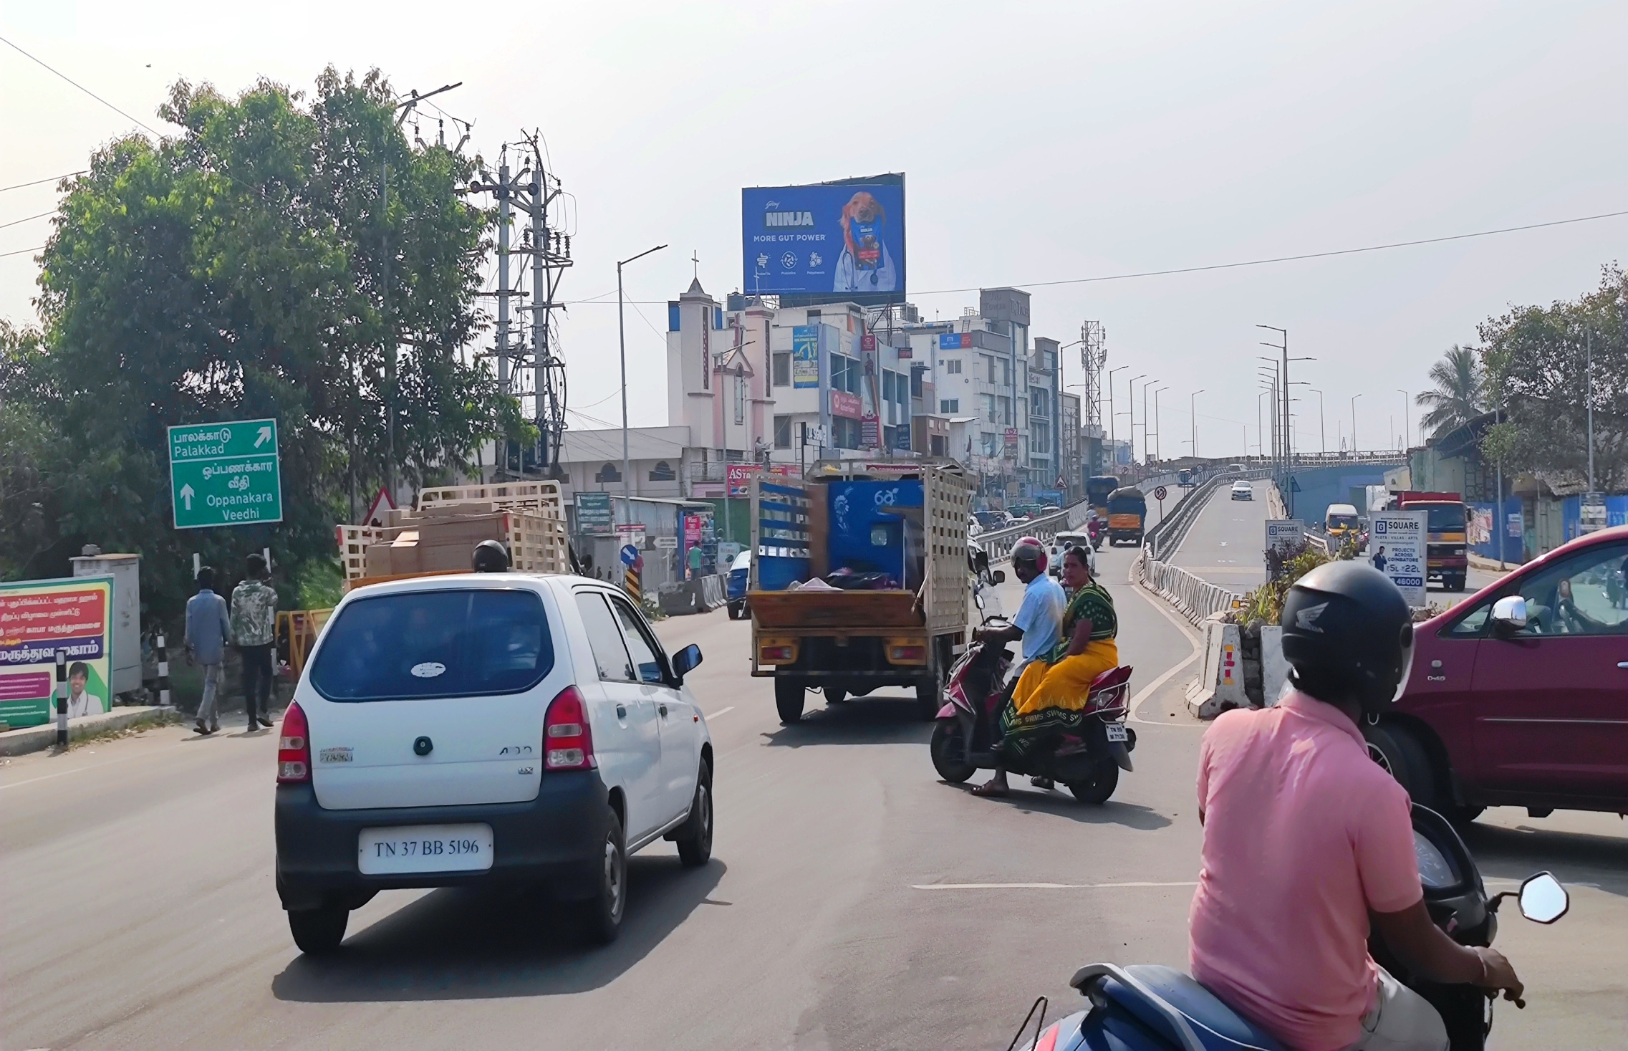
Sungam to Ukkadam Busstand 35X20

Slide 15
Kalapatti

Slide 16
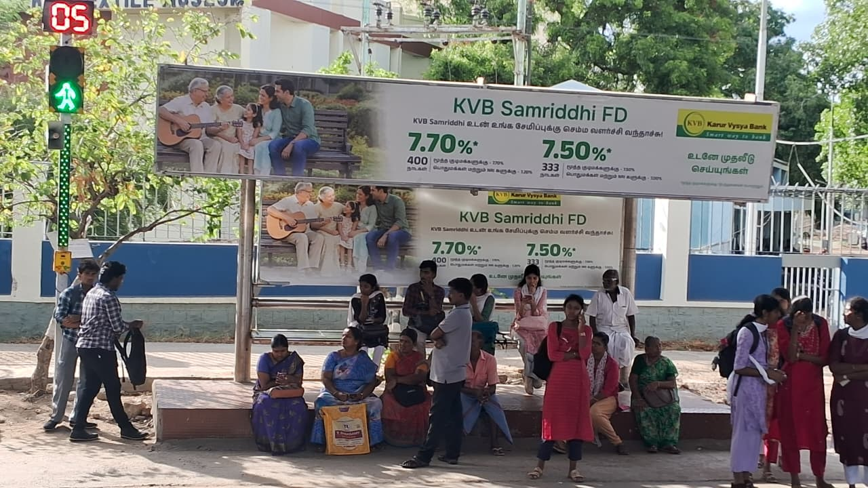
Aravind Eye Hospital Towards Sitra

Slide 17
Vadavalli

Slide 18
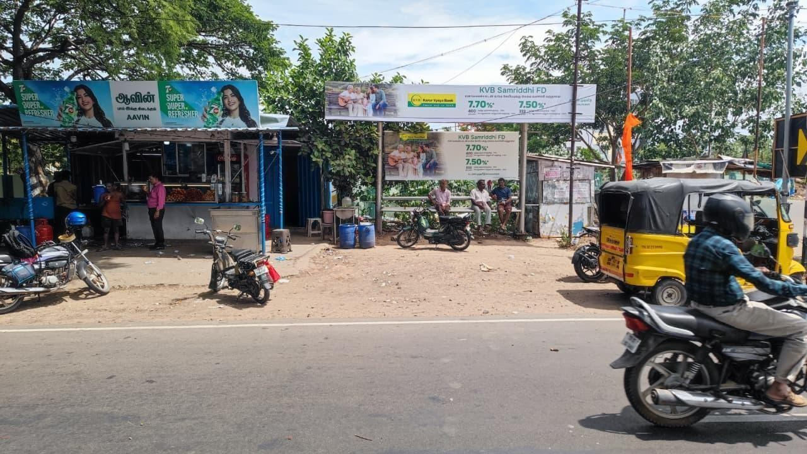
Vadavalli Road, P N Pudur Puliyamaram Bus Stop Towards Vadavalli

Slide 19
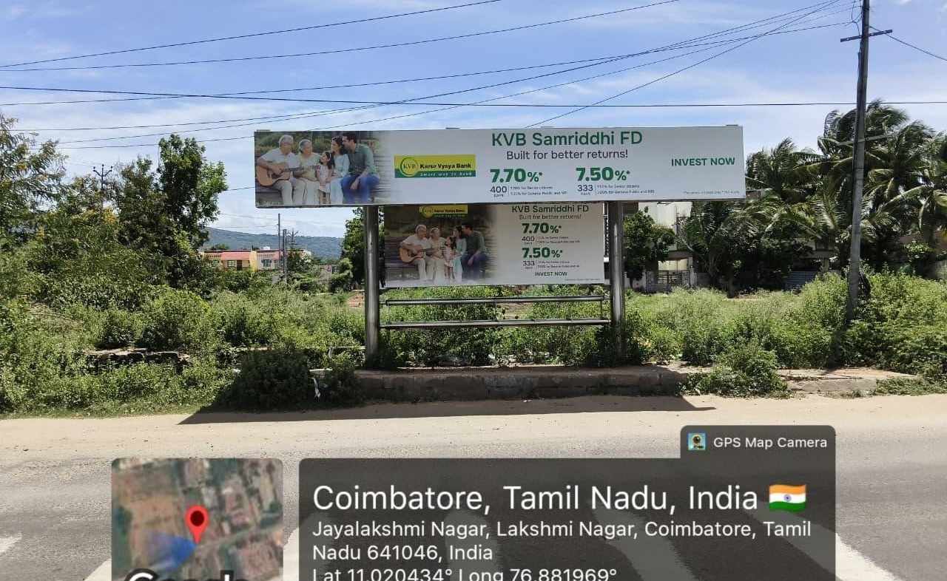
Vadavalli, Lakshmi Nagar Towards Thondamuthur

Slide 20
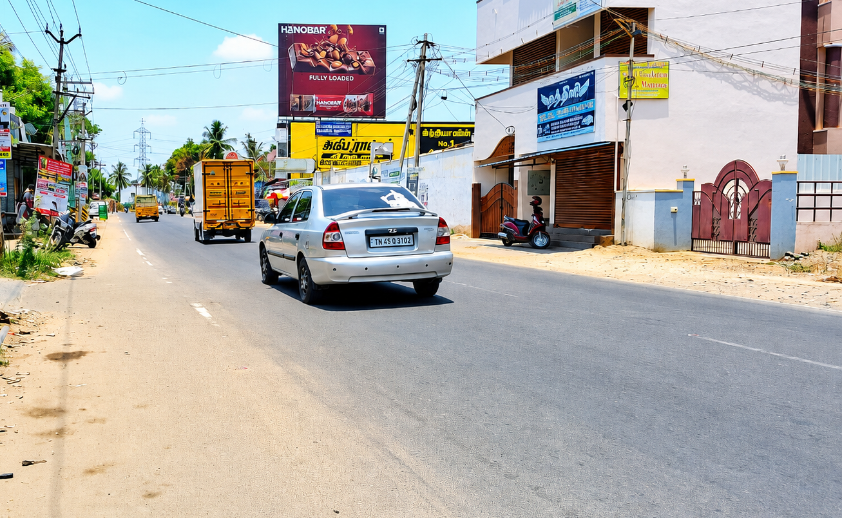
Vadavali to Kaundampalayam 30X25

Slide 21
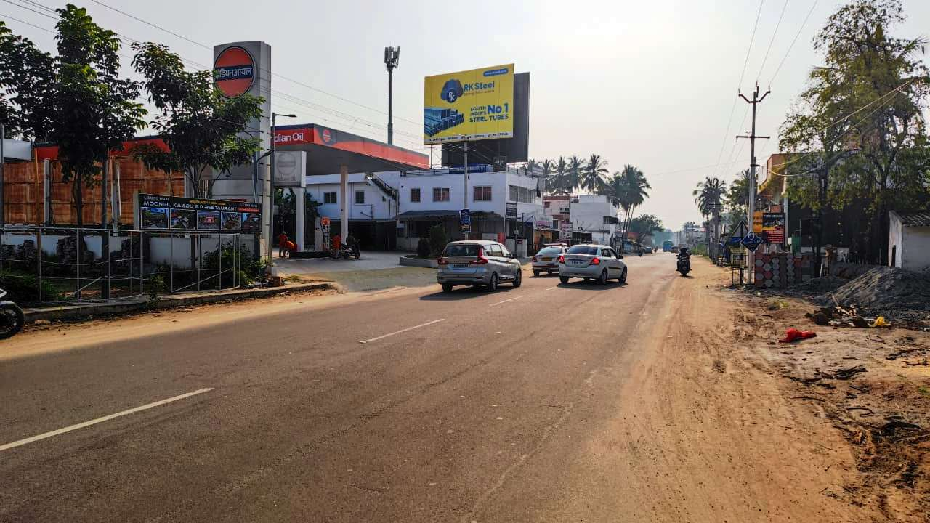
Kaundampalayam to Vadavalli 30X20

Slide 22
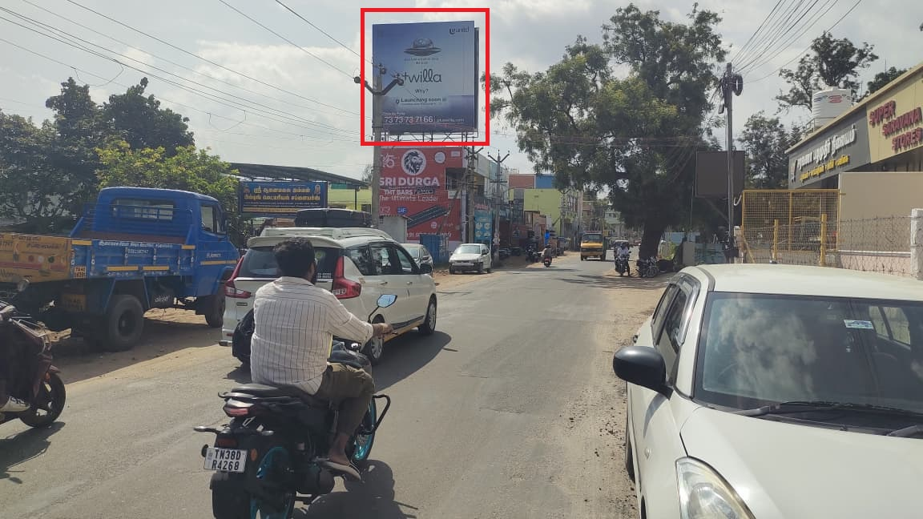
Kavundampalayam to maruthamail road (vadavalli ) Junction 25X25

Slide 23
Tiruppur

Slide 24
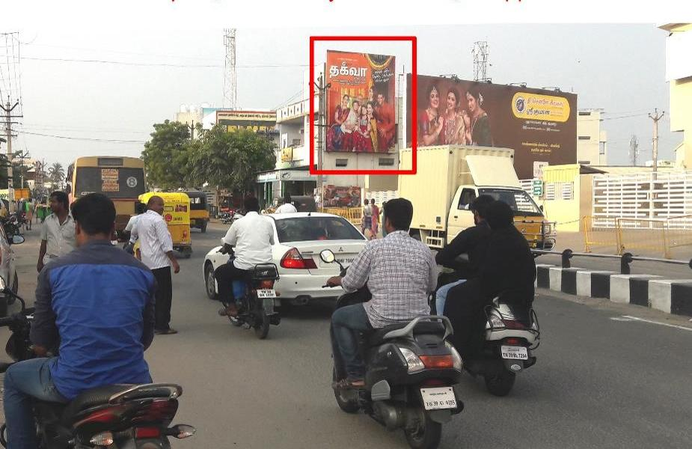
Sri Sakthi Multiplex 18x20

Slide 25
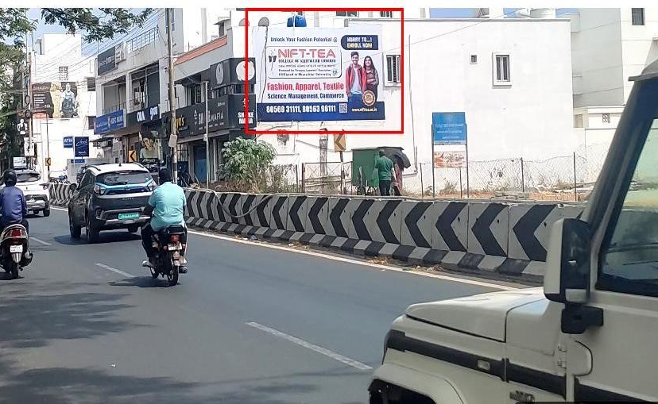
DSK Hospital Opp, Nr.Indian & SBI Bank, Amarjothi Garden, JMHS School 25x15

Slide 26
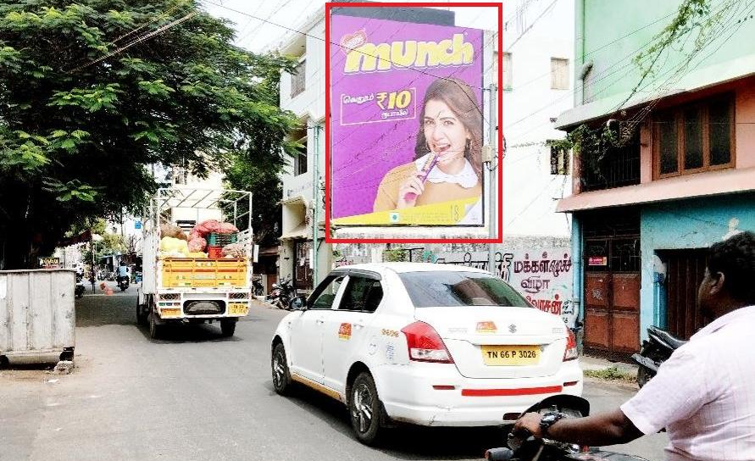
ABT Road, Behind Old Bus Stand 22x25

Slide 27
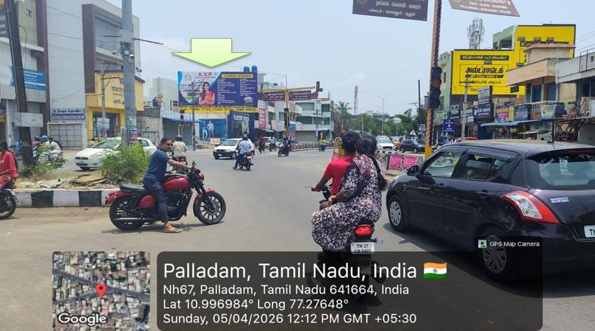
Towards Bus Stand, Near S.A.P.S Theatre, Palladam. size 40*20

Slide 28
Kangeyam

Slide 29
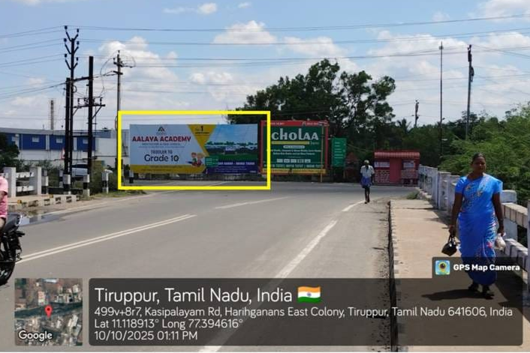
kangayam Road, Near Muthalipalayam sidco, 3 Cross Road, Tirupur. Size 40*15

Slide 30
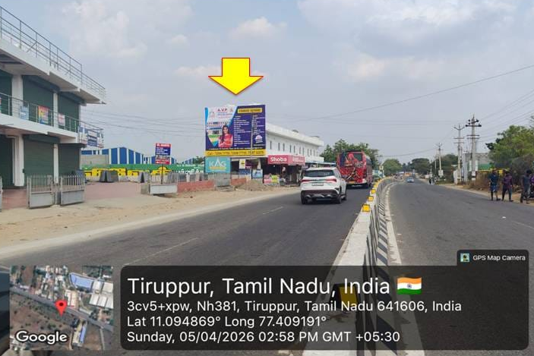
Kangayam Road, Towers Kangayam, Tirupur. Size 26*20

Slide 31
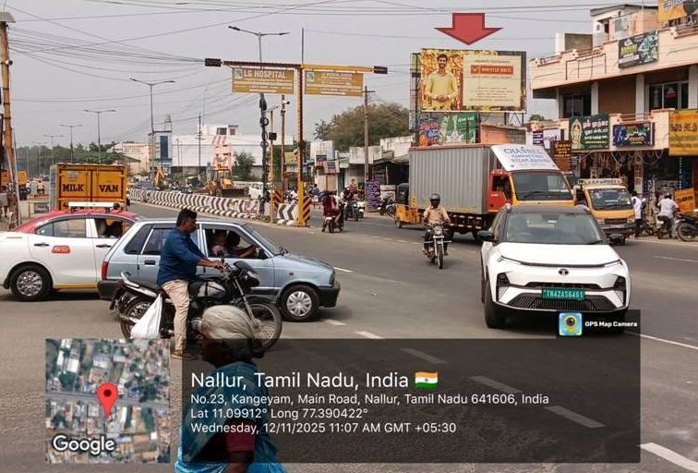
Kangayam road Nallur Tiruppur 25x13

Slide 32
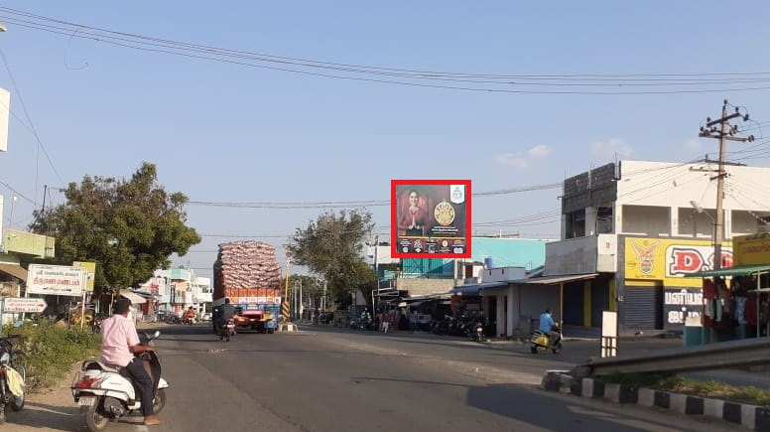
Kangeyam Near Busstand (20x25)

Slide 33
Namakkal

Slide 34
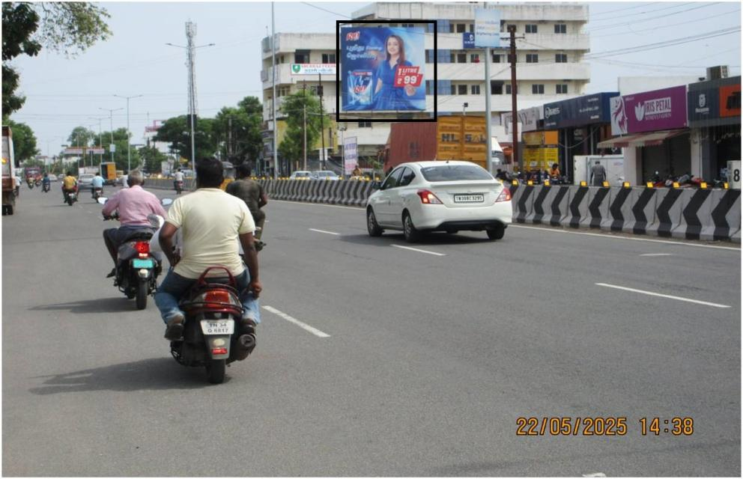
Salem Road - Pon Nagar 30X30

Slide 35
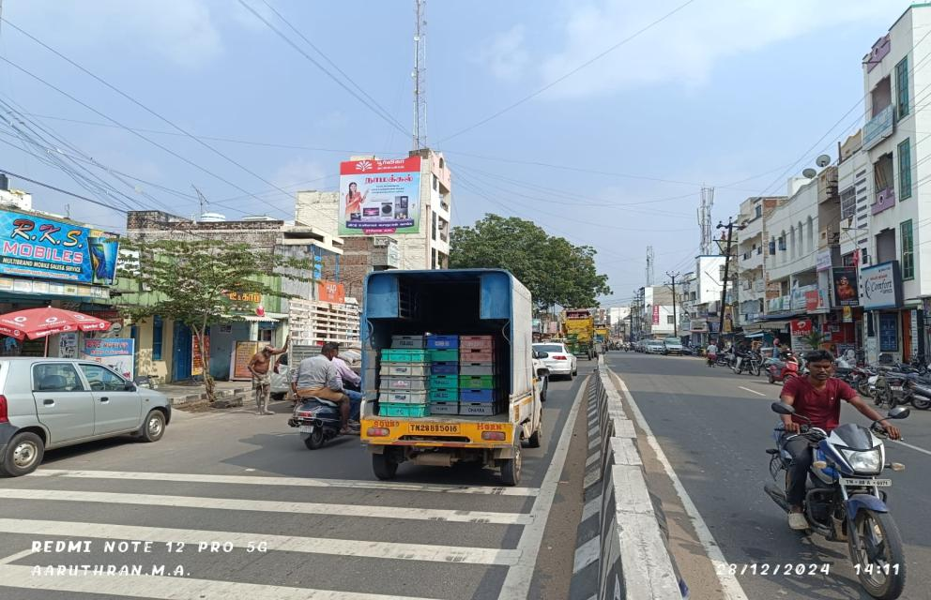
Namakkal - Nr Bus stand 20X22

Slide 36
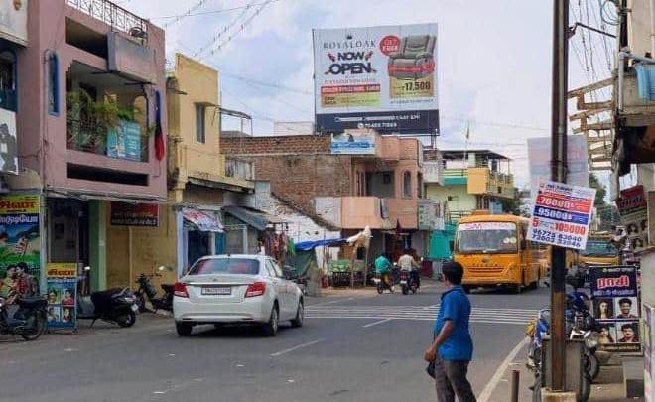
Paramathi Opp Busstop - 22 X 20

Slide 37
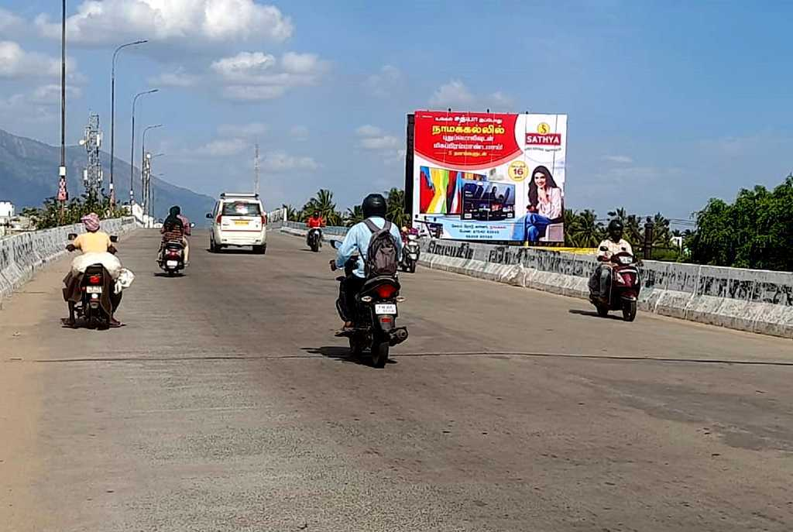
Namakkal – Duraiyur road (nkl to Duraiyur) : 30x25

Slide 38
Thiruchengode

Slide 39
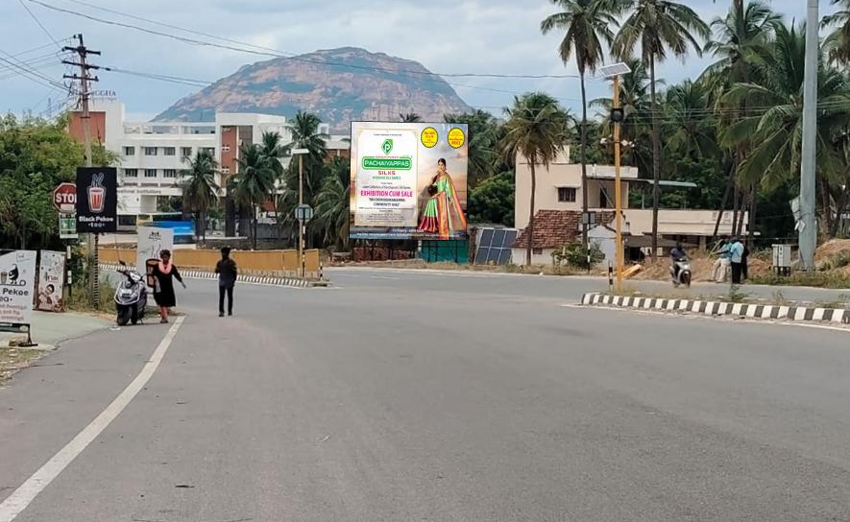
Tiruchengode - Near Sri Shanmuga College Towards Sankari Railway Station 40x30

Slide 40
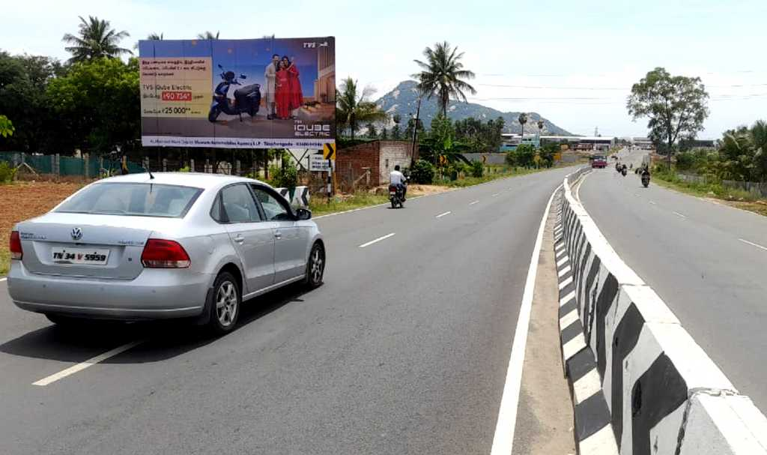
Thiruchengode – Sangakiri road : 40x20

Slide 41
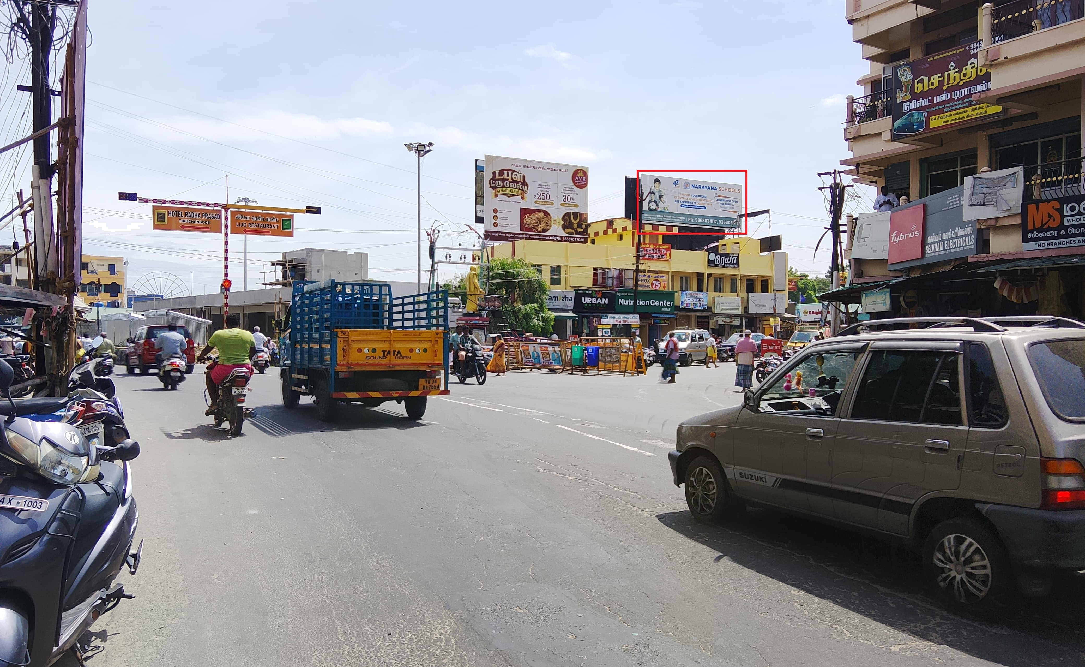
Thiruchengode Busstand 30x12

Slide 42
Tanjore

Slide 43
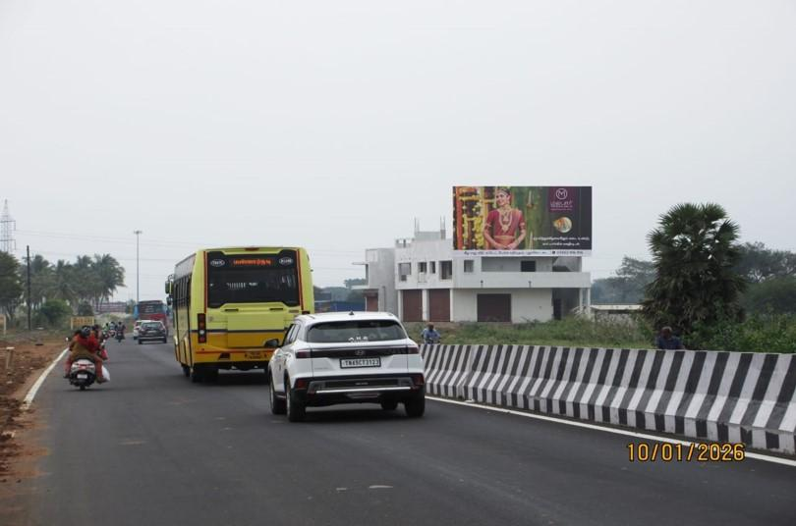
Pattukkottai Entrance (R) 40X20

Slide 44
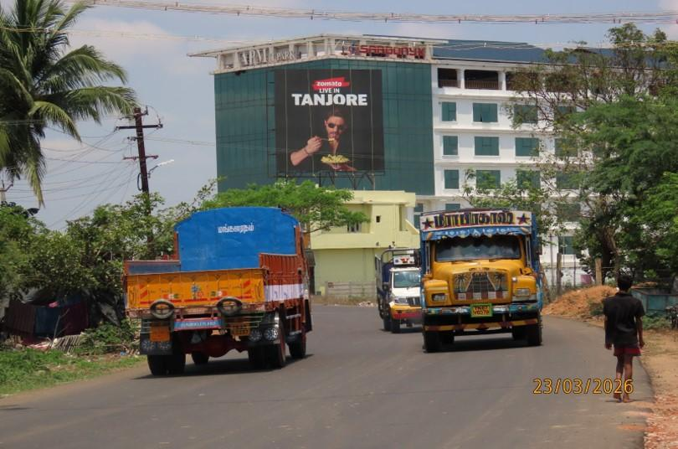
IT Park(R) 25X25

Slide 45
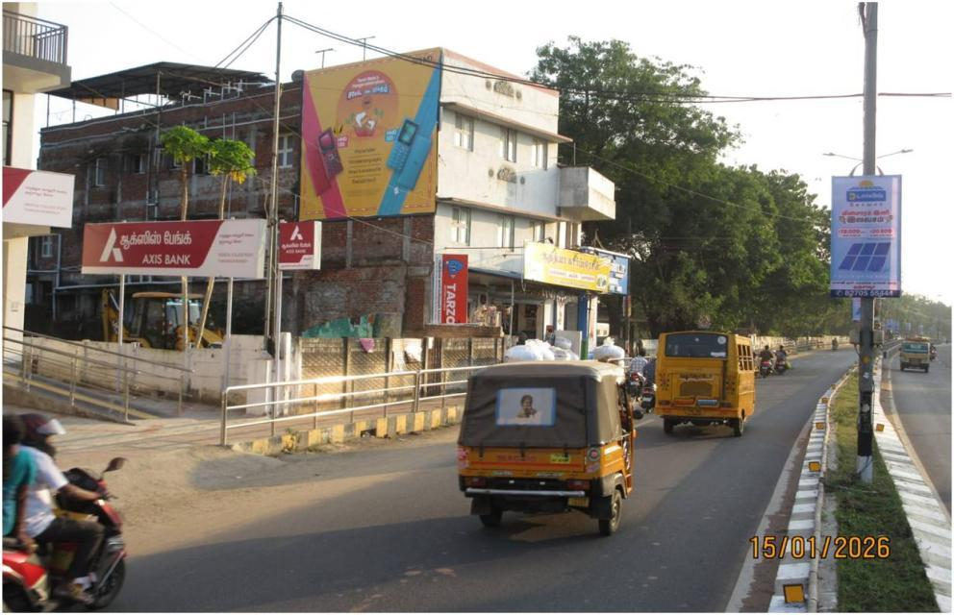
Medical College Road 20x18

Slide 46
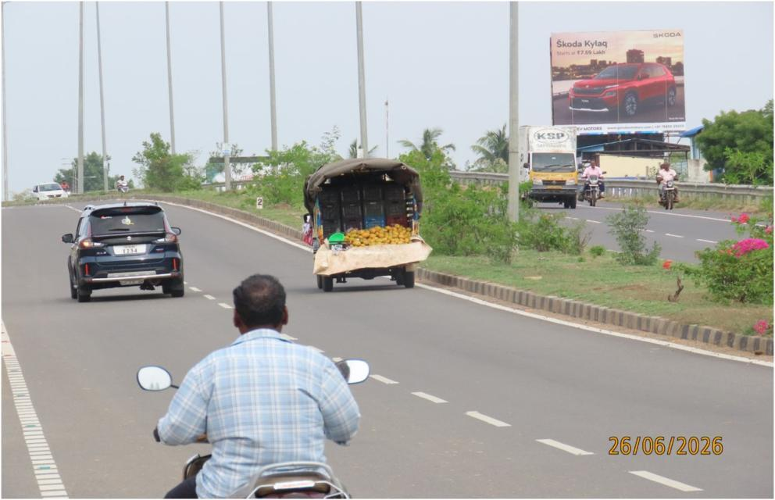
Mariamman Kovil Roundana (R ) 25X20

Slide 47
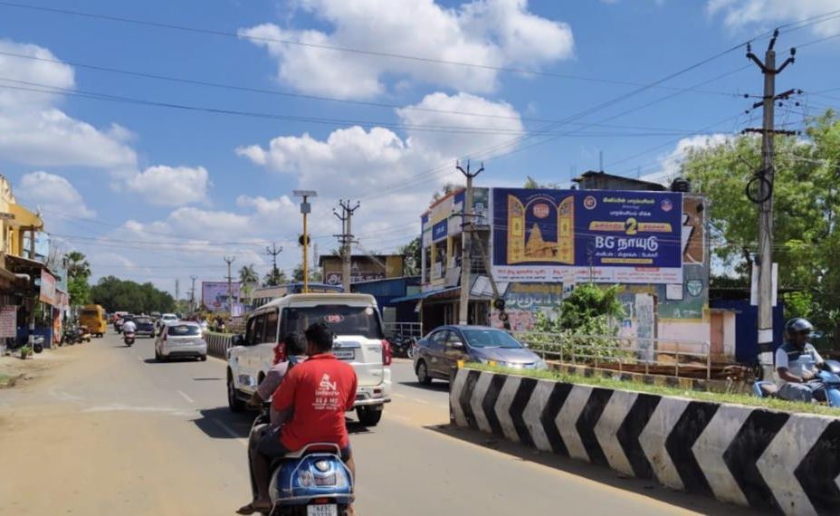
EB Colony 30x14

Slide 48
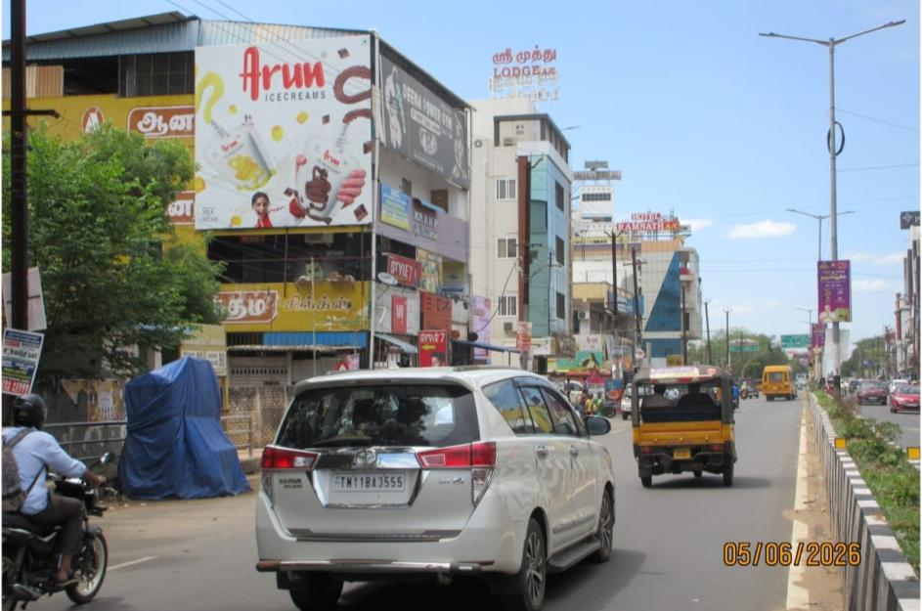
Near New Bus Stand 20x20

Slide 49
Salem

Slide 50
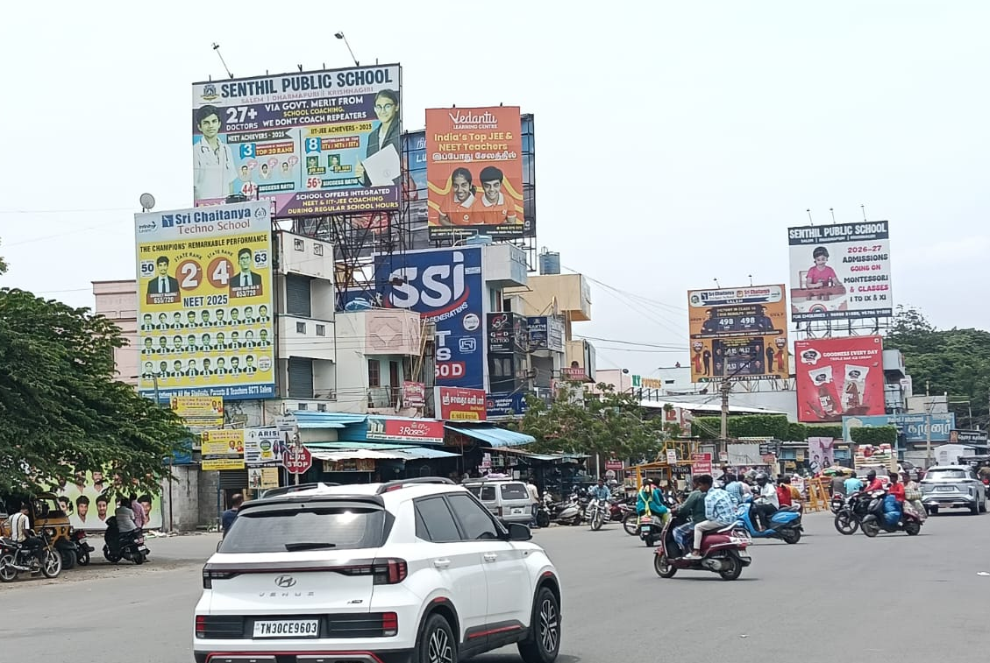
Salem – Kuranguchavadi Jn Towards 5 Roads 15x20

Slide 51
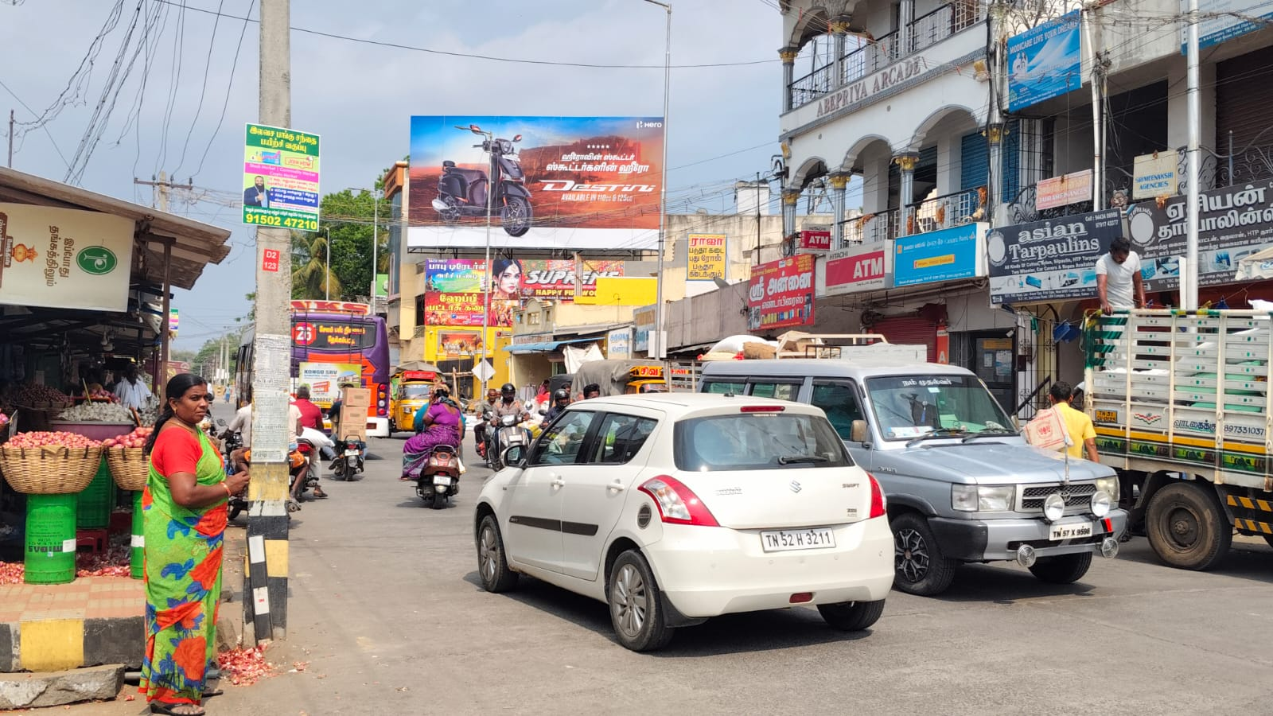
Salem – Lee Bhazaar Towards 4 Roads -40x20

Slide 52
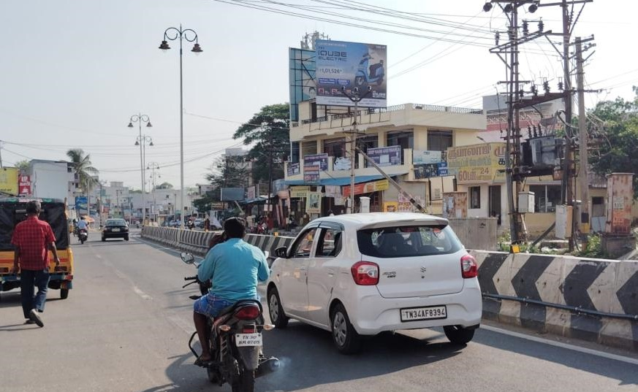
Salem – Opp.Law Collage Towards Hasthampatty – 20x15

Slide 53
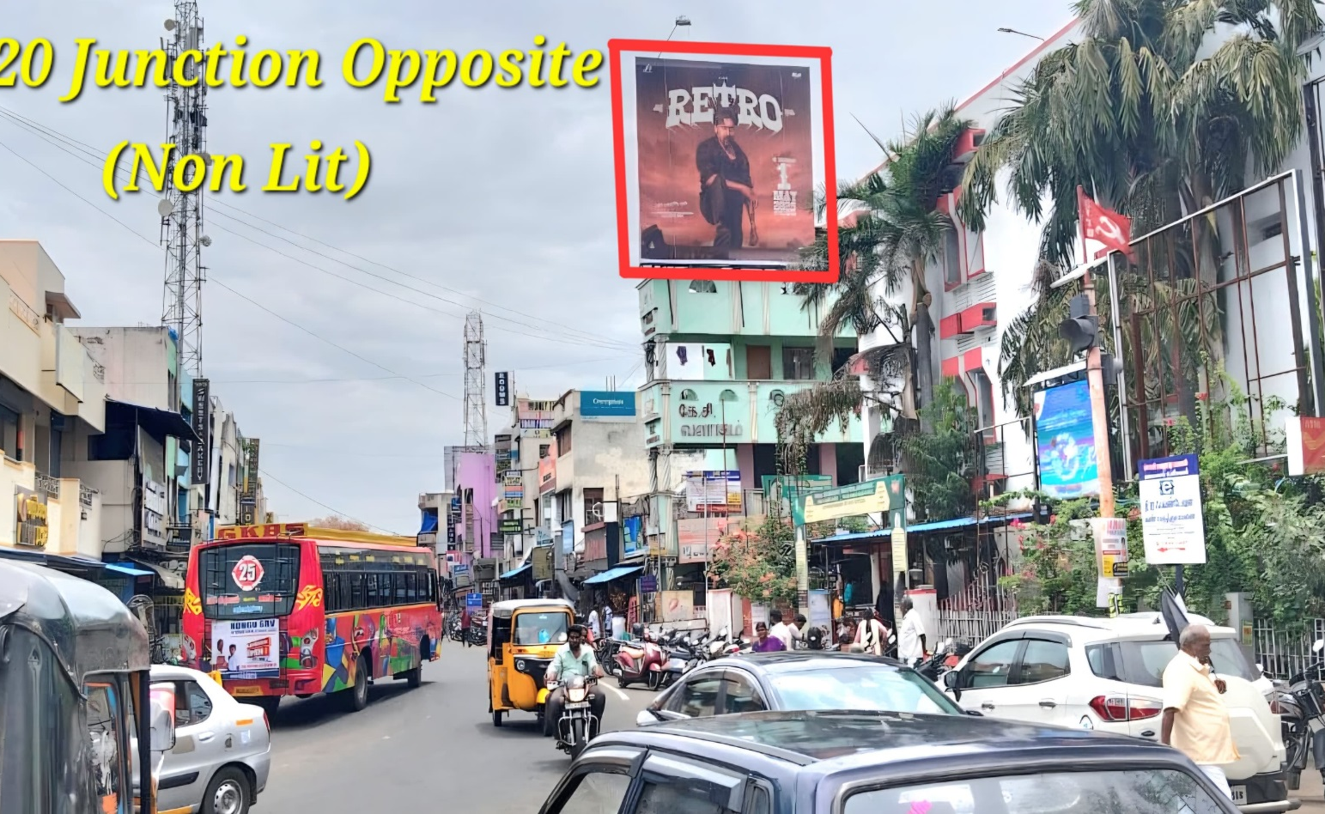
Junction Post Office 20x20

Slide 54
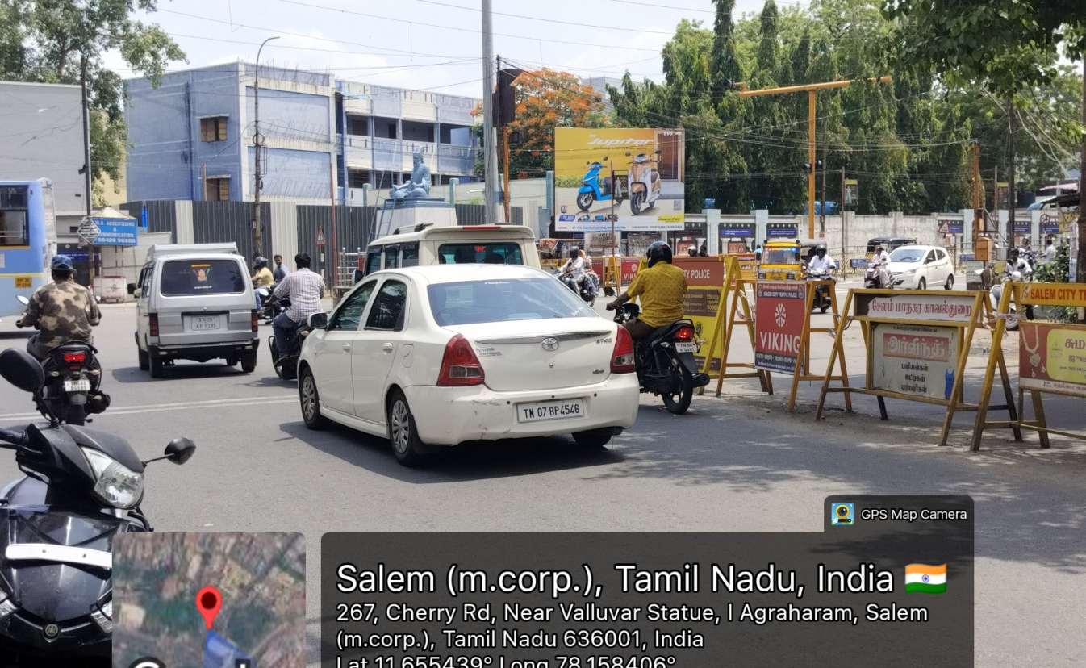
Valluvar Statue Poompukar 20x15

Slide 55
Kondalampatti

Slide 56
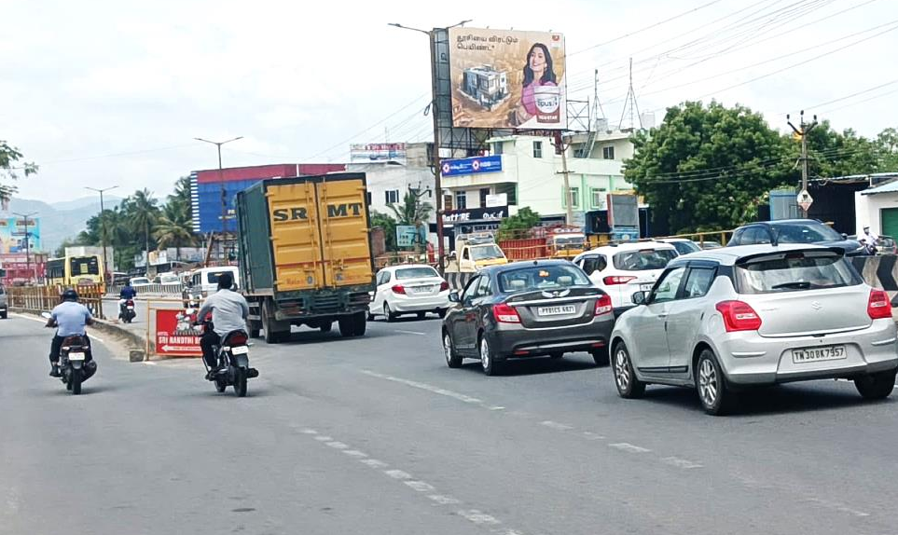
Salem – Kondalampatty Circle - 35x25

Slide 57
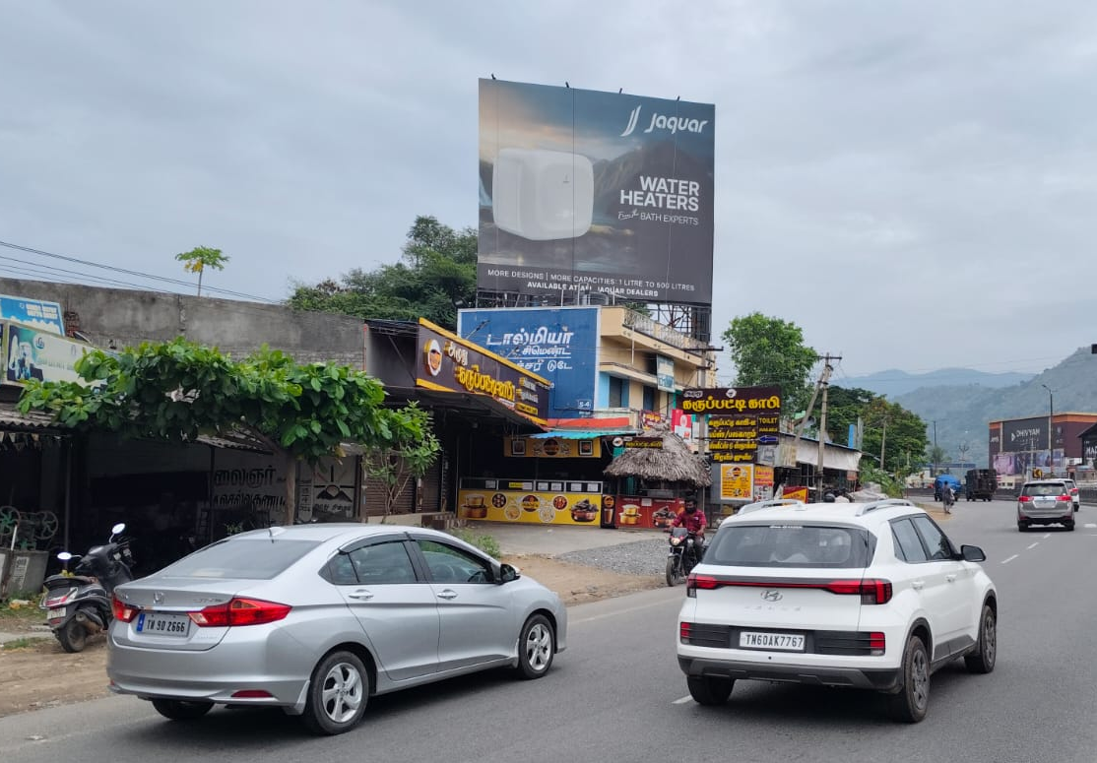
Kondalampatty Circle Towards Seelanaiken Patty /Old Bus Stand – 30x25

Slide 58
Omalur

Slide 59
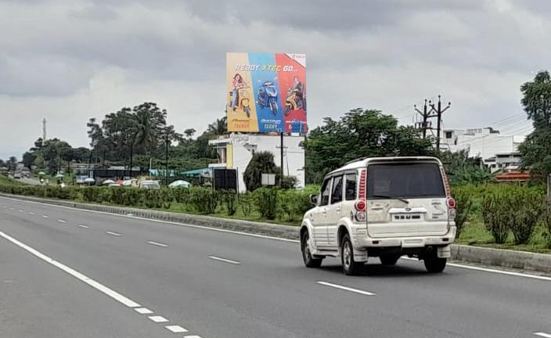
Salem – Omalur Near Periar University / GOVT Eng Collage /Toll-25x25

Slide 60
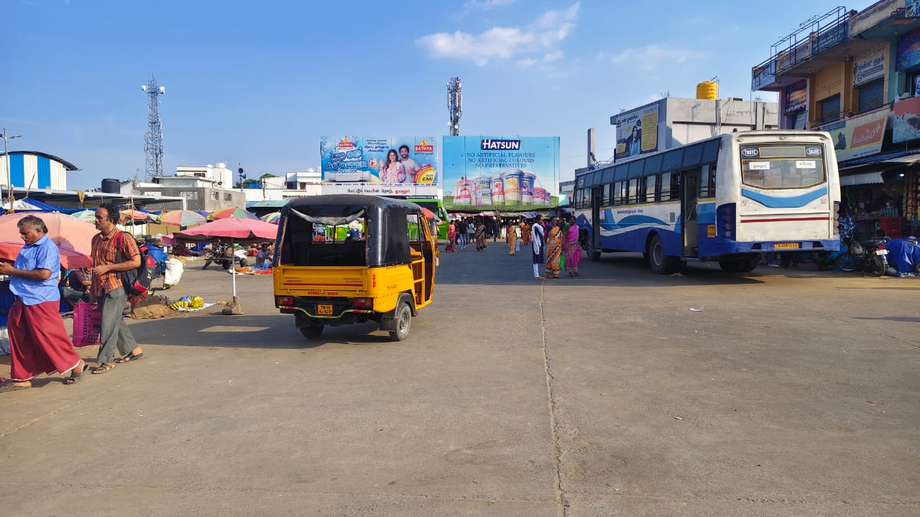
Salem - Omalur Bus Stand 40x25

Slide 61
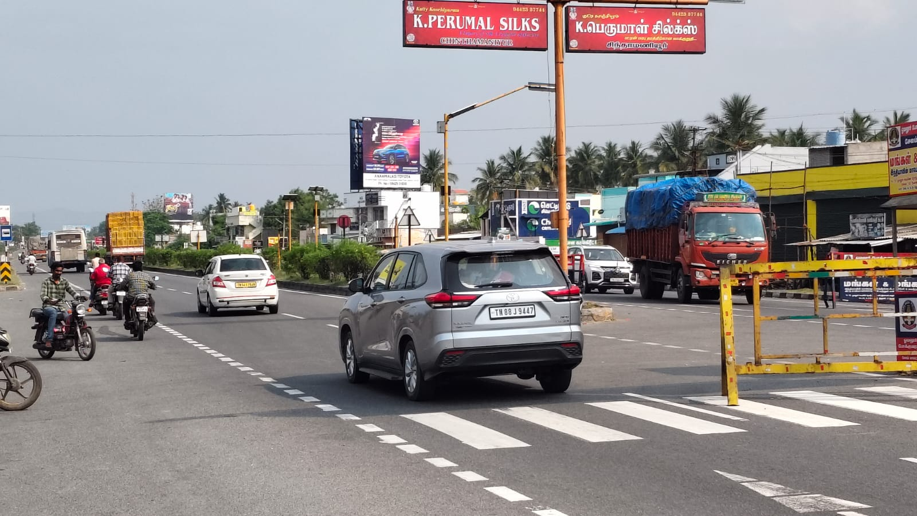
Salem – Omalur Airport Road FTT Salem -25x25

Slide 62
Attur

Slide 63
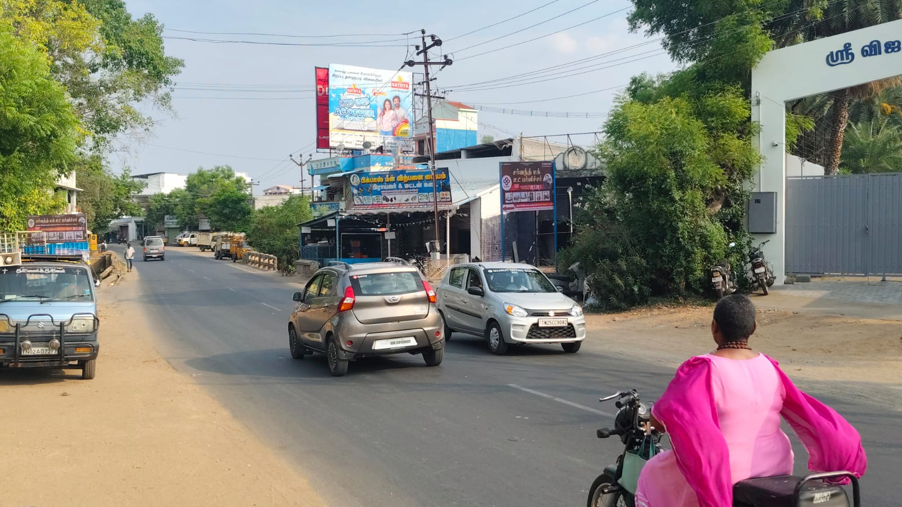
Salem – Attur Kamaraj Road - 23x20

Slide 64
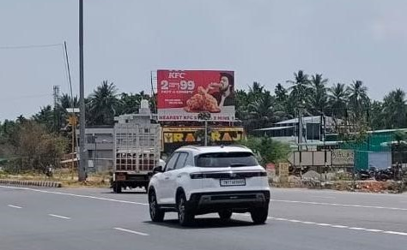
Attur Towards KFC /ibaco Kallakurichi - 40x25

Slide 65

From Kallakurichi to Attur 50x25

Slide 66
Mettur

Slide 67

Salem – Mettur Road Towards Mecheri /Mettur – 35x25

Slide 68

Salem – Mettur Dam - 40x20

Slide 69
Thank You.

