Slide 1
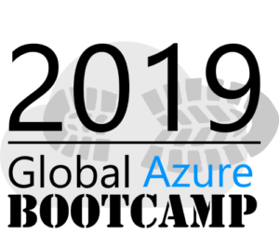
Global Azure Bootcamp
2019- Adelaide, SA
Building Intelligent Chat Bots Using MS Bot Framework
Mandar Dharmadhikari

Slide 2






Who Am I?
Mandar Dharmadhikari
Integration Developer and Administrator
Integration and AI enthusiast
TechNet Wiki Ninja and Author
Reviewer For Packt Video Courses
Die Hard Metallica and GOT fan
https://www.linkedin.com/in/mandar-dharmadhikari/
@mandark003
https://theserverlessspirit.wordpress.com/
mandardhikari@gmail.com
https://github.com/mandardhikari

Slide 3
Takeaway from the session
3 Ws of Conversational AI
What are chat bots
Available Tools and Frameworks for development
Demo of few chat bots
Best Practices
Reading resources

Slide 4

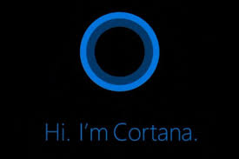
Before We Begin
When I say Artificial Intelligence….
I mean
Is NOT what I mean

Slide 5



Common Engagement scenarios
Where to use Conversational AI
Customer Care
Customer Complaints
Customer Retention
It Systems Management
Account Management
Product Feedback
Brand Awareness
DevOps
Product FAQs
Brand Loyalty
Source Control Management
Issue Resolution

Slide 6
Why Use Conversational AI?
Gartner Predicts that “By 2020, People will have more conversations with bots than their spouse”
Keeping a human force to handle the repetitive tasks like answering FAQs, getting feedbacks, IT operations incurs lot of cost
Conversational AI enables Business to
Create and Develop Intelligent Virtual Assistants which customers can interact from their cars, devices, home etc.
Automate daily mundane tasks
Empower the org to more effectively connect people, services and tasks

Slide 7
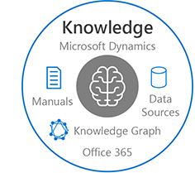
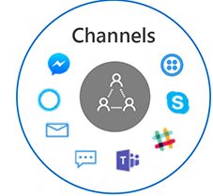
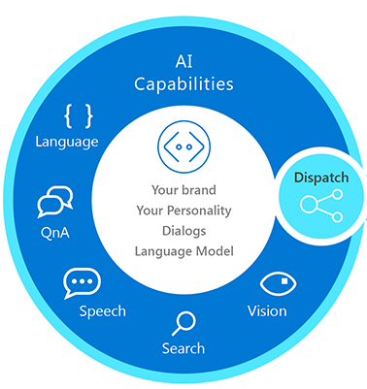
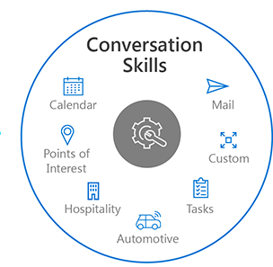
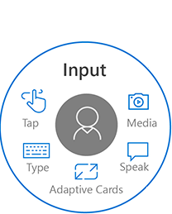

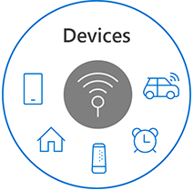
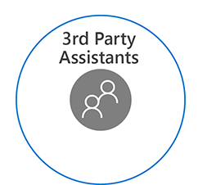

What Constitutes a Conversational AI

Slide 8
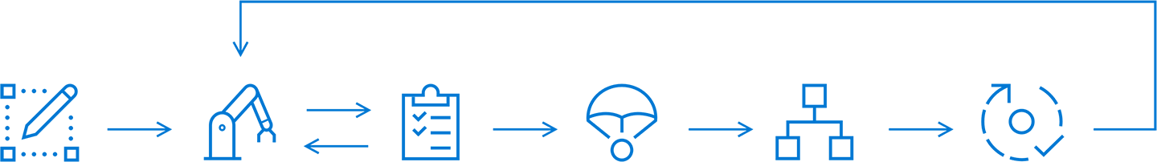
What are Chat bots?
Web Apps like normal web sites, but with conversation as front end
Starting points to develop a full fledged Conversational AI
Design
Build
Test
Publish
Connect
Evaluate

Slide 9
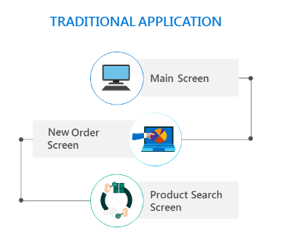
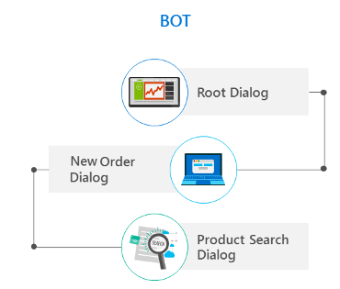
Traditional Apps vs Bots

Slide 10


Why Microsoft Bot Framework?
AI and Natural Language Processing
Security and Availability
Ownership and Control
Open Source
Speak
Listen
Understand
Learn
With Cognitive Services
ASP.NET Core
Cross Platform Dev
Node JS
Extensibility
Secure
High Availability
Own the product
Enhance as per need

Slide 11
Tools and Frameworks
Microsoft Bot Framework SDK v4
ASP.NET Core 2.x
Visual Studio
Bot Framework Emulator
Adaptive Cards

Slide 12
Demo Time!!

Slide 13
Best Practices
Consider how fine grained the bot needs to be
Strike a balance between the Natural Language and Menus
Do Iterative development and testing and introduce deltas at a time
Exploit the DevOps to fast track CI and CD
Set the expectations straight

Slide 14
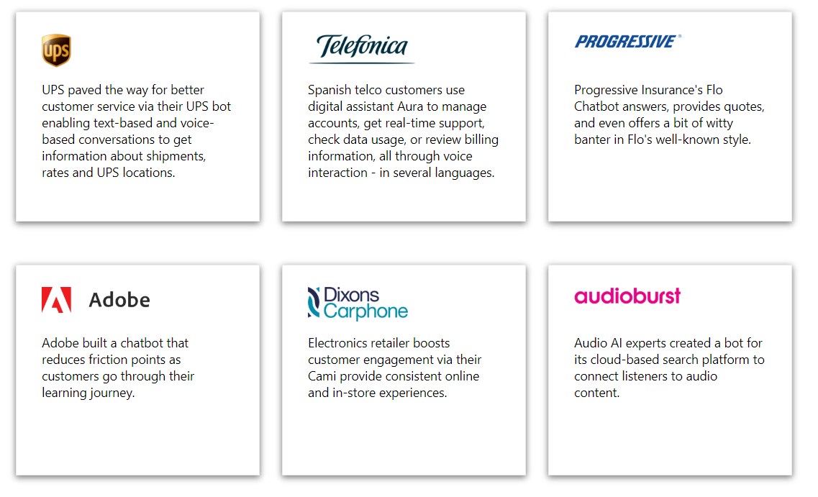
Success Stories

Slide 15
Reading Resources
Bot Service Documentation: https://docs.microsoft.com/en-us/azure/bot-service/?view=azure-bot-service-4.0
Bot Framework Team Official Blog: https://blog.botframework.com
Adaptive Cards: https://adaptivecards.io/
Cognitive Services: https://azure.microsoft.com/en-us/services/cognitive-services/

Slide 16
That’s it Folks!!
Questions?

