Slide 1

Global Azure Bootcamp
2019- Adelaide, SA
Logic Apps For Beginners
Mandar Dharmadhikari

Slide 2






Who Am I?
Mandar Dharmadhikari
Integration Developer and Administrator
Integration and AI enthusiast
TechNet Wiki Ninja and Author
Reviewer For Packt Video Courses
Die Hard Metallica and GOT fan
https://www.linkedin.com/in/mandar-dharmadhikari/
@mandark003
https://theserverlessspirit.wordpress.com/
mandardhikari@gmail.com
https://github.com/mandardhikari

Slide 3
Takeaway from this session…
Understand what Azure Integration Services are
Understand what Logic Apps are
Why use Logic Apps
Basics of Logic Apps
Uses Cases of Logic Apps
Some fun demos

Slide 4

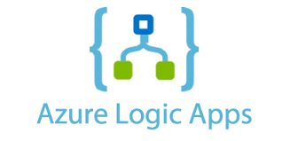




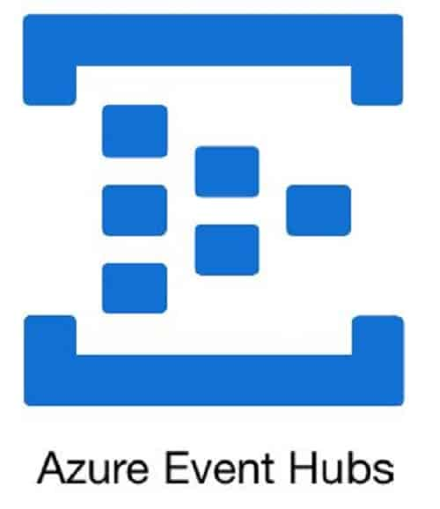
Azure Integration Services & Components
Orchestrate and build sturdy integrations on premises
Orchestrate and automate workflows in cloud
Run Serverless piece of code
Securely expose API to external world
Fully Managed Event routing Service
Ideal For transferring IOT and Telemetry data
Secure on-Prem and Azure Message Transfer

Slide 5



Vision Behind Azure Integration Services
Reduced Time to Market the products
Leader in Integration Field
Easy To Develop

Slide 6
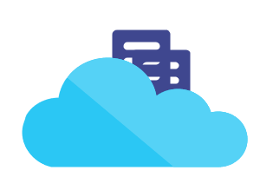
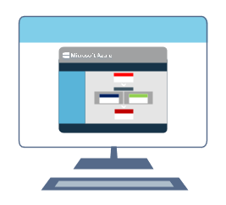
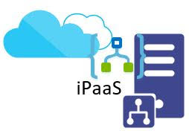

What Are Logic Apps
Data
Enterprise
B2B
Application
Integrations
Designer First Approach
Out of the Box Connectors for light weight Integrations
Integration Platform as a Service
Serverless

Slide 7
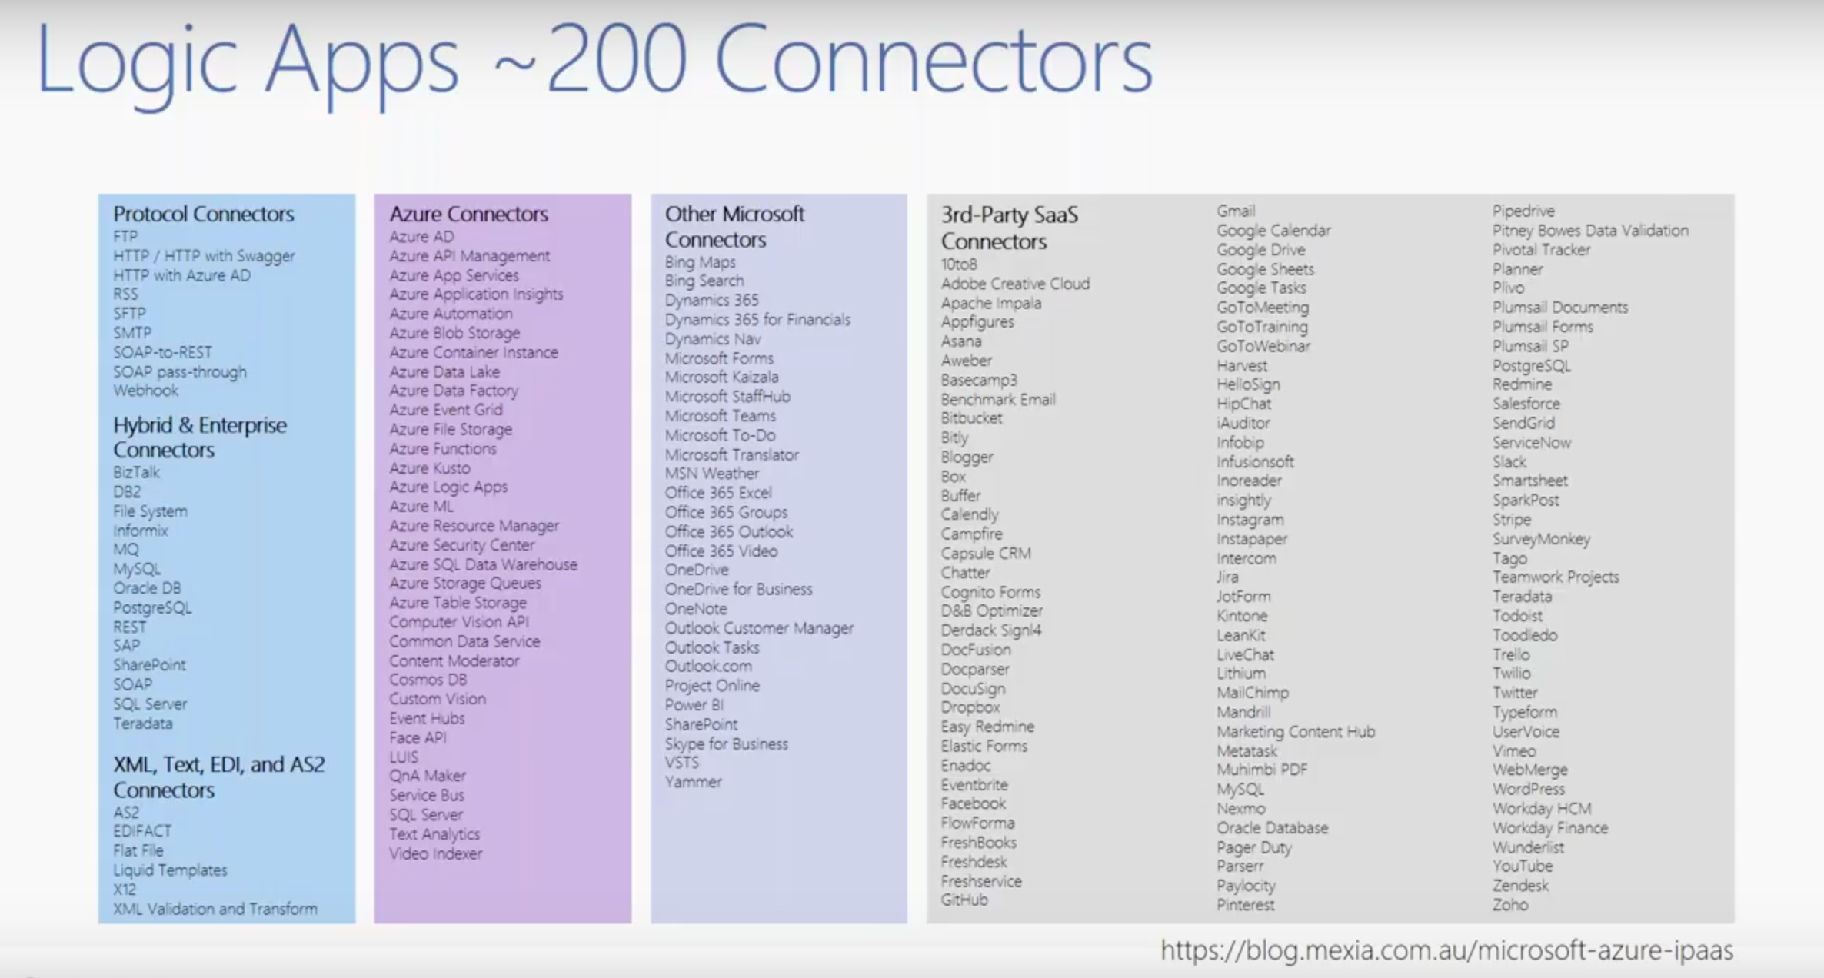
Logic App Connectors

Slide 8


Why Use Logic Apps
Serverless integration
Connect Legacy System to new Cutting edge systems
Reduced time to release
iPaas : Reduced Operational cost
Pay for what you use
Easy to design using portal and Visual Studio
Easy deployment with ARM templates
Easy to set up CI and CD
200 + Out of Box Connectors for API consumption
Ability to create Custom connectors

Slide 9
Logic Apps Basic
Trigger
Actions
Starting point of Logic App
Each trigger fires up a new instance of Logic Apps
Multiple types of trigger for same Logic Apps
Examples of Triggers:
Receive HTTP request
Run Logic App on a schedule
Run when blob is created/deleted
Steps after the trigger. Can be
API calls
Control and looping statements
Variable manipulations
Examples
A call to Gmail API to send mails
A call to Text Analytics API

Slide 10
Some Logic Apps Use Cases

Slide 11
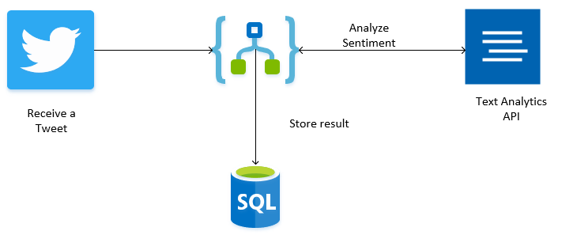
Analyse the sentiment behind the tweets and store the results in Database

Slide 12
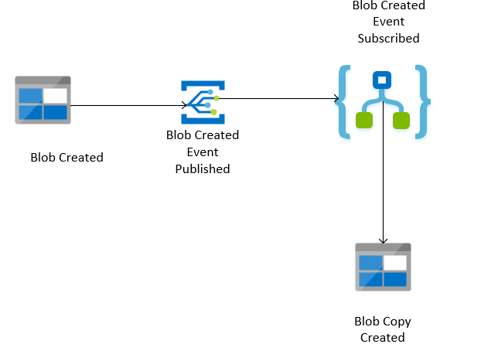
Backup Blobs to Different Containers

Slide 13
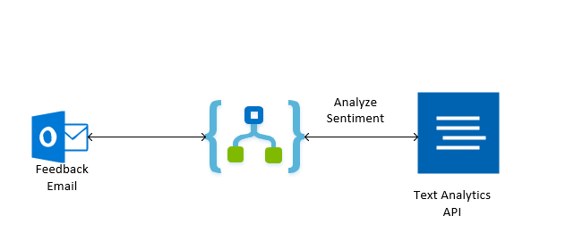
Intelligent Mail Responders

Slide 14
Demo Time

Slide 15
That’s All Folks!! Questions?

