Slide 1
Git Remotes
A simple example
Casey Neubauer

Slide 2
Overview
new “bare” repo
Basic git remote commands
More complex mirror example

Slide 3
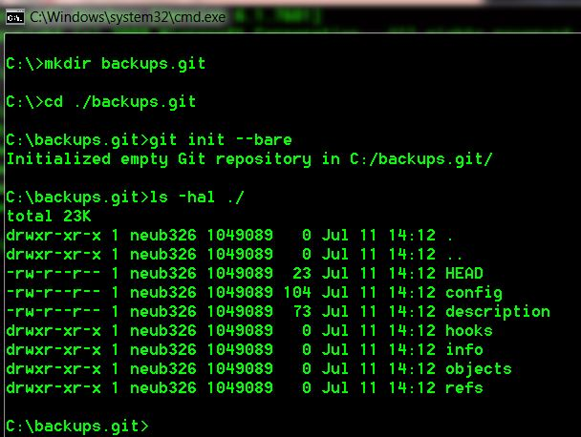
Bare Repo
Notes:
This creates a “bare” git repo, which will be important later
A bare repo is just the refs, git objs, etc
No working tree, aka no files, folders, local commits, and so on.
Essentially what we get when using GitHub, GitLab, Bitbucket, etc.

Slide 4
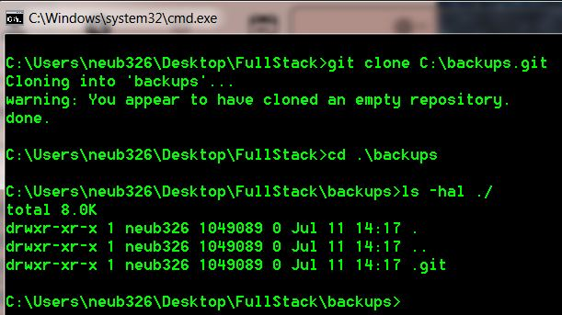
Clone the repo

Slide 5
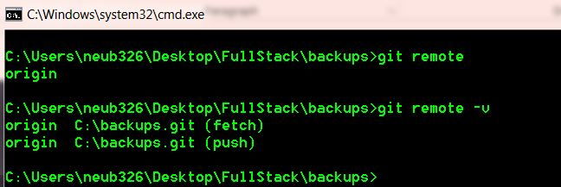
Show existing remotes

Slide 6
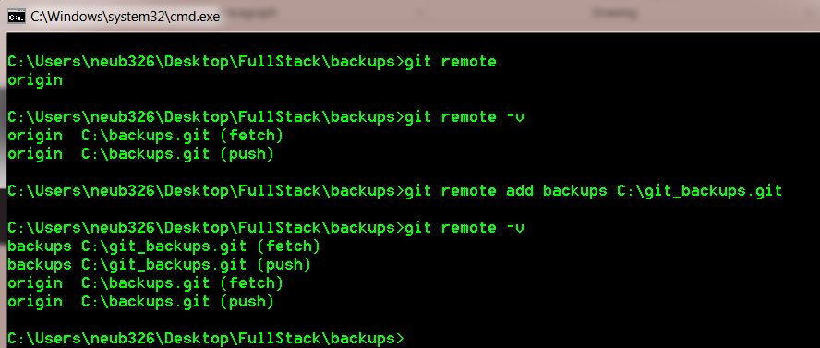
Add new remote
Notes:
Need to specify remote name and path to remote

Slide 7
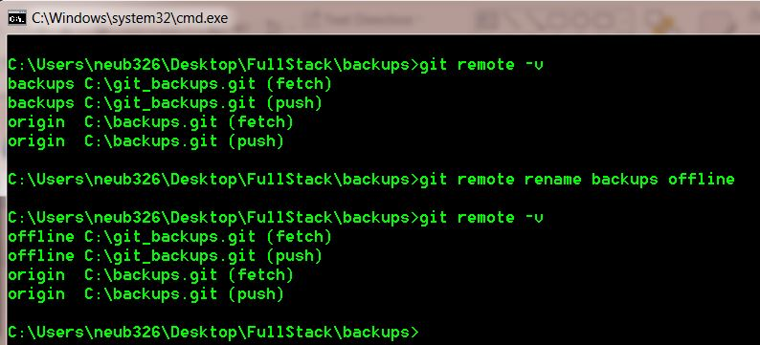
Rename remote
Notes:
So we can rename remotes.
Maybe I named it wrong, or I like another name better, or I had a temporary name until I found a better one.

Slide 8
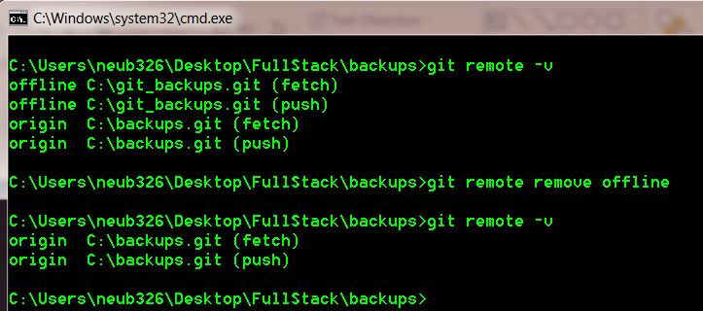
Remove existing remote

Slide 9
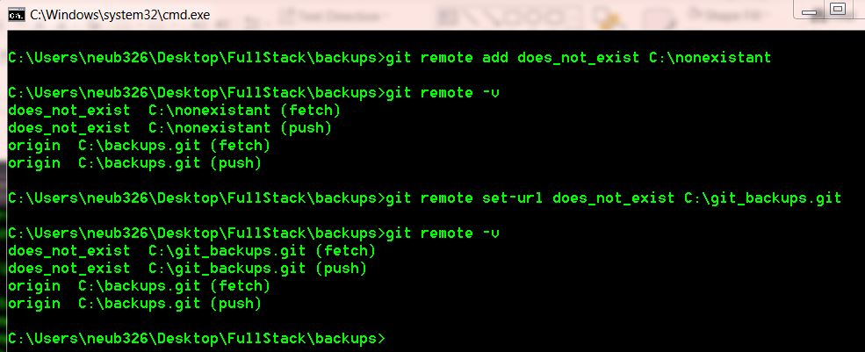
Set remote url
Notes:
Setting the remote URL can be either a local or remote path.
If it’s a “bad path” like shown here, there is no warning or error message.
There are --fetch and --push options to specify fetch/push URLs separately, however, they have to point to the same place.
That is, whatever is pushed to the push URL should be whatever we would see if we immediately fetched from the fetch URL
If we want to fetch from one place and push to a different place, we do this by using completely different remotes.

Slide 10
More complicated: mirroring
Duplicate refs across remotes
Git-like way to essentially copy entire .git directory
Useful for complete repo backup
Notes:
Mirroring is exactly what it sounds like – mirroring a repo to another place.
Has parallels in other git commands, including clone and push

Slide 11
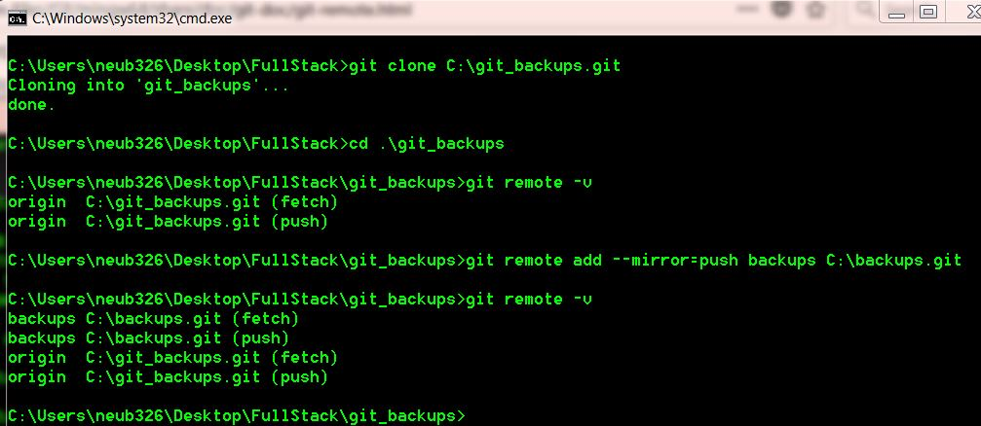
Add Mirror
Notes:
Future git push will act as though it has --mirror
Will duplicate refs, and that repo’s refs will be overwritten by “git remote update”

Slide 12
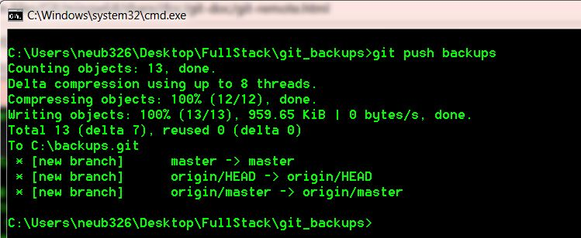
Mirror Push

Slide 13
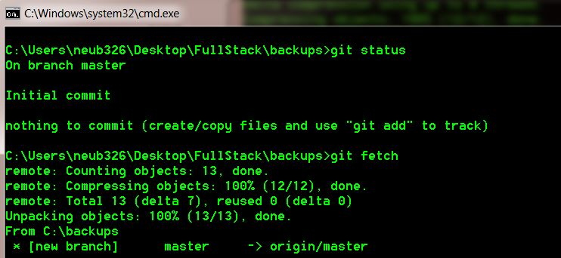
Updated Mirror
Notes:
Also a --mirror=fetch which mirrors all remote refs to local repo
This is why “bare” repo is required, as otherwise a git fetch would override local commits

Slide 14
Commands
New Repo
Basic Remote
Mirror
git init --bare
git clone
git remote
git remote -v
git remote add
git remote rename
git remote remove
git remote set-url
git remote add --mirror=push

Slide 15
Questions/Comments

