Slide 1
COMPONENT 2
Presenter: Rathnayake S
ID: IT23156838
Subsystem 1:
Contactless rPPG Pulse Scanner
&
Bimodal Kinematic Fusion
IT23156838 | Rathnayake S
Title of the individual component:
Active Recovery, Joint Health &
Fatigue Management Suite
Specialization: Software Engineering
SLIIT FACULTY OF COMPUTING | IT23156838 | Rathnayake S | J26-SE-342 | Slide 9

Slide 2
Active Recovery, Joint Health & Fatigue Management Suite
Component 2 | Contactless rPPG Fatigue Extraction & Bimodal Fusion
The Problem: Central Nervous System (CNS) Fatigue
Research Gap & Project Objective
• Systemic Neural Exhaustion: High-intensity compound lifting (squats, deadlifts) severely taxes the brain and CNS, reducing high-threshold motor unit recruitment capacity.
• Catastrophic Injury Risk: Attempting maximal loading while the autonomic nervous system is depleted leads to spinal buckling, tendon failure, and acute soft-tissue tears.
• Subjective Perception Fails: Athletes cannot accurately self-judge CNS fatigue; physical muscles may feel ready while the neural drive is severely suppressed.
• Clinical Wearables are Expensive: Gold-standard Heart Rate Variability (HRV) requires $100-$300 chest straps or multi-lead ECGs, creating high friction for everyday lifters.
• Commercial Apps Are Inadequate: Basic mobile apps compute average Heart Rate (BPM), completely failing to measure autonomic balance or vagal parasympathetic recovery.
• Proposed Software Solution: Transform standard smartphone cameras into a contactless photoplethysmography (rPPG) optical sensor that extracts beat-to-beat HRV metrics in 45 seconds.
• Autonomous Readiness Triage: Predict CNS recovery state (GREEN, YELLOW, RED) and prescribe auto-regulated workout volume adjustments.
SLIIT FACULTY OF COMPUTING | IT23156838 - Rathnayake S | J26-SE-342 | Slide 10

Slide 3
Active Recovery, Joint Health & Fatigue Management Suite
Component 2 | Contactless rPPG Fatigue Extraction & Bimodal Fusion
End-to-End Digital Signal Processing (DSP)
18-Feature Cardiorespiratory Extraction
• 1. Hardware Locking: Locks Auto-Exposure (AE), Auto-Focus (AF), and Auto-White-Balance (AWB) on rear mobile camera to eliminate artificial sensor noise.
• 2. Green Channel Intensity: Extracts mean green luminance (520-570 nm) across ROI — green light matches peak oxygenated hemoglobin absorption, maximizing AC/DC pulsatile SNR.
• 3. 3rd-Order Butterworth Filter: Zero-phase bandpass filter (0.75 - 3.0 Hz / 45 - 180 BPM) eliminates respiratory baseline wander (<0.75 Hz) and high-frequency thermal noise.
• 4. Peak Detection & Outlier Rejection: Adaptive thresholding extracts systolic peaks and RR interval series; physiologically impossible intervals (RR < 330ms or > 1500ms) are strictly rejected.
• Time-Domain HRV: rMSSD (Primary vagal tone marker), SDNN (Total autonomic variance), HR Mean & Std, pNN50, pNN20, CV_RR.
• Non-Linear Poincaré Geometry: SD1 (Short-term parasympathetic variance), SD2 (Long-term variance), SD1/SD2 Ratio.
• Autonomic Strain (Baevsky SI): Stress Index (SI = AMo / [2 × Mo × MxDMn]) — spikes to 300-1000+ under acute sympathetic exhaustion.
• Frequency-Domain (Welch PSD): Low Frequency (LF: 0.04-0.15 Hz), High Frequency (HF: 0.15-0.40 Hz), LF/HF Ratio (Sympathovagal balance).
• Optical Morphometrics: Perfusion Index (Pulsatile blood absorption), Pulse Rise Time (Systolic arterial wave upstroke).
SLIIT FACULTY OF COMPUTING | IT23156838 - Rathnayake S | J26-SE-342 | Slide 11

Slide 4
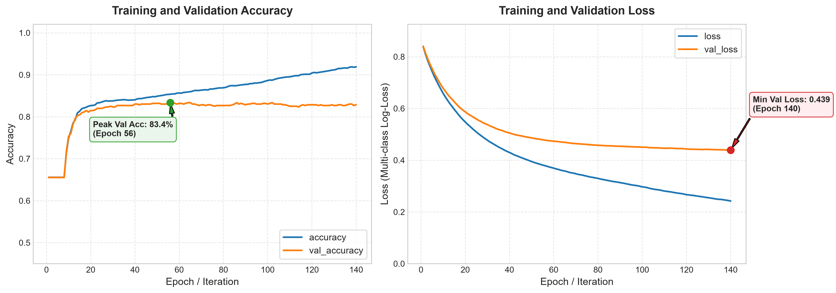
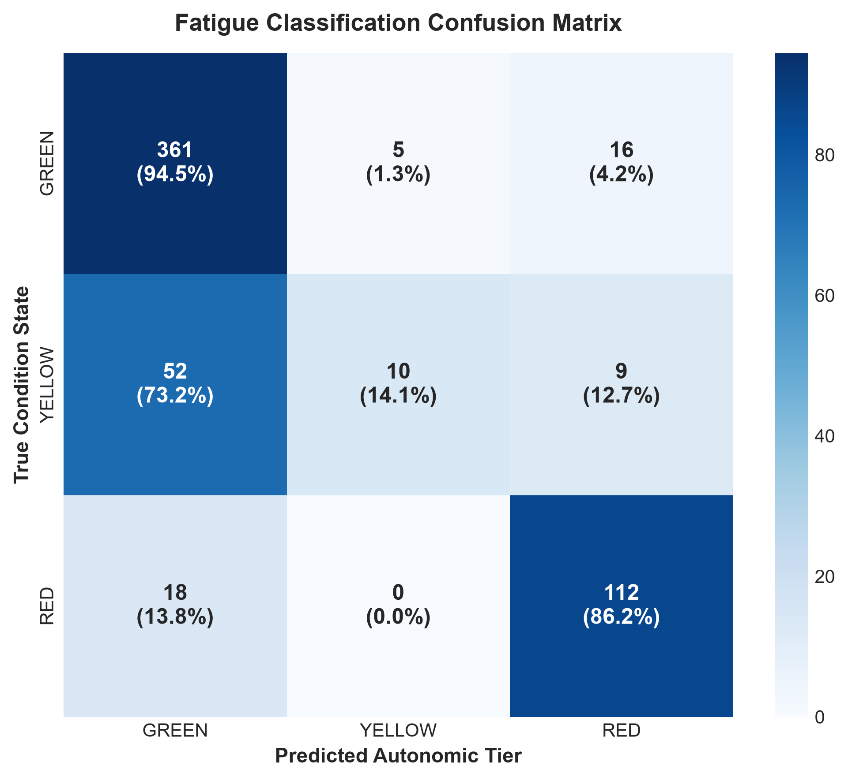
Active Recovery, Joint Health & Fatigue Management Suite
Component 2 | Contactless rPPG Fatigue Extraction & Bimodal Fusion
Empirical Validation on WESAD Dataset
• WESAD Benchmark Ingestion: Trained on 15 human subjects (S2-S17), 2,912 sliding 45-second windows across Baseline, Amusement, and TSST Stress.
• Zero-Leakage GroupKFold CV: 5-Fold cross-validation grouped by subject to guarantee the model generalizes to completely unseen individuals.
• Validation Accuracy: 82.85% overall accuracy (Peak: 83.36% @ Epoch 56).
• Multi-Class ROC-AUC: Macro AUC of 0.8922 (Red Exhaustion Tier AUC: 0.978).
• Safety in Exhaustion: 86.2% true positive detection of acute fatigue (0% misclassified as mild Yellow).
• Production ONNX Export: Converted to .onnx format (2.5MB) with 100% numerical parity for offline sub-10ms Flutter execution.
SLIIT FACULTY OF COMPUTING | IT23156838 - Rathnayake S | J26-SE-342 | Slide 12

Slide 5
Active Recovery, Joint Health & Fatigue Management Suite
Component 2 | Contactless rPPG Fatigue Extraction & Bimodal Fusion
Bimodal Decision Fusion: Connecting Subsystem 1 & Subsystem 2
A drop in rMSSD alone cannot distinguish Mental Stress from Physical Neuromuscular Damage. Subsystem 1 fuses with Subsystem 2 (5-Rep Squat Kinematics via MediaPipe) to evaluate the Bilateral Asymmetry Index (ASI): ASI = (|L_load - R_load| / max(L_load, R_load)) × 100%
Case 1: Fully Recovered
Case 2: Cognitive Stress
Case 3: Neuromuscular Fatigue
• ANS Tier: GREEN (rMSSD ≥ 45ms)
• Kinematic ASI: ≤ 10% (Symmetrical)
• Root Driver: Homeostatic Balance
• Prescription: 100% Volume cleared. Green-lit for maximal compound lifts (Squats, Deadlifts, 1-5 RM, Plyometrics).
• ANS Tier: YELLOW / RED (rMSSD < 45ms)
• Kinematic ASI: ≤ 10% (Symmetrical)
• Root Driver: Mental Load / Sleep Deficit
• Prescription: DO NOT CANCEL. Motor firing is balanced. Train at RPE 7-8; reduce working sets by 20%; avoid failure.
• ANS Tier: YELLOW / RED (rMSSD < 45ms)
• Kinematic ASI: > 15% (Asymmetrical)
• Root Driver: Structural Muscle Microtrauma
• Prescription: HIGH INJURY RISK! Postpone axial spinal loading. Prescribe 20 mins low-intensity Zone-2 cardio & mobility.
SLIIT FACULTY OF COMPUTING | IT23156838 - Rathnayake S | J26-SE-342 | Slide 13

